Slide 1
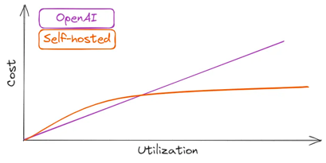
Why Hosting Local LLMs vs Cloud ?
Azure OpenAI Service provide private enterprise hosting. But recently they have exposed more than 30 TBytes of data - including passwords and secure keys.
OpenAI’s Terms of Use doc mentions that they “may use Content from Services other than our API ... to help develop and improve our Services”. This means that anything you send to ChatGPT may and will be included in their training data.
On-prem solutions provide more privacy, security, control, flexibility, no external dependencies. Also on-prem solutions are cheaper in the long run (own vs rent)
https://betterprogramming.pub/you-dont-need-hosted-llms-do-you-1160b2520526
Self-hosting for for LLaMA-2–70B
on AWS or Google:
8x Nvidia A100
g5.48xlarge on AWS ($17K/mo)
a2-megagpu-16g on GCP ($6K/mo)

Slide 2
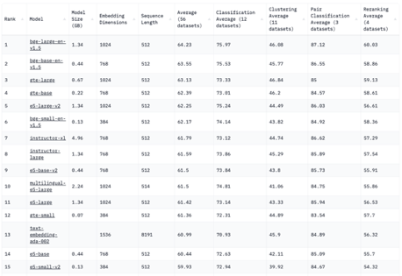
Hosting Your Own Embeddding Model
Massive Text Embedding Benchmark (MTEB) Leaderboard
https://huggingface.co/spaces/mteb/leaderboard
Hosting A Text Embedding Model That is Better, Cheaper, and Faster Than OpenAI’s Solution (which is #13 below)
https://medium.com/@kelvin.lu.au/hosting-a-text-embedding-model-that-is-better-cheaper-and-faster-than-openais-solution-7675d8e7cab2

