Slide 1
AI Updates
October 06, 2023

Slide 2
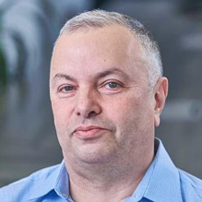

About the Speaker
Lev Selector, Ph.D.
40+ years of software engineering, data science, and building teams (hiring, training, and managing)
Ph.D. in mathematical modeling and computer simulations
Interests:
Generative AI, Using LLM with your data
Local AI for Local Private Data
Cloud architecture, fin-tech, application security
Find/connect: Linkedin, GitHub, YouTube, Google
https://eais.ai

Slide 3
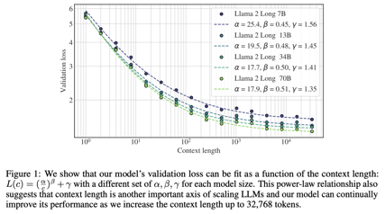
Meta LLaMa 2 Long
Meta LLaMa 2 Long - a new Meta model (Sep 27, 2023)
Effective Long-Context Scaling of Foundation Models - https://arxiv.org/pdf/2309.16039.pdf
Not open source (yet ?)
32K context window
the 70B variant can already surpass gpt-3.5-turbo-16k’s overall performance on a suite of long-context tasks
long context continual pretraining
added a 400 B tokens of training data
Rotary Positional Embedding (RoPE)
reinforcement learning from human feedback (RLHF)
https://www.digitalinformationworld.com/2023/09/meta-unveils-llama-2-long-ai.html

Slide 4
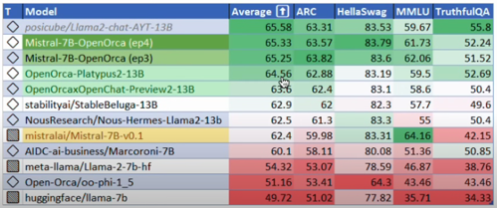
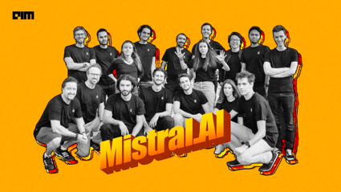
Mistral-7B-OpenOrca
Original Mistral-7B: https://github.com/mistralai
https://huggingface.co/mistralai/Mistral-7B-v0.1
Fine-tuned MistralOrca:
https://huggingface.co/Open-Orca/Mistral-7B-OpenOrca
Demo: https://huggingface.co/spaces/Open-Orca/Mistral-7B-OpenOrca
Colab notebook:
https://colab.research.google.com/drive/1uTJvyjhH-mvi1AmuwAOL2384X8TugGf0?usp=sharing
https://mistral.ai - Mistral - strong fast wind through southern France - https://www.youtube.com/watch?v=riCU5GzUZVw
- https://analyticsindiamag.com/mistral-ai-is-making-generative-ai-fun/
Mistral models are open source - but NOT LLaMa
MistralOrca is a fine-tuned version of original Mistral-7B using Mistral's own OpenOrca dataset, OpenChat packing
HF Leaderboard evals average 65.33 - placing as #2 for all models smaller 30B, outperforming all but one 13B model
Quantized down versions - https://huggingface.co/TheBloke/Mistral-7B-OpenOrca-AWQ https://huggingface.co/TheBloke/Mistral-7B-OpenOrca-GPTQ https://huggingface.co/TheBloke/Mistral-7B-OpenOrca-GGUF
Mistral-7B uses a Sliding Window Attention (SWA) mechanism, allowing handling long sequences and using stacked layers of a transformer to reach tokens in the past beyond the window size. It also uses a Grouped Query Attention (GQA) to handle multiple queries simultaneously.

Slide 5

Model files
GGUF = GGML Universal File - new format (August 21, 2023) r eplacing the GGML (Georgi Gerganov ML) format for llama.cpp project.
GPTQ - GPT Quantized
AWQ - efficient, accurate and blazing-fast low-bit weight quantization method, currently supporting 4-bit quantization. Compared to GPTQ, it offers faster Transformers-based inference AWQ: Activation-aware Weight Quantization for LLM Compression and Acceleration (June 2023)
https://arxiv.org/abs/2306.00978
pt or bin - Pytorch models
ONNX = Open Neural Network eXchange
pb - protocol buffer files (for TensorFlow models)
h5 - hierarchical files for Keras models
pkl - pickle files (sklearn, ...)
Georgi Gerganov
https://github.com/ggerganov/llama.cpp
Sofia, Bulgaria
https://ggerganov.com

Slide 6
Running Mistral-7B-OpenOrca
download and compile llama.cpp (run "make" command)
https://github.com/ggerganov/llama.cpp
download the model https://huggingface.co/TheBloke/Mistral-7B-OpenOrca-GGUF
run it:
./main -ngl 32 -m ~/Downloads/mistral-7b-openorca.Q5_K_M.gguf --color -c 2048 --temp 0.7 --repeat_penalty 1.1 -n -1 -i -ins
Change -c 2048 to the desired sequence length.
For extended sequence models - eg 8K, 16K, 32K - the necessary RoPE scaling parameters are read from the GGUF file and set by llama.cpp automatically.

Slide 7

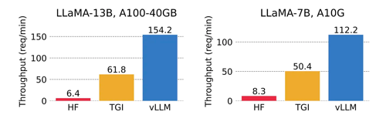
vLLM
vLLM - UC Berkeley’s Open Source Framework
for Super Fast and Cheap LLM Serving for everyone
https://github.com/vllm-project/vllm
https://pub.towardsai.net/meet-vllm-uc-berkeleys-open-source-framework-for-super-fast-and-chearp-llm-serving-23b2f540a756
from vllm import LLM
prompts = ["Hello, my name is", "The capital of France is"] # Sample prompts
llm = LLM(model="lmsys/vicuna-7b-v1.3") # Create an LLM
outputs = llm.generate(prompts) # Generate outputs
vLLM showed over 20x gains in performance
HF = Hugging Face
TGI - Text Generation Inference (HF)

Slide 8
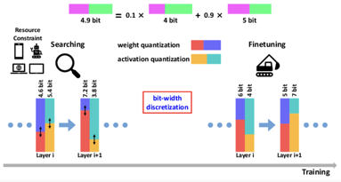
Mixed-precision quantization (average 3 bit)
Very interesting work.
Run Llama 2 70B on Your GPU with ExLlamaV2 - Sept 29, 2023
https://towardsdatascience.com/run-llama-2-70b-on-your-gpu-with-exllamav2-588141a88598
ExLlamaV2 (MIT license) implements mixed-precision quantization - quantize important parts of the model to a higher precision and the less important parts to a lower precision - https://github.com/turboderp/exllamav2
Original 70b LLaMa2 needs 140GB of memory.
You can quantize it down to 24GB using mixed-precision conversion to 2.5bit (conversion takes ~ 2 hrs in Colab):
python convert.py \
-i ./Llama-2-70b-hf/ \
-o ./Llama-2-70b-hf/temp/ \
-c test.parquet \
-cf ./Llama-2-70b-hf/2.5bpw/ \
-b 2.5
Then you can run converted 70b model locally (fits into one 24GB Nvidia RTX 3090)
git clone https://github.com/turboderp/exllamav2
cd exllamav2
pip install -r requirements.txt
python test_inference.py -m <path_to_model> -p "Once upon a time,"

Slide 9
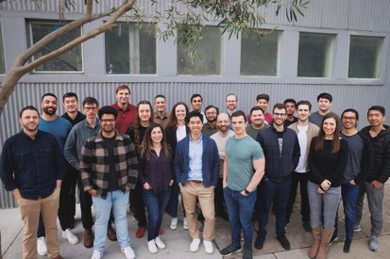
Adept.AI
Adept.AI - raised $350 Mln (ser. B, March 2023)
San Francisco, CA, ~100 people
ML research and product lab
ACT-1 - take actions on computers in response to your natural language commands (in common software like Google Sheets, Salesforce, Craiglist, Redfin, etc, etc)
Examples: Google Sheets, Create profit and loss columns for the last quarter
Salesforce, Add Emma Jacobs from Acme Co as a new contact
Craigslist, Find me a refrigerator for under $1,000
Redfin, Find me a property in Houston under $600,000
https://www.adept.ai
https://www.linkedin.com/company/adeptai/
https://medium.com/@ignacio.de.gregorio.noblejas/ai-more-impressive-than-chatgpt-4cc9cf343185

Slide 10
How to Get HuggingFace LLM Leaderboard Data
# full script is here:
# https://github.com/lselector/ai/blob/master/llm_leaderboard.py
import os, sys, json, time
from gradio_client import Client
import pandas as pd
import numpy as np
client = Client("https://felixz-open-llm-leaderboard.hf.space/")
json_data = client.predict("","", api_name='/predict')
with open(json_data, 'r') as file:
file_data = file.read()
data = json.loads(file_data)
df = pd.DataFrame(data=data['data'], columns=data['headers'])

Slide 11
Open LLM Leaderboard
https://huggingface.co/spaces/HuggingFaceH4/open_llm_leaderboard
https://huggingface.co/datasets/open-llm-leaderboard/results - underlying dataset and links
https://huggingface.co/spaces/gsaivinay/open_llm_leaderboard - added GPT-4 and GPT-3.5
Oct 04, 2023 1496 entries (was ~346 entries on July 16th before LLaMa July 18)
GPT-4 (best) and GPT-3.5 (33rd place) provided for comparison
All top positions (except GPT) are LLaMa 70B 16bit and require ~160 GB VRAM to run.
Reducing N-params from 70B down to 30,13,7B causes severe reduction of average test scores
Reducing precision from 16bits down to 4bits surprisingly preserves the quality of the model
rank size avg_quality bits VRAM name
0 1,760B 84.3 16 4,000 GPT-4
1 70B 74.07 16 160 Riiid/sheep-duck-llama-2-70b-v1.1
2 70B 74.06 16 160 AIDC-ai-business/Marcoroni-70B-v1
...
34 175B 71.9 16 400 GPT-3.5
49 70B 71.36 8 160 garage-bAInd/Camel-Platypus2-70B
52 70B 70.99 4 45 lloorree/jfdslijsijdgis
93 180B 68.74 16 400 tiiuae/falcon-180B
131 70B 66.8 16 160 meta-llama/Llama-2-70b-chat-hf (original LLaMa2, July 18)
150 13B 66.03 16 30 Aspik101/trurl-2-13b-pl-instruct_unload
162 13B 65.58 16 30 posicube/Llama2-chat-AYT-13B
165 7B 65.33 16 18 Mistral-Orca (not in leaderboard yet)
213 30B 64.21 4 20 gaodrew/gaodrew-llama-30b-instruct-2048-Open-Platypus-100steps
245 40b 63.47 16 tiiuae/falcon-40b-instruct (was #1 before LLaMa2)
264 13B 63.19 4 10 Open-Orca/OpenOrca-Platypus2-13B
320 7b 62.4 16 18 mistralai/Mistral-7B-v0.1
480 7b 60.02 16 18 oh-yeontaek/llama-2-7B-LoRA-assemble
791 7b 55.72 4 6 joehuangx/spatial-vicuna-7b-v1.5-LoRA

Slide 12
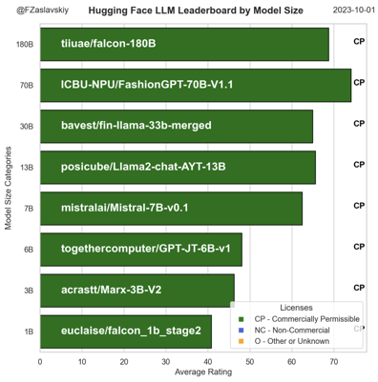
Meta Open LLM Leaderboard - by Feliks Zaslavskiy
https://huggingface.co/spaces/felixz/meta_open_llm_leaderboard
Oct 01, 2023

Slide 13

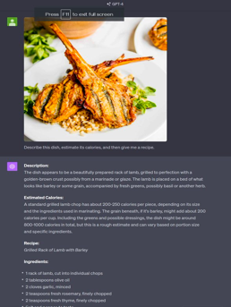
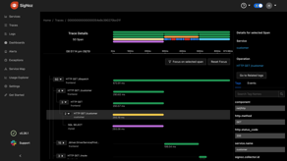

Misc
SigNoz - get $6.5M
https://signoz.io
open source, alternative to Datadog or New Relic. An observability tool for your apps: APM, logs, metrics, exceptions, alerts, and dashboards
Nvidia's RTX 5000 Ada Now Available:
AD102 GPU, 32GB of GDDR6, 250W, $4-5K, basic cut-down board
GPT-4 Vision for converting food pics into recipes
Access DALL-E 3 with Bing
https://www.bing.com/images/create

Slide 14
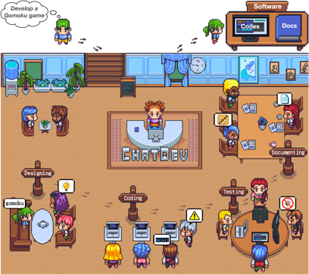
Misc 2
MSFT Open Orca - https://huggingface.co/Open-Orca/OpenOrca-Preview1-13B
MSFT phi - https://huggingface.co/microsoft/phi-1_5
MSFT AutoGen - framework for simplifying the orchestration, optimization, and automation of LLM workflows - https://www.microsoft.com/en-us/research/blog/autogen-enabling-next-generation-large-language-model-applications/
ChatDev - a virtual software company that operates through various intelligent agents holding different roles, including CEO, CPO, CTO, programmer , reviewer , tester , art designer - https://github.com/OpenBMB/ChatDev
https://www.youtube.com/watch?v=yoAWsIfEzCw

Slide 15
Misc 3
RAG — Retrieval as a Multi-Step Process: Optimizing Knowledge Graph and Vector Retrieval https://pub.aimind.so/rag-optimization-retrieval-as-a-multi-step-process-optimizing-knowledge-graph-and-vector-d249fc82b497
Building a Reward Model for Your LLM Using RLHF in Python https://python.plainenglish.io/building-a-reward-model-for-your-llm-using-rlhf-in-python-49abaf4906f
How To Create A Custom Fine-Tuned Prediction Model Using Base GPT-3 models https://cobusgreyling.medium.com/how-to-create-a-custom-fine-tuned-prediction-model-using-base-gpt-3-models-3dfd1eb1de0e
What is MetaGPT? LLM Agents Collaborating to Solve Complex Tasks https://pub.towardsai.net/what-is-metagpt-llm-agents-collaborating-to-solve-complex-tasks-63a453df6654
“Graph of Thoughts” (GoT) Revolution: Next Level to Chains and Trees of Thought (ToT) https://medium.com/mlearning-ai/graph-of-thoughts-got-revolution-next-level-to-chains-and-trees-of-thought-tot-bc9725661f3c
AI Startup Trends: Insights from Y Combinator https://towardsdatascience.com/ai-startup-trends-insights-from-y-combinators-latest-batch-282efc9080ae
Feature Engineering: How LLMs Can Enrich Your Data https://medium.com/@swansburg.justin/the-brave-new-world-of-feature-engineering-how-llms-can-enrich-your-data-b6896f1b2b80

Slide 16
Misc 4
RAG vs Fine-Tuning https://medium.com/@abhishekranjandev/rag-vs-fine-tuning-choosing-the-best-tool-for-your-llm-f185dcc142da
Extracting text from PDF files with Python: A comprehensive guide https://towardsdatascience.com/extracting-text-from-pdf-files-with-python-a-comprehensive-guide-9fc4003d517
A Pro’s Guide to Finetuning LLMs https://medium.com/@dave-shap/a-pros-guide-to-finetuning-llms-c6eb570001d3 https://github.com/daveshap/GPT3_Finetunes
A New Document Summary Index for LLM-powered QA Systems https://blog.llamaindex.ai/a-new-document-summary-index-for-llm-powered-qa-systems-9a32ece2f9ec
Create Your Own Data Analyst Assistant With Langchain Agents https://pub.towardsai.net/create-your-own-data-analyst-assistant-with-langchain-agents-722f1cdcdd7e
Generating Summaries for Large Documents with Llama2 using Hugging Face and Langchain https://medium.com/@ankit941208/generating-summaries-for-large-documents-with-llama2-using-hugging-face-and-langchain-f7de567339d2
Improving RAG (Retrieval Augmented Generation) Answer Quality with Re-ranker https://medium.com/towards-generative-ai/improving-rag-retrieval-augmented-generation-answer-quality-with-re-ranker-55a19931325

Slide 17
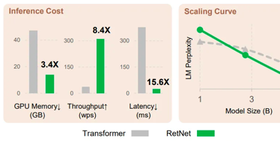
RetNet: Transformer killer (developed at Meta AI)
https://medium.com/aiguys/retnet-transformer-killer-is-here-1dc7f50d1205
RetNet is a hybrid CNN-Transformer model
It achieves state-of-the-art results on image recognition benchmarks like ImageNet while using far fewer parameters than models like EfficientNet and Vision Transformer (ViT).
RetNet incorporates ideas from Vision Transformers like split attention and residual connections while also using CNNs in parts of the model. The hybrid design (CNNs and Transformers).
By using 30-50x fewer parameters than ViT models, RetNet is more efficient and requires less compute resources to train.
The researchers plan to scale up RetNet substantially, which they believe could match or surpass the accuracy of models like ViT-Huge while using far fewer computational resources.

Slide 18
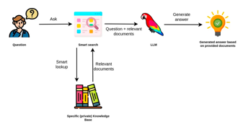
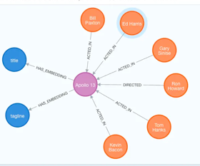
Enhance Semantic Search of Text Embeddings
through Collaborative Filtering over A Knowledge Graph
https://medium.com/@yu-joshua/enhance-semantic-search-of-text-embeddings-through-collaborative-filtering-over-a-knowledge-graph-8321fce4607b
RAG was introduced by Facebook AI at NeurIPS 2020 in a paper titled “Retrieval-Augmented Generation for Knowledge-Intensive NLP Tasks”.
Challenges - retrieval accuracy, data quality and relevance, data overlapping (bias), size limitation of the LLM prompt, domain awareness of data
Limitations of LLM generated embeddings - they are contextual (depend on context), they are high-dimension (capture too many details, noise), training data may be biased, different phrases may get similar embeddings
# use vector similarity, then apply collaborative filtering
# to calculate a weight and adjust similarity score
# using a graph database
from neo4j import GraphDatabase
from openai.embeddings_utils import get_embedding
import openai

Slide 19
Fine-Tuning
Fine-tune your own Llama 2 to replace GPT-3.5/4
https://news.ycombinator.com/item?id=37484135
How to Run Llama 2 on Mac M1 and Train with Your Own Data
https://itnext.io/how-to-run-llama-2-on-mac-m1-and-train-with-your-own-data-8aba7d5ef95e
The Cheapskate’s Guide to Fine-Tuning LLaMA-2 and Running It on Your Laptop
https://hackernoon.com/the-cheapskates-guide-to-fine-tuning-llama-2-and-running-it-on-your-laptop
The EASIEST way to finetune LLAMA-v2 on local machine!
https://www.youtube.com/watch?v=3fsn19OI_C8 https://github.com/huggingface/autotrain-advanced
Fine-Tuning Llama-2: A Comprehensive Case Study for Tailoring Models to Unique Applications
https://www.anyscale.com/blog/fine-tuning-llama-2-a-comprehensive-case-study-for-tailoring-models-to-unique-applications
Fine-tune Llama 2 with DPO
https://huggingface.co/blog/dpo-trl
Fine-Tune Your Own Llama 2 Model in a Colab Notebook
https://towardsdatascience.com/fine-tune-your-own-llama-2-model-in-a-colab-notebook-df9823a04a32
Fine-Tuning LLaMA 2 Models using a single GPU, QLoRA and AI Notebooks (on HuggingFace)
https://blog.ovhcloud.com/fine-tuning-llama-2-models-using-a-single-gpu-qlora-and-ai-notebooks/
Fine-tune Llama-2 with few lines of code! (HuggingFace|Colab)
https://www.linkedin.com/posts/younes-belkada-b1a903145_fine-tune-llama-2-with-few-lines-of-code-activity-7087412907029737472-_5-u/
Fine-tuning large language models in practice: LLaMA 2 (Paperspace's Nvidia Ampere GPUs)
https://blog.paperspace.com/fine-tuning-llms-in-practice-llama-2/
Fine-Tuning Large Language Models (LLMs)
https://towardsdatascience.com/fine-tuning-large-language-models-llms-23473d763b91
train a model locally https://www.reddit.com/r/LocalLLaMA/comments/16x4zr2/will_we_ever_be_able_to_train_a_model_locally/

Slide 20
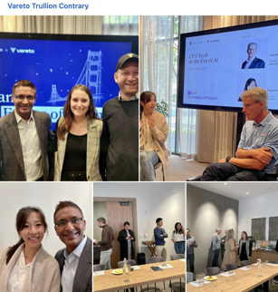
AI and Future of Finance
Attention CFOs, FP&A professionals, and Accounting
Finance teams are increasingly recognizing automation and AI technology as instrumental in streamlining manual tasks, thereby creating time for critical analyses and decision-making
The issue of burnout in the finance orgs is a major concern. There will be a surge in demand for tools that alleviate this strain, as businesses strive to achieve more with fewer resources
Back-office functions such as Accounting, Accounts Payable (AP), and Accounts Receivable (AR) are poised to experience a substantial reduction in labor requirements thanks to the implementation of RPA and AI-powered automation
Managing risks associated with AI implementation is of paramount importance and demands careful attention
https://www.linkedin.com/feed/update/urn:li:activity:7115385812996739072/
https://www.vareto.com

Slide 21

LLM as the kernel of a new Operating System
... LLMs not as a chatbot, but the kernel process of a new Operating System
... today it orchestrates:
Input & Output across modalities (text, audio, vision)
Code interpreter, ability to write & run programs
Browser / internet access
Embeddings database for files and internal memory storage & retrieval
A lot of computing concepts carry over.
Currently we have single-threaded execution running at ~10Hz (tok/s) and enjoy looking at the assembly-level execution traces stream by.
Concepts from computer security carry over, with attacks, defenses and emerging vulnerabilities.
I also like the nearest neighbor analogy of "Operating System"
because the industry is starting to shape up similar:
Windows, OS X, and Linux <-> GPT, PaLM, Claude, and Llama/Mistral(?:)).
An OS comes with default apps but has an app store.
Most apps can be adapted to multiple platforms.
TLDR looking at LLMs as chatbots is the same as looking at early computers as calculators.
We're seeing an emergence of a whole new computing paradigm, and it is very early.
Andrej Karpathy

Slide 22
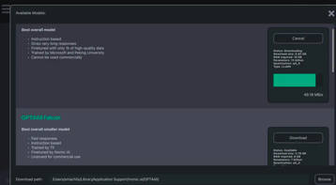
5 easy ways to run an LLM locally
5 easy ways to run an LLM locally
https://www.infoworld.com/article/3705035/5-easy-ways-to-run-an-llm-locally.html
GPT4All - Run a local chatbot with GPT4All
llm on cmd line: pip install lm llm install mymodel llm -m mymodel "some query"
Ollama - run models on Mac & Linux
h2oGPT - chat with your own documents
PrivateGPT - easy but slow chat with your data
LocalGPT - a PrivateGPT spinoff
LM Studio -
LangChain framework
GPT4All

Slide 23
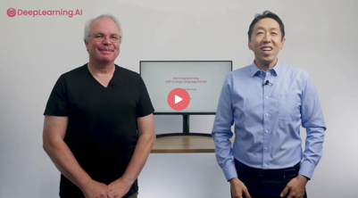
Pair Programming with a LLM
https://www.deeplearning.ai/short-courses/pair-programming-llm/
AI pair programming = using AI to help in software dev. process
Uses Google’s PaLM API
Understands all coding languages
Simplify and improve your code
Write test cases
Debug and refactor your code
Explain and document your code

Slide 24
Thank You!

