Slide 1
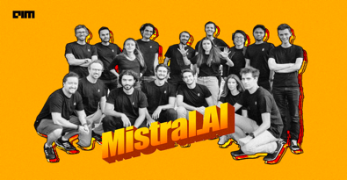
Mistral.ai
Mistral.AI - new startup from former DeepMind and Meta researchers
It was founded in June 2023
It raised $113 Million in seed funding
It develops original open source models (NOT LLaMa)
word Mistral - strong fast wind in southern France
https://github.com/mistralai
Mistral-7B is the first "teaser" model
Mistral-7B-OpenOrca - fine-tuned, 65.84 aver. score
Quantized 4bit versions available
Sliding Window Attention (SWA) to handle long sequences
Uses a Grouped Query Attention (GQA) to handle multiple queries simultaneously

Slide 2
HuggingFace LLM Leaderboard
https://huggingface.co/spaces/HuggingFaceH4/open_llm_leaderboard
Rank | Model | Aver | Precision | Nparam
0 | GPT-4 | 84.3 | 16bit | 1800
1 | Riiid/sheep-duck-llama-2-70b-v1.1 | 74.07 | 16bit | 70
35 | GPT-3.5 | 71.9 | 16bit | 175
51 | garage-bAInd/Camel-Platypus2-70B | 71.36 | 8bit | 70
54 | lloorree/jfdslijsijdgis | 70.99 | 4bit | 70
96 | tiiuae/falcon-180B | 68.74 | 16bit | 180
135 | meta-llama/Llama-2-70b-chat-hf | 66.8 | 16bit | 70
158 | Open-Orca/Mistral-7B-OpenOrca | 65.84 | 16bit | 7
299 | Open-Orca/OpenOrca-Platypus2-13B | 63.19 | 4bit | 13
361 | mistralai/Mistral-7B-v0.1 | 62.4 | 16bit | 7
874 | joehuangx/spatial-vicuna-7b-v1.5-LoRA | 55.72 | 4bit | 7
1716 | baseline | 25 | None | 0

Slide 3
Running Mistral-7B-OpenOrca
download and compile llama.cpp
(run "make" command)
https://github.com/ggerganov/llama.cpp
download the model https://huggingface.co/TheBloke/Mistral-7B-OpenOrca-GGUF
run it:
./main -ngl 32 -m ~/Downloads/mistral-7b-openorca.Q5_K_M.gguf --color -c 4096 --temp 0.7 --repeat_penalty 1.1 -n -1 --interactive-first -ins

