Slide 1
Fine-Tuning LLMs
How do you train an LLM to learn your local or private domain specific data?
Train a new LLM from scratch is expensive ($2-5Mln)
Train a new small LLM - much cheaper (but still $40-400K)
Fine-tune existing model (much-cheaper)
Fine-tune existing small model (even cheaper)
Fine-tune existing small model quantized down to 4 bits (on laptop)
PEFT = Parameter Efficient Fine Tuning fine-tuning while minimizing the resources and cost
Two common ways of achieving PEFT:
LoRA = Low Rank Parameter Adaptation https://arxiv.org/abs/2106.09685 (June 2021, Montréal, QC, Canada)
QLoRA = Quantized Low-Ranking Adaptation (fast, using 4bit) https://arxiv.org/abs/2305.14314 (May 2023, Seattle, WA)

Slide 2
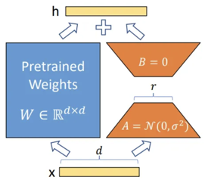
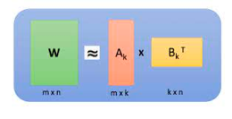
Fine Tuning LLM
LoRA - add trainable parameters (weights) in each layer of the model in parallel with frozen original parameters. The trainable layer uses dimension/rank decomposition to reduce number of parameters to train
QLora - trains using 4-bit (does Normalization & Quantization) - thus making calculations much faster and require less resources
Read these two articles explaining the basics:
Fine Tuning LLM: Parameter Efficient Fine Tuning (PEFT) — LoRA & QLoRA — Part 1 & Part 2 - by A B Vijay Kumar (using HuggingFace)
https://abvijaykumar.medium.com/fine-tuning-llm-parameter-efficient-fine-tuning-peft-lora-qlora-part-1-571a472612c4
https://abvijaykumar.medium.com/fine-tuning-llm-parameter-efficient-fine-tuning-peft-lora-qlora-part-2-d8e23877ac6f

Slide 3
Fine Tuning LLM using QLoRA
Instructions and examples
https://github.com/artidoro/qlora
Video - How to Fine-Tune Open-Source LLMs Locally Using QLoRA!
(link to python code under the video)
https://www.youtube.com/watch?v=2bkrL2ZcOiM
Two more articles with examples:
https://www.analyticsvidhya.com/blog/2023/08/lora-and-qlora/
https://medium.com/@amodwrites/a-definitive-guide-to-qlora-fine-tuning-falcon-7b-with-peft-78f500a1f337

