Slide 1
AI Updates
October 13, 2023

Slide 2
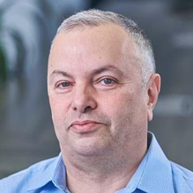

About the Speaker
Lev Selector, Ph.D.
40+ years of software engineering, data science, and building teams (hiring, training, and managing)
Ph.D. in mathematical modeling and computer simulations
Interests:
Generative AI, Using LLM with your data
Local AI for Local Private Data
Cloud architecture, fin-tech, application security
Find/connect: Linkedin, GitHub, YouTube, Google
https://eais.ai

Slide 3

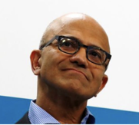
Tools for the Mind
Steve Jobs
"Computers are like a bicycle for our minds"
Satya Nadella
"AI is like a steam engine for the mind"
Next ?
race car ?
rocket ?

Slide 4
Misc
Mistal-OpenOrca is available on ollama.ai !!!
https://ollama.ai/library/mistral-openorca
In June 2023, Databricks bought MosaicML for $1.3 Bln
https://www.mosaicml.com
MosaicML is a generative AI platform that allows enterprises to build and deploy their own AI models inside their private cloud
Mistral-11B released - and it is better than original LLaMa2 (67.21 vs 66.8)
LLaVA: Large Language and Vision Assistant
- Open Source and FREE
- uses LLaMa 2
- comparable with "ChatGPT Vision"
- by Univ of Wisconsin-Madison ,
Microsoft Research, Columbia University
- https://llava-vl.github.io
- https://github.com/haotian-liu/LLaVA
- https://www.youtube.com/watch?v=kx1VpI6JzsY
Ollama meets LangChain
https://www.youtube.com/watch?v=k_1pOF1mj8k

Slide 5
HuggingFace LLM Leaderboard
https://huggingface.co/spaces/HuggingFaceH4/open_llm_leaderboard
https://huggingface.co/datasets/open-llm-leaderboard/results
https://huggingface.co/spaces/felixz/open_llm_leaderboard
https://huggingface.co/spaces/felixz/meta_open_llm_leaderboard
https://github.com/lselector/ai/blob/master/llm_leaderboard.py
Look at Mistral 7b and 11b - better than original LLaMa2
Rank | Model | Aver | Precision | Nparam
0 | GPT-4 | 84.3 | 16bit | 1800
1 | ValiantLabs/ShiningValiant | 74.17 | 16bit | 70
2 | ICBU-NPU/FashionGPT-70B-V1.2 | 74.11 | 16bit | 70
41 | GPT-3.5 | 71.9 | 16bit | 175
57 | garage-bAInd/Camel-Platypus2-70B | 71.36 | 8bit | 70
62 | lloorree/jfdslijsijdgis | 70.99 | 4bit | 70
107 | tiiuae/falcon-180B | 68.74 | 16bit | 180
141 | Undi95/Mistral-11B-TestBench11 | 67.21 | 16bit | 11
147 | ehartford/dolphin-2.1-mistral-7b | 67.06 | 16bit | 7
155 | meta-llama/Llama-2-70b-chat-hf | 66.8 | 16bit | 70
165 | Weyaxi/SlimOpenOrca-Mistral-7B | 66.54 | 16bit | 7
177 | Aspik101/trurl-2-13b-pl-instruct_unload | 66.03 | 16bit | 13
183 | Open-Orca/Mistral-7B-OpenOrca | 65.84 | 16bit | 7
357 | Open-Orca/OpenOrca-Platypus2-13B | 63.19 | 4bit | 13
422 | mistralai/Mistral-7B-v0.1 | 62.4 | 16bit | 7
988 | joehuangx/spatial-vicuna-7b-v1.5-LoRA | 55.72 | 4bit | 7
1870 | baseline | 25 | nan | 0

Slide 6
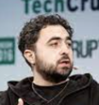
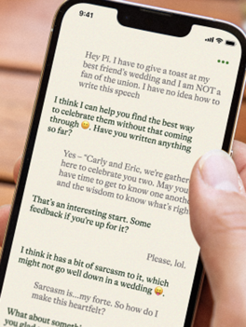

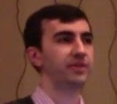
inflection.ai - Pi
Inflection AI, Inc. is a machine learning startup founded by Reid Hoffman, Mustafa Suleyman (CEO), Karén Simonyan in 2022, based in in Palo Alto, CA
Raised $225M in 2022, then $1.3 Bln in June 2023 from investors like Microsoft, Reid Hoffman (founder of LinkedIn), Bill Gates, Eric Schmidt, Nvidia
Created Pi chatbot, https://heypi.com , May 2023 - a kind and supportive companion offering conversations, friendly advice, and concise information in a natural, flowing style. Helps to process thoughts and feelings, curious and humble, gives feedback in plain, natural language. Creative and fun: it is playful and silly, laughs easily and is quick to make a surprising, creative connection.
Pi = "Personal intelligence" because it learns person’s unique interests and needs. Pi is a teacher, coach, confidante, creative partner, and sounding board
https://inflection.ai
https://github.com/topics/inflection-ai
https://en.wikipedia.org/wiki/Inflection_AI
https://pi.ai/onboarding
Mustafa Suleyman
co-founder of Inflection AI
co-founder of DeepMind
Reid Hoffman
co-founder of Inflection AI
co-founder of Linkedin
Karén Simonyan from DeepMind
Chief Scientist and co-Founder of Inflection AI

Slide 7
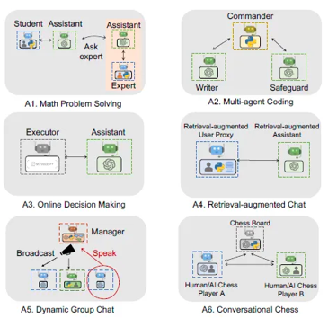
AutoGen (MSFT) - Build Systems of Co-operating Agents
AutoGen - open-source framework to enable the development of LLM applications using multiple agents that can converse with each other to solve tasks - on GitHub - https://github.com/microsoft/autogen
pip install pyautogen
AutoGen: Enabling Next-Gen LLM Applications via Multi-Agent Conversation - https://www.microsoft.com/en-us/research/publication/autogen-enabling-next-gen-llm-applications-via-multi-agent-conversation-framework/
Good article - https://jrodthoughts.medium.com/inside-autogen-microsoft-research-new-autonomous-agent-framework-b413648af24d
Some use cases:
Math Problem Solving
Multi-Agent Coding (3 agents solving optimization problem)
Online Decision Making
Retrieval-Augmented Chat (code generation, question-answering)
Dynamic Group Chat - versatile group communication systems
Conversational Chess - allowing players to engage in an interactive and creative chess game through conversation

Slide 8
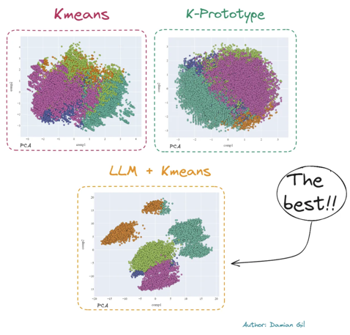
Mastering Customer Segmentation with LLM
Mastering Customer Segmentation with LLM
https://towardsdatascience.com/mastering-customer-segmentation-with-llm-3d9008235f41

Slide 9
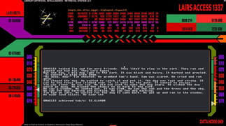
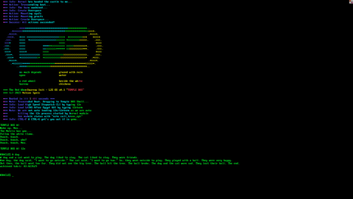
An OS that boots to a baby Llama 2
An OS that boots to a baby Llama 2
Standalone, Binary Portable, Bootable
L2E = Llama 2 Everywhere OS (Linux Kernel)
https://github.com/trholding/llama2.c
The primary objective of Llama 2 Everywhere (L2E) is to ensure its compatibility across a wide range of devices.
We can harness a legion of small specialized LLMs with modest hardware requirements which are networked, distributed, and self-coordinated.
L2E has the potential to democratize access to AI and unlock collective intelligence that surpasses that of a single large LLM.

Slide 10
RAG = Retrieval Augmented Generation
The idea is to enable a LLM to use external data.
RAG = Retrieval Augmented Generation
Examples of using external data:
ChatGPT, Bard, Bing use web search to retrieve recent relevant information
LLM uses local SQL DB search or vector DB search (similarity search)
LLM uses APIs for relevant systems to do the search
...
Question
LLM Agents
Answer
Get Data

Slide 11
RAG = Retrieval Augmented Generation
Search Query
Embedding
vector
Embedding
vectors
Docs
Chunks
Vector DB
Similarity search
Query augmented
with relevant data
Answer
LLM
Relevant
chunks

Slide 12
RAG - Vector Similarity Search is Not Enough
Embeddings fail to capture the inferential link Q -> A when Q and A vectors are not similar
One text passage may contain several ideas. If encoded into a single vector, it is impossible to distinguish relevant sections from irrelevant ones.
Some questions demand synthesizing facts spread across multiple documents. Vector search can NOT do such multi-vector hop reasoning.
Ways to improve:
add metadata, add summaries & tags (use LLM to create them)
add relationships between vectors based on topics, vector similarity, structural (connections between sections, pages, documents), temporal (events linked chronologically), links (references) between passages

Slide 13
RAG = Retrieval Augmented Generation
metadata
summaries, tags, references
Search Query, tags, metadata
Embedding
vector
Embedding
vectors
Docs
Chunks
Vector DB
Similarity search, re-ranking
Splitting
with
overlap
Encoding
Query augmented
with relevant data
(up to 50pages)
Answer
LLM
Relevant
chunks
Example: - https://madhukarkumar.medium.com/secrets-to-optimizing-rag-llm-apps-for-better-accuracy-performance-and-lower-cost-da1014127c0a

Slide 14
Fine-Tuning LLMs
How do you train an LLM to learn your local or private domain specific data?
Train a new LLM from scratch is expensive ($2-5Mln)
Train a new small LLM - much cheaper (but still $40K-400K)
Fine-tune existing model (much-cheaper)
Fine-tune existing small model (even cheaper)
Fine-tune existing small model quantized down to 4 bits (on laptop)
PEFT = Parameter Efficient Fine Tuning fine-tuning while minimizing the resources and cost
Two common ways of achieving PEFT:
LoRA = Low Rank Parameter Adaptation https://arxiv.org/abs/2106.09685 (June 2021, Montréal, QC, Canada)
QLoRA = Quantized Low-Ranking Adaptation (fast, using 4bit) https://arxiv.org/abs/2305.14314 (May 2023, Seattle, WA)

Slide 15
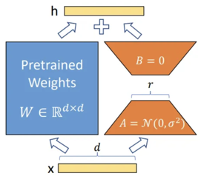
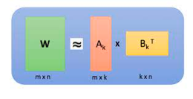
Fine Tuning LLM
LoRA - add trainable parameters (weights) in each layer of the model in parallel with frozen original parameters. The trainable layer uses dimension/rank decomposition to reduce number of parameters to train
QLora - trains using 4-bit (does Normalization & Quantization) - thus making calculations much faster and require less resources
Read these two articles explaining the basics:
Fine Tuning LLM: Parameter Efficient Fine Tuning (PEFT) — LoRA & QLoRA — Part 1 & Part 2 - by A B Vijay Kumar (using HuggingFace)
https://abvijaykumar.medium.com/fine-tuning-llm-parameter-efficient-fine-tuning-peft-lora-qlora-part-1-571a472612c4
https://abvijaykumar.medium.com/fine-tuning-llm-parameter-efficient-fine-tuning-peft-lora-qlora-part-2-d8e23877ac6f

Slide 16
Fine Tuning LLM using QLoRA
Instructions and examples
https://github.com/artidoro/qlora
Video - How to Fine-Tune Open-Source LLMs Locally Using QLoRA!
(link to python code under the video)
https://www.youtube.com/watch?v=2bkrL2ZcOiM
Two more articles with examples:
https://www.analyticsvidhya.com/blog/2023/08/lora-and-qlora/
https://medium.com/@amodwrites/a-definitive-guide-to-qlora-fine-tuning-falcon-7b-with-peft-78f500a1f337

Slide 17

Tagging - Extract Keywords From Documents
A good way to improve RAG is to use summaries and tags for text chunks. You can ask LLM to create a summary in 200 words.
You can use KeyLLM to extract keywords.
About KeyBERT - https://maartengr.github.io/KeyBERT/
About KeyLLM - https://maartengr.github.io/KeyBERT/guides/keyllm.html
Colab - https://colab.research.google.com/drive/1A1lbPnBhtxL9jR7vFcm7Z0F0aJdEl-zj
Video - https://www.youtube.com/watch?v=xF2UJTmRU_Y
from keybert import KeyLLM
from ctransformers import AutoModelForCausalLM
model = AutoModelForCausalLM.from_pretrained(
"TheBloke/Mistral-7B-Instruct-v0.1-GGUF",
model_file="mistral-7b-instruct-v0.1.Q4_K_M.gguf",
model_type="mistral",
gpu_layers=50, hf=True)
Using TF.IDF for article tag recommender systems
https://shaswatlenka.medium.com/using-tf-idf-for-article-tag-recommender-systems-in-python-d1cf74e28b6a
AI-Powered Topic Modeling
https://mikulskibartosz.name/topic-modeling-and-clustering-with-word-embeddings-and-ai
You can also use tagging in LangChain - https://python.langchain.com/docs/use_cases/tagging
from langchain.chains import create_tagging_chain, create_tagging_chain_pydantic

Slide 18
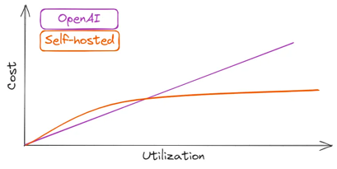
Why Hosting Local LLMs vs Cloud ?
Azure OpenAI Service provide private enterprise hosting. But recently they have exposed 38 TBytes of data - including passwords and secure keys.
OpenAI’s Terms of Use doc mentions that they “may use Content from Services other than our API ... to help develop and improve our Services”. This means that anything you send to ChatGPT may and will be included in their training data.
On-prem solutions provide more privacy, security, control, flexibility, no external dependencies. Also on-prem solutions are cheaper in the long run (own vs rent)
https://betterprogramming.pub/you-dont-need-hosted-llms-do-you-1160b2520526
Self-hosting for for LLaMA-2–70B
on AWS or Google:
8x Nvidia A100
g5.48xlarge on AWS ($17K/mo)
a2-megagpu-16g on GCP ($6K/mo)

Slide 19
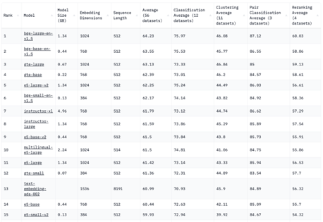
Hosting Your Own Embedding Model
Massive Text Embedding Benchmark (MTEB) Leaderboard
https://huggingface.co/spaces/mteb/leaderboard
Hosting A Text Embedding Model That is Better, Cheaper, and Faster Than OpenAI’s Solution (which is #13 below)
https://medium.com/@kelvin.lu.au/hosting-a-text-embedding-model-that-is-better-cheaper-and-faster-than-openais-solution-7675d8e7cab2

Slide 20
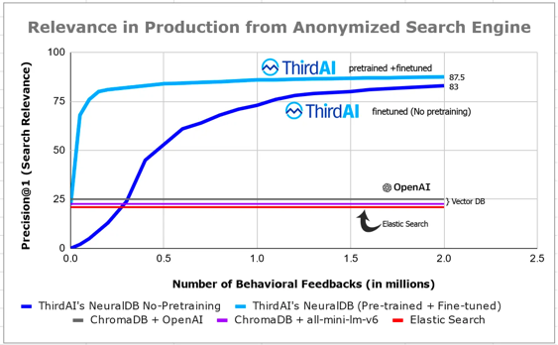
ThirdAI Labs: Fine-Tuning vs RAG
NeuralDB - an efficient, private, teachable database for neural text search over your documents
https://github.com/ThirdAILabs/Demos/tree/main/neural_db
Demystifying LLM-Driven Search: Stop Comparing Embeddings or VectorDBs and Start Fine-Tuning
https://medium.com/thirdai-blog/demystifying-llm-driven-search-stop-comparing-embeddings-or-vectordbs-and-start-fine-tuning-d9b6791146fe

Slide 21
Misc 2
Automating Ontology Construction with LLMs - create ontology over text documents
https://ai.plainenglish.io/automating-ontology-construction-with-large-language-models-76081364dc7b
LCEL = LangChain Expression Language: LangChain rewrote every agent from a pre-defined black box to a series of deconstructed modules by using LangChain expression language
https://levelup.gitconnected.com/building-a-powerful-agent-has-no-challenge-today-774e27be818d
Making AI Hallucinate Less with Chain-of-Verification (CoVe)
https://medium.com/@raphael.mansuy/making-ai-hallucinate-less-with-chain-of-verification-2e27682e842c
Based on the response " ... ", suggest 2-3 questions to verify key facts that could identify inaccuracies in the response if any.
Ask each question separately.
The model is more likely to respond accurately when given a focused factual query.
This is similar to Socrates and Plato method of asking questions
CoVe reduced hallucinations in question answering by 15–38% across different base models, improved factuality in list generation by up to 5x over baselines, increased factual scoring of biographies by a significant 28%.

Slide 22
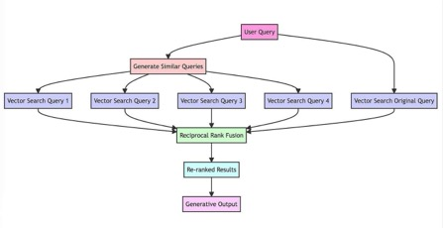
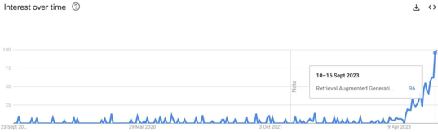
RAG-Fusion
https://github.com/Raudaschl/rag-fusion
Forget RAG, the Future is RAG-Fusion
https://towardsdatascience.com/forget-rag-the-future-is-rag-fusion-1147298d8ad1
The system converts user query into multiple queries (using LLM), conducts vector-based searches on all these generated queries to retrieve relevant documents, applies the Reciprocal Rank Fusion algorithm to re-rank the documents based on their relevance across multiple queries, produces a final output consisting of the re-ranked list of documents
Interest in RAG skyrocketed in 2023

Slide 23
Thank You!

