Slide 1
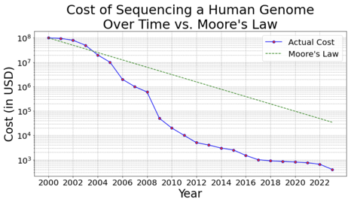
LLMs - Costs of fine-tuning is Going Down
The costs of fine-tuning the LLMs models going down.
This is similar to how the cost of Human Genome sequencing was dropping
from $100 Mln in 2000
to $400 in 2023
Training of original big models is still in millions of dollars. But fine-tuning of small 4bit models on small amount of data is already in single dollar range. It took only one year for this million-times cost drop.
You soon will be able to custom-train multiple models for your personal or business use on a daily basis without even noticing the costs.
Millions $$
cents

