Slide 1
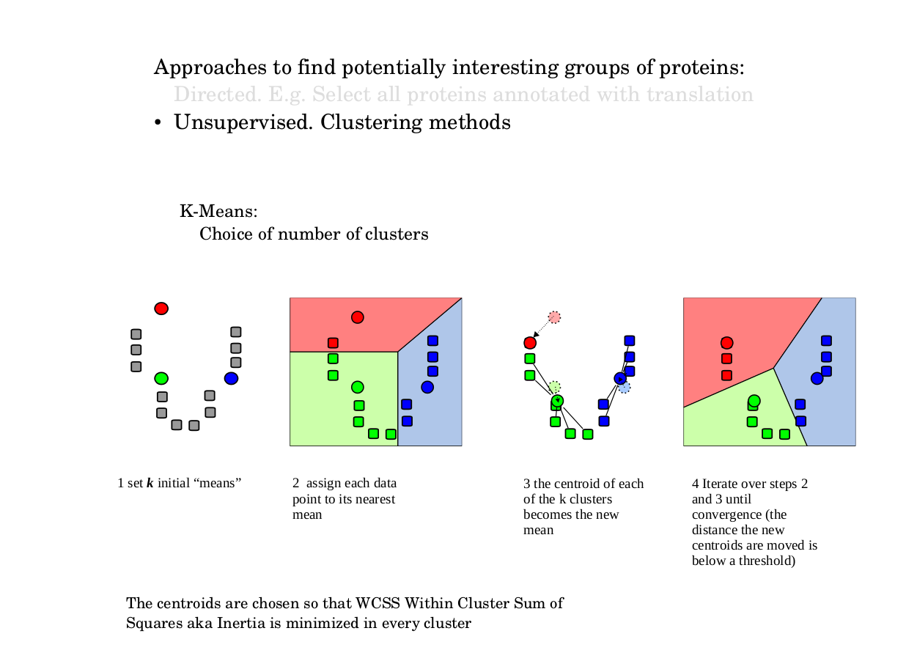

Slide 2
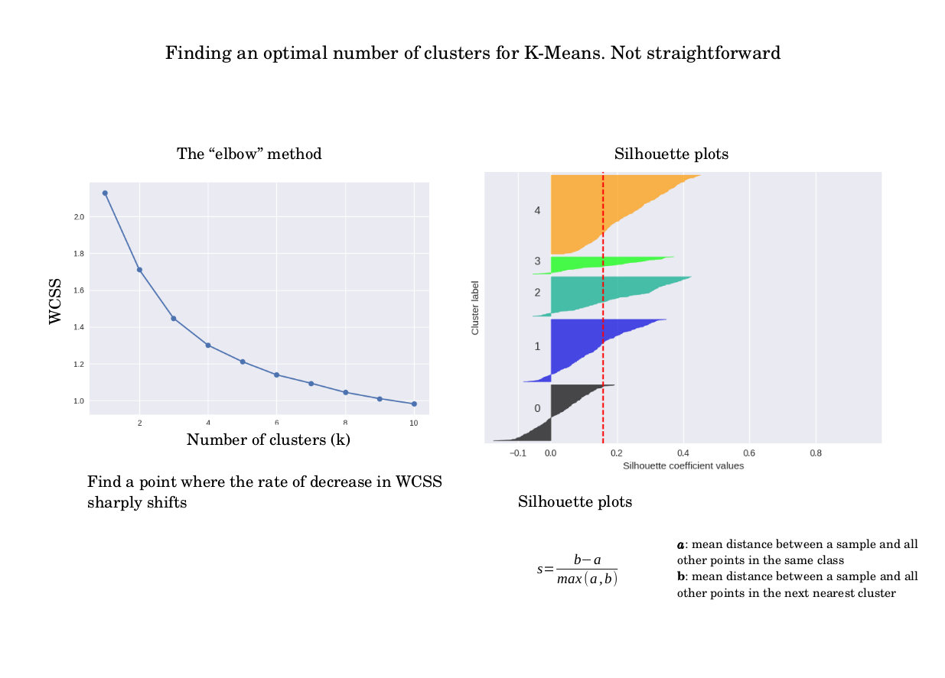

Slide 3
Cluster 0 | dean | clark | edwards | lieberman | gephardt
Cluster 1 | dean | iowa | edwards | kerry | clark
Cluster 2 | party | nader | ballot | republican | democratic
Cluster 3 | kerry | bush | poll | nader | results
Cluster 4 | november | voting | vote | account | electoral
Cluster 5 | percent | voters | bush | poll | kerry
Cluster 6 | senate | race | elections | house | seat
Cluster 7 | marriage | gay | amendment | hate | samesex
Cluster 8 | administration | intelligence | bush | cia | iraq
Cluster 9 | delay | ethics | committee | house | morrison
Cluster 10 | iraq | war | iraqi | troops | soldiers
Cluster 11 | november | account | electoral | turnout | governor
Cluster 12 | million | raised | money | campaign | kerry
Cluster 13 | time | general | people | media | news
Cluster 14 | cheney | president | dick | vice | edwards
Cluster 15 | keyes | bloggers | blogs | blog | internet
Cluster 16 | bush | poll | kerry | polling | polls
Cluster 17 | abu | ghraib | bin | bush | laden
Cluster 18 | bush | kerry | president | administration | bushs
Cluster 19 | november | voting | account | electoral | governor

Slide 4
