Slide 1

Belgian Real Estate Market through Postal Codes
Vitaly Shalem
Junior Data Scientist @ BeCode
AI Bootcamp: ARAI 5
11 July, 2023 - Immo Eliza: Data Analysis presentation

Slide 2

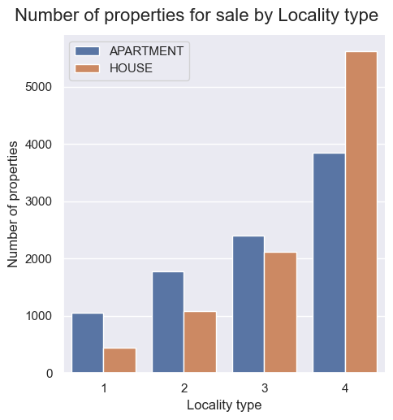
Belgian Postal codes hypothesis
4-digit codes
No leading zeros
Can be categorized as (Locality type):
X000 – main cities (also includes X00X)
X0X0 – main cities’ “satellites” (also includes X0XX)
XX00 – smaller cities (also includes XX0X)
XXX0 – small towns (also includes XXXX)
In theory such categorization can
have some impact on real estate property prices
help to track market activity and distribution of sales
Can it be really significant?
Can data help to prove this hypothesis?

Slide 3

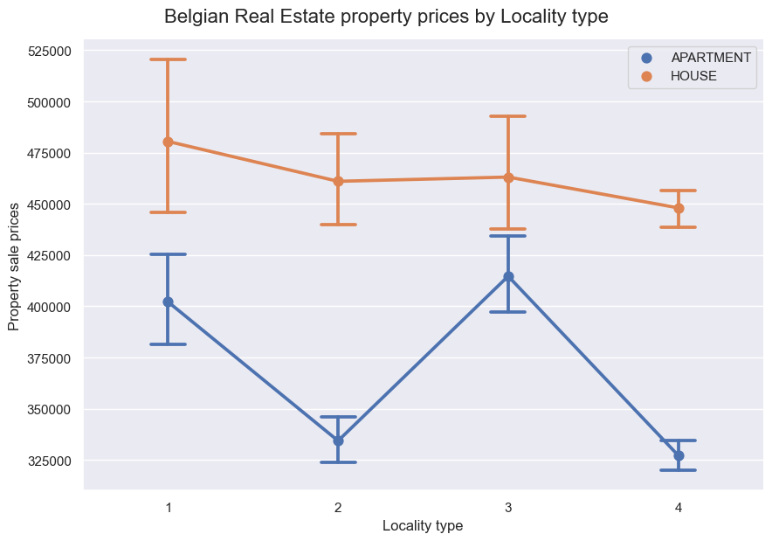
Property prices by locality type

Slide 4

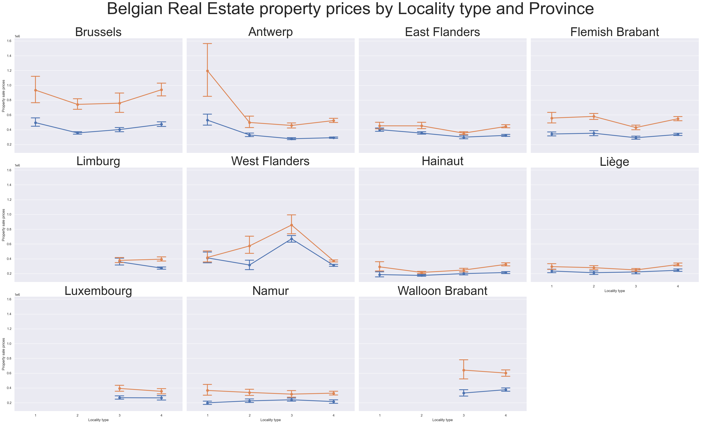
Property prices by locality type / province

Slide 5
Conclusion
xxx

Slide 6


Thank you!..
vitaly shalem | junior data scientist @ </becode>

