Slide 1
Prospective Business in LA
How does income impact venue frequency?

Slide 2
Motivation
Recent LA resident
COVID-19 social distancing
Cannot go out
Use this opportunity to explore

Slide 3
Data
Median income by zip code
City name by zip code
Foursqaured API to call popular venues

Slide 4
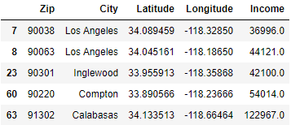
Merged locational and zip code data

Slide 5
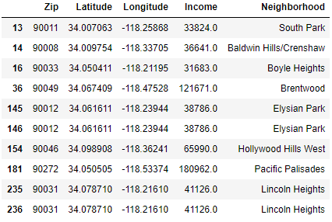
K means clustering center points data and city name

Slide 6
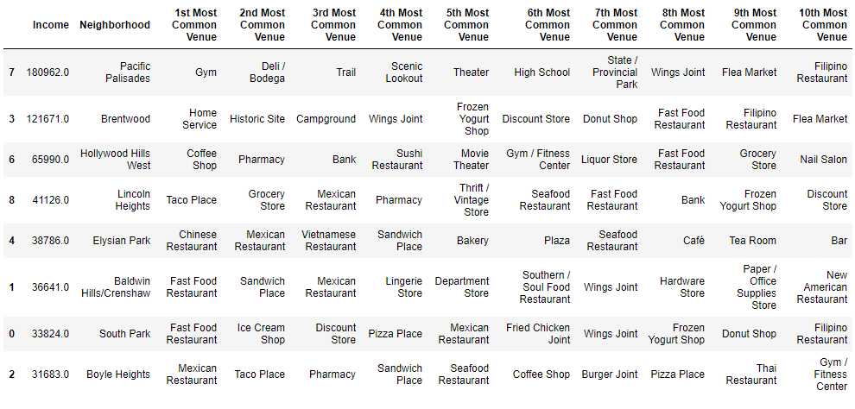
Venue frequency by income

Slide 7
Conclusion
Open activity venues for richer areas
Open Chinese, Mexican, or fast food chains in relatively lower income areas

