Slide 1
Final Project Presentation
Group C, NLP
Marta Colmenar Herrera, Mena Lerf, Vinzenz Uhr
19.12.2023

Slide 2
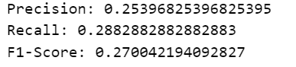

Looking back
Preprocessing
NER Types
Feedback:
Lemmatization
No Lemmatization
NER Type Ambiguity
Merge Entities: e.g. ‘CARDINAL’ and ‘DOSAGE’
→ ‘DOSAGE’ includes terms that may not be captured by ‘CARDINAL’ → keep both
Notes:
After the midterm presentation, we received feedback regarding ambiguities in our Named Entity Recognition (NER) entities and suggestions on how to enhance the model by avoiding lemmatization for NER recognition. Firstly, our ambiguities arose from the model sometimes assigning 'CARDINAL' and other times 'DOSAGE'. We couldn't merge them or eliminate one, as 'DOSAGE' also includes terms that may not be captured by 'CARDINAL', such as single. Furthermore, not every instance of a cardinal number implies a dosage of a medication.
Secondly, as demonstrated at the end of our notebook, not normalizing the data does not yield better results.
Additionally, in text 4671, our model successfully recognizes some routes of medication administration (such as endotracheal or ear) but fails to identify others that we have found (such as oral or nasal). It's important to note that the model is not failing; rather, the texts are challenging, containing numerous medical terms that, as non-experts, we may not have considered. Upon visually inspecting various texts, we can conclude that we have developed a robust model for recognizing drugs in medical texts.
As seen in the printed examples from the med8 and english models, the recognized entities make sense and are correct.
Disclaimer: The scores between Lemmatization and No Lemmatization can’t be compared directly because different texts were used

Slide 3
Looking back
Preprocessing
NER Types
Classification
Notes:
After the midterm presentation, we received feedback regarding ambiguities in our Named Entity Recognition (NER) entities and suggestions on how to enhance the model by avoiding lemmatization for NER recognition. Firstly, our ambiguities arose from the model sometimes assigning 'CARDINAL' and other times 'DOSAGE'. We couldn't merge them or eliminate one, as 'DOSAGE' also includes terms that may not be captured by 'CARDINAL', such as single. Furthermore, not every instance of a cardinal number implies a dosage of a medication.
Secondly, as demonstrated at the end of our notebook, not normalizing the data does not yield better results.
Additionally, in text 4671, our model successfully recognizes some routes of medication administration (such as endotracheal or ear) but fails to identify others that we have found (such as oral or nasal). It's important to note that the model is not failing; rather, the texts are challenging, containing numerous medical terms that, as non-experts, we may not have considered. Upon visually inspecting various texts, we can conclude that we have developed a robust model for recognizing drugs in medical texts.
As seen in the printed examples from the med8 and english models, the recognized entities make sense and are correct.

Slide 4
Agenda Classification
Environment
Baseline results
Preprocessing
Further tuning
Final results
Discussion

Slide 5
Environment
Environment
Baseline results
Preprocessing
Further tuning
Final results
Discussion

Slide 6
Setup
Pipeline
Tools
Custom preprocessing as in task 1
Tokenization defined by clincalBERT model (WordPiece)
Split text because of 512 token limitation
Split into trainings and test set with 20% testsize and label stratification
Training
Evaluation
Jupyter Notebook for demonstration
Training on Ubelix
Pytorch for model training
NLTK for preprocessing
Tensorboard for visualization
Notes:
Prepocessing: remove punctuation, to lowercase (-> done by BERT tokenization as well), remove stopwords, lemmatization -> also done by BERT should be left out

Slide 7
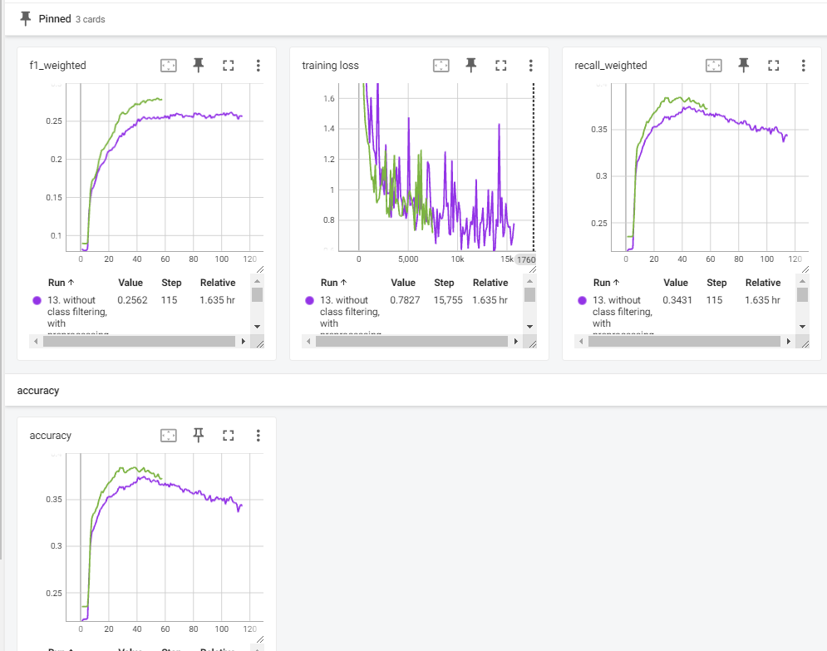
Training and evaluation metrics
Metrics
Tensorboard
Training loss every 1/8 epoch
Evaluationmetrics every epoch
Accuracy
Precision
Recall
F1 score
Bild einfügen

Slide 8
Baseline results
Environment
Baseline results
Preprocessing
Further tuning
Final results
Discussion

Slide 9
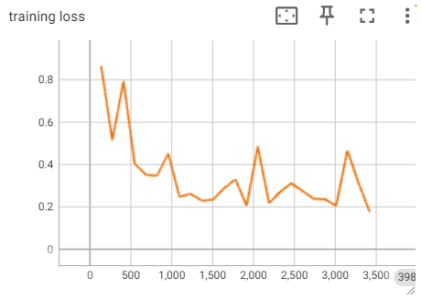
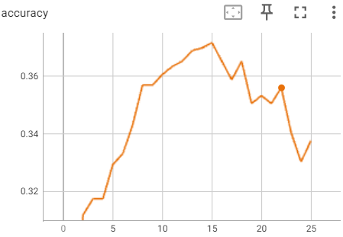
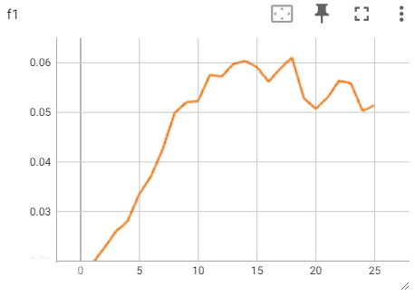
BERT baseline
Learns something from data
Best accuracy around 0.37
Low F1 score with 0.06
Notes:
Disclaimer: Misleading scores, because no stratification in trainings and test split and no weighted sampling.

Slide 10
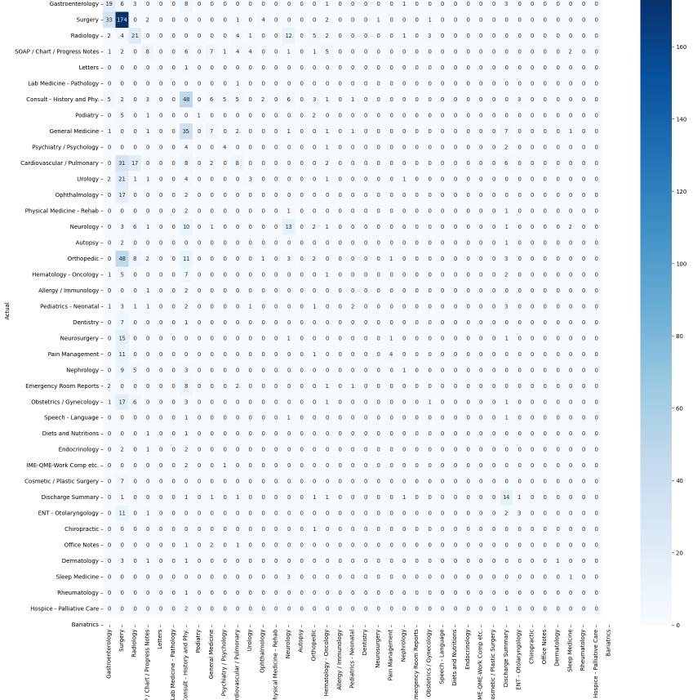
Confusion matrix
Conclusion
Too much weight given to class surgery

Slide 11
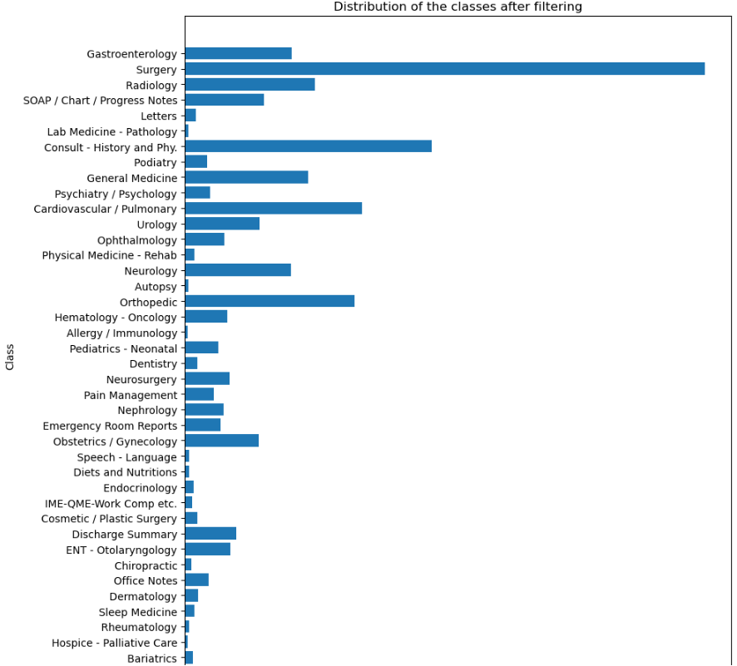
Class imbalance

Slide 12
Machine Learning baselines
Scores
Naïve Bayes
Accuracy: 0.28
F1: 0.22
Random Forest
Accuracy: 0.21
F1: 0.28
Support Vector Machines
Accuracy: 0.26
F1: 0.20
Notes:
Disclaimer: Dataset are balanced compared to the scores in the slides before

Slide 13
Preprocessing
Environment
Baseline results
Preprocessing
Further tuning
Final results
Discussion

Slide 14
Custom preprocessing
Preprocessing steps
Lowercase
Replace ‘\n’, ‘t’ and ‘\r’ with ‘ ‘
WordNet Lemmatizer
Remove stop words
Remove punctuation tokens

Slide 15
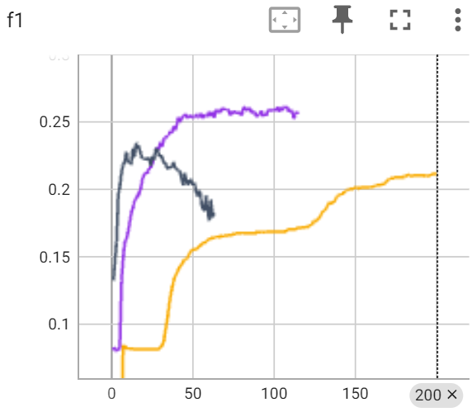
Evaluation
Results
with preprocessing
with preprocessing but no lemmatization without preprocessing
Mostly preprocessing leads to better evaluation scores

Slide 16
Conclusion
With our dataset more preprocessing increases the evaluation scores
We can imagine that the dataset is difficult to learn and that the classifier favours any kind of complexity reduction
We assume this behaviour changes with a bigger training set

Slide 17
Further tuning
Environment
Baseline results
Preprocessing
Further tuning
Final results
Discussion

Slide 18
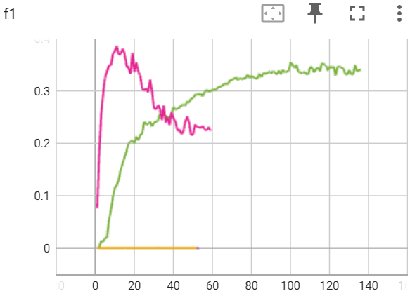
Different learning rate
Lr 5e-4
Lr 5e-5
Lr 5e-6
Lr 5e-7
Results
Best F1 5e-4: 0.01
Best F1 5e-5: 0.01
Best F1 5e-6: 0.38
Best F1 5e-7: 0.35
Insert

Slide 19
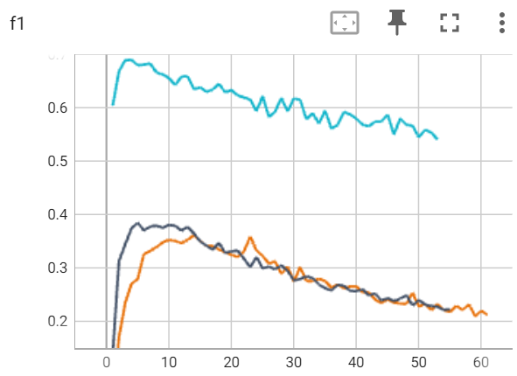
Reduce number of classes
Results
with 40 classes
with 23 classes (num samples > 30) with 4 classes
Best F1 40 classes: 0.35
Best F1 23 classes: 0.38
Best F1 4 classes: 0.69

Slide 20
Final results
Environment
Baseline results
Preprocessing
Further tuning
Final results
Discussion

Slide 21
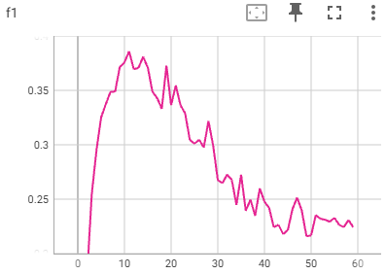
Evaluation metrics
Results
40 classes
With custom preprocessing
Early stopping based on F1 score
F1 score: 0.38
Precision: 0.32
Recall: 0.59

Slide 22
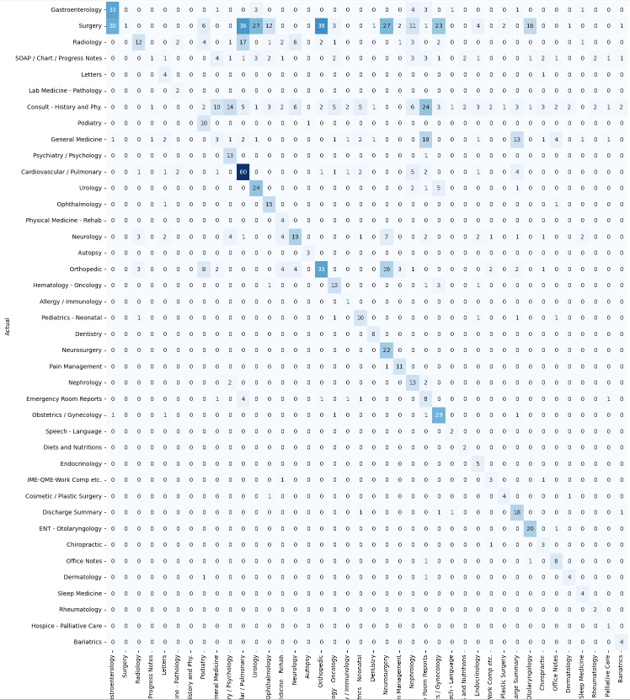
Confusion matrix

Slide 23
Discussion
Environment
Baseline results
Preprocessing
Further tuning
Final results
Discussion

Slide 24
Discussing results
The scores are too low to be used in a real application
Training on classes with six samples does not make sense → need more data per class or (depending on application) merge similar classes.
Data: hard to get in medical domain
Baseline: use naive bayes to see performance (boost?) of BERT

Slide 25
Further possibilities
Trying other models
Increase training size with cross-validation
Other preprocessing steps
Comparing to non-BERT baseline

Slide 26
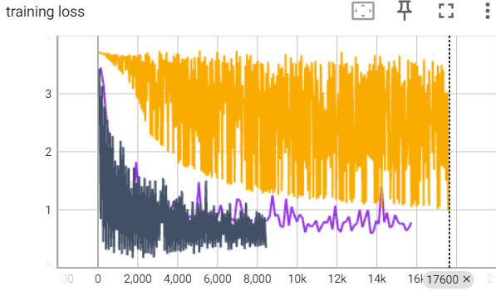
Open questions
Oscillating training loss
Lr: 5e-7
Batch size: 32
Impact splitting text because of restriction in token size
Top-k scores
Oscillating training loss
Notes:
Influence if we split training data?
There may always be something in the introduction that clearly indicates an OP report. If we cut this, it will no longer apply.
Only allowing texts with fewer than 512 tokens restricts the scope of the model.
Alternatives: Use another NLP model which writes us a shorter summary. This can then have completely different side effects because it is no longer real data but synthetic data.

Slide 27
Discussion / Questions

