Slide 1
Final Project Presentation
Group C, NLP
Marta Herrera, Mena Lerf, Vinzenz Uhr
19.11.2023

Slide 2
Agenda
Environment
Baseline results
Preprocessing
Further tuning
Final results
Discussion

Slide 3
Environment
Environment
Baseline results
Preprocessing
Further tuning
Final results
Discussion

Slide 4
Setup
Pipeline
Tools
Custom preprocessing
Tokenization defined by clincalBERT model (WordPiece)
Split text because of 512 token limitation
Split into trainings and test set with 20% testsize and label stratification
Training
Evaluation
Jupyter Notebook for demonstration
Training on Ubelix
Pytorch for model training
NLTK for preprocessing
Tensorboard for visualization

Slide 5
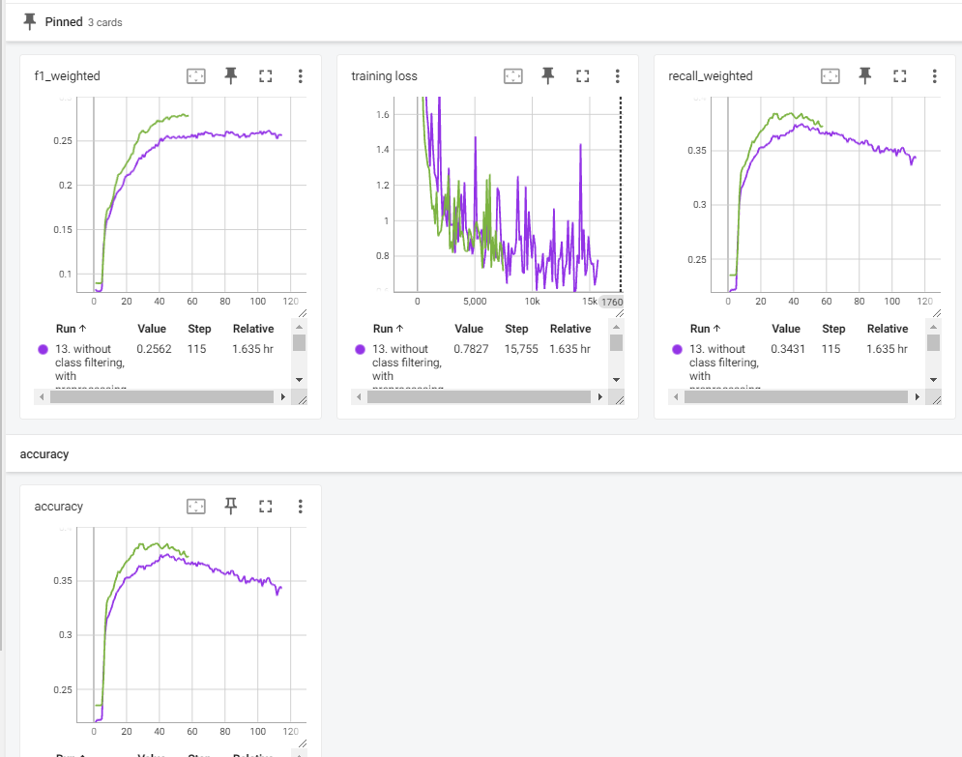
Training and evaluation metrics
Metrics
Tensorboard
Training loss every 1/8 epoch
Evaluationmetrics every epoch
Accuracy
Precision
Recall
F1 score
Bild einfügen

Slide 6
Baseline results
Environment
Baseline results
Preprocessing
Further tuning
Final results
Discussion

Slide 7
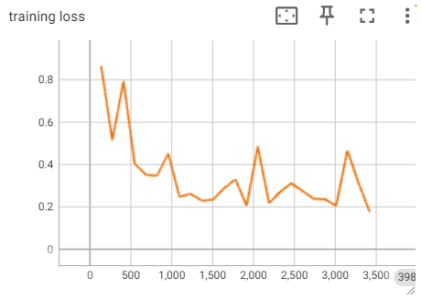
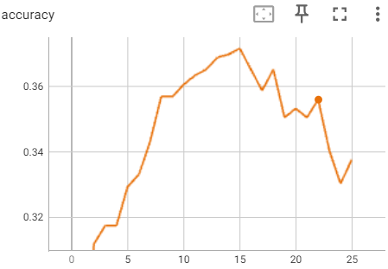
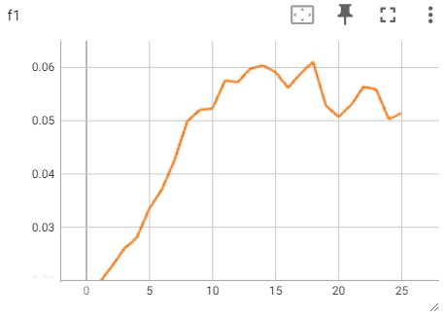
Result baseline
It is able to learn from the training data
Best accuracy around 0.37
Low F1 score with 0.06
Disclaimer: Misleading scores, because no stratification in trainings and test split and no weighted sampling.

Slide 8
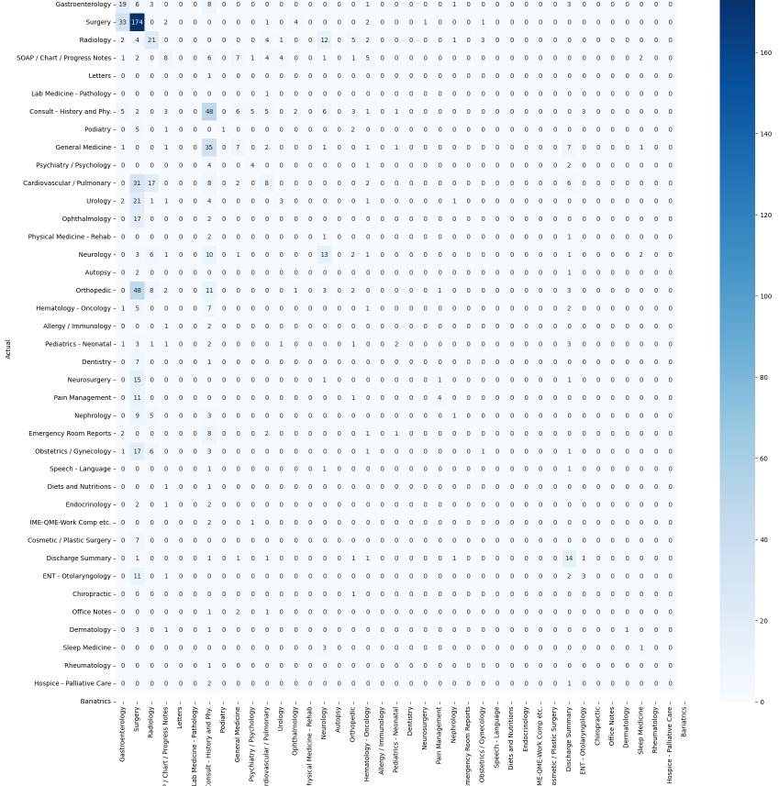
Confusion matrix
Conclusion
Too much weight given to class surgery

Slide 9
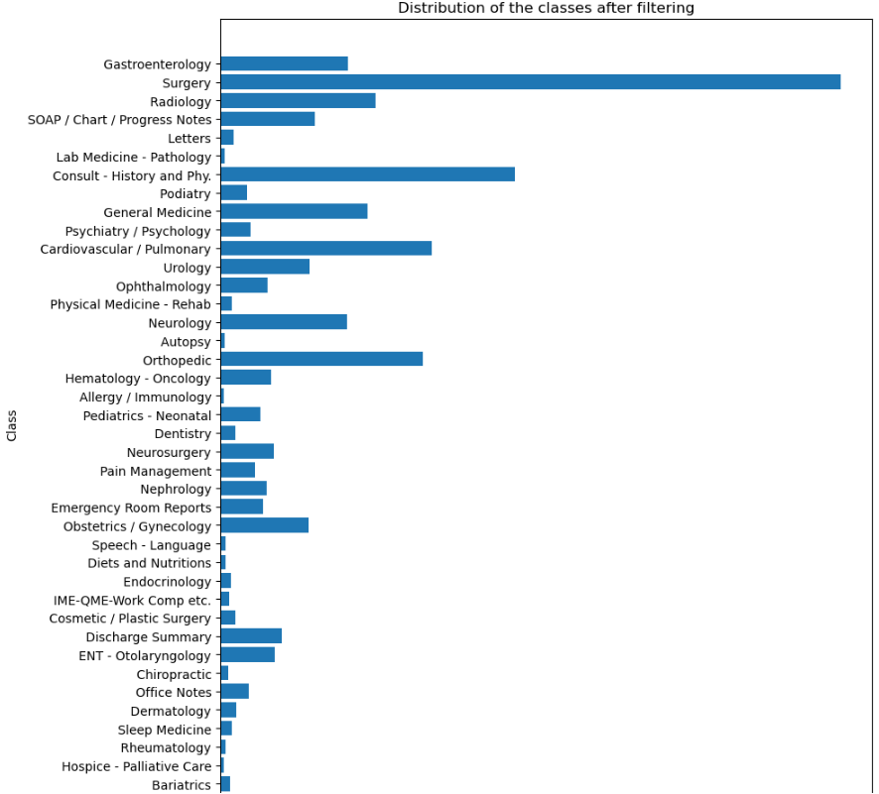
Class imbalance

Slide 10
Preprocessing
Environment
Baseline results
Preprocessing
Further tuning
Final results
Discussion

Slide 11
Custom preprocessing
Preprocessing steps
Lowercase
Replace ‘\n’, ‘t’ and ‘\r’ with ‘ ‘
WordNet Lemmatizer
Remove stop words
Remove punctuation tokens

Slide 12
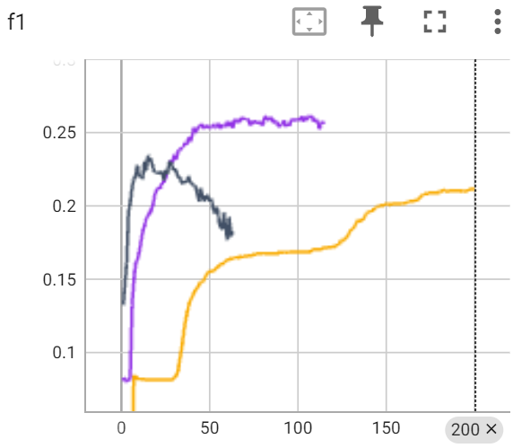
Evaluation
Results
with preprocessing
with preprocessing but no lemmatization without preprocessing
Mostly preprocessing leads to better evaluation scores

Slide 13
Conclusion
With our dataset more preprocessing increases the evaluation scores
We can imagine that the dataset is difficult to learn and that the classifier favours any kind of complexity reduction
We assume this behaviour changes with a bigger training set

Slide 14
Further tuning
Environment
Baseline results
Preprocessing
Further tuning
Final results
Discussion

Slide 15
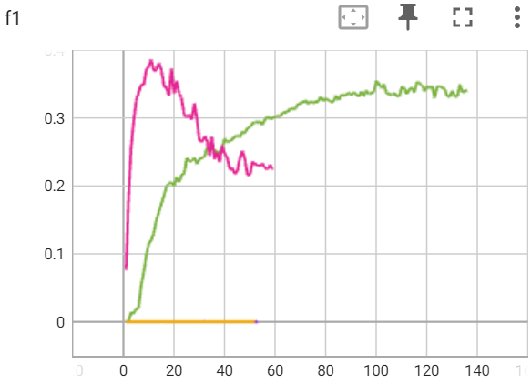
Different learning rate
Lr 5e-4
Lr 5e-5
Lr 5e-6
Lr 5e-7
Results
Best F1 5e-4: 0.01
Best F1 5e-5: 0.01
Best F1 5e-6: 0.38
Best F1 5e-7: 0.35
Insert

Slide 16
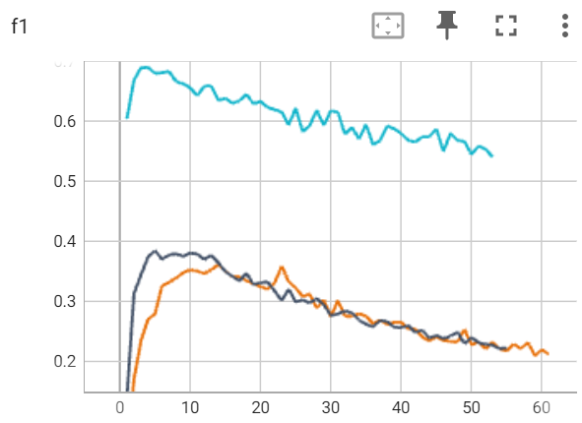
Reduce number of classes
Results
with 40 classes
with 23 classes (num samples > 30) with 4 classes
Best F1 40 classes: 0.35
Best F1 23 classes: 0.38
Best F1 4 classes: 0.69

Slide 17
Final results
Environment
Baseline results
Preprocessing
Further tuning
Final results
Discussion

Slide 18
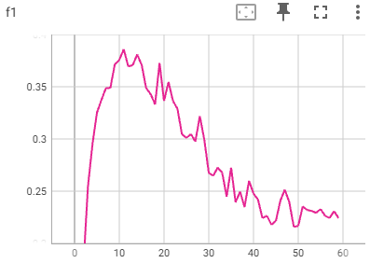
Evaluation metrics
Results
40 classes
With custom preprocessing
Early stopping based on F1 score
F1 score: 0.38
Precision: 0.32
Recall: 0.59

Slide 19
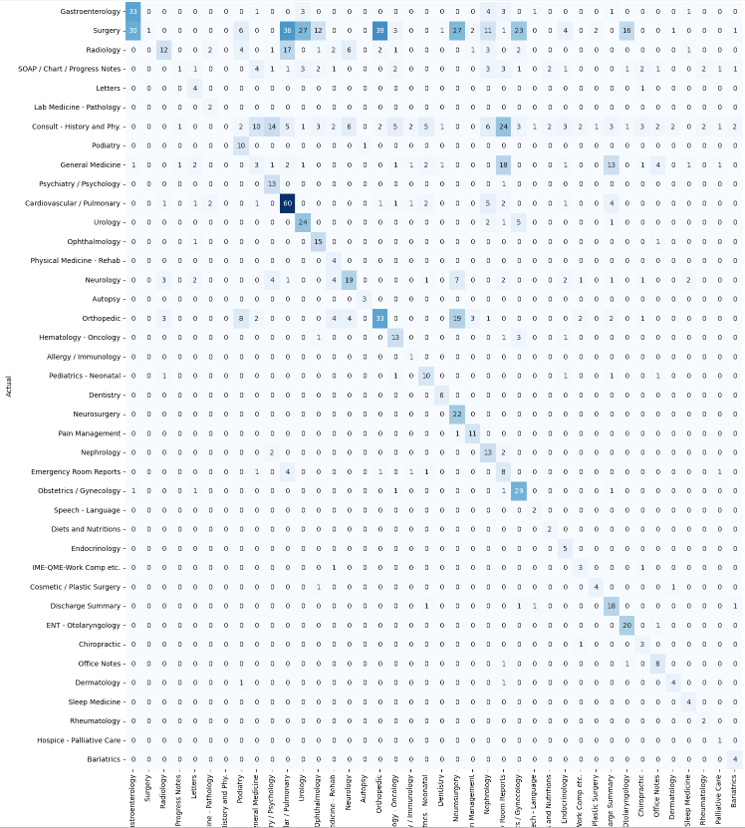
Confusion matrix

Slide 20
Discussion
Environment
Baseline results
Preprocessing
Further tuning
Final results
Discussion

Slide 21
Discussing results
The scores are too low to be used in critical environments
Training on classes with six samples is absurd

Slide 22
Further possibilities
Trying other models
Increase training size with cross-validation
Other preprocessing steps

Slide 23
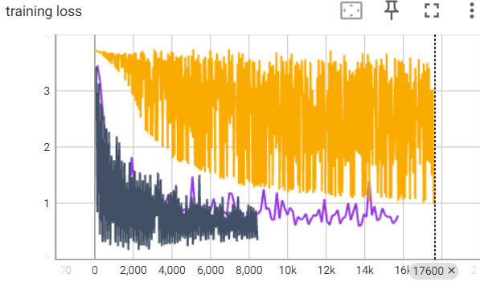
Open questions
Oscillating training loss
Lr: 5e-7
Batch size: 32
Impact splitting text because of restriction in token size
Top-k scores
Oscillating training loss
Notes:
Influence if we split training data?
There may always be something in the introduction that clearly indicates an OP report. If we cut this, it will no longer apply.
Only allowing texts with fewer than 512 tokens restricts the scope of the model.
Alternatives: Use another NLP model which writes us a shorter summary. This can then have completely different side effects because it is no longer real data but synthetic data.

Slide 24
Discussion / Questions

