Slide 1
Interim Project Presentation
Group C, NLP
Marta Herrera, Mena Lerf, Vinzenz Uhr
07.11.2023

Slide 2
Task 1: Data Exploration and Processing
Notes:
It is a team of 14 people, which have different projects mainly focused on colon cancer.

Slide 3
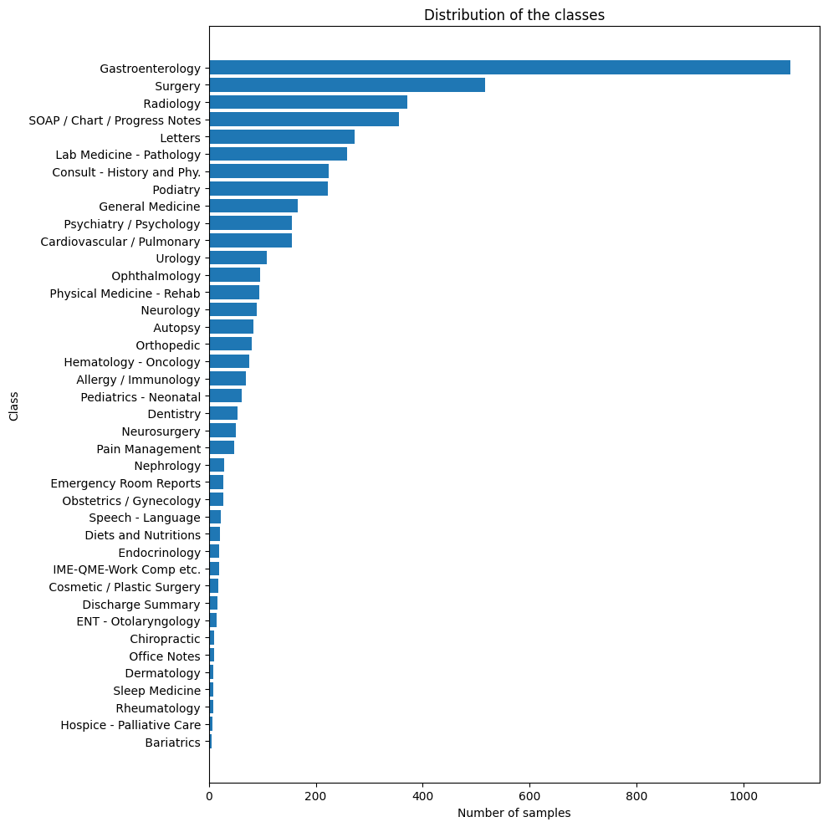
Dataset
Task 1
40 classes
min: 11
avg: 3052
max: 18425

Slide 4
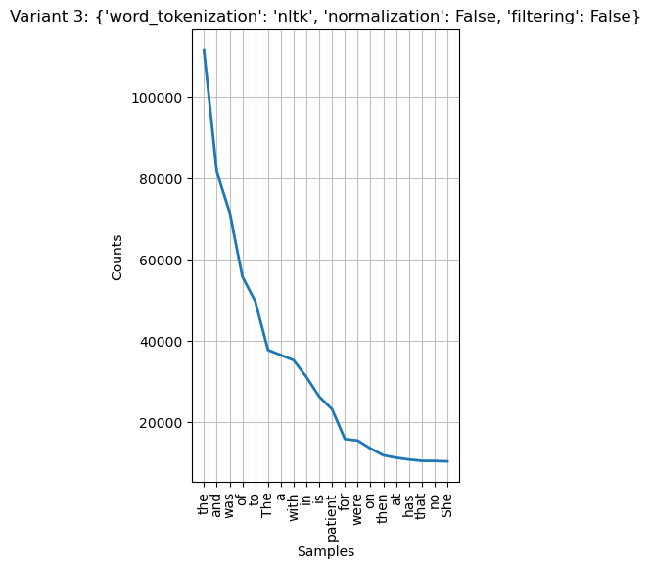
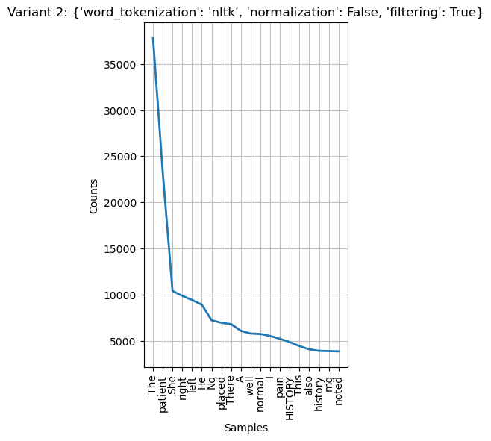
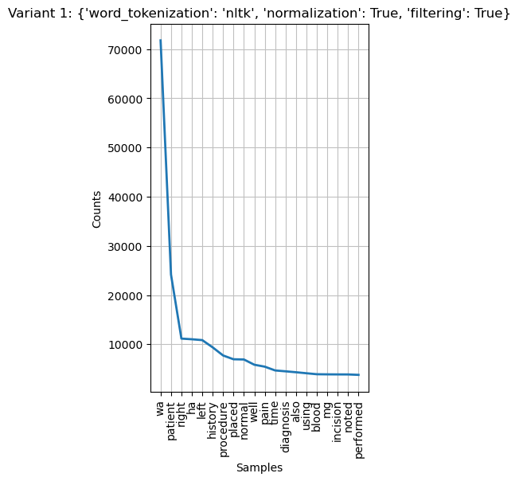
Processing Pipeline
Task 1
Notes:
Filtering: removes stopwords -> not filtered, some variants of stopwords still there
Normalization: all to lowercase, lemmatization -> some words get lemmatized to something non-meaningful (eg was -> wa instead of be)

Slide 5
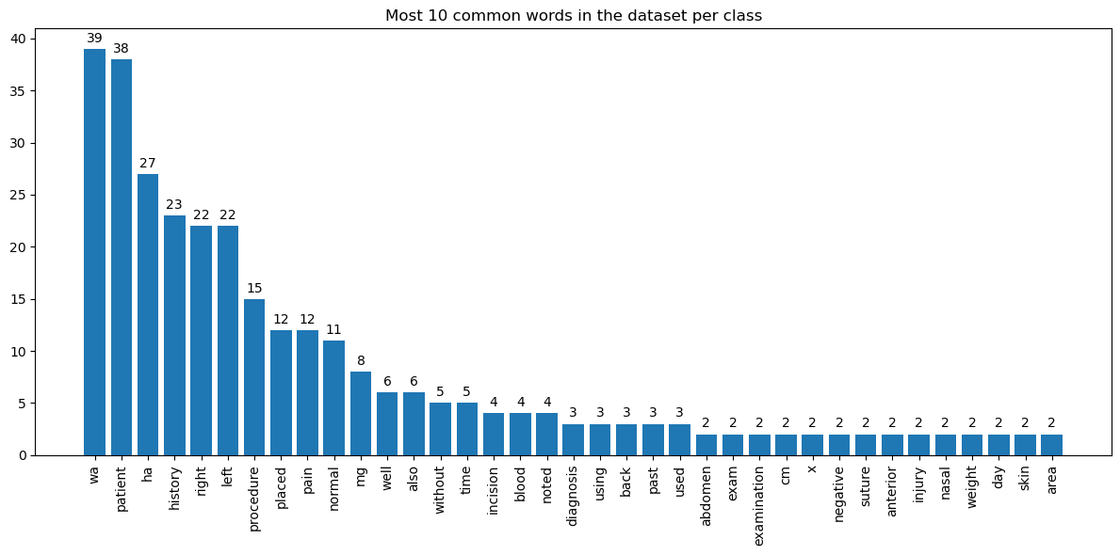
Differences per class
Task 1
Notes:
Most common words are same in all classes -> medical data; patient is second most common word
More specific, such as skin, abdomen -> not all texts same medical topic

Slide 6
Task 2: NER
Notes:
It is a team of 14 people, which have different projects mainly focused on colon cancer.

Slide 7
Potential new NER Types
Task 2
Healthcare profession
Administrative event
Care environment
Demographic
Anatomy
Diseases
Symptom
Examination
Measurement unit
Measurement value
Treatment
Medication
Medication Dosage
Medication form (e.g. tablet)
Medication route

Slide 8
Med7: NLP model for electronic health records
Task 2
DOSAGE
DRUG
DURATION
FORM
FREQUENCY
ROUTE
STRENGTH

Slide 9
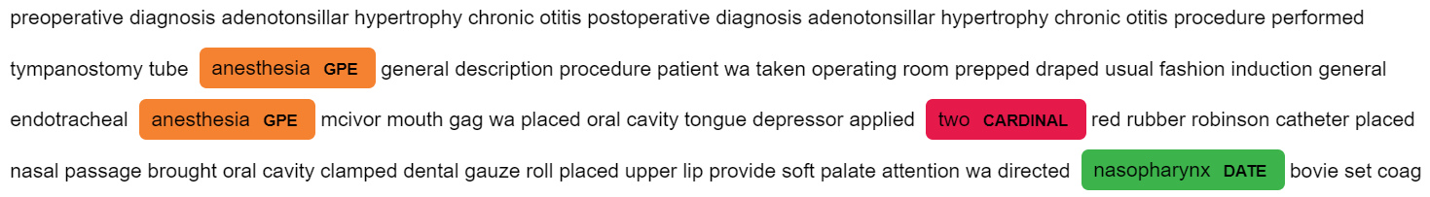
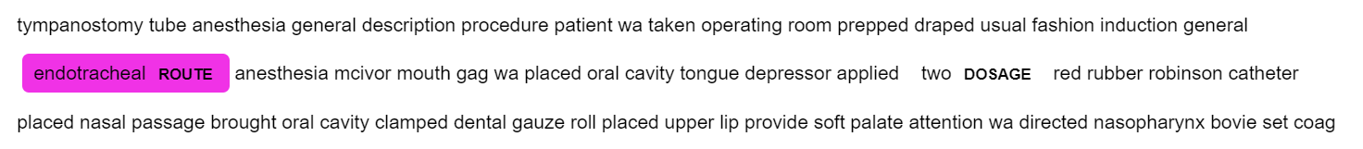
Evaluation
Task 2
Manual by comparing NE with ground truth
Notes:
Wrong classifications
Also: concurrent classification between 2 models (eg 2 -> cardinal /dosage)

Slide 10
Evaluation
Task 2
Manual by comparing NE with ground truth
Automatic evaluation using precision, recall and F1-score
Precision: 0.37 (+/-) 0.17
Recall: 0.33 (+/-) 0.21
F1-Score: 0.3 (+/-) 0.09
Conclusion
Training with large annotated corpus
Difficulty with manually annotating data

Slide 11
NER Use Cases
Task 2
Information Extraction
Sentiment Analysis
Question Answering
Machine Translation
Notes:
Skip if overtime
improve the understanding of texts
enable more advanced processing of text.
1. **Information Extraction**: NER can identify and classify entities, such as people, organizations, locations, dates, and more. This information is crucial for extracting structured data from unstructured text (legal documents, forms, news).
2. **Sentiment Analysis**: identifying that a positive sentiment is expressed towards a particular brand or product in customer reviews can be valuable for businesses.
3. **Question Answering**: NER can assist in locating entities within a text that are relevant to user queries.
4. **Machine Translation**: NER can help identify and preserve the entities during the translation process, ensuring that names, places, and other important entities remain consistent across languages.
NER can help identify sensitive information, such as personal names, addresses, or credit card numbers, and facilitate data protection measures.

