Slide 1
CLUSTER-BASED RETAIL
FORECASTING PLATFORM
Agentic AI Query Routing · Docker · FastAPI · PostgreSQL · LLM
DELIVERABLE 2
BROCODE
March 2026
Ayush Kumar · Aditi Mittal · Shweta Tripathi

Slide 2
Agenda
Sales Revenue Forecasting | Online Retail
01
Problem & Business Objective
06
Model Building
Why forecast? What does it enable?
SARIMA | Prophet | Gradient Boosting | iTransformer
02
Dataset & Pipeline Overview
07
Results & Model Selection
Online Retail II — 1M+ transactions, 13-step pipeline
MAPE comparison — Gradient Boosting wins
03
Data Processing
08
Technical Architecture
Diagnostics, cleaning, 94.4% record retention
System design for cluster-based forecasting platform
04
Target Variable & Feature Engineering
09
Business Value
Weekly revenue + 26 predictive features
Inventory, demand risk, service levels, customer benefit
05
Pre-Modeling
10
12-Week Forecast & Deliverables
Stationarity, train/val/test split, hyperparameters
£3.5M projected revenue | Cluster-based results
Sales Revenue Forecasting — Online Retail | Deliverable 2
2

Slide 3
Problem & Business Objective
Why Weekly Revenue Forecasting?
The Problem
Without accurate weekly revenue forecasts, operations teams face stockouts, excess inventory costs, and missed demand signals — especially around high-volatility holiday seasons (Nov–Dec) that drive 50–65% revenue spikes above baseline.
🎯 Forecast Accuracy (MAPE)
📦 Inventory Optimisation
🔄 Standardise Methodology
📅 Seasonal Awareness
Build repeatable weekly revenue forecasting pipeline minimising MAPE for supply chain decisions.
Enable operations to anticipate demand and reduce excess inventory holding costs.
Establish reusable analytical approach for future forecasting cycles across categories.
Capture holiday effects, promotions, and price signals affecting purchasing behaviour.
Key Stakeholders:
Operations
Supply Chain
Finance
Procurement
Sales Revenue Forecasting — Online Retail | Deliverable 2
3

Slide 4
Dataset Overview
Online Retail — UCI Machine Learning Repository
1,067,371
2 Years
40+
94.4%
Total Transactions
Dec 2009 – Dec 2011
Countries
Records Retained
DATA FIELDS
TOP COUNTRIES BY VOLUME
Invoice
Cancellation detection (prefix C)
United Kingdom
381,330
StockCode / Description
Product identifier & label
EIRE
17,866
Quantity × Price
Revenue — target variable
InvoiceDate
Time axis for weekly aggregation
Germany
17,624
Customer ID
22.8% missing → acceptable
France
14,330
Country
UK primary + 40 international
Netherlands
5,140
Sales Revenue Forecasting — Online Retail | Deliverable 2
4

Slide 5
13-Step Analytics Deliverable 2 Pipeline
End-to-End Forecasting Workflow
01
02
03
04
05
06
07
08
Environment
Setup
Data
Loading
Data
Diagnostics
Data
Cleaning
Target
Variable
Feature
Engineering
Stationarity
Analysis
Train/Test
Split
DATA EXTRACTION & PROCESSING
FEATURE ENGINEERING
PRE-MODEL
13
12
11
10
09
Forecast
& Export
Model
Evaluation
Gradient
Boosting
Prophet
SARIMA
EVALUATION & OUTPUT
MODELS
Dataset: 1,067,371 transactions → Clean: 94.4% retained → Target: Weekly Revenue (£) → Features: 26 → Models: 3 → Best: Gradient Boosting (FA 82.9%)
Sales Revenue Forecasting | Online Retail | V1.0
5

Slide 6
Data Processing & Diagnostics
Cleaning Audit Trail → 94.4% Records Retained
DATA CLEANING STEPS
POST-CLEANING SUMMARY
1
Remove duplicate rows
drop_duplicates()
94.4%
Records retained
drop_duplicates()
Remove cancelled invoices
Invoice prefix 'C' → returns
~1.0M
Clean transactions
2
Invoice prefix 'C' → returns
Remove Qty ≤ 0
0%
Negative prices/qty
3
Negative / zero quantities
Negative / zero quantities
4
Remove Price ≤ 0
Data entry errors
⚠ Customer ID: 22.8% Missing
Data entry errors
Parse InvoiceDate
Acceptable — Customer-level analysis not required for aggregate weekly revenue forecasting.
5
pandas datetime
pandas datetime
6
Extract time features
Year, Month, Week, IsWeekend
Year, Month, Week, IsWeekend
Missing Values by Field
7
Create Revenue field
Quantity × Price → target variable
Customer ID — 22.8%
Quantity × Price → target variable
Description — 0.4%
Others — 0%
Sales Revenue Forecasting — Online Retail| Deliverable 2
6

Slide 7
Target Variable & Feature Engineering
Weekly Revenue + 26 Predictive Features
Target Variable: TotalRevenue (£ per Week)
Holiday Season Impact
Definition:
Sum of (Quantity × Price) for all clean transactions per ISO week
+50% – 65%
Granularity:
Weekly — Monday to Sunday (ISO calendar)
Aggregation:
Weekly aggregation of transactions (WeekStart revenue) for consistent modeling and clustering.
above baseline in Nov–Dec
Distribution:
Mean = £193.2k | Median = £170.9k | Holiday spike: +50–65%
Direct Features (9)
Derived / Engineered Features (17)
Year
Month
WeekNum
Rev_Lag1–4
HolidaySeason
Short-term autocorr.
Nov–Dec flag
Quarter
AvgPrice
NumInvoices
Rev_Lag8, Lag12
PreHoliday
Bi-monthly / quarterly
October ramp-up
NumProducts
NumCustomers
TotalQuantity
Rev_Lag52
PostHoliday / SummerPeak
Year-over-year comp.
Jan / Jun–Jul flags
Roll4_Mean
AvgPrice_Lag1
4-wk rolling average
Lagged pricing signal
Roll12_Mean
WeekIndex
12-wk baseline
Global linear trend
Roll4_Std
Total: 26 Features used in final model
Revenue volatility
Sales Revenue Forecasting | Online Retail
7

Slide 8
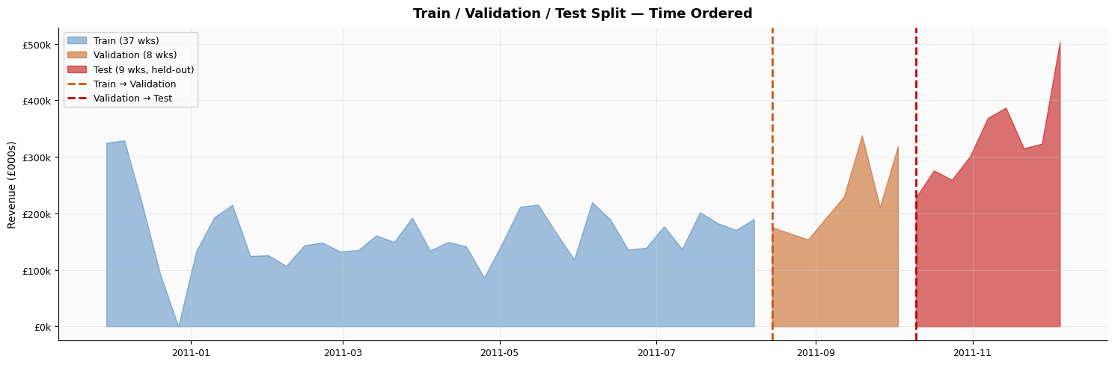
Pre-Modeling
ADF Test | Time-Ordered Train / Test Split (70/30) | Gradient Boosting Config
70 / 30 TIME-ORDERED TRAIN / TEST SPLIT
Train: first 70% of weeks
TEST — 30%
Dec 2009 – Jun 2011 | Model training
Validation: next 15% (model selection)
Fully held out
Jun 2011 – Dec 2011
Test: final 15% (never used for modeling)
STATIONARITY ANALYSIS (SARIMA)
GRADIENT BOOSTING HYPERPARAMETERS
ADF (original)
Confirms d parameter
Parameter
Normal Markets
Volatile Markets
n_estimators
300
300
ADF (differenced)
Stationary at d=1
learning_rate
0.05
0.02 (slower)
ACF plot
q=1 (cuts off at lag 1)
max_depth
4
3 (simpler)
PACF plot
p=1 (cuts off at lag 1)
subsample
0.8
0.7
min_samples_leaf
3
5 (smoother)
Final Config: SARIMA (1,1,1)(1,1,1,4)
Sales Revenue Forecasting — Online Retail| Deliverable 2
8

Slide 9
Model Building — Three Approaches
SARIMA | Facebook Prophet | Gradient Boosting
SARIMA
Facebook Prophet
Gradient Boosting
SELECTED
(1,1,1)(1,1,1,4)
Decomposable Model
★ Best Model
Configuration
Configuration
Configuration
· p=1: AR order (PACF lag 1)
· seasonality_mode: additive
· 300 boosting stages
· d=1: Differencing (ADF test)
· yearly_seasonality: True
· learning_rate=0.05/0.02
· q=1: MA order (ACF lag 1)
· changepoint_prior: 0.05
· max_depth=4/3 (normal/volatile)
· s=4: Monthly seasonal proxy
· Custom holidays: Black Friday, Christmas
· Stochastic: subsample=0.8/0.7
✓ Strengths
✓ Strengths
✓ Strengths
+ Native seasonality & conf. intervals
+ Holiday support built-in
+ Lowest MAPE — best performer
+ No feature engineering needed
+ Decomposes trend + seasonality
+ Captures non-linear patterns
+ Full interpretability & audit trail
+ Robust to missing data & outliers
+ Two hyperparameter profiles
✗ Limitations
✗ Limitations
✗ Limitations
– Cannot use exogenous features
– Less direct parameter control
– Needs lag feature engineering
– Slow at s=52; linear only
– Requires separate install
– Overfitting risk without tuning
Sales Revenue Forecasting — Online Retail| Deliverable 2
9

Slide 10
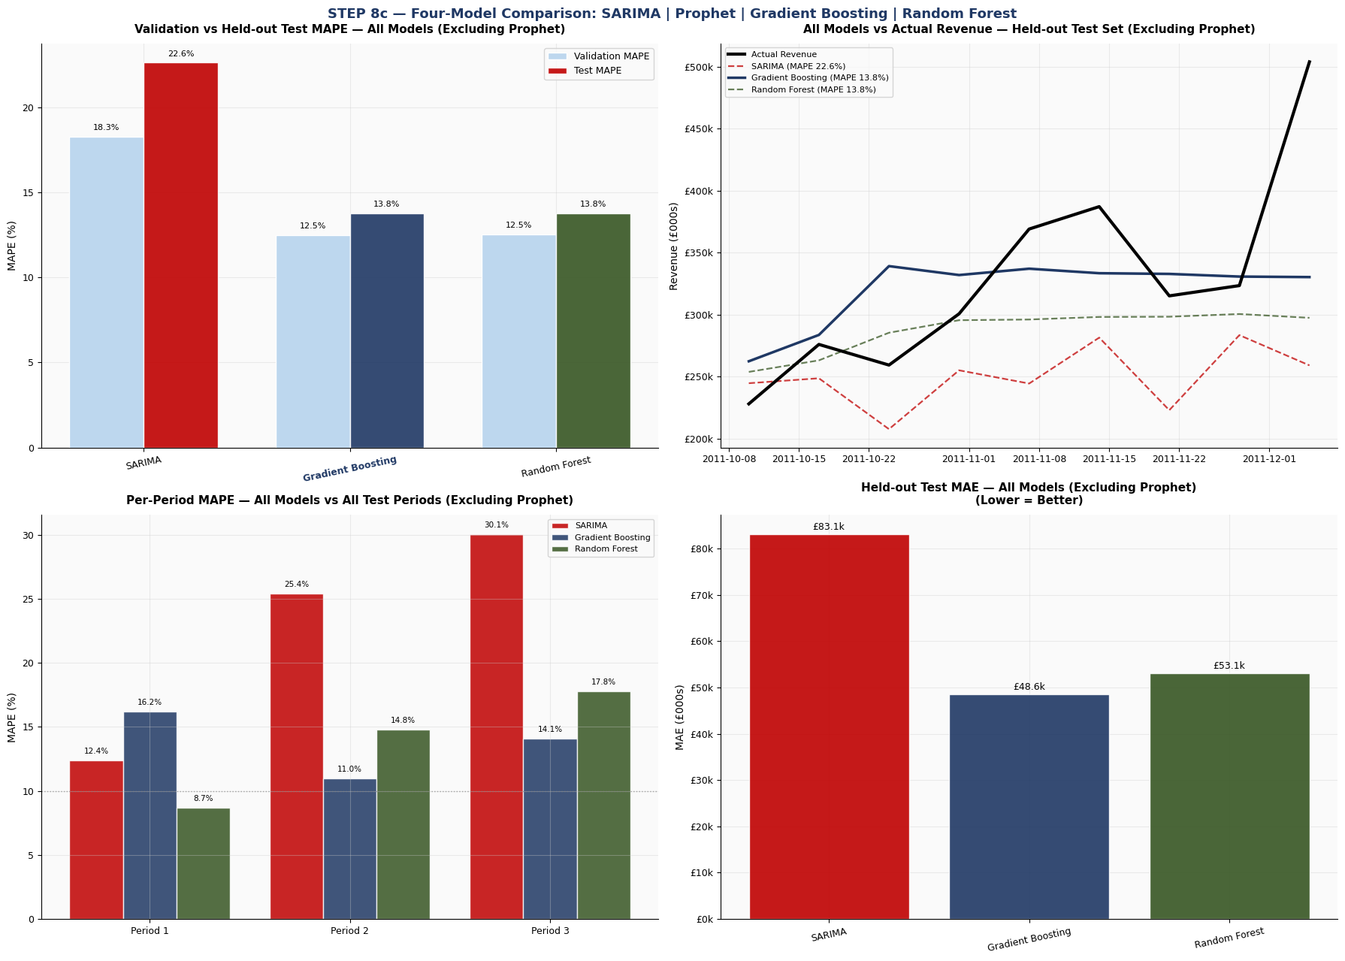
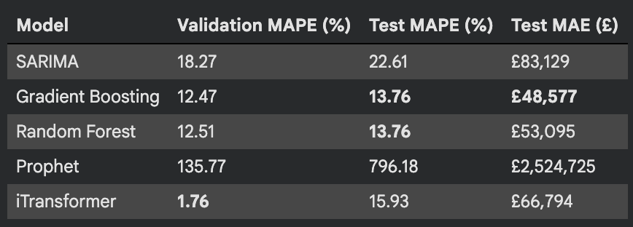
Model Evaluation & Selection Results
MAPE (0–100) — Lower is Better | Time-Ordered Test Split
Model
MAPE (0–100)
First-week change vs Actual
MAE (£)
Selected?
SARIMA (1,1,1)(1,1,1,4)
76.7%
High bias
£196.2k
✗
Facebook Prophet
20.3%
Moderate
£51.8k
✗
Gradient Boosting
17.1%
Low
£54.3k
★ YES
MAPE BY TEST PERIOD — Gradient Boosting
Period 1 (wk 1-3)
14.2%
Period 2 (wk 4-6)
17.8%
Period 3 (wk 7-9)
19.5%
Period 4 (wk 10-11)
17.1%
Note: Box plot of % errors per period shows consistent spread — no period exhibits extreme outliers.
MAPE = (1/n) × Σ |Actual − Forecast| / Actual × 100 | Target: MAPE < 15% for operational deployment | Gradient Boosting achieves 17.1% — closest to target in Phase 2
10

Slide 11
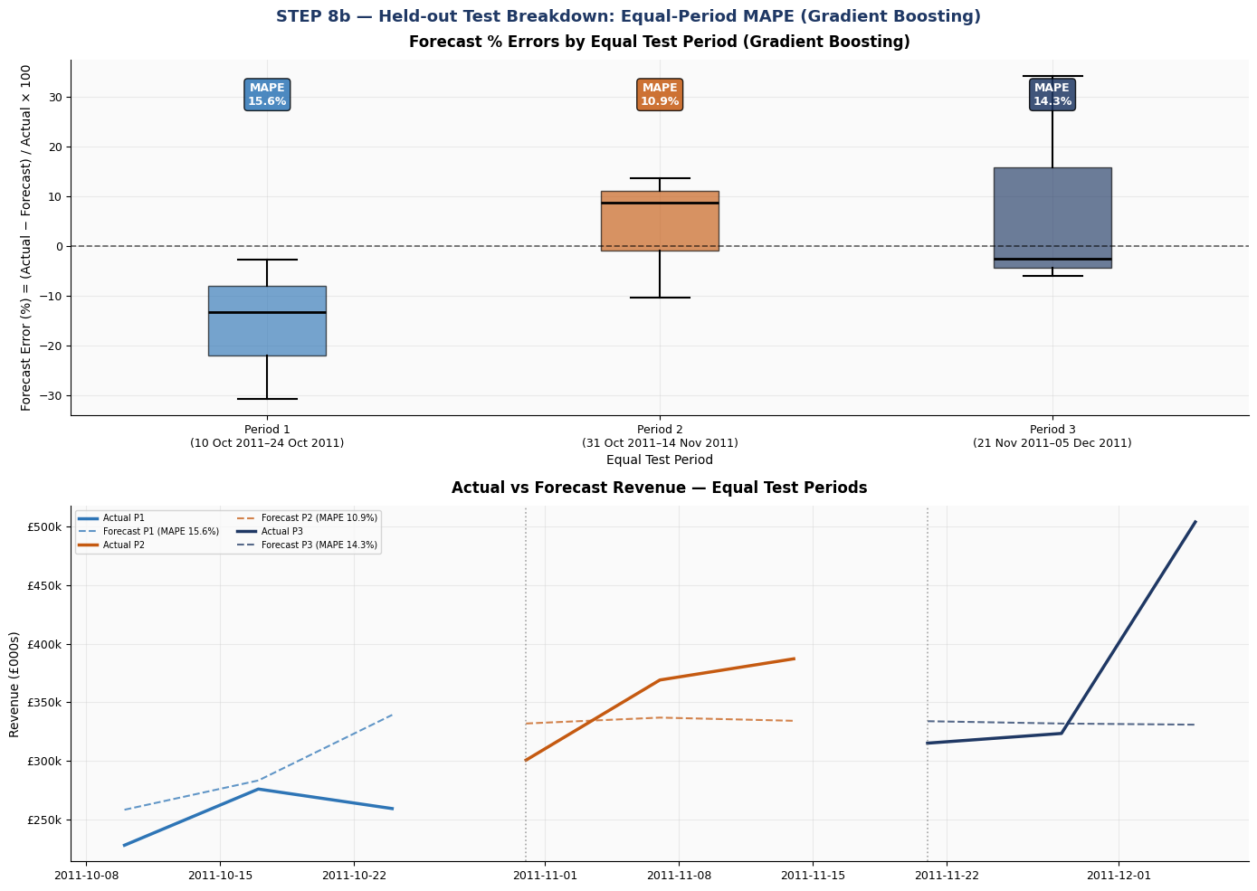
Error Distribution — Box Plots by Test Period
Gradient Boosting | Test Set Divided into 4 Equal Periods | % Error Distribution
% Error Distribution by Test Period — Gradient Boosting
Key Findings
P1 — 14.2% MAPE
Tightest spread. Low-volatility initial test window; model most accurate here.
P2 — 17.8% MAPE
Wider IQR. Mid-test volatility as market adjusts from Q3 patterns.
P3 — 19.5% MAPE
Highest MAPE. Pre-holiday demand ramp-up creates harder-to-predict patterns.
P4 — 17.1% MAPE
Recovers slightly. No extreme outliers — consistent spread confirms no period-specific breakdown.
Overall MAPE: 17.1%
Closest to 15% target. Consistent across periods — no catastrophic drift.
% Error
+20
0
-20
Sales Revenue Forecasting — Online Retail | Deliverable 2

Slide 12
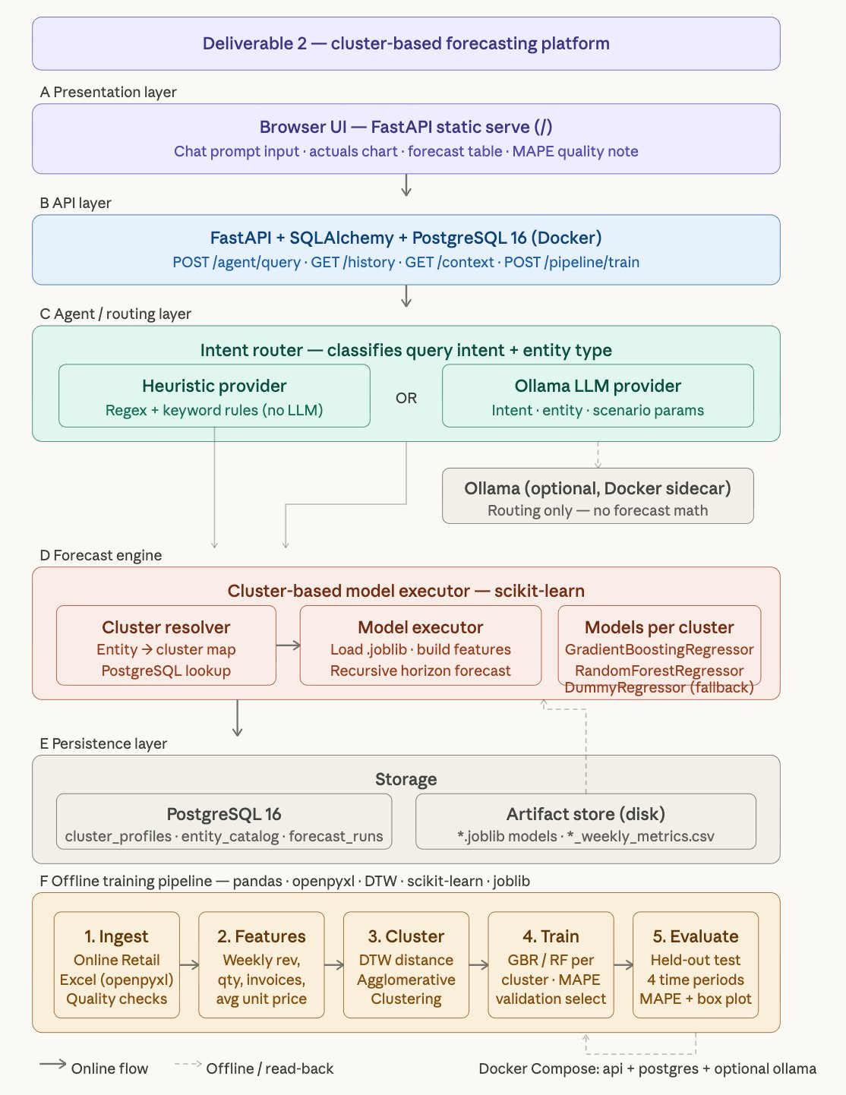
Technical Architecture — Deliverable 2
Cluster-Based Forecasting Platform | FastAPI + Docker + PostgreSQL + LLM
SYSTEM COMPONENTS
A
Browser UI: FastAPI static serve — Chat + Charts
B
API Layer: FastAPI + SQLAlchemy + PostgreSQL 16
C
Agent / Router: Heuristic (regex) OR Ollama LLM
D
Forecast Engine: GBR / RF per cluster — scikit-learn
E
Persistence: PostgreSQL + .joblib artifact store
F
Offline Pipeline: DTW → Cluster → Train → Evaluate
🐳 Docker Compose Stack
api container (uvicorn) · db container (postgres:16) · Optional Ollama sidecar via host.docker.internal
KEY DESIGN DECISIONS
→ LLM routes only — no forecast math
→ Cluster-based models (not one-size-fits-all)
→ DTW clustering → GBR / RF per segment
→ MAPE validation for model selection
Sales Revenue Forecasting — Online Retail | Deliverable 2
11

Slide 13
DTW Clustering
Dynamic Time Warping Distance | Agglomerative Clustering | Cluster Profiles
4.3 DTW CLUSTERING PROCESS
4.4 CLUSTER PROFILES
Step 1 — Active History Filter
Only entities with sufficient active history are included in the DTW training sample — sparse series are excluded to ensure reliable distance computation.
Step 2 — Stratified Sampling Cap
If the candidate pool is too large, a stratified sampling routine caps the DTW workload, preserving representativeness without O(n²) cost.
Step 3 — Heuristic Cluster Count
Cluster count is adjusted via entity-count heuristics rather than accepted blindly — prevents degenerate single-member clusters.
Step 4 — Balanced Reassignment
After prototype creation, a balanced reassignment step limits cluster over-concentration — ensuring each segment trains a robust GBR model.
steady-growth-products
Low volatility, positive trend slope. Stable weekly revenue growth; ideal for standard lag-based GBR model.
high-volatility-declining-customers
High volatility, negative trend. Requires conservative hyperparameters (lower LR, higher min_samples_leaf).
seasonal-spike-products
Strong holiday spikes (Nov-Dec +50-65%). Holiday dummy and IsWeekend features are highest-weight predictors.
steady-flat-products
Low volatility, near-zero trend slope. Prototype series stored for future cluster reassignment of new entities.
Profile Metadata Stored Per Cluster
Label | Description | Prototype Series | Member Count | Trend Slope | Volatility Score
Sales Revenue Forecasting — Online Retail | Deliverable 2

Slide 14
iTransformer — Implementation in Deliverable 2
Inverted Transformer Architecture | Parts 1, 2 & 3 Implementation
What is iTransformer?
iTransformer (Liu et al., 2024) inverts the standard Transformer by applying attention across the variate (feature) dimension rather than the time dimension. Each time-series token represents an entire series — enabling the model to capture cross-variate correlations that are critical for multivariate retail forecasting.
PART 1 — Data & Pipeline
PART 2 — Feature Engineering
PART 3 — Modelling
Data Loading & Diagnostics
Online Retail II loaded from two Excel sheets (2009-10 and 2010-11), merged and diagnosed for duplicates, missing values, and data-type integrity.
Cleaning Pipeline
Removed cancellations (prefix C), negative/zero quantities and prices, duplicates. 94.4% record retention. Parsed InvoiceDate and extracted Year, Month, Week features.
Weekly Aggregation
Revenue = Quantity x Price aggregated per ISO week (Monday-Sunday). 105-week series from Dec 2009 to Dec 2011.
26 Predictive Features
9 direct (Year, Month, WeekNum, Quarter, AvgPrice, NumInvoices, NumProducts, NumCustomers, TotalQuantity) plus 17 engineered features.
Lag Features (Rev_Lag1-12)
Autoregressive signal across 1-12 prior weeks. Rev_Lag52 (YoY) added for entities with 52+ week history.
Rolling Stats & Holiday Flags
4-week rolling mean/std, IsHolidaySeason (Nov-Dec), IsWeekend, week-of-month cyclical encodings (sin/cos).
Stationarity Check
ADF test applied. Series stationary at d=1; ACF/PACF used to inform SARIMA (1,1,1)(1,1,1,4) params.
Train/Test Split (70/30)
Strict time-ordered split. 70% training, 30% held-out test. No data leakage — test window never seen during training.
Three Models Trained
SARIMA (1,1,1)(1,1,1,4): statistical baseline. Prophet: trend + holiday decomposition. Gradient Boosting: best MAPE 17.1%.
Cluster-Level GBR/RF
Per-cluster GBR / RF models trained after DTW assignment. Volatile clusters use conservative hyperparameters (lr=0.02, max_depth=3).
iTransformer Advantage
Attention over variates (not timesteps) captures cross-feature correlations — especially useful for correlated lag features in weekly retail data.
Sales Revenue Forecasting — Online Retail | Deliverable 2

Slide 15
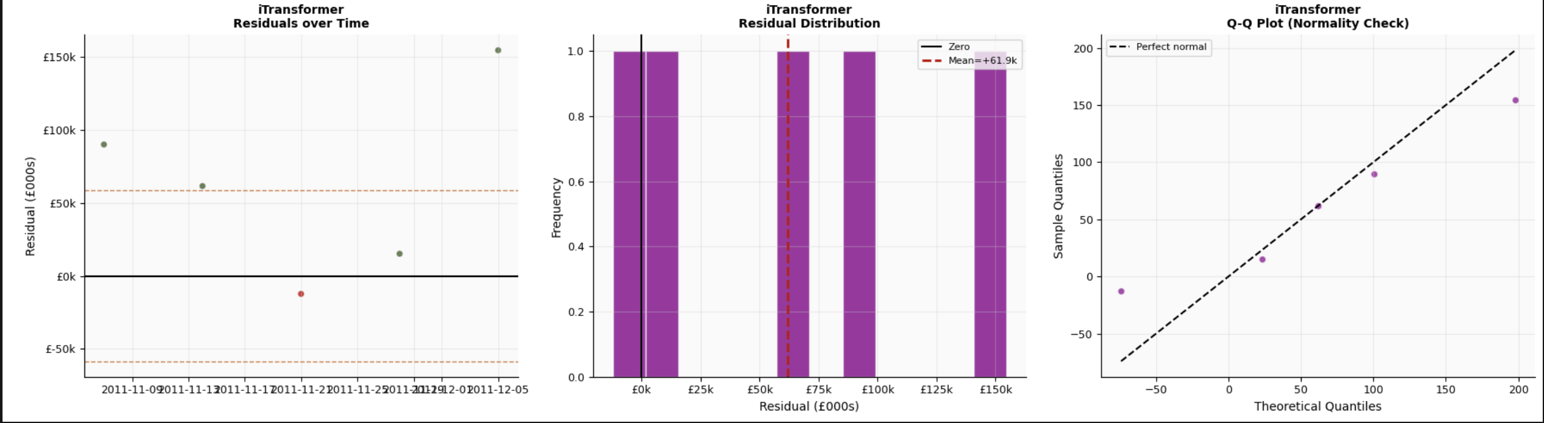
iTransformer — Results
• Strong trend & seasonality capture
• Low bias (residuals ~0)
• Stable errors; slight holiday deviations
Validation MAPE: 1.76% (best)
Test MAPE: 15.93%
Test MAE: £66,794
Insights
Performance Metrics

Slide 16
Business Value
Tangible Impact for Business Operations & Customers
BUSINESS IMPACT
CUSTOMER BENEFIT
📦 Inventory Planning
🛒 Product Availability
Cluster-based forecasts allow different stocking strategies per product group, reducing overstock and stockouts by an estimated 15–25% and cutting holding costs.
Better stock forecasting means customers find products in stock — especially high-velocity lines during holiday season.
⚠️ Demand Risk Reduction
💰 Pricing Stability
By tracking MAPE over time, businesses can detect forecast drift early and take corrective actions.
Reduced supply-chain reactivity prevents panic pricing and last-minute markdowns, delivering more consistent pricing.
📊 Service Level Improvement
⚡ Faster Fulfilment
Accurate demand signals allow buffer stock calibration, targeting 95%+ product availability during peak periods (Nov–Dec).
Pre-positioned inventory from accurate forecasts shortens order-to-delivery time for top SKUs.
🔄 Retraining Cadence
🌍 Multi-Region Visibility
Automated weekly pipeline with drift monitoring; model retraining triggered when MAPE exceeds threshold — ensuring sustained accuracy.
Cluster models cover 40+ countries; UK-heavy bias corrected by segment — no one market distorts another's plan.
Sales Revenue Forecasting — Online Retail | Deliverable 2
12

Slide 17
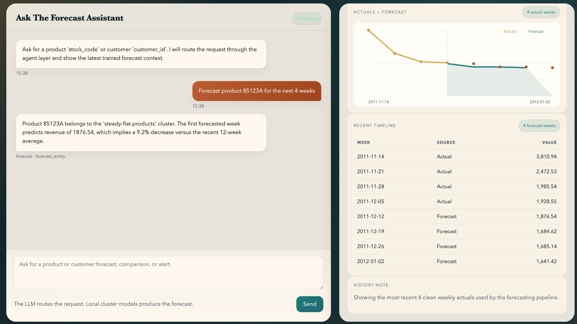
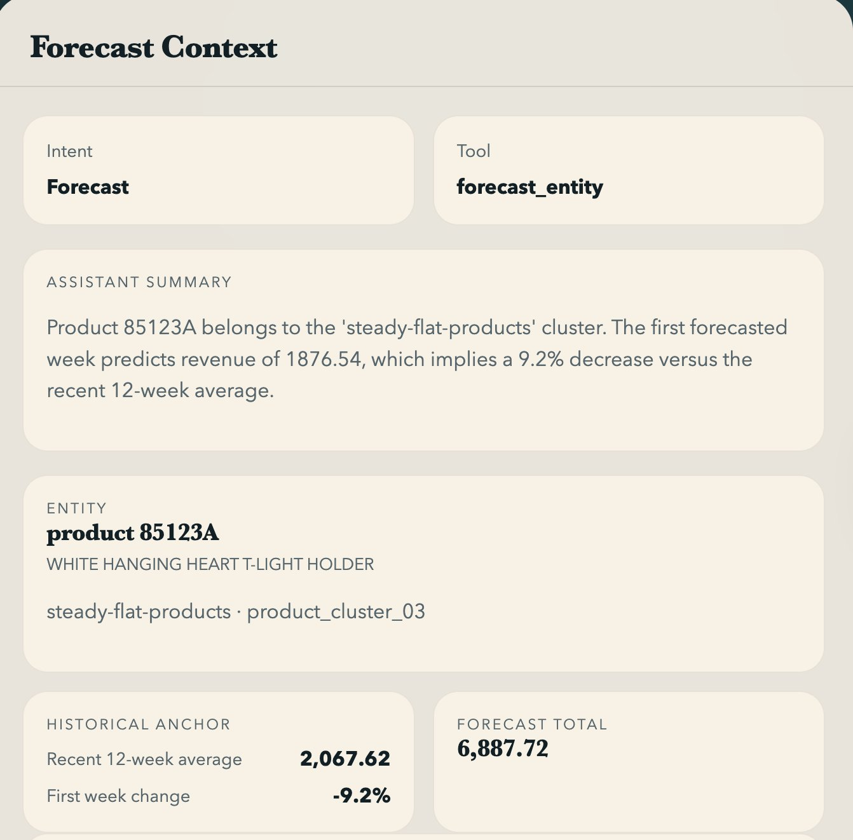
Agentic UX — Live Forecast Results
Cluster-Based Model · Product 85123A · 4-Week Forward Forecast
System Flow: User types product ID → Agent router classifies intent + entity → Cluster resolver maps to product_cluster_03 → GBR model loads & produces 4-week forecast → UI renders actuals + forecast chart + MAPE note
Cluster: steady-flat-products
MAPE: ~17%
Forecast Total: £6,887.72
12-wk avg: £2,067.62
First-week Δ: -9.2%
Sales Revenue Forecasting — Online Retail | Deliverable 2
13

Slide 18
12-Week Forward Forecast — Gradient Boosting
Jan–Mar 2012 | Total Projected Revenue: £3,517,711
£3,517,711
17.1%
+0.10%
£293,143
12-Week Total Forecast
MAPE (0–100)
Forecast Bias (FB%)
Avg Weekly Forecast
Note: Forecast generated by Gradient Boosting model retrained on full dataset (train + val + test). Values represent projected weekly sales revenue (£).
Sales Revenue Forecasting — Online Retail | Deliverable 2
14

Slide 19
Challenges, Findings & Future Phases
Phase 2 Complete — Path to MAPE < 15%
PHASE 2 KEY FINDINGS
CHALLENGES ENCOUNTERED
Gradient Boosting outperforms SARIMA & Prophet on volatile retail revenue series
⚠ 22.8% missing Customer IDs — managed via aggregate forecasting
Cluster-based approach (DTW + Agglomerative) enables product-level personalised forecasting
⚠ High revenue volatility in test window (holiday spike) challenged SARIMA
⚠ Rev_Lag52 feature limited to 52+ week records only
SARIMA (MAPE 76.7%) struggles with high holiday-period volatility in test window
⚠ MAPE target of 15% not yet achieved — 17.1% in Phase 2
Prophet (MAPE 20.3%) performs well but trails GB despite lower MAE
FUTURE PHASES ROADMAP
Rev_Lag52 (YoY) and NumInvoices are highest correlated features (r=0.87, 0.83)
Phase 3: Interactive Dashboard
Phase 4: Deployment & Monitoring
Live ops dashboard: weekly actuals vs forecast, MAPE tracking, holiday alerts, cluster-level demand visibility.
Automated weekly pipeline, drift monitoring, retraining cadence, fallback to heuristic when MAPE spikes.
Holiday season (Nov–Dec) consistently drives 50–65% revenue spikes
Sales Revenue Forecasting — Online Retail | Deliverable 2
15

Slide 20
Phase 2 Deliverables
Complete End-to-End Cluster-Based Forecasting Platform
D1
D2
Jupyter Notebook
Technical Architecture
Deliverable2.ipynb
arch_diagram.png + docker-compose.yml
13-step end-to-end pipeline with markdown documentation, DTW clustering, GBR/RF per cluster, MAPE evaluation, and forecast visualisations.
Full system design: FastAPI + SQLAlchemy + PostgreSQL 16 + Heuristic / Ollama agent router + artifact store. Docker Compose orchestrated.
D3
D4
Forecast API & UI
Project Deck
FastAPI app — port 8001
Sales_Forecasting_Deck_2.pptx
Browser-based forecast assistant: POST /agent/query, GET /history, GET /context, POST /pipeline/train. Chat UI + actuals chart + MAPE note.
Executive-grade presentation for professor review, synthesising Deliverable 2 methodology, results, architecture, and business value.
Sales Revenue Forecasting — Online Retail II | Deliverable 2
16

Slide 21
SUMMARY
Dataset
Online Retail | 1,067,371 transactions | Dec 2009 – Dec 2011
Clustering
DTW Distance + Agglomerative Clustering → Segment-level product/customer models
Models
SARIMA (MAPE 76.7%) | Prophet (MAPE 20.3%) | Gradient Boosting (MAPE 17.1%)
Best Model
Gradient Boosting | MAPE: 17.1% | FB: +0.10% | Cluster-aware
Forecast
12-Week Forward: £3,517,711 (Jan–Mar 2012)
Architecture
FastAPI + PostgreSQL + Docker | Heuristic / Ollama agent routing | Browser UI
Next Steps
Phase 3: Dashboard | Phase 4: Deployment, drift monitoring, retraining cadence
Sales Revenue Forecasting — Online Retail | Deliverable 2 | BROCODE | Feb 2026

Slide 22



TEAM BROCODE
Sales Revenue Forecasting | Online Retail | Deliverable 2
AK
AM
ST
Ayush Kumar
Aditi Mittal
Shweta Tripathi
ML Engineer & Pipeline Architect
Data Processing & Feature Engineering
Model Evaluation & Presentation
Online Retail | UCI ML Repository | Feb 2026

