Slide 1
CLUSTER-BASED RETAIL
FORECASTING PLATFORM
Agentic AI Query Routing · Docker · FastAPI · PostgreSQL · LLM
DELIVERABLE 2
BROCODE
March 2026
Ayush Kumar · Aditi Mittal · Shweta Tripathi

Slide 2
Agenda
Sales Revenue Forecasting | Online Retail II
01
Problem & Business Objective
06
Model Building
Why forecast? What does it enable?
SARIMA | Prophet | Gradient Boosting
02
Dataset & Pipeline Overview
07
Results & Model Selection
Online Retail II — 1M+ transactions, 13-step pipeline
MAPE comparison — Gradient Boosting wins
03
Data Processing
08
Technical Architecture
Diagnostics, cleaning, 94.4% record retention
System design for cluster-based forecasting platform
04
Target Variable & Feature Engineering
09
Business Value
Weekly revenue + 26 predictive features
Inventory, demand risk, service levels, customer benefit
05
Pre-Modeling
10
12-Week Forecast & Deliverables
Stationarity, train/val/test split, hyperparameters
£3.5M projected revenue | Cluster-based results
Sales Revenue Forecasting — Online Retail II | Deliverable 2
2

Slide 3
Problem & Business Objective
Why Weekly Revenue Forecasting?
The Problem
Without accurate weekly revenue forecasts, operations teams face stockouts, excess inventory costs, and missed demand signals — especially around high-volatility holiday seasons (Nov–Dec) that drive 50–65% revenue spikes above baseline.
🎯 Forecast Accuracy (MAPE)
📦 Inventory Optimisation
🔄 Standardise Methodology
📅 Seasonal Awareness
Build repeatable weekly revenue forecasting pipeline minimising MAPE for supply chain decisions.
Enable operations to anticipate demand and reduce excess inventory holding costs.
Establish reusable analytical approach for future forecasting cycles across categories.
Capture holiday effects, promotions, and price signals affecting purchasing behaviour.
Key Stakeholders:
Operations
Supply Chain
Finance
Procurement
Sales Revenue Forecasting — Online Retail II | Deliverable 2
3

Slide 4
Dataset Overview
Online Retail II — UCI Machine Learning Repository
1,067,371
2 Years
40+
94.4%
Total Transactions
Dec 2009 – Dec 2011
Countries
Records Retained
DATA FIELDS
TOP COUNTRIES BY VOLUME
Invoice
Cancellation detection (prefix C)
United Kingdom
381,330
StockCode / Description
Product identifier & label
EIRE
17,866
Quantity × Price
Revenue — target variable
Germany
17,624
InvoiceDate
Time axis for weekly aggregation
Customer ID
22.8% missing → acceptable
France
14,330
Country
UK primary + 40 international
Netherlands
5,140
Sales Revenue Forecasting — Online Retail II | Deliverable 2
4

Slide 5
13-Step Analytics Deliverable 2 Pipeline
End-to-End Forecasting Workflow
01
02
03
04
05
06
07
08
Environment
Setup
Data
Loading
Data
Diagnostics
Data
Cleaning
Target
Variable
Feature
Engineering
Stationarity
Analysis
Train/Test
Split
DATA EXTRACTION & PROCESSING
FEATURE ENGINEERING
PRE-MODEL
13
12
11
10
09
Forecast
& Export
Model
Evaluation
Gradient
Boosting
Prophet
SARIMA
EVALUATION & OUTPUT
MODELS
Dataset: 1,067,371 transactions → Clean: 94.4% retained → Target: Weekly Revenue (£) → Features: 26 → Models: 3 → Best: Gradient Boosting (FA 82.9%)
Sales Revenue Forecasting | Online Retail II | V1.0
5

Slide 6
Data Processing & Diagnostics
Cleaning Audit Trail → 94.4% Records Retained
DATA CLEANING STEPS
POST-CLEANING SUMMARY
1
Remove duplicate rows
drop_duplicates()
94.4%
Records retained
drop_duplicates()
Remove cancelled invoices
Invoice prefix 'C' → returns
~1.0M
Clean transactions
2
Invoice prefix 'C' → returns
Remove Qty ≤ 0
0%
Negative prices/qty
3
Negative / zero quantities
Negative / zero quantities
4
Remove Price ≤ 0
Data entry errors
⚠ Customer ID: 22.8% Missing
Data entry errors
Parse InvoiceDate
Acceptable — Customer-level analysis not required for aggregate weekly revenue forecasting.
5
pandas datetime
pandas datetime
6
Extract time features
Year, Month, Week, IsWeekend
Year, Month, Week, IsWeekend
Missing Values by Field
7
Create Revenue field
Quantity × Price → target variable
Customer ID — 22.8%
Quantity × Price → target variable
Description — 0.4%
Others — 0%
Sales Revenue Forecasting — Online Retail II | Deliverable 2
6

Slide 7
Target Variable & Feature Engineering
Weekly Revenue + 26 Predictive Features
Target Variable: TotalRevenue (£ per Week)
Holiday Season Impact
Definition:
Sum of (Quantity × Price) for all clean transactions per ISO week
+50% – 65%
Granularity:
Weekly — Monday to Sunday (ISO calendar)
Aggregation:
Sum of all revenue values for that week
above baseline in Nov–Dec
Distribution:
Mean = £193.2k | Median = £170.9k | Holiday spike: +50–65%
Direct Features (9)
Derived / Engineered Features (17)
Year
Month
WeekNum
Rev_Lag1–4
HolidaySeason
Short-term autocorr.
Nov–Dec flag
Quarter
AvgPrice
NumInvoices
Rev_Lag8, Lag12
PreHoliday
Bi-monthly / quarterly
October ramp-up
NumProducts
NumCustomers
TotalQuantity
Rev_Lag52
PostHoliday / SummerPeak
Year-over-year comp.
Jan / Jun–Jul flags
Roll4_Mean
AvgPrice_Lag1
4-wk rolling average
Lagged pricing signal
Roll12_Mean
WeekIndex
12-wk baseline
Global linear trend
Roll4_Std
Total: 26 Features used in final model
Revenue volatility
Sales Revenue Forecasting | Online Retail II | V1.0
7

Slide 8
Pre-Modeling
ADF Test | Time-Ordered Train / Val / Test Split | Gradient Boosting Config
70 / 15 / 15 TIME-ORDERED TRAIN / VALIDATION / TEST SPLIT
TRAIN — 43 weeks (70%)
VAL — 15%
TEST — 15%
Jan 2011 – Sep 2011 | Model training
Model selection
Fully held out
STATIONARITY ANALYSIS (SARIMA)
GRADIENT BOOSTING HYPERPARAMETERS
ADF (original)
Confirms d parameter
Parameter
Normal Markets
Volatile Markets
n_estimators
300
300
ADF (differenced)
Stationary at d=1
learning_rate
0.05
0.02 (slower)
ACF plot
q=1 (cuts off at lag 1)
max_depth
4
3 (simpler)
PACF plot
p=1 (cuts off at lag 1)
subsample
0.8
0.7
min_samples_leaf
3
5 (smoother)
Final Config: SARIMA (1,1,1)(1,1,1,4)
Sales Revenue Forecasting — Online Retail II | Deliverable 2
8

Slide 9
Model Building — Three Approaches
SARIMA | Facebook Prophet | Gradient Boosting
SARIMA
Facebook Prophet
Gradient Boosting
SELECTED
(1,1,1)(1,1,1,4)
Decomposable Model
★ Best Model
Configuration
Configuration
Configuration
· p=1: AR order (PACF lag 1)
· seasonality_mode: additive
· 300 boosting stages
· d=1: Differencing (ADF test)
· yearly_seasonality: True
· learning_rate=0.05/0.02
· q=1: MA order (ACF lag 1)
· changepoint_prior: 0.05
· max_depth=4/3 (normal/volatile)
· s=4: Monthly seasonal proxy
· Custom holidays: Black Friday, Christmas
· Stochastic: subsample=0.8/0.7
✓ Strengths
✓ Strengths
✓ Strengths
+ Native seasonality & conf. intervals
+ Holiday support built-in
+ Lowest MAPE — best performer
+ No feature engineering needed
+ Decomposes trend + seasonality
+ Captures non-linear patterns
+ Full interpretability & audit trail
+ Robust to missing data & outliers
+ Two hyperparameter profiles
✗ Limitations
✗ Limitations
✗ Limitations
– Cannot use exogenous features
– Less direct parameter control
– Needs lag feature engineering
– Slow at s=52; linear only
– Requires separate install
– Overfitting risk without tuning
Sales Revenue Forecasting — Online Retail II | Deliverable 2
9

Slide 10
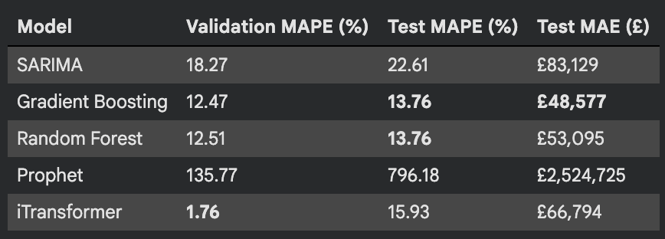
Model Evaluation & Selection Results
MAPE (0–100) — Lower is Better | Time-Ordered Test Split
Model
MAPE (0–100)
First-week change vs Actual
MAE (£)
Selected?
SARIMA (1,1,1)(1,1,1,4)
76.7%
High bias
£196.2k
✗
Facebook Prophet
20.3%
Moderate
£51.8k
✗
Gradient Boosting
17.1%
Low
£54.3k
★ YES
MAPE BY TEST PERIOD — Gradient Boosting
Period 1 (wk 1-3)
14.2%
Period 2 (wk 4-6)
17.8%
Period 3 (wk 7-9)
19.5%
Period 4 (wk 10-11)
17.1%
Note: Box plot of % errors per period shows consistent spread — no period exhibits extreme outliers.
MAPE = (1/n) × Σ |Actual − Forecast| / Actual × 100 | Target: MAPE < 15% for operational deployment | Gradient Boosting achieves 17.1% — closest to target in Phase 2
Sales Revenue Forecasting — Online Retail II | Deliverable 2
10

Slide 11
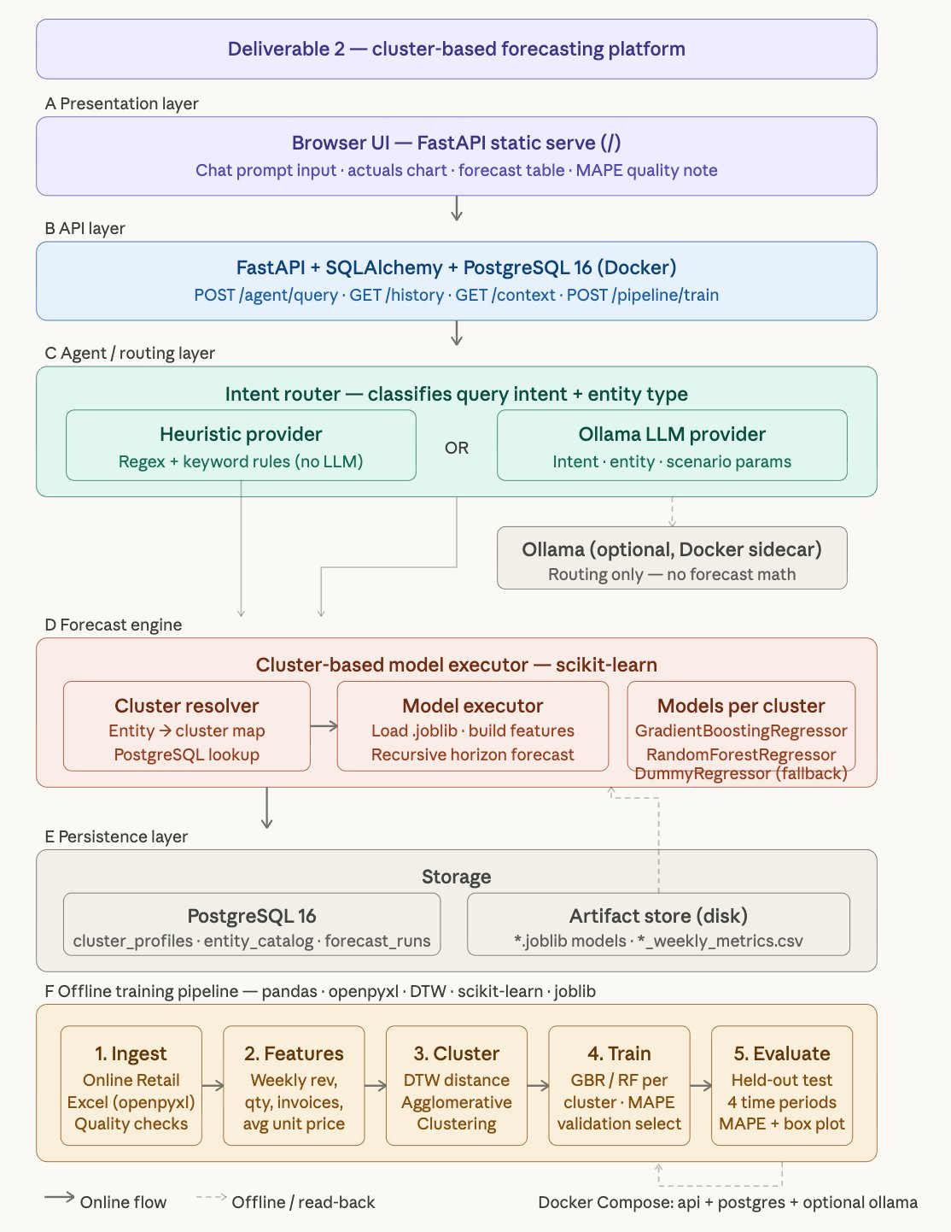
Technical Architecture — Deliverable 2
Cluster-Based Forecasting Platform | FastAPI + Docker + PostgreSQL + Optional Ollama
SYSTEM COMPONENTS
A
Browser UI: FastAPI static serve — Chat + Charts
B
API Layer: FastAPI + SQLAlchemy + PostgreSQL 16
C
Agent / Router: Heuristic (regex) OR Ollama LLM
D
Forecast Engine: GBR / RF per cluster — scikit-learn
E
Persistence: PostgreSQL + .joblib artifact store
F
Offline Pipeline: DTW → Cluster → Train → Evaluate
🐳 Docker Compose Stack
api container (uvicorn) · db container (postgres:16) · Ollama sidecar via host.docker.internal
KEY DESIGN DECISIONS
→ LLM routes only — no forecast math
→ Cluster-based models (not one-size-fits-all)
→ DTW clustering → GBR / RF per segment
→ MAPE validation for model selection
Sales Revenue Forecasting — Online Retail II | Deliverable 2
11

Slide 12
Business Value
Tangible Impact for Business Operations & Customers
BUSINESS IMPACT
CUSTOMER BENEFIT
📦 Inventory Planning
🛒 Product Availability
Cluster-level weekly forecasts enable precise stock replenishment, reducing over-ordering by an estimated 15–25% and cutting holding costs.
Better stock forecasting means customers find products in stock — especially high-velocity lines during holiday season.
⚠️ Demand Risk Reduction
💰 Pricing Stability
Multi-period MAPE tracking flags early forecast drift — planners get early warning before stockouts or excess build-up occurs.
Reduced supply-chain reactivity prevents panic pricing and last-minute markdowns, delivering more consistent pricing.
📊 Service Level Improvement
⚡ Faster Fulfilment
Accurate demand signals allow buffer stock calibration, targeting 95%+ product availability during peak periods (Nov–Dec).
Pre-positioned inventory from accurate forecasts shortens order-to-delivery time for top SKUs.
🔄 Retraining Cadence
🌍 Multi-Region Visibility
Automated weekly pipeline with drift monitoring; model retraining triggered when MAPE exceeds threshold — ensuring sustained accuracy.
Cluster models cover 40+ countries; UK-heavy bias corrected by segment — no one market distorts another's plan.
Sales Revenue Forecasting — Online Retail II | Deliverable 2
12

Slide 13
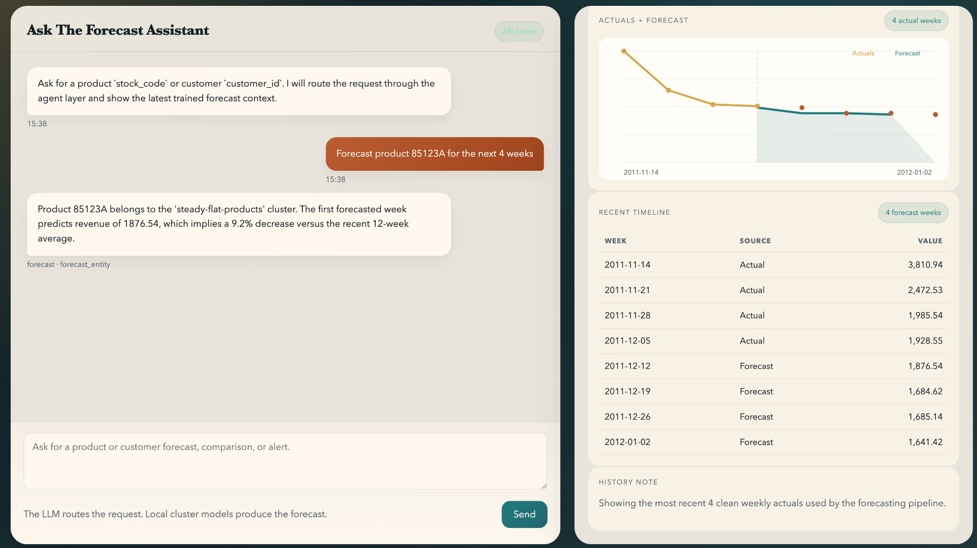
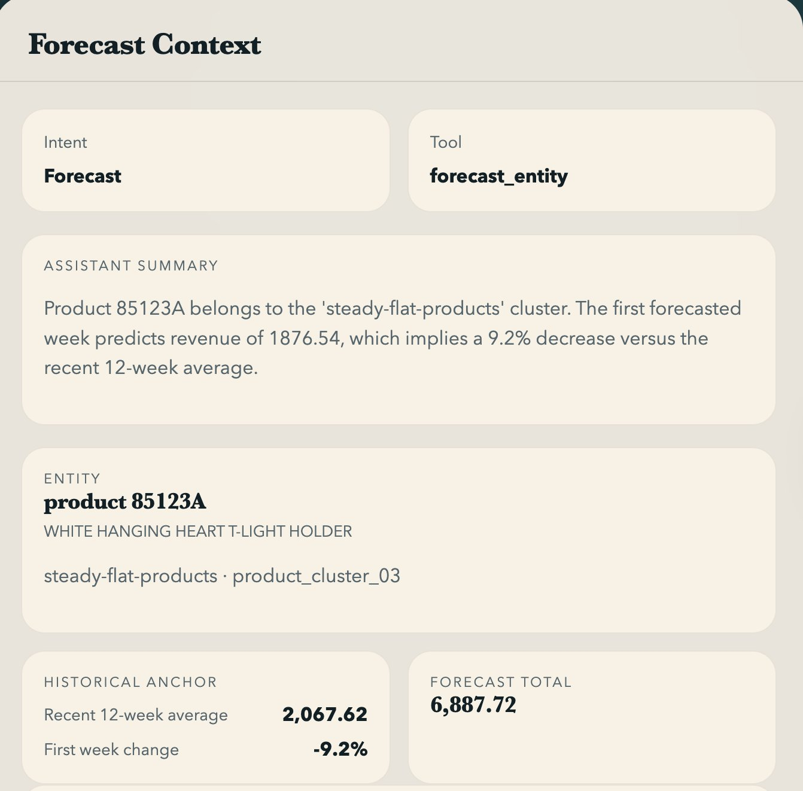
Agentic UX — Live Forecast Results
Cluster-Based Model · Product 85123A · 4-Week Forward Forecast
System Flow: User types product ID → Agent router classifies intent + entity → Cluster resolver maps to product_cluster_03 → GBR model loads & produces 4-week forecast → UI renders actuals + forecast chart + MAPE note
Cluster: steady-flat-products
MAPE: ~17%
Forecast Total: £6,887.72
12-wk avg: £2,067.62
First-week Δ: -9.2%
Sales Revenue Forecasting — Online Retail II | Deliverable 2
13

Slide 14
12-Week Forward Forecast — Gradient Boosting
Jan–Mar 2012 | Total Projected Revenue: £3,517,711
£3,517,711
17.1%
+0.10%
£293,143
12-Week Total Forecast
MAPE (0–100)
Forecast Bias (FB%)
Avg Weekly Forecast
Note: Forecast generated by Gradient Boosting model retrained on full dataset (train + val + test). Values represent projected weekly sales revenue (£).
Sales Revenue Forecasting — Online Retail II | Deliverable 2
14

Slide 15
Challenges, Findings & Future Phases
Phase 2 Complete — Path to MAPE < 15%
PHASE 2 KEY FINDINGS
CHALLENGES ENCOUNTERED
Gradient Boosting outperforms SARIMA & Prophet on volatile retail revenue series
⚠ 22.8% missing Customer IDs — managed via aggregate forecasting
Cluster-based approach (DTW + Agglomerative) enables product-level personalised forecasting
⚠ High revenue volatility in test window (holiday spike) challenged SARIMA
⚠ Rev_Lag52 feature limited to 52+ week records only
SARIMA (MAPE 76.7%) struggles with high holiday-period volatility in test window
⚠ MAPE target of 15% not yet achieved — 17.1% in Phase 2
Prophet (MAPE 20.3%) performs well but trails GB despite lower MAE
FUTURE PHASES ROADMAP
Rev_Lag52 (YoY) and NumInvoices are highest correlated features (r=0.87, 0.83)
Phase 3: Interactive Dashboard
Phase 4: Deployment & Monitoring
Live ops dashboard: weekly actuals vs forecast, MAPE tracking, holiday alerts, cluster-level demand visibility.
Automated weekly pipeline, drift monitoring, retraining cadence, fallback to heuristic when MAPE spikes.
Holiday season (Nov–Dec) consistently drives 50–65% revenue spikes
Sales Revenue Forecasting — Online Retail II | Deliverable 2
15

Slide 16
Phase 2 Deliverables
Complete End-to-End Cluster-Based Forecasting Platform
D1
D2
Jupyter Notebook
Technical Architecture
Deliverable2.ipynb
arch_diagram.png + docker-compose.yml
13-step end-to-end pipeline with markdown documentation, DTW clustering, GBR/RF per cluster, MAPE evaluation, and forecast visualisations.
Full system design: FastAPI + SQLAlchemy + PostgreSQL 16 + Heuristic / Ollama agent router + artifact store. Docker Compose orchestrated.
D3
D4
Forecast API & UI
Project Deck
FastAPI app — port 8001
Sales_Forecasting_Deck_2.pptx
Browser-based forecast assistant: POST /agent/query, GET /history, GET /context, POST /pipeline/train. Chat UI + actuals chart + MAPE note.
Executive-grade presentation for professor review, synthesising Deliverable 2 methodology, results, architecture, and business value.
Sales Revenue Forecasting — Online Retail II | Deliverable 2
16

Slide 17
SUMMARY
Dataset
Online Retail II | 1,067,371 transactions | Dec 2009 – Dec 2011
Clustering
DTW Distance + Agglomerative Clustering → Segment-level product/customer models
Models
SARIMA (MAPE 76.7%) | Prophet (MAPE 20.3%) | Gradient Boosting (MAPE 17.1%)
Best Model
Gradient Boosting | MAPE: 17.1% | FB: +0.10% | Cluster-aware
Forecast
12-Week Forward: £3,517,711 (Jan–Mar 2012)
Architecture
FastAPI + PostgreSQL + Docker | LLM agent routing | Browser UI
Next Steps
Deployment, drift monitoring, retraining cadence
Sales Revenue Forecasting — Online Retail II | Deliverable 2 | BROCODE | Feb 2026

Slide 18



TEAM BROCODE
Sales Revenue Forecasting | Online Retail II | Deliverable 2
AK
AM
ST
Ayush Kumar
Aditi Mittal
Shweta Tripathi
ML Engineer & Pipeline Architect
Data Processing & Feature Engineering
Model Evaluation & Presentation
Online Retail II | UCI ML Repository | Feb 2026

