Slide 1
INCOMELYZER: AI-POWERED SALARY PREDICTION USING ML MODELS
CAPSTONE PROJECT
Presented By:
1. Vitarna Sharma – Manipal University Jaipur - Department of Information Technology

Slide 2
OUTLINE
Problem Statement (Should not include solution)
System Development Approach (Technology Used)
Algorithm & Deployment (Step by Step Procedure)
Result
Conclusion
Future Scope(Optonal)
References

Slide 3
Problem Statement
In today’s rapidly evolving corporate environment, determining employee salary categories is a crucial but challenging task.
Traditional methods often rely on limited criteria and fail to consider the combined influence of education, work-class, and socio-economic factors.
Manual classification techniques are inefficient, error-prone, and non-scalable.
Our project aims to automate this process using advanced machine learning algorithms, improving both efficiency and accuracy.
This solution benefits HR departments by simplifying salary classification based on historical data patterns.
The motivation is to develop a scalable, explainable, and efficient model accessible via a user-friendly web app.

Slide 4
System Approach
System Requirements:
Minimum 8 GB RAM (tested on 16 GB laptop)
Intel i5 Processor or equivalent
Google Colab Pro for faster training
Development Platform:
Google Colab Notebook for training and visualization
Streamlit Web App for live user interaction and predictions

Slide 5
System Approach
Libraries Used:
Pandas, NumPy for data handling
Seaborn, Plotly for data visualization
Scikit-learn, XGBoost, LightGBM, CatBoost for modeling
SHAP, Joblib for explainability and model saving
Streamlit for web app deployment

Slide 6
Algorithm & Deployment
Data Loading
Loaded adult 3.csv dataset containing demographic & work-related attributes.
Data Preprocessing
Handled missing values (? replaced with "Not-Listed")
Removed outliers using range limits on age, hours-per-week, etc.
Applied Label Encoding for categorical features.

Slide 7
Algorithm & Deployment
Feature Scaling
Used MinMaxScaler to normalize features between 0 and 1.
Model Training
Trained and compared 7 ML models:
Logistic Regression, Random Forest, KNN, SVM, Gradient Boosting, Decision Tree, XGBoost
Hyperparameter Tuning
Performed GridSearchCV to improve model performance.

Slide 8
Algorithm & Deployment
Model Evaluation
Compared models using accuracy, confusion matrix, and SHAP explainability.
Chose best model based on performance (e.g., XGBoost with ~85%+ accuracy).
Deployment
Built a modular, interactive Streamlit app with:
Single prediction tab
Batch upload with automated data cleaning
UI hosted locally and tested on Google Colab output.

Slide 9
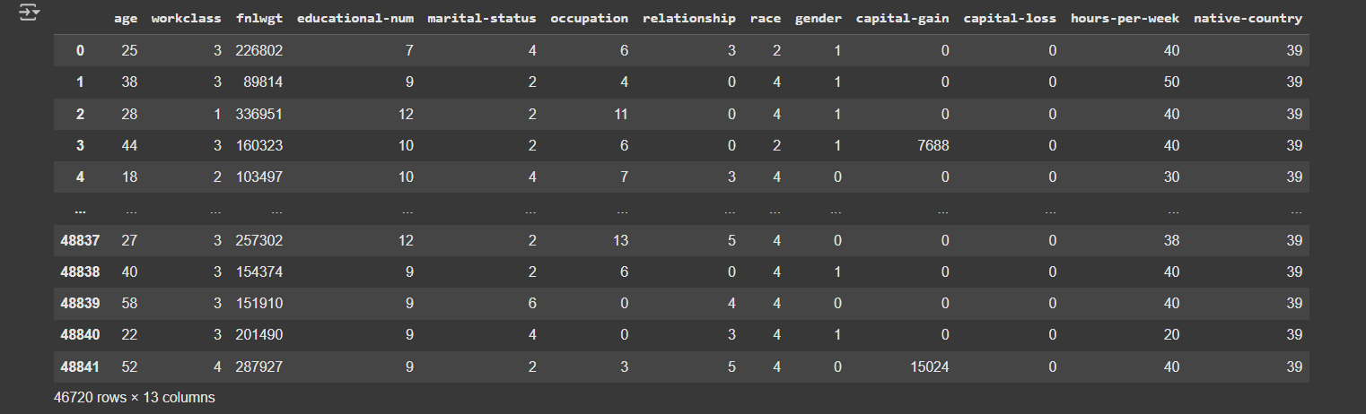
Result
Data Cleaning Output

Slide 10
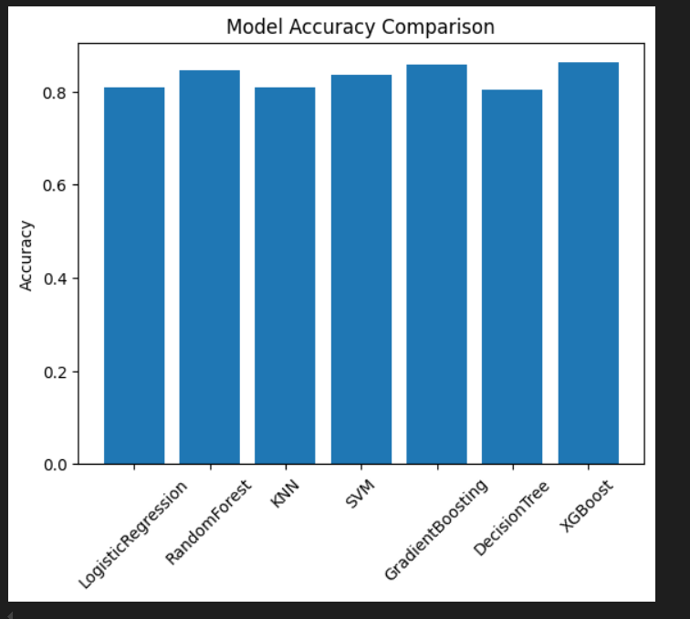
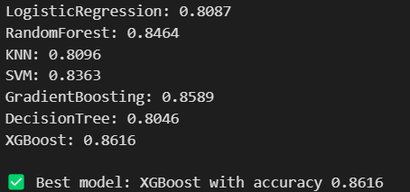
Result
Model Comparison Graph ->
Best Model Metrics

Slide 11
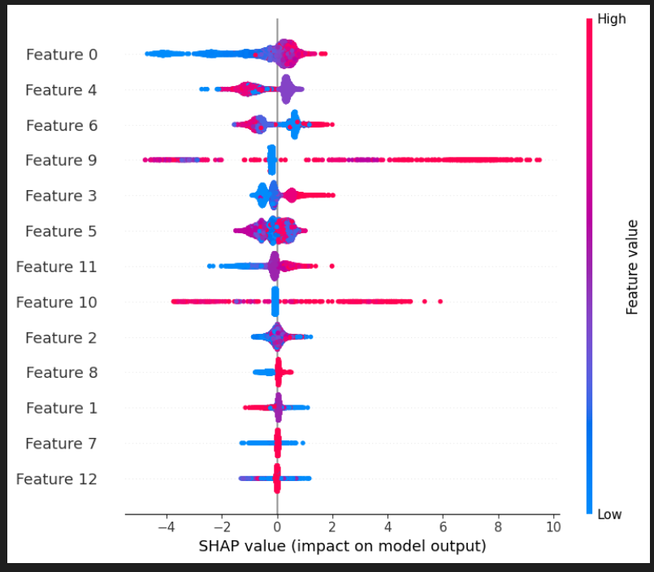
Result
SHAP Explainability Plot

Slide 12
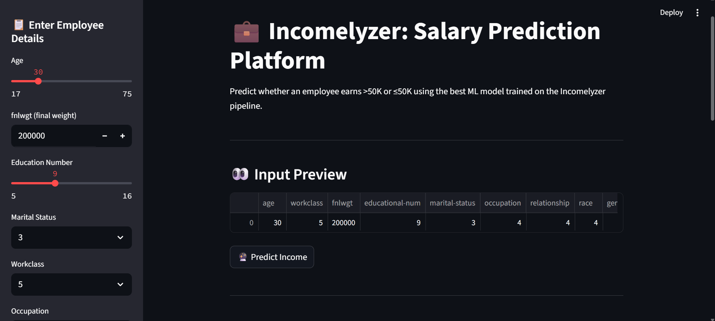
Result
Streamlit App – Single Prediction

Slide 13
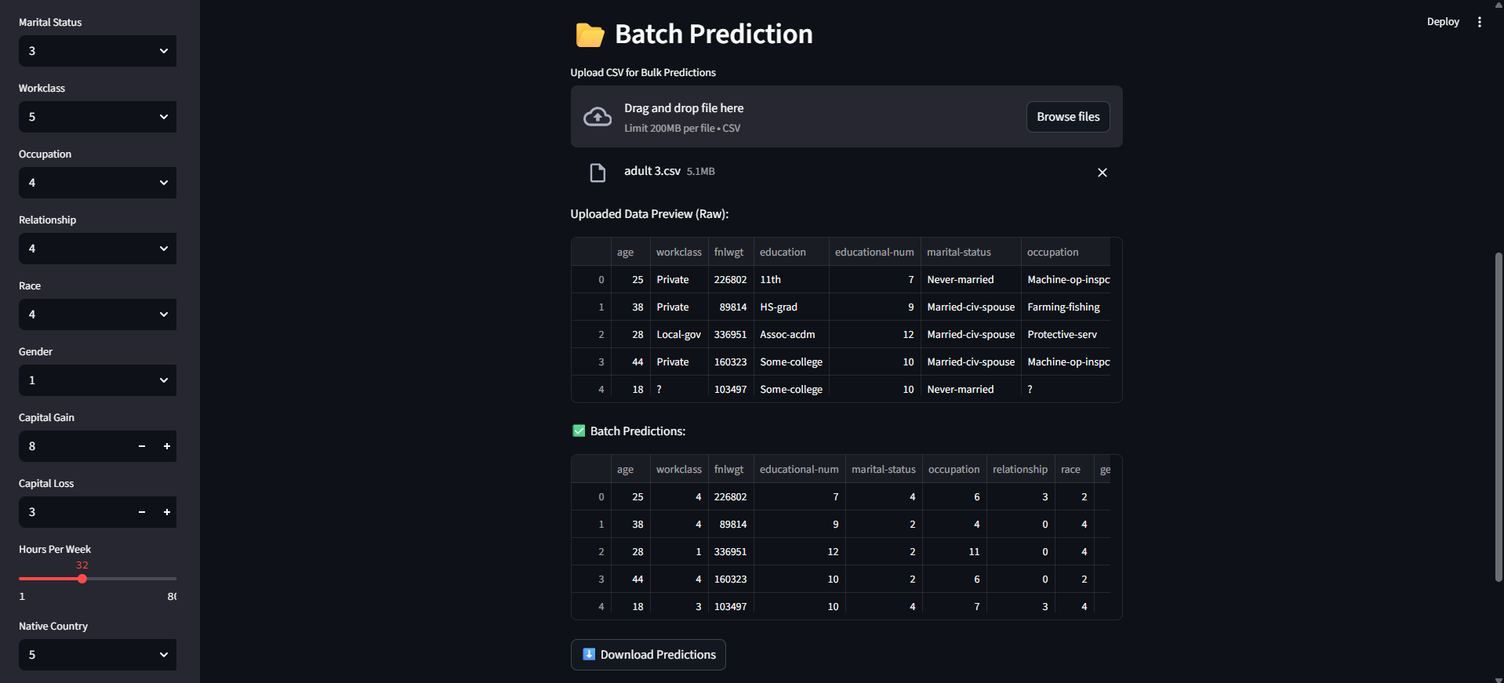
Result
Streamlit App – Batch Prediction

Slide 14
Conclusion
The Incomelyzer project successfully demonstrates how machine learning can be used to predict salary categories with high accuracy.
By integrating advanced models like XGBoost and Random Forest, we achieved an accuracy of over 86% on cleaned and processed data.
The solution is scalable, user-friendly (via Streamlit app), and ensures explainability with feature importance analysis.
Challenges included handling categorical data encoding, addressing class imbalance, and optimizing model hyperparameters.
Overall, the project offers an efficient, automated, and transparent solution for salary classification, suitable for HR analytics or career guidance platforms.

Slide 15
Future scope
Deep Learning Integration: Explore Neural Networks or AutoML frameworks for potential performance gains.
Real-Time API Deployment: Host the model as an API (e.g., using FastAPI) for live production-grade deployment.
Mobile App Version: Extend Streamlit interface to mobile-friendly apps using Streamlit Sharing or Flutter integration.
Dashboard Enhancement: Add interactive dashboards using Plotly Dash or Streamlit Charts for HR departments.
Explainability Improvements: Incorporate more advanced explainability (e.g., LIME along with SHAP) for transparency in decision-making.

Slide 16
References
Google Colab Notebook: https://colab.research.google.com/drive/1uZjj_zP8O6M0q75YHuoDEk2tthTdUv7D#scrollTo=bLNl-_N8KuZ2
Streamlit Web App: Local URL: http://localhost:8501
Network URL: http://192.168.1.5:8501
GitHub Repository: https://github.com/vitarna19/INCOMELYZER-AI-POWERED-SALARY-PREDICTION-USING-ML-MODELS.git
References:
Scikit-Learn Documentation: https://scikit-learn.org/stable/
XGBoost Documentation: https://xgboost.readthedocs.io/en/latest/
Streamlit Docs: https://docs.streamlit.io/
SHAP Explainability: https://shap.readthedocs.io/en/latest/

Slide 17
THANK YOU

