Slide 1
Prediction OF rate of success fOR the Starbucks stores in particular area Applied Data Science Capstone Project
Author: VITALIY PUSTOVIT

Slide 2
Content
Business Problem
Data description
Workflow
Results
Conclusion

Slide 3
Business Problem
The objective of this project is to explore the possibilities to expand Starbucks cafe network in the Ohio state neighborhood and predict the place with greater chance of success due to the characteristics of the place (cost of living, livability). To do that we will analyze variety of Starbucks locations with different level of success and suggest places to open a new one following these characteristics.

Slide 4
Data description
This code uses the data from https://foursquare.com to get the store number, latitude and longitude and customer rating.
An additional parameter as the “cost of living” and “livability” rates were introduced to characterize particular neighborhood and taken from the realtors public database: https://www.areavibes.com.

Slide 5
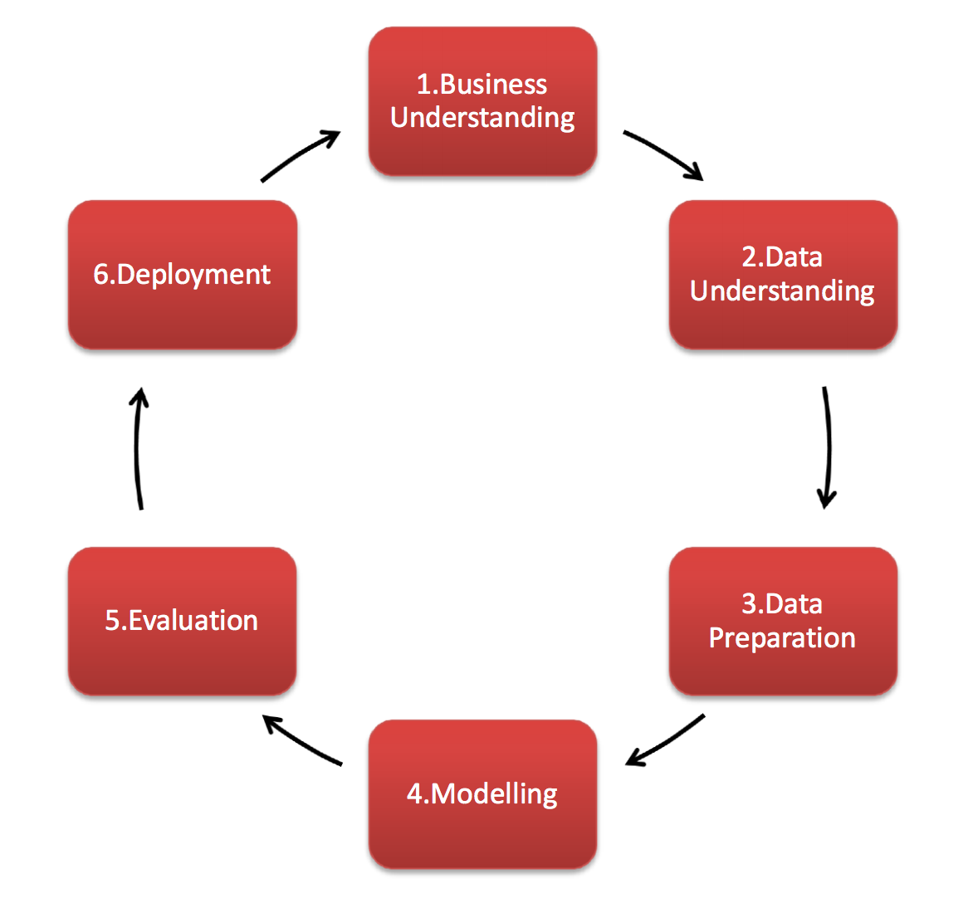
Data methodology

Slide 6
FOURSQUARE.COM
TRAINING SET FOR
STARBUCKS CAFÉ IN DAYTON
TEST SET FOR
STARBUCKS CAFÉ IN COLUMBUS
Workflow
RAITING CLUSTERING
OF STARBUCKS CAFÉ IN DAYTON
RAITING CLUSTERING
OF STARBUCKS CAFÉ IN COLUMBUS
TRAINING SET FOR
STARBUCKS CAFÉ IN DAYTON
TESTING SET FOR
STARBUCKS CAFÉ IN COLUMBUS
TRAINING OF ML MODELS
TEST RUNNING OF ML MODELS ON COLUMBUS SET
PREDICTION OF SUCCESS BASED ON CUSTOMER RATING

Slide 7

Results
The obtained “features” data was used on initially trained Decision Tree and Gaussian NB models to predict customer rating for this new set of stores. It seems prediction works well (100%).

Slide 8
Conclusion
It is possible to classify set of Starbucks café in two groups based on consumer rating which we directly relate to the rate of their success. The model trained (ML methods) on one set located in one geographical area seems working well on other set of cafes in the completely different area.

