Slide 1



{
Welcome to
Java Programming
}

Slide 2
How to take Input
{
..
Using Scanner...
};
..

Slide 3
How to display Output
{
..
Using System.out...
};
..

Slide 4
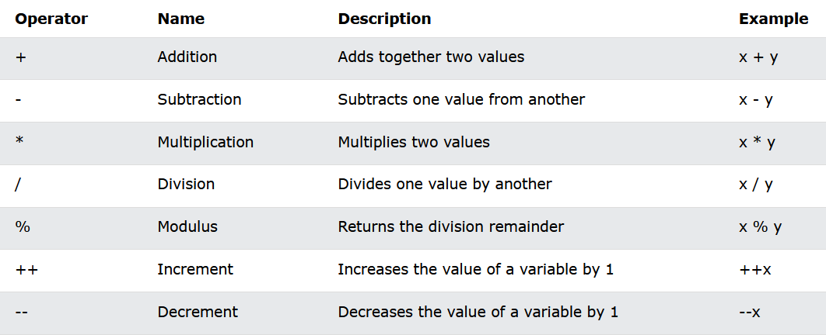
Arithmetic Operators

Slide 5
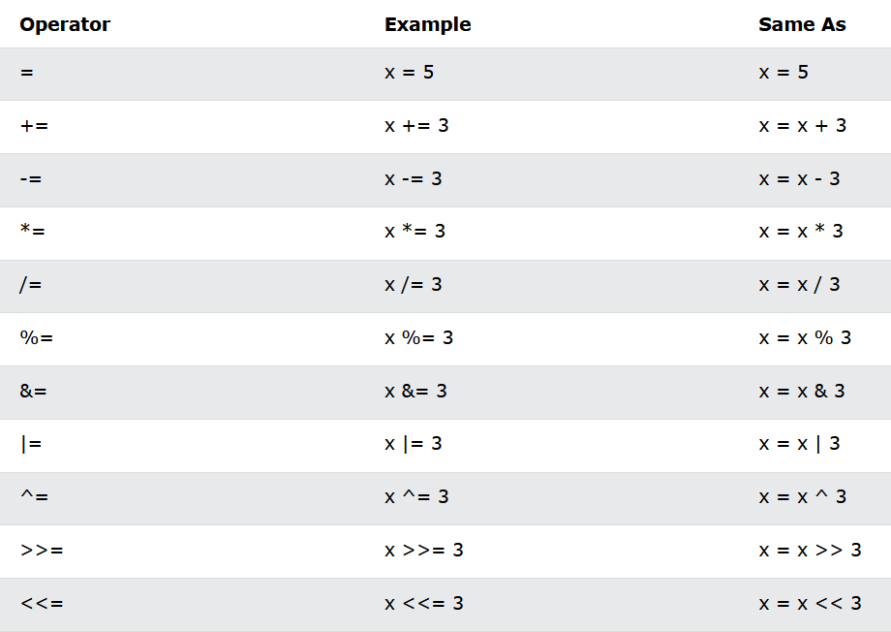
Assignment Operators

Slide 6
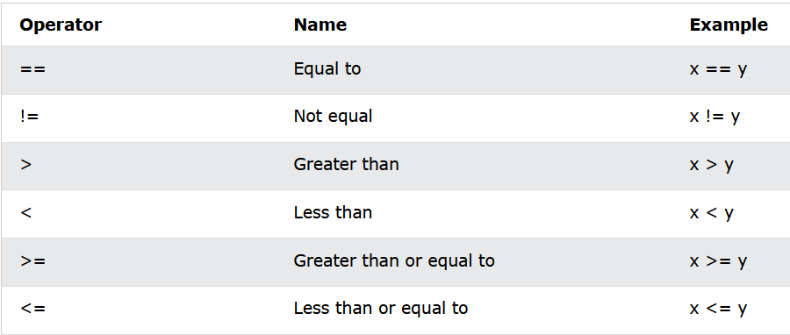
Comparision Operators

Slide 7
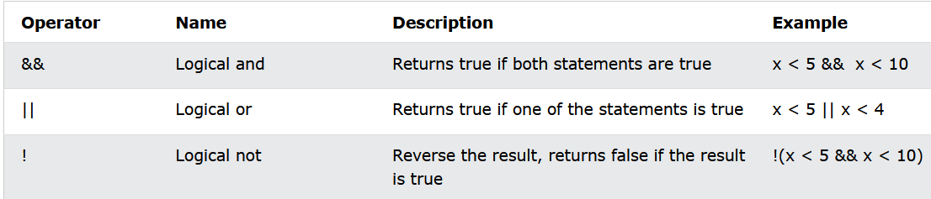
Logical Operators

Slide 8
What Is a Library
{
..
a library is a collection of pre-written code, functions, and routines that can be used by developers to perform common tasks or functions without having to write the code from scratch.
};
..

Slide 9
What is Operator Precedence
{
..
The operator precedence represents how two expressions are bind together. In an expression, it determines the grouping of operators with operands and decides how an expression will evaluate. Precedence is the priority for grouping different types of operators with their operands.
};
..

Slide 10
Type Casting
{
..
There are two types of Type Casting, Implicit and Explicit type casting.
Implicit Casting: Occurs when a value of a narrower data type is automatically converted to a wider data type without the need for explicit instructions.
Explicit Casting: Often used when converting from a wider data type to a narrower data type, as this may result in data loss.
};
..

Slide 11
Ternary Operators
{
..
The ternary operator, also known as the conditional operator, is a shorthand way to write a simple conditional expression.
};
..

Slide 12



Thanks!
< Do you have any questions? >
mail: vitacmsc@gmail.com
website: https://vitchennai.acm.org/
vitchennai.acm.org
acm_vitcc
ACM VITC

