Slide 1


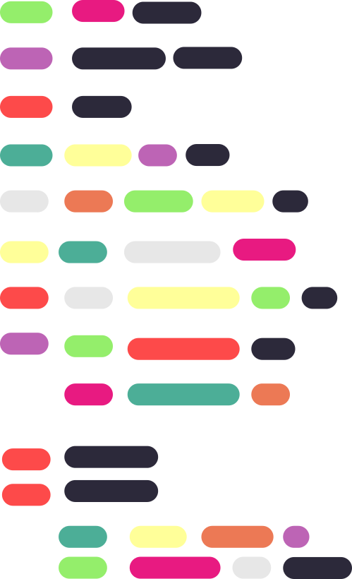
{
Welcome to
Java Programming
}

Slide 2
What are For Loops
{
..
A "for loop" in programming is a control structure used to repeatedly execute a block of code based on a specific condition.
};
..

Slide 3
Nested For Loops
{
..
Looking at code example...
};
..

Slide 4
Drawing Patterns
{
..
Looking at code example...
};
..

Slide 5
What are While Loops
{
..
In programming, a while loop is a control flow structure that allows you to repeatedly execute a block of code as long as a specified condition remains true. while loops are used when you want to perform a task repeatedly until a certain condition is met or becomes false.
};
..

Slide 6
What are Do While Loops
{
..
In programming, a "do-while" loop is a control flow structure that is used to execute a block of code repeatedly, similar to a "while" loop. However, unlike a "while" loop, a "do-while" loop guarantees that the block of code is executed at least once before checking the loop condition.
};
..

Slide 7
What is Break
{
..
In programming, the break keyword is a control flow statement that is used to exit a loop prematurely.
};
..

Slide 8
What is Continue
{
..
In programming, the continue keyword is a control flow statement that is used within loops to skip the current iteration of the loop and move to the next iteration.
};
..

Slide 9
What is If statement
{
..
The if statement is used to execute a block of code only if a specified condition is true.
};
..

Slide 10
What is If else statement
{
..
The else if statement is used to test multiple conditions one by one. It comes after an if statement and before an optional else statement.
};
..

Slide 11
What is else statement
{
..
The else statement is used to specify a default block of code to execute when none of the preceding conditions are true. It follows an if or else if statement and is optional
};
..

Slide 12
What is Switch statement
{
..
switch is a control flow statement that allows you to select one of several code blocks to be executed based on the value of a variable or expression. It's often used as a more efficient alternative to a series of if-else if statements when you have multiple conditions to evaluate.
};
..

Slide 13



Thanks!
< Do you have any questions? >
mail: vitacmsc@gmail.com
website: https://vitchennai.acm.org/
vitchennai.acm.org
acm_vitcc
ACM VITC

