Slide 1
YouTube Vitess
Scaling MySQL in the cloud with Vitess and Kubernetes
Percona Live MySQL Conference April 14, 2015
Anthony Yeh, Software Engineer, YouTube
Notes:
Vitess started in YouTube's own datacenters
Then YouTube moved into Google's container cluster
With help from Google MySQL team, Vitess evolved to run in this cloud-like environment
Many small containers, automatically packed onto machines, dynamically managed
Kubernetes builds on Google's container cluster experience, so it's a perfect fit for Vitess

Slide 2
Vitess in a Nutshell

Slide 3
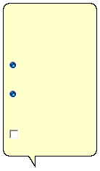
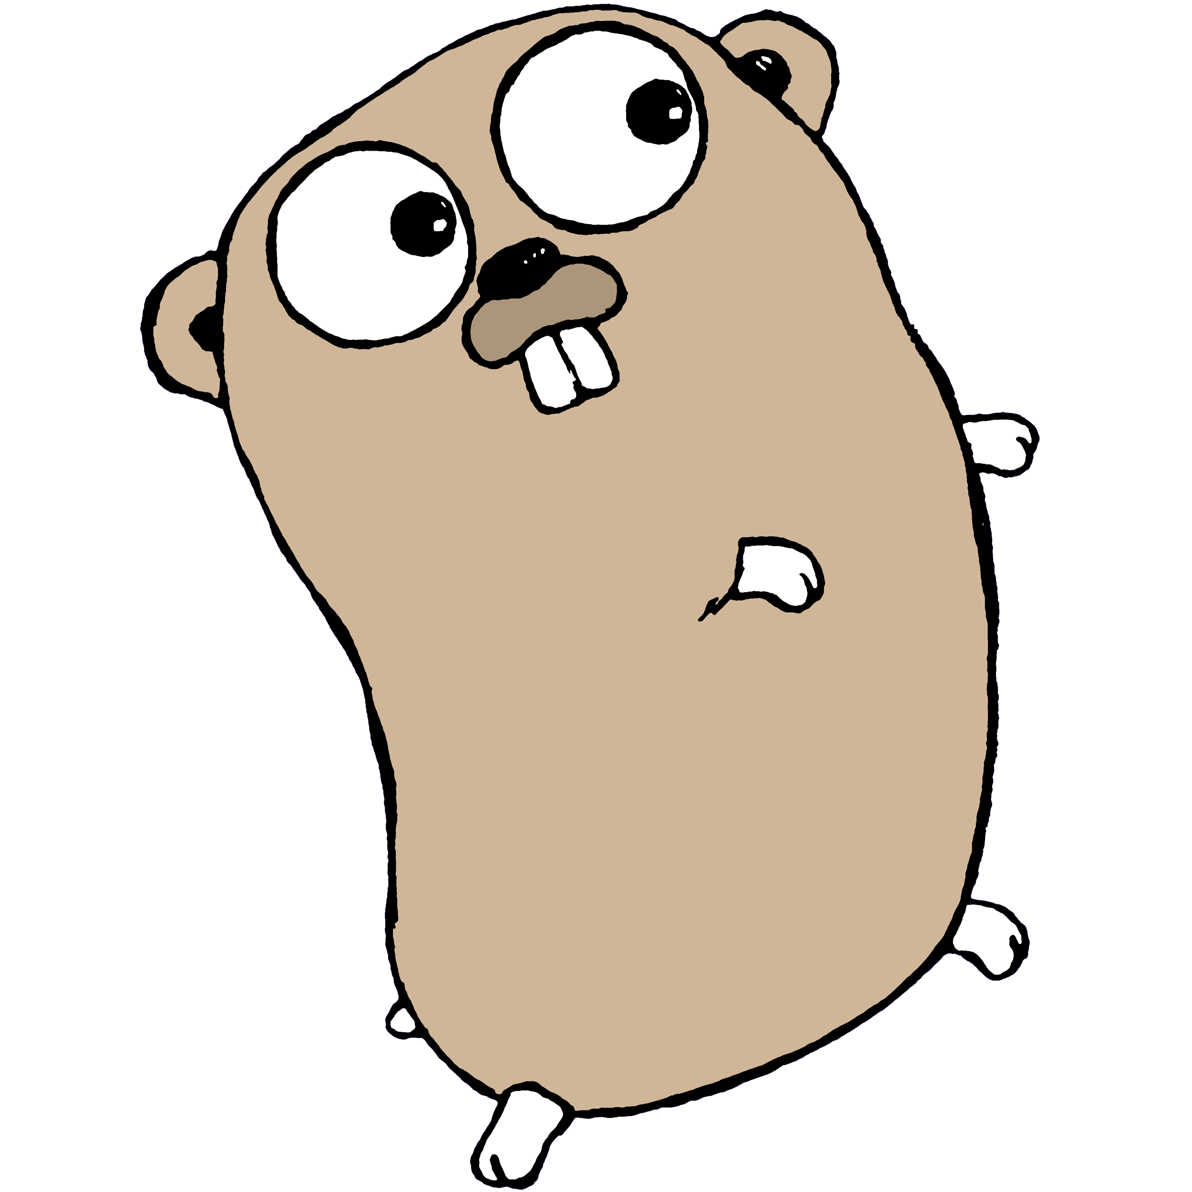
Vitess Overview
Performance
Connection pooling
Query deduplication
Transaction manager
Rowcache
Protection
Query sanitation
Query blacklist
Query killer
Table ACLs
Health check
Monitoring / Analysis
Performance analysis
Query stream
Update stream
MapReduce (Hadoop)
It looks like you're sharding MySQL.
Would you like help?
Get help with
sharding MySQL
Just do it at the app layer without help
Management
Reparent (master failover)
Web console
Multi-region coordination
Sharding
Range-based or app-defined
Live resharding
Split by row
Split by table
Don't show me this tip again
App Logic
Vitess
DB Admin
Details: vitess.io/overview
Notes:
Vitess straddles the border between the app and the DB
It's an abstraction layer for apps
Hides sharding, dynamic route changes
It's a DB cluster management system
Control large deployments
Vitess has a lot of features…
Just use what you need
The highlight is sharding, but there's more
See vitess.io

Slide 4

App View of Vitess
app server
vtctld
etcd
shard
vttablet
app server
mysqld
vtgate
master
app server
vtgate
vttablet
vttablet
vttablet
vttablet
mysqld
mysqld
mysqld
mysqld
batch job
replicas
batch replicas
App
Vitess
Notes:
App just needs to find any VTGate
Connection pooling - 100K at VTTablet
VTGate routes queries according to table stored in etcd
Each shard has a master and separate replica pools for live vs. batch traffic
VTTablet sits 1:1 with mysqld, connecting over localhost
brain slug
VTCtld controls everything - next slide

Slide 5
Admin View of Vitess
region
region
zone
zone
zone
etcd
etcd
etcd
GUI / CLI / RPC
vtctld
vtctld
vtctld
Examine/modify tablets, shards, keyspaces
Backup/Restore
Reparent (failover)
Schema changes
Live migrations (e.g. resharding)
vtgate
vtgate
vtgate
vtgate
vtgate
vtgate
vttablet
vttablet
vttablet
vttablet
vttablet
vttablet
mysqld
mysqld
mysqld
mysqld
mysqld
mysqld
Notes:
Admin just needs to find any vtctld
Simple control over a global Vitess cluster
Web interface, command-line client, RPC API

Slide 6
Performance and Protection
Requests
Query Combiner
Row Cache (Vitess)
9bZkp7q19f0
9bZkp7q19f0
id | title | views | ...
9bZkp7q19f0 | 강남스타일 | 2298169867 | ...
9bZkp7q19f0
dQw4w9WgXcQ
9bZkp7q19f0
Block Cache (MySQL)
9bZkp7q19f0
Rewriter / Killer
id | title | views | ...
... | ... | ... | ...
9bZkp7q19f0 | 강남스타일 | 2298169867 | ...
dQw4w9WgXcQ | ... | 114838229 | ...
... | ... | ... | ...
dQw4w9WgXcQ
SELECT * FROM *;
9bZkp7q19f0
UPDATE * SET *=6;
9bZkp7q19f0
Notes:
Suppose you have some really popular items (yellow), and some not-so-popular ones (blue)
A flood of requests for the popular one will be combined and only executed once
Row cache automatically caches rows by primary key
can take the place of app-level object cache servers (memcached)
MySQL's built-in block cache is optimized for scans rather than object lookups
Vitess also protects the database from the app
automatic query rewrite rules
a poorly-designed query returns an error to the app, rather than bogging down the database

Slide 7
Sharding Schemes
Vitess
range
custom
unsharded
Keyspace
00-80
80-FF
0
1
0
Shard
master
master
master
master
master
replica
replica
replica
replica
replica
Tablet Type
batch
batch
batch
batch
batch
Notes:
Vitess can manage all your databases at once
Each keyspace is a logical DB, and has its own sharding scheme and sharding key
One keyspace could use range-based sharding
based on the first byte of a uniform hash on some ID
use first 2 bytes for >256 shards
Another keyspace in the same cluster could use app-defined sharding
Data that doesn't need to be sharded (yet) can still be managed under Vitess

Slide 8
Vitess in a Container Cluster
Notes:
Vitess has evolved to live in a containerized world
A container cluster takes all the pieces and connects them together
It makes a big collection of machines (or VMs) look like a single computer

Slide 9
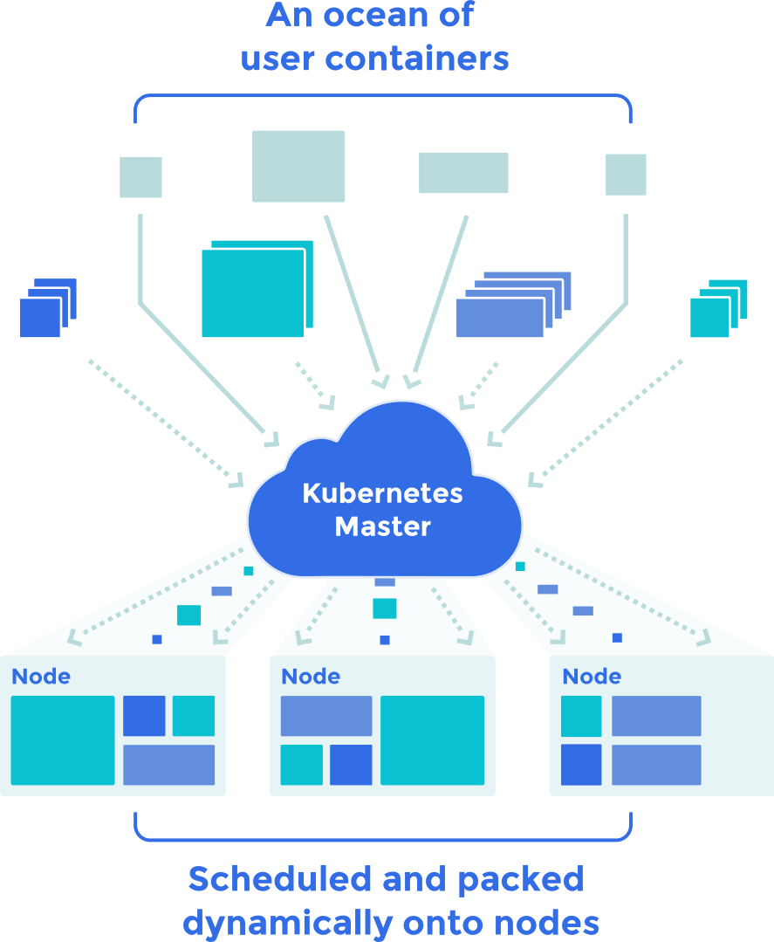
Docker and Kubernetes
Container: Lightweight kernel-level VM
Docker: Container image compiler and runtime
Kubernetes: Container Cluster OS
Shortcut for starting Vitess on Google Container Engine:
$ go get github.com/youtube/vitess/go/cmd/vtctlclient
$ cd $GOPATH/src/github.com/youtube/vitess/examples/kubernetes
$ export KUBECTL='gcloud alpha container kubectl'
$ ./cluster-up.sh
kubernetes.io
Detailed guide: vitess.io/getting-started
Notes:
Kubernetes is a container cluster manager based on Docker
The cluster is a computer - Kubernetes is the OS
Goal: make running distributed systems as easy as
We're making Vitess into a Kubernetes app
Starting Vitess:
The easy way: cluster-up.sh
To understand what's going on: detailed guide

Slide 10
Vitess in Kubernetes
pod
pod
pod
Query Path
vttablet
vtgate service
app server
vtgate
mysqld
Kubernetes
pod
etcd service
batch job
pod
pod
vtctld service
Admin
vtctld
etcd
Notes:
Pods are the units of scheduling
If it has multiple containers, they will always be together
e.g. VTTablet and mysqld are two containers in the same pod
Services are a mechanism for discovery
You never know where pods will be placed
Each service has a fixed IP that will forward connections to a pool of pods
e.g. App just connects to VTGate service IP
VTGate connects directly to VTTablet pods since they're stateful
Vitess components connect to the etcd service to coordinate among themselves

Slide 11
Vitess in the Cloud
Notes:
With a large number of small instances, servers will go up and down all the time
Vitess automatically routes to healthy replicas
Reparents are routine because the master is just another fragile replica
With small instances, scaling is achieved by adding more instances

Slide 12
Transparent Rerouting
etcd
Queries
app server
vtgate
vttablet-1
app server
mysqld
app server
vtgate
app server
vttablet-2
app server
mysqld
app server
vtgate
Notes:
VTGates route queries to any replica
One replica goes down - e.g. mysqld gets stuck, or the pod is moved to another node
VTGates notice it go away and fetch updated routes
It comes back, but it may need time to restore
Restore is routinely exercised!
When it's ready, it adds itself back to the route list
VTGates randomly rebalance back onto it over time

Slide 13
Routine Reparent
etcd
Updates
app server
vtgate
vttablet-1
mysqld
Reparent to vttablet-2
vtctld
replica
master
read-only
Replication
vttablet-2
vttablet-3
mysqld
mysqld
master
replica
replica
Notes:
Updates are automatically routed to the current master
Routine reparent occurs - e.g. the node has to reboot for a kernel update
VTCtld coordinates; first it sets the old master read-only
Then it promotes the new master
And tells the other slaves to replicate from it
using GTID-based positioning
Then it updates the route in etcd
VTGate fetches the updated route and redirects to the new master
If possible, the old master is converted into a slave

Slide 14
Live Resharding
Streaming Split-Copy
00-40
Replication
Filtered Replication
00-80
00-80
40-80
app server
vtgate
80-C0
80-FF
80-FF
Details: vitess.io/doc/HorizontalReshardingGuide
C0-FF
Notes:
Start with 2 shards; 2nd column is batch replicas
Freeze a batch replica in each shard
Create new shards; they're empty and not serving
Streaming split-copy and diff - avoids using double the disk space (you're already near limit; that's why you're resharding)
Filtered replication - catch up on updates you missed while copying
Live migration - no downtime
Remove old shards

Slide 15
Vitess in the Future

Slide 16
Roadmap
MySQL 5.6
Benchmarks (YCSB)
VTGate V3
Automatic lookup tables
Cross-shard auto_increment
MySQL binary protocol
High-level automation
One-click resharding
Rolling (OOB) schema changes
More documentation
Architecture / design
How-to guides
Kubernetes
API server proxy for debug access
Replication controllers for tablets
Cloud plugins for backup/restore (Google Cloud Storage)
More client support
gRPC
PHP
Long-term
Cross-shard transactions (2PC)
Cross-shard joins/aggregation
Let us know what you'd like to see at vitess@googlegroups.com, or better yet...

Slide 17
Contribute!
Vitess in Kubernetes on other platforms (AWS, Azure, OpenShift, ...)
Backup/Restore plugins (e.g. Amazon S3)
Startup guides (firewall rules, load balancers, etc.)
InfluxDB (monitoring)
Vitess can already publish to InfluxDB, but needs work to integrate with Kubernetes
Other client languages
PHP was started, but needs someone who can patch a BSON plugin for PHP
https://github.com/youtube/vitess
Notes:
These are some examples of areas with a low barrier to making a significant contribution

Slide 18

Questions?

Slide 19
Resources
Vitess
vitess.io
github.com/youtube/vitess
vitess@googlegroups.com
Kubernetes
kubernetes.io
github.com/GoogleCloudPlatform/kubernetes
Google's MariaDB 10.0 Branch
code.google.com/p/google-mysql
Other Percona Live talks about MySQL at Google
Exploring Your Data with InnoDB Explorer - Jeremy Cole (Wednesday 1pm @ Ballroom A)
Encrypting MySQL Data at Google - Jeremy Cole, Jonas Oreland (Thursday 11am @ Ballroom D)
Notes:
Thanks
YouTube SRE
Google MySQL
Kubernetes

