Slide 1


Understanding Generalization
in Adaptive Data Analysis
Vitaly Feldman

Slide 2
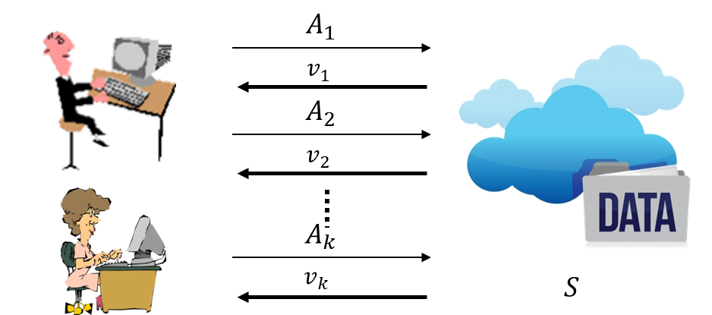
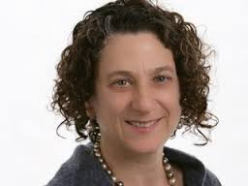
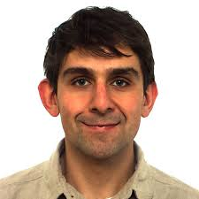
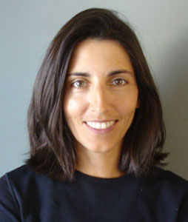
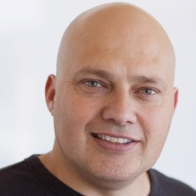
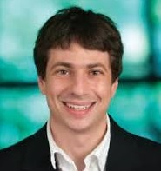
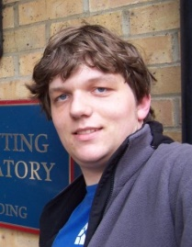
Overview
Adaptive data analysis
Motivation
Definitions
Basic techniques
With Dwork, Hardt, Pitassi, Reingold, Roth [DFHPRR 14,15]
New results [F, Steinke 17]
Open problems

Slide 3

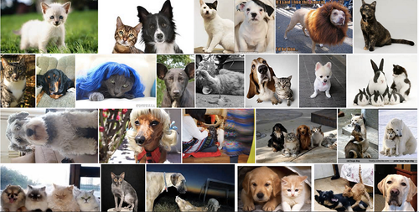
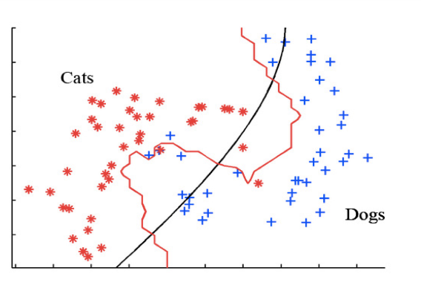


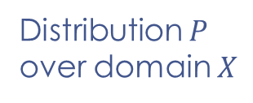



$E_{x∼P}[Loss(f,x)]$=?
Learning
problem
Distribution $P$
over domain $X$
Data
Model
$$S=\left(x_{1},…,x_{n}\right)∼P^{n}$$
$$f=A(S)$$
XGBoost SVRG Adagrad SVM
Analysis
$$A$$

Slide 4
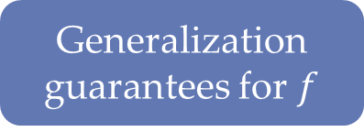

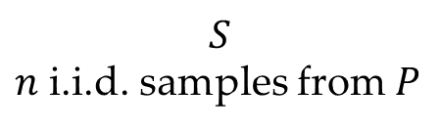
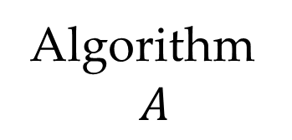
Statistical inference
Data
Data
Data
$$S$$
$n$ i.i.d. samples from $P$
Theory
Model complexity
Rademacher compl.
Stability
Online-to-batch
…
Algorithm
$$A$$
Generalization
guarantees for $f$
$$f=A(S)$$

Slide 5










Data analysis is adaptive
Steps depend on previous analyses of the same dataset
$$A_{1}$$
$$v_{1}$$
Exploratory data analysis
Feature selection
Model stacking
Hyper-parameter tuning
Shared datasets
…
$$A_{2}$$
$$v_{2}$$
$$A_{k}$$
$$v_{k}$$
$$S$$
Data analyst(s)

Slide 6

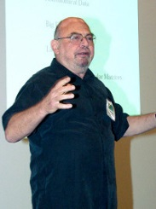
Thou shalt not test
hypotheses suggested
by data
“Quiet scandal of statistics”
[Leo Breiman, 1992]

Slide 7


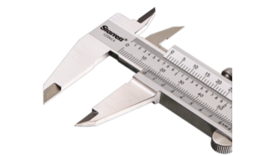
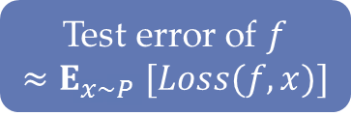

ML practice
Data
Data
Data
Data
Data
Data
Training
Testing
$$f$$
Lasso k-NN SVM C4.5 Kernels
Test error of $f$
$${≈E}_{x∼P}[Loss(f,x)]$$

Slide 8
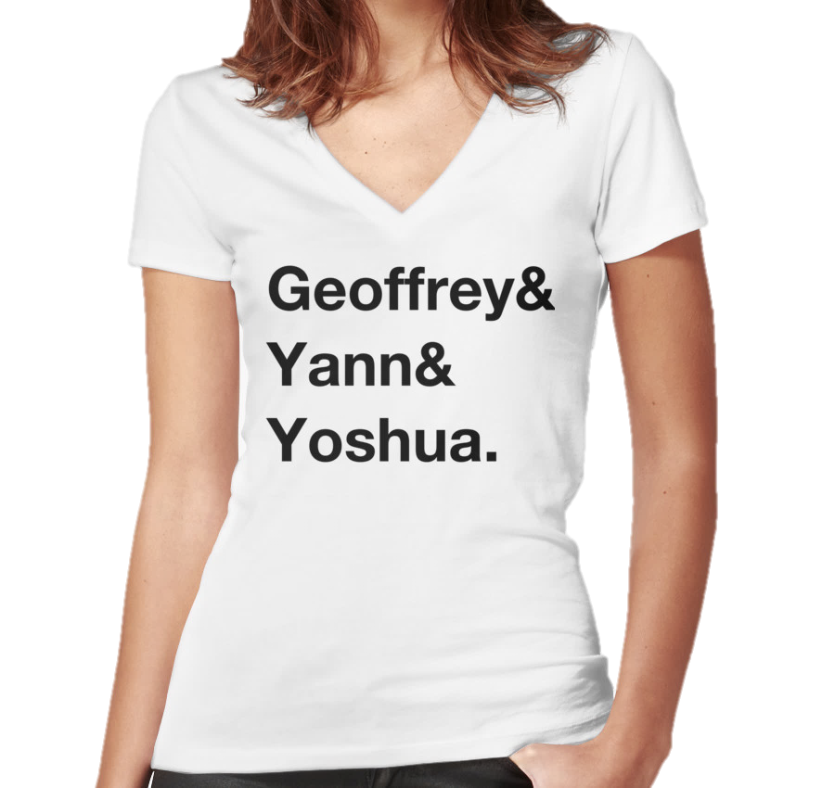
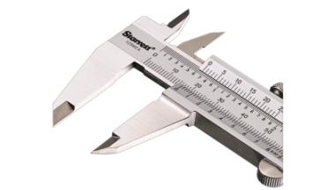


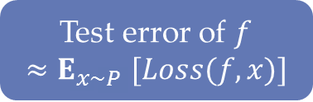


ML practice now
Data
Data
Data
Data
Data
Data
Data
Training
Validation
Testing
$$θ$$
XGBoost SVRG Tensorflow
$$f$$
$$f_{θ}$$
Test error of $f$
$${≈E}_{x∼P}[Loss(f,x)]$$

Slide 9


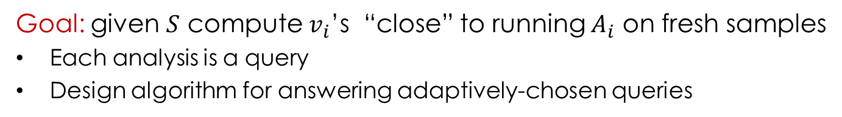


Adaptive data analysis [DFHPRR 14]
$$A_{1}$$
Algorithm
$$v_{1}$$
$$A_{2}$$
$$v_{2}$$
$$A_{k}$$
$$v_{k}$$
$$S=\left(x_{1},…,x_{n}\right)∼P^{n}$$
Data analyst(s)
Goal: given $S$ compute $v_{i}$’s “close” to running $A_{i}$ on fresh samples
Each analysis is a query
Design algorithm for answering adaptively-chosen queries

Slide 10

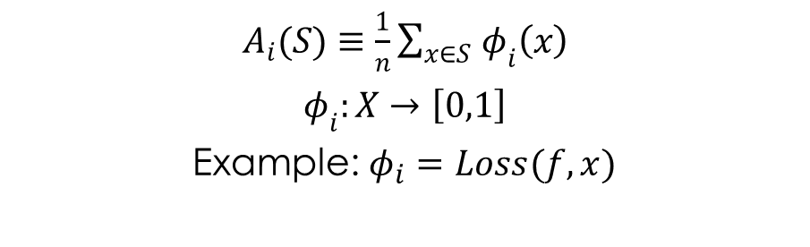



Adaptive statistical queries
$$A_{1}$$
$$v_{1}$$
$$A_{2}$$
$$v_{2}$$
$$S$$
$$A_{k}$$
$$v_{k}$$
Statistical query oracle
[Kearns 93]
Data analyst(s)
$$S=\left(x_{1},…,x_{n}\right)∼P^{n}$$
$A_{i}(S)≡$ $\frac{1}{n}\sum_{x∈S }{φ_{i}\left(x\right)}$
$φ_{i}:X→\left[0,1\right]$
Example: $φ_{i}=Loss(f,x)$
$\left|v_{i}−E_{x∼P}\left[φ_{i}\left(x\right)\right]\right|≤τ$ with prob. $1−β$
Can measure correlations, moments, accuracy/loss
Run any statistical query algorithm

Slide 11
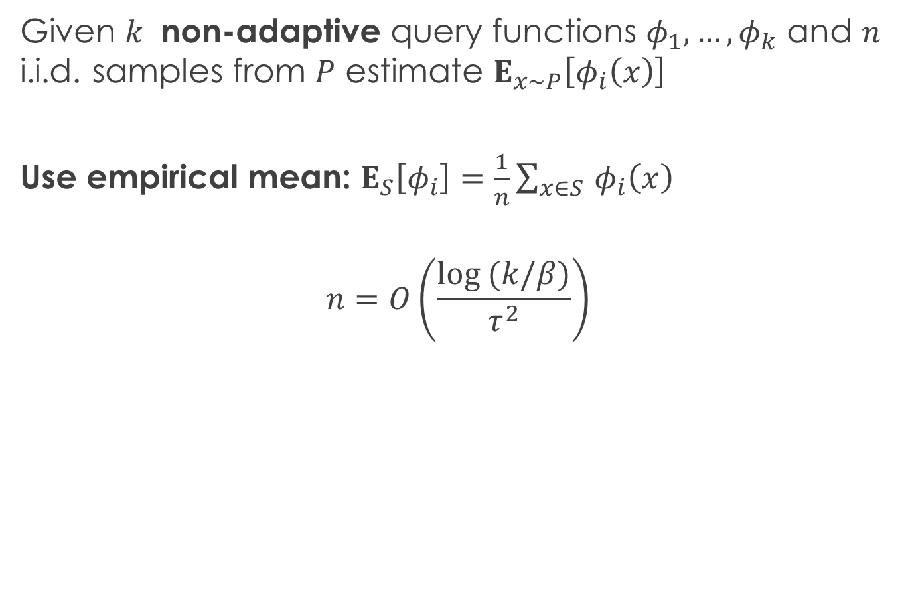
Answering non-adaptive SQs
Given $k$ non-adaptive query functions $φ_{1},…{,φ}_{k}$ and $n$ i.i.d. samples from $P$ estimate $E_{x∼P}\left[φ_{i}\left(x\right)\right]$
Use empirical mean: $E_{S}\left[φ_{i}\right]=\frac{1}{n}\sum_{x∈S }{φ_{i}\left(x\right)}$
$$n=O\left(\frac{log (k/β)}{τ^{2}}\right)$$

Slide 12

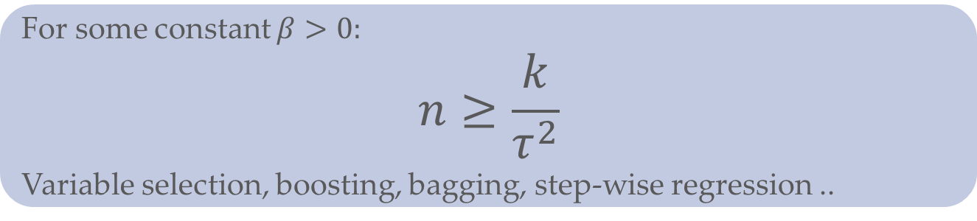
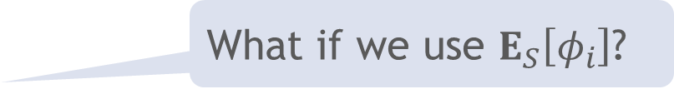
Answering adaptively-chosen SQs
What if we use $E_{S}\left[φ_{i}\right]$?
For some constant $β>0:$
$$n≥\frac{k}{τ^{2}}$$
Variable selection, boosting, bagging, step-wise regression ..
Data splitting: $n=O\left(\frac{k⋅log k}{τ^{2}}\right)$

Slide 13
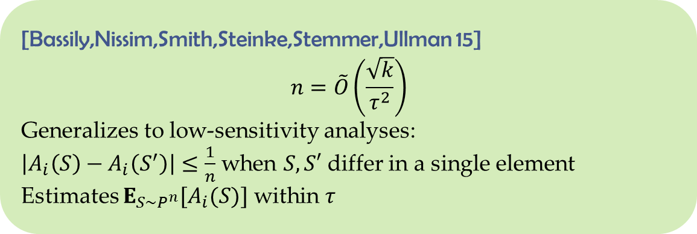
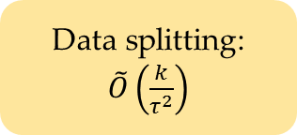
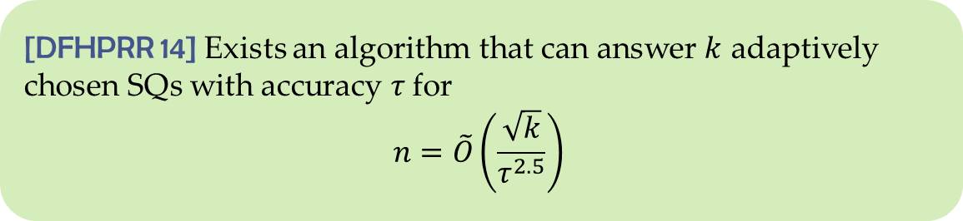
Answering adaptive SQs
[DFHPRR 14] Exists an algorithm that can answer $k$ adaptively chosen SQs with accuracy $τ$ for
$$n=\tilde{O}\left(\frac{\sqrt{k}}{τ^{2.5}}\right)$$
Data splitting:
$\tilde{O}\left(\frac{k}{τ^{2}}\right)$
[Bassily,Nissim,Smith,Steinke,Stemmer,Ullman 15]
$$n=\tilde{O}\left(\frac{\sqrt{k}}{τ^{2}}\right)$$
Generalizes to low-sensitivity analyses:
$\left|A_{i}\left(S\right)−A_{i}\left(S^{′}\right)\right|≤\frac{1}{n}$ when $S,S′$ differ in a single element
Estimates $E_{S∼P^{n}}[A_{i}(S)]$ within $τ$

Slide 14


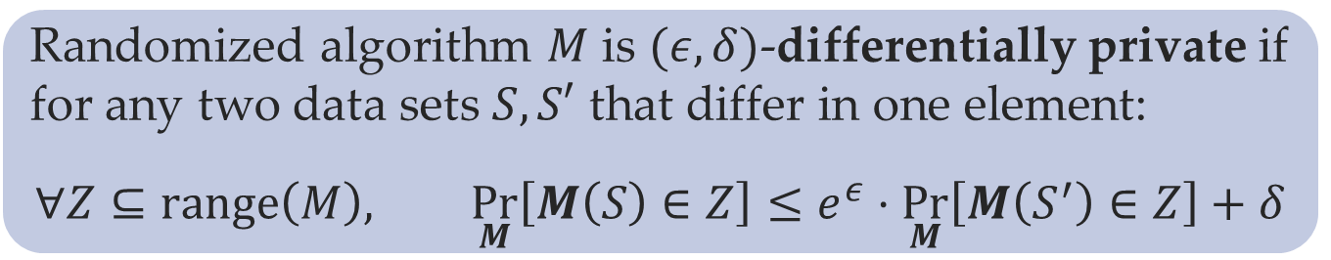

Differential privacy [Dwork,McSherry,Nissim,Smith 06]
$$S$$
$$S′$$
M
ratio bounded
$$\underset{M}{Pr}{[r]}$$
Randomized algorithm $M$ is $(ε,δ)$-differentially private if for any two data sets $S,S′$ that differ in one element:
$$∀Z⊆range\left(M\right), \underset{M}{Pr}\left[M\left(S\right)∈Z\right]≤e^{ε}⋅\underset{M}{Pr}\left[M\left(S^{′}\right)∈Z\right]+δ$$

Slide 15


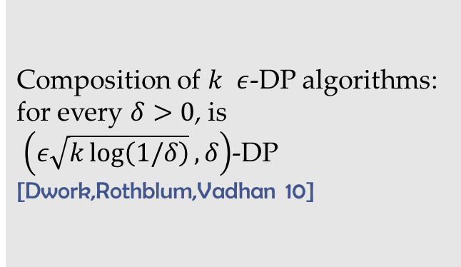
DP implies generalization
DP composes adaptively
Differential privacy is stability
Implies strongly uniform replace-one stability and generalization in expectation
DP implies generalization with high probability [DFHPRR 14, BNSSSU 15]
Composition of $k$ $ε$-DP algorithms:
for every $δ>0$, is
$\left(ε\sqrt{k\log\left(1/δ\right)},δ\right)$-DP
[Dwork,Rothblum,Vadhan 10]

Slide 16
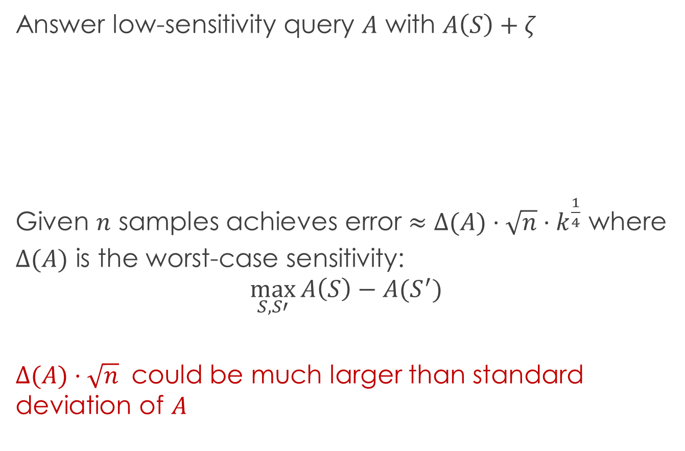
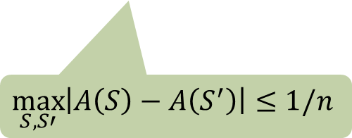
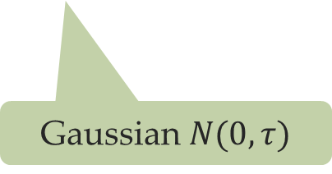
Value perturbation [DMNS 06]
Answer low-sensitivity query $A$ with $A\left(S\right)+ζ$
Given $n$ samples achieves error $≈Δ(A)⋅\sqrt{n}⋅k^{\frac{1}{4}}$ where
$Δ(A)$ is the worst-case sensitivity:
$$\max_{S,S′}{A\left(S\right)−A(S^{′})}$$
$Δ(A)⋅\sqrt{n}$ could be much larger than standard deviation of $A$
$$\max_{S,S′}\left|A\left(S\right)−A\left(S^{′}\right)\right|≤1/n$$
Gaussian $N(0,τ)$

Slide 17
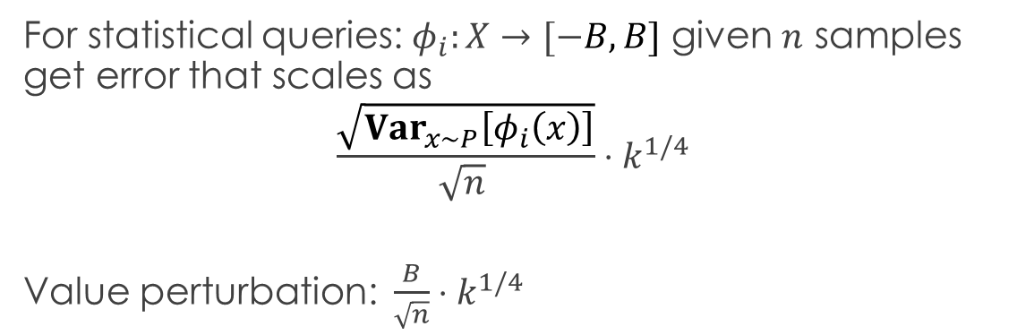
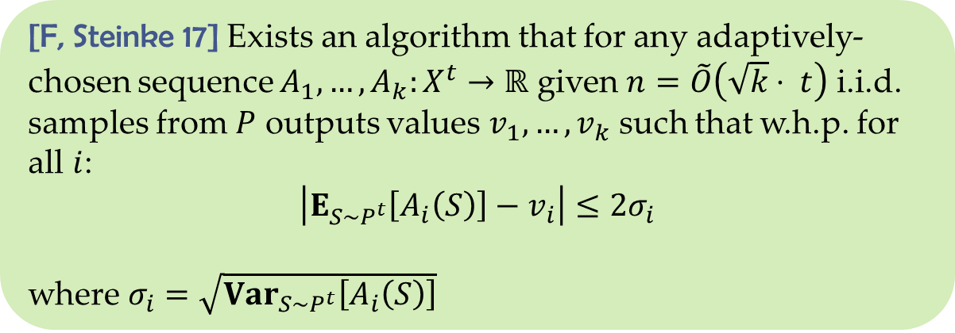
Beyond low-sensitivity
[F, Steinke 17] Exists an algorithm that for any adaptively-chosen sequence $A_{1},…,A_{k}:X^{t}→ℝ$ given $n=\tilde{O}\left(\sqrt{k}⋅ t\right)$ i.i.d. samples from $P$ outputs values $v_{1},…,v_{k}$ such that w.h.p. for all $i$:
$$\left|E_{S∼P^{t}}\left[A_{i}\left(S\right)\right]−v_{i}\right|≤2σ_{i}$$
where $σ_{i}=\sqrt{{Var}_{S∼P^{t}}\left[A_{i}\left(S\right)\right]}$
For statistical queries: $φ_{i}:X→[−B,B]$ given $n$ samples get error that scales as
$$\frac{\sqrt{{Var}_{x∼P}\left[φ_{i}\left(x\right)\right]}}{{\sqrt{n}}^{ }}⋅k^{1/4}$$
Value perturbation: $\frac{B}{\sqrt{n}}⋅k^{1/4}$

Slide 18



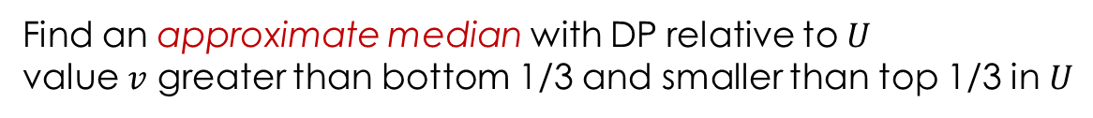















Stable Median
$$S$$
$$S^{1}$$ | $S^{2}$ | $$S^{3}$$ | $⋯$ | $$⋯$$ | $$⋯$$ | $$S^{m}$$
$$n=tm$$
$⋯$
$$A_{i}$$
$$A_{i}$$
$$A_{i}$$
$⋯$
$$A_{i}$$
$$A_{i}$$
$$A_{i}$$
$$y_{1}$$
$$y_{2}$$
$$y_{3}$$
$$y_{m−2}$$
$$y_{m−1}$$
$$y_{m}$$
$$U$$
$$v$$
Find an approximate median with DP relative to $U$
value $v$ greater than bottom 1/3 and smaller than top 1/3 in $U$

Slide 19
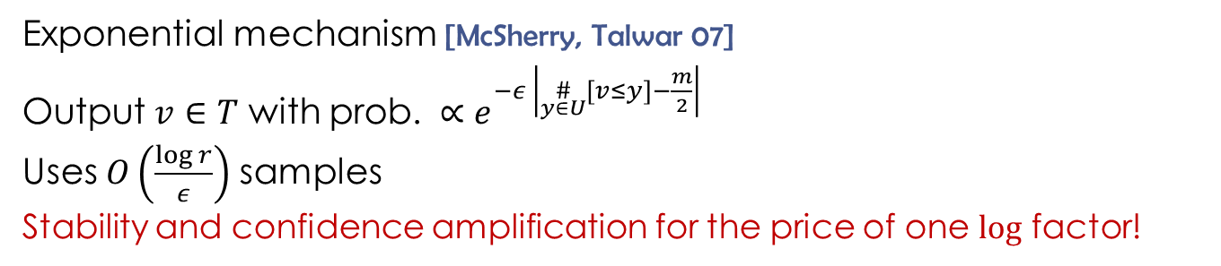
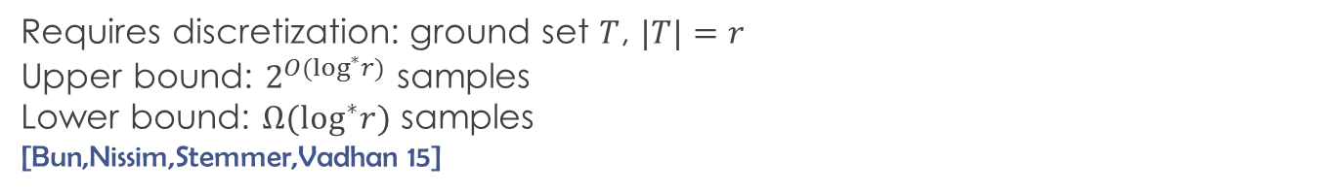


Median algorithms
Requires discretization: ground set $T$, $|T|=r$
Upper bound: $2^{O(\log^{∗}r)}$ samples
Lower bound: $Ω(\log^{∗}r)$ samples
[Bun,Nissim,Stemmer,Vadhan 15]
$$U$$
$$T$$
Exponential mechanism [McSherry, Talwar 07]
Output $v∈T$ with prob. $∝e^{−ε \left|\underset{y∈U}{\#}\left[v≤y\right]−\frac{m}{2}\right|}$
Uses $O\left(\frac{log r}{ε}\right)$ samples
Stability and confidence amplification for the price of one $log$ factor!

Slide 20
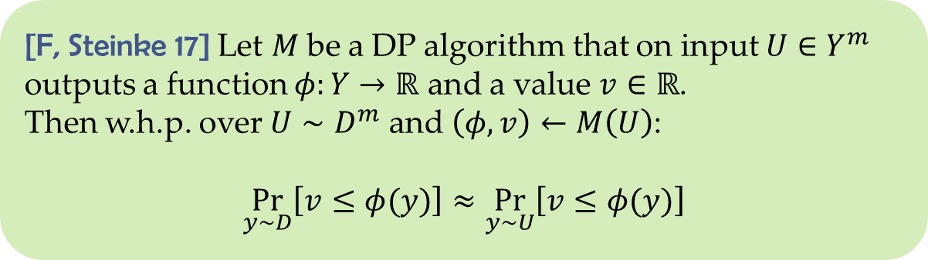
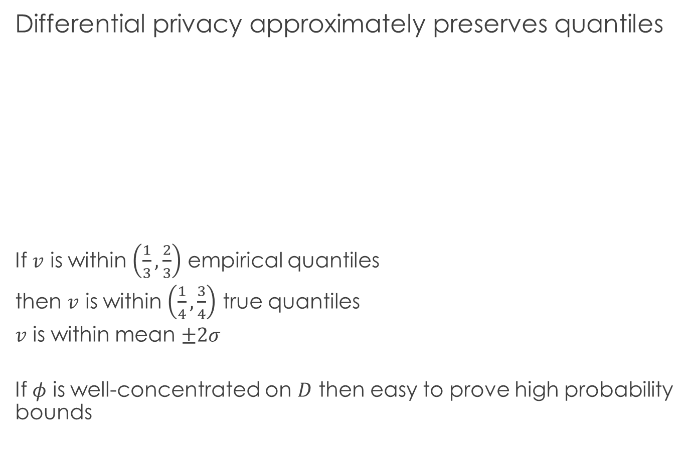
Analysis
Differential privacy approximately preserves quantiles
If $v$ is within $\left(\frac{1}{3},\frac{2}{3}\right)$ empirical quantiles
then $v$ is within $\left(\frac{1}{4},\frac{3}{4}\right)$ true quantiles
$v$ is within mean $±2σ$
If $φ$ is well-concentrated on $D$ then easy to prove high probability bounds
[F, Steinke 17] Let $M$be a DP algorithm that on input $U∈Y^{m}$ outputs a function $φ:Y→ℝ$ and a value $v∈ℝ$.
Then w.h.p. over $U∼D^{m}$ and $\left(φ,v\right)←M\left(U\right)$:
$$\underset{y∼D}{Pr}\left[v≤φ(y)\right]≈\underset{y∼U}{Pr}\left[v≤φ(y)\right]$$

Slide 21
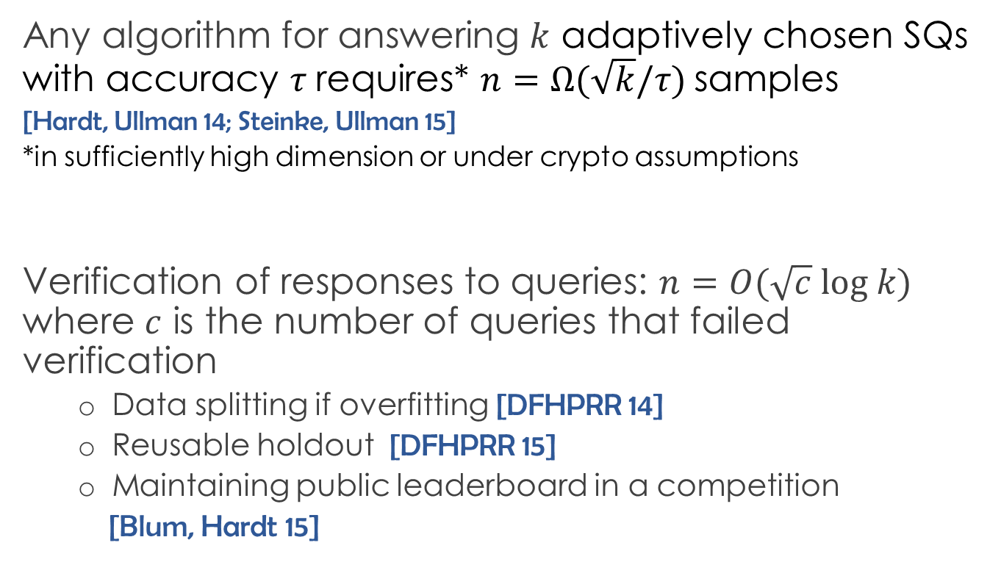
Limits
Any algorithm for answering $k$ adaptively chosen SQs with accuracy $τ$ requires* $n=Ω(\sqrt{k}/τ)$ samples
[Hardt, Ullman 14; Steinke, Ullman 15]
*in sufficiently high dimension or under crypto assumptions
Verification of responses to queries: $n=O(\sqrt{c} log k)$ where $c$ is the number of queries that failed verification
Data splitting if overfitting [DFHPRR 14]
Reusable holdout [DFHPRR 15]
Maintaining public leaderboard in a competition
[Blum, Hardt 15]

Slide 22
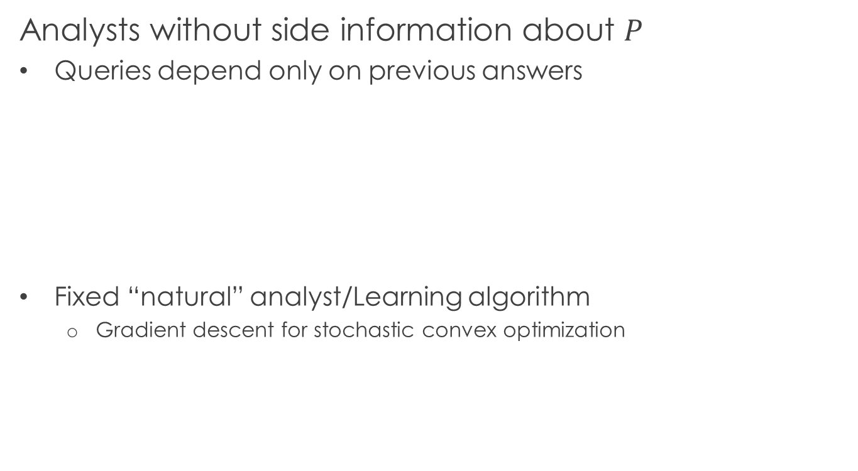
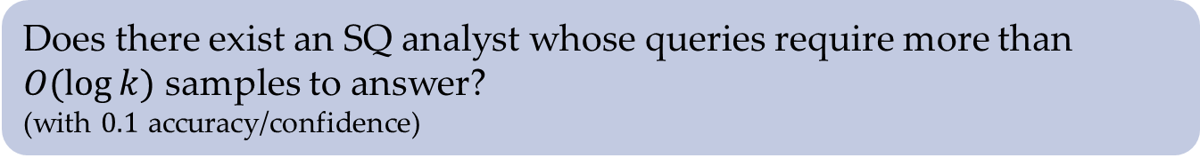
Open problems
Analysts without side information about $P$
Queries depend only on previous answers
Fixed “natural” analyst/Learning algorithm
Gradient descent for stochastic convex optimization
Does there exist an SQ analyst whose queries require more than $O(\log{k)}$ samples to answer?
(with $0.1$ accuracy/confidence)

Slide 23

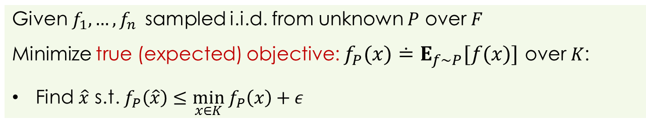

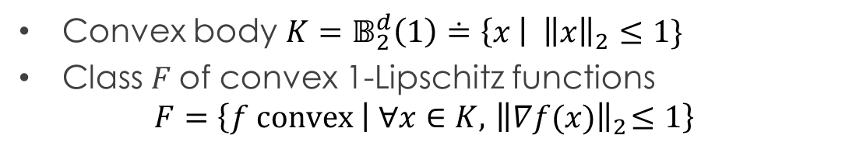

Stochastic convex optimization
Convex body $K=𝔹_{2}^{d}\left(1\right)≐\left\{x \right| {\left\|x\right\|}_{2}≤1\}$
Class $F$of convex 1-Lipschitz functions
$$F=\left\{f convex | ∀x∈K,{ \left\|∇f(x)\right\|}_{2}≤1\right\}$$
Given $f_{1},…,f_{n}$ sampled i.i.d. from unknown $P$ over $F$
Minimize true (expected) objective: $f_{P}(x)≐E_{f∼P}[f(x)]$ over $K$:
Find $\hat{x}$ s.t. $f_{P}\left(\hat{x}\right)≤\min_{x∈K} f_{P}\left(x\right)+ε$
$$f_{1}$$
$$f_{2}$$
$$…$$
$$f_{n}$$
$$f_{P}$$
$$x$$

Slide 24
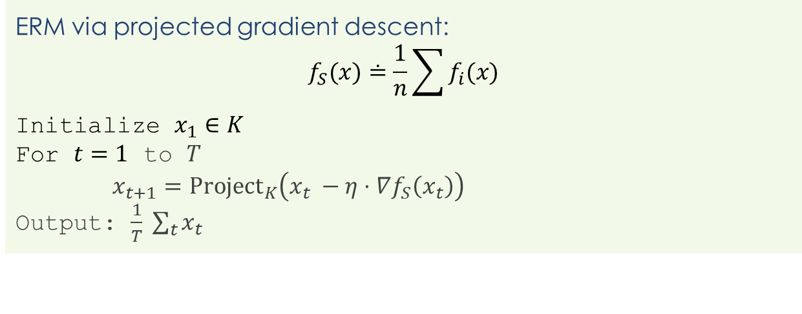
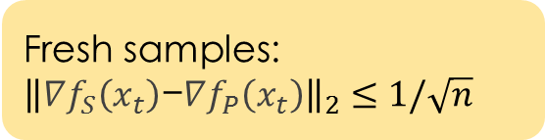
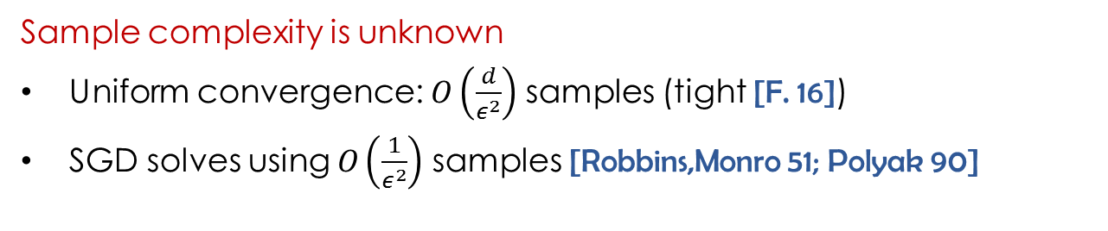

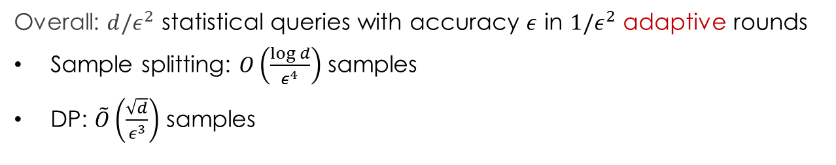
Gradient descent
ERM via projected gradient descent:
$$f_{S}(x)≐\frac{1}{n}\sum{f_{i}(x)}$$
Initialize $x_{1}∈K$
For $t=1$ to $T$
$x_{t+1}={Project}_{K}\left(x_{t} −η⋅∇f_{S}\left(x_{t}\right)\right)$
Output: $\frac{1}{T} \sum_{t}{x_{t}}$
$$\frac{1}{n}\sum{{∇f}_{i}(x_{t})}$$
Fresh samples: ${\left\|∇f_{S}\left(x_{t}\right)\text{−}∇f_{P}\left(x_{t}\right)\right\|}_{2}≤1/\sqrt{n}$
Sample complexity is unknown
Uniform convergence: $O\left(\frac{d}{ε^{2}}\right)$ samples (tight [F. 16])
SGD solves using $O\left(\frac{1}{ε^{2}}\right)$ samples [Robbins,Monro 51; Polyak 90]
Overall: $d/ε^{2}$ statistical queries with accuracy $ε$ in $1/ε^{2}$ adaptive rounds
Sample splitting: $O\left(\frac{log d}{ε^{4}}\right)$ samples
DP: $\tilde{O}\left(\frac{\sqrt{d}}{ε^{3}}\right)$ samples

Slide 25
Conclusions
Real-valued analyses (without any assumptions)
Going beyond tools from DP
Other notions of stability for outcomes
Max/mutual information
Generalization beyond uniform convergence
Using these techniques in practice

