Slide 1
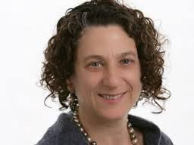
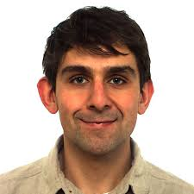
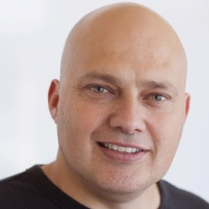
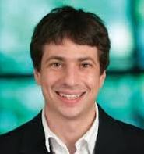
Using Data Privacy for Better Adaptive Predictions
Vitaly Feldman
IBM Research – Almaden
Cynthia Dwork Moritz Hardt Omer Reingold Aaron Roth
MSR SVC IBM Almaden MSR SVC UPenn, CS
Foundations of Learning Theory, 2014

Slide 2
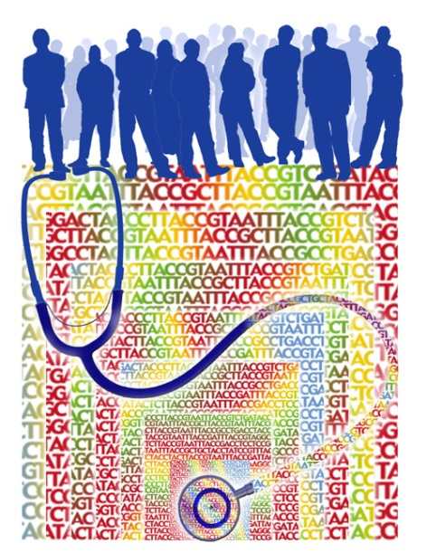
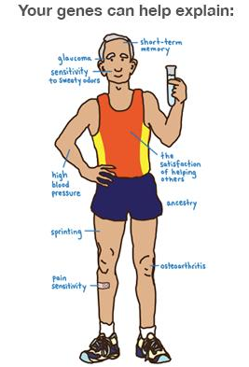

Statistical inference
Genome Wide Association Studies
Given: DNA sequences with medical records
Discover:
Find SNPs associated with diseases
Predict chances of developing some condition
Predict drug effectiveness
Hypothesis testing
Given: $n$ samples $S=\{x_{1},…,x_{n}\}$ drawn i.i.d. from unknown distribution $P$ over $X$
Output solution $w$ of value $v$ with a guarantee that w.p. $1−β$ (over $S$)
$$\left\|v−\underset{x∼P}{E}\left[L\left(w,x\right)\right]\right\|≤α$$

Slide 3

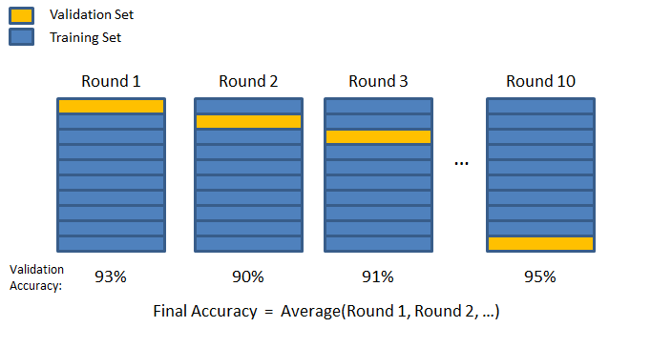
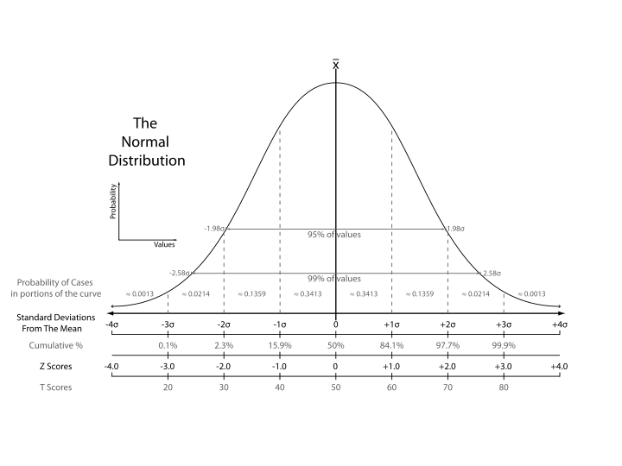
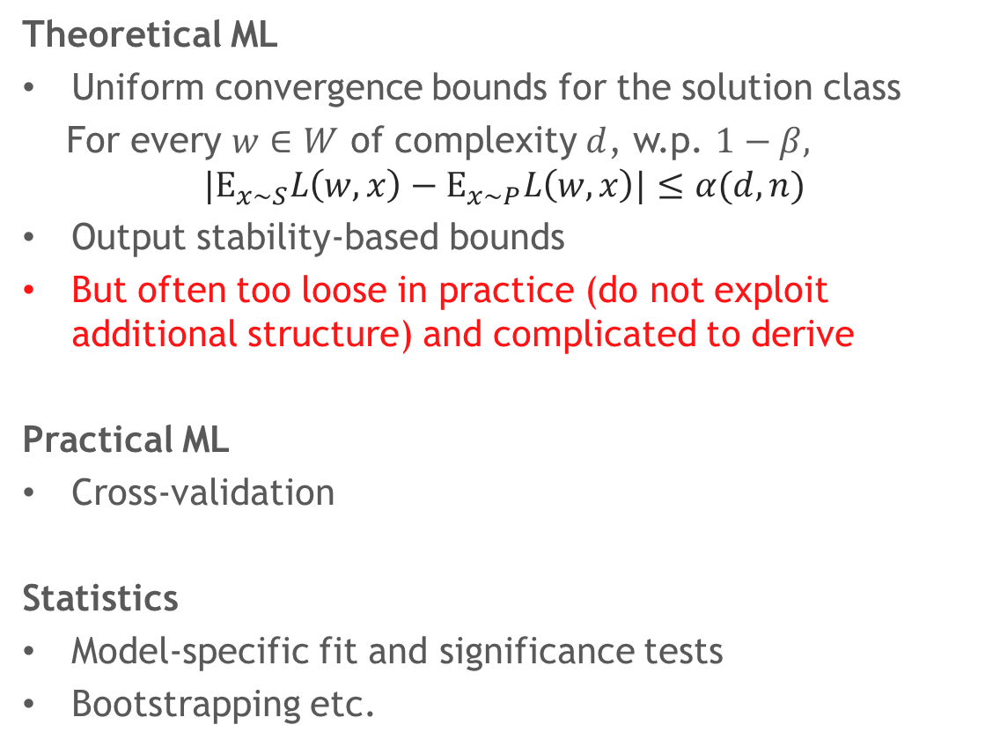
Existing approaches
Theoretical ML
Uniform convergence bounds for the solution class
For every $w∈W$ of complexity $d$, w.p. $1−β,$
$$|E_{x∼S}L\left(w,x\right)−E_{x∼P}L\left(w,x\right)|≤α(d,n)$$
Output stability-based bounds
But often too loose in practice (do not exploit additional structure) and complicated to derive
Practical ML
Cross-validation
Statistics
Model-specific fit and significance tests
Bootstrapping etc.

Slide 4

Real world is interactive
Outcomes of analyses inform future manipulations on the same data
Exploratory data analysis
Model selection
Feature selection
Hyper-parameter tuning
Public data - findings inform others
Samples are no longer i.i.d.!

Slide 5

Is the issue real?
Freedman’s paradox (1983):
Data: $R^{d}×R$
Throw away uncorrelated variables: $R^{d} →R^{d^{′}}$
Perform least squares regression over: $R^{d^{′}}$
“Such practices can distort the signiﬁcance levels of conventional statistical tests. The existence of this effect is well known, but its magnitude may come as a surprise, even to a hardened statistician.”

Slide 6

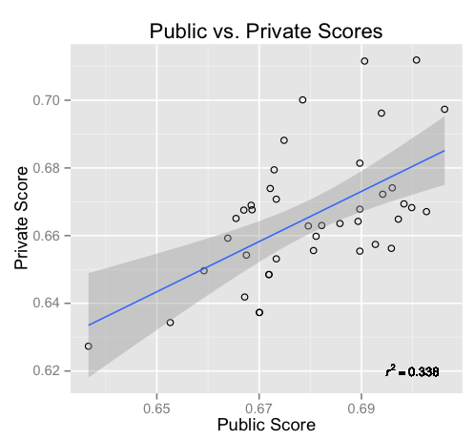
competitions
Data
Public
Private
“If you based your model solely on the data which gave you constant feedback, you run the danger of a model that overfits to the specific noise in that data.” –Kaggle FAQ.
Private data
Public score
Private score
http://www.rouli.net/2013/02/five-lessons-from-kaggles-event.html

Slide 7











Adaptive statistical queries
$$φ_{1}$$
$$v_{1}$$
$$φ_{2}$$
$$v_{2}$$
$$S$$
$$φ_{t}$$
$$v_{t}$$
SQ oracle
[K93, FGRVX13]
Learning algorithm(s)
$$φ_{i}:X→\left[0,1\right], \left|v_{i}−E_{P}\left[φ_{i}\left(x\right)\right]\right|≤τ$$
$τ$is tolerance of the query
With probability $1−β,$for all $i≤t$
Can measure error/performance and test hypotheses
Can be used in place of samples in most algorithms!

Slide 8

SQ algorithms
PAC learning algorithms (except parities)
Convex optimization (Ellipsoid, iterative methods)
Expectation maximization (EM)
SVM (with kernel)
PCA
ICA
ID3
k-means
method of moments
MCMC
Naïve Bayes
Neural Networks (backprop)
Perceptron
Nearest neighbors
Boosting
[K 93, BDMN 05, CKLYBNO 06, FPV 14]

Slide 9
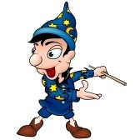
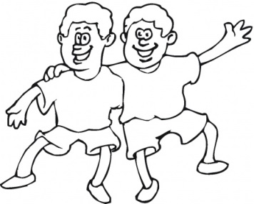
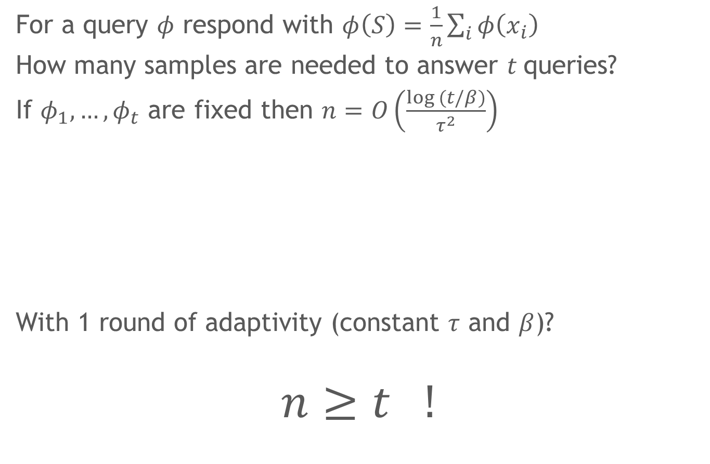
Naïve answering
For a query $φ$ respond with $φ\left(S\right)=\frac{1}{n}\sum_{i}{φ\left(x_{i}\right)}$
How many samples are needed to answer $t$queries?
If $φ_{1},…{,φ}_{t}$ are fixed then $n=O\left(\frac{log (t/β)}{τ^{2}}\right)$
With 1 round of adaptivity (constant $τ$ and $β$)?
$$n≥t !$$
Chernoff Union

Slide 10
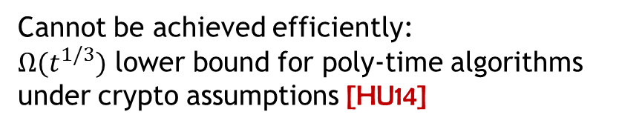

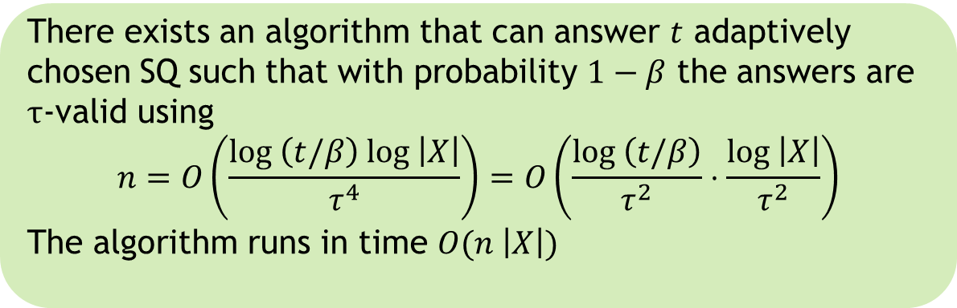
Our result
There exists an algorithm that can answer $t$ adaptively chosen SQ such that with probability $1−β$ the answers are $τ$-valid using
$$n=O\left(\frac{log \left(t/β\right) log \left|X\right|}{τ^{4}}\right)=O\left(\frac{log \left(t/β\right)}{τ^{2}}⋅\frac{log \left|X\right|}{τ^{2}}\right)$$
The algorithm runs in time $O(n \left|X\right|)$
Also: $O\left(\frac{log \left(t/β\right)}{τ^{2}}⋅\frac{\sqrt{log\left|X\right| log \left(t/β\right)log \left(1/τ\right)} }{τ^{3/2}}\right)$
Cannot be achieved efficiently:
${Ω(t}^{1/3})$ lower bound for poly-time algorithms
under crypto assumptions [HU14]

Slide 11



Data set analyzed
differentially privately
Fresh samples

Slide 12


Privacy-preserving data analysis
How to get utility from data while preserving privacy of individuals
DATA

Slide 13

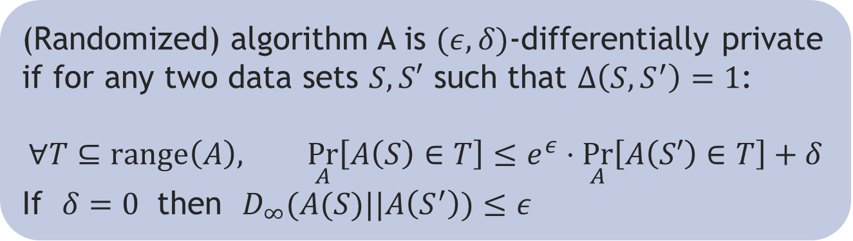
Differential Privacy
Each sample point is created from
personal data of an individual
(GTTCACG…TC, “YES”)
Differential Privacy [DMNS06]
(Randomized) algorithm A is $(ε,δ)$-differentially private if for any two data sets $S,S′$ such that $Δ\left(S,S^{′}\right)=1$:
$$∀T⊆range\left(A\right), \underset{A}{Pr}\left[A\left(S\right)∈T\right]≤e^{ε}⋅\underset{A}{Pr}\left[A\left(S′\right)∈T\right]+δ$$
If $δ=0$ then $D_{∞}(A(S)||A\left(S^{′}\right))≤ε$

Slide 14
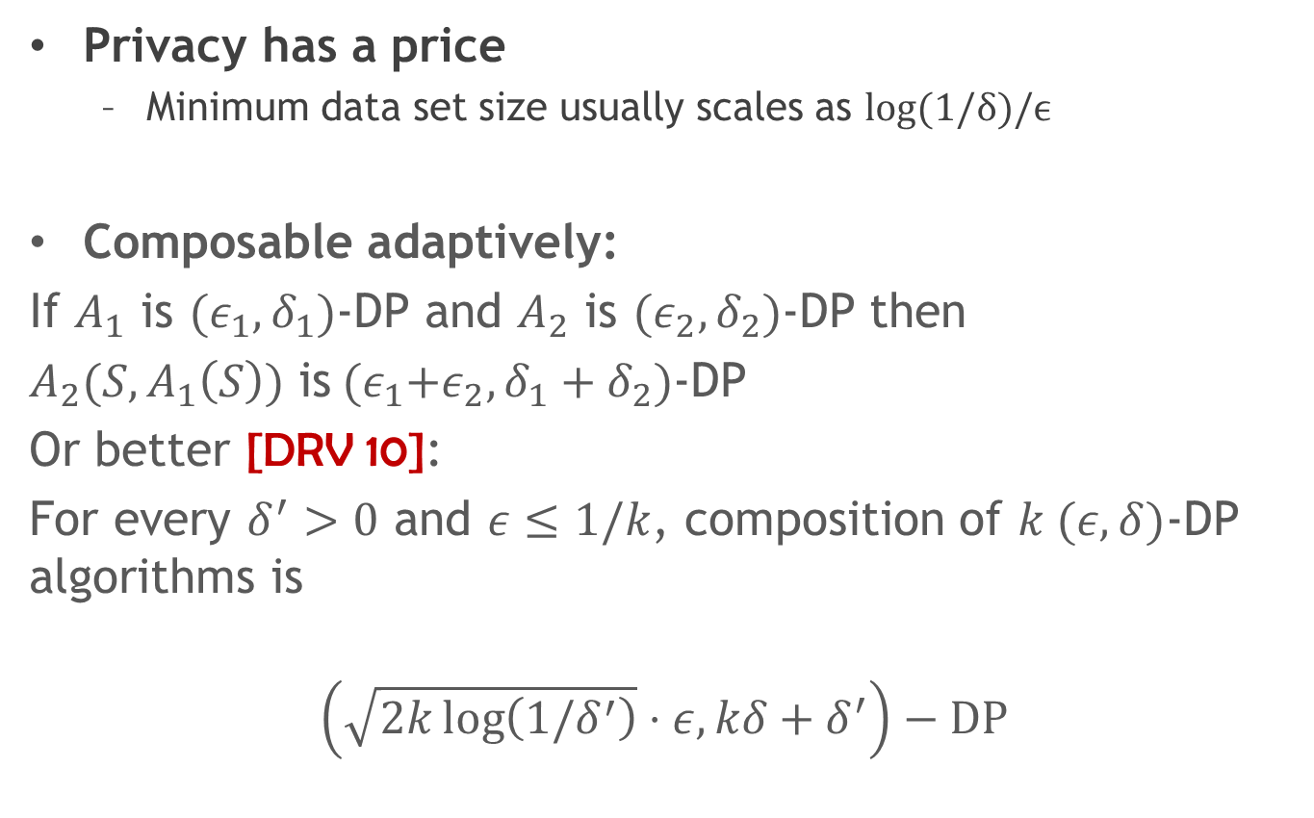
Properties of DP
Privacy has a price
Minimum data set size usually scales as $log⁡(1/δ)/ϵ$
Composable adaptively:
If $A_{1}$ is ${(ε}_{1},δ_{1})$-DP and $A_{2}$ is ${(ε}_{2},δ_{2})$-DP then
$A_{2}(S,A_{1}\left(S\right))$ is${(ε}_{1}+ε_{2},δ_{1}+δ_{2})$-DP
Or better [DRV 10]:
For every $δ^{′}>0$ and $ε≤1/k$, composition of $k (ε,δ)$-DP algorithms is
$$\left(\sqrt{2k\log\left(1/δ^{′}\right)}⋅ε, kδ+δ^{′}\right)−DP$$

Slide 15

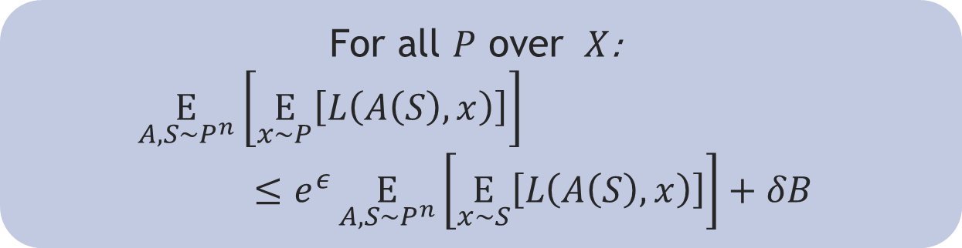
DP implies generalization
$L:W×X→[0,B]$ is a loss function
$A$ an $(ε,δ)$-DP algorithm such that $range\left(A\right)⊆ W$
For all $P$ over $X$:
$$\underset{A,S∼P^{n}}{E}\left[\underset{x∼P}{E}\left[L\left(A\left(S\right),x\right)\right]\right]≤e^{ε}\underset{A,S∼P^{n}}{E}\left[\underset{x∼S}{E}\left[L\left(A\left(S\right),x\right)\right]\right]+δB$$
DP composition implies that DP preserving algorithms can reuse data adaptively

Slide 16
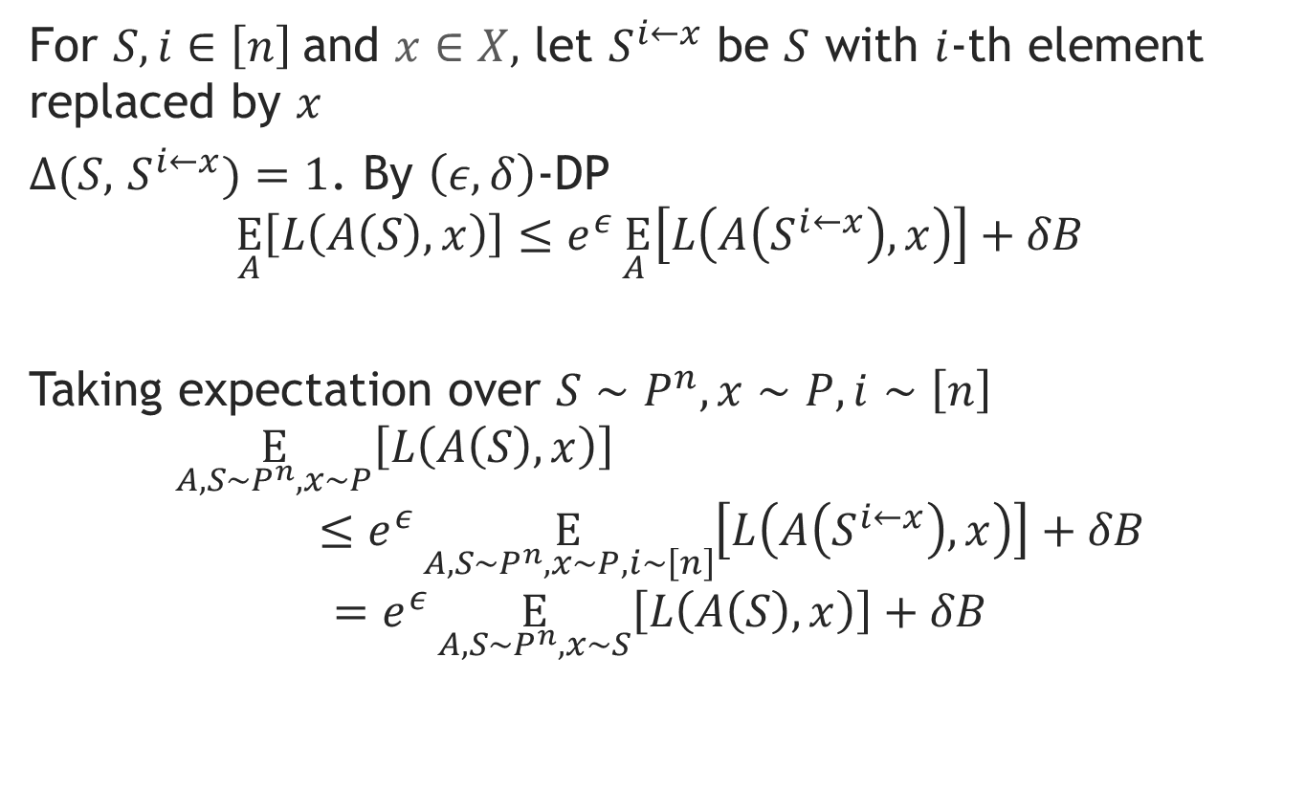
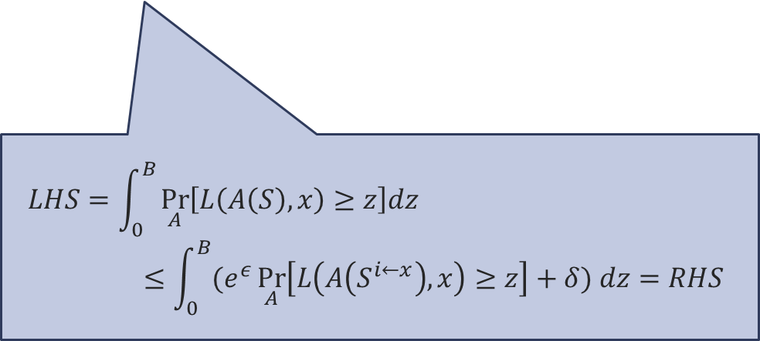
Proof
For $S,i∈\left[n\right]$and $x∈X,$ let $S^{i←x}$ be $S$ with $i$-th element replaced by $x$
$Δ(S,$ $S^{i←x})=1$. By $\left(ε,δ\right)$-DP
$$\underset{A}{E}\left[L\left(A\left(S\right),x\right)\right]≤e^{ε}\underset{A }{E}\left[L\left(A\left(S^{i←x}\right),x\right)\right]+δB$$
Taking expectation over $S∼P^{n},x∼P,i∼\left[n\right]$
$$\underset{A,S∼P^{n},x∼P}{E}\left[L\left(A\left(S\right),x\right)\right]≤e^{ε}\underset{A,S∼P^{n},x∼P,i∼\left[n\right]}{E}\left[L\left(A\left(S^{i←x}\right),x\right)\right]+δB$$
$$=e^{ε}\underset{A,S∼P^{n},x∼S}{E}\left[L\left(A\left(S\right),x\right)\right]+δB$$
$$LHS=\int_{0}^{B}{\underset{A}{Pr}\left[L\left(A\left(S\right),x\right)≥z\right]dz}≤\int_{0}^{B}{(e^{ε}\underset{A}{Pr}\left[L\left(A\left(S^{i←x}\right),x\right)≥z\right]+δ) dz}=RHS$$

Slide 17


Counting queries
Counting query on a data set $S=(x_{1},…,x_{n})$
For function $φ:X→[0,1]$, value $φ\left(S\right)=\frac{1}{n}\sum_{i}{φ(x_{i})}$
DP algorithms for approximate answering of counting queries are actively studied for ~10 years
$$φ_{1}$$
$$v_{1}$$
$$φ_{2}$$
$$v_{2}$$
$$S$$
$$φ_{t}$$
$$v_{t}$$
Data analyst(s)
Query release algorithm
$$φ_{i}:X→\left[0,1\right], \left|v_{i}−φ_{i}\left(S\right)\right|≤τ$$

Slide 18


From private counting to SQs
Let $B$ be an (adaptive) query asking strategy
Let $A$ be an algo that answers counting queries of $B$ s.t.
$A$ is $ε$-DP
For any data set $S \text{of} \text{size} n≥N(ε,τ,β)$
w.p. $≥1−β$ answers are $τ$-accurate
Then for any $P$ over $X$, $A$ applied to $S∼P^{n}$, w.p. $≥1−2β$ outputs $3τ$-valid response to SQs of $B$ provided that
$$n≥max\left\{N\left(τ,τ,β\right),\frac{4 log \left(t/β\right)}{τ^{2}}\right\}$$
Can be extended to $\left(ε,δ\right)$-DP $A$ with $log\left(\frac{1}{δ}\right)=O\left(\frac{log\left(t/β\right)\log\left(1/τ\right)}{τ}\right)$

Slide 19

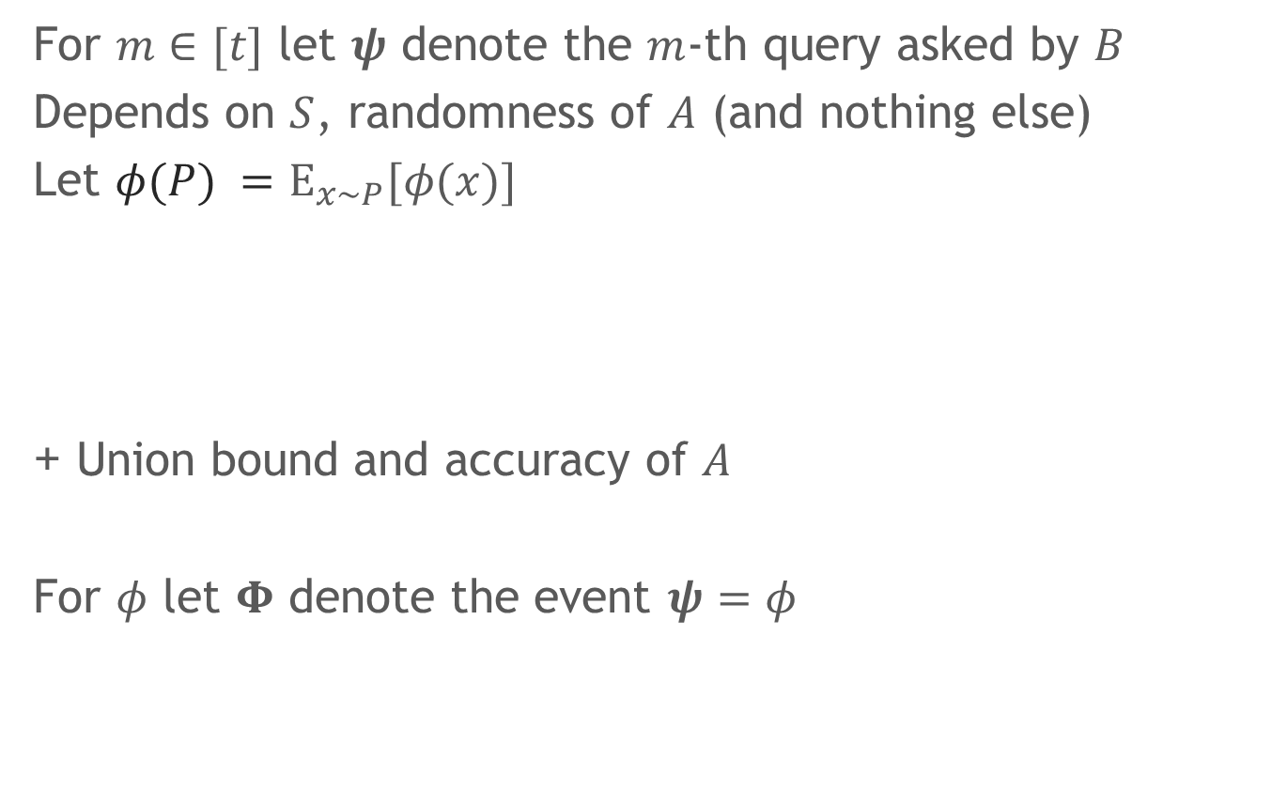

Proof I
For $m∈[t]$ let $ψ$ denote the $m$-th query asked by $B$
Depends on $S$, randomness of $A$ (and nothing else)
Let $φ(P) =E_{x∼P}[φ(x)]$
+ Union bound and accuracy of $A$
For $φ$ let $Φ$ denote the event $ψ=φ$
$$\underset{A,S∼P^{n}}{Pr}\left[\left|ψ(P)−ψ(S) \right|≥2τ\right]≤β/t$$
$$\underset{A,S∼P^{n}}{E}\left[{ψ(S)}^{k} | Φ\right]≤e^{kε}⋅\underset{S∼P^{n}}{E}\left[φ{\left(S\right)}^{k}\right]$$

Slide 20
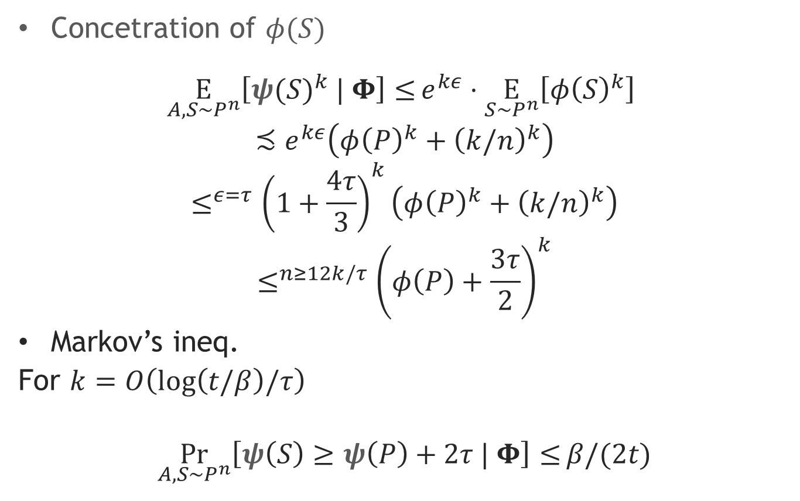
Proof II
Concetration of $φ(S)$
$$\underset{A,S∼P^{n}}{E}\left[{ψ(S)}^{k} | Φ\right]≤e^{kε}⋅\underset{S∼P^{n}}{E}\left[φ{\left(S\right)}^{k}\right]$$
$$≾e^{kε}\left(φ{\left(P\right)}^{k}+{\left(k/n\right)}^{k}\right)$$
$$≤^{ε=τ}{\left(1+\frac{4τ}{3}\right)}^{k}\left(φ{\left(P\right)}^{k}+{\left(k/n\right)}^{k}\right)$$
$$≤^{n≥12k/τ}{ \left(φ\left(P\right)+\frac{3τ}{2}\right)}^{k}$$
Markov’s ineq.
For $k=O\left(log\left(t/β\right)/τ\right)$
$$\underset{A,S∼P^{n}}{Pr}\left[ψ\left(S\right)≥ψ\left(P\right)+2τ | Φ\right]≤β/(2t)$$

Slide 21
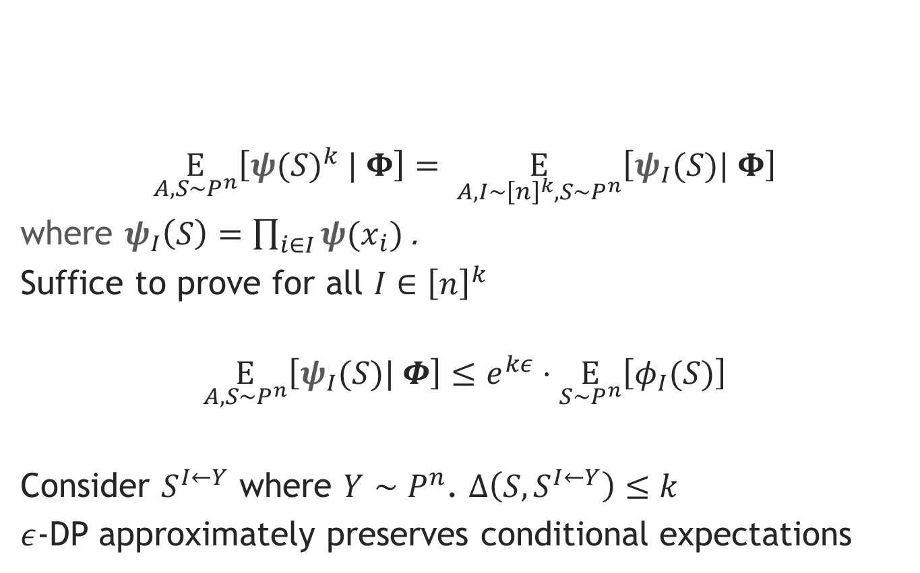

Proof: moment bound
$$\underset{A,S∼P^{n}}{E}\left[{ψ(S)}^{k} | Φ\right]≤e^{kε}⋅\underset{S∼P^{n}}{E}\left[φ{\left(S\right)}^{k}\right]$$
$$\underset{A,S∼P^{n}}{E}\left[{ψ(S)}^{k} | Φ\right]= \underset{A,I∼{\left[n\right]}^{k},S∼P^{n}}{E}\left[ψ_{I}(S)| Φ\right]$$
where $ψ_{I}\left(S\right)=\prod_{i∈I}{ψ(x_{i})}$.
Suffice to prove for all $I∈{\left[n\right]}^{k}$
$$\underset{A,S∼P^{n}}{E}\left[ψ_{I}(S)| Φ\right]≤e^{kε}⋅\underset{S∼P^{n}}{E}\left[φ_{I}(S)\right]$$
Consider $S^{I←Y}$ where $Y∼P^{n}$. $Δ\left(S,S^{I←Y}\right)≤k$
$ε$-DP approximately preserves conditional expectations

Slide 22
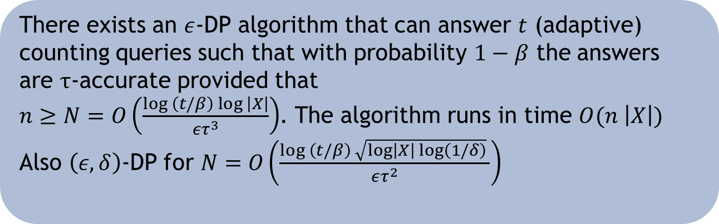
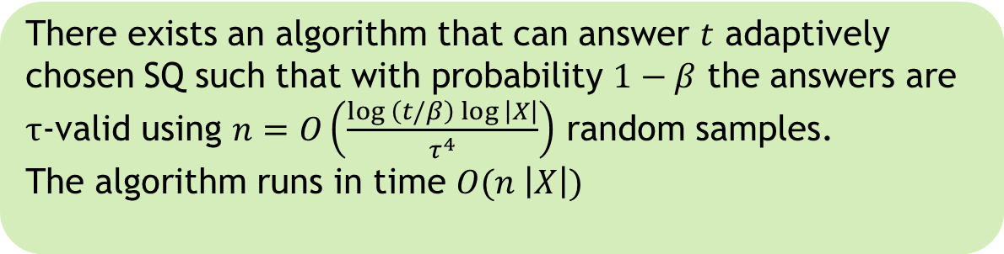
Corollaries
There exists an $ε$-DP algorithm that can answer $t$ (adaptive) counting queries such that with probability $1−β$ the answers are $τ$-accurate provided that
$n≥N=O\left(\frac{log \left(t/β\right) log \left|X\right|}{ετ^{3}}\right)$. The algorithm runs in time $O(n \left|X\right|)$
Also $\left(ε,δ\right)$-DP for $N=O\left(\frac{log \left(t/β\right) \sqrt{log\left|X\right| log\left(1/δ\right)} }{ετ^{2}}\right)$
[HR10]
There exists an algorithm that can answer $t$ adaptively chosen SQ such that with probability $1−β$ the answers are $τ$-valid using $n=O\left(\frac{log \left(t/β\right) log \left|X\right|}{τ^{4}}\right)$ random samples.
The algorithm runs in time $O(n \left|X\right|)$

Slide 23
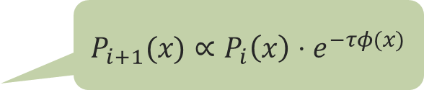
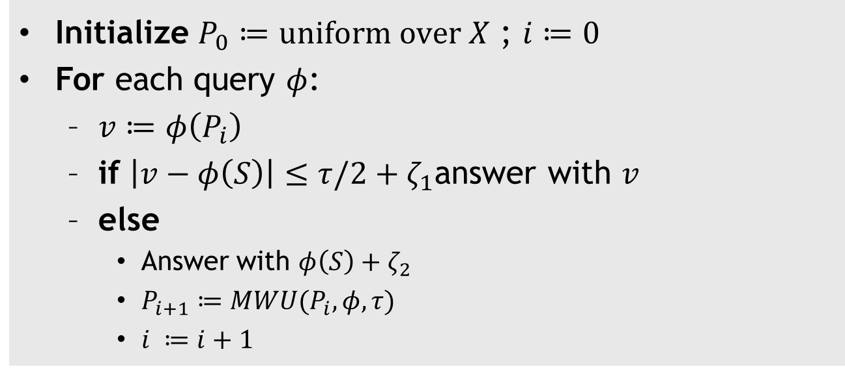
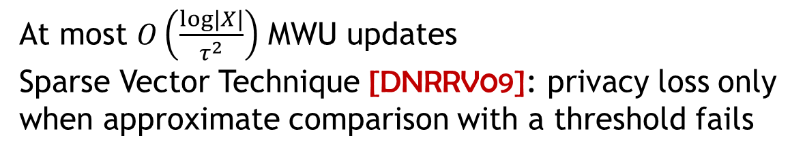
MWU + Sparse Vector
Initialize $P_{0}≔uniform over X$ ; $i≔0$
For each query $φ$:
$v≔φ\left(P_{i}\right)$
if $\left|v−φ\left(S\right)\right|≤τ/2+ζ_{1}$answer with $v$
else
Answer with $φ\left(S\right)+ζ_{2}$
$P_{i+1}≔MWU(P_{i},φ, τ)$
$i ≔i+1$
Laplace noise
$P_{i+1}(x)∝$ $P_{i}\left(x\right)⋅e^{−τφ(x)}$
At most $O\left(\frac{log\left|X\right|}{τ^{2}}\right)$ MWU updates
Sparse Vector Technique [DNRRV09]: privacy loss only when approximate comparison with a threshold fails

Slide 24

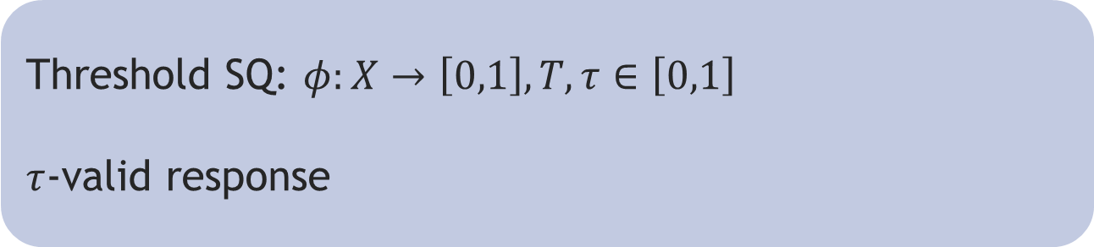
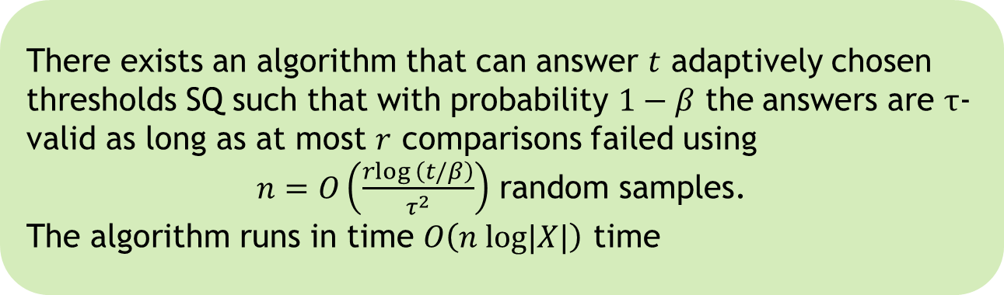
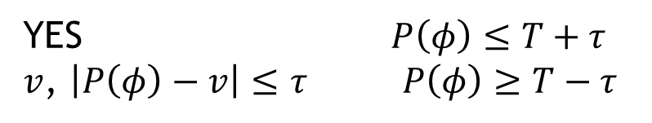
Threshold validation queries
Threshold SQ: $φ:X→\left[0,1\right], T,τ∈\left[0,1\right]$
$τ$-valid response
$$\{$$
YES $P\left(φ\right)≤T+τ$
$v$, $\left|P\left(φ\right)−v\right|≤τ$ $P\left(φ\right)≥T−τ$
There exists an algorithm that can answer $t$ adaptively chosen thresholds SQ such that with probability $1−β$ the answers are $τ$-valid as long as at most $r$ comparisons failed using
$n=O\left(\frac{rlog \left(t/β\right)}{τ^{2}}\right)$ random samples.
The algorithm runs in time $O\left(n log|X|\right)$ time

Slide 25





Applications
DATA
$$S$$
Working set
$$S_{1}$$
Validation set
$$S_{2}$$
$$φ_{1}$$
$$v_{1}$$
$$φ_{2},T_{2}$$
$$v_{2}$$
$$S_{2}$$
$$φ_{t}$$
$$v_{t}$$
SQ oracle
Learning algorithm(s)

Slide 26
Conclusions
Adaptive data manipulations can cause overfitting/false discovery
Theoretical model of the problem based on SQs
Using exact empirical means is risky
DP provably preserves “freshness” of samples: adding noise can provably prevent overfitting
In applications not all data must be used with DP

Slide 27

Future work
Better (direct) bounds on $n$?
Is $log |X|$ necessary?
Better dependence on $δ$?
Efficient algorithms for special cases?
Practical implementations?
THANKS!

