Slide 1


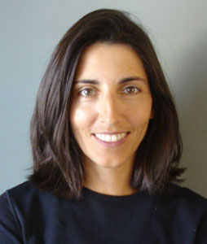

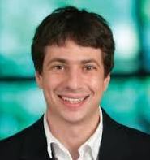
Preserving Statistical Validity in Adaptive Data Analysis
Vitaly Feldman
IBM Research - Almaden
Cynthia Dwork Moritz Hardt Toni Pitassi Omer Reingold Aaron Roth
Microsoft Res. Google Res. U. of Toronto Samsung Res. Penn, CS

Slide 2


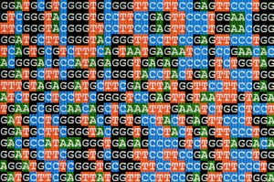


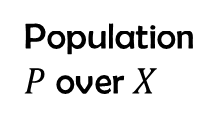
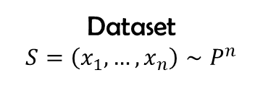
Population
$P$ over $X$
Param. estimates
Correlations
Predictive model
Classifier,
Clustering
etc.
Dataset
$$S=\left(x_{1},…,x_{n}\right)∼P^{n}$$
Findings
Analysis

Slide 3
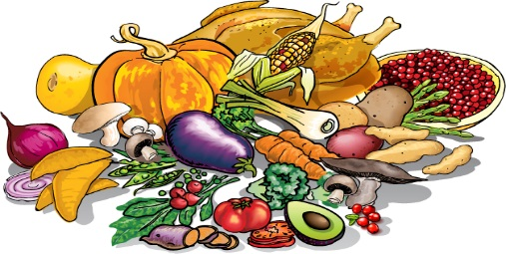


Data Science 101
Does student nutrition affect academic performance?
Normalized grade
50
100

Slide 4
Check correlations

Slide 5



Pick candidate foods

Slide 6


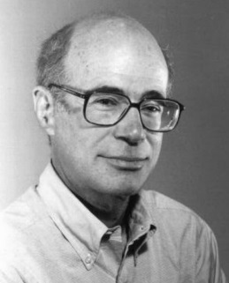
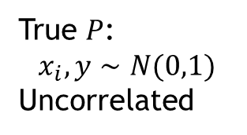

Fit linear function of 3 selected foods
SUMMARY OUTPUT
Regression Statistics
Multiple R | 0.4453533
R Square | 0.1983396
Adjusted R Square | 0.1732877
Standard Error | 1.0041891
Observations | 100
ANOVA
 | df | SS | MS | F | Significance F
Regression | 3 | 23.95086544 | 7.983622 | 7.917151 | 8.98706E-05
Residual | 96 | 96.80600126 | 1.008396
Total | 99 | 120.7568667
 | Coefficients | Standard Error | t Stat | P-value
Intercept | -0.044248 | 0.100545016 | -0.44008 | 0.660868
Mushroom | -0.296074 | 0.10193011 | -2.90468 | 0.004563
Pumpkin | 0.255769 | 0.108443069 | 2.358555 | 0.020373
Nutella | 0.2671363 | 0.095186165 | 2.806462 | 0.006066
FALSE
DISCOVERY
$$≈0.0001<0.05$$
True $P$:
$$x_{i},y∼N(0,1)$$
Uncorrelated
Freedman’s Paradox:
“Such practices can distort the signiﬁcance levels of conventional statistical tests. The existence of this effect is well known, but its magnitude may come as a surprise, even to a hardened statistician.” (1983)

Slide 7
Statistical inference
Data
Data
Data
“Fresh” data
Procedure
Hypothesis tests
Regression
Learning
Result and statistical guarantees
p-values
confidence intervals
prediction intervals

Slide 8

Data analysis is adaptive
Data
Data
Data
Exploratory data analysis
Variable selection
Hyper-parameter tuning
Shared data - findings inform others
Result
Result
Result
Result
Notes:
Mention that had we unlimited amount of data that would not be an issue.

Slide 9
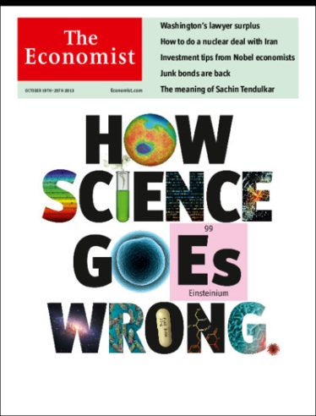
Is this a real problem?
“Why Most Published Research Findings Are False” [Ioannidis 05]
1,000,000+ downloads; 1400+ citations
“Irreproducible preclinical research exceeds 50%,
resulting in approximately US$28B/year loss”
[Freedman,Cockburn,Simcoe 15]
Adaptive data analysis is one of the causes
In the course of collecting and analyzing data, researchers have many decisions to make […] It is rare, and sometimes impractical, for researchers to make all these decisions beforehand. Rather, it is common (and accepted practice) for researchers to explore various analytic alternatives, to search for a combination that yields “statistical significance”, and to then report only what “worked”. [Simmons,Nelson,Simonsohn 11]

Slide 10











Evaluating adaptive queries
$$φ_{1}$$
$$v_{1}$$
$$φ_{2}$$
$$v_{2}$$
$$S$$
$$φ_{m}$$
$$v_{m}$$
Statistical query oracle
[Kearns 93]
$$S=\left(x_{1},…,x_{n}\right)∼P^{n}$$
Data analyst(s)
$$φ_{i}:X→\left[0,1\right]$$
$$\left|v_{i}−E_{x∼P}\left[φ_{i}\left(x\right)\right]\right|≤τ$$
with prob. $1−β$
Can measure correlations, moments, accuracy/error, parameters and run any SQ-based algorithm!

Slide 11
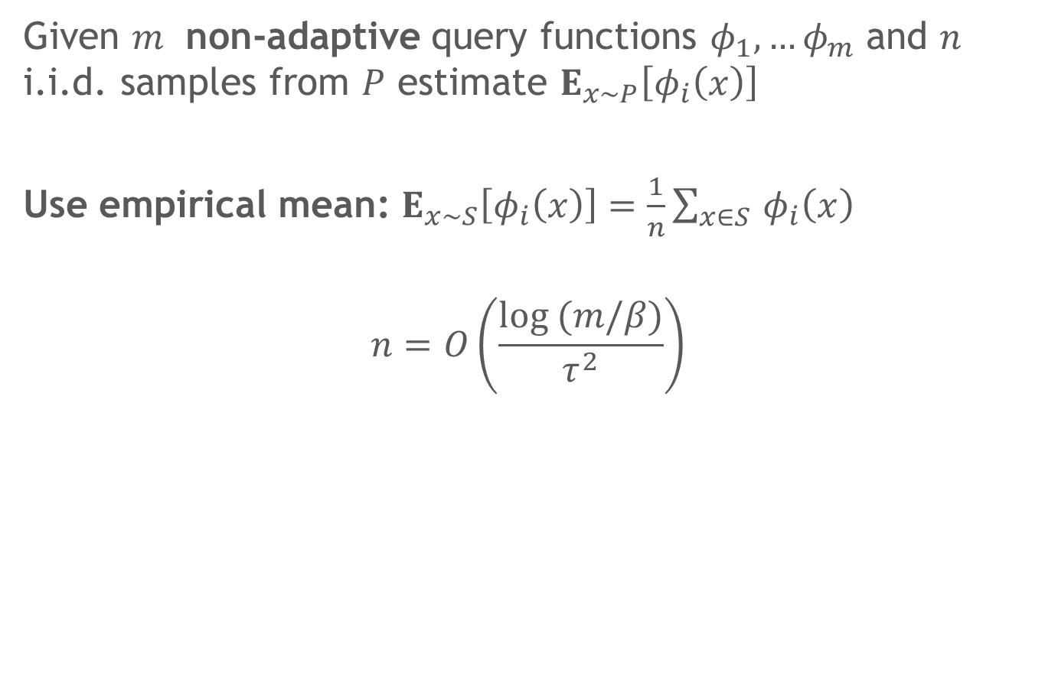
Answering non-adaptive SQs
Given $m$ non-adaptive query functions $φ_{1},…φ_{m}$ and $n$ i.i.d. samples from $P$ estimate $E_{x∼P}\left[φ_{i}\left(x\right)\right]$
Use empirical mean: $E_{x∼S}\left[φ_{i}\left(x\right)\right]=\frac{1}{n}\sum_{x∈S }{φ_{i}\left(x\right)}$
$$n=O\left(\frac{log (m/β)}{τ^{2}}\right)$$

Slide 12
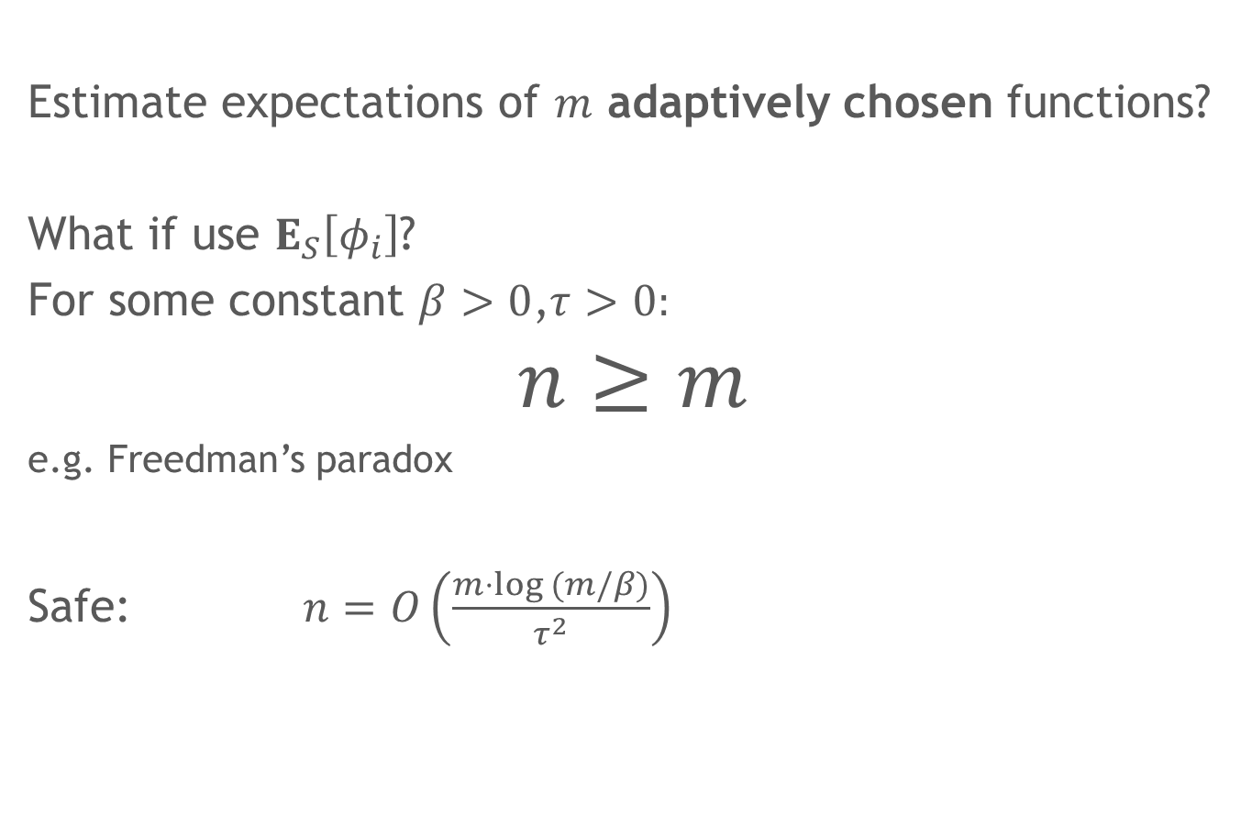
Answering adaptive SQs
Estimate expectations of $m$ adaptively chosen functions?
What if use $E_{S}\left[φ_{i}\right]$?
For some constant $β>0$,$τ>0:$
$$n≥m$$
e.g. Freedman’s paradox
Safe: $n=O\left(\frac{m⋅log (m/β)}{τ^{2}}\right)$

Slide 13
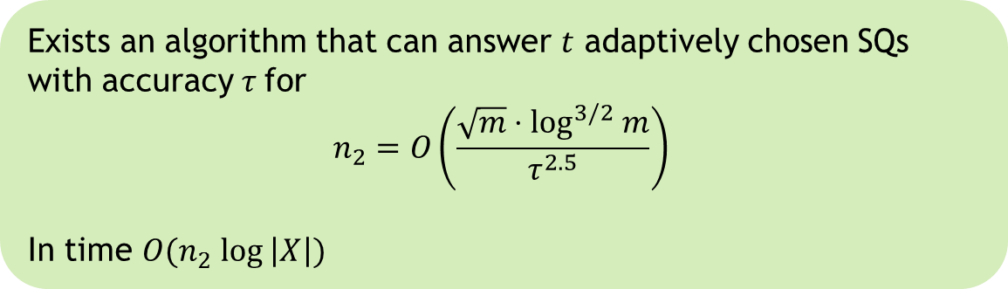
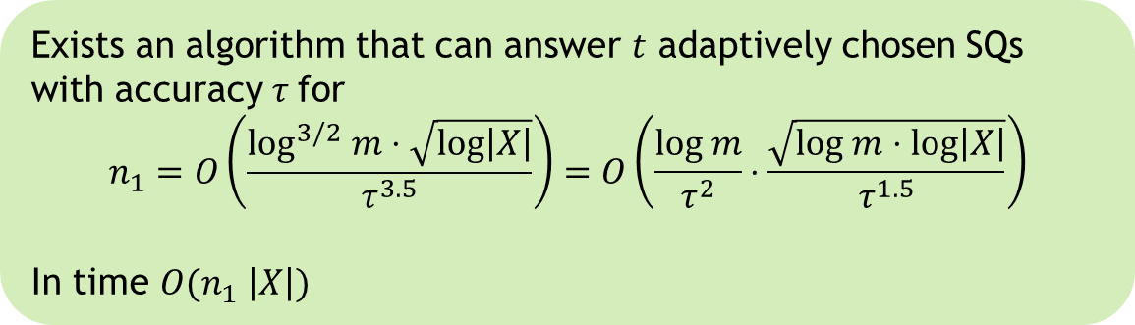

Our results
Exists an algorithm that can answer $t$ adaptively chosen SQs with accuracy $τ$ for
$$n_{1}=O\left(\frac{\log^{3/2} m⋅\sqrt{log\left|X\right|}}{τ^{3.5}}\right)=O\left(\frac{log m}{τ^{2}}⋅\frac{\sqrt{log m⋅log\left|X\right|}}{τ^{1.5}}\right)$$
In time $O(n_{1} \left|X\right|)$
Exists an algorithm that can answer $t$ adaptively chosen SQs with accuracy $τ$ for
$$n_{2}=O\left(\frac{\sqrt{m}⋅\log^{3/2} m}{τ^{2.5}}\right)$$
In time $O(n_{2} log \left|X\right|)$
Previously:
$O\left(\frac{m⋅ log m}{τ^{2}}\right)$

Slide 14


Tool: differential privacy
DATA

Slide 15

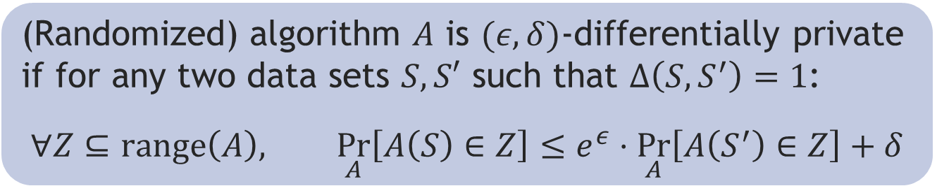
Differential Privacy [Dwork,McSherry,Nissim,Smith 06]
S
Frank
Aaron
Cynthia
Chris
Kobbi
Adam
Algorithm
ratio bounded
$$\underset{A}{Pr}{[r]}$$
(Randomized) algorithm $A$ is $(ε,δ)$-differentially private if for any two data sets $S,S′$ such that $Δ\left(S,S^{′}\right)=1$:
$$∀Z⊆range\left(A\right), \underset{A}{Pr}\left[A\left(S\right)∈Z\right]≤e^{ε}⋅\underset{A}{Pr}\left[A\left(S^{′}\right)∈Z\right]+δ$$

Slide 16








Why DP?
DP composes
adaptively
$$X^{n}$$
A
$$Y$$
$$ε_{1}, δ_{1}$$
$$Y$$
$$X^{n}$$
B
$$ε_{2}, δ_{2}$$
$$Y′$$

Slide 17


Why DP?
DP composes
adaptively
$$X^{n}$$
A
B
$$Y′$$
$$ε_{1}+ε_{2}, δ_{1}+δ_{2}$$

Slide 18


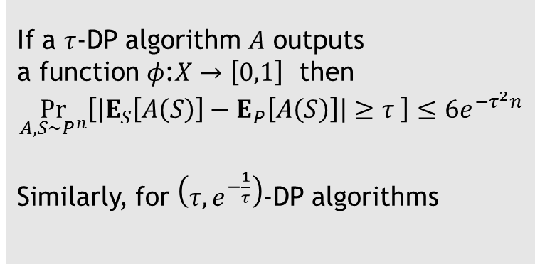

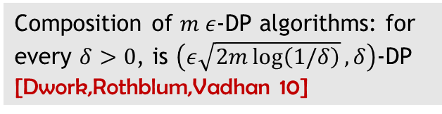
Why DP?
DP composes
adaptively
DP implies
generalization
If a $τ$-DP algorithm $A$ outputs
a function $φ$:$X→\left[0,1\right]$ then
$$\underset{A,S∼P^{n}}{Pr}\left[\left|E_{S}\left[A\left(S\right)\right]−E_{P}\left[A\left(S\right)\right]\right|≥τ \right]≤{6e}^{{−τ}^{2}n}$$
Similarly, for $\left(τ,e^{−\frac{1}{τ}}\right)$-DP algorithms
Composition of $m ε$-DP algorithms: for every $δ>0$, is $\left(ε\sqrt{2m\log\left(1/δ\right)},δ\right)$-DP
[Dwork,Rothblum,Vadhan 10]
Folklore: $\left|\underset{A,S∼P^{n}}{E}\left[E_{S}\left[A\left(S\right)\right]−E_{P}\left[A\left(S\right)\right] \right]\right|≤τ$

Slide 19
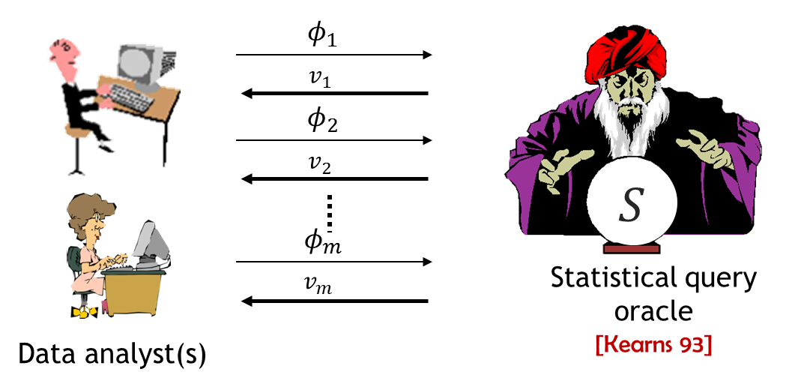

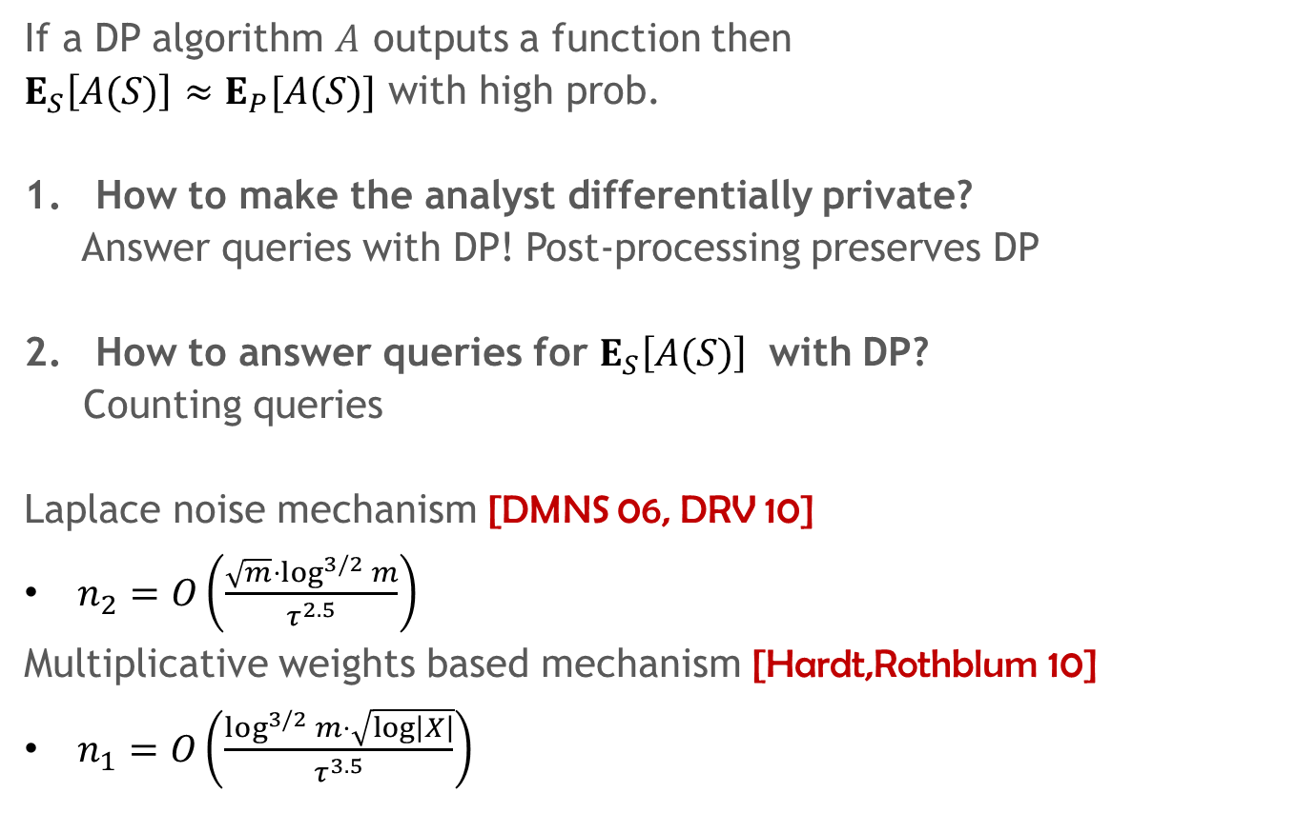
Back to queries
If a DP algorithm $A$ outputs a function then
$E_{S}\left[A(S)\right]≈E_{P}[A(S)]$ with high prob.
How to make the analyst differentially private?
Answer queries with DP! Post-processing preserves DP
How to answer queries for $E_{S}\left[A(S)\right]$ with DP?
Counting queries
Laplace noise mechanism [DMNS 06, DRV 10]
$n_{2}=O\left(\frac{\sqrt{m}⋅\log^{3/2} m}{τ^{2.5}}\right)$
Multiplicative weights based mechanism [Hardt,Rothblum 10]
$n_{1}=O\left(\frac{\log^{3/2} m⋅\sqrt{log\left|X\right|}}{τ^{3.5}}\right)$

Slide 20

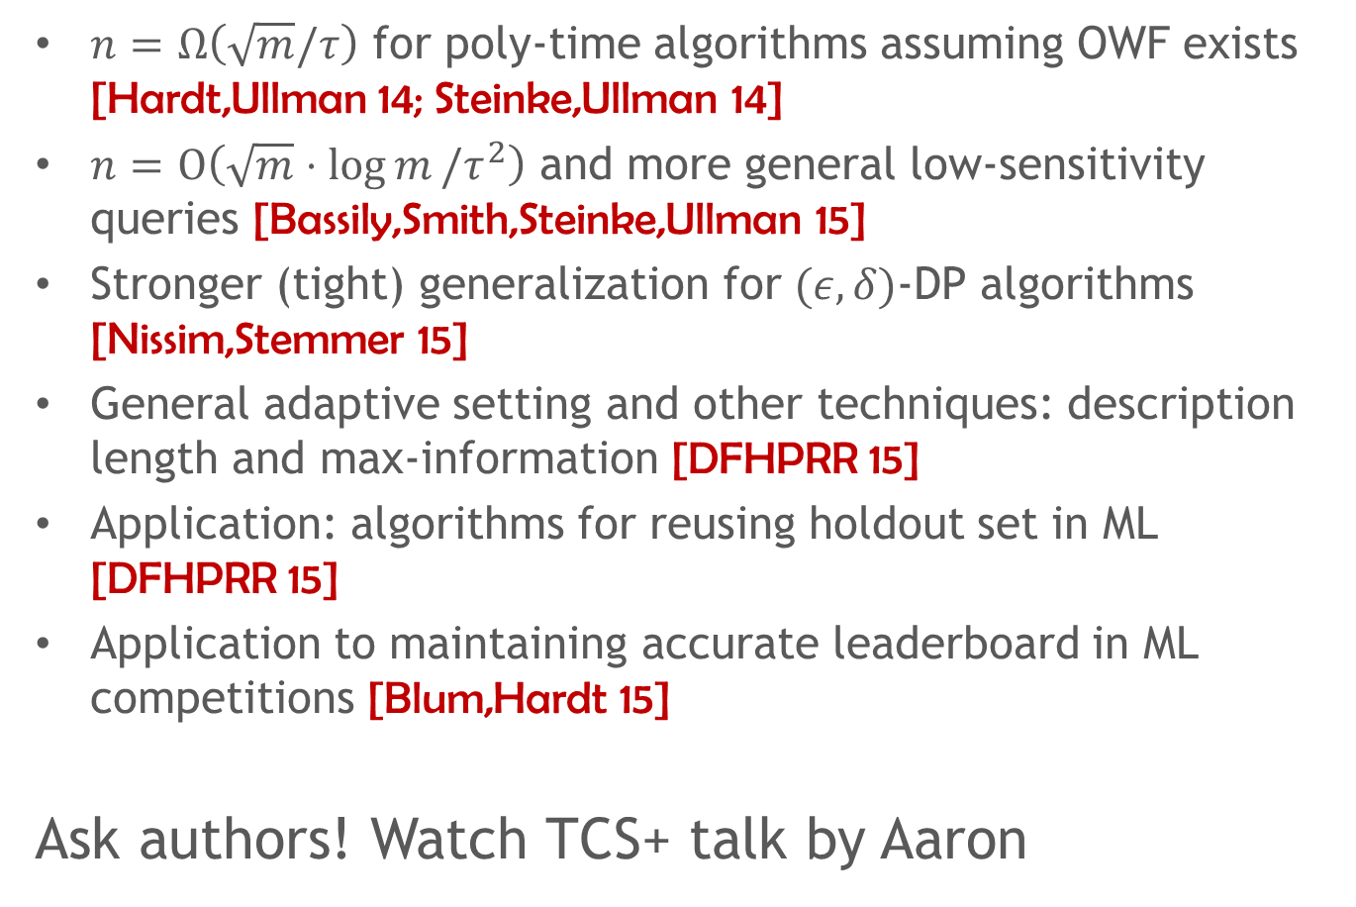
Further developments
$n=$ $Ω\left(\sqrt{m}/τ\right)$ for poly-time algorithms assuming OWF exists [Hardt,Ullman 14; Steinke,Ullman 14]
$n=$ $O\left(\sqrt{m}⋅\log{m}/τ^{2}\right)$ and more general low-sensitivity queries [Bassily,Smith,Steinke,Ullman 15]
Stronger (tight) generalization for $(ε,δ)$-DP algorithms [Nissim,Stemmer 15]
General adaptive setting and other techniques: description length and max-information [DFHPRR 15]
Application: algorithms for reusing holdout set in ML [DFHPRR 15]
Application to maintaining accurate leaderboard in ML competitions [Blum,Hardt 15]
Ask authors! Watch TCS+ talk by Aaron

Slide 21
