Slide 1
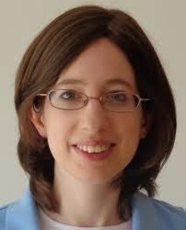
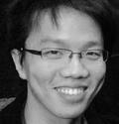
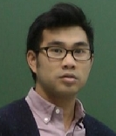

Approximate resilience, Monotonicity, and the Complexity of agnostic learning
Vitaly Feldman
IBM Research – Almaden
Dana Dachman-Soled Li-Yang Tan Andrew Wan Karl Wimmer
UMD Simons Inst. IDA Duquesne
SODA, 2015

Slide 2
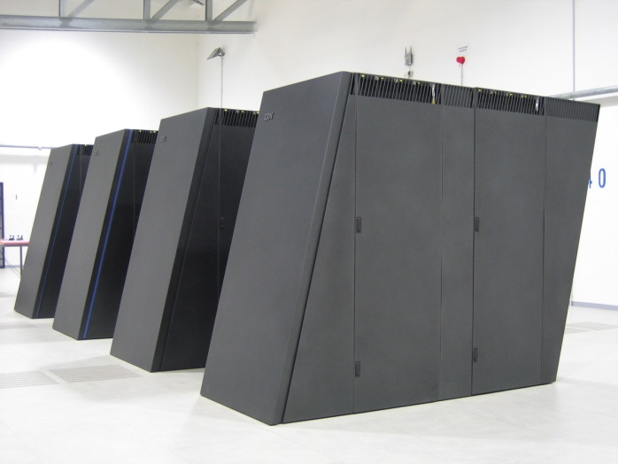
Learning from examples
-
-
Learning algorithm
+
+
-
-
+
-
-
-
+
-
+
-
+
+
Labeled examples
Classifier

Slide 3

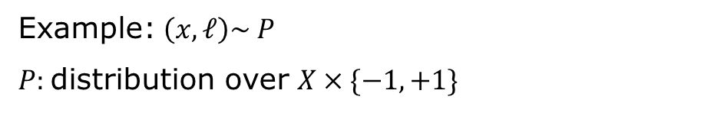
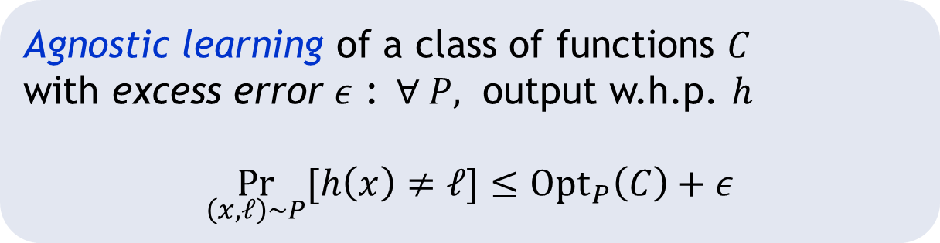
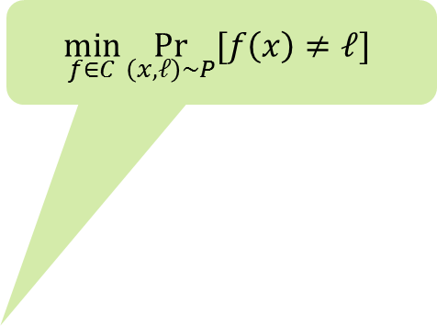
Agnostic learning [V 84; H 92; KSS 94]
-
-
-
+
Example: $\left(x,ℓ\right)\sim P$
$P:$distribution over $X×\{−1,+1\}$
-
+
+
-
-
+
-
$$h$$
-
+
-
+
+
$$\min_{f∈C}{\underset{\left(x,ℓ\right)∼P}{Pr}{[f\left(x\right)≠ℓ]}}$$
Agnostic learning of a class of functions $C$
with excess error $ε$ :$∀ P,$ output w.h.p. $h$
$$\underset{\left(x,ℓ\right)∼P}{Pr}{[h\left(x\right)≠ℓ]}≤Opt_{P}\left(C\right)+ε$$

Slide 4
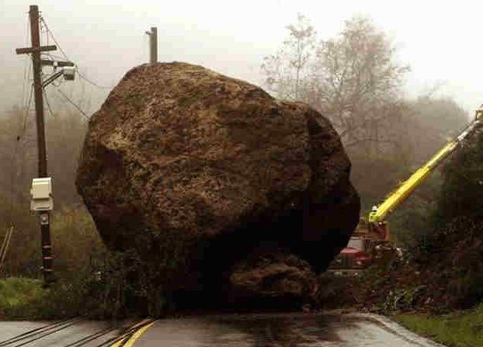

Complexity of agnostic learning
Too hard
Conjunctions over ${\left\{0,1\right\}}^{n}$: $n^{O(\sqrt{n})}$for$ε=Ω\left(1\right)$ [KKMS 05]
… but can’t prove lower bounds

Slide 5
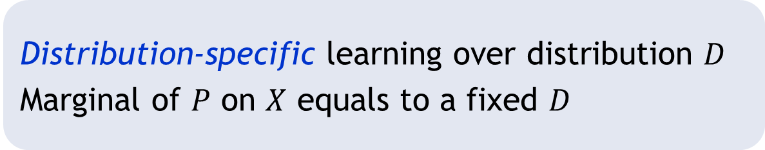

Complexity of agnostic learning
For uniform distribution $U$ over ${\left\{0,1\right\}}^{n}$
Conjunctions: $n^{O(\log{1/ε})}$
Halfspaces: $n^{O(1/ε^{4})}$ [KKMS 05]; $n^{\tilde{O}(1/ε^{2})}$ [FKV 14]
Monotone juntas?
Distribution-specific learning over distribution $D$
Marginal of $P$ on $X$ equals to a fixed $D$

Slide 6
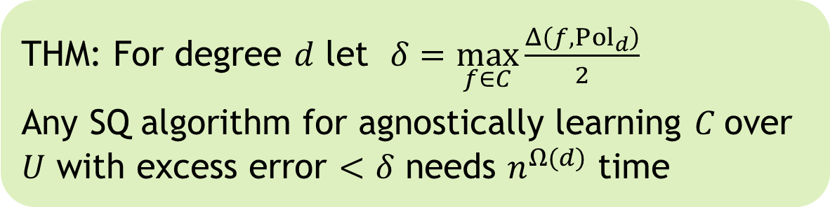

Our characterization
${\left|g\right|}_{1}=E_{x∼U}\left[\left|g\left(x\right)\right|\right]$
${Pol}_{d}$ : polynomials of degree $d$ over $n$ vars
$Δ\left(f,{Pol}_{d}\right)=\min_{p∈P_{d}}{{\left|f−p\right|}_{1 }}$
* $C$ is closed under renaming of variables; $d≤\sqrt[3]{n}$
THM: For degree $d$ let $δ=\max_{f∈C}\frac{Δ\left(f,{Pol}_{d}\right)}{2}$
Any SQ algorithm for agnostically learning $C$over $U$ with excess error $<δ$ needs $n^{Ω(d)}$ time

Slide 7
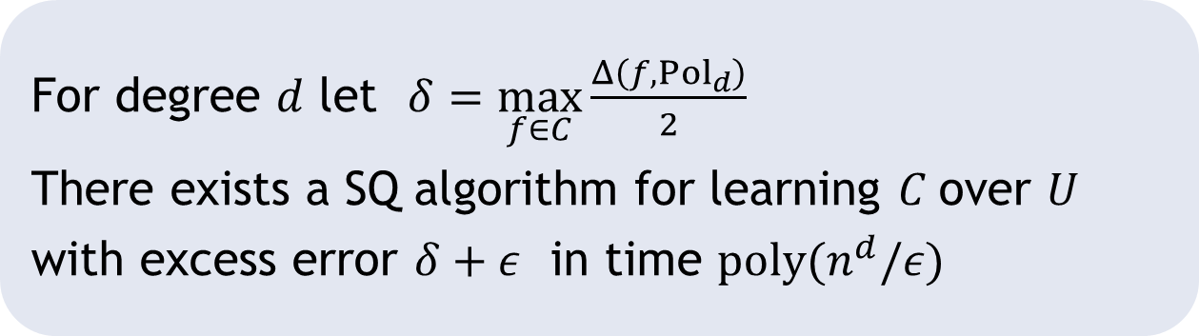

Polynomial $L_{1}$ regression [KKMS 05]
For degree $d$ let $δ=\max_{f∈C}\frac{Δ\left(f,{Pol}_{d}\right)}{2}$
There exists a SQ algorithm for learning $C$over $U$
with excess error $δ+ε$ in time $poly(n^{d}/ε)$

Slide 8





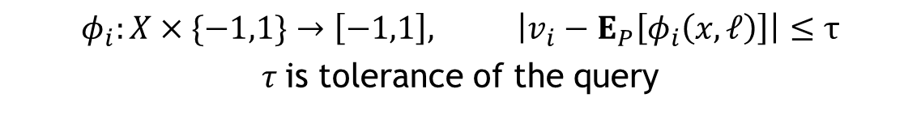




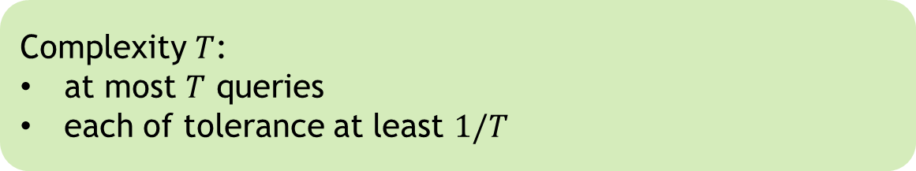
Statistical queries [Kearns 93]
$$φ_{1}$$
$$v_{1}$$
$$φ_{2}$$
$$v_{2}$$
$$P$$
$$φ_{t}$$
SQ learning algorithm
$$v_{t}$$
SQ oracle
$$φ_{i}:X×\{−1,1\}→\left[−1,1\right], \left|v_{i}−E_{P}\left[φ_{i}\left(x,ℓ\right)\right]\right|≤τ$$
$τ$is tolerance of the query
Complexity $T$:
at most $T$ queries
each of tolerance at least $1/T$

Slide 9
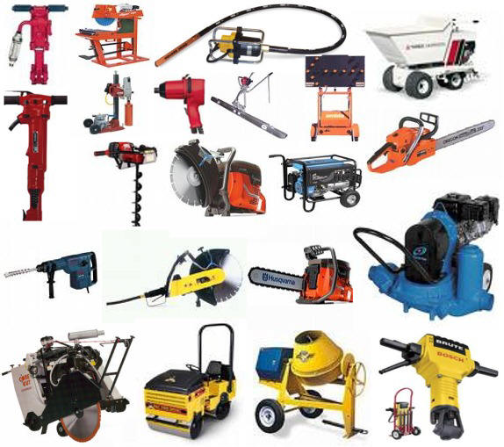
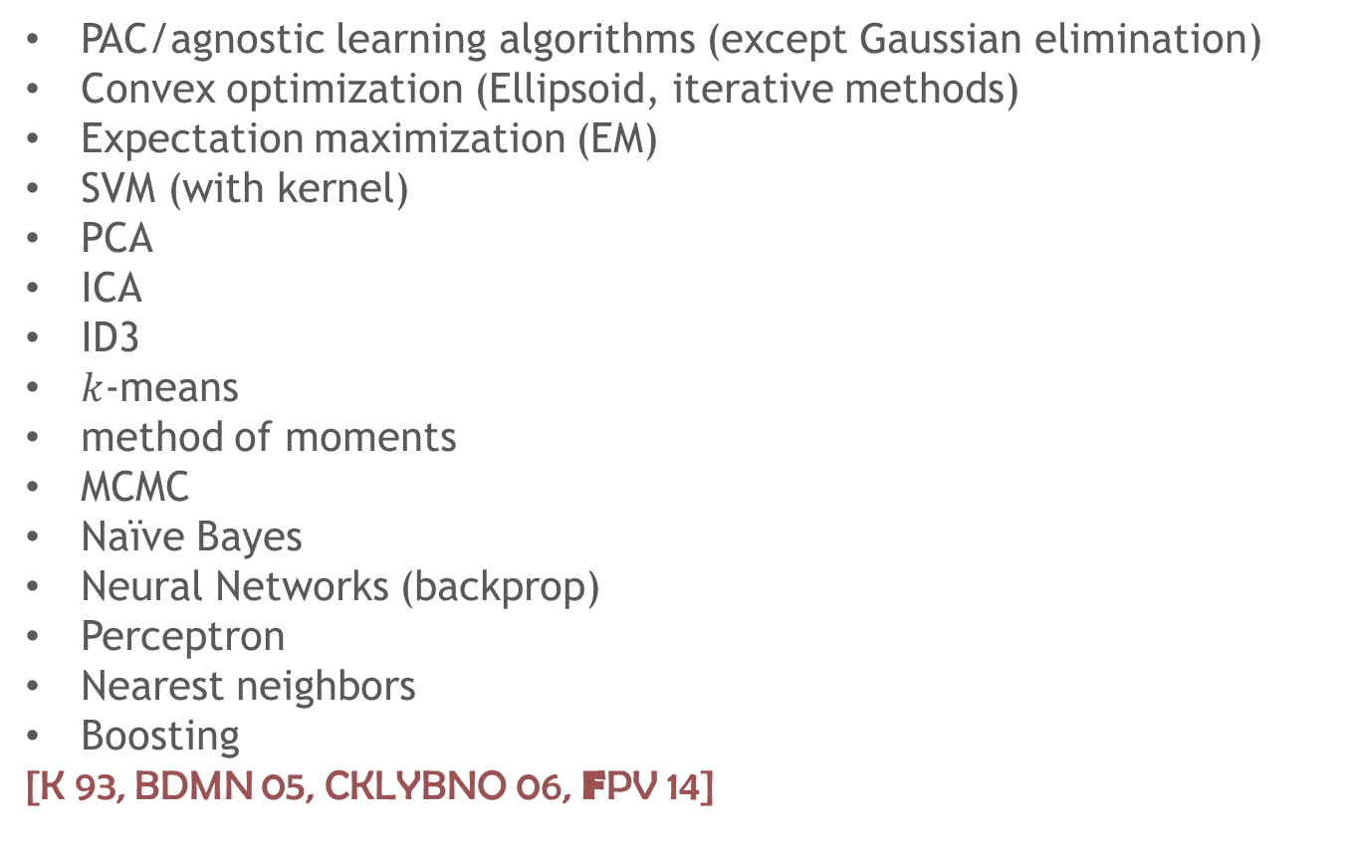
SQ algorithms
PAC/agnostic learning algorithms (except Gaussian elimination)
Convex optimization (Ellipsoid, iterative methods)
Expectation maximization (EM)
SVM (with kernel)
PCA
ICA
ID3
$k$-means
method of moments
MCMC
Naïve Bayes
Neural Networks (backprop)
Perceptron
Nearest neighbors
Boosting
[K 93, BDMN 05, CKLYBNO 06, FPV 14]

Slide 10
Roadmap
Proof: approximate resilience
Tools: analysis of approximate resilience
Application: monotone functions
Open problems

Slide 11
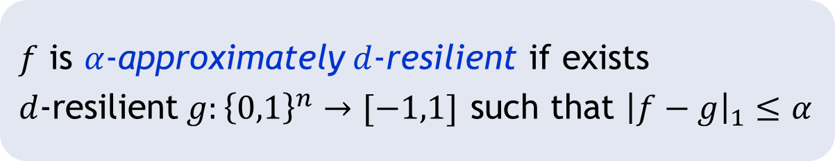
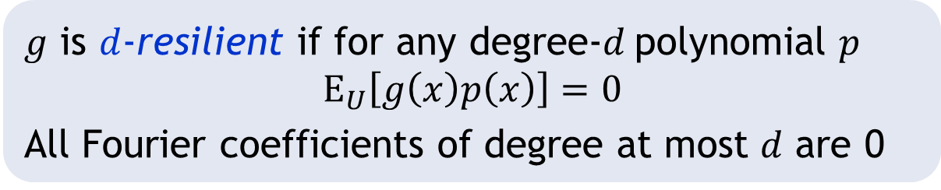
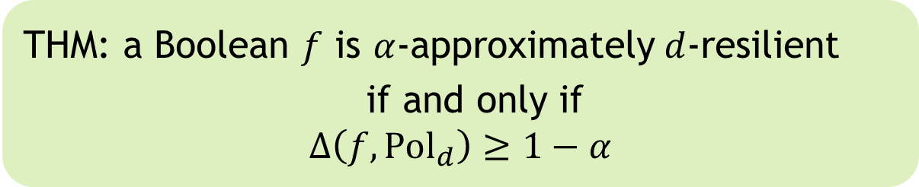
Approximate resilience
$g$ is $d$-resilient if for any degree-$d$polynomial $p$
$$E_{U}\left[g\left(x\right)p\left(x\right)\right]=0$$
All Fourier coefficients of degree at most $d$ are 0
$f$ is $α$-approximately$d$-resilient if exists
$d$-resilient$g:{\left\{0,1\right\}}^{n}→[−1,1]$ such that ${\left|f−g\right|}_{1}≤α$
THM: a Boolean $f$ is $α$-approximately$d$-resilient
if and only if
$$Δ\left(f,{Pol}_{d}\right)≥1−α$$

Slide 12
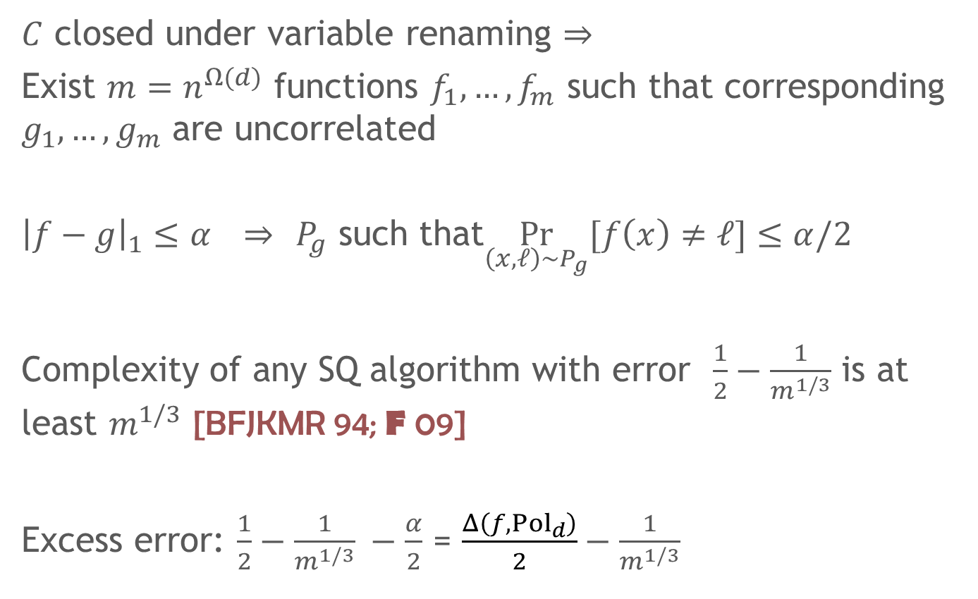
From approx. resilience to SQ hardness
$C$ closed under variable renaming $⇒$
Exist $m=n^{Ω(d)}$ functions $f_{1},…{,f}_{m}$ such that corresponding $g_{1},…,g_{m}$ are uncorrelated
${\left|f−g\right|}_{1}≤α$ $⇒$ $P_{g}$ such that$\underset{\left(x,ℓ\right)∼P_{g}}{Pr}{[f\left(x\right)≠ℓ]}≤α/2$
Complexity of any SQ algorithm with error $\frac{1}{2}−\frac{1}{m^{1/3}}$ is at least $m^{1/3}$ [BFJKMR 94; F 09]
Excess error: $\frac{1}{2}−\frac{1}{m^{1/3}} −\frac{α}{2}$ = $\frac{Δ\left(f,{Pol}_{d}\right)}{2}−\frac{1}{m^{1/3}}$

Slide 13
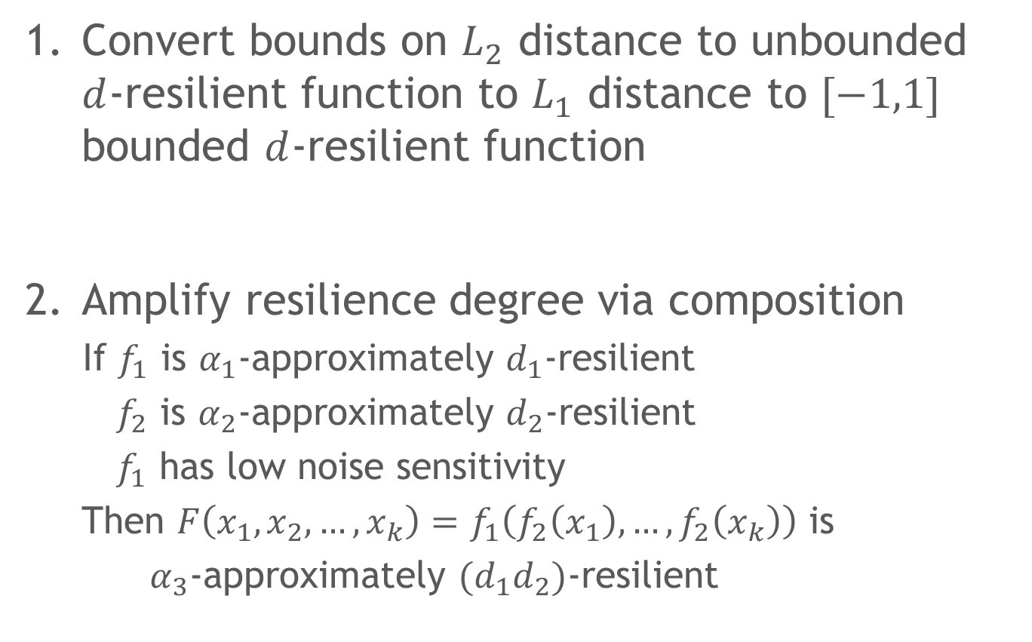
Bounds on approximate resilience
Convert bounds on $L_{2}$ distance to unbounded $d$-resilient function to $L_{1}$ distance to $[−1,1]$ bounded $d$-resilient function
Amplify resilience degree via composition
If $f_{1}$ is $α_{1}$-approximately $d_{1}$-resilient
$f_{2}$ is $α_{2}$-approximately $d_{2}$-resilient
$f_{1}$ has low noise sensitivity
Then $F\left(x_{1},x_{2},…,x_{k}\right)=f_{1}\left(f_{2}\left(x_{1}\right),…,f_{2}\left(x_{k}\right)\right)$ is
$α_{3}$-approximately $(d_{1}d_{2})$-resilient

Slide 14
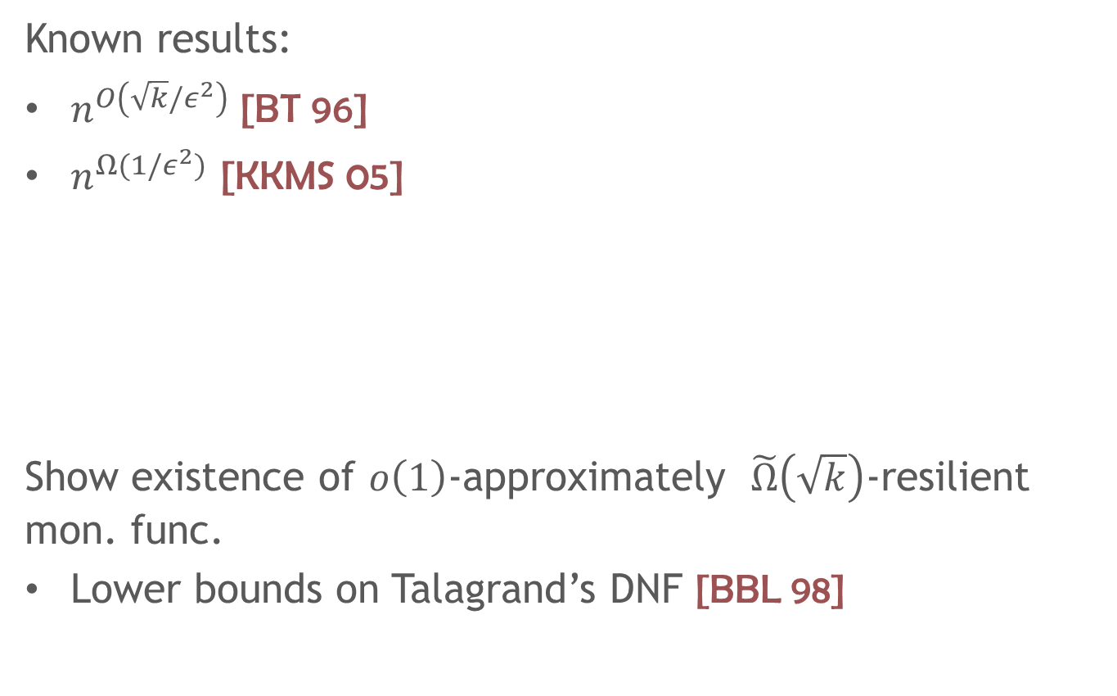

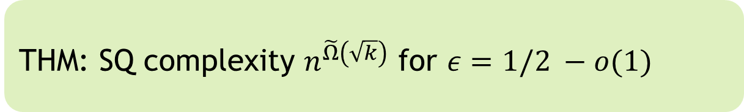
Monotone functions of $k$ variables
Known results:
$n^{O\left(\sqrt{k}/ε^{2}\right)}$ [BT 96]
$n^{Ω(1/ε^{2})}$ [KKMS 05]
Show existence of $o\left(1\right)$-approximately $\tilde{Ω}\left(\sqrt{k}\right)$-resilient mon. func.
Lower bounds on Talagrand’s DNF [BBL 98]
THM: SQ complexity $n^{\tilde{Ω}\left(\sqrt{k}\right)}$ for $ε=1/2 −o(1)$

Slide 15
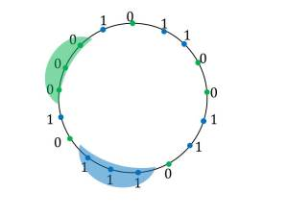
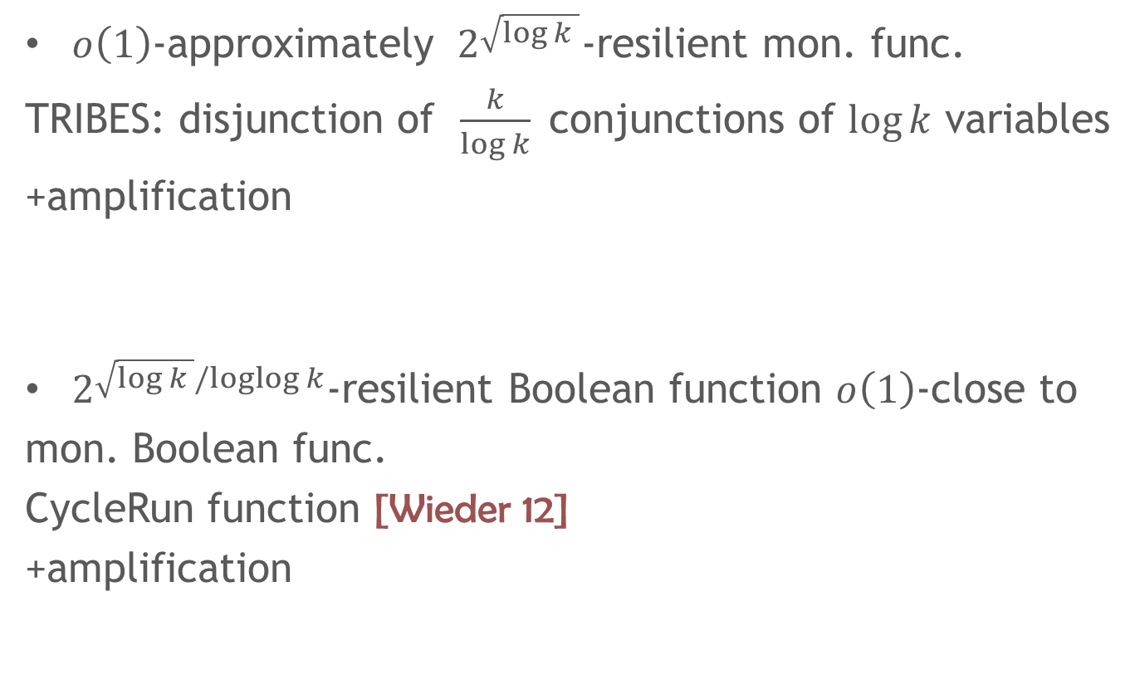
Explicit constructions
$o\left(1\right)$-approximately $2^{\sqrt{\log{k }}}$-resilient mon. func.
TRIBES: disjunction of $\frac{k}{log k}$ conjunctions of $\log{k}$ variables
+amplification
$2^{\sqrt{\log{k }}/loglog k}$-resilient Boolean function $o\left(1\right)$-close to
mon. Boolean func.
CycleRun function [Wieder 12]
+amplification

Slide 16
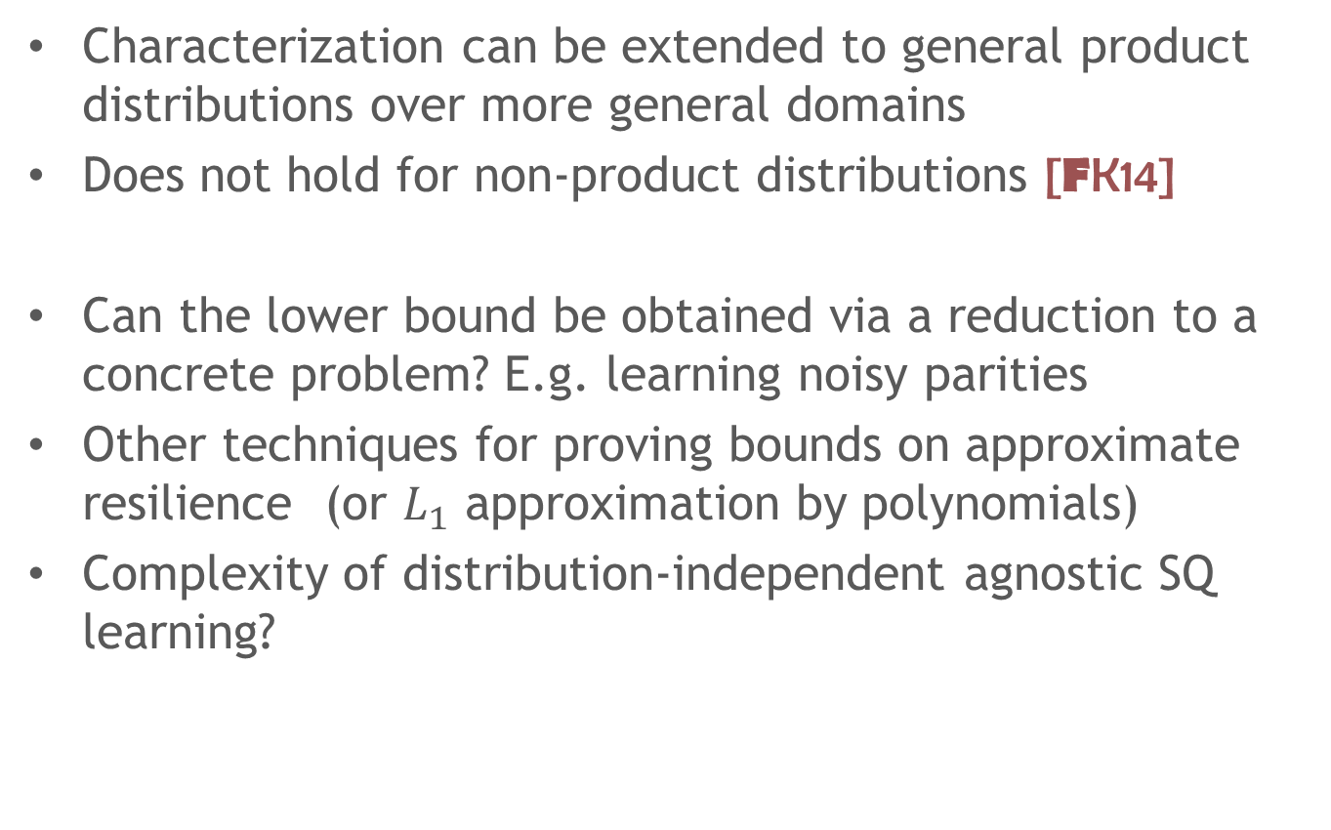
Conclusions and open problems
Characterization can be extended to general product distributions over more general domains
Does not hold for non-product distributions [FK14]
Can the lower bound be obtained via a reduction to a concrete problem? E.g. learning noisy parities
Other techniques for proving bounds on approximate resilience (or $L_{1}$ approximation by polynomials)
Complexity of distribution-independent agnostic SQ learning?

