Slide 1



Generalization of ERM in stochastic convex optimization:
Vitaly Feldman

Slide 2
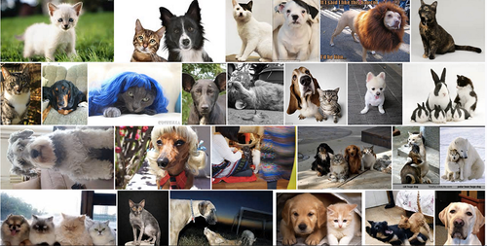


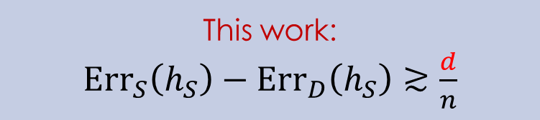

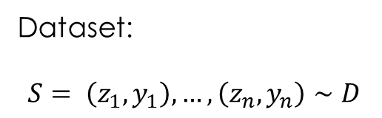
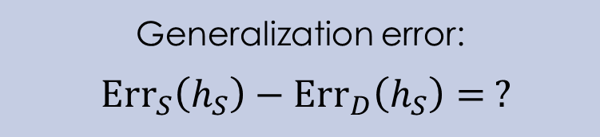
Dataset:
$$S= \left(z_{1},y_{1}\right),…,\left(z_{n},y_{n}\right)∼D$$
ERM
Ellipsoid SVRG Adagrad NEwTON
Learning problem
$$h_{S}$$
Stochastic convex optimization
Generalization error:
$Err_{S}\left(h_{S}\right)−Err_{D}\left(h_{S}\right)= ?$
This work:
$Err_{S}\left(h_{S}\right)−Err_{D}\left(h_{S}\right)≳\frac{d}{n}$

Slide 3
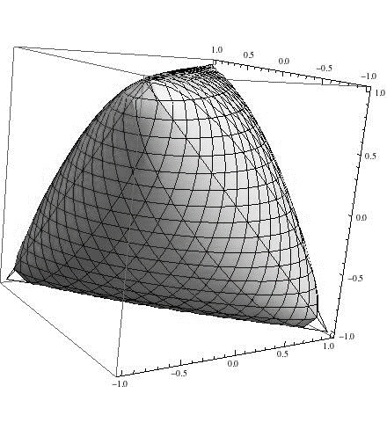




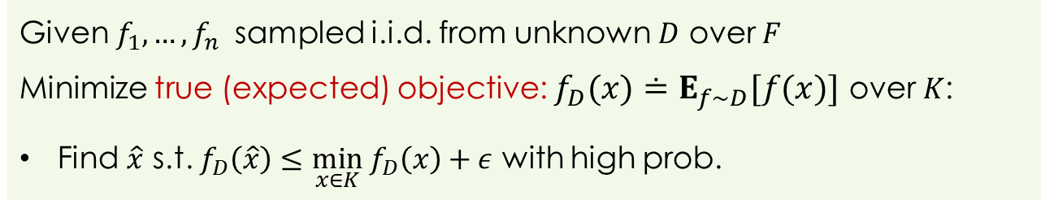
Stochastic convex optimization
Convex body $K⊆ℝ^{d}$
Class $F$of convex functions over $K$
Given $f_{1},…,f_{n}$ sampled i.i.d. from unknown $D$ over $F$
Minimize true (expected) objective: $f_{D}(x)≐E_{f∼D}[f(x)]$ over $K$:
Find $\hat{x}$ s.t. $f_{D}\left(\hat{x}\right)≤\min_{x∈K} f_{D}\left(x\right)+ε$ with high prob.
$$f_{1}$$
$$f_{2}$$
$$…$$
$$f_{n}$$
$$f_{D}$$
$$x$$
Notes:
In SCO the goal is to optimize the (pointwise) expected function from samples. D and hence f_D is unknown

Slide 4
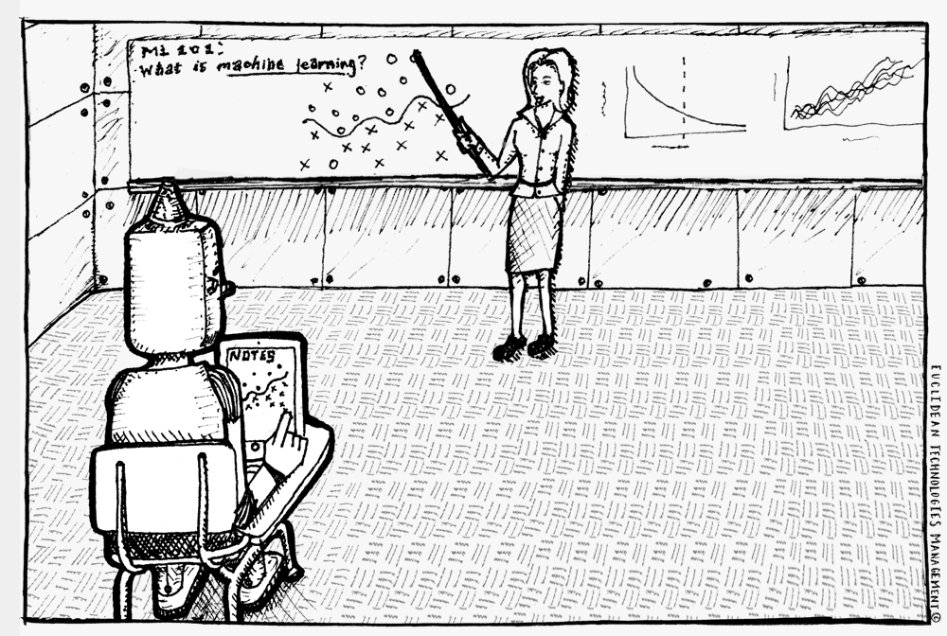
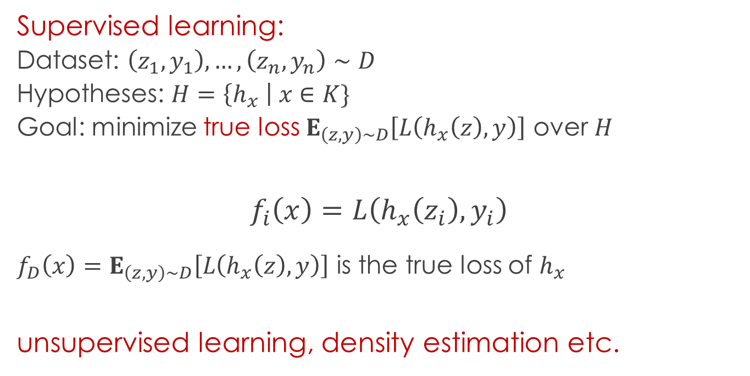
Applications
Machine learning and
statistics
Supervised learning:
Dataset: $\left(z_{1},y_{1}\right),…,\left(z_{n},y_{n}\right)∼D$
Hypotheses: $H=\left\{h_{x} \right| x∈K\}$
Goal: minimize true loss $E_{\left(z,y\right)∼D}\left[L\left(h_{x}\left(z\right), y\right)\right]$ over $H$
$$f_{i}\left(x\right)=L\left(h_{x}\left(z_{i}\right), y_{i}\right)$$
$f_{D}\left(x\right)=E_{\left(z,y\right)∼D}\left[L\left(h_{x}\left(z\right), y\right)\right]$ is the true loss of $h_{x}$
unsupervised learning, density estimation etc.

Slide 5




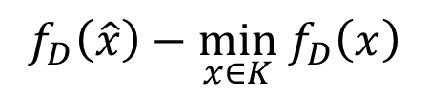


ERM (empirical risk minimization)
Given $S=f_{1},…,f_{n}$
Minimize empirical objective: $f_{S}(x)≐\frac{1}{n}\sum_{i∈\left[n\right]}{f_{i}}(x)$
$$f_{1}$$
$$f_{2}$$
$$…$$
$$f_{n}$$
$$f_{S}$$
$$x$$
$$\hat{x}$$
Often known to be optimal (e.g. VC theory)
$$f_{D}\left(\hat{x}\right)−\min_{x∈K} f_{D}\left(x\right)$$
$$≲f_{D}\left(\hat{x}\right)−f_{S}(\hat{x})$$
generalization error

Slide 6
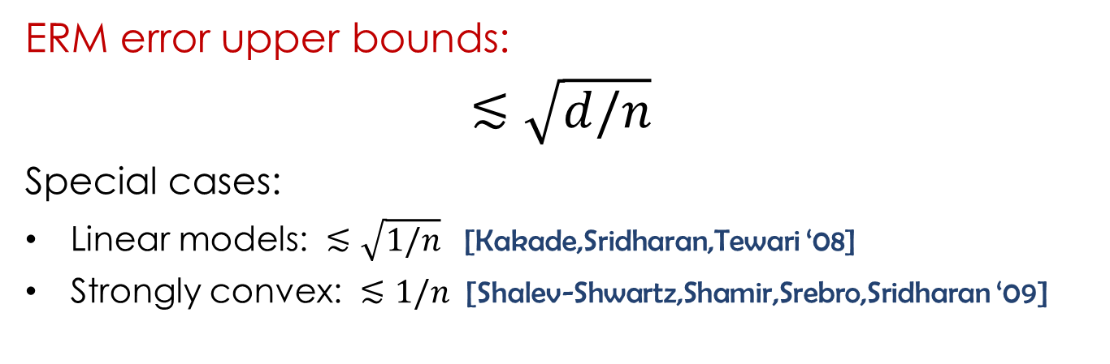

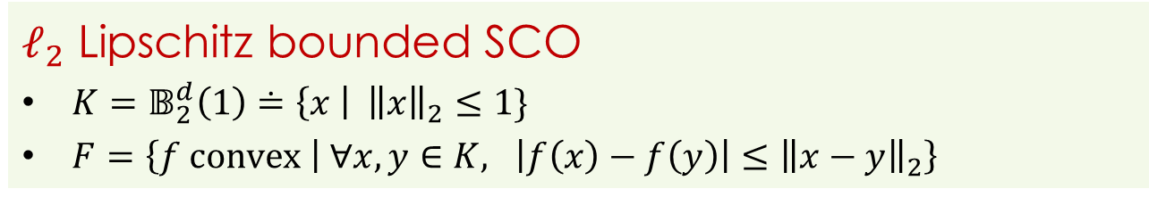
The gap
$ℓ_{2}$ Lipschitz bounded SCO
$K=𝔹_{2}^{d}\left(1\right)≐\left\{x \right| {\left\|x\right\|}_{2}≤1\}$
$F=\left\{f convex | ∀x,y∈K, {\left|f\left(x\right)−f\left(y\right)\right|≤\left\|x−y\right\|}_{2}\right\}$
ERM error upper bounds:
$$≲\sqrt{d/n}$$
Special cases:
Linear models: $≲\sqrt{1/n}$ [Kakade,Sridharan,Tewari ‘08]
Strongly convex: $≲1/n$ [Shalev-Shwartz,Shamir,Srebro,Sridharan ‘09]
ERM might have generalization error: $≳\frac{log d}{n}$
[Shalev-Shwartz,Shamir,Srebro,Sridharan ‘09]

Slide 7

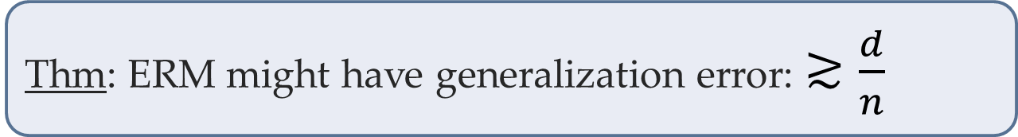
New result
Can the bounds be improved?
Thm: ERM might have generalization error: $≳\frac{d}{n}$
Can be solved with error: $≲\sqrt{1/n}$
stochastic gradient descent [Robbins,Monro ‘51; Polyak ‘90]
strongly-convex regularization
[Shalev-Shwartz,Shamir,Srebro,Sridharan ‘09]
Generalization error depends on optimization algorithm!

Slide 8
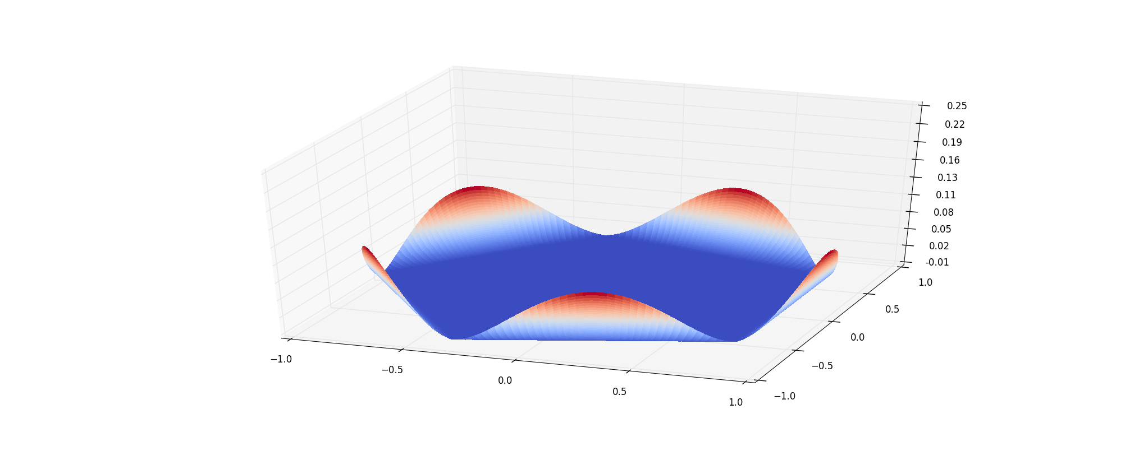
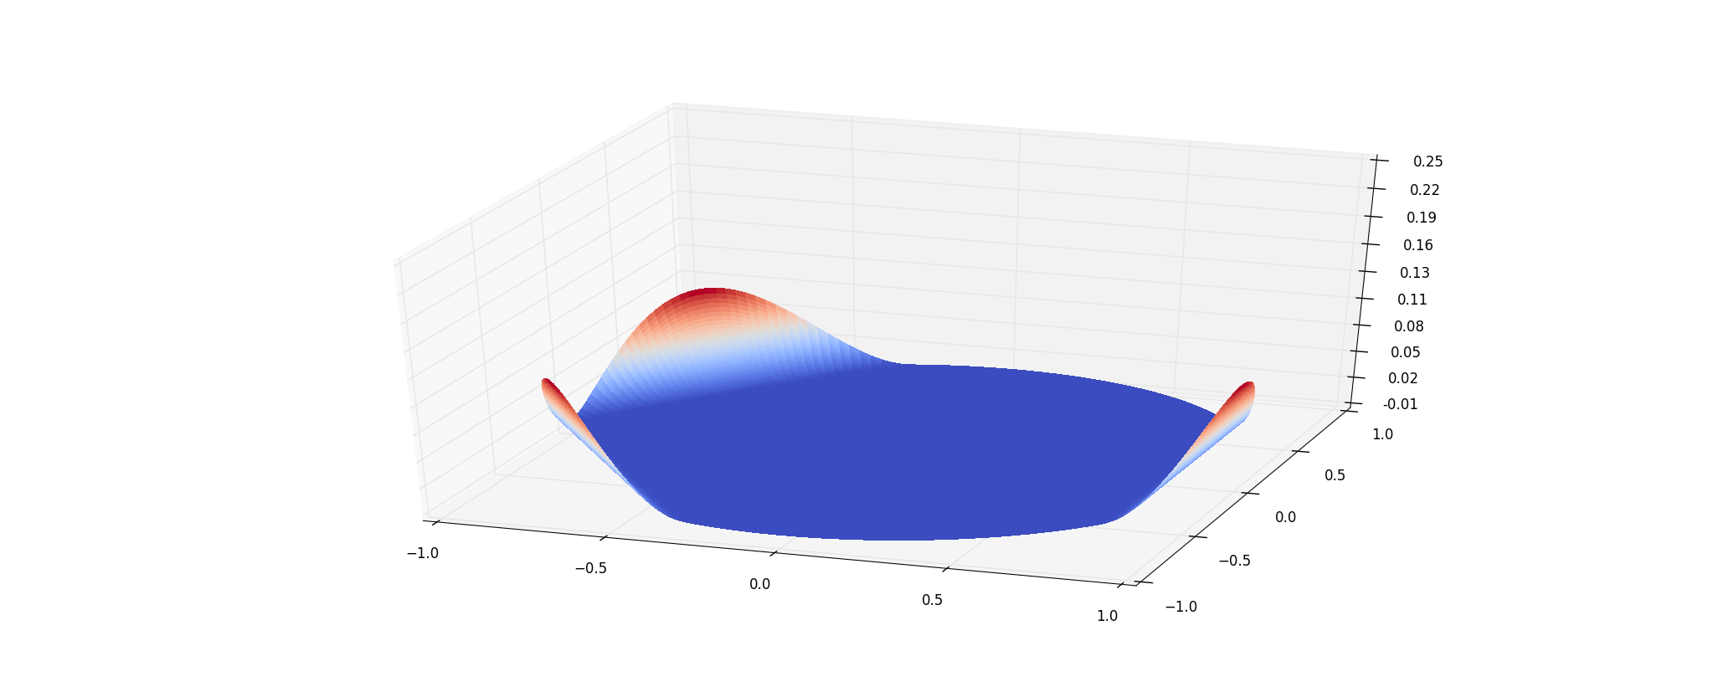
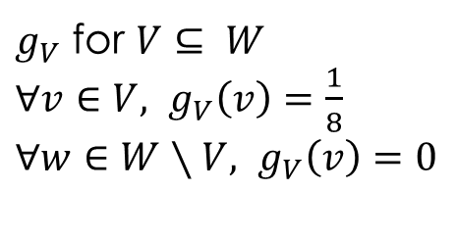
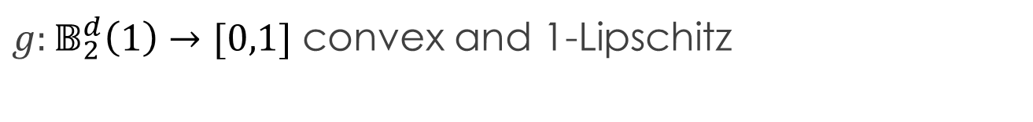
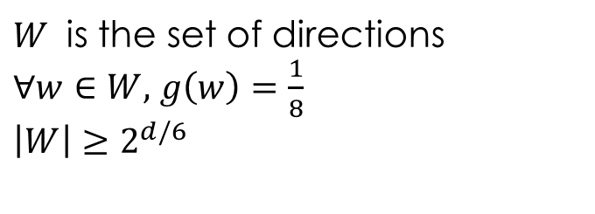
Construction
$g:𝔹_{2}^{d}\left(1\right)→[0,1]$ convex and 1-Lipschitz
$W$ is the set of directions
$∀w∈W,$ $g\left(w\right)=\frac{1}{8}$
$\left|W\right|≥2^{d/6}$
$g_{V}$ for $V⊆ W$
$∀v∈V,$ $g_{V}\left(v\right)=\frac{1}{8}$
$∀w∈W∖V,$ $g_{V}\left(v\right)=0$

Slide 9
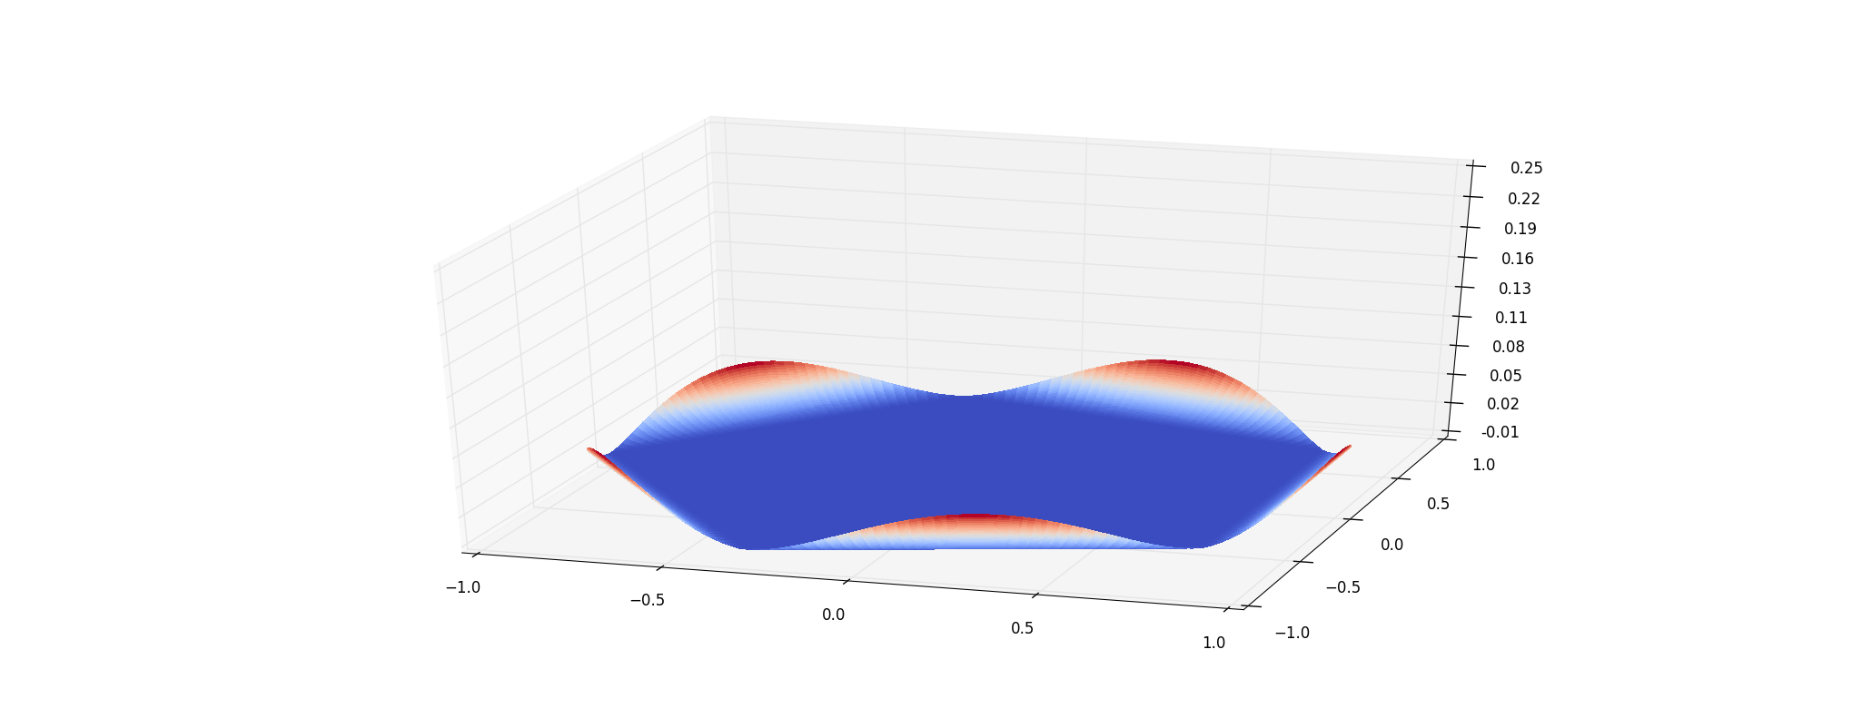


Distribution
$D$: $g_{V}$ where $V$ is a random subset of $W$
Given: $S=g_{V_{1}},…,g_{V_{n}}$
If exists $w^{∗}∈W$, such that $w^{∗}∉V_{1}∪⋯∪V_{n}$
Then $f_{S}\left(w^{∗}\right)=0=\min_{x∈K}{f_{S}\left(x\right)}$ but $f_{D}\left(w^{∗}\right)=1/16$
What is the probability that $V_{1}∪⋯∪V_{n}≠W$?
If $n≤log\left|W\right|≤d/6$ then this prob. $≥1/2$
$$f_{D}≡ \frac{g}{2}$$

Slide 10
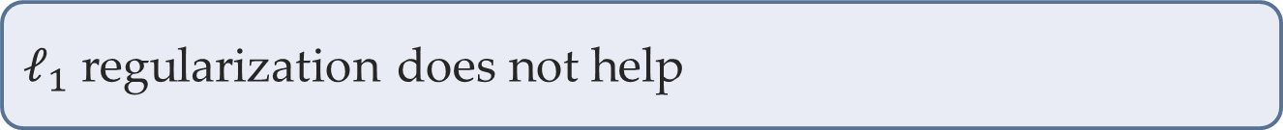
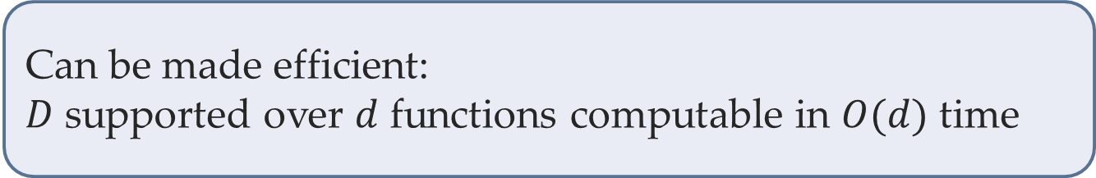
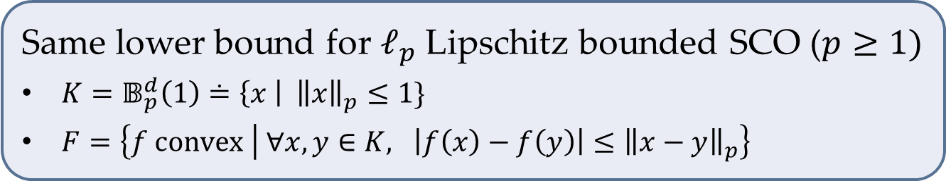
Extensions
Same lower bound for $ℓ_{p}$ Lipschitz bounded SCO ($p≥1)$
$K=𝔹_{p}^{d}\left(1\right)≐\left\{x \right| {\left\|x\right\|}_{p}≤1\}$
$F=\left\{f convex | ∀x,y∈K, {\left|f\left(x\right)−f\left(y\right)\right|≤\left\|x−y\right\|}_{p}\right\}$
Can be made efficient:
$D$ supported over $d$ functions computable in $O(d)$ time
$ℓ_{1}$ regularization does not help

Slide 11

Summary
Solutions to ERM might have poor generalization
Optimization algorithm matters
Which optimization algorithms generalize well?
Does gradient descent on $f_{S}$ generalize?
Need new analysis techniques

