Slide 1

On the power and the limits of evolvability
Vitaly Feldman
Almaden Research Center

Slide 2
Learning from examples vs evolvability
Learnable from examples
Evolvable
Parity functions
Notes:
Evolvable within learnable diagram

Slide 3


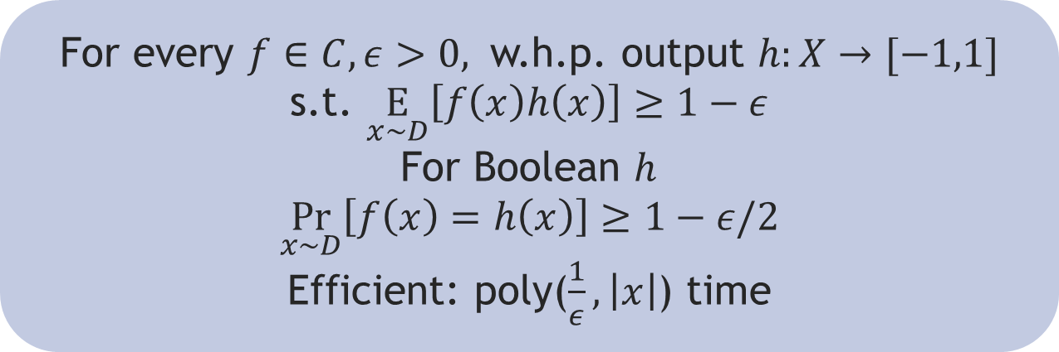
The core model: PAC [Valiant 84]
Learner observes random examples: $(x,f(x))$
Assumption: unknown Boolean function $f:X→\{−1,1\}$ labeling the examples comes from a known class of functions $C$
Distribution $D$ over $X$ (e.g. $R^{n}$ or ${\left\{−1,1\right\}}^{n}$)
every distribution $D$
For every $f∈C, ε>0,$ w.h.p. output $h:X→[−1,1]$ s.t. $\underset{x∼D}{E}\left[f\left(x\right)h\left(x\right)\right]≥1−ε$
For Boolean $h$
$$\underset{x∼D}{Pr}\left[f\left(x\right)=h\left(x\right)\right]≥1−ε/2$$
Efficient: poly($\frac{1}{ε},\left|x\right|$) time
Notes:
Add distribution independent

Slide 4
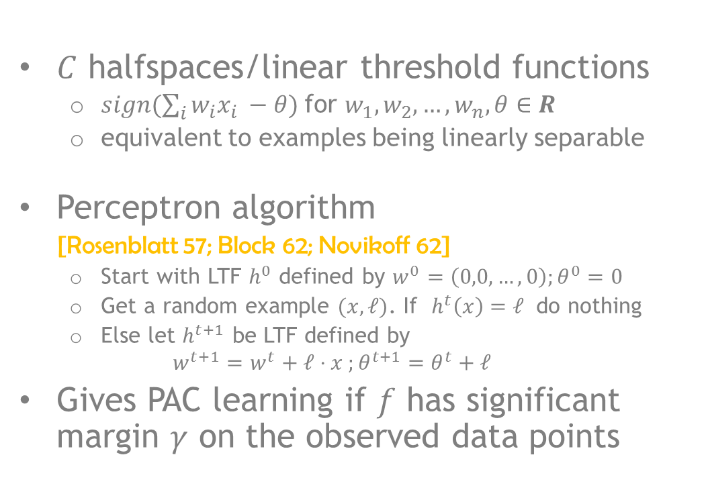

Classical example
$C$ halfspaces/linear threshold functions
$sign(\sum_{i}{w_{i}x_{i} −θ) }$for $w_{1},w_{2},…,w_{n},θ∈R$
equivalent to examples being linearly separable
Perceptron algorithm
[Rosenblatt 57; Block 62; Novikoff 62]
Start with LTF $h^{0}$ defined by $w^{0}=\left(0,0,…,0\right);θ^{0}=0$
Get a random example $(x,ℓ)$. If $h^{t}\left(x\right)=ℓ$ do nothing
Else let $h^{t+1}$ be LTF defined by
$$w^{t+1}=w^{t}+ℓ⋅x ;θ^{t+1}=θ^{t}+ℓ$$
Gives PAC learning if $f$ has significant margin $γ$ on the observed data points
-
-
-
-
-
-
-
-
-
-
-
$γ${
-
+
+
+
+
+
+
+
+
+
+
+
+

Slide 5




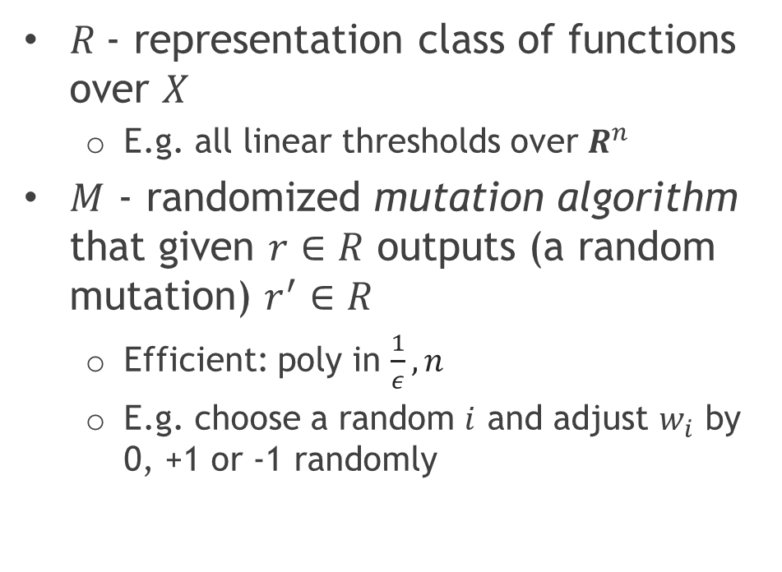
Evolution algorithm
$R$- representation class of functions over $X$
E.g. all linear thresholds over $R^{n}$
$M$ - randomized mutation algorithm that given $r∈R$ outputs (a random mutation) $r^{′}∈R$
Efficient: poly in $\frac{1}{ε}, n$
E.g. choose a random $i$ and adjust $w_{i}$ by 0, +1 or -1 randomly
Hypothesis
Mutation
algorithm

Slide 6
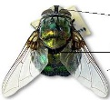
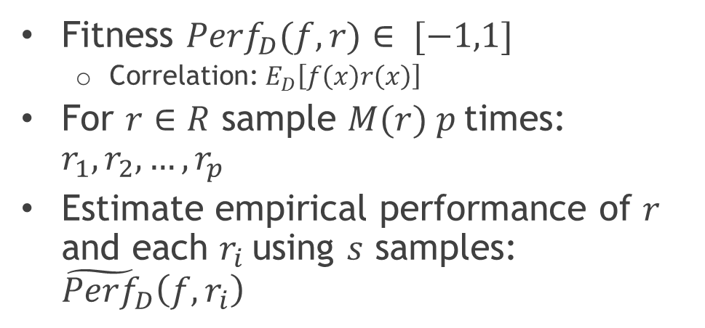
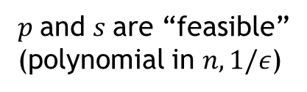



Selection
Fitness ${Perf}_{D}(f,r)∈ [−1,1]$
Correlation: $E_{D}\left[f\left(x\right)r\left(x\right)\right]$
For $r∈R$ sample $M(r) p$times: $r_{1},r_{2},…,r_{p}$
Estimate empirical performance of $r$ and each $r_{i}$using $s$ samples: ${\tilde{Perf}}_{D}\left(f,r_{i}\right)$
Natural selection
$${\tilde{Perf}}_{D}\left(f,r\right)$$
$p$and $s$are “feasible”
(polynomial in $n, 1/ε$)
-1
1
Empirical performance
$$t$$
$$t$$

Slide 7



Evolvability
Class of functions $C$ is evolvable over $D$ if exists an evolution algorithm $(R,M)$ and a polynomial $g$($⋅,⋅$) s.t.
For every $f∈C$,$r∈R$,ε>0 and a sequence
$r0=r,r1,r2,…$where $r_{i+1}←$ Select$(R,M,r_{i})$
it holds: ${Perf}_{D}(f$,$r_{g\left(n,\frac{1}{ε}\right)}$)$≥1−$ w.h.p.
Evolvable (distribution-independently)
Evolvable for all $D$ by the same mutation algorithm $(R,M)$

Slide 8










Limits of evolvability
Feedback is restricted to values of ${\tilde{Perf}}_{D}\left(f,r_{i}\right)$ for some polynomial number of samples $s$
$$h_{1}$$
$$v_{1}$$
$$h_{2}$$
$$v_{2}$$
$$h_{q}$$
learning algorithm
$$v_{q}$$
${\tilde{Perf}}_{D}$($s$) oracle
$v_{i}= {\tilde{Perf}}_{D}\left(f,h_{i}\right)$ evaluated on $s$fresh examples

Slide 9
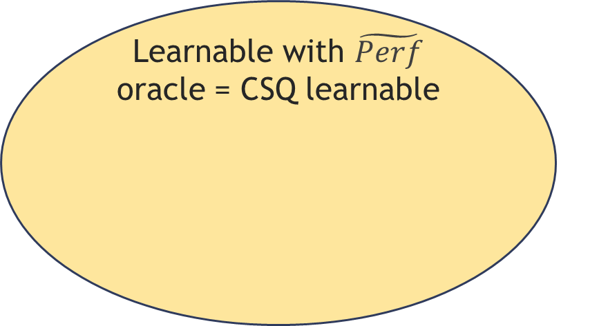
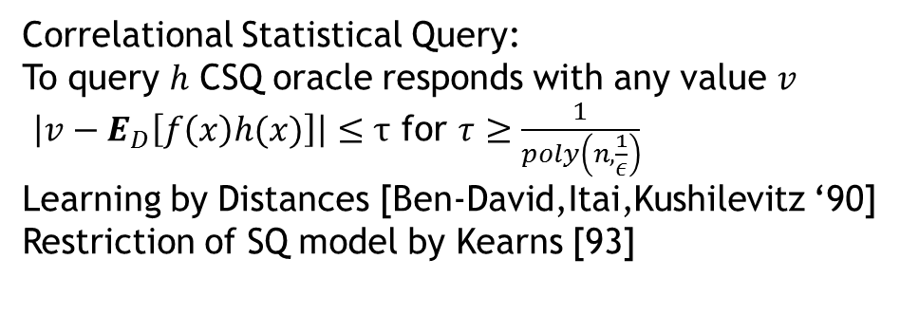

Evolvable $⊆$ CSQ learnable
PAC learnable
Learnable with $\tilde{Perf}$ oracle = CSQ learnable
Evolvable
Correlational Statistical Query:
To query $h$ CSQ oracle responds with any value $v$
$\left|v−E_{D}\left[f\left(x\right)h(x)\right]\right|≤τ$ for $τ≥\frac{1}{poly\left(n,\frac{1}{ε}\right)}$
Learning by Distances [Ben-David,Itai,Kushilevitz ‘90]
Restriction of SQ model by Kearns [93]

Slide 10

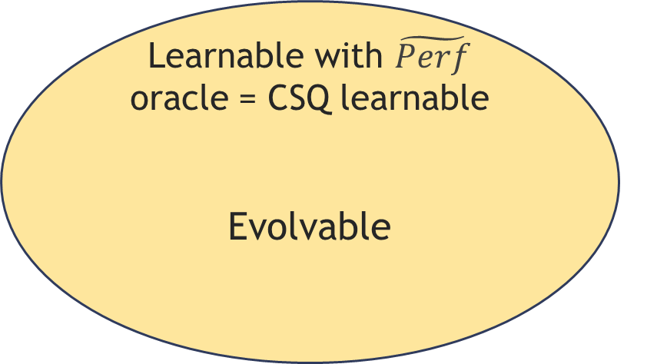
CSQ learnable $⊆$ Evolvable [F. 08]
PAC learnable
Learnable with $\tilde{Perf}$ oracle = CSQ learnable
Evolvable

Slide 11
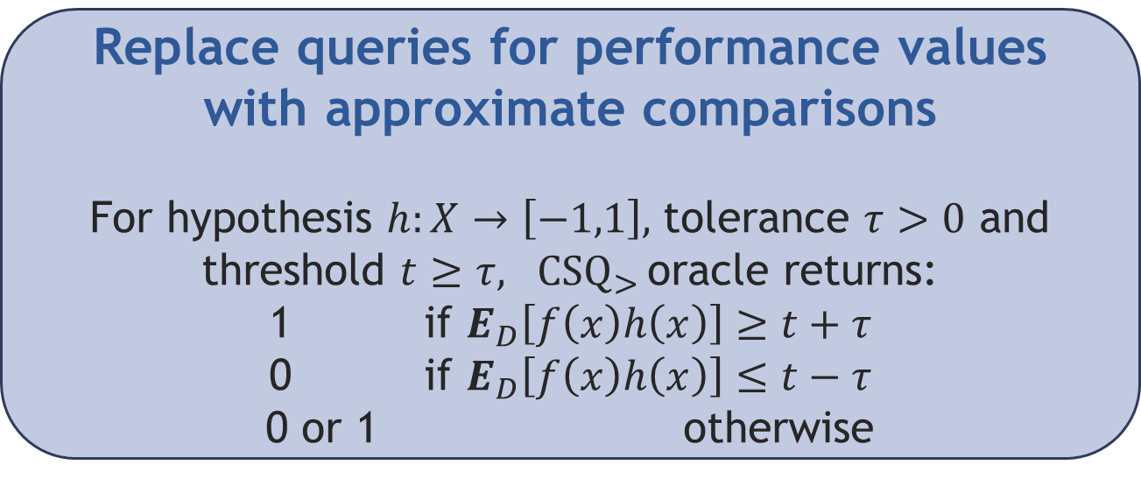
Proof outline
Replace queries for performance values with approximate comparisons
For hypothesis $h:X→\left[−1,1\right],$ tolerance $τ>0$ and threshold $t≥τ, {CSQ}_{>}$oracle returns:
1 if $E_{D}\left[f\left(x\right)h\left(x\right)\right]≥t+τ$
0 if $E_{D}\left[f\left(x\right)h\left(x\right)\right]≤t−τ$
0 or 1 otherwise
Design evolution algorithm with mutations that simulate comparison queries

Slide 12
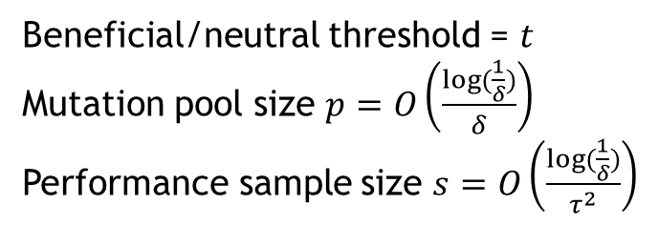
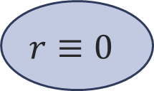

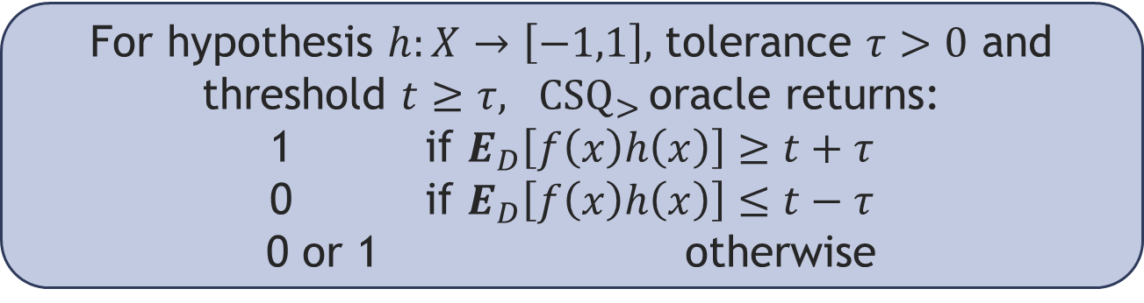

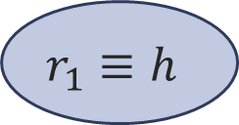
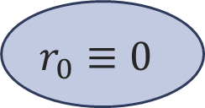

From comparisons to mutations
For hypothesis $h:X→\left[−1,1\right],$ tolerance $τ>0$ and threshold $t≥τ, {CSQ}_{>}$oracle returns:
1 if $E_{D}\left[f\left(x\right)h\left(x\right)\right]≥t+τ$
0 if $E_{D}\left[f\left(x\right)h\left(x\right)\right]≤t−τ$
0 or 1 otherwise
$$1−δ$$
$$r_{0}≡0$$
Beneficial/neutral threshold = $t$
Mutation pool size $p=O\left(\frac{log⁡(\frac{1}{δ})}{δ}\right)$
Performance sample size $s=O\left(\frac{log⁡(\frac{1}{δ})}{τ^{2}}\right)$
$$r≡0$$
$$r_{1}≡h$$
$$δ$$
With probability at least $1−δ$, Select$\left(r\right)=r_{b}$
where $b$is valid response to comparison query

Slide 13
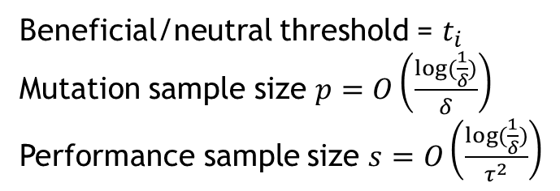
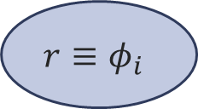




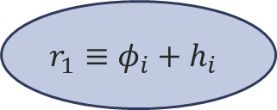

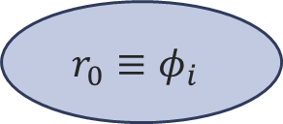

Simulating $CSQ_{>}$ algorithm
Need to answer $q$queries
$φ_{i}$ is the function obtained after answering $i$ queries
Need to answer query $h_{i}$ with threshold $t_{i}$
$$1−δ$$
$$r_{0}≡φ_{i}$$
Beneficial/neutral threshold = $t_{i}$
Mutation sample size $p=O\left(\frac{log⁡(\frac{1}{δ})}{δ}\right)$
Performance sample size $s=O\left(\frac{log⁡(\frac{1}{δ})}{τ^{2}}\right)$
$$r≡φ_{i}$$
$$r_{1}≡φ_{i}+h_{i}$$
$$δ$$
Leads to representations with values in $[−q,q]$!
Rescale by $1/q$ to get functions with values in [-1,1]
Given answers to queries can compute $h$such that
$Perf_{D}\left(f,h\right)≥1−ε$ and mutate into it

Slide 14


CSQ learnable $≡$ Evolvable [F.08; F. 09]
PAC learnable
CSQ learnable $≡$
Evolvable
ROBUST
E.g. optimizing selection; recombination [Kanade 11]; changing thresholds;
number of mutations

Slide 15
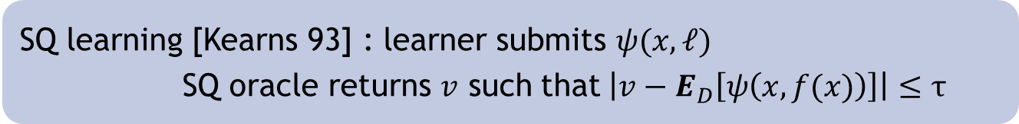
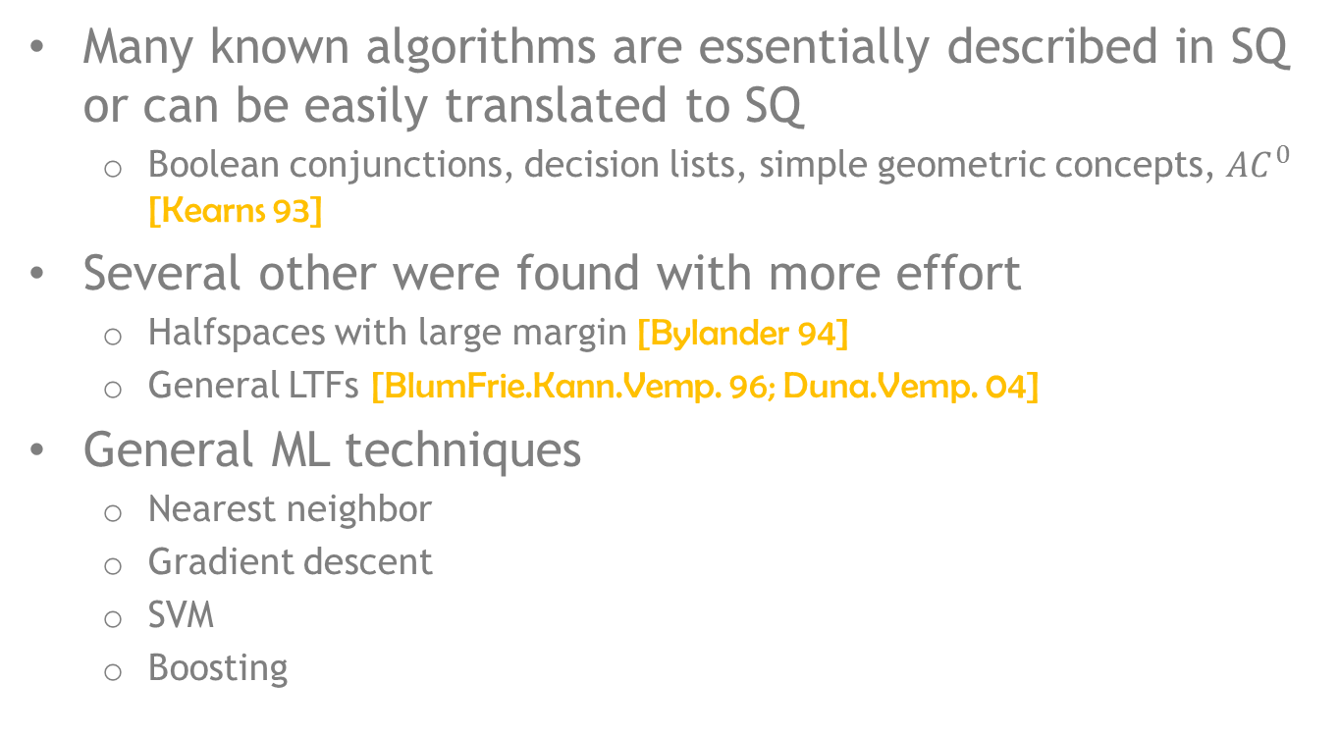
How powerful is CSQ learning?
SQ learning [Kearns 93] : learner submits $ψ(x, ℓ)$
SQ oracle returns $v$ such that$\left|v−E_{D}\left[ψ\left(x, f(x)\right)\right]\right|≤τ$
Many known algorithms are essentially described in SQ or can be easily translated to SQ
Boolean conjunctions, decision lists, simple geometric concepts, $AC^{0}$ [Kearns 93]
Several other were found with more effort
Halfspaces with large margin [Bylander 94]
General LTFs [BlumFrie.Kann.Vemp. 96; Duna.Vemp. 04]
General ML techniques
Nearest neighbor
Gradient descent
SVM
Boosting
Notes:
result of query can be thought of as obtained estimating the expectation empirically from a polynomial number of examples

Slide 16



Perceptron in SQ
Recall the Perceptron algorithm:
Add false negatives, subtract false positive examples
Use SQs to find the centroid of false positives
$E_{D}[x_{1}⋅ I\left(f\left(x\right)=−1\right)⋅ I(h^{t}(x) = 1)]$ gives the first coordinate of the centroid
Use the centroid for the Perceptron update
-
-
False
positive
-
-
-
-
-
-
-
-
-
-
+
+
+
+
$$f$$
+
+
+
+
+
+
+
+
$$h^{t}$$
Notes:
An example that should give an idea why SQ is so general.
Perceptron seemingly makes uses of points in a very strong way

Slide 17
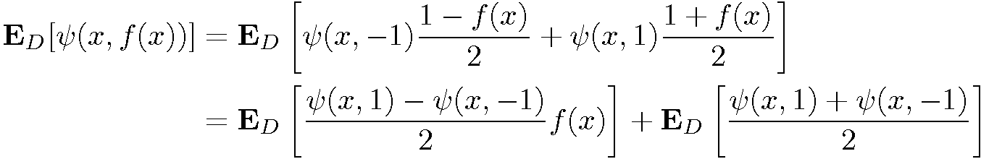


If $D$ is fixed then SQ$≡$CSQ
Decompose SQ into CSQ and a constant
Corollary: linear threshold functions are evolvable for any fixed distribution $D$
CSQ

Slide 18
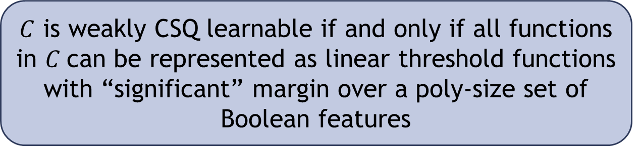
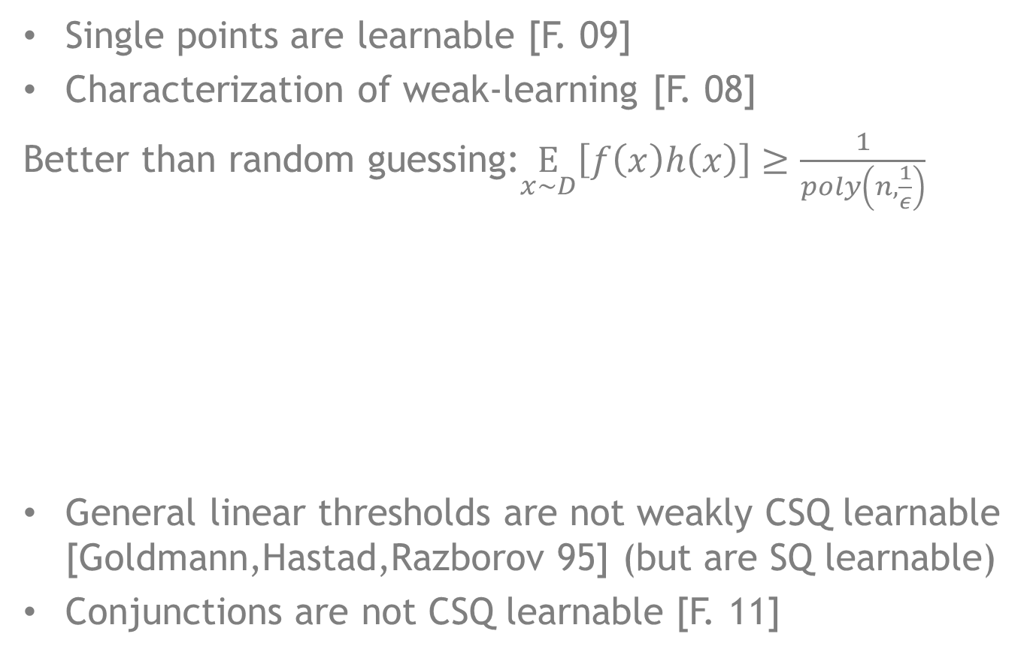
Distribution-independent CSQ
Single points are learnable [F. 09]
Characterization of weak-learning [F. 08]
Better than random guessing:$\underset{x∼D}{E}\left[f\left(x\right)h\left(x\right)\right]≥\frac{1}{poly\left(n,\frac{1}{ε}\right)}$
General linear thresholds are not weakly CSQ learnable [Goldmann,Hastad,Razborov 95] (but are SQ learnable)
Conjunctions are not CSQ learnable [F. 11]
$C$ is weakly CSQ learnable if and only if all functions in $C$can be represented as linear threshold functions with “significant” margin over a poly-size set of Boolean features

Slide 19

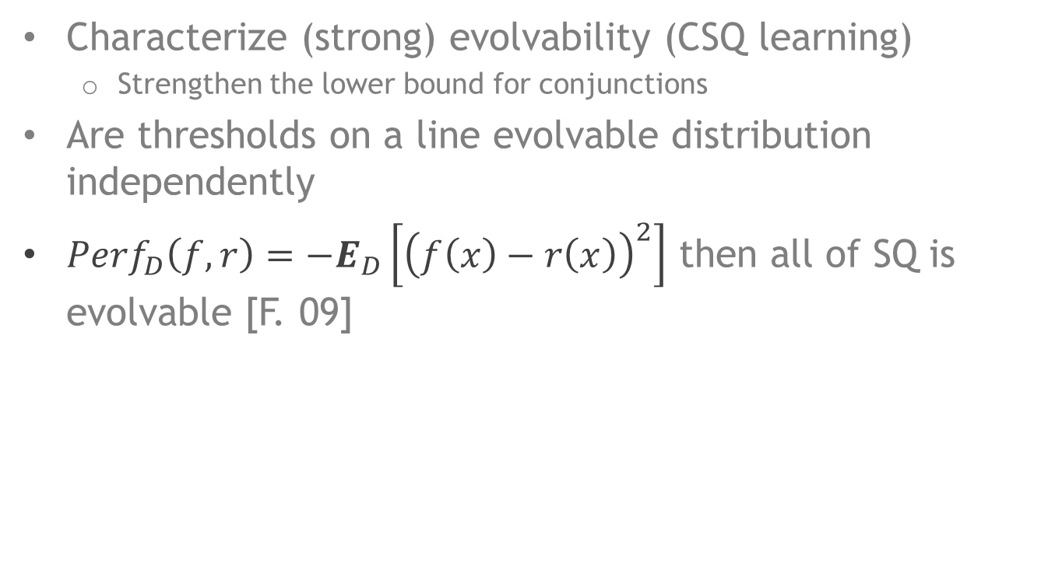
Further directions
Characterize (strong) evolvability (CSQ learning)
Strengthen the lower bound for conjunctions
Are thresholds on a line evolvable distribution independently
${Perf}_{D}\left(f,r\right)={−E}_{D}\left[{\left(f\left(x\right)−r\left(x\right)\right)}^{2}\right]$ then all of SQ is evolvable [F. 09]

