Slide 1


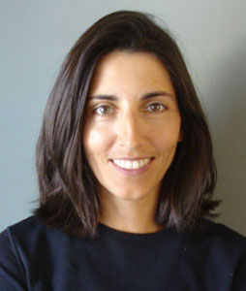

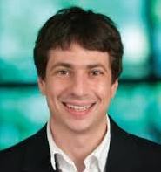
Adaptive Data Analysis without Overfitting
Vitaly Feldman
Accelerated Discovery Lab
IBM Research - Almaden
Cynthia Dwork Moritz Hardt Toni Pitassi Omer Reingold Aaron Roth
Microsoft Res. Google Res. U. of Toronto Samsung Res. Penn, CS

Slide 2


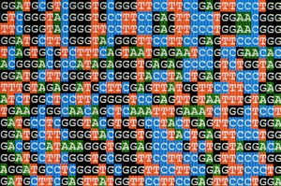


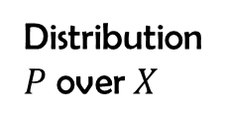
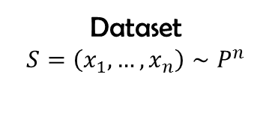
Distribution
$P$ over $X$
Param. estimates
Classifier,
Clustering
etc.
Dataset
$$S=\left(x_{1},…,x_{n}\right)∼P^{n}$$
Results
Analysis

Slide 3
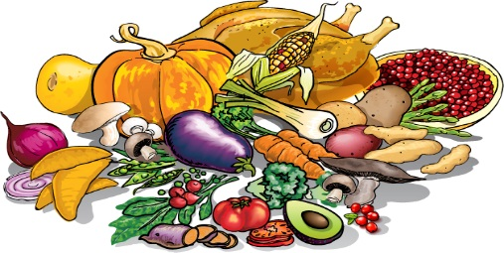


Data Analysis 101
Does student nutrition affect academic performance?
Normalized grade
50
100

Slide 4
Check correlations

Slide 5



Pick candidate foods

Slide 6


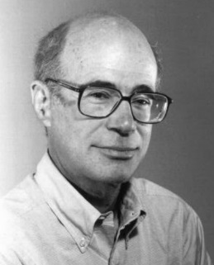
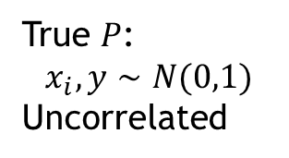

Fit linear function of 3 selected foods
SUMMARY OUTPUT
Regression Statistics
Multiple R | 0.4453533
R Square | 0.1983396
Adjusted R Square | 0.1732877
Standard Error | 1.0041891
Observations | 100
ANOVA
 | df | SS | MS | F | Significance F
Regression | 3 | 23.95086544 | 7.983622 | 7.917151 | 8.98706E-05
Residual | 96 | 96.80600126 | 1.008396
Total | 99 | 120.7568667
 | Coefficients | Standard Error | t Stat | P-value
Intercept | -0.044248 | 0.100545016 | -0.44008 | 0.660868
Mushroom | -0.296074 | 0.10193011 | -2.90468 | 0.004563
Pumpkin | 0.255769 | 0.108443069 | 2.358555 | 0.020373
Nutella | 0.2671363 | 0.095186165 | 2.806462 | 0.006066
FALSE
DISCOVERY
$$≈0.0001$$
True $P$:
$$x_{i},y∼N(0,1)$$
Uncorrelated
Freedman’s Paradox [1983]

Slide 7

Statistical inference
Data
Data
Data
“Fresh” i.i.d. samples
Techniques
CLT
VC dimension
Rademacher compl.
Stability
…
Procedure
Hypothesis tests
Regression
Learning
Result + generalization guarantees
0
$$\hat{μ}$$
Notes:
Illustrate separately

Slide 8

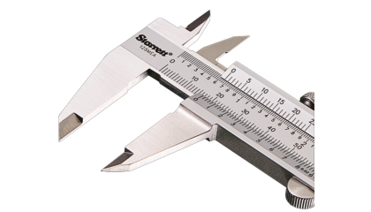



Holdout validation
Data
Data
Data
Data
Data
Data
Training
Holdout/Testing
Predictor $f$
Test error of $f$
0
$$\hat{Err}(f)$$
Notes:
Learning happens here Inference only happens

Slide 9

Data analysis is adaptive
Procedure at step $t$ depends on results of previous procedures on the same dataset
Data
Data
A
Data
Exploratory data analysis
Variable selection
Hyper-parameter tuning
Shared datasets
…
B
Notes:
Mention that had we unlimited amount of data that would not be an issue. There is plenty of empirical evidence for that: from effects of selection to papers demonstrating overfitting to the test set.

Slide 10
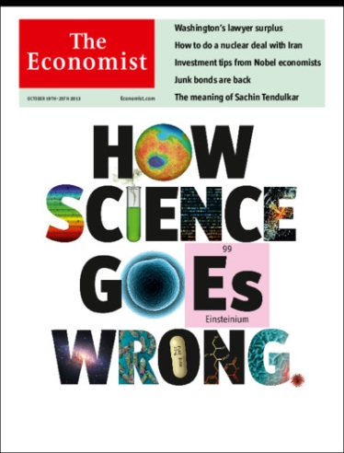
Is this a real problem?
“Why Most Published Research Findings Are False” [Ioannidis 05]
1,000,000+ downloads; 1,400+ citations
Adaptive data analysis is one of the causes
Researcher degrees of freedom
[Simmons,Nelson,Simonsohn 11]
Garden of forking paths
[Gelman, Loken 15]
Leads to invalid (cross-)validation error estimates
[Reunanen 03; Rao, Fung 08; Cawley, Talbot 10]
Notes:
Add learning references

Slide 11
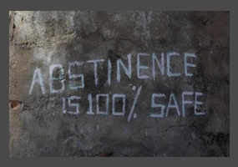
Approaches to adaptive analysis
Abstinence
e.g. pre-registration and data splitting
Need safe techniques
Notes:
Abstain from adaptivity

Slide 12








Adaptive analysis
$$A_{1}$$
$$v_{1}$$
$$A_{2}$$
$$v_{2}$$
$$A_{m}$$
$$v_{m}$$
$$S=\left(x_{1},…,x_{n}\right)∼P^{n}$$
Data analyst(s)
$$A_{i}:Δ(X)→Y_{i}$$
$v_{i}$ is “close” to $A_{i}\left(P\right)$ with prob. $1−β$

Slide 13

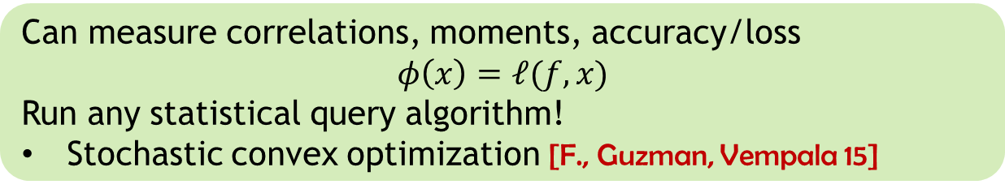





Adaptive statistical queries
$$φ_{1}$$
$$v_{1}$$
$$φ_{2}$$
$$v_{2}$$
$$S$$
$$φ_{m}$$
$$v_{m}$$
Statistical query oracle
[Kearns 93]
$$S=\left(x_{1},…,x_{n}\right)∼P^{n}$$
Data analyst(s)
$$φ_{i}:X→\left[0,1\right]$$
$$\left|v_{i}−E_{x∼P}\left[φ_{i}\left(x\right)\right]\right|≤τ$$
with prob. $1−β$
Can measure correlations, moments, accuracy/loss
$$φ\left(x\right)=ℓ(f,x)$$
Run any statistical query algorithm!
Stochastic convex optimization [F., Guzman, Vempala 15]

Slide 14
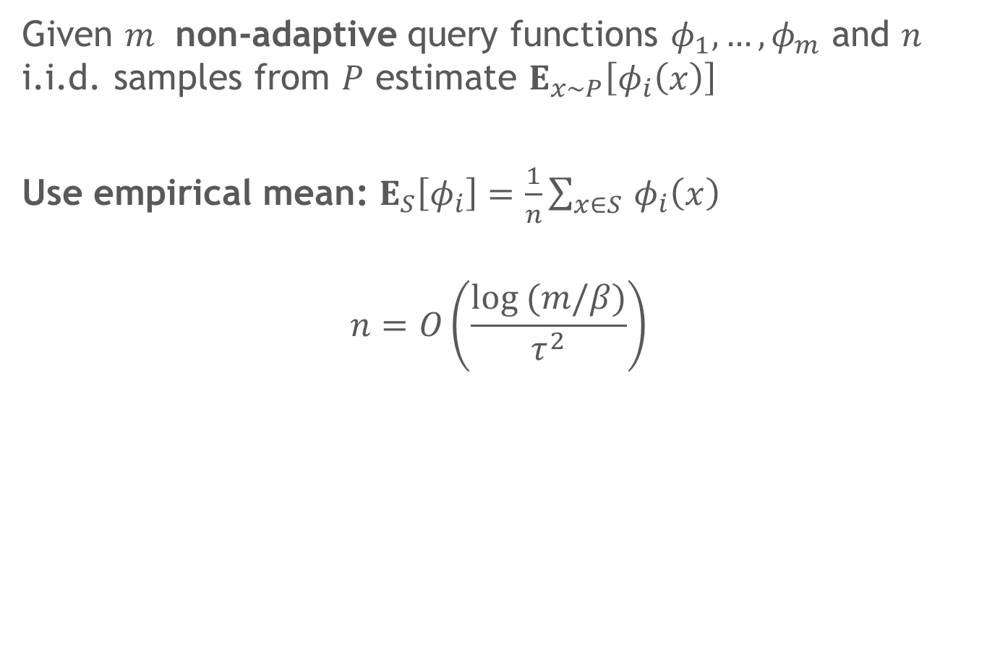
Answering non-adaptive SQs
Given $m$ non-adaptive query functions $φ_{1},…{,φ}_{m}$ and $n$ i.i.d. samples from $P$ estimate $E_{x∼P}\left[φ_{i}\left(x\right)\right]$
Use empirical mean: $E_{S}\left[φ_{i}\right]=\frac{1}{n}\sum_{x∈S }{φ_{i}\left(x\right)}$
$$n=O\left(\frac{log (m/β)}{τ^{2}}\right)$$

Slide 15




Answering adaptive SQs
Estimate expectations of $m$ adaptively chosen functions
Data splitting: $n=O\left(\frac{m⋅log m}{τ^{2}}\right)$
What if we use $E_{S}\left[φ_{i}\right]$?
For some constant $β>0:$
$$n≥m/τ^{2}$$
e.g. Freedman’s paradox

Slide 16
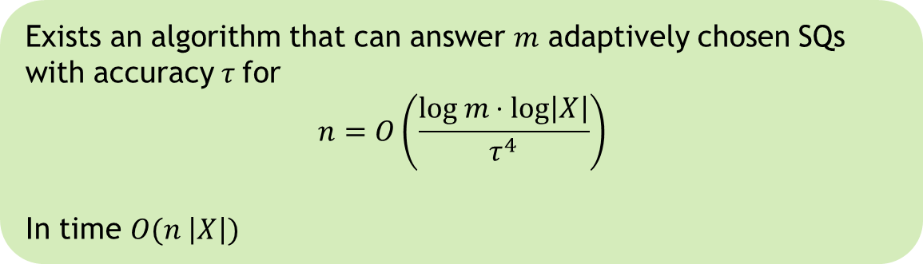
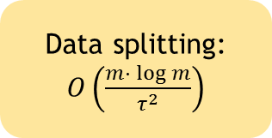
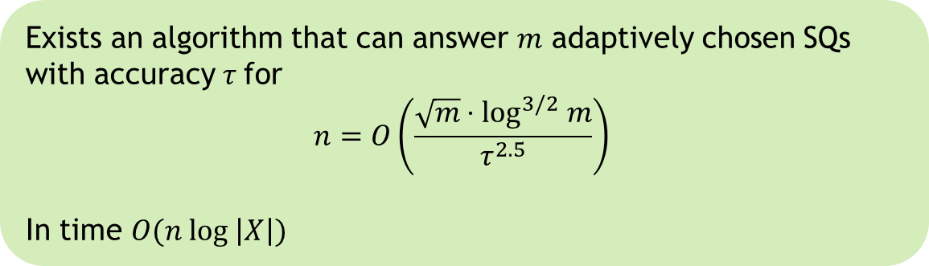
Our results
Exists an algorithm that can answer $m$ adaptively chosen SQs with accuracy $τ$ for
$$n=O\left(\frac{\sqrt{m}⋅\log^{3/2} m}{τ^{2.5}}\right)$$
In time $O(n log \left|X\right|)$
Data splitting:
$O\left(\frac{m⋅ log m}{τ^{2}}\right)$
Exists an algorithm that can answer $m$ adaptively chosen SQs with accuracy $τ$ for
$$n=O\left(\frac{log m⋅log\left|X\right|}{τ^{4}}\right)$$
In time $O(n \left|X\right|)$
Notes:
Switch the order

Slide 17
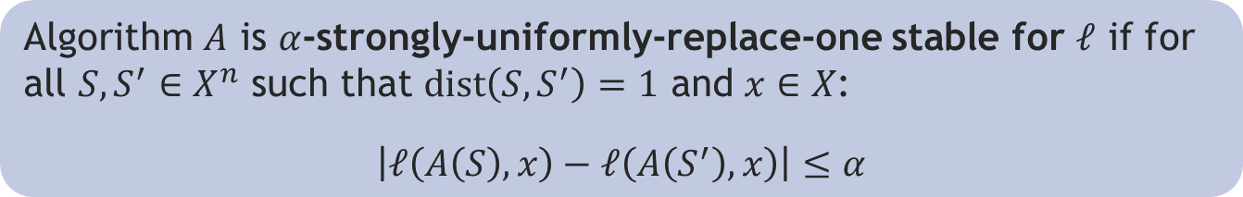
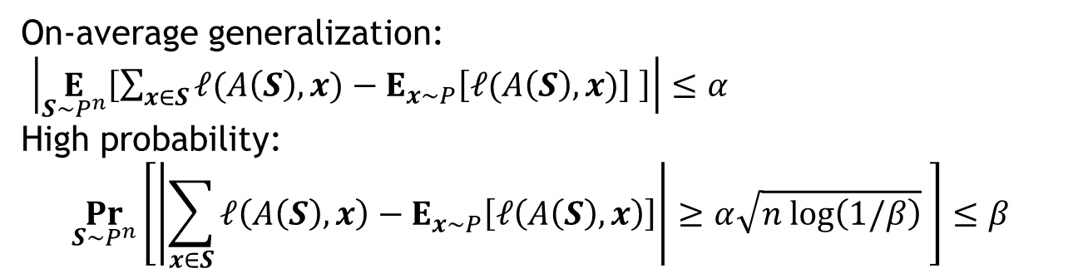
Algorithmic stability
“Small changes” to the dataset have “small effect” on the output
[Rogers,Wagner 78; Devroye,Wagner 79]
[Bousquet,Eliseeff 02; Kutin,Nyogi 02; Raklin, Mukherjee, Poggio 05; Shalev-Shwatrz,Shamir,Srebro,Sridharan 10]
Algorithm $A$ is $α$-strongly-uniformly-replace-one stable for $ℓ$ if for all $S,S^{′}∈X^{n}$ such that $dist\left(S,S^{′}\right)=1$ and $x∈X$:
$$\left|ℓ\left(A\left(S\right),x\right)−ℓ\left(A\left(S^{′}\right),x\right)\right|≤α$$
On-average generalization:
$\left|\underset{S∼P^{n}}{E}\left[\sum_{x∈S}{ℓ(A\left(S\right),x)}−E_{x∼P}\left[ℓ(A\left(S\right),x)\right] \right]\right|≤α$
High probability:
$$\underset{S∼P^{n}}{Pr}\left[\left|\sum_{x∈S}{ℓ\left(A\left(S\right),x\right)}−E_{x∼P}\left[ℓ\left(A\left(S\right),x\right)\right]\right|≥α\sqrt{n log\left(1/β\right)} \right]≤β$$
Notes:
Need stability that is preserved in an adaptive setting

Slide 18

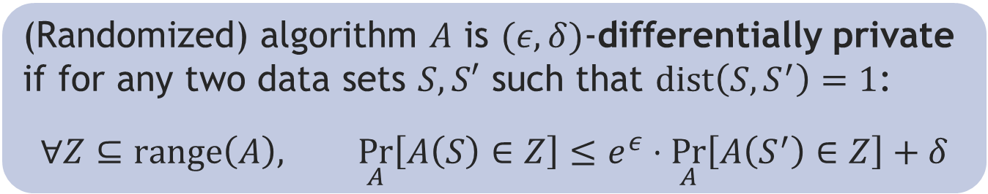
Differential Privacy [Dwork,McSherry,Nissim,Smith 06]
S
Frank
Aaron
Cynthia
Chris
Kobbi
Adam
Algorithm
ratio bounded
$$\underset{A}{Pr}{[r]}$$
(Randomized) algorithm $A$ is $(ε,δ)$-differentially private if for any two data sets $S,S′$ such that $dist\left(S,S^{′}\right)=1$:
$$∀Z⊆range\left(A\right), \underset{A}{Pr}\left[A\left(S\right)∈Z\right]≤e^{ε}⋅\underset{A}{Pr}\left[A\left(S^{′}\right)∈Z\right]+δ$$
Foklore: $\left(ε,δ\right)$-DP implies $\left(e^{ε}−1+δ\right)$-strongly-uniform-replace-one stability
for any $ℓ$ with range $[0,1]$

Slide 19








DP composes
adaptively
$$X^{n}$$
A
$$Y$$
$$ε_{1}, δ_{1}$$
$$Y$$
$$X^{n}$$
B
$$ε_{2}, δ_{2}$$
$$Y′$$

Slide 20


DP composes
adaptively
$$X^{n}$$
A
B
$$Y′$$
$$ε_{1}+ε_{2}, δ_{1}+δ_{2}$$

Slide 21


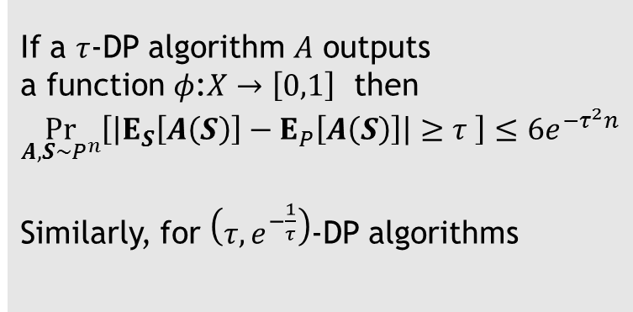

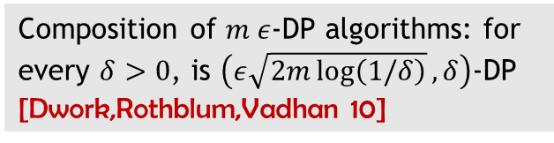
DP composes
adaptively
DP implies
generalization
If a $τ$-DP algorithm $A$ outputs
a function $φ$:$X→\left[0,1\right]$ then
$$\underset{A,S∼P^{n}}{Pr}\left[\left|E_{S}\left[A\left(S\right)\right]−E_{P}\left[A\left(S\right)\right]\right|≥τ \right]≤{6e}^{{−τ}^{2}n}$$
Similarly, for $\left(τ,e^{−\frac{1}{τ}}\right)$-DP algorithms
Composition of $m ε$-DP algorithms: for every $δ>0$, is $\left(ε\sqrt{2m\log\left(1/δ\right)},δ\right)$-DP
[Dwork,Rothblum,Vadhan 10]
RO stability: $\left|\underset{A,S∼P^{n}}{E}\left[E_{S}\left[A\left(S\right)\right]−E_{P}\left[A\left(S\right)\right] \right]\right|≤τ$

Slide 22
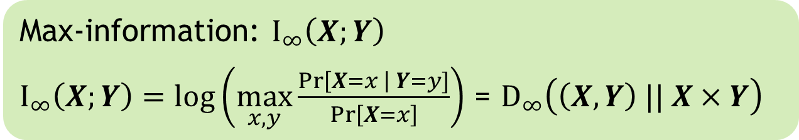

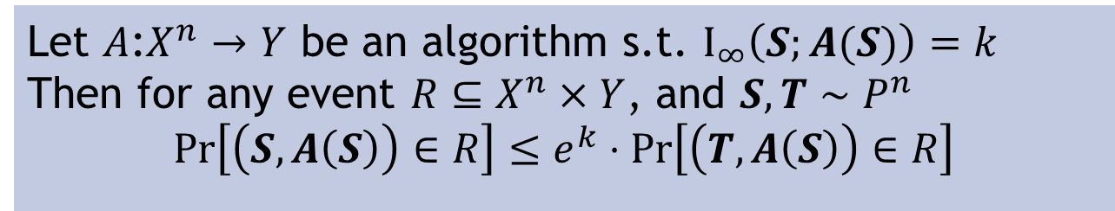
Proof ideas
If a $τ$-DP algorithm $A$ outputs a function then
${|E}_{S}\left[A(S)\right]−E_{P}[A(S)]|≤τ$ with high prob. over $S∼P^{n}$
Define $R =\left\{\left(S,φ\right) s.t. \left|E_{S}\left[φ\right]−E_{P}\left[φ\right]\right|>τ\right\}$
Then $Pr\left[\left(T,A\left(S\right)\right)∈R\right]≤2 exp⁡(−2τ^{2}n)$
$k≤τ^{2}n$ gives $Pr\left[{|E}_{S}\left[A(S)\right]−E_{P}[A(S)]|>τ\right]≤2 exp⁡(−τ^{2}n)$
Max-information: $I_{∞}\left(X;Y\right)$
$I_{∞}\left(X;Y\right)=log\left(\max_{x,y}\frac{Pr\left[X=x \right| Y=y]}{Pr\left[X=x\right]}\right)$ = $D_{∞}\left(\left(X,Y\right) || X×Y\right)$
Let $A$:$X^{n}→Y$ be an algorithm s.t. $I_{∞}\left(S;A(S)\right)=k$
Then for any event $R⊆X^{n}×Y$, and $S,T∼P^{n}$
$$Pr\left[\left(S,A\left(S\right)\right)∈R\right]≤e^{k}⋅Pr\left[\left(T,A\left(S\right)\right)∈R\right]$$

Slide 23
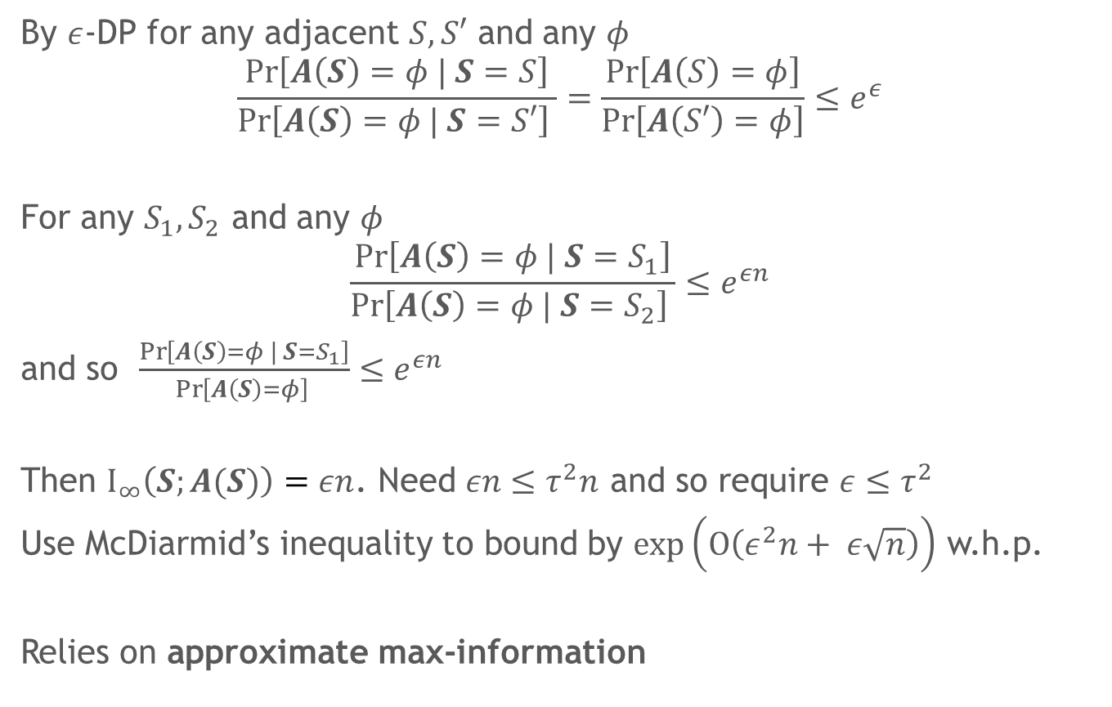

Bounding $I_{∞}\left(S;A(S)\right)$
By $ε$-DP for any adjacent $S,S′$ and any $φ$
$$\frac{\operatorname{Pr}\left[A\left(S\right)=φ | S=S\right]}{\operatorname{Pr}\left[A\left(S\right)=φ | S=S′\right] }=\frac{\operatorname{Pr}\left[A\left(S\right)=φ\right]}{\operatorname{Pr}\left[A\left(S′\right)=φ\right]}≤e^{ε}$$
For any $S_{1},S_{2}$ and any $φ$
$$\frac{\operatorname{Pr}\left[A\left(S\right)=φ | S=S_{1}\right]}{\operatorname{Pr}\left[A\left(S\right)=φ | S=S_{2}\right] }≤e^{εn}$$
and so $\frac{\operatorname{Pr}\left[A\left(S\right)=φ | S=S_{1}\right]}{\operatorname{Pr}\left[A\left(S\right)=φ\right] }≤e^{εn}$
Then $I_{∞}\left(S;A(S)\right)=εn$. Need $εn≤τ^{2}n$ and so require $ε≤τ^{2}$
Use McDiarmid’s inequality to bound by $exp\left(O\left(ε^{2}n+ ε\sqrt{n}\right)\right)$ w.h.p.
Relies on approximate max-information

Slide 24

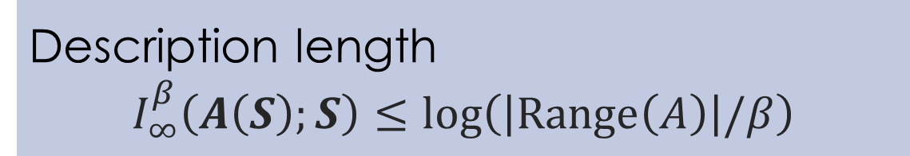
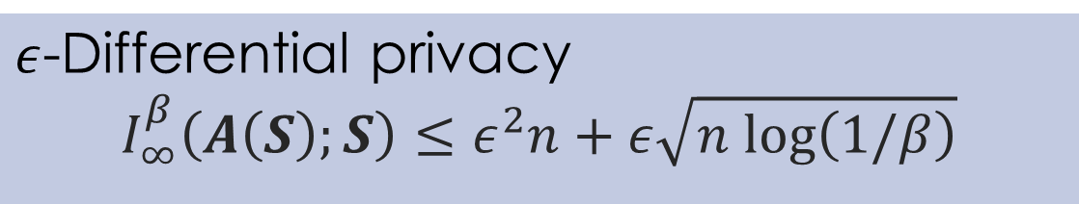
Approximate max-information: $I_{∞}^{β}(A\left(S\right);S)$
Preserves generalization
Composes adaptively
$ε$-Differential privacy
$$I_{∞}^{β}\left(A\left(S\right);S\right)≤ε^{2}n+ε\sqrt{n log\left(1/β\right)}$$
Description length
$$I_{∞}^{β}\left(A\left(S\right);S\right)≤log\left(\left|Range\left(A\right)\right|/β\right)$$
Notes:
Can be used to analyze any algorithm.

Slide 25


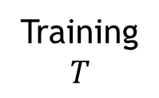
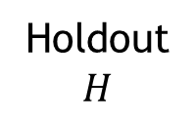
Reusable holdout
Data
Data
Data
Training
$$T$$
Data
Data
Data
Holdout
$$H$$
$$φ_{1}$$
$$v_{1}$$
$$φ_{2}$$
$$v_{2}$$
$$H$$
$$φ_{m}$$
$$v_{m}$$
Reusable Holdout algorithm
Analyst(s)

Slide 26
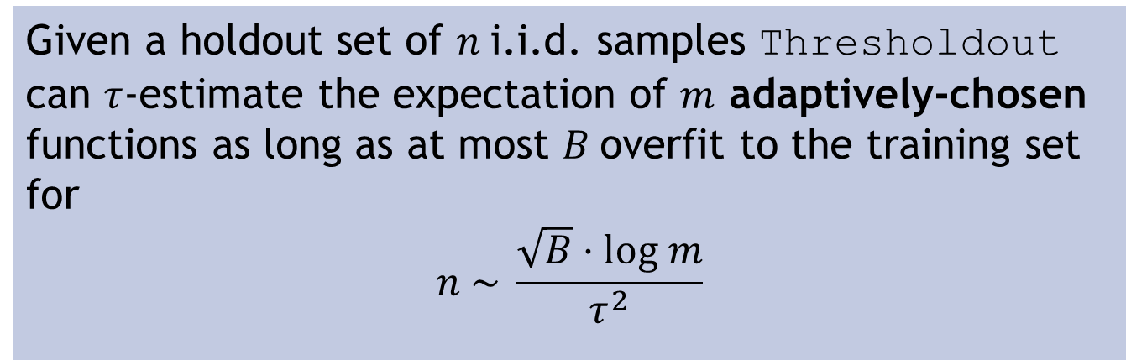

Reusable holdout
Given a holdout set of $n$i.i.d. samples Thresholdout can $τ$-estimate the expectation of $m$ adaptively-chosen functions as long as at most $B$overfit to the training set for
$$n \sim \frac{\sqrt{B}⋅log m}{τ^{2}}$$
Overfitting: $\left|E_{T}[φ]−E_{P}[φ]\right|>τ/2$
Standard holdout (empirical mean): $n \sim \frac{m log m}{τ^{2 }}$
Notes:
We know reasonably well what the test set is used for: primarily to estimate the error.

Slide 27
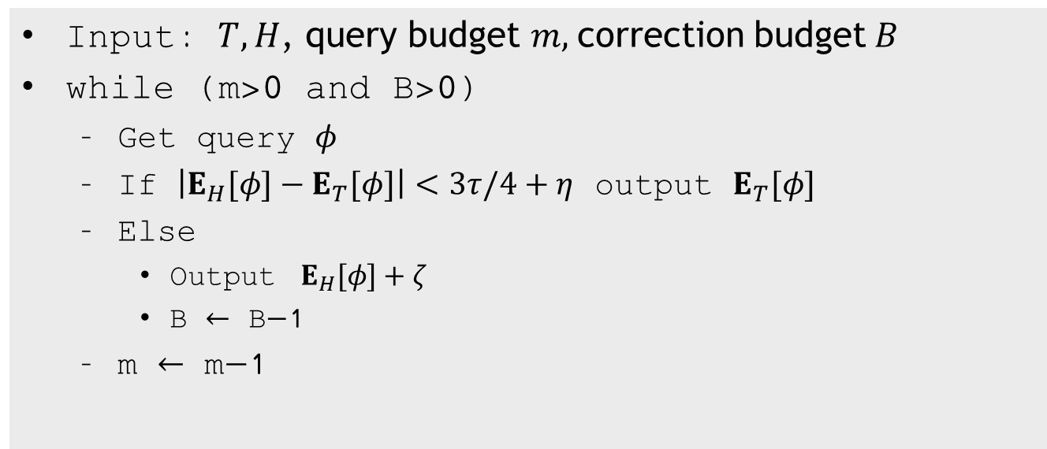
Thresholdout algorithm
Input: $T,H$, query budget $m,$correction budget$B$
while (m>0 and B>0)
Get query $φ$
If $\left|E_{H}[φ]−E_{T}[φ]\right|<3τ/4+η$ output $E_{T}[φ]$
Else
Output $E_{H}[φ]+ζ$
B $←$ B$−$1
m $←$ m$−$1
noise
noise

Slide 28
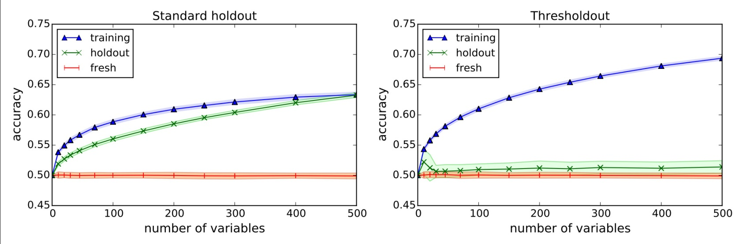

Illustration
Given points in $R^{d}×\left\{−1,+1\right\}$
Pick variables correlated with the label on the training set. Validate on the holdout set.
$V$ is the set of variables correlated on both training and holdout
Check prediction error of the linear classifier given by
$sign\left(\sum_{i∈V }{ s_{i}x_{i}}\right)$ where $s_{i}$ is the sign of the correlation
Data distribution: 10,000 points from $N{\left(0,1\right)}^{10,000}$ randomly labeled

Slide 29
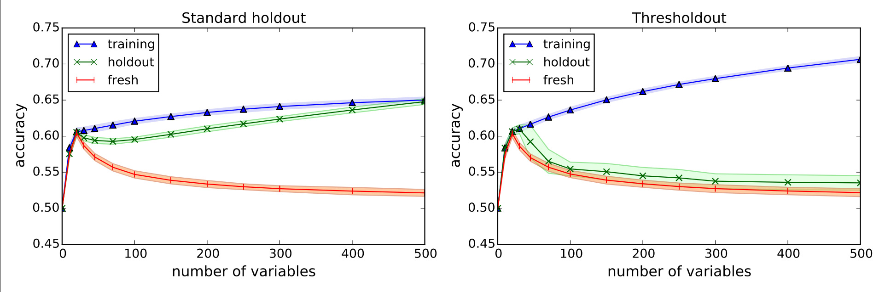

More experiments
Randomly labeled with 20 truly correlated normal variables
the rest uncorrelated $N(0,1)$

Slide 30
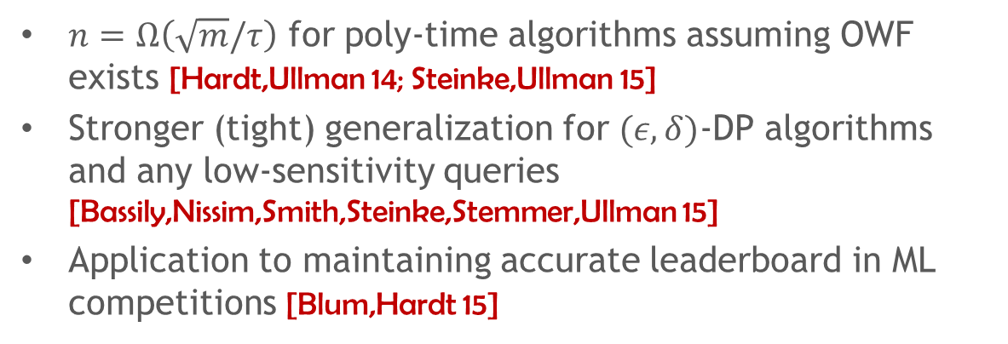
Further reading
Preserving Statistical Validity in Adaptive Data Analysis, http://arxiv.org/abs/1411.2664 [STOC 2015]
Generalization in Adaptive Data Analysis and Holdout Reuse http://arxiv.org/abs/1506.02629 [NIPS 2015]
Overview: Reusable holdout: Preserving validity in adaptive data analysis.
[Science, 2015]
Come to workshop on “Adaptive Data Analysis” at NIPS 2015! wadapt.org
$n=$ $Ω\left(\sqrt{m}/τ\right)$ for poly-time algorithms assuming OWF exists [Hardt,Ullman 14; Steinke,Ullman 15]
Stronger (tight) generalization for $(ε,δ)$-DP algorithms and any low-sensitivity queries [Bassily,Nissim,Smith,Steinke,Stemmer,Ullman 15]
Application to maintaining accurate leaderboard in ML competitions [Blum,Hardt 15]

