Slide 1
Sample Complexity Bounds on Differentially Private Learning via Communication Complexity
Vitaly Feldman David Xiao
IBM Research – Almaden CNRS, Universite Paris 7
ITA, 2015

Slide 2

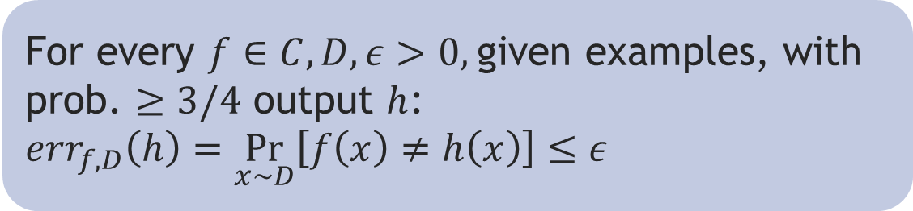
Learning model
Learner has $n$i.i.d. examples:
$\left(x_{1},y_{1}\right),…,\left(x_{n},y_{n}\right)$ over $X×\{0,1\}$
PAC model [V 84]:
each $x_{i}∼D$ and $y_{i}=f(x_{i})$ for unknown $D$ and $f∈C$
For every $f∈C,D, ε>0,$given examples, with prob. $≥3/4$ output $h$: ${err}_{f,D}\left(h\right)=\underset{x∼D}{Pr}\left[f\left(x\right)≠h\left(x\right)\right]≤ε$

Slide 3


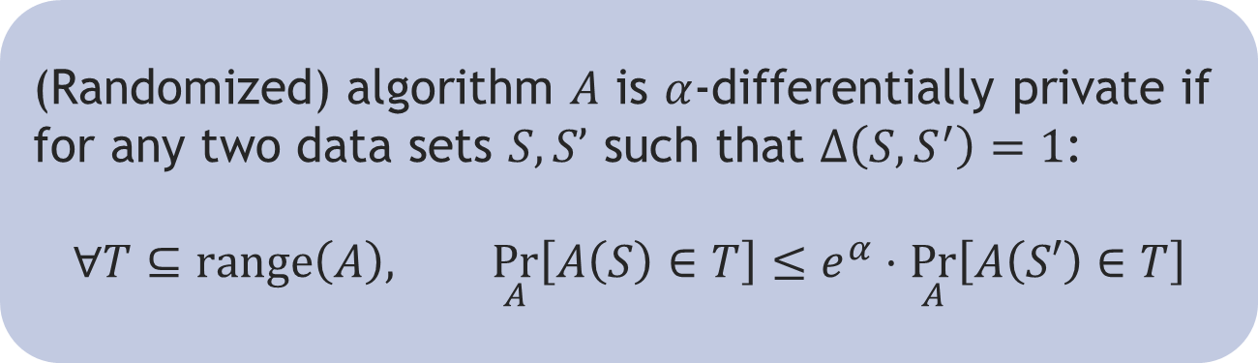
Privacy
Each example is created from
personal data of an individual
$(x_{i},y_{i})$ = (GTTCACG…TC, “YES”)
Differential Privacy [DMNS 06]
(Randomized) algorithm $A$ is $α$-differentially private if
for any two data sets $S,S’$ such that $Δ\left(S,S^{′}\right)=1$:
$$∀T⊆range\left(A\right), \underset{A}{Pr}\left[A\left(S\right)∈T\right]≤e^{α}⋅\underset{A}{Pr}\left[A\left(S′\right)∈T\right]$$

Slide 4

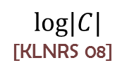





What is the cost of privacy?
$SCDP(C)$ = sample complexity of PAC learning $C$with $ε=1/4$ and $1$-differential privacy
$${Thr}_{b}$$
$$Points$$
$$log|C|$$
[KLNRS 08]
$VCDIM$($C$)
$$SCDP(C)$$
$Points$:
$\left\{I{ND}_{a} \right|a∈X\}; IND_{a}\left(x\right)=1$ iff $x=a$
$SCDP\left(Points\right)=O(1)$ [F 09, BKN 10]
${Thr}_{b}$:
$X=\left\{1,…,2^{b}\right\}; GT_{a}\left(x\right)=1$ iff $x≥a$ ; ${Thr}_{b}=\left\{{GT}_{a} \right|a∈X\};$
$VCDIM\left({Thr}_{b}\right)=1$; $log\left(\left|{Thr}_{b}\right|\right)=b$

Slide 5

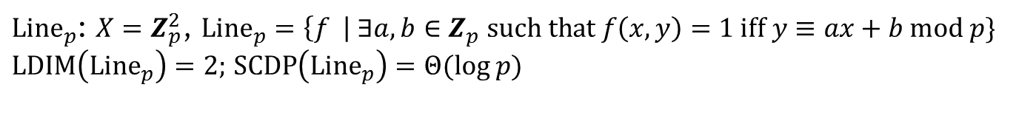




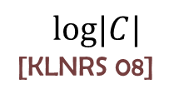
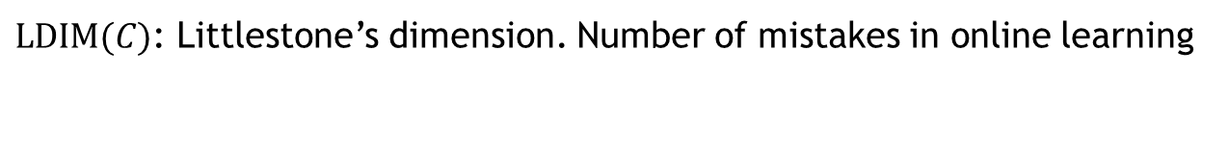

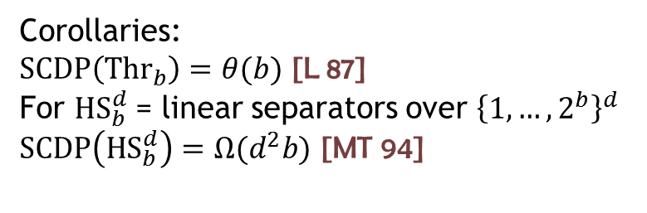
Our results: lower bounds
$${Thr}_{b}$$
$${Line}_{p}$$
$${Point}_{b}$$
$$log|C|$$
[KLNRS 08]
$VCDIM$($C$)
$$LDIM(C)$$
$$SCDP(C)$$
$LDIM(C)$: Littlestone’s dimension. Number of mistakes in online learning
Corollaries:
$SCDP\left({Thr}_{b}\right)=θ(b)$ [L 87]
For $HS_{b}^{d}$= linear separators over ${\left\{1,…,2^{b}\right\}}^{d}$
$SCDP\left(HS_{b}^{d}\right)=Ω(d^{2}b)$ [MT 94]
${Line}_{p}$: $X=Z_{p}^{2}$, ${Line}_{p}=\left\{f \right| ∃a,b∈Z_{p} such that f\left(x,y\right)=1 iff y≡ax+b mod p\}$
$LDIM\left({Line}_{p}\right)=2;$ $SCDP\left({Line}_{p}\right)=Θ(log p)$

Slide 6
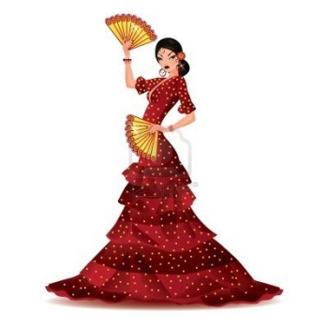
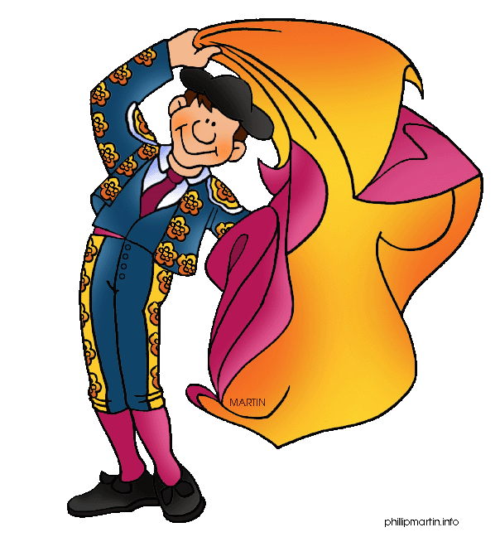



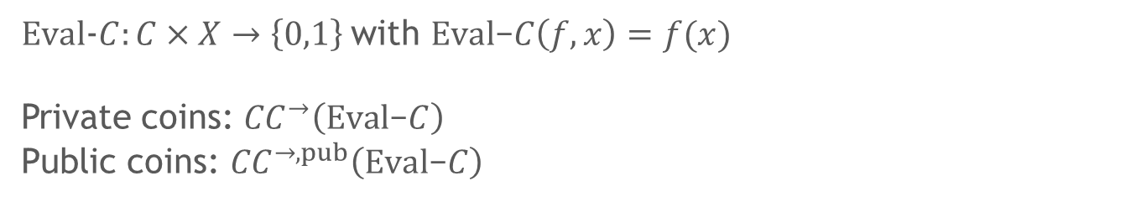
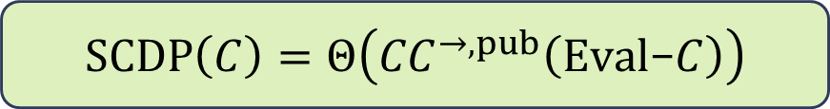



Our results: characterization
$$f∈C$$
$$x∈X$$
$$σ$$
Alicia
Roberto
$$z$$
$∀x∈X,f∈C,$ $Pr\left[z≠f\left(x\right)\right]≤1/4$
$Eval$-$C:C×X→\left\{0,1\right\}$with $Eval\text{−}C\left(f,x\right)=f(x)$
Private coins: ${CC}^{→}\left(Eval\text{−}C\right)$
Public coins: ${CC}^{→,pub}\left(Eval\text{−}C\right)$
$SCDP\left(C\right)=Θ\left({CC}^{→,pub}\left(Eval\text{−}C\right)\right)$

Slide 7

Related results
Distributional assumptions/Label privacy only/Count only labeled
$Θ\left(VCDIM\left(C\right)\right)$ [CH 11, BNS 15]
Characterization in terms of distribution independent covers:
$SCDP\left(C\right)=Θ\left(RCOVER\left(C\right)\right)$ [BNS 13a]

Slide 8

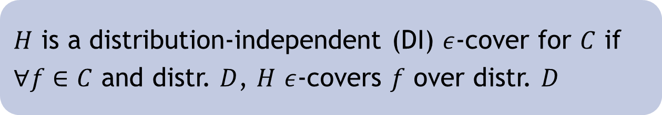
Distribution-independent covers
$H$ $ε$-covers $f$ over distr. $D$ if $∃h∈H$ s.t$. err_{f,D}\left(h\right)≤ε$
$COVER\left(C\right)=min\left\{log \left|H\right| \right| H$is DI $1/4$-cover for $C\}$
Proof: exponential mechanism [MT 07]
$H$ is a distribution-independent (DI) $ε$-cover for $C$ if
$∀f∈C$ and distr. $D$, $H$ $ε$-covers $f$ over distr. $D$
Thm:$SCDP\left(C\right)=O(COVER\left(C\right))$ [KLNRS 08, BKN 10]

Slide 9
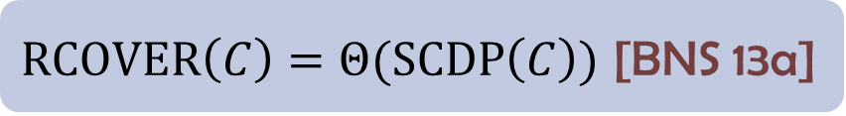

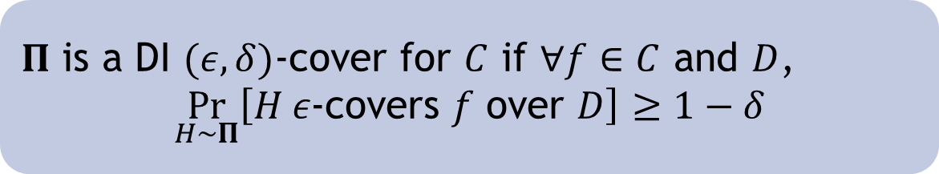
Randomized DI covers
Let $Π$ be a distribution over sets of hypotheses
size($Π$)$=\max_{H∈supp(Π)}{|H|}$
$RCOVER\left(C\right)=min\left\{log size\left(Π\right) \right| Π$ is DI $\left(\frac{1}{4},\frac{1}{4}\right)$-cover for $C\}$
$Π$ is a DI $(ε,δ)$-cover for $C$ if $∀f∈C$ and $D$,
$$\underset{H∼Π}{Pr}\left[H ε\text{-}\text{covers} f \text{over} D\right]≥1−δ$$
$RCOVER\left(C\right)=Θ(SCDP\left(C\right))$ [BNS 13a]

Slide 10

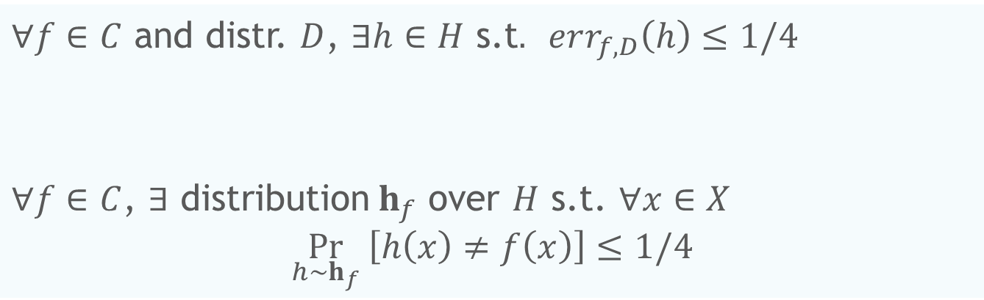




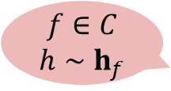
From covers to CC
$∀f∈C$ and distr. $D$, $∃h∈H$ s.t$. err_{f,D}\left(h\right)≤1/4$
$∀f∈C$, $∃$ distribution$h_{f}$ over $H$ s.t. $∀x∈X$
$$\underset{h∼h_{f}}{Pr} \left[h\left(x\right)≠f\left(x\right)\right]≤1/4$$
von Neumann minimax
$$f∈C$$
$$h∼h_{f}$$
$$x∈X$$
$$h$$
$$h(x)$$
CC$\left(π\right)=\log{|H|}$
$∀f∈C, x∈X,$ $Pr\left[h\left(x\right)≠f\left(x\right)\right]≤1/4$

Slide 11


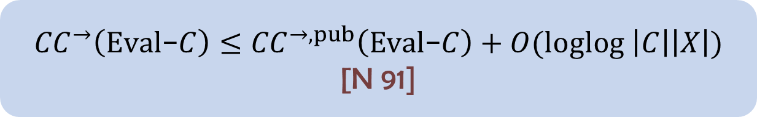
From covers to CC
$COVER\left(C\right)=Θ\left({CC}^{→}\left(Eval\text{−}C\right)\right)$
$RCOVER\left(C\right)=Θ\left({CC}^{→,pub}\left(Eval\text{−}C\right)\right)$
$${CC}^{→}\left(Eval\text{−}C\right)≤{CC}^{→,pub}\left(Eval\text{−}C\right)+O(loglog \left|C\right|\left|X\right|)$$
[N 91]

Slide 12




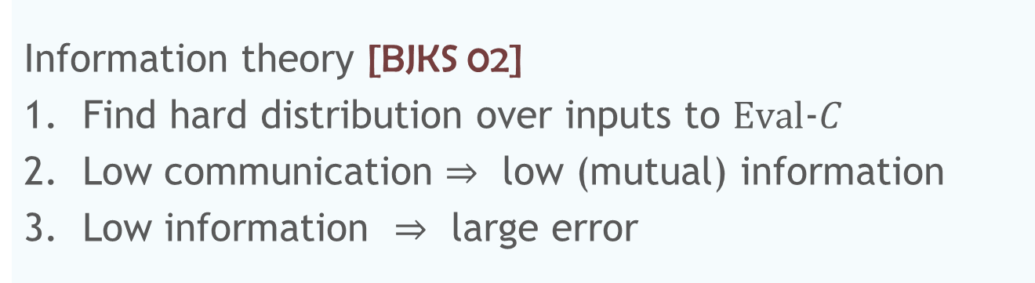




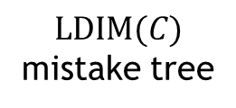








Lower bound tools
Information theory [BJKS 02]
Find hard distribution over inputs to $Eval$-$C$
Low communication $⇒$ low (mutual) information
Low information $⇒$ large error
Augmented Index
[BJKK 04, BIPW 10]
$${ x}_{∅}$$
$${ x}_{0}$$
$${ x}_{1}$$
0 | 1 | 0 | 0 | 0 | 1 | 0 | 1 | 0 | 1
$${ x}_{0..0}$$
$${ x}_{0..1}$$
$${ x}_{1..0}$$
$${ x}_{1..1}$$
0 | 1 | 0 | 0 | 0
$${ f}_{0..00}$$
$${ f}_{0..01}$$
$${ f}_{0..10}$$
$${ f}_{0..11}$$
$${ f}_{1..00}$$
$${ f}_{1..01}$$
$${ f}_{1..10}$$
$${ f}_{1..11}$$
$$LDIM(C)$$
mistake tree

Slide 13
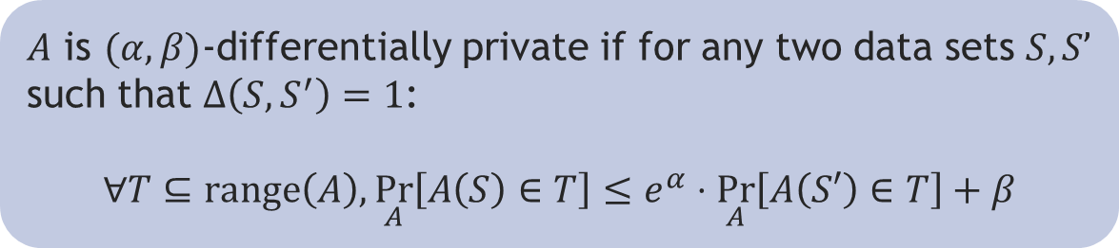

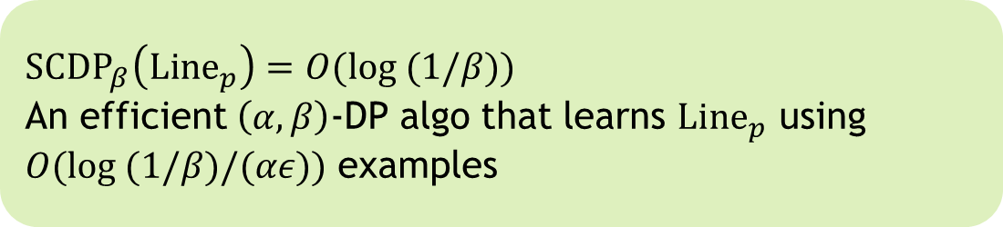
Our results: upper bounds
Relaxed $(α,β)$-differential privacy
${SCDP}_{β}\left({Thr}_{b}\right)=O({16}^{\log^{∗}b} log (1/β))$ [BNS 13b]
$A$ is $(α,β)$-differentially private if for any two data sets $S,S’$ such that $Δ\left(S,S^{′}\right)=1$:
$$∀T⊆range\left(A\right),\underset{A}{Pr}\left[A\left(S\right)∈T\right]≤e^{α}⋅\underset{A}{Pr}\left[A\left(S′\right)∈T\right]+β$$
${SCDP}_{β}\left({Line}_{p}\right)=O(log (1/β))$
An efficient $\left(α,β\right)$-DP algo that learns ${Line}_{p}$ using $O(log (1/β)/(αε))$ examples

Slide 14

Conclusions and open problems
Characterization in terms of communication
Tools from information theory
Additional applications
Is sample complexity of $\left(α,β\right)$-diff. private learning different from $VCDIM$?
What is the sample complexity of efficient DP learning of $HS_{b}^{d}$?

Slide 15
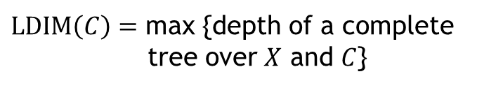

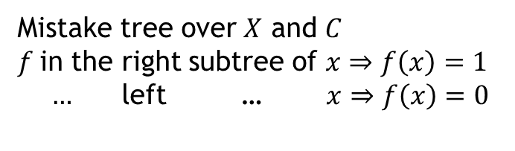

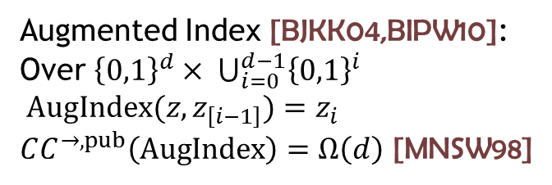
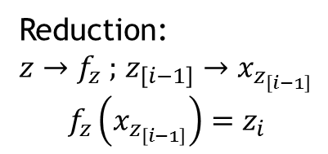
From LDIM to AugIndex
$${ x}_{∅}$$
Mistake tree over $X$ and $C$
$f$in the right subtree of $x⇒f\left(x\right)=1$
$…$ left … $x⇒f\left(x\right)=0$
$x_{z_{\left[i−1\right]}}$
$${ x}_{0}$$
$${ x}_{1}$$
$${ x}_{0..0}$$
$${ x}_{0..1}$$
$${ x}_{1..0}$$
$${ x}_{1..1}$$
$LDIM\left(C\right)=$ max {depth of a complete
tree over $X$ and $C$}
$${ f}_{0..00}$$
$${ f}_{0..01}$$
$${ f}_{0..10}$$
$${ f}_{0..11}$$
$${ f}_{1..00}$$
$${ f}_{1..01}$$
$${ f}_{1..10}$$
$${ f}_{1..11}$$
$$f_{z}$$
Augmented Index [BJKK04,BIPW10]:
Over ${\left\{0,1\right\}}^{d}× ⋃_{i=0}^{d−1}{\left\{0,1\right\}}^{i}$
$AugIndex(z,z_{\left[i−1\right]})=z_{i}$
$CC^{→,pub}\left(AugIndex\right)=Ω\left(d\right)$ [MNSW98]
Reduction:
$z→f_{z} ;$ $z_{\left[i−1\right]}→x_{z_{\left[i−1\right]}}$
$$f_{z}\left(x_{z_{\left[i−1\right]}}\right)=z_{i}$$

Slide 16

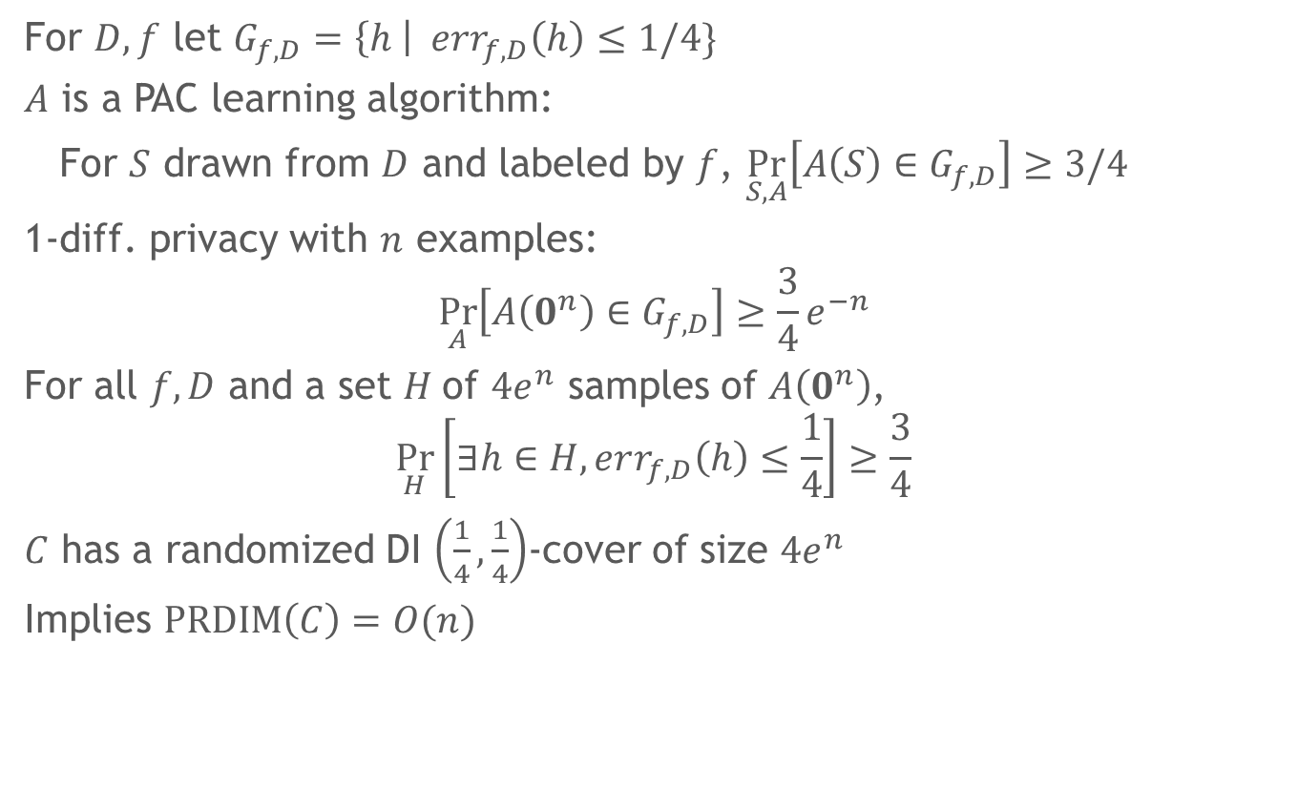
Randomized DI covers
For $D, f$ let $G_{f,D}=\left\{h \right| err_{f,D}\left(h\right)≤1/4\}$
$A$ is a PAC learning algorithm:
For $S$ drawn from $D$ and labeled by $f$, $\underset{S,A}{Pr}\left[A\left(S\right)∈G_{f,D}\right]≥3/4$
1-diff. privacy with $n$ examples:
$$\underset{A}{Pr}\left[A\left(0^{n}\right)∈G_{f,D}\right]≥\frac{3}{4}e^{−n}$$
For all $f,D$ and a set $H$of $4e^{n}$ samples of $A\left(0^{n}\right)$,
$$\underset{H}{Pr}\left[∃h∈H,err_{f,D}\left(h\right)≤\frac{1}{4}\right]≥\frac{3}{4}$$
$C$ has a randomized DI $\left(\frac{1}{4},\frac{1}{4}\right)$-cover of size $4e^{n}$
Implies $PRDIM\left(C\right)=O(n)$
$PRDIM\left(C\right)=Θ(SCDP\left(C\right))$ [BNS13a]

