Slide 1

Lower bounds against convex relaxations via statistical query complexity
Based on:
V. F., Will Perkins, Santosh Vempala. On the Complexity of Random Satisfiability Problems with Planted Solutions. STOC 2015
V. F., Cristobal Guzman, Santosh Vempala. Statistical Query Algorithms for Stochastic Convex Optimization. SODA 2017
V. F. A General Characterization of the Statistical Query Complexity. arXiv 2016
Vitaly Feldman
IBM Research – Almaden

Slide 2
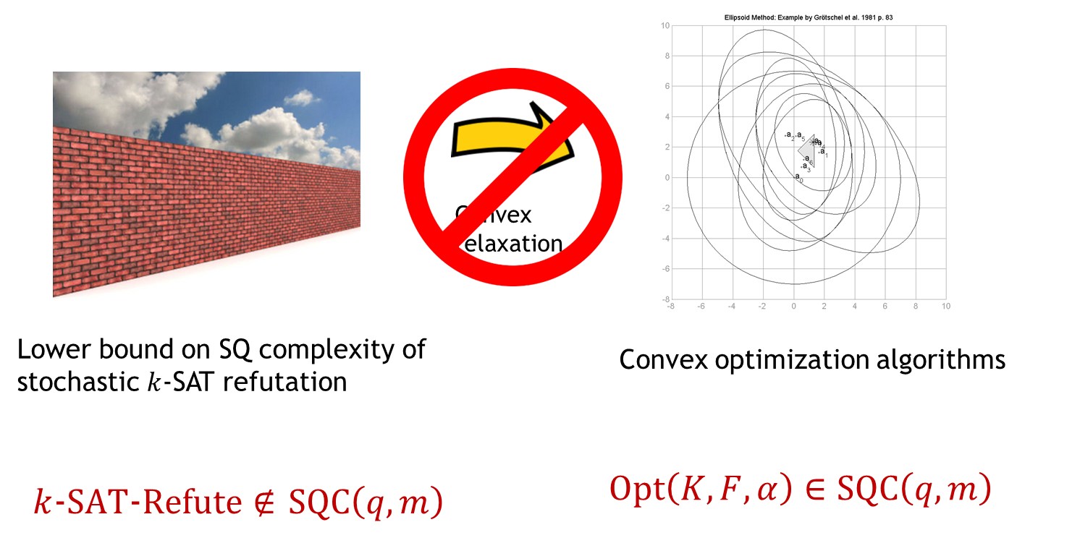
The plan
Boolean constraint satisfaction problems
Convex relaxations
Comparison with lower bounds against LP/SDP hierarchies
(Known) sign-rank lower bounds via SQ complexity

Slide 3

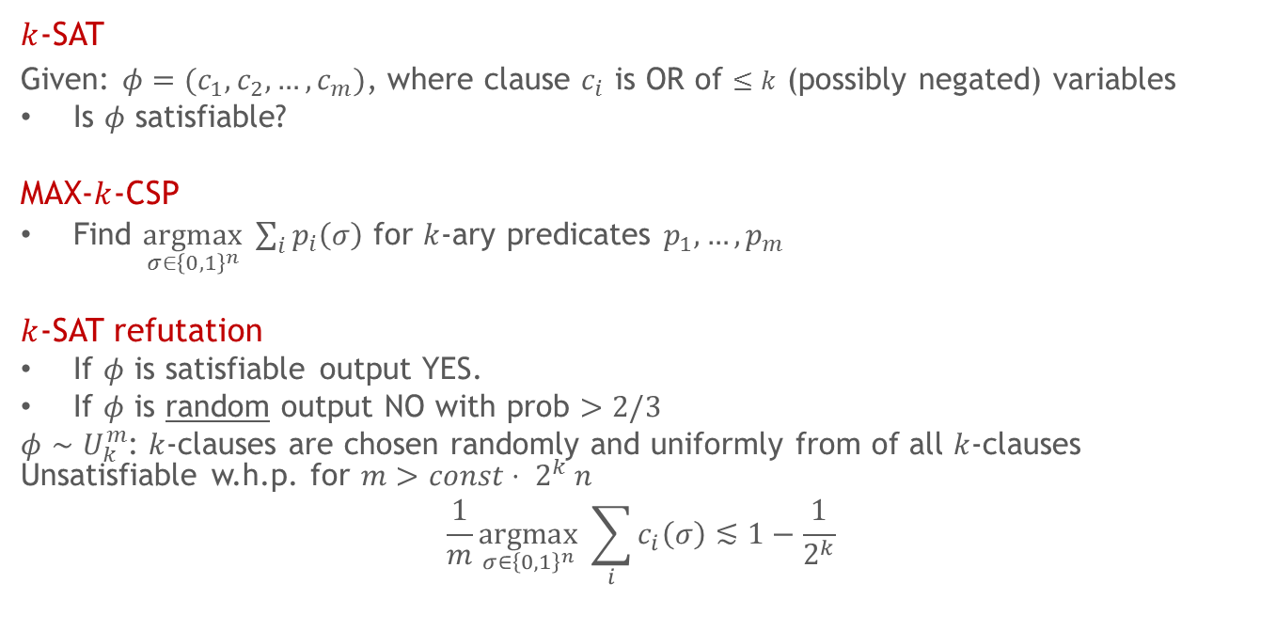
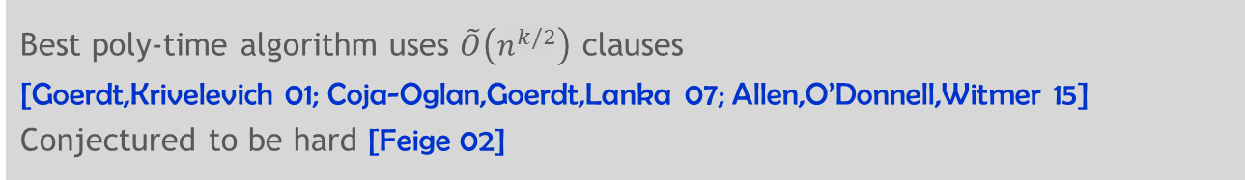
MAX-CSPs
$k$-SAT
Given: $φ=(c_{1},c_{2},…,c_{m})$, where clause $c_{i}$ is OR of $≤k$ (possibly negated) variables
Is $φ$ satisfiable?
MAX-$k$-CSP
Find $\underset{σ∈{\left\{0,1\right\}}^{n}}{argmax} \sum_{i}{p_{i}\left(σ\right)}$ for $k$-ary predicates $p_{1},…,p_{m}$
$k$-SAT refutation
If $φ$ is satisfiable output YES.
If $φ$ is random output NO with prob $>2/3$
$φ∼U_{k}^{m}$: $k$-clauses are chosen randomly and uniformly from of all $k$-clauses Unsatisfiable w.h.p. for $m>const⋅ 2^{k} n$
$$\frac{1}{m}\underset{σ∈{\left\{0,1\right\}}^{n}}{argmax} \sum_{i}{c_{i}\left(σ\right)}≲1−\frac{1}{2^{k}}$$
Best poly-time algorithm uses $\tilde{O}\left(n^{k/2}\right)$ clauses
[Goerdt,Krivelevich 01; Coja-Oglan,Goerdt,Lanka 07; Allen,O’Donnell,Witmer 15]
Conjectured to be hard [Feige 02]

Slide 4


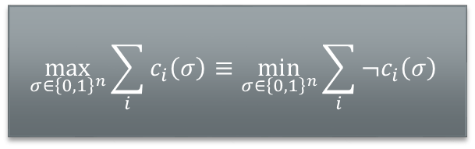
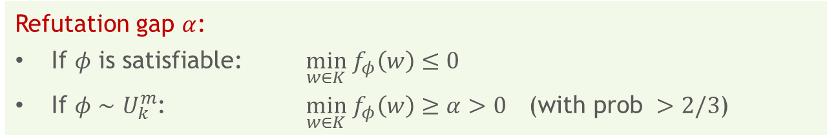
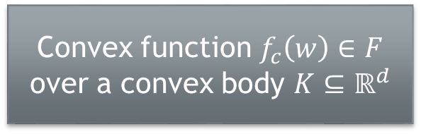
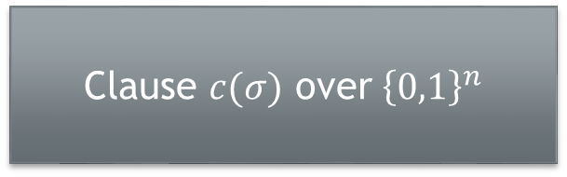
Convex relaxation for MAX-CSPs
Objective-wise mapping:
Denote $f_{φ}≐\frac{1}{m}\sum_{i}{f_{c_{i}}}$
Which $(K,F,α)$ allow such mappings?
Clause $c(σ)$ over ${\left\{0,1\right\}}^{n}$
Convex function $f_{c}\left(w\right)∈F$ over a convex body $K⊆ℝ^{d}$
$$\max_{σ∈{\left\{0,1\right\}}^{n}}\sum_{i}{c_{i}\left(σ\right)}≡\min_{σ∈{\left\{0,1\right\}}^{n}}\sum_{i}{¬c_{i}\left(σ\right)}$$
$$\min_{w∈K}\sum_{i}{f_{c_{i}}\left(w\right)}$$
Refutation gap $α$:
$\text{If} φ \text{is} \text{satisfiable}\text{:}$ $\min_{w∈K} f_{φ}\left(w\right)≤0$
$\text{If} φ∼U_{k}^{m}$: $\min_{w∈K} f_{φ}\left(w\right)≥α>0$ ($\text{with} \text{prob} >2/3$)
Notes:
Can kCSPs be solved using convex programming? Only need to rule out relaxations for which the convex optimization problem can be solved efficiently. The complexity depends on K, F, and alpha

Slide 5
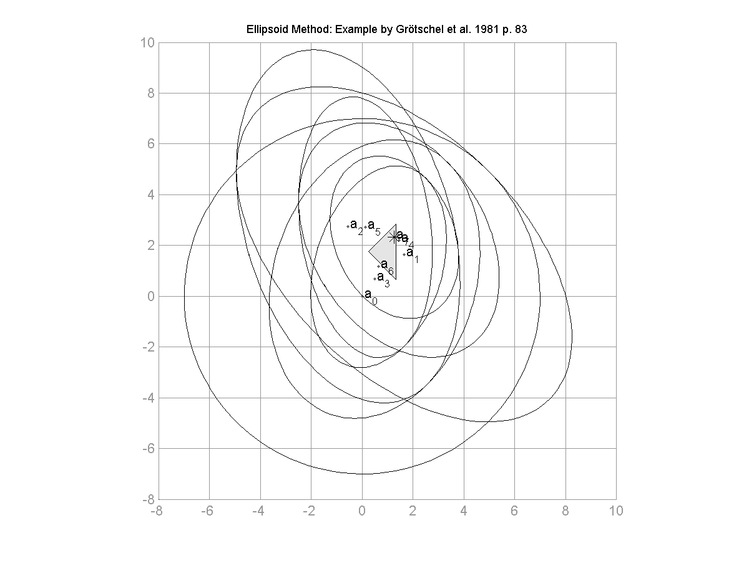
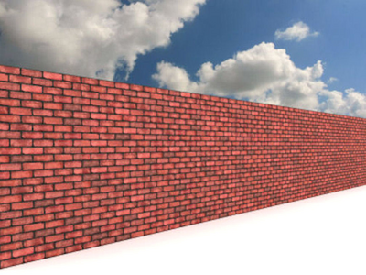

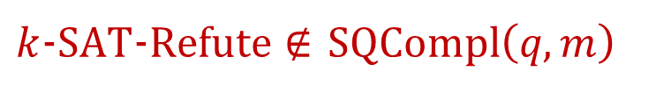
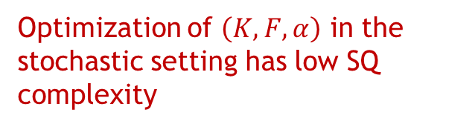

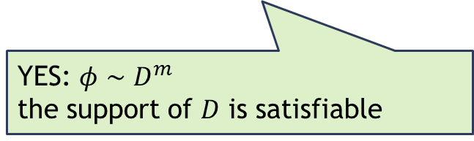
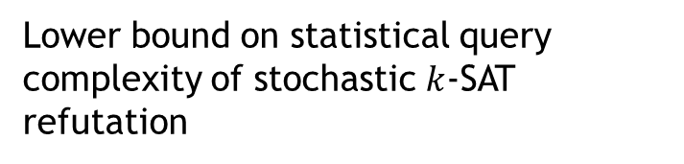
Outline
Convex
relaxation
Lower bound on statistical query complexity of stochastic $k$-SAT refutation
Convex optimization algorithms
Optimization of $\left(K,F,α\right)$ in the stochastic setting has low SQ complexity
YES: $φ∼D^{m}$
the support of $D$ is satisfiable
$k$-$SAT$-$Refute∉$ $SQCompl\left(q,m\right)$
$$Opt\left(K,F,α\right)∈SQCompl\left(q,m\right)$$
Notes:
Convex relaxation is a reduction from stochastic k-SAT and stochastic convex optimization
If for (F,K,\alpha) the upper bound for SCO is lower than the lower bound for k-SAT then obtain a contradiction

Slide 6
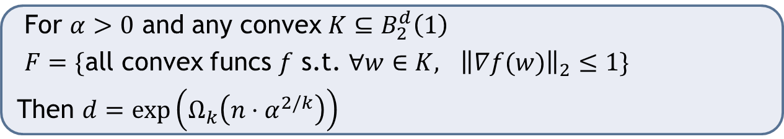

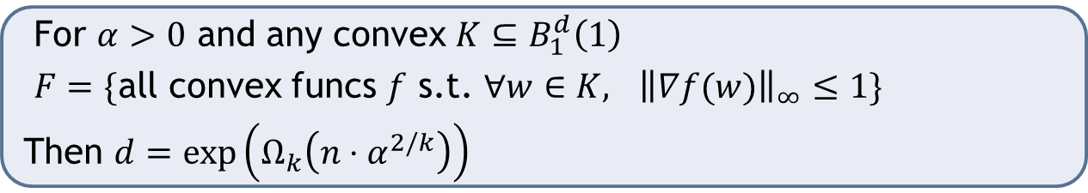
Lower bound example I
$ℓ_{2}$-Lipschitz convex optimization needs $d=exp⁡(n⋅α^{2/k})$
$ℓ_{1}$-Lipschitz convex optimization needs $d=exp⁡(n⋅α^{2/k})$
For $α>0$ and any convex $K⊆B_{2}^{d}\left(1\right)$
$F=\{$all convex funcs $f$ s.t. $∀w∈K,$ ${\left\|∇f(w)\right\|}_{2}≤1\}$
Then $d=\exp\left(Ω_{k}\left(n⋅α^{2/k}\right)\right)$
For $α>0$ and any convex $K⊆B_{1}^{d}\left(1\right)$
$F=\{$all convex funcs $f$ s.t. $∀w∈K,$ ${\left\|∇f(w)\right\|}_{∞}≤1\}$
Then $d=\exp\left(Ω_{k}\left(n⋅α^{2/k}\right)\right)$

Slide 7
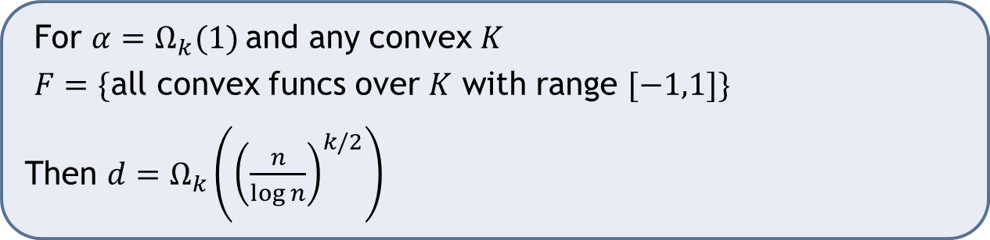

Lower bound example II
General convex optimization needs $d={{\tilde{Ω}}_{k}(n}^{k/2})$
For $α=Ω_{k}(1)$and any convex $K$
$F=\{$all convex funcs over $K$ with range $[−1,1]\}$
Then $d=Ω_{k}\left({\left(\frac{n}{\log{n}}\right)}^{k/2}\right)$

Slide 8
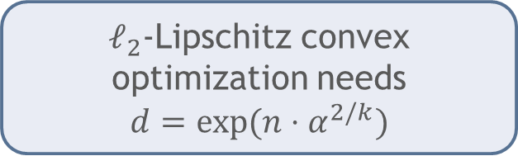
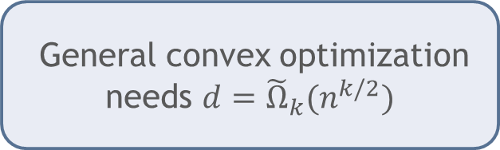
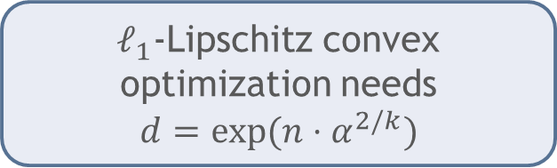
Lower bounds from algorithms
$ℓ_{2}$-Lipschitz convex optimization needs
$$d=exp⁡(n⋅α^{2/k})$$
Projected gradient descent
$ℓ_{1}\text{−}\text{Lipschitz}$ convex optimization needs
$$d=exp⁡(n⋅α^{2/k})$$
Entropic mirror descent
(multiplicative weights)
General convex optimization needs $d={{\tilde{Ω}}_{k}(n}^{k/2})$
Random walks
Center of gravity
Notes:
Many more lower bounds of this type can be easily obtained: different norms, exploit smoothness and/or strong convexity

Slide 9


Statistical queries [Kearns ‘93]
$x_{1},x_{2},…,x_{m}∼D$ over $X$
Notes:
Replace i.i.d. inputs from D with oracle access to D. The oracle approximately evaluates average of any function with range [-1,1]

Slide 10



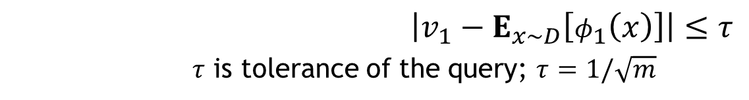
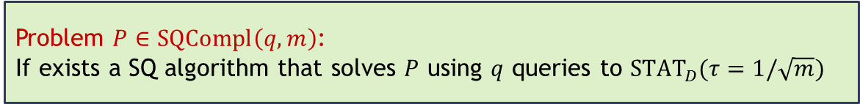







Statistical queries [Kearns ‘93]
$$φ_{1}$$
$$v_{1}$$
$$φ_{2}$$
$$v_{2}$$
$$D$$
$$φ_{q}$$
SQ algorithm
$$v_{q}$$
$STAT_{D}(τ)$ oracle
$\left|v_{1}−E_{x∼D}\left[φ_{1}\left(x\right)\right]\right|≤τ$
$τ$ is tolerance of the query; $τ=1/\sqrt{m}$
$$φ_{1}:X→\left[−1,1\right]$$
Problem $P∈SQCompl\left(q, m\right)$:
If exists a SQ algorithm that solves $P$ using $q$ queries to ${STAT}_{D}(τ=1/\sqrt{m})$
Notes:
Replace i.i.d. inputs from D with oracle access to D. The oracle approximately evaluates average of any function with range [-1,1]

Slide 11
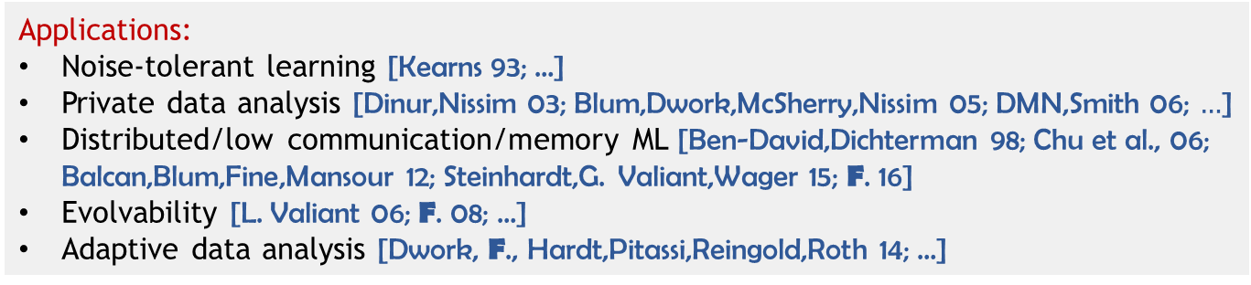
Statistical queries [Kearns ‘93]
$$φ_{1}$$
$$v_{1}$$
$$φ_{2}$$
$$v_{2}$$
$$D$$
$$φ_{q}$$
SQ algorithm
$$v_{q}$$
$STAT_{D}(τ)$ oracle
$\left|v_{1}−E_{x∼D}\left[φ_{1}\left(x\right)\right]\right|≤τ$
$τ$ is tolerance of the query; $τ=1/\sqrt{m}$
$$φ_{1}:X→\left[−1,1\right]$$
Applications:
Noise-tolerant learning [Kearns 93; …]
Private data analysis [Dinur,Nissim 03; Blum,Dwork,McSherry,Nissim 05; DMN,Smith 06; $…$]
Distributed/low communication/memory ML [Ben-David,Dichterman 98; Chu et al., 06; Balcan,Blum,Fine,Mansour 12; Steinhardt,G. Valiant,Wager 15; F. 16]
Evolvability [L. Valiant 06; F. 08; …]
Adaptive data analysis [Dwork, F., Hardt,Pitassi,Reingold,Roth 14; …]
Notes:
Replace i.i.d. inputs from D with oracle access to D. The oracle approximately evaluates average of any function with range [-1,1]

Slide 12
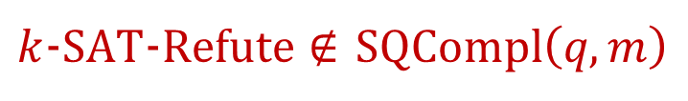

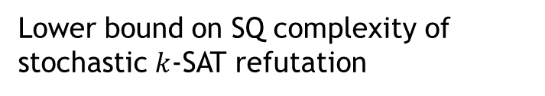
Outline
Convex
relaxation
Lower bound on SQ complexity of stochastic $k$-SAT refutation
Convex optimization algorithms
Optimization of $\left(K,F,α\right)$ in the stochastic setting has low SQ complexity
$k$-$SAT$-$Refute∉$ $SQCompl\left(q,m\right)$
$$Opt\left(K,F,α\right)∈SQCompl\left(q,m\right)$$

Slide 13




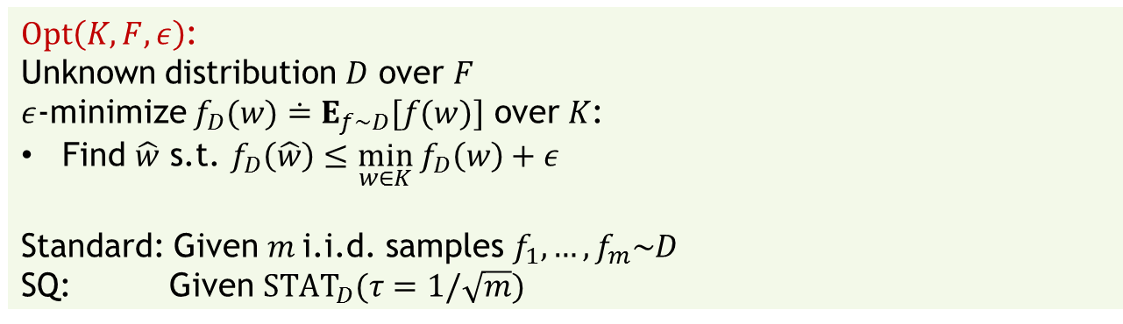
Stochastic convex optimization (SCO)
Convex body $K⊆ℝ^{d}$
Class of convex functions $F$ over $K$
What is the SQ complexity of $Opt\left(K,F,ε\right)$?
$Opt\left(K,F,ε\right)$:
Unknown distribution $D$ over $F$
$ε$-minimize $f_{D}(w)≐E_{f∼D}[f(w)]$ over $K$:
Find $\hat{w}$ s.t. $f_{D}\left(\hat{w}\right)≤\min_{w∈K} f_{D}\left(w\right)+ε$
Standard: Given $m$i.i.d. samples $f_{1},…,f_{m}\sim D$
SQ: Given ${STAT}_{D}(τ=1/\sqrt{m})$
$$f_{1}$$
$$f_{2}$$
$$…$$
$$f_{m}$$
$$f_{D}$$
$$w$$
Notes:
In SCO the goal is to optimize the expected function. Generalizes convex problems in ML/statistics

Slide 14
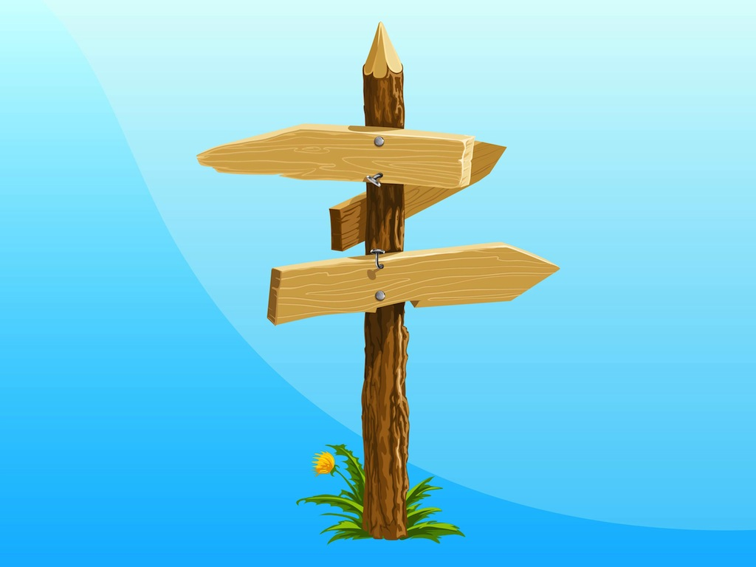
SQ algorithms for SCO
Reduction from an optimization oracle to SQ oracle
Direct analysis of an existing SCO algorithm
New/modified algorithm
Reductions
Hard work

Slide 15








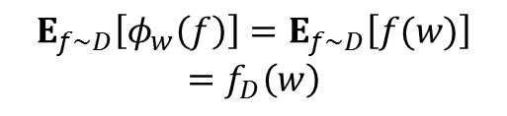
Zero-order/value oracle
𝜂-approximate value oracle for 𝑓 over $K⊆ℝ^{d}:$
Given $w∈K,$ ${Val}_{f}(η)$ returns $v$, $\left|v−f\left(w\right)\right|≤η$
$$f$$
$$w$$
If for all $f∈F,$ $range\left(f\right)⊆[−1,1]$ then for any $D$ over $F$, ${STAT}_{D}(η)$ can simulate ${Val}_{f_{D}}\left(η\right)$ [P.Valiant ‘11]
$$w$$
$$φ_{w}\left(f\right)≐f\left(w\right)$$
$$E_{f∼D}\left[φ_{w}\left(f\right)\right]=E_{f∼D}\left[f(w)\right]$$
$$=f_{D}\left(w\right)$$
$$v$$
$$D$$
$$STAT_{D}(η)$$
$${Val}_{f_{D}}\left(η\right)$$

Slide 16
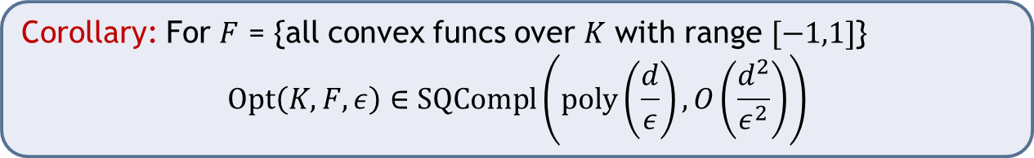
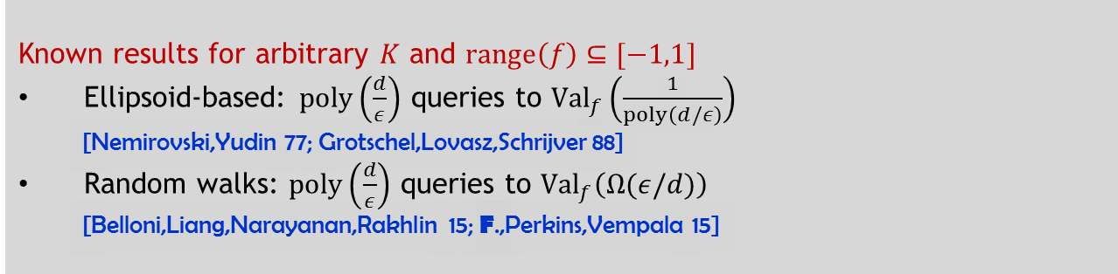
Corollaries
Known results for arbitrary $K$ and $range\left(f\right)⊆[−1,1]$
Ellipsoid-based: $poly\left(\frac{d}{ε}\right)$ queries to ${Val}_{f}\left(\frac{1}{poly\left(d/ε\right)}\right)$
[Nemirovski,Yudin 77; Grotschel,Lovasz,Schrijver 88]
Random walks: $poly\left(\frac{d}{ε}\right)$ queries to ${Val}_{f}\left(Ω(ε/d)\right)$
[Belloni,Liang,Narayanan,Rakhlin 15; F.,Perkins,Vempala 15]
Corollary: For $F$ = {all convex funcs over $K$ with range $[−1,1]$}
$$Opt\left(K,F,ε\right)∈SQCompl\left(poly\left(\frac{d}{ε}\right),O\left(\frac{d^{2}}{ε^{2}}\right)\right)$$
In high dimension weaker than full access/gradient oracle
[Nemirovski,Yudin ‘77; Singer,Vondrak ‘15; Li, Risteski ‘16]

Slide 17

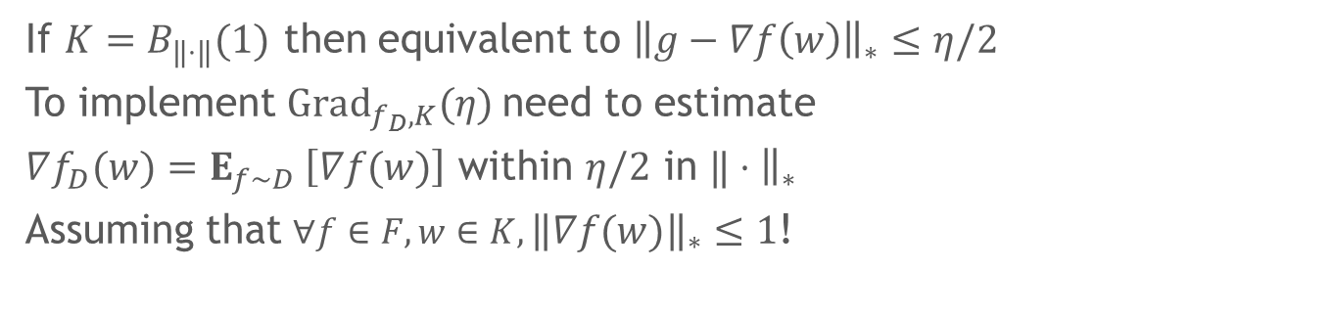






First-order/gradient oracles
Global approximate gradient oracle of $f$ over $K:$
Given $w∈K,$ ${Grad}_{f,K}(η)$ returns $g$, s.t. for all $u,v∈ K$
$$\left|〈g−∇f\left(w\right), v−u〉\right|≤η$$
$$f$$
$$f\left(w_{0}\right)+〈∇f\left(w_{0}\right),w−w_{0}〉$$
$$f\left(w_{0}\right)+〈g,w−w_{0}〉$$
$$w_{0}$$
$$w$$
$$\} η$$
If $K=B_{‖⋅‖}(1)$ then equivalent to ${\left\|g−∇f\left(w\right)\right\|}_{∗}≤η/2$
To implement ${Grad}_{f_{D},K}(η)$need to estimate
$∇f_{D}(w)=E_{f∼D} \left[∇f(w)\right]$ within $η/2$ in $‖⋅{\left.​\right\|}_{∗}$
Assuming that $∀f∈F, w∈K, {\left\|∇f\left(w\right)\right\|}_{∗}≤1$!
Notes:
Global approximate oracle behaves like the true oracle over the whole domain: linear approximation of f at every point is \eta close to the true one
The assumption on F imply that the gradients of functions in the support of D are uniformly bounded. This can be related to a bound on the variance

Slide 18
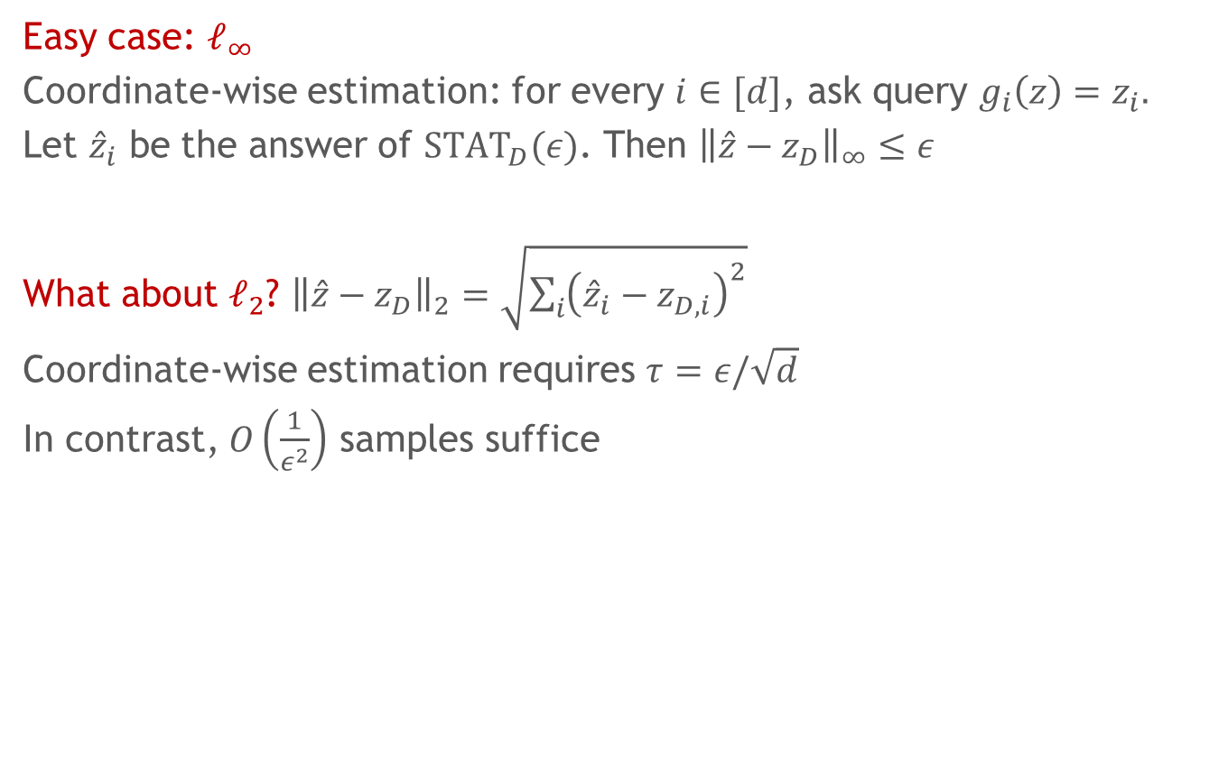
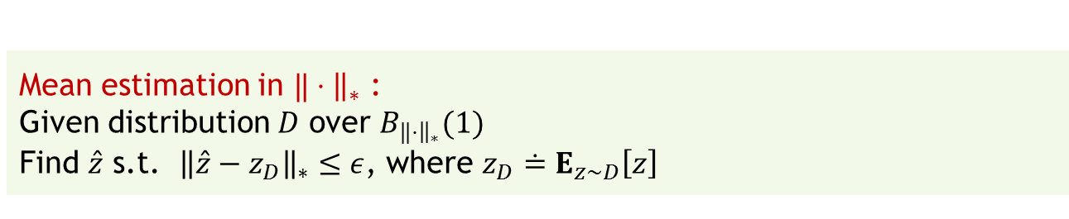
Mean vector estimation
Mean estimation in $‖⋅{\left.​\right\|}_{∗}$ :
Given distribution $D$ over $B_{‖⋅{\left.​\right\|}_{∗}}(1)$
Find $\hat{z}$ s.t. ${\left\|\hat{z}−z_{D}\right\|}_{∗}≤ε$, where ${z_{D}≐E}_{z∼D}\left[z\right]$
Easy case: $ℓ_{∞}$
Coordinate-wise estimation: for every $i∈[d]$, ask query $g_{i}\left(z\right)=z_{i}.$
Let ${\hat{z}}_{i}$ be the answer of ${STAT}_{D}(ε)$. Then ${\left\|\hat{z}−z_{D}\right\|}_{∞}≤ε$
What about $ℓ_{2}$? ${\left\|\hat{z}−z_{D}\right\|}_{2}=\sqrt{\sum_{i}{{\left({\hat{z}}_{i}−z_{D,i}\right)}^{2}}}$
Coordinate-wise estimation requires $τ=ε/\sqrt{d}$
In contrast, $O\left(\frac{1}{ε^{2}}\right)$ samples suffice
Notes:
We abstract the gradient estimation problem to estimation of mean vector.
The problem can be thought of as reducing high-dimensional concentration to one-dimensional.

Slide 19
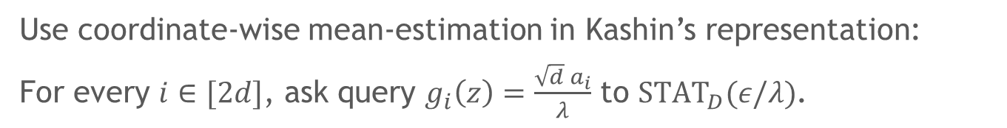
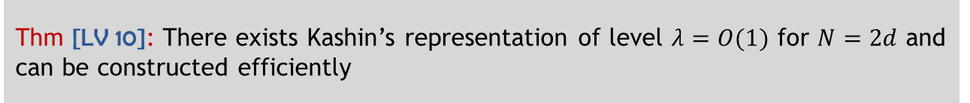
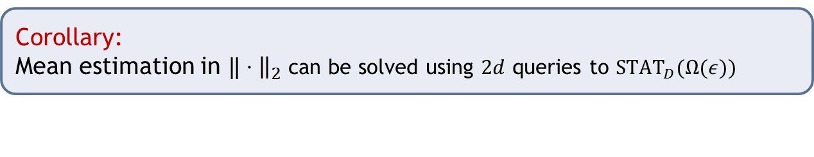
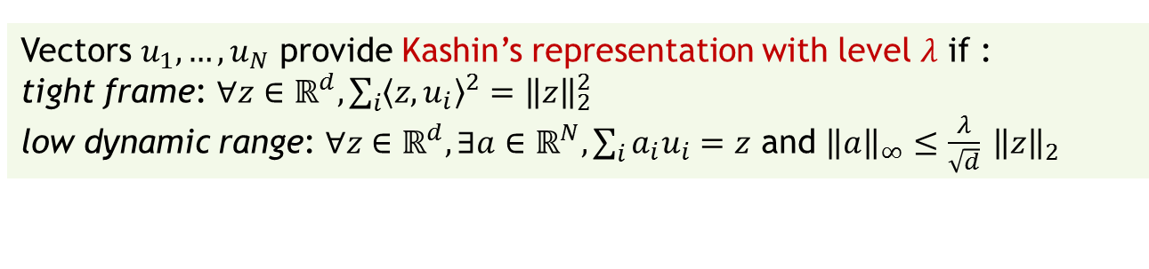
Kashin’s representation [Lyubarskii, Vershynin 10]
Vectors $u_{1},…,u_{N}$ provide Kashin’s representation with level $λ$ if :
tight frame: $∀z∈ℝ^{d}, \sum_{i}{{〈z,u_{i}〉}^{2}={\left\|z\right\|}_{2}^{2}}$
low dynamic range: $∀z∈ℝ^{d}, ∃a∈ℝ^{N}, \sum_{i}{a_{i}u_{i}=z}$ and ${\left\|a\right\|}_{∞}≤\frac{λ}{\sqrt{d}} {\left\|z\right\|}_{2}$
Thm [LV 10]: There exists Kashin’s representation of level $λ=O(1)$ for $N=2d$ and can be constructed efficiently
Use coordinate-wise mean-estimation in Kashin’s representation:
For every $i∈[2d]$, ask query $g_{i}\left(z\right)=\frac{\sqrt{d}{ a}_{i}}{λ}$ to ${STAT}_{D}(ε/λ)$.
Corollary:
Mean estimation in $‖⋅{\left.​\right\|}_{2}$ can be solved using $2d$ queries to ${STAT}_{D}(Ω(ε))$
Notes:
\ell_2 mean estimation
Improvement from \eps/\sqrt d matching sample complexity.

Slide 20
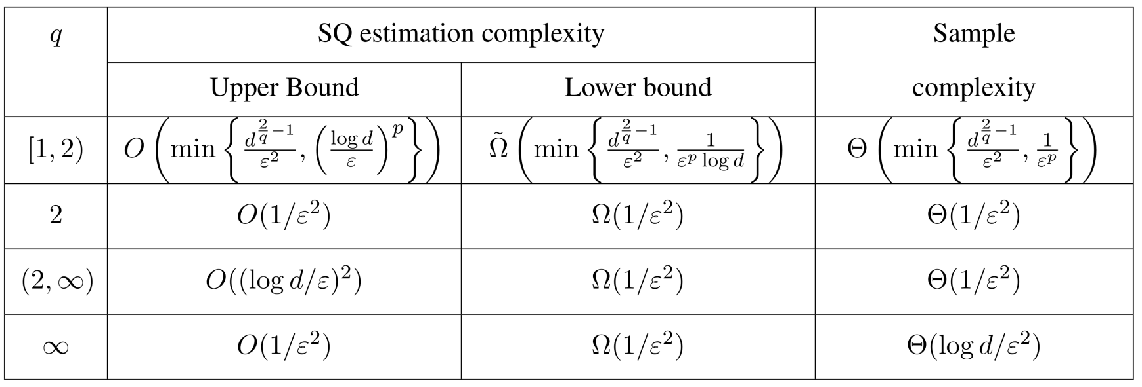

Other norms
$ℓ_{q}$ norms
What about the general case?
Always in $SQCompl\left(d,\frac{d}{ε^{2}}\right)$
Mostly open
Different from sample complexity for some hard to compute norms
Notes:
Tight upper and lower bounds. SQ estimation complexity (1/\tau^2) matches sample complexity for \ell_q norm up to log d factor.
For any norm the estimation complexity if at most d/\epsilon^2
The problem is open for most norms
Norms for which SQ complexity is known to be different from information theoretic complexity are hard to compute norms such nuclear tensor norms

Slide 21
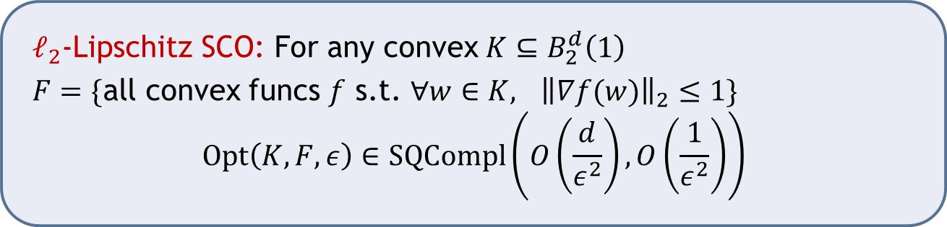
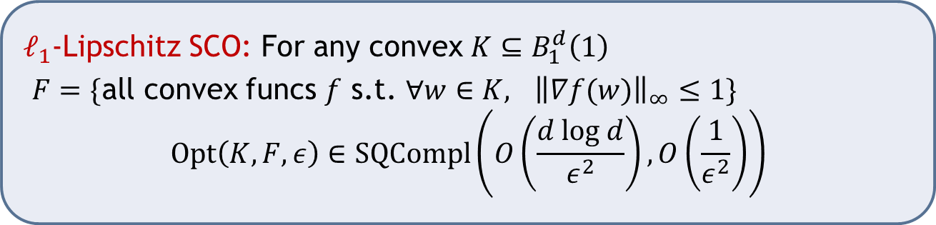
Example corollaries
$ℓ_{2}$-Lipschitz SCO: For any convex $K⊆B_{2}^{d}\left(1\right)$
$F=\{$all convex funcs $f$ s.t. $∀w∈K,$ ${\left\|∇f(w)\right\|}_{2}≤1\}$
$$Opt\left(K,F,ε\right)∈SQCompl\left(O\left(\frac{d}{ε^{2}}\right),O\left(\frac{1}{ε^{2}}\right)\right)$$
$ℓ_{1}$-Lipschitz SCO: For any convex $K⊆B_{1}^{d}\left(1\right)$
$F=\{$all convex funcs $f$ s.t. $∀w∈K,$ ${\left\|∇f(w)\right\|}_{∞}≤1\}$
$$Opt\left(K,F,ε\right)∈SQCompl\left(O\left(\frac{d log d}{ε^{2}}\right),O\left(\frac{1}{ε^{2}}\right)\right)$$
Notes:
Corollaries from plugging the approximate gradient into standard gradient based algorithms

Slide 22



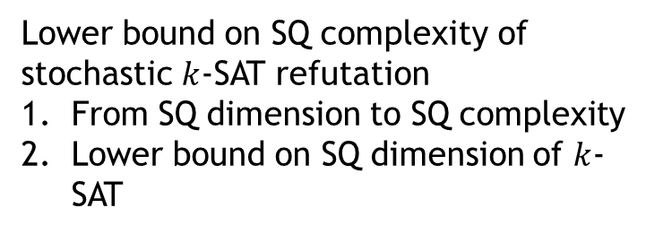
Outline
Convex
relaxation
Lower bound on SQ complexity of stochastic $k$-SAT refutation
From SQ dimension to SQ complexity
Lower bound on SQ dimension of $k$-SAT
Convex optimization algorithms
Optimization of $\left(K,F,α\right)$ in the stochastic setting has low SQ complexity
$k$-$SAT$-$Refute∉$ $SQCompl\left(q,m\right)$
$$Opt\left(K,F,α\right)∈SQCompl\left(q,m\right)$$

Slide 23


Stochastic $k$-SAT refutation
If $φ∼D^{m}$ s.t. the support of $D$ is satisfiable, output YES
If $φ∼U_{k}^{m}$, output NO with prob $>2/3$

Slide 24
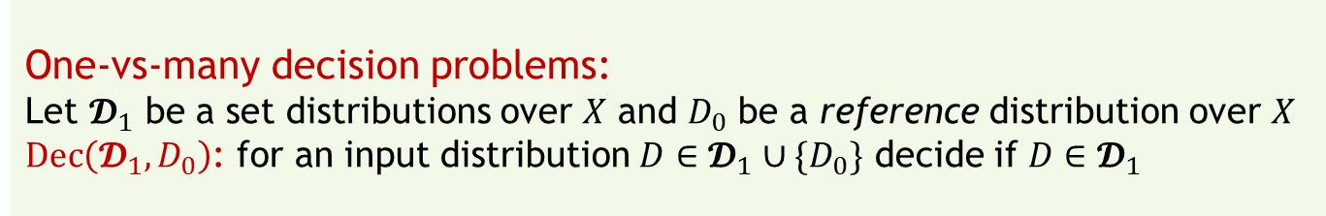
SQ dimension
Fixed-distribution PAC learning [Blum,Furst,Jackson,Kearns,Mansour,Rudich 95; …]
General statistical problems
Lower bounds [F.,Grigorescu,Reyzin,Vempala,Xiao 13; FPV 15]
Characterization [F. 16]
One-vs-many decision problems:
Let $𝓓_{1}$ be a set distributions over $X$ and $D_{0}$ be a reference distribution over $X$
$Dec\left(𝓓_{1},D_{0}\right)$: for an input distribution $D∈𝓓_{1}∪\{D_{0}\}$ decide if $D∈𝓓_{1}$
Notes:
Several other notions of dimension and analysis techniques are known
In this talk a simple SQ dimension for decision problems that suffices for k-SAT.

Slide 25
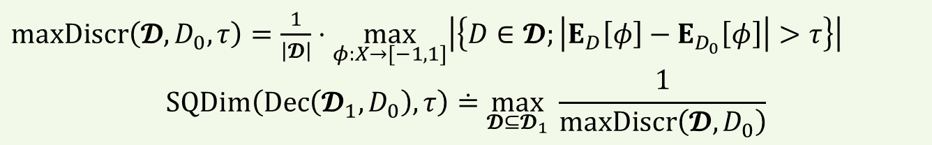

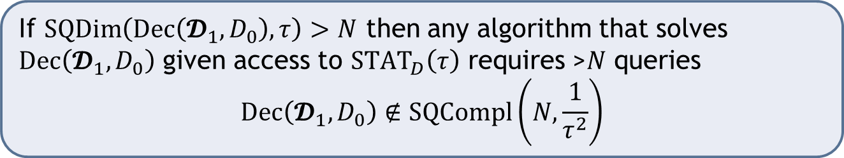





SQ dimension of $Dec\left(𝓓_{1},D_{0}\right)$ [F. 16]
$maxDiscr\left(𝓓,D_{0},τ\right)=\frac{1}{\left|𝓓\right|}⋅\max_{φ:X→[−1,1]}\left|\left\{D∈𝓓;\left|E_{D}\left[φ\right]−E_{D_{0}}\left[φ\right]\right|>τ\right\}\right|$
$$SQDim\left(Dec\left(𝓓_{1},D_{0}\right),τ\right)≐\max_{𝓓⊆𝓓_{1}} \frac{1}{maxDiscr\left(𝓓,D_{0}\right)}$$
$$τ$$
$$τ$$
$$𝓓$$
$$φ$$
$$D_{0}$$
If $SQDim\left(Dec\left(𝓓_{1},D_{0}\right),τ\right)>N$ then any algorithm that solves $Dec\left(𝓓_{1},D_{0}\right)$ given access to ${STAT}_{D}\left(τ\right)$ requires >$N$ queries
$$Dec\left(𝓓_{1},D_{0}\right)∉SQCompl\left(N,\frac{1}{τ^{2}}\right)$$

Slide 26




$SQD$of$k$-SAT refutation
Hard family of distributions:
$D_{σ}$ uniform over all $k$-clauses in which $σ$ satisfies an odd number of literals
$D_{0}=U_{k};$ $𝓓=\left\{D_{σ}; σ∈{\left\{−1,1\right\}}^{n}\right\}$
$E_{D_{σ}}\left[φ\right]−E_{U_{k}}\left[φ\right]$ is a degree-$k$ (multilinear) polynomial of $σ$ with constant term $=0$
$$maxDiscr\left(𝓓,D_{0},τ\right)=\frac{1}{\left|𝓓\right|}⋅\max_{φ:X→[−1,1]}\left|\left\{σ;\left|E_{D_{σ}}\left[φ\right]−E_{U_{k}}\left[φ\right]\right|>τ\right\}\right|$$
Concentration properties of low-degree polynomials over ${\left\{−1,1\right\}}^{n}$:
for all $t>0$,
$$\underset{σ∈{\left\{−1,1\right\}}^{n}}{Pr}\left[\left|E_{D_{σ}}\left[φ\right]−E_{U_{k}}\left[φ\right]\right|>{t⋅n}^{−k/2}\right]=e^{−Ω(k⋅t^{2/k})}$$
Thm: $SQDim\left(Dec\left(𝓓_{1},D_{0}\right),{t⋅n}^{−k/2}\right)=e^{Ω(k⋅t^{2/k})}$
$∀q>1, k$-$SAT$-$Refute∉SQCompl\left(q,{\left(\frac{n}{log q}\right)}^{k}\right)$
Notes:
Can be used for various other classes of CSPs and gives tight lower bounds
Lower bound holds against other algorithmic approaches that are SQ implementable

Slide 27


Outline
Convex
relaxation
Lower bound on SQ complexity of stochastic $k$-SAT refutation
Convex optimization algorithms
Optimization of $\left(K,F,α\right)$ in the stochastic setting has low SQ complexity
$k$-$SAT$-$Refute∉$ $SQCompl\left(q,m\right)$
$$Opt\left(K,F,α\right)∈SQCompl\left(q,m\right)$$

Slide 28


Comparison with known approaches
Sherali-Adams,SOS/Laserre hierarchies: [Grigoriev 01; Shoenebeck 08; Charikar,Makarychev,Makarychev 09; O’Donnell,Witmer 14]
LP extended formulations: [Chan,Lee,Raghavendra,Steurer 13; Kothari,Meka,Raghavendra 16]
Same:
Objective-wise relaxation to functions over a fixed $K$
Incomparable/complementary:
Known SQ based
Linear functions $c→w_{c}$ | Convex functions: $c→f_{c}∈F$
$K$ is a polytope with bounded number of facets | $K$ is any convex body. $SQCompl(K,F,α)$ is bounded
Assumes mapping $M: {\left\{0,1\right\}}^{n}→K$ s.t. $c\left(σ\right)=〈w_{c},M\left(σ\right)〉$ and gap | Assumes an $α$ gap in optimization outcomes
“Variance”/“Overfitting” | “Bias”/“Model misspecification”
[Barak,Moitra ’16]
Notes:
In known approaches enforcing linear structure makes the model too rich. Overfits since the number of given clauses is too small. Hence lower bounds only hold against relaxations that are not efficient from the point of view of sample complexity.
In SQ lower bounds low SQC complexity ensures that there is no overfitting. The lower bound shows that models that are efficient from both computational and statistical points of view are not rich enough to express the CSPs
The results are incomparable/complementary.

Slide 29




Sign-rank lower bounds via SQ complexity
For a matrix $A∈{\left\{−1,1\right\}}^{m×n}$,
$$signRank\left(A\right)≐\min_{A^{′}:sign\left(A^{′}[i,j]\right)=A[i,j]}rank(A^{′})$$
Dimension complexity:
Let $H$ be a set of $\left\{−1,1\right\}$-valued functions over $X$
$DC(H)$ is the lowest $d$ such that exists a mapping $M:X→ℝ^{d}$ such that:
$∀h∈H$ exists $w∈ℝ^{d}$, such that $∀x∈X$, $h\left(x\right)=sign\left(〈w,M\left(x\right)〉\right)$
Define $A_{H}∈{\left\{−1,1\right\}}^{|H|×|X|}$
$$A_{H}\left[h,x\right]=h(x)$$
Then $DC\left(H\right)=signRank\left(A_{H}\right)$
Halfspaces over $ℝ^{d}$ can be PAC learned in $SQCompl(poly\left(d\right),poly\left(d\right))$
[Blum,Frieze,Kannan,Vempala 96]
Learning of $PAR$ (parity functions) not in $SQcompl\left(2^{n/3},2^{n/3}\right)$ [Kearns 93; BFJKMR 95]
Corollary: $signRank\left(A_{PAR}\right)=2^{Ω(n)}$
Proved by Forster [2001]
Notes:
Same approach to get lower bounds in a different context.
A_PAR is the Hadamard matrix.
Provides a proof of Forster’s result: breakthrough on a problem open for 15 years. Follows easily from results known 5 years earlier
Heavy lifting done by the BFKV algorithm.

Slide 30

Conclusions
Convex relaxations fail for XOR constraint optimization
SQ complexity lower bounds bridge between algorithms and structural lower bounds
Extensions
Other MAX-$k$-CSPs
Stronger $n^{1−β}$-wise reductions [F., Ghazi ‘17]
Many open problems

