Slide 1

Optimal bounds on approximation of submodular and XOS functions by juntas
Vitaly Feldman and Jan Vondrâk
IBM Research - Almaden

Slide 2

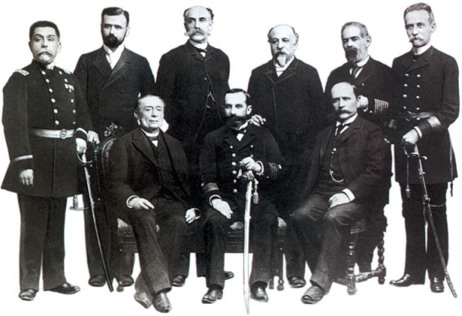
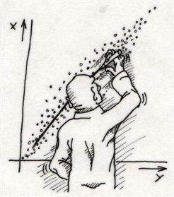
$20
$27
Approximation by juntas
Prelims:
Submodular and XOS
Functions; Learning
Applications to learning

Slide 3
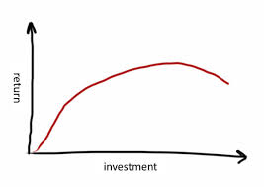
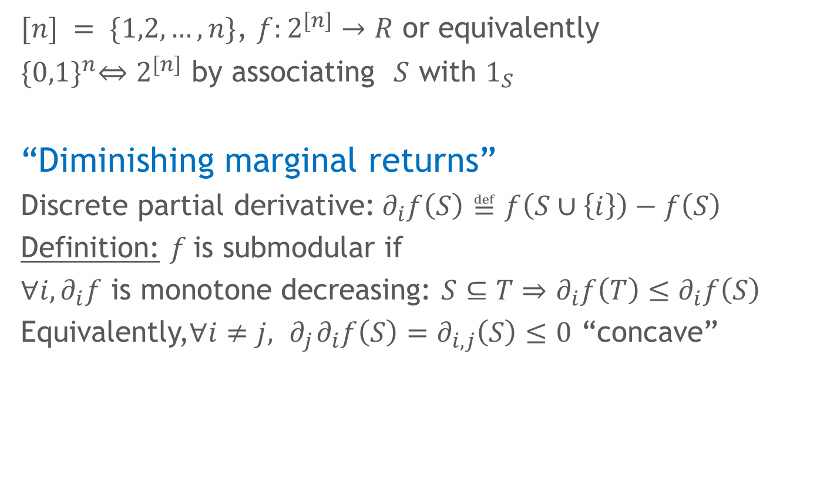
Submodularity
$[n] = \{1,2,…,n\}$, $f:2^{[n]}→R$ or equivalently
${\{0,1\}}^{n}⇔2^{[n]}$ by associating $S$ with $1_{S}$
“Diminishing marginal returns”
Discrete partial derivative:$∂_{i}f\left(S\right)≝f\left(S∪\left\{i\right\}\right)−f\left(S\right)$
Definition: $f$ is submodular if
$∀i,∂_{i}f$ is monotone decreasing: $S⊆T⇒$ $∂_{i}f\left(T\right)≤∂_{i}f\left(S\right)$
Equivalently,$∀i≠j, { ∂}_{j}∂_{i}f\left(S\right)=∂_{i,j}\left(S\right)≤0$ “concave”

Slide 4

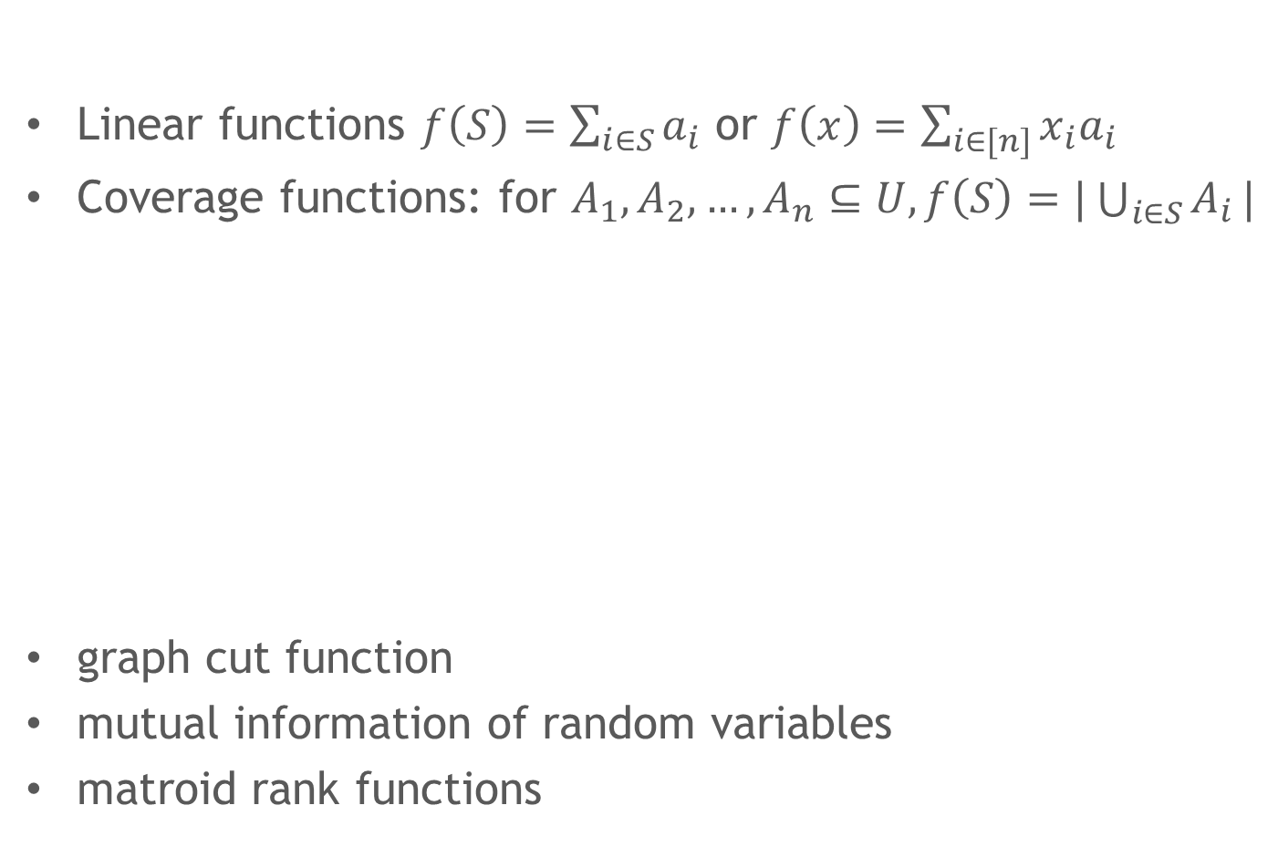



Submodularity: examples
Linear functions $f\left(S\right)=\sum_{i∈S}{a_{i}}$ or $f\left(x\right)=\sum_{i∈[n]}{x_{i}a_{i}}$
Coverage functions: for $A_{1},A_{2},…,A_{n}⊆U, f\left(S\right)=|\bigcup_{i∈S}{A_{i}}|$
graph cut function
mutual information of random variables
matroid rank functions
$$f(S)$$
$$f(T)$$
$$f(S∪\{i\})$$
$$f(T∪\{i\})$$

Slide 5
Submodularity: applications
Operations research
TCS: approximation algorithms
Machine learning
Algorithmic game theory/Economics
Represent valuation functions
$20
$27

Slide 6
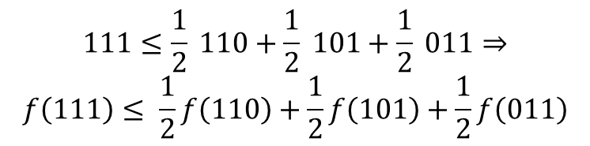
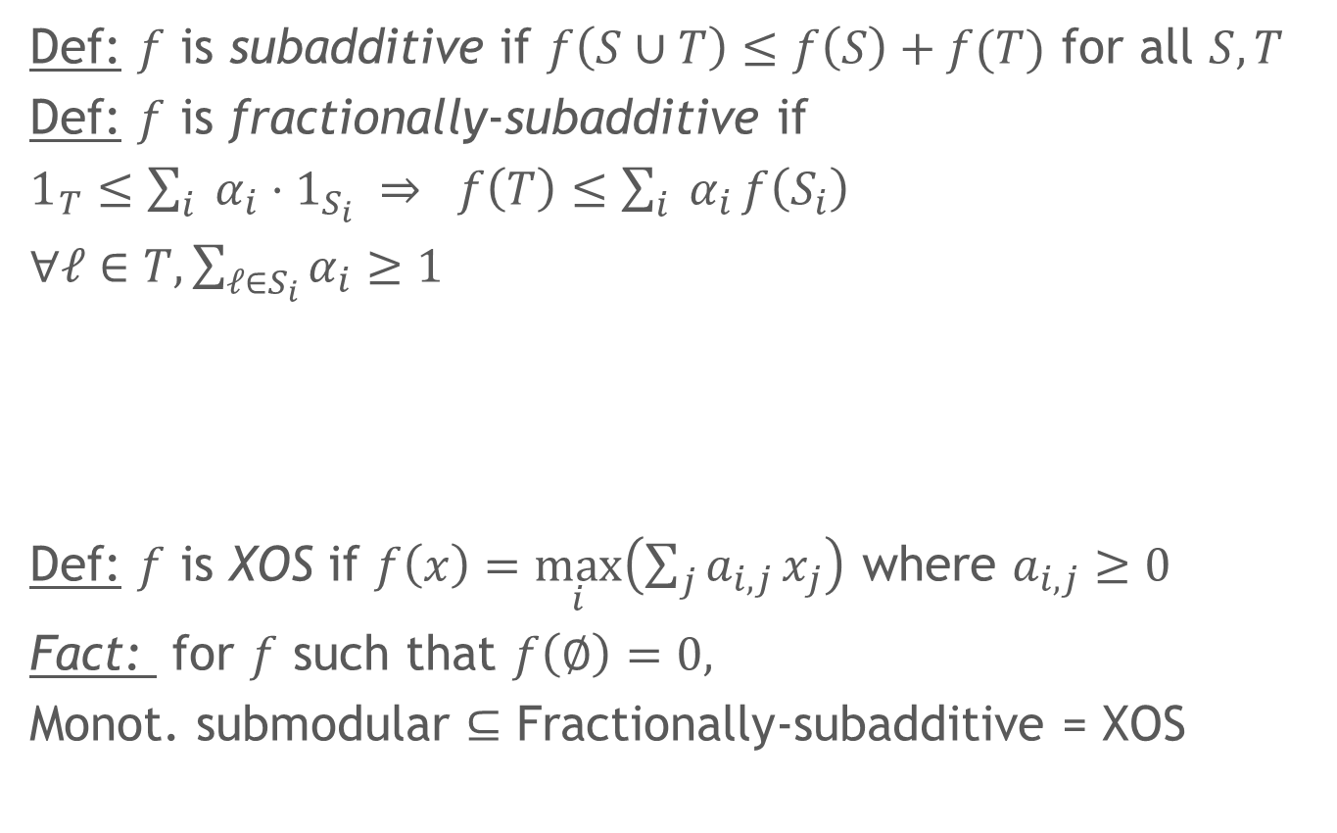
Fractionally-subadditive (XOS)
Def: $f$ is subadditive if $f\left(S∪T\right)≤f\left(S\right)+f(T)$ for all $S,T$
Def: $f$ is fractionally-subadditive if
$1_{T}≤\sum_{i}{ α_{i}}⋅1_{S_{i}} ⇒$ $f\left(T\right)≤\sum_{i}{ α_{i}}f\left(S_{i}\right)$
$∀ℓ∈T, \sum_{ℓ∈S_{i}}{α_{i}}≥1$
Def: $f$ is XOS if $f\left(x\right)=\max_{i}\left(\sum_{j}{a_{i,j}}x_{j}\right)$ where $a_{i,j}≥0$
Fact: for $f$ such that $f\left(∅\right)=0,$
Monot. submodular $⊆$ Fractionally-subadditive = XOS
$$111≤\frac{1}{2} 110+\frac{1}{2} 101+\frac{1}{2} 011⇒$$
$$f\left(111\right)≤ \frac{1}{2}f\left(110\right)+\frac{1}{2}f\left(101\right)+\frac{1}{2}f\left(011\right)$$

Slide 7



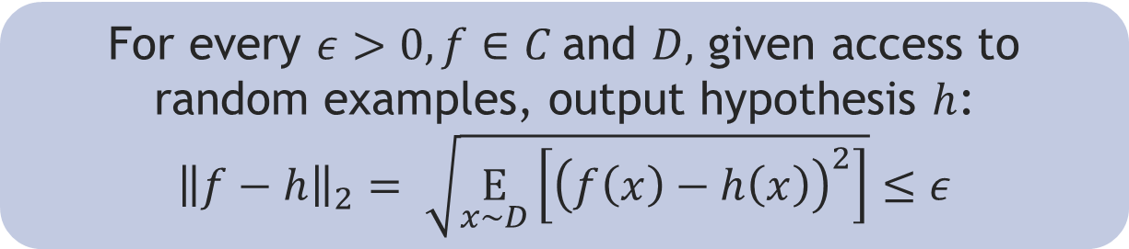
Learning model: PAC [Valiant 84]
Learner has access to random examples: $\left(x,f\left(x\right)\right)$where
$x$is drawn randomly from
distribution $D$ over ${\left\{0,1\right\}}^{n}$
$f∈ C$ (e.g. submodular, XOS)
For every $ε>0, f∈C$and $D,$ given access to random examples, output hypothesis $h$:
$${\left\|f−h\right\|}_{2}= \sqrt{\underset{x∼D}{E}\left[{\left(f\left(x\right)−h\left(x\right)\right)}^{2}\right]}≤ε$$
Multiplicative (PMAC) [Balcan, Harvey 11] :
$$\underset{x∼D}{Pr}\left[h(x)≤f\left(x\right)≤α h\left(x\right)\right]≥1−δ$$

Slide 8
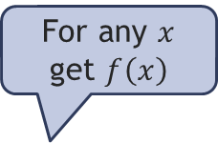
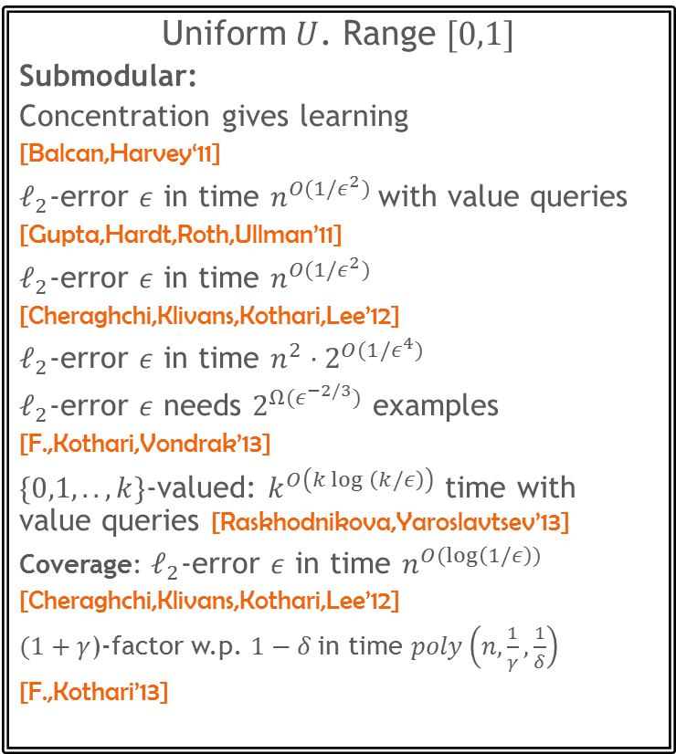
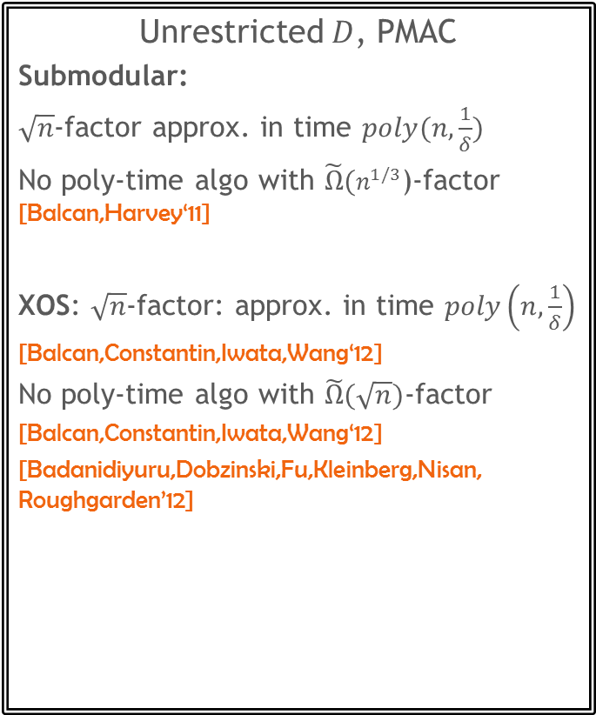
Prior work
Unrestricted $D$, PMAC
Submodular:
$\sqrt{n}$-factor approx. in time $poly(n,\frac{1}{δ})$
No poly-time algo with ${\tilde{Ω}(n}^{1/3}$)-factor [Balcan,Harvey‘11]
XOS: $\sqrt{n}$-factor: approx. in time $poly\left(n,\frac{1}{δ}\right)$
[Balcan,Constantin,Iwata,Wang‘12]
No poly-time algo with $\tilde{Ω}(\sqrt{n})$-factor
[Balcan,Constantin,Iwata,Wang‘12]
[Badanidiyuru,Dobzinski,Fu,Kleinberg,Nisan, Roughgarden’12]
Uniform $U$. Range $[0,1]$
Submodular:
Concentration gives learning
[Balcan,Harvey‘11]
$ℓ_{2}$-error $ε$ in time $n^{O({1/ε}^{2})}$with value queries
[Gupta,Hardt,Roth,Ullman’11]
$ℓ_{2}$-error $ε$ in time $n^{O({1/ε}^{2})}$
[Cheraghchi,Klivans,Kothari,Lee’12]
$ℓ_{2}$-error $ε$ in time $n^{2}⋅2^{O({1/ε}^{4})}$
$ℓ_{2}$-error $ε$ needs $2^{Ω(ε^{−2/3})}$ examples
[F.,Kothari,Vondrak’13]
$\{0,1,..,k\}$-valued: $k^{O\left(k log \left(k/ε\right)\right)}$ time with value queries [Raskhodnikova,Yaroslavtsev’13]
Coverage: $ℓ_{2}$-error $ε$ in time $n^{O(log\left(1/ε\right))}$
[Cheraghchi,Klivans,Kothari,Lee’12]
$(1+γ$)-factor w.p. $1−δ$in time $poly\left(n,\frac{1}{γ},\frac{1}{δ}\right)$
[F.,Kothari’13]
For any $x$ get $f\left(x\right)$

Slide 9
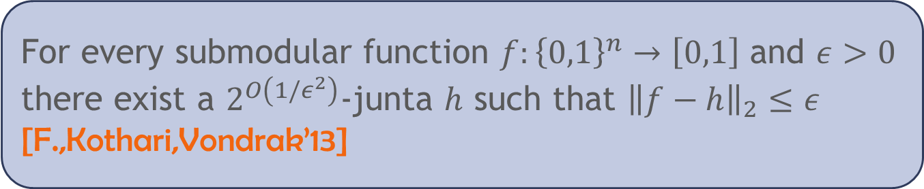

Approximation by juntas
$ℓ$-junta: function that depends on at most $ℓ$ variables
$\{0,1,..,k\}$-valued:
${\left(k log \left(1/ε\right)\right)}^{O\left(k\right)}$-junta [Blais,Onak,Servedio,Yaroslavtsev‘13]
$poly{(2}^{k}/ε)$-junta [FKV‘13]
Coverage: $O\left(1/ε^{2}\right)$-junta [F.,Kothari‘13]
For every submodular function $f:{\left\{0,1\right\}}^{n}→\left[0,1\right]$ and $ε>0$ there exist a $2^{O\left(1/ε^{2}\right)}$-junta $h$ such that ${\left\|f−h\right\|}_{2}≤ε$ [F.,Kothari,Vondrak’13]

Slide 10

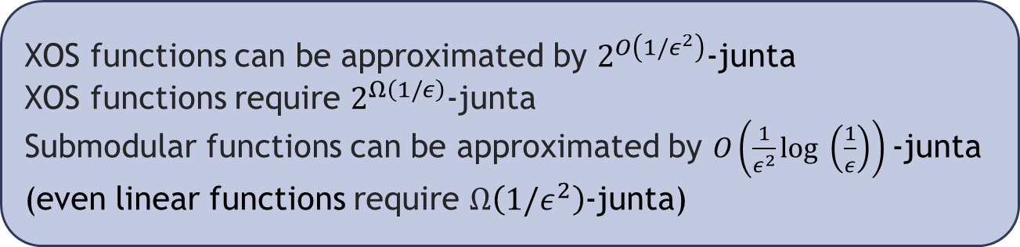

Questions
Can broader classes of functions (XOS) be approximated by juntas?
Is $2^{O\left(1/ε^{2}\right)}$optimal for submodular functions?
Can techniques for Boolean functions be used?
XOS functions can be approximated by $2^{O\left(1/ε^{2}\right)}$-junta
XOS functions require $2^{Ω\left(1/ε\right)}$-junta
Submodular functions can be approximated by $O\left(\frac{1}{ε^{2}}log \left(\frac{1}{ε}\right)\right)$-junta
(even linear functions require $Ω\left({1/ε}^{2}\right)$-junta)

Slide 11


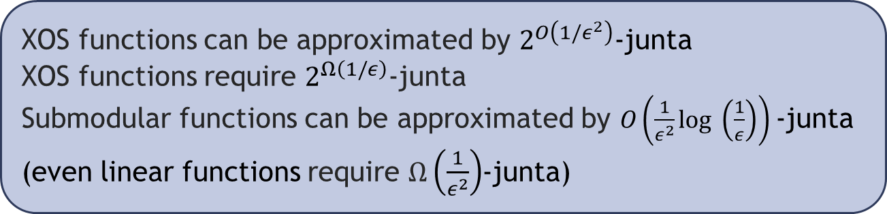



Answers
XOS functions can be approximated by $2^{O\left(1/ε^{2}\right)}$-junta
XOS functions require $2^{Ω\left(1/ε\right)}$-junta
Submodular functions can be approximated by $O\left(\frac{1}{ε^{2}}log \left(\frac{1}{ε}\right)\right)$-junta
(even linear functions require $Ω\left(\frac{1}{ε^{2}}\right)$-junta)
Monot. submodular
$O\left(\frac{1}{ε^{2}}log \left(\frac{1}{ε}\right)\right)$
Constant total
$ℓ_{1}$-influence
$$2^{O(1/ε^{2})}$$
Monot.linear $Ω\left(1/ε^{2}\right)$
Coverage
$O\left({1/ε}^{2}\right)$ [FK’13]
XOS
$$2^{Ω(1/ε)}$$

Slide 12

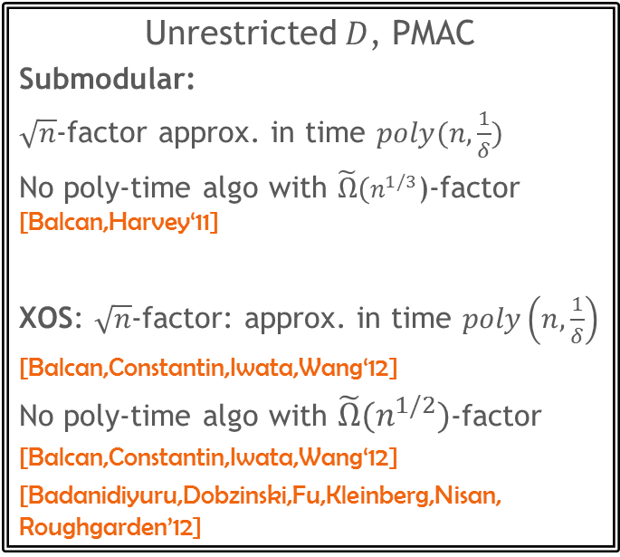
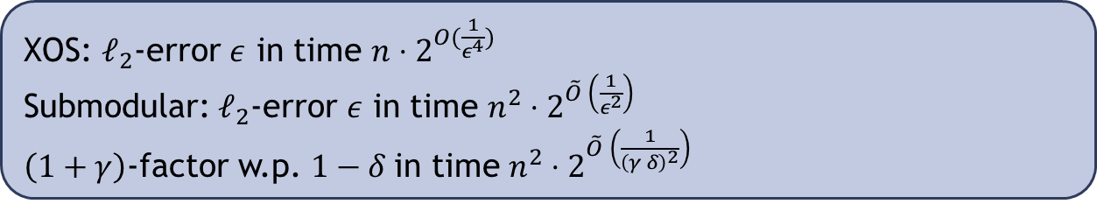
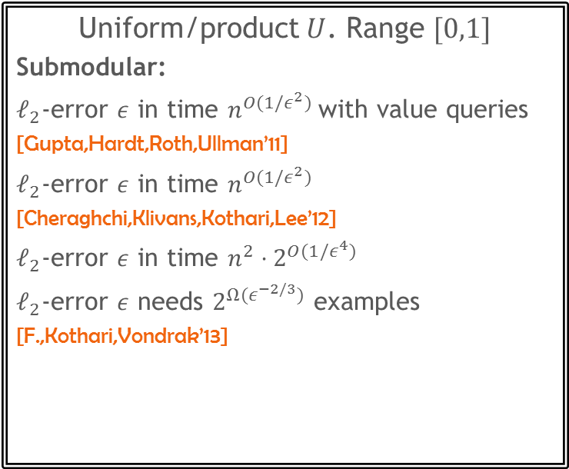
New learning results
Unrestricted $D$, PMAC
Submodular:
$\sqrt{n}$-factor approx. in time $poly(n,\frac{1}{δ})$
No poly-time algo with ${\tilde{Ω}(n}^{1/3}$)-factor [Balcan,Harvey‘11]
XOS: $\sqrt{n}$-factor: approx. in time $poly\left(n,\frac{1}{δ}\right)$
[Balcan,Constantin,Iwata,Wang‘12]
No poly-time algo with ${\tilde{Ω}(n}^{1/2})$-factor
[Balcan,Constantin,Iwata,Wang‘12]
[Badanidiyuru,Dobzinski,Fu,Kleinberg,Nisan, Roughgarden’12]
Uniform/product $U$. Range $[0,1]$
Submodular:
$ℓ_{2}$-error $ε$ in time $n^{O({1/ε}^{2})}$with value queries
[Gupta,Hardt,Roth,Ullman’11]
$ℓ_{2}$-error $ε$ in time $n^{O({1/ε}^{2})}$
[Cheraghchi,Klivans,Kothari,Lee’12]
$ℓ_{2}$-error $ε$ in time $n^{2}⋅2^{O({1/ε}^{4})}$
$ℓ_{2}$-error $ε$ needs $2^{Ω(ε^{−2/3})}$ examples
[F.,Kothari,Vondrak’13]
XOS: $ℓ_{2}$-error $ε$ in time $n⋅2^{O(\frac{1}{ε^{4}})}$
Submodular: $ℓ_{2}$-error $ε$ in time $n^{2}⋅2^{\tilde{O} \left(\frac{1}{ε^{2}}\right)}$
$\left(1+γ\right)$-factor w.p. $1−δ$in time $n^{2}⋅2^{\tilde{O} \left(\frac{1}{{\left(γ δ\right)}^{2}}\right)}$

Slide 13
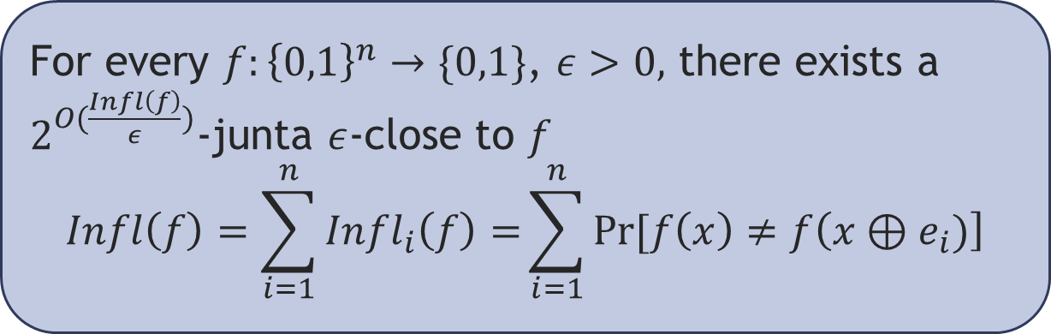
Approximation by juntas for Boolean functions
Well-studied:
[Nisan,Szegedy‛92] [Friedgut‛98] [Bourgain‛01] [Friedgut,Kalai,Naor‛01] [Kindler,Safra‛04] [Alon,Dinur,Friedgut,Sudakov‛04]
[Dinur,Friedgut,Kindler,O'Donnell‛06] [O’Donnell,Servedio‛07] [Diakonikolas,Servedio‛09]
Friedgut’s theorem
For every $f:{\left\{0,1\right\}}^{n}→\{0,1\}$, $ε>0,$ there exists a $2^{O(\frac{Infl\left(f\right)}{ε})}$-junta $ε$-close to $f$
$$Infl\left(f\right)=\sum_{i=1}^{n}{Infl_{i}\left(f\right)=}\sum_{i=1}^{n}{Pr⁡[f\left(x\right)≠f\left(x⊕e_{i})\right]}$$

Slide 14
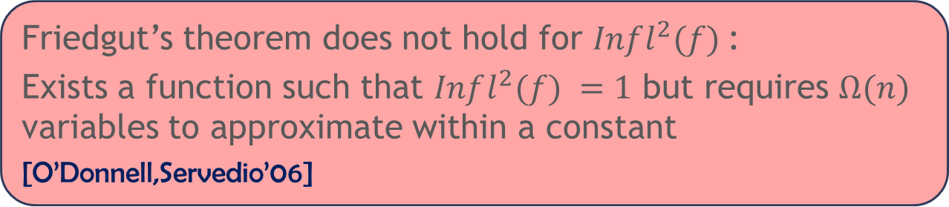
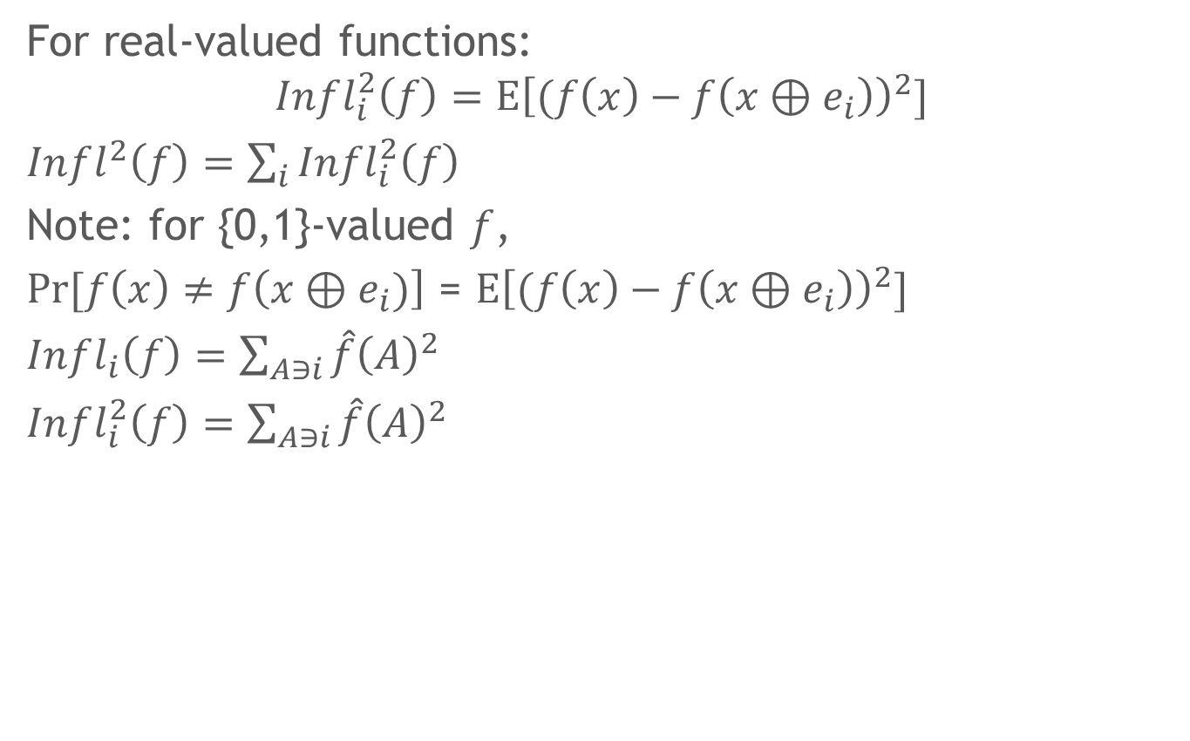
Approximation by juntas
For real-valued functions:
$$Infl_{i}^{2}\left(f\right)=E{\left[(f\left(x\right)−f\left(x⊕e_{i}\right)\right)}^{2}]$$
$Infl_{}^{2}\left(f\right)=\sum_{i}{Infl_{i}^{2}\left(f\right)}$
Note: for {0,1}-valued $f$,
$Pr⁡[f\left(x\right)≠f\left(x⊕e_{i})\right]$ = $E{\left[(f\left(x\right)−f\left(x⊕e_{i}\right)\right)}^{2}]$
$Infl_{i}\left(f\right)=\sum_{A∋i}{\hat{f}{\left(A\right)}^{2}}$
$Infl_{i}^{2}\left(f\right)=\sum_{A∋i}{\hat{f}{\left(A\right)}^{2}}$
Friedgut’s theorem does not hold for $Infl^{2}(f)$:
Exists a function such that $Infl^{2}(f) =1$ but requires $Ω(n)$ variables to approximate within a constant
[O’Donnell,Servedio’06]

Slide 15
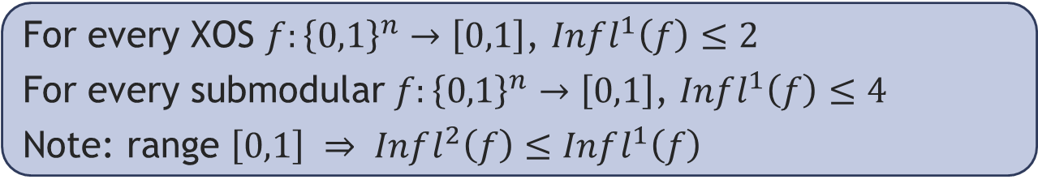
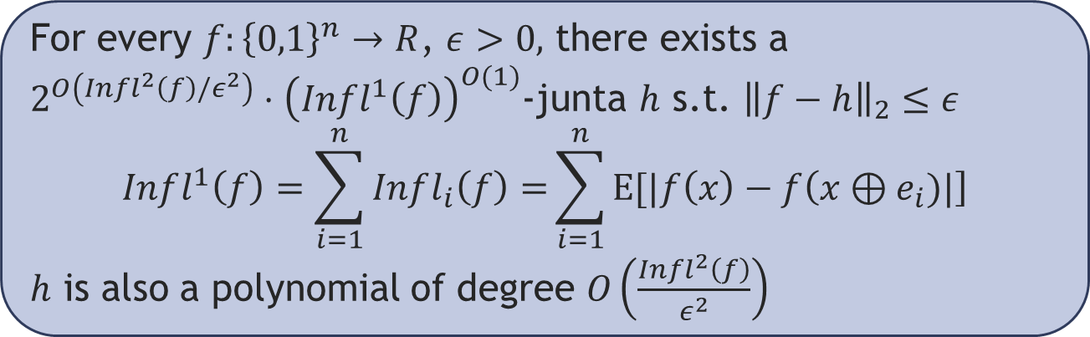
Our approach
Analogue of Friedgut’s theorem for real-valued functions
Influence bounds for XOS functions
For every $f:{\left\{0,1\right\}}^{n}→R$, $ε>0,$ there exists a
$2^{O\left(Infl^{2}\left(f\right)/ε^{2}\right)}⋅{\left(Infl^{1}\left(f\right)\right)}^{O(1)}$-junta $h$ s.t. ${\left\|f−h\right\|}_{2}≤ε$
$$Infl^{1}\left(f\right)=\sum_{i=1}^{n}{Infl_{i}\left(f\right)=}\sum_{i=1}^{n}{E[|f\left(x\right)−f\left(x⊕e_{i})|\right]}$$
$h$ is also a polynomial of degree $O\left(\frac{Infl^{2}\left(f\right)}{ε^{2}}\right)$
For every XOS $f:{\left\{0,1\right\}}^{n}→\left[0,1\right]$, $Infl^{1}\left(f\right)≤2$
For every submodular $f:{\left\{0,1\right\}}^{n}→\left[0,1\right]$, $Infl^{1}\left(f\right)≤4$
Note: range $\left[0,1\right] ⇒ Infl^{2}\left(f\right)≤Infl^{1}\left(f\right)$

Slide 16
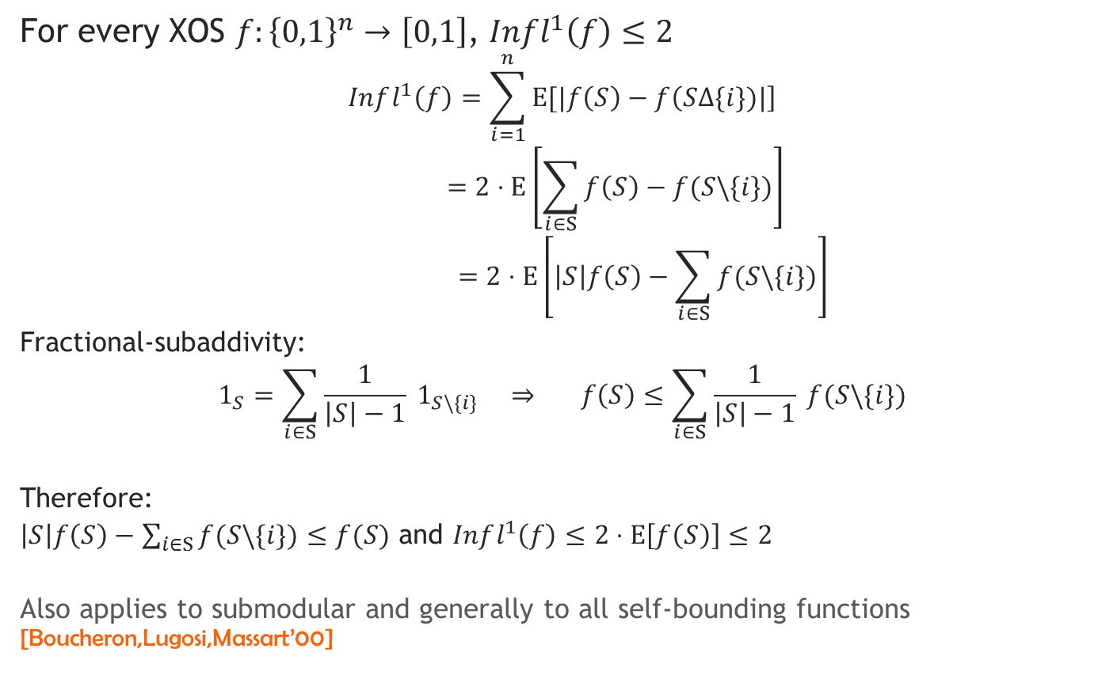
Bounding influence
For every XOS $f:{\left\{0,1\right\}}^{n}→\left[0,1\right]$, $Infl^{1}\left(f\right)≤2$
$$Infl^{1}\left(f\right)=\sum_{i=1}^{n}{E[|f\left(S\right)−f\left(S∆\{i\})|\right]}$$
$$=2⋅E\left[\sum_{i∈S}{f\left(S\right)−f(S\backslash \{i\})}\right]$$
$$=2⋅E\left[\left|S\right|f\left(S\right)−\sum_{i∈S}{f(S\backslash \{i\})}\right]$$
Fractional-subaddivity:
$$1_{S}=\sum_{i∈S}{\frac{1}{\left|S\right|−1} 1_{S\backslash \{i\}}} ⇒ f\left(S\right)≤\sum_{i∈S}{\frac{1}{\left|S\right|−1} f(S\backslash \{i\})}$$
Therefore:
$\left|S\right|f\left(S\right)−\sum_{i∈S}{f(S\backslash \{i\})}≤f(S)$ and $Infl^{1}\left(f\right)≤2⋅E\left[f\left(S\right)\right]≤2$
Also applies to submodular and generally to all self-bounding functions [Boucheron,Lugosi,Massart’00]

Slide 17
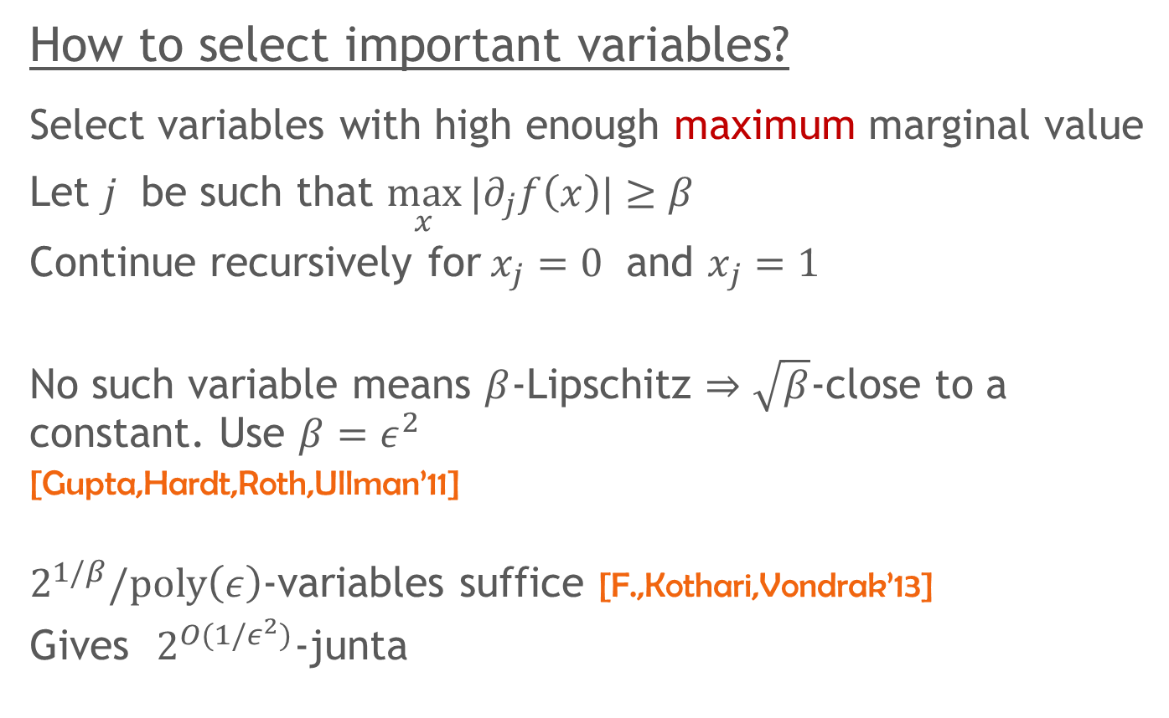
Juntas for submodular functions
How to select important variables?
Select variables with high enough maximum marginal value
Let $j$ be such that $\max_{x}{|∂_{j}f\left(x\right)|}≥β$
Continue recursively for$x_{j}=0$ and $x_{j}=1$
No such variable means $β$-Lipschitz $⇒\sqrt{β}$-close to a constant. Use $β=ε^{2}$
[Gupta,Hardt,Roth,Ullman’11]
$2^{1/β}/poly\left(ε\right)$-variables suffice [F.,Kothari,Vondrak’13]
Gives $2^{O(1/ε^{2})}$-junta

Slide 18

The solution (monotone case)
For a set $J$ and $δ∈[0,1]$ let
$J(δ)$ = each element of $J$ included w.p. $δ$ rand. and indep.
Start $J=∅$
Given a set $J$ and element $i$∉$J$ s.t.
$$\operatorname{Pr}{[∂_{i}f(J\left(δ\right))≥β]}>1/2$$
Add $i$ to $J$
Where $β=\frac{ε^{2}}{4}$
How many variables are selected?
$$E\left[f\left(J\left(δ\right)\right)\right]≥\frac{βE\left[\left|J\left(δ\right)\right|\right]}{2}=\frac{βδ\left|J\right|}{2}⇒\left|J\right|≤\frac{2}{βδ}$$

Slide 19

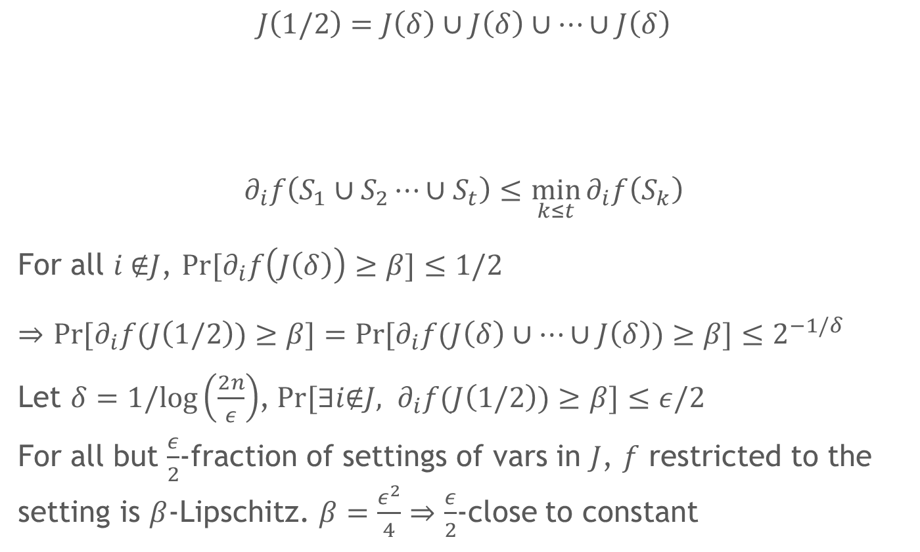
Boosting lemma [Goemans,Vondrak’04]
$$J\left(1/2\right)=J\left(δ\right)∪J\left(δ\right)∪⋯∪J\left(δ\right)$$
$$∂_{i}f\left(S_{1}∪S_{2}⋯∪S_{t}\right)≤\min_{k≤t}{∂_{i}f\left(S_{k}\right)}$$
For all $i$∉$J$, $\operatorname{Pr}{[∂_{i}f\left(J\left(δ\right)\right)≥β]}≤1/2$
$⇒$ $\operatorname{Pr}{[∂_{i}f(J\left(1/2\right))≥β]}=\operatorname{Pr}{[∂_{i}f(J\left(δ\right)∪⋯∪J\left(δ\right))≥β]}≤2^{−1/δ}$
Let $δ=1/log\left(\frac{2n}{ε}\right)$,$\operatorname{Pr}{[∃i\text{∉}J, ∂_{i}f(J\left(1/2\right))≥β]}≤ε/2$
For all but $\frac{ε}{2}$-fraction of settings of vars in $J$, $f$ restricted to the setting is $β$-Lipschitz. $β=\frac{ε^{2}}{4}⇒$ $\frac{ε}{2}$-close to constant
$t=1/log \left(\frac{1}{1−δ}\right)≈1/δ$

Slide 20
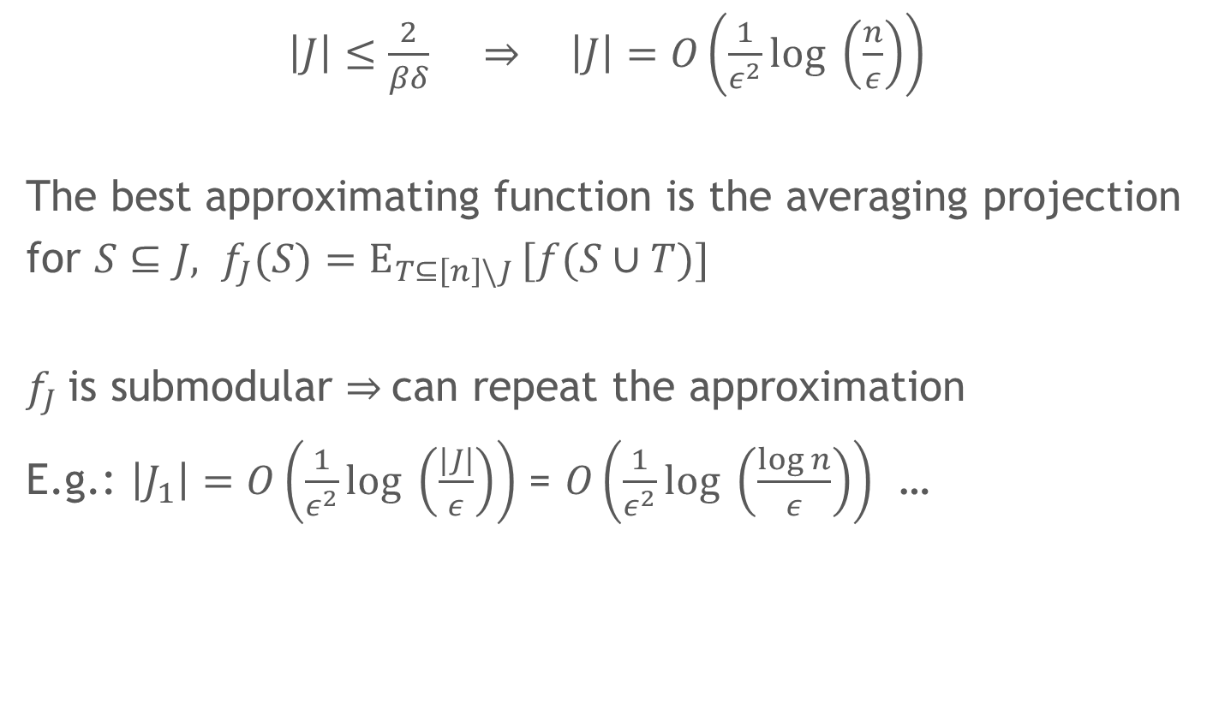
Junta approximation for submodular functions
$\left|J\right|≤\frac{2}{βδ}$ $⇒ \left|J\right|=O\left(\frac{1}{ε^{2}}log \left(\frac{n}{ε}\right)\right)$
The best approximating function is the averaging projection
for $S⊆J, f_{J}(S)=E_{T⊆\left[n\right]\backslash J }[f(S∪T)]$
$f_{J}$is submodular $⇒$can repeat the approximation
E.g.: $\left|J_{1}\right|=O\left(\frac{1}{ε^{2}}log \left(\frac{|J|}{ε}\right)\right)$ = $O\left(\frac{1}{ε^{2}}log \left(\frac{log n}{ε}\right)\right)$ …

Slide 21
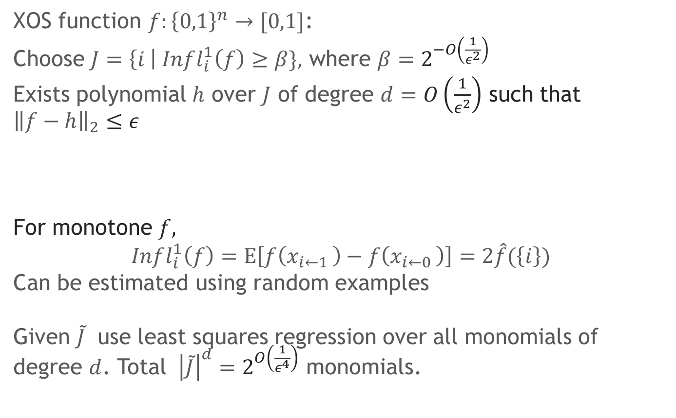
Applications to learning
XOS function $f:{\left\{0,1\right\}}^{n}→[0,1]$:
Choose $J=\left\{i \right| Infl_{i}^{1}\left(f\right)≥β\},$ where $β=2^{−O\left(\frac{1}{ε^{2}}\right)}$
Exists polynomial $h$ over $J$ of degree $d=O\left(\frac{1}{ε^{2}}\right)$ such that ${\left\|f−h\right\|}_{2}≤ε$
For monotone $f,$
$$Infl_{i}^{1}\left(f\right)=E\left[f\left(x_{i←1 }\right)−f\left(x_{i←0 }\right)\right]=2\hat{f}(\left\{i\right\})$$
Can be estimated using random examples
Given $\tilde{J}$ use least squares regression over all monomials of degree $d$. Total ${\left|\tilde{J}\right|}^{d}=2^{O\left(\frac{1}{ε^{4}}\right)}$ monomials.

Slide 22
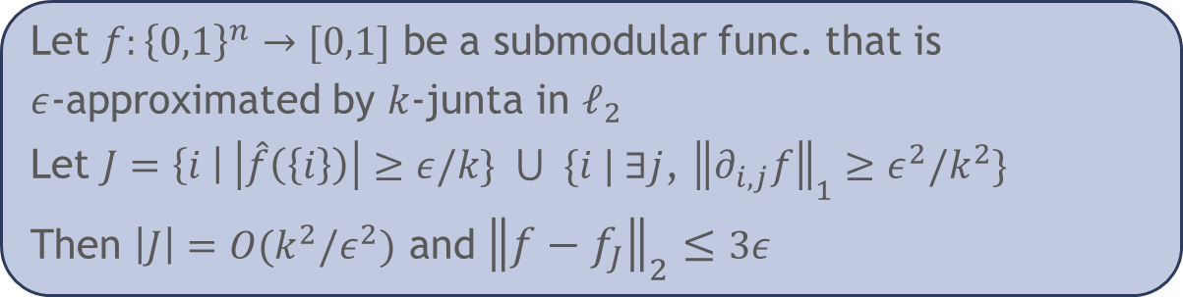
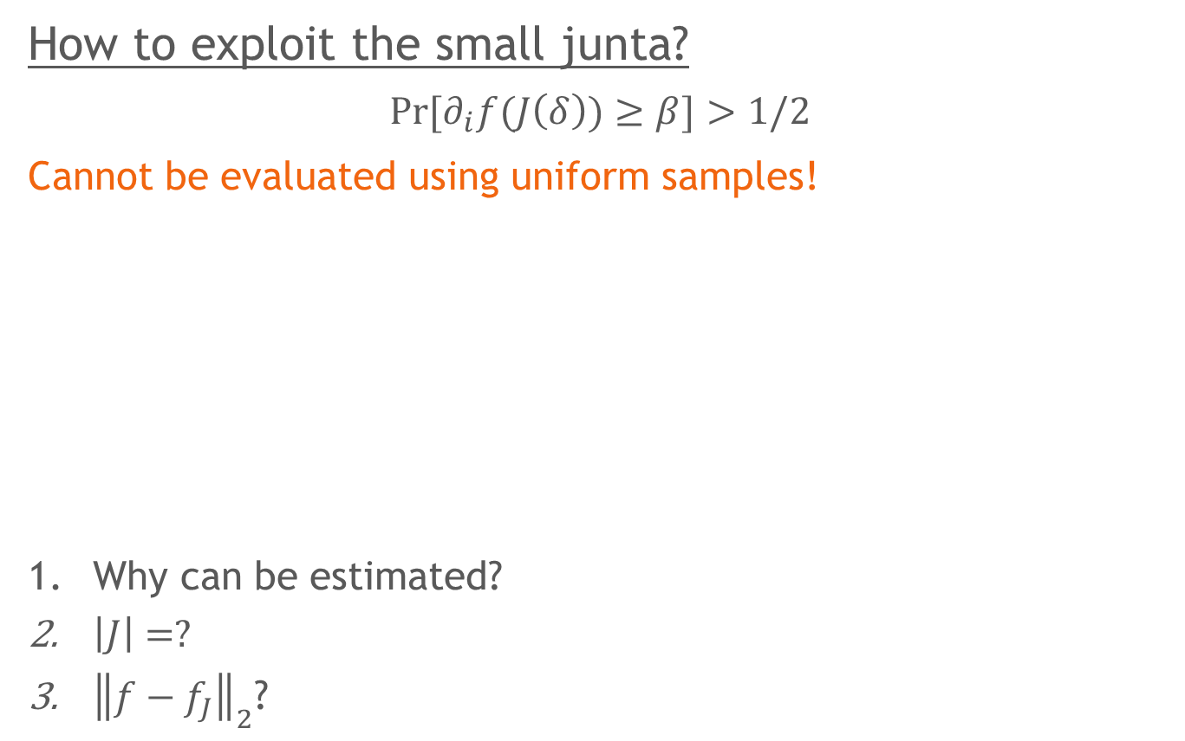
Learning submodular functions
How to exploit the small junta?
$$\operatorname{Pr}{[∂_{i}f(J\left(δ\right))≥β]}>1/2$$
Cannot be evaluated using uniform samples!
Why can be estimated?
$\left|J\right|=?$
${\left\|f−f_{J}\right\|}_{2}$?
Let $f:{\left\{0,1\right\}}^{n}→[0,1]$ be a submodular func. that is
$ε$-approximated by $k$-junta in $ℓ_{2}$
Let $J=\left\{i \right| \left|\hat{f}\left(\left\{i\right\}\right)\right|≥ε/k\} ⋃ \{i | ∃j$, ${\left\|∂_{i,j}f\right\|}_{1}≥ε^{2}/k^{2}\}$
Then $\left|J\right|=O(k^{2}/ε^{2})$ and ${\left\|f−f_{J}\right\|}_{2}≤3ε$

Slide 23
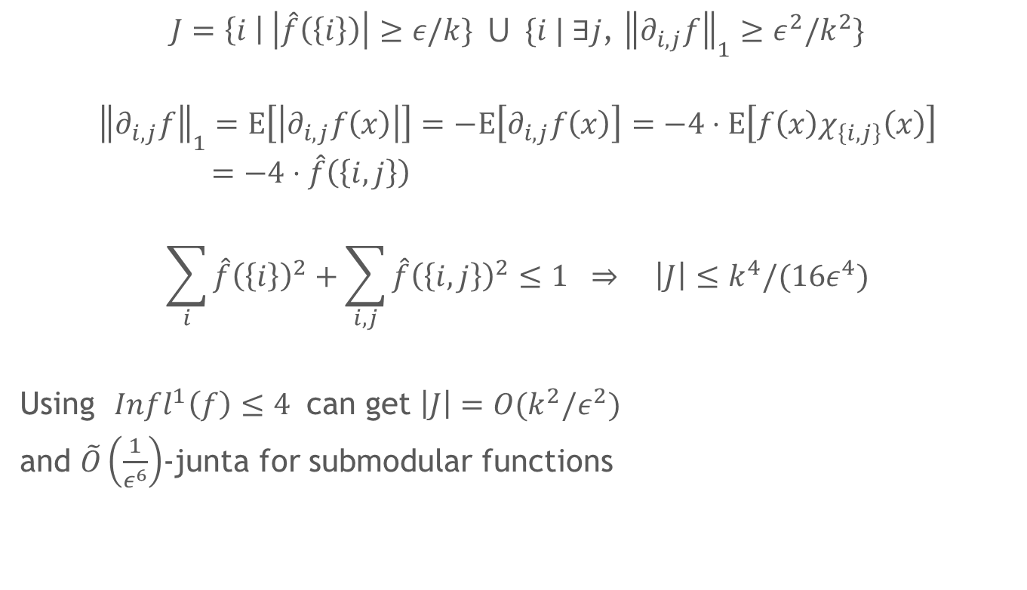

Estimation, $|J|$
$J=\left\{i \right| \left|\hat{f}\left(\left\{i\right\}\right)\right|≥ε/k\} ⋃ \{i | ∃j$, ${\left\|∂_{i,j}f\right\|}_{1}≥ε^{2}/k^{2}\}$
$${\left\|∂_{i,j}f\right\|}_{1}=E\left[\left|∂_{i,j}f\left(x\right)\right|\right]=−E\left[∂_{i,j}f\left(x\right)\right]=−4⋅E\left[f\left(x\right)χ_{\left\{i,j\right\}}\left(x\right)\right]=−4⋅\hat{f}\left(\left\{i,j\right\}\right)$$
$$\sum_{i}{\hat{f}{\left(\left\{i\right\}\right)}^{2}}+\sum_{i,j}{\hat{f}{\left(\left\{i,j\right\}\right)}^{2}}≤1 ⇒ \left|J\right|≤k^{4}/(16ε^{4})$$
Using $Infl^{1}\left(f\right)≤4$ can get $\left|J\right|=O(k^{2}/ε^{2})$
and $\tilde{O}\left(\frac{1}{ε^{6}}\right)$-junta for submodular functions

Slide 24
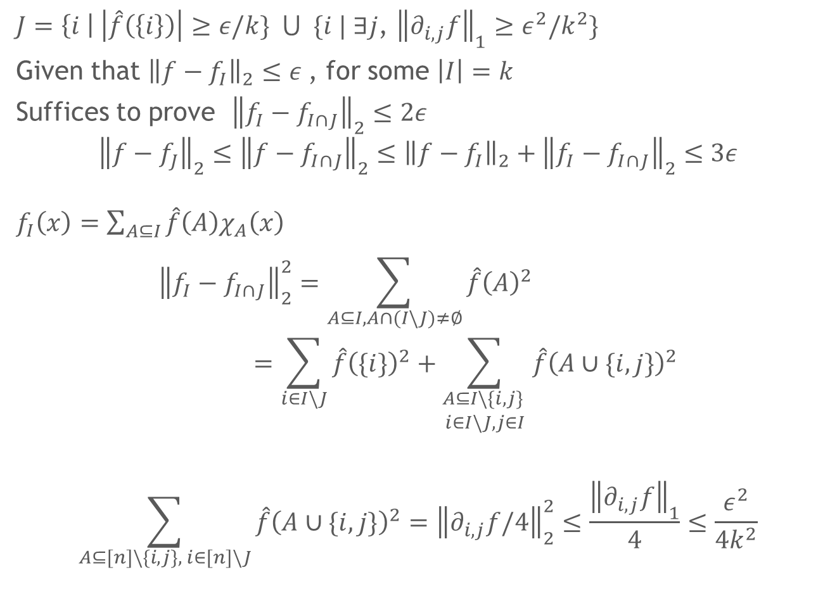

$${\left\|f−f_{J}\right\|}_{2}$$
$J=\left\{i \right| \left|\hat{f}\left(\left\{i\right\}\right)\right|≥ε/k\} ⋃ \{i | ∃j$, ${\left\|∂_{i,j}f\right\|}_{1}≥ε^{2}/k^{2}\}$
Given that ${\left\|f−f_{I}\right\|}_{2}≤ε$, for some $\left|I\right|=k$
Suffices to prove ${\left\|f_{I}−f_{I∩J}\right\|}_{2}≤2ε$
$${\left\|f−f_{J}\right\|}_{2}≤{\left\|f−f_{I∩J}\right\|}_{2}≤{{\left\|f−f_{I}\right\|}_{2}+\left\|f_{I}−f_{I∩J}\right\|}_{2}≤3ε$$
$f_{I}\left(x\right)=\sum_{A⊆I}{\hat{f}\left(A\right)χ_{A}\left(x\right)}$
$${\left\|f_{I}−f_{I∩J}\right\|}_{2}^{2}=\sum_{A⊆I, A∩(I\backslash J)≠∅}{\hat{f}{\left(A\right)}^{2}}=\sum_{i∈I\backslash J}{\hat{f}{\left(\{i\}\right)}^{2}}+\sum_{\begin{aligned}A⊆I\backslash \{i,j\} \\ i∈I\backslash J, j∈I\end{aligned}}{\hat{f}{\left(A∪\{i,j\}\right)}^{2}}$$
$$\sum_{A⊆[n]\backslash \{i,j\}, i∈[n]\backslash J}{\hat{f}{\left(A∪\{i,j\}\right)}^{2}}={\left\|∂_{i,j}f/4\right\|}_{2}^{2}≤\frac{{\left\|∂_{i,j}f\right\|}_{1}}{4}≤\frac{ε^{2}}{4k^{2}}$$
$$≤ε^{2}+ε^{2}/4$$

Slide 25
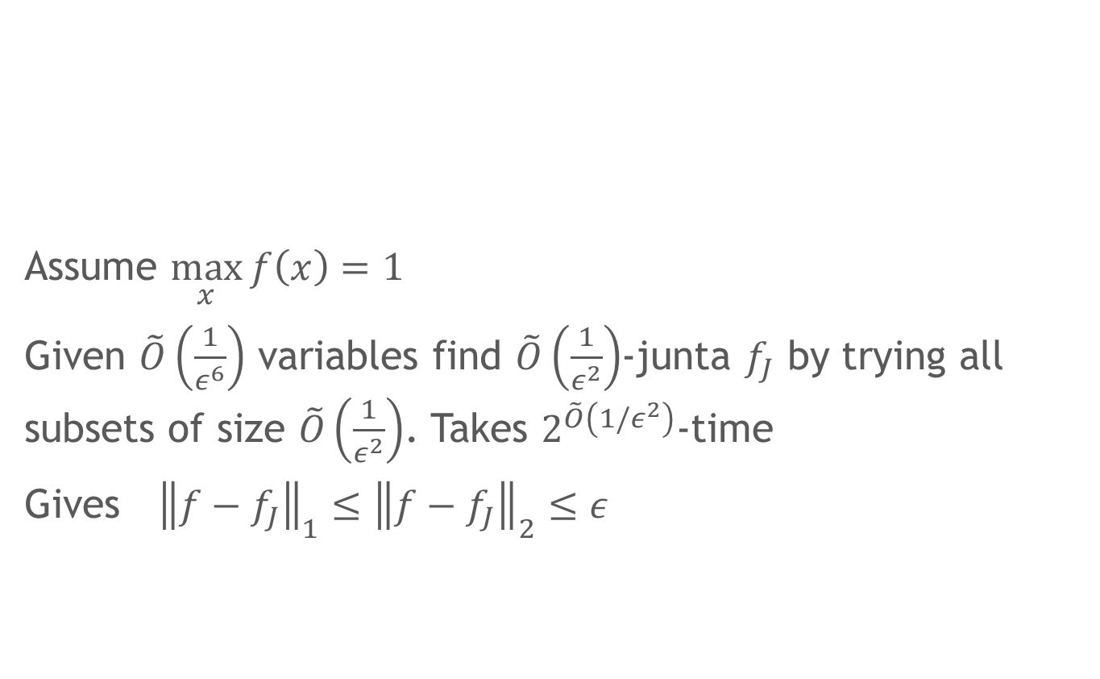

PMAC Learning
Assume $\max_{x}{f\left(x\right)=1}$
Given $\tilde{O}\left(\frac{1}{ε^{6}}\right)$ variables find $\tilde{O}\left(\frac{1}{ε^{2}}\right)$-junta $f_{J}$ by trying all subsets of size $\tilde{O}\left(\frac{1}{ε^{2}}\right)$. Takes $2^{\tilde{O}\left(1/ε^{2}\right)}$-time
Gives ${\left\|f−f_{J}\right\|}_{1}≤{\left\|f−f_{J}\right\|}_{2}≤ε$
Multiplicative (PMAC) [Balcan, Harvey 11] :
$$\underset{x∼D}{Pr}\left[h(x)≤f\left(x\right)≤(1+γ) h\left(x\right)\right]≥1−δ$$

Slide 26
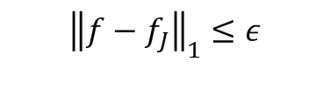


PMAC algo
$${\left\|f−f_{J}\right\|}_{1}≤ε$$
0 | 0 | … | 0
0 | 0 | … | 1
… | … | … | …
0 | 1 | … | 1
… | … | … | …
1 | 1 | … | 0
1 | 1 | … | 1
$$T⊆[n]\backslash J$$
$$S⊆J$$

Slide 27
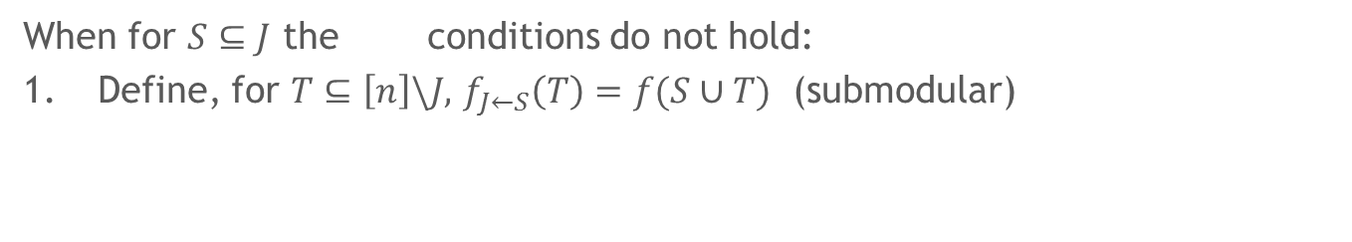


When for $S⊆J$ the conditions do not hold:
Define, for $T⊆\left[n\right]\backslash J,$ $f_{J←S}\left(T\right)=f(S∪T)$ (submodular)
$${\left\|f−f_{J}\right\|}_{1}≤ε$$
0 | 0 | … | 0
0 | 0 | … | 1
… | … | … | …
0 | 1 | … | 1
… | … | … | …
1 | 1 | … | 0
1 | 1 | … | 1
$$S⊆J$$

Slide 28
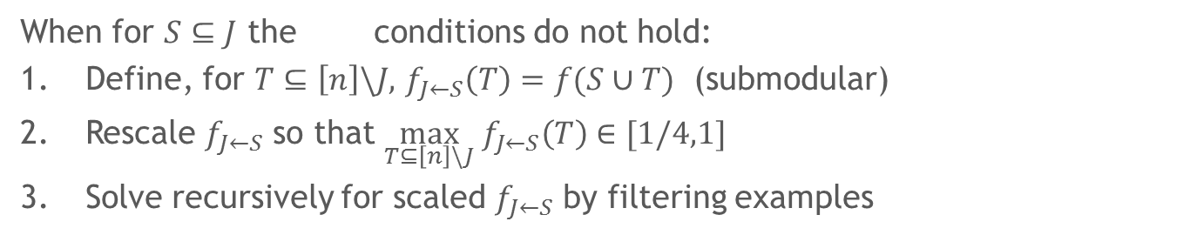
When for $S⊆J$ the conditions do not hold:
Define, for $T⊆\left[n\right]\backslash J,$ $f_{J←S}\left(T\right)=f(S∪T)$ (submodular)
Rescale $f_{J←S}$ so that $\max_{T⊆\left[n\right]\backslash J} f_{J←S}\left(T\right)∈[1/4,1]$
Solve recursively for scaled $f_{J←S}$ by filtering examples
$${\left\|f−f_{J}\right\|}_{1}≤ε$$
0 | 0 | … | 0
0 | 0 | … | 1
… | … | … | …
0 | 1 | … | 1
… | … | … | …
1 | 1 | … | 0
1 | 1 | … | 1
$$S⊆J$$

Slide 29
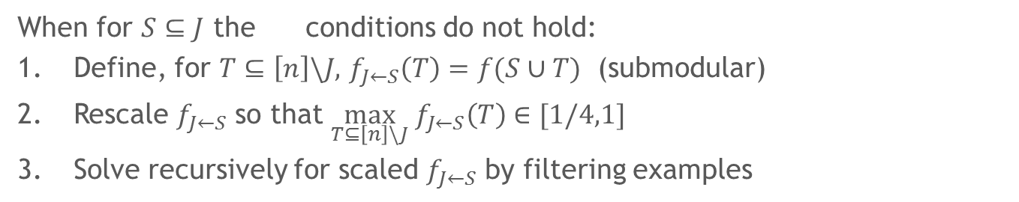
When for $S⊆J$ the conditions do not hold:
Define, for $T⊆\left[n\right]\backslash J,$ $f_{J←S}\left(T\right)=f(S∪T)$ (submodular)
Rescale $f_{J←S}$ so that $\max_{T⊆\left[n\right]\backslash J} f_{J←S}\left(T\right)∈[1/4,1]$
Solve recursively for scaled $f_{J←S}$ by filtering examples
$${\left\|f−f_{J}\right\|}_{1}≤ε$$
0 | 0 | … | 0
0 | 0 | … | 1
… | … | … | …
0 | 1 | … | 1
… | … | … | …
1 | 1 | … | 0
1 | 1 | … | 1
0 | … | 0
… | … | …
0 | … | 1
… | … | …
1 | … | 1
0 | … | 0
… | … | …
0 | … | 1
… | … | …
1 | … | 1
0 | … | 0
… | … | …
0 | … | 1
… | … | …
1 | … | 1
0 | … | 0
… | … | …
0 | … | 1
… | … | …
1 | … | 1
$$S⊆J$$

Slide 30
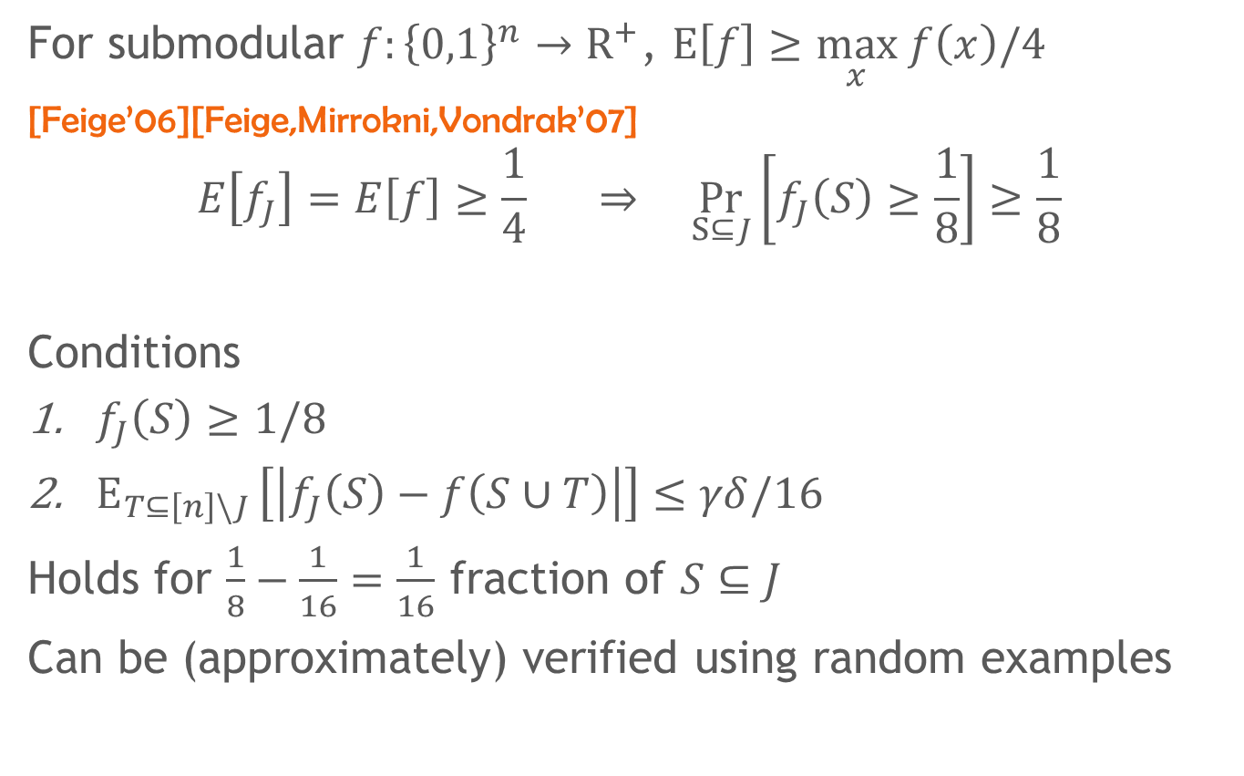
For submodular $f:{\left\{0,1\right\}}^{n}→R^{+}$, $E\left[f\right]≥\max_{x} f\left(x\right)/4$
[Feige’06][Feige,Mirrokni,Vondrak’07]
$$E\left[f_{J}\right]=E\left[f\right]≥\frac{1}{4} ⇒ \underset{S⊆J}{Pr}\left[f_{J}\left(S\right)≥\frac{1}{8}\right]≥\frac{1}{8}$$
Conditions
$f_{J}\left(S\right)≥1/8$
$E_{T⊆\left[n\right]\backslash J }\left[\left|f_{J}\left(S\right)−f\left(S∪T\right)\right|\right]≤γδ/16$
Holds for $\frac{1}{8}−\frac{1}{16}=\frac{1}{16}$ fraction of $S⊆J$
Can be (approximately) verified using random examples

Slide 31
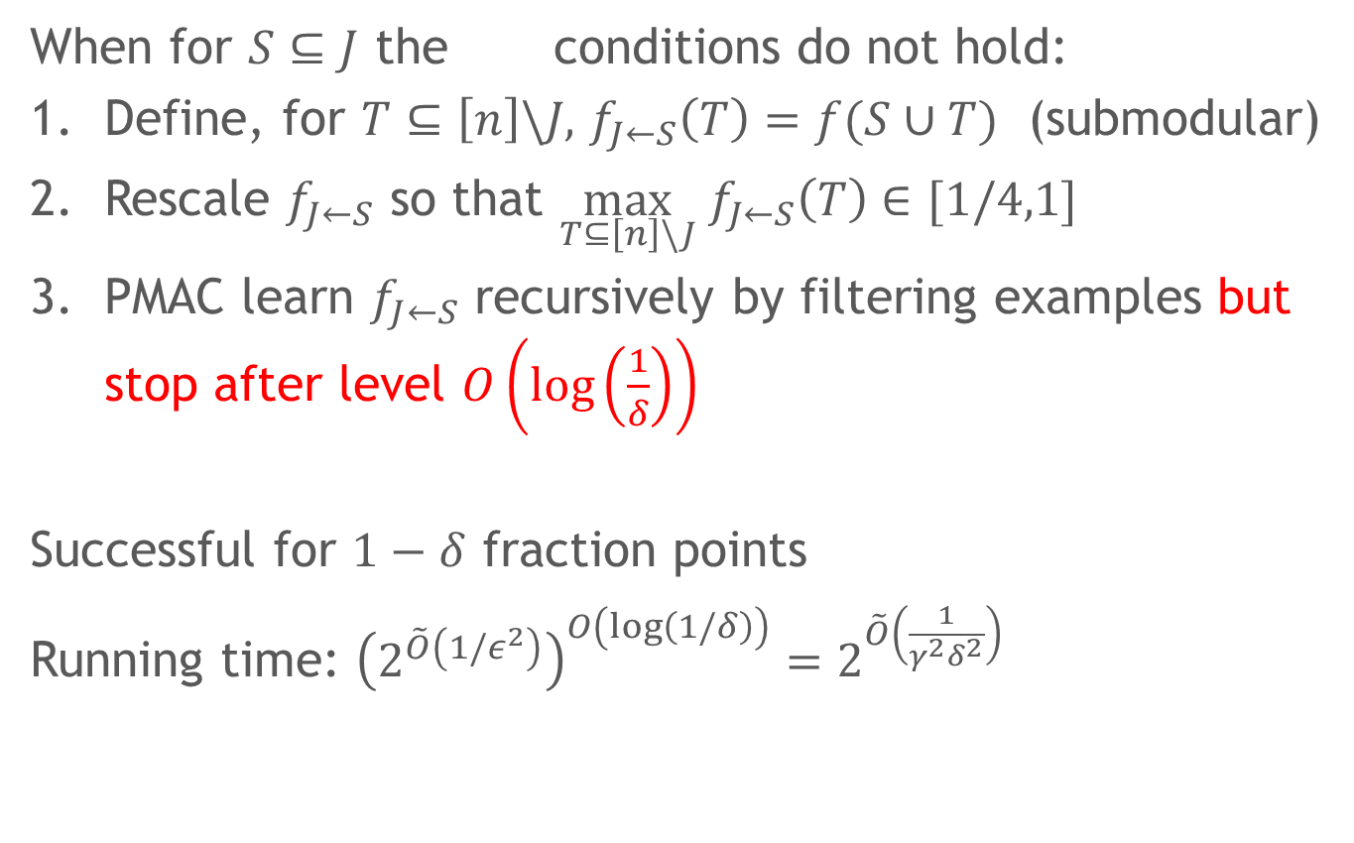
PMAC algorithm
When for $S⊆J$ the conditions do not hold:
Define, for $T⊆\left[n\right]\backslash J,$ $f_{J←S}\left(T\right)=f(S∪T)$ (submodular)
Rescale $f_{J←S}$ so that $\max_{T⊆\left[n\right]\backslash J} f_{J←S}\left(T\right)∈[1/4,1]$
PMAC learn $f_{J←S}$ recursively by filtering examples but stop after level $O\left(log\left(\frac{1}{δ}\right)\right)$
Successful for $1−δ$ fraction points
Running time: ${\left(2^{\tilde{O}\left({1/ε}^{2}\right)}\right)}^{O\left(log\left(1/δ\right)\right)}=2^{\tilde{O}\left(\frac{1}{γ^{2}δ^{2}}\right)}$

Slide 32
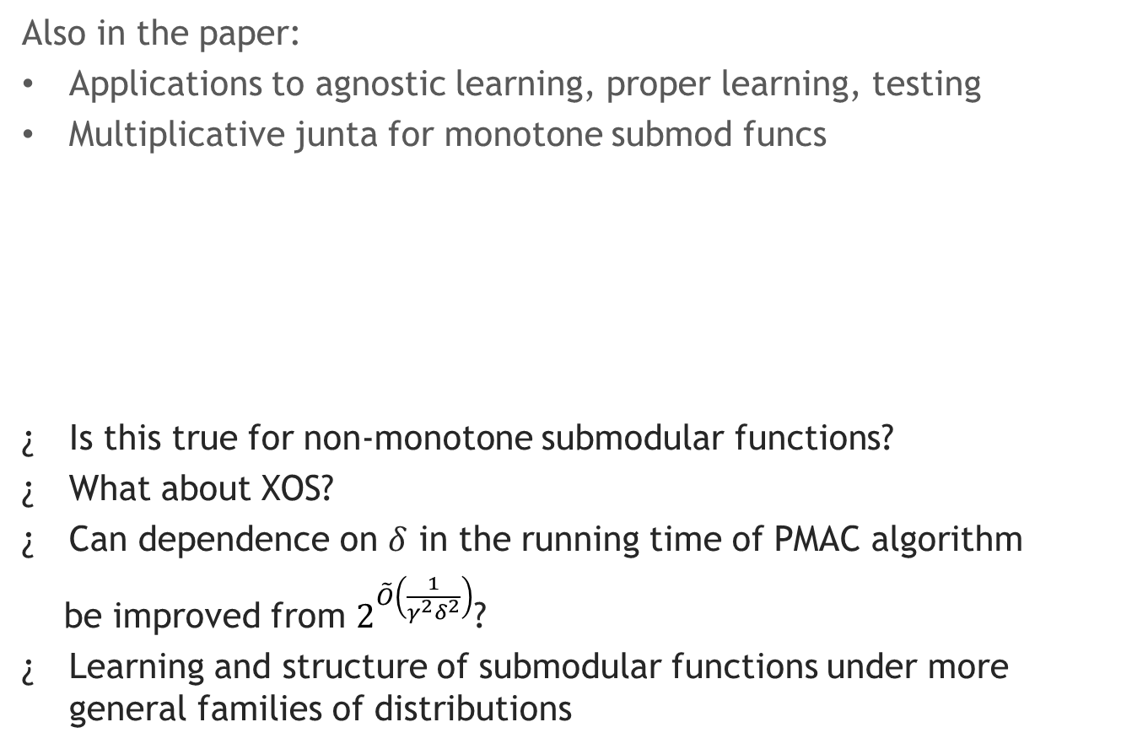
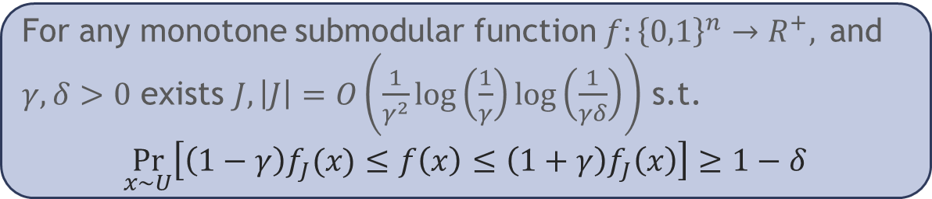
Conclusions and open problems
Also in the paper:
Applications to agnostic learning, proper learning, testing
Multiplicative junta for monotone submod funcs
Is this true for non-monotone submodular functions?
What about XOS?
Can dependence on $δ$ in the running time of PMAC algorithm
be improved from $2^{\tilde{O}\left(\frac{1}{γ^{2}δ^{2}}\right)}$?
Learning and structure of submodular functions under more general families of distributions
For any monotone submodular function $f:{\left\{0,1\right\}}^{n}→R^{+},$and $γ,δ>0$ exists $J, \left|J\right|=O\left(\frac{1}{γ^{2}}log\left(\frac{1}{γ}\right)log\left(\frac{1}{γδ}\right)\right)$ s.t.
$$\underset{x∼U}{Pr}\left[\left(1−γ\right)f_{J}(x)≤f\left(x\right)≤\left(1+γ\right)f_{J}\left(x\right)\right]≥1−δ$$

