Slide 1
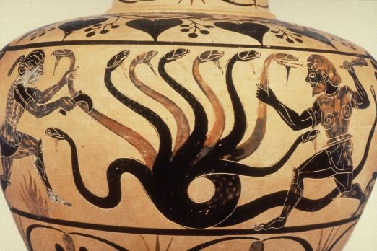


On the power of learning from $k$-wise queries
Vitaly Feldman Badih Ghazi
IBM Research – Almaden MIT, CSAIL
2017

Slide 2


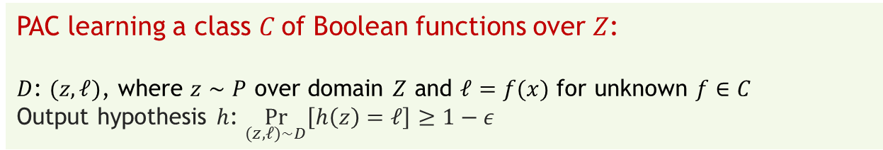
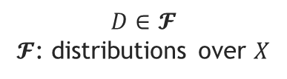
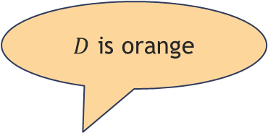
Statistical problems
$D$ is orange
$$D∈𝓕$$
$𝓕$: distributions over $X$
$$x_{1},x_{2},…,x_{m}∼D$$
Algorithm
PAC learning a class $C$of Boolean functions over $Z$:
$D$: $(z,ℓ)$, where $z∼P$ over domain $Z$ and $ℓ=f(x)$ for unknown $f∈C$
Output hypothesis $h$: $\underset{(z,ℓ)∼D}{Pr}\left[h\left(z\right)=ℓ\right]≥1−ε$

Slide 3



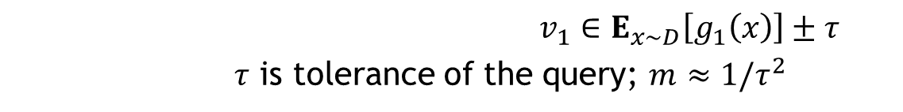









Statistical queries [Kearns ‘93]
$$g_{1}$$
$$v_{1}$$
$$D∈𝓕$$
$𝓕$: distributions over $X$
$$g_{2}$$
$$v_{2}$$
$$x_{1},x_{2},…,x_{m}∼D$$
$$D$$
$$g_{t}$$
SQ algorithm
$$v_{t}$$
$STAT_{D}(τ)$ oracle
$v_{1}∈E_{x∼D}\left[g_{1}\left(x\right)\right]±τ$
$τ$ is tolerance of the query; $m≈1{/τ}^{2}$
$$g_{1}:X→\left[−1,1\right]$$
Abstraction
Noise-tolerance, privacy, distributed ML, evolvability, adaptive data analysis
SQ complexity
Most techniques for statistical problems have SQ analogues
Easier to prove lower bound against SQ algorithms
Notes:
Replace input with oracle access to input. The oracle approximately evaluates average of any function with range [-1,1]
Proxy for computational complexity
Lower bounds are unconditional

Slide 4



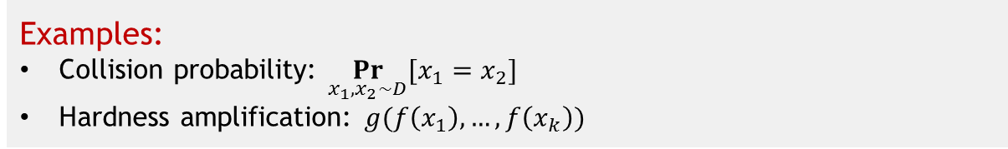

$k$-wise SQs
$$g_{1}$$
$$v_{1}$$
$$g_{2}$$
$$v_{2}$$
$$D$$
$$g_{t}$$
$k$-wise SQ algorithm
$$v_{t}$$
$STAT_{D}^{(k)}(τ)$ oracle
$g_{1}:X^{k}→\left[−1,1\right]$, $v_{1}∈E_{x_{1},…,x_{k}∼D}\left[g_{1}\left(x_{1},…,x_{k}\right)\right]±τ$
Examples:
Collision probability: $\underset{x_{1},x_{2}∼D}{Pr}⁡[x_{1}=x_{2}]$
Hardness amplification: $g(f\left(x_{1}\right),…,f\left(x_{k}\right))$
Notes:
Stronger model that interpolates between SQ and general algorithms

Slide 5
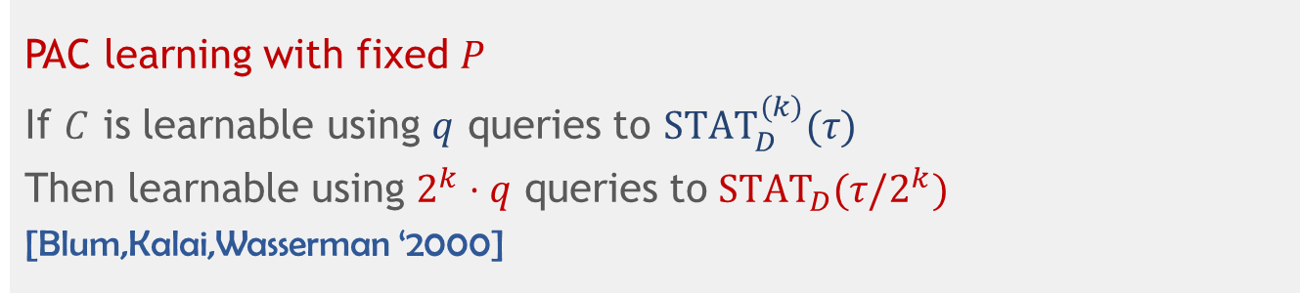

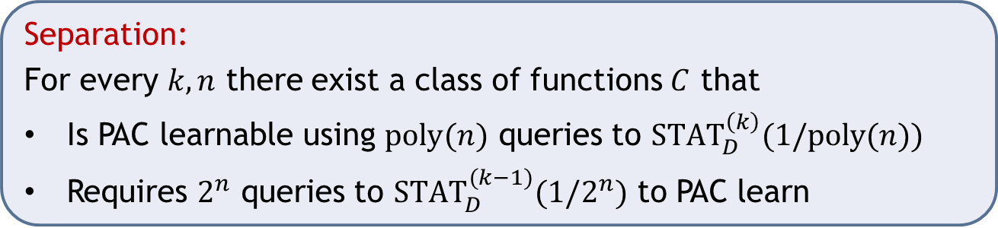
Are $k$-wise SQs more powerful?
PAC learning with fixed $P$
If $C$ is learnable using $q$ queries to $STAT_{D}^{(k)}(τ)$
Then learnable using $2^{k}⋅q$ queries to$STAT_{D}(τ/2^{k})$
[Blum,Kalai,Wasserman ‘2000]
Separation:
For every $k,n$ there exist a class of functions $C$ that
Is PAC learnable using $poly(n)$ queries to $STAT_{D}^{\left(k\right)}(1/poly(n))$
Requires $2^{n}$ queries to $STAT_{D}^{(k−1)}(1/2^{n})$ to PAC learn

Slide 6

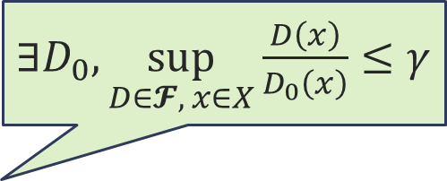
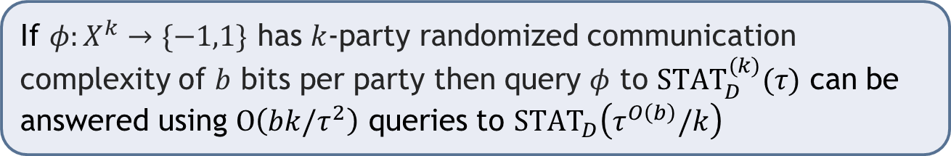
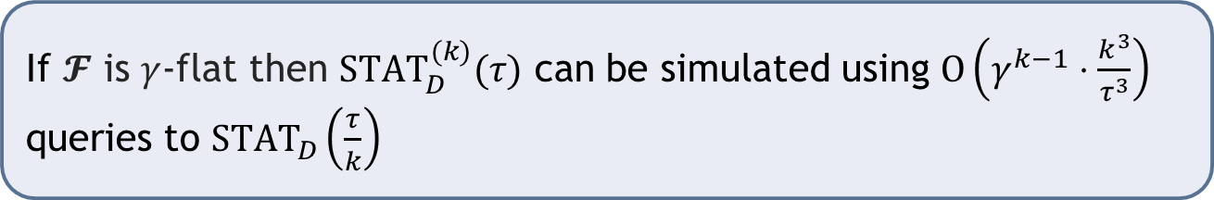
Reductions from $k$-wise to unary
$∃D_{0},\sup_{D∈𝓕, x∈X}{\frac{D\left(x\right)}{D_{0}\left(x\right)}}≤γ$
If $𝓕$ is $γ$-flat then $STAT_{D}^{(k)}(τ)$ can be simulated using $O\left(γ^{k−1}⋅\frac{k^{3}}{τ^{3}}\right)$ queries to $STAT_{D}\left(\frac{τ}{k}\right)$
PAC learning with fixed $P$ is $2$-flat. Generalizes and strengthens [BKW ‘00]
If $φ:X^{k}→\{−1,1\}$ has $k$-party randomized communication complexity of $b$ bits per party then query $φ$ to $STAT_{D}^{(k)}(τ)$ can be answered using $O\left(bk/τ^{2}\right)$ queries to $STAT_{D}\left(τ^{O\left(b\right)}/k\right)$
Build on [F. 16] and [Steinhardt,Valiant,Wager 16]

Slide 7
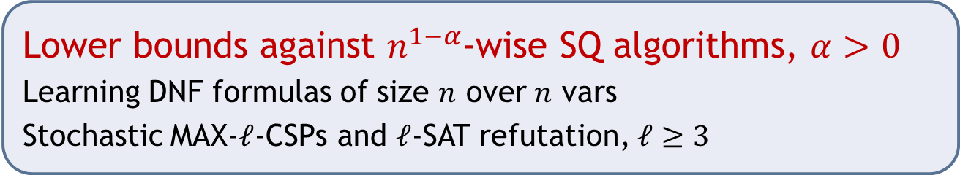
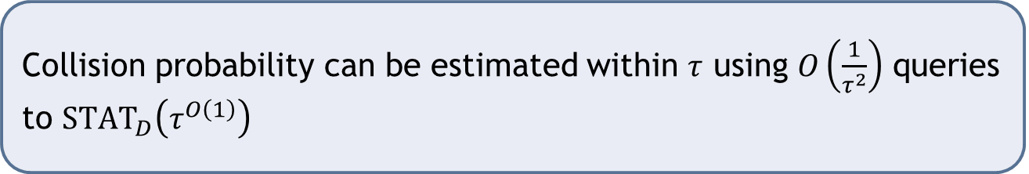
Example corollaries
Lower bounds against $n^{1−α}$-wise SQ algorithms, $α>0$
Learning DNF formulas of size $n$ over $n$ vars
Stochastic MAX-$ℓ$-CSPs and $ℓ$-SAT refutation, $ℓ≥3$
Collision probability can be estimated within $τ$ using $O\left(\frac{1}{τ^{2}}\right)$ queries to $STAT_{D}\left(τ^{O\left(1\right)}\right)$
Notes:
Corollaries from plugging the approximate gradient into standard gradient based algorithms
Additional application for noise tolerant learning via Perceptron

Slide 8
Discussion
Implications for additional models
Local differential privacy
Algorithms that extract few bits from each sample
Open problems
General approach that unifies the two reductions

