Slide 1


A General Characterization of
Statistical Query Complexity
Vitaly Feldman
work done while at IBM Research - Almaden

Slide 2
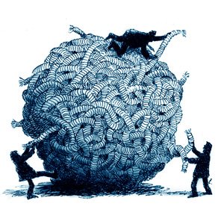

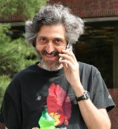

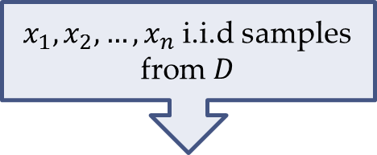
$x_{1},x_{2},…,x_{n}$ i.i.d samples from $D$
Sparse
halfspaces
PCA
regression
SCO
Learning juntas
We are working on it!
Parameter
estimation
In the mean time try a reduction …
Clustering
Gaussian mixtures
DNF
What is the computational complexity?
HELP!!!

Slide 3

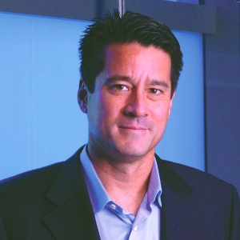








$x_{1},x_{2},…,x_{n}$ i.i.d samples from $D$
Statistical query (SQ) oracle
$$φ_{1}$$
Sparse
$$v_{1}$$
halfspaces
PCA
$$φ_{2}$$
regression
SCO
Learning juntas
$$v_{2}$$
Parameter
estimation
Clustering
$$D$$
$$φ_{q}$$
Gaussian mixtures
DNF
$$v_{q}$$
HELP!!!
Convex opt, Boosting
Moment matching
decision trees, SVM

Slide 4

Thm: For any problem its SQ complexity can be nearly tightly characterized by a “simple” dimension
$$φ_{1}$$
Sparse
$$v_{1}$$
halfspaces
PCA
$$φ_{2}$$
regression
SCO
Learning juntas
$$v_{2}$$
Parameter
estimation
Clustering
$$D$$
$$φ_{q}$$
Gaussian mixtures
DNF
$$v_{q}$$
SQ dimension?
Convex opt, Boosting
Moment matching
decision trees, SVM

Slide 5


Statistical problems
$x_{1},x_{2},…,x_{n}∼D$ over $X$
Notes:
Replace i.i.d. inputs from D with oracle access to D. The oracle approximately evaluates average of any function with range [-1,1]

Slide 6
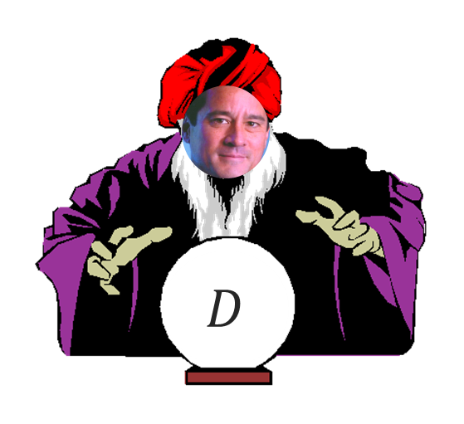
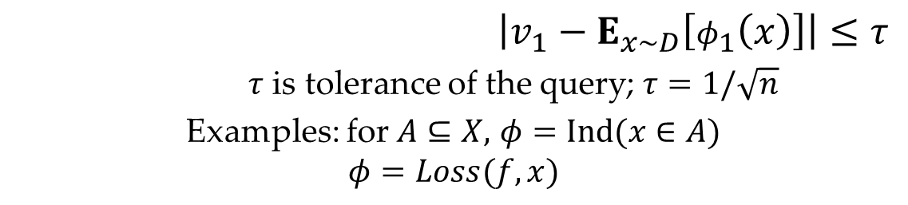


Statistical query model [Kearns ‘93]
$$φ_{1}$$
$$v_{1}$$
$$φ_{2}$$
$$v_{2}$$
$$φ_{q}$$
SQ algorithm
$$v_{q}$$
$STAT_{D}(τ)$ oracle
$\left|v_{1}−E_{x∼D}\left[φ_{1}\left(x\right)\right]\right|≤τ$
$τ$ is tolerance of the query; $τ=1/\sqrt{n}$
Examples: for $A⊆X,$ $φ=Ind(x∈A)$
$$φ=Loss(f,x)$$
$$φ_{1}:X→\left[−1,1\right]$$
Known aliases:
Counting query
Linear query
Linear statistical functional/estimator
Notes:
Replace i.i.d. inputs from D with oracle access to D. The oracle approximately evaluates average of any function with range [-1,1]

Slide 7
SQ applications
Noise-tolerant learning
[Kearns 93; BFKV 96; F,Balcan 13]
Differentially private data analysis
[Dinur,Nissim 03; BDMN 05; DMNS 06]
Local model [KLNRS 08]
Distributed/low communication/streaming ML
Theory [Ben-David,Dichterman 98; BBFM 12; FGRVX 13; Steinhardt,G.Valiant,Wager 15]
Practice [CKLYBNO 06; RSKSW 10; SLB+ 11; ACDL 14 …]
Evolvability
[F 08; F 09; Kanade,Wortman,L.Valiant 10; Kanade 11; P.Valiant 11; …]
Adaptive data analysis
[DFHPRR 14; Hardt,Ullman 14; Steinke,Ullman 15; F,Steinke 17; …]

Slide 8

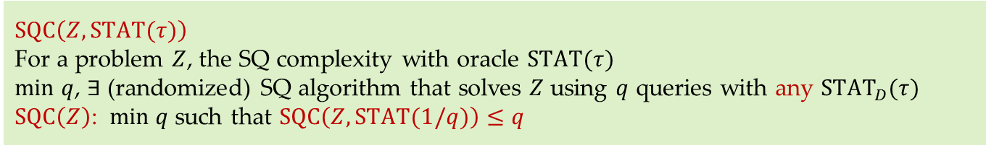
SQ complexity
$$SQC\left(Z,STAT(τ)\right)$$
For a problem $Z$, the SQ complexity with oracle $STAT(τ)$
$min$ $q$, $∃$ (randomized) SQ algorithm that solves $Z$ using $q$ queries with any ${STAT}_{D}(τ)$
$SQC\left(Z\right)$: $min q$ such that $SQC\left(Z,STAT(1/q)\right)≤q$
Proxy for computational complexity of $Z$ given $1/τ^{2}$ samples
For many known $Z$ solvable in time $T$ using $n$ samples we have:
$$SQC\left(Z,STAT(1/poly(n))\right)=poly(T)$$
SQ equivalents
Decision trees/lists [Kearns 93]
Linear thresholds [BFKV 96; Dunagan,Vempala 01; F,Guzman,Vempala 15]
Method of moments
Boosting [Aslam,Decatur 93]
Stochastic convex optimization [F,Guzman,Vempala 15]
Possible to analyze and prove lower bounds!

Slide 9
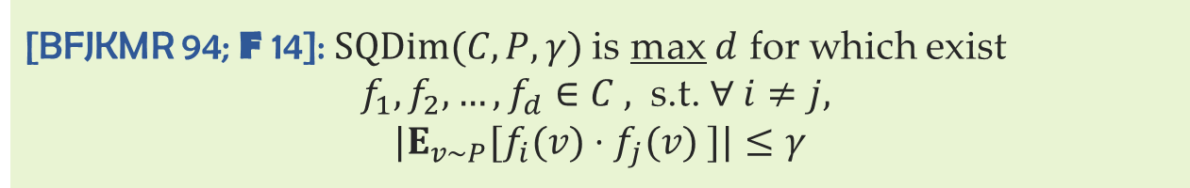
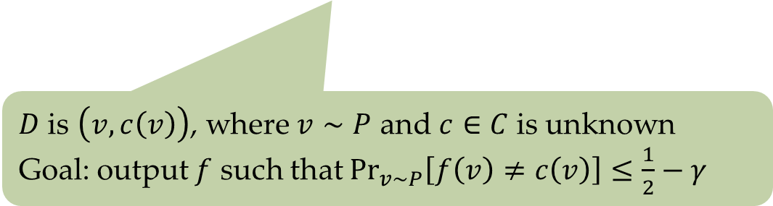
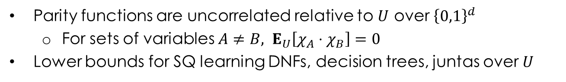
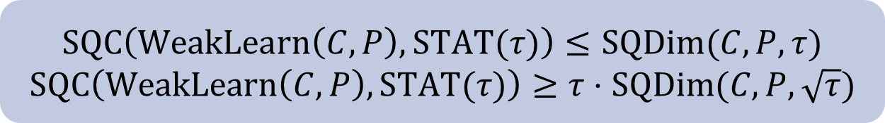
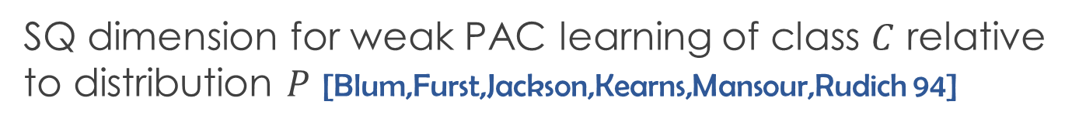
SQ dimension
SQ dimension for weak PAC learning of class $C$ relative to distribution $P$ [Blum,Furst,Jackson,Kearns,Mansour,Rudich 94]
[BFJKMR 94; F 14]: $SQDim(C,P,γ)$is max $d$ for which exist
$f_{1},f_{2},…,f_{d}∈C ,$ s.t. $∀ i≠j,$
$$|E_{v∼P}[f_{i}(v)⋅f_{j}(v) ]|≤γ$$
$D$ is $\left(v,c\left(v\right)\right)$, where $v∼P$ and $c∈C$ is unknown
Goal: output $f$ such that $\underset{v∼P}{Pr}\left[f\left(v\right)≠c\left(v\right)\right]≤\frac{1}{2}−γ$
$$SQC\left(WeakLearn\left(C,P\right),STAT(τ)\right)≤SQDim(C,P,τ)$$
$$SQC\left(WeakLearn\left(C,P\right),STAT(τ)\right)≥τ⋅SQDim(C,P,\sqrt{τ})$$
Parity functions are uncorrelated relative to $U$ over ${\left\{0,1\right\}}^{d}$
For sets of variables $A≠B, E_{U}\left[χ_{A}⋅χ_{B}\right]=0$
Lower bounds for SQ learning DNFs, decision trees, juntas over $U$

Slide 10


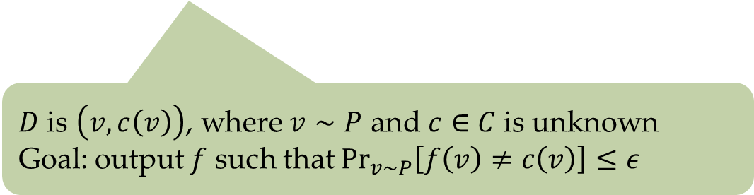
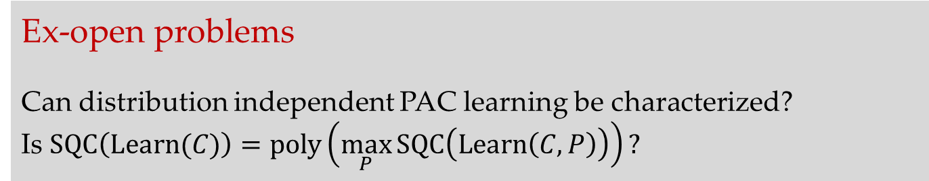
Beyond fixed $P$
(Strong) PAC learning relative to fixed $P$
[BCGKL 07; Simon 07; F 09; Szorenyi 09]
$D$ is $\left(v,c\left(v\right)\right)$, where $v∼P$ and $c∈C$ is unknown
Goal: output $f$ such that $\underset{v∼P}{Pr}\left[f\left(v\right)≠c\left(v\right)\right]≤ε$
Ex-open problems
Can distribution independent PAC learning be characterized?
Is $SQC\left(Learn(C)\right)=poly\left(\max_{P}{SQC\left(Learn\left(C,P\right)\right)}\right)?$

Slide 11
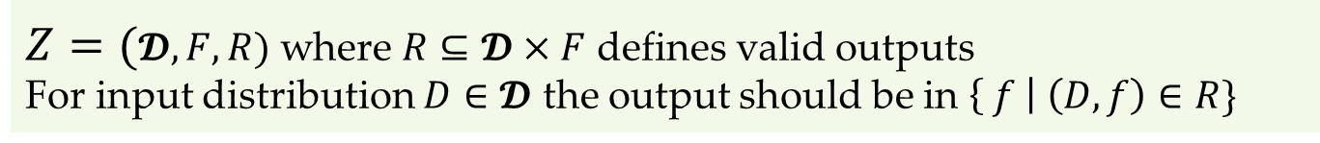
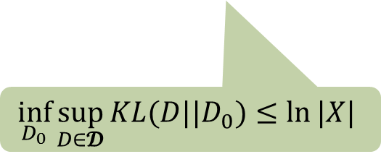
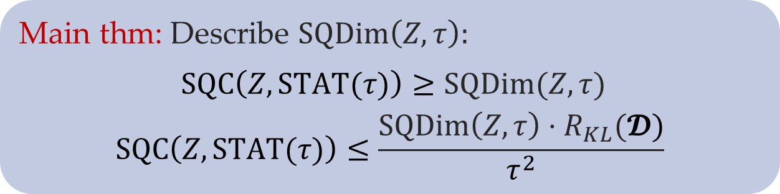
Main result
$Z=(𝓓,F,R)$ where $R⊆𝓓×F$ defines valid outputs
For input distribution $D∈𝓓$ the output should be in $\left\{ f \right| \left(D,f\right)∈R\}$
SQ lower bounds
[FGRVX 13; F,Perkins,Vempala 15]
Main thm: Describe $SQDim\left(Z,τ\right):$
$SQC\left(Z,STAT(τ)\right)≥SQDim(Z,τ)$
$$SQC\left(Z,STAT(τ)\right)≤\frac{SQDim\left(Z,τ\right)⋅R_{KL}(𝓓)}{τ^{2}}$$
$$\inf_{D_{0}}{\sup_{D∈𝓓}{KL(D||D_{0})}}≤\ln{|X|}$$
Notes:
Several other notions of dimension and analysis techniques are known
In this talk a simple SQ dimension for decision problems that suffices for k-SAT.

Slide 12
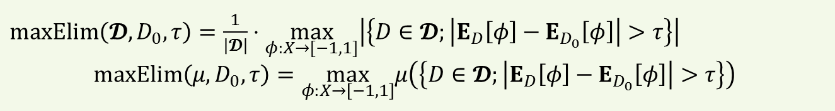


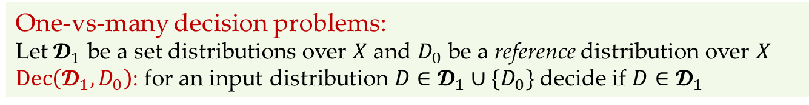




Decision problems
One-vs-many decision problems:
Let $𝓓_{1}$ be a set distributions over $X$ and $D_{0}$ be a reference distribution over $X$
$Dec\left(𝓓_{1},D_{0}\right)$: for an input distribution $D∈𝓓_{1}∪\{D_{0}\}$ decide if $D∈𝓓_{1}$
$maxElim\left(𝓓,D_{0},τ\right)=\frac{1}{\left|𝓓\right|}⋅\max_{φ:X→[−1,1]}\left|\left\{D∈𝓓;\left|E_{D}\left[φ\right]−E_{D_{0}}\left[φ\right]\right|>τ\right\}\right|$
$$maxElim\left(μ,D_{0},τ\right)=\max_{φ:X→\left[−1,1\right]}μ\left(\left\{D∈𝓓;\left|E_{D}\left[φ\right]−E_{D_{0}}\left[φ\right]\right|>τ\right\}\right)$$
$$τ$$
$$τ$$
$$𝓓$$
$$φ$$
$$D_{0}$$
$$SQDim\left(Dec\left(𝓓_{1},D_{0}\right),τ\right)≐\max_{μ over 𝓓_{1}} \frac{1}{maxElim\left(μ,D_{0},τ\right)}$$
$$=SQC\left(Dec\left(𝓓_{1},D_{0}\right),STAT(τ)\right)$$

Slide 13
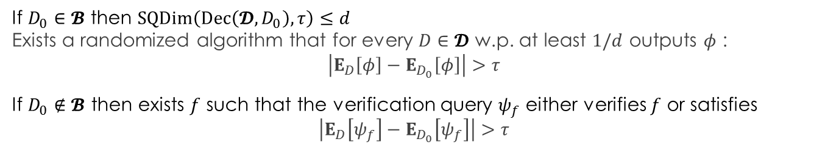
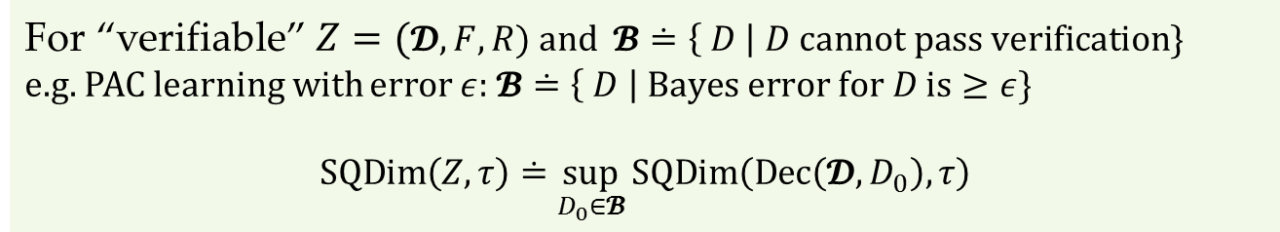
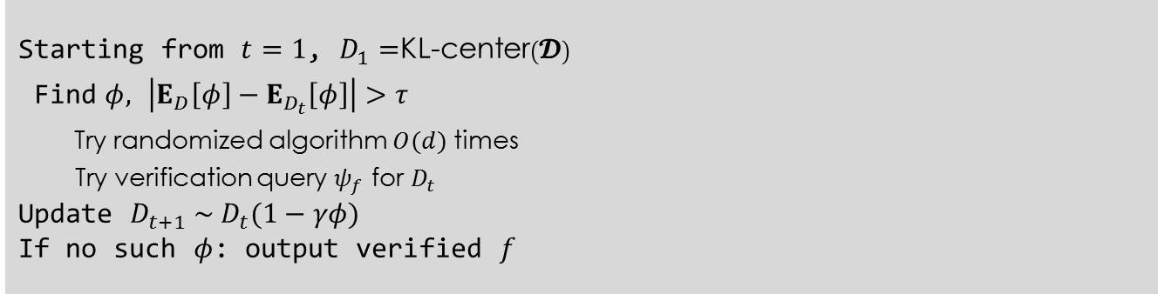
(Almost) General case
For “verifiable” $Z=(𝓓,F,R)$ and $𝓑≐\left\{ D \right| D cannot pass verification\}$
e.g. PAC learning with error $ε$: $𝓑≐\left\{ D \right| Bayes error for D is≥ε\}$
$$SQDim\left(Z,τ\right)≐\sup_{D_{0}∈𝓑}{SQDim\left(Dec\left(𝓓,D_{0}\right),τ\right)}$$
If $D_{0}∈𝓑$ then $SQDim\left(Dec\left(𝓓,D_{0}\right),τ\right)≤d$
Exists a randomized algorithm that for every $D∈𝓓$ w.p. at least $1/d$ outputs $φ$ :
$$\left|E_{D}\left[φ\right]−E_{D_{0}}\left[φ\right]\right|>τ$$
If $D_{0}∉𝓑$ then exists $f$ such that the verification query $ψ_{f}$ either verifies $f$ or satisfies
$$\left|E_{D}\left[ψ_{f}\right]−E_{D_{0}}\left[ψ_{f}\right]\right|>τ$$
Starting from $t=1$, $D_{1}=$KL-center$\left(𝓓\right)$
Find $φ,$ $\left|E_{D}\left[φ\right]−E_{D_{t}}\left[φ\right]\right|>τ$
Try randomized algorithm $O(d)$ times
Try verification query $ψ_{f}$ for $D_{t}$
Update $D_{t+1} \sim D_{t}(1−γφ)$
If no such $φ$: output verified $f$

Slide 14
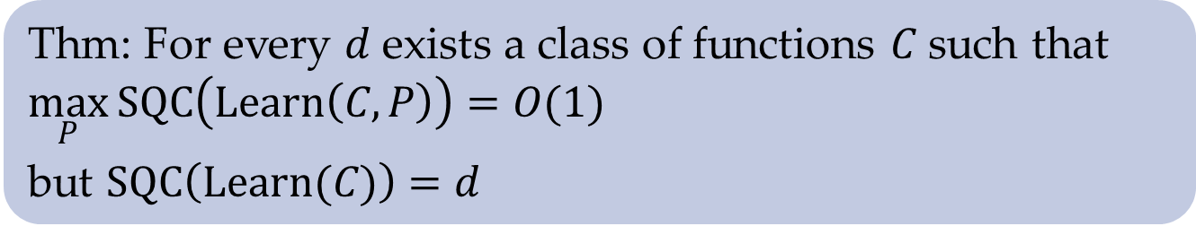

Applications
Thm: For every $d$ exists a class of functions $C$ such that $\max_{P}{SQC\left(Learn\left(C,P\right)\right)}=O(1)$
but $SQC\left(Learn(C)\right)=d$
$$C=Line_{p}≐\left\{ ℓ_{a,b} \right|a,b∈ℤ_{p}\}$$
$ℓ_{a,b}\left(z_{1},z_{2}\right)=1$ iff $az_{1}+b≡z_{2} (mod p)$

Slide 15
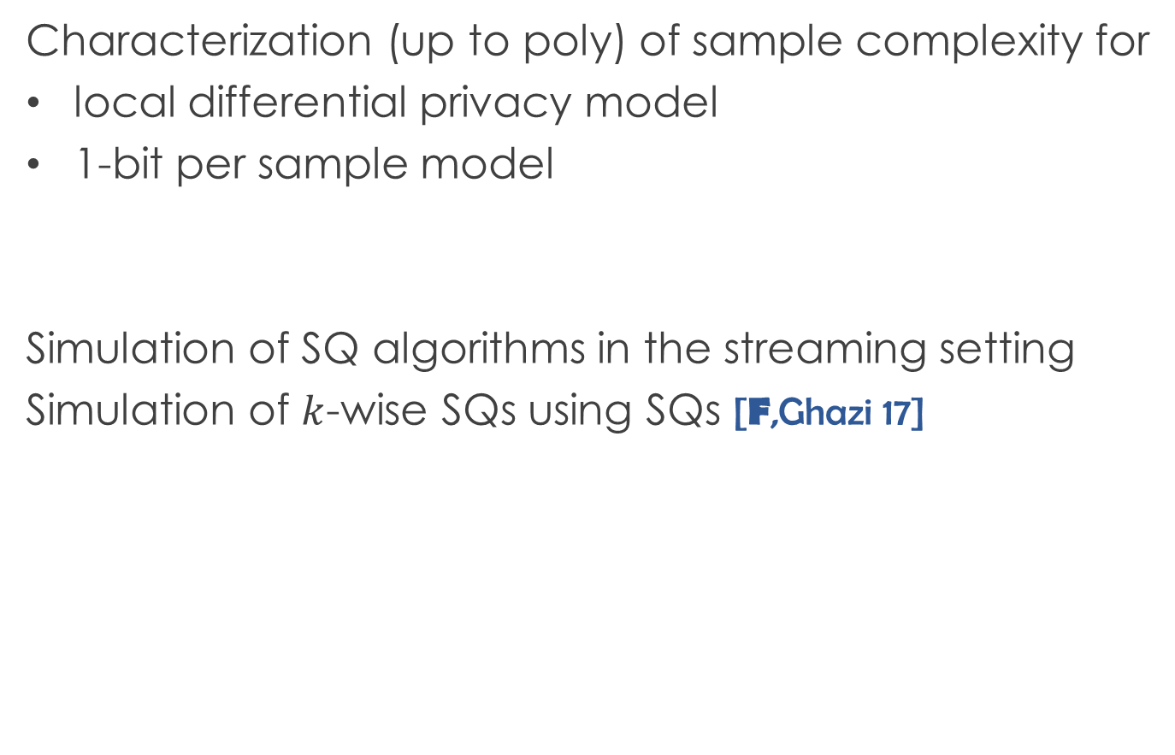
Applications
Characterization (up to poly) of sample complexity for
local differential privacy model
1-bit per sample model
Simulation of SQ algorithms in the streaming setting
Simulation of $k$-wise SQs using SQs [F,Ghazi 17]

Slide 16
Conclusions
SQ is a restricted yet powerful model of data access
Reasonably simple dimension tightly characterizes the (randomized) SQ complexity
Open problems:
Simpler versions for specific problems (e.g. PAC learning)
Analysis techniques
SQ complexity of specific problems

