Slide 1


Dealing with Range Anxiety in
Mean Estimation
Vitaly Feldman
work done while at IBM Research - Almaden

Slide 2

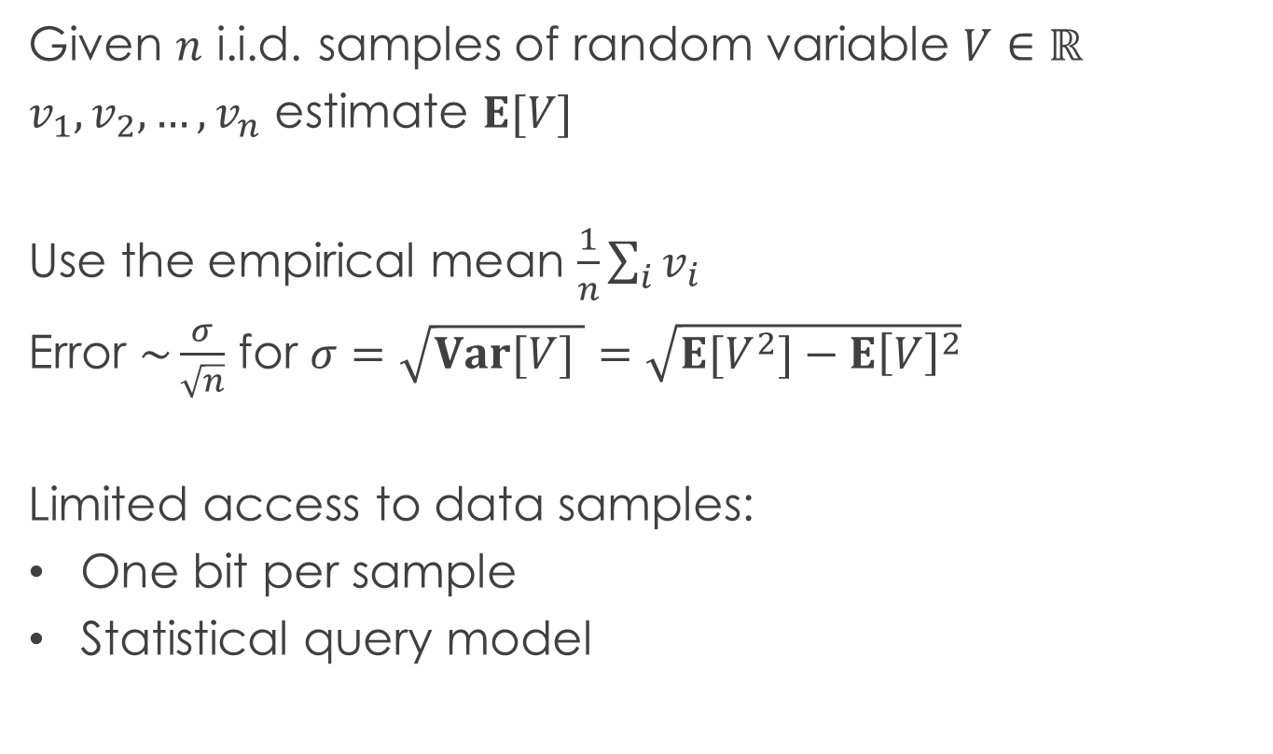
Mean estimation
Given $n$ i.i.d. samples of random variable $V∈ℝ$
$v_{1},v_{2},…,v_{n}$ estimate $E[V]$
Use the empirical mean $\frac{1}{n}\sum_{i}{v_{i}}$
Error $\sim \frac{σ}{\sqrt{n}}$ for $σ=\sqrt{Var[V] }=\sqrt{E[V^{2}]−E{\left[V\right]}^{2}}$
Limited access to data samples:
One bit per sample
Statistical query model
Notes:
Add locked data picture

Slide 3
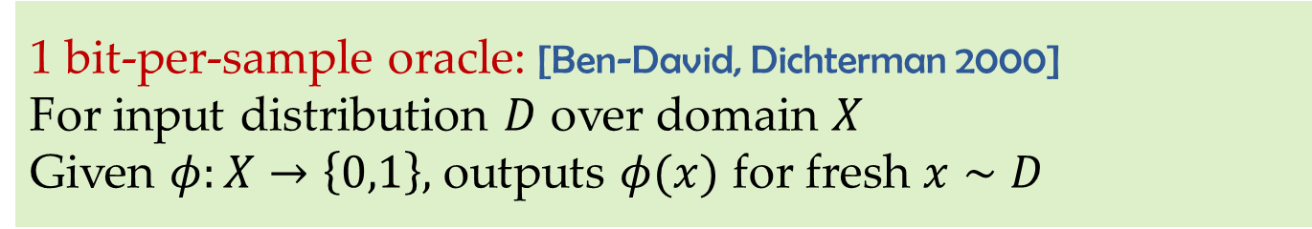
One bit per sample
1 bit-per-sample oracle: [Ben-David, Dichterman 2000]
For input distribution $D$ over domain $X$
Given $φ:X→\left\{0,1\right\},$ outputs $φ(x)$ for fresh $x∼D$
Distributed/low-communication learning/stats
[Rajagopal,Wainwright,Varaiya 06; Zhang,Duchi,Jordan,Wainwright 13;
Steinhardt,Duchi 15; Steinhardt,Valiant,Wager 16; Suresh,Yu,McMahan,Kumar 17]
Sensor networks
[Luo 05; Ribeiro,Giannakis 06; ……….]

Slide 4
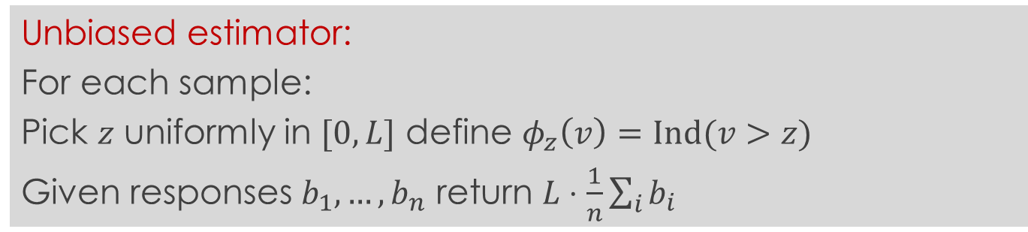
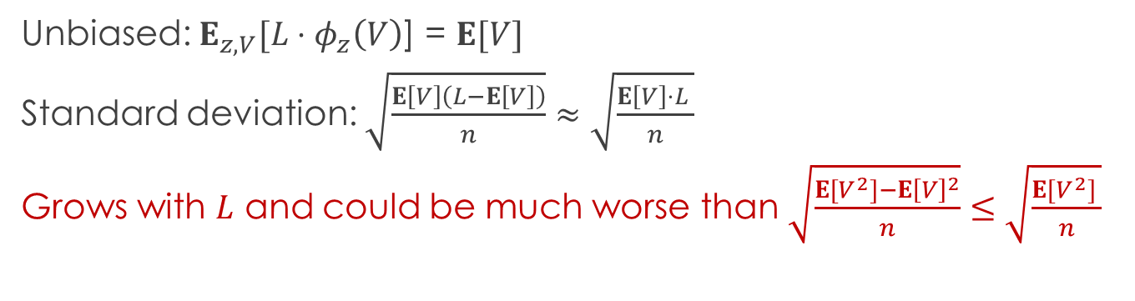
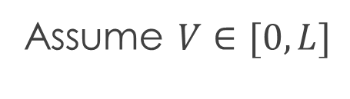
Range anxiety
Assume $V∈[0,L]$
Unbiased estimator:
For each sample:
Pick $z$ uniformly in $[0,L]$ define $φ_{z}\left(v\right)=Ind(v>z)$
Given responses $b_{1},…,b_{n}$ return $L⋅\frac{1}{n}\sum_{i}{b_{i}}$
Unbiased: $E_{z,V}[L⋅φ_{z}\left(V\right)$] = $E[V]$
Standard deviation: $\sqrt{\frac{E\left[V\right]\left(L−E\left[V\right]\right)}{n}}≈\sqrt{\frac{E\left[V\right]⋅L }{n}}$
Grows with $L$ and could be much worse than $\sqrt{\frac{E[V^{2}]−E{\left[V\right]}^{2}}{n}}≤\sqrt{\frac{E[V^{2}] }{n}}$

Slide 5



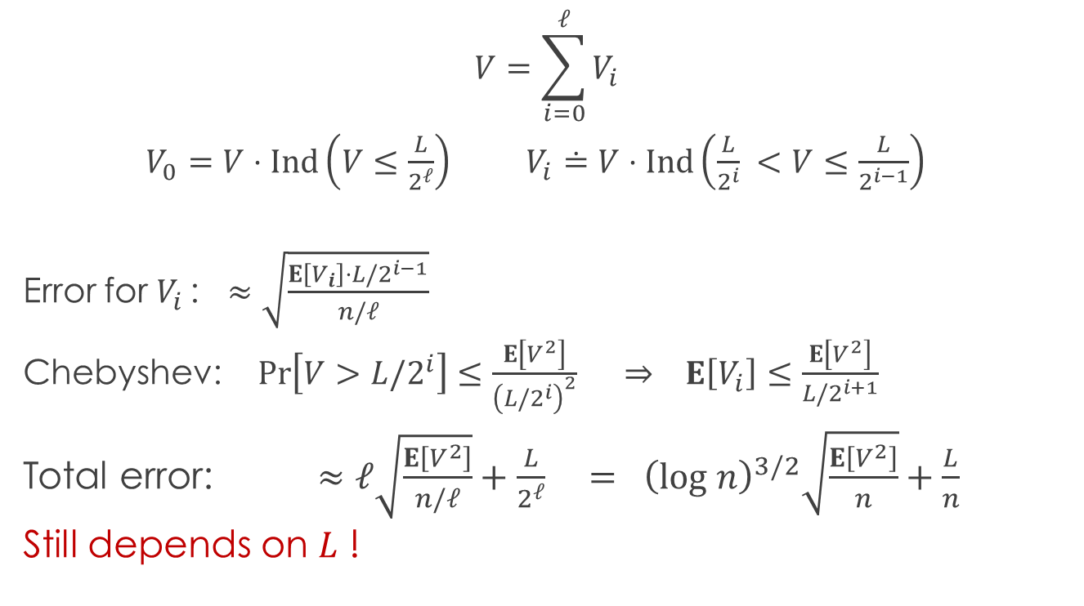



Reducing dynamic range
$$0$$
$$L$$
$$L/2^{ℓ}$$
$$⋯$$
$$L/4$$
$$L/2$$
$$V=\sum_{i=0}^{ℓ}{V_{i}}$$
$V_{0}=V⋅Ind\left(V≤\frac{L}{2^{ℓ}}\right)$ $V_{i}≐V⋅Ind\left(\frac{L}{2^{i}} <V≤\frac{L}{2^{i−1}}\right)$
Error for $V_{i }$: $≈\sqrt{\frac{E\left[V_{i}\right]⋅L/2^{i−1}}{n/ℓ}}$
Chebyshev: $Pr\left[V>L{/2}^{i}\right]≤\frac{E\left[V^{2}\right]}{{\left(L/2^{i}\right)}^{2}} ⇒ E\left[V_{i}\right]≤\frac{E\left[V^{2}\right]}{L/2^{i+1}}$
Total error: $≈ℓ\sqrt{\frac{E\left[V^{2}\right]}{n/ℓ}}+\frac{L}{2^{ℓ}} = {\left(log n\right)}^{3/2}\sqrt{\frac{E\left[V^{2}\right]}{n}}+\frac{L}{n}$
Still depends on $L$ !

Slide 6
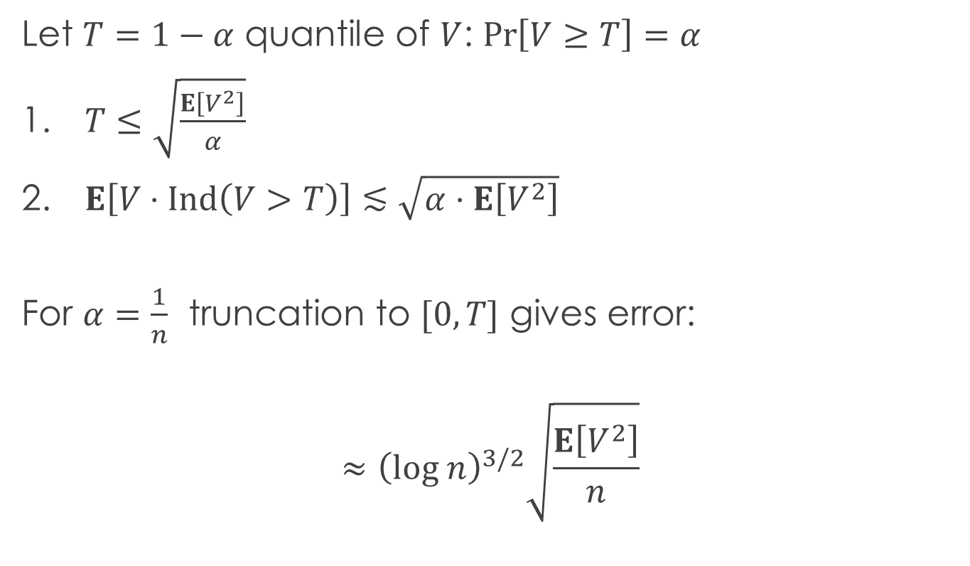
Quantile truncation
Let $T=1−α$ quantile of $V$: $\operatorname{Pr}\left[V≥T\right]=α$
$T≤\sqrt{\frac{E\left[V^{2}\right]}{α}}$
$E\left[V⋅Ind\left(V>T\right)\right]≲\sqrt{α⋅E\left[V^{2}\right]}$
For $α=\frac{1}{n}$ truncation to $[0,T]$ gives error:
$$≈{\left(log n\right)}^{3/2}\sqrt{\frac{E\left[V^{2}\right]}{n}}$$

Slide 7
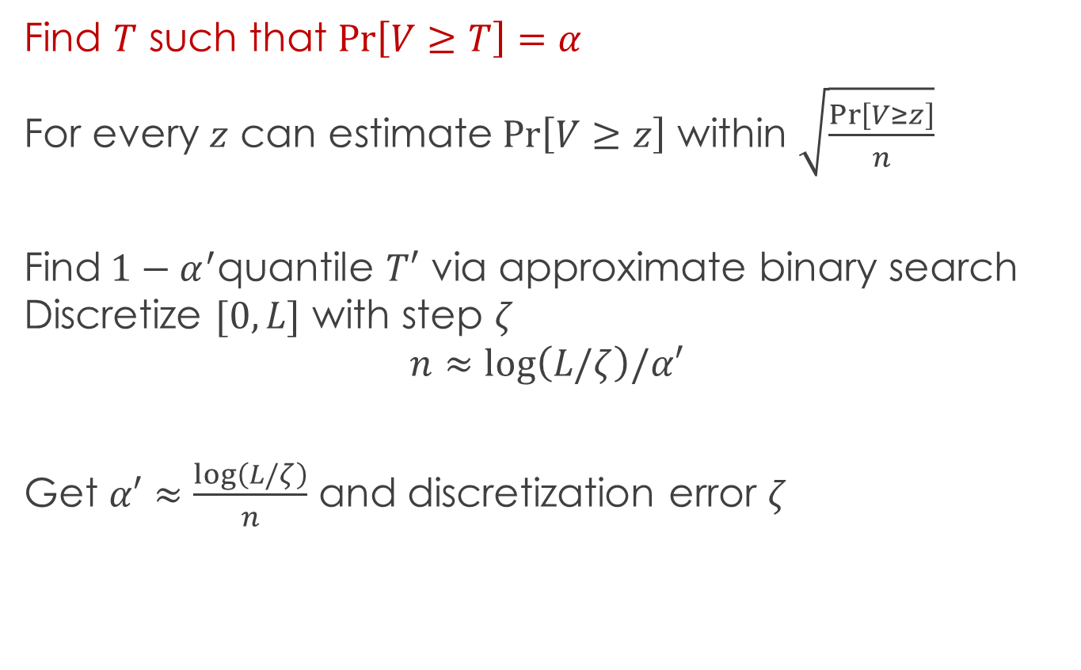
Quantile estimation
Find $T$ such that $\operatorname{Pr}\left[V≥T\right]=α$
For every $z$ can estimate$\operatorname{Pr}\left[V≥z\right]$ within $\sqrt{\frac{Pr\left[V≥z\right]}{n}}$
Find$1−α^{′}$quantile $T′$ via approximate binary search Discretize $[0,L]$ with step $ζ$
$$n≈log\left(L/ζ\right)/α′$$
Get $α′≈\frac{log\left(L/ζ\right)}{n}$ and discretization error $ζ$

Slide 8
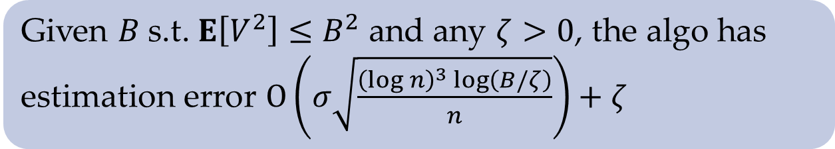
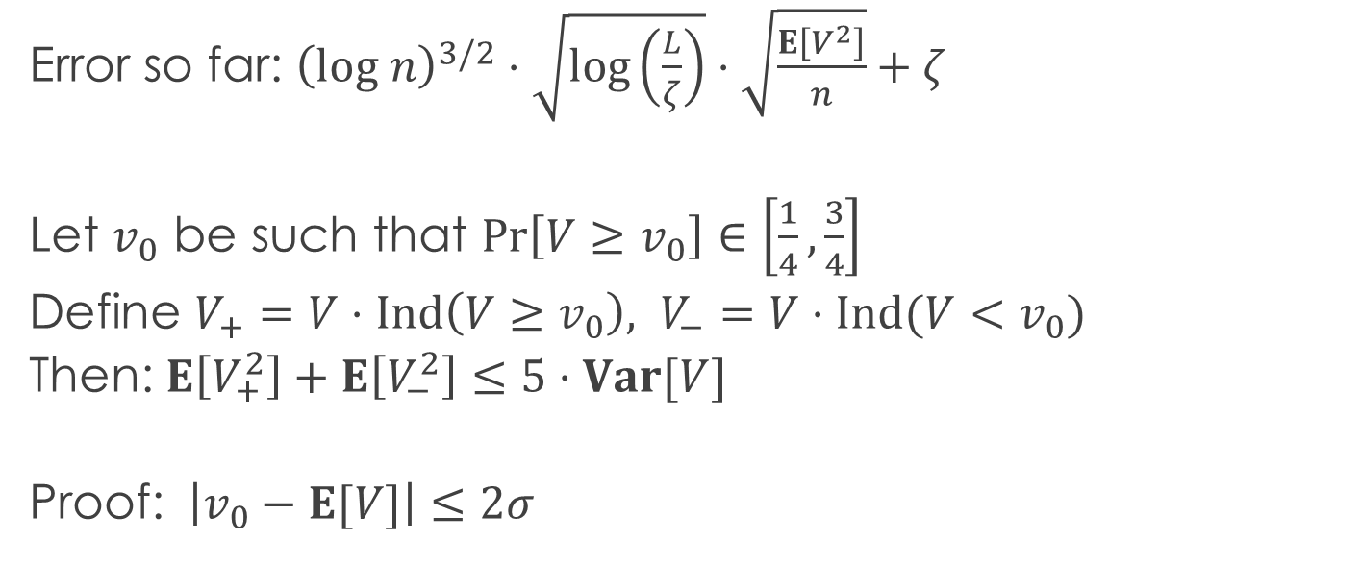
Centering
Error so far: ${\left(log n\right)}^{3/2}⋅\sqrt{\log\left(\frac{L}{ζ}\right)}⋅\sqrt{\frac{E\left[V^{2}\right]}{n}}+ζ$
Let $v_{0}$ be such that $Pr\left[V≥v_{0}\right]∈\left[\frac{1}{4},\frac{3}{4}\right]$
Define $V_{+}=V⋅Ind\left(V≥v_{0}\right), V_{−}=V⋅Ind(V<v_{0})$
Then: $E\left[V_{+}^{2}\right]+E\left[V_{−}^{2}\right]≤5⋅Var[V]$
Proof: $\left|v_{0}−E[V]\right|≤2σ$
Given $B$s.t. $E\left[V^{2}\right]≤B^{2}$ and any $ζ>0$, the algo has
estimation error $O\left(σ\sqrt{\frac{{\left(log n\right)}^{3}\log\left(B/ζ\right)}{n}}\right)+ζ$

Slide 9


Statistical problems
$x_{1},x_{2},…,x_{n}∼D$ over $X$
Notes:
Replace i.i.d. inputs from D with oracle access to D. The oracle approximately evaluates average of any function with range [-1,1]

Slide 10
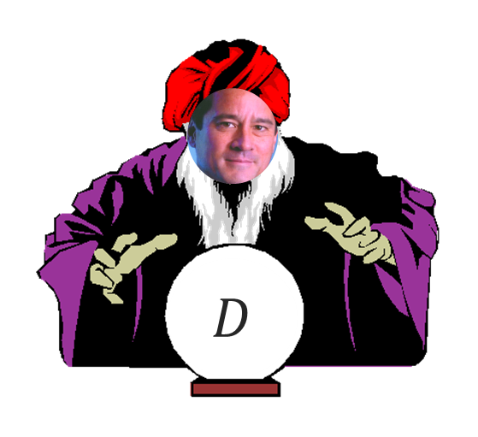









Statistical query model [Kearns ‘93]
$$φ_{1}$$
$$v_{1}$$
$$φ_{2}$$
$$v_{2}$$
$$φ_{q}$$
SQ algorithm
$$v_{q}$$
$STAT_{D}(τ)$ oracle
$$φ_{1}:X→\left[0,1\right]$$
$$\left|v_{1}−E_{x∼D}\left[φ_{1}\left(x\right)\right]\right|≤τ$$
$τ$ is the proxy for the number of samples $τ≈1/\sqrt{n}$
Not faithful for lower bounds!
Notes:
Replace i.i.d. inputs from D with oracle access to D. The oracle approximately evaluates average of any function with range [-1,1]

Slide 11
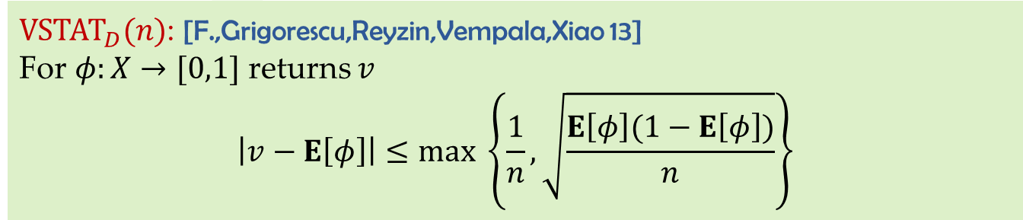
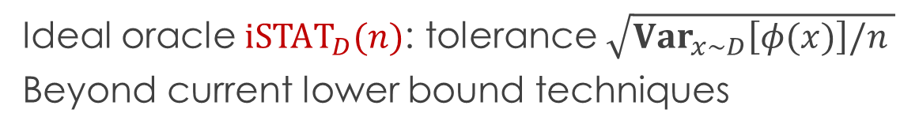


Simulating ideal SQ oracle
Ideal oracle $iSTAT_{D}(n)$: tolerance $\sqrt{Var_{x∼D}\left[φ(x)\right]/n }$
Beyond current lower bound techniques
${VSTAT}_{D}(n)$: [F.,Grigorescu,Reyzin,Vempala,Xiao 13]
For $φ:X→[0,1]$ returns $v$
$$\left|v−E\left[φ\right]\right|≤max \left\{\frac{1}{n},\sqrt{\frac{E\left[φ\right](1−E\left[φ\right])}{n}}\right\}$$
Possible to analyze and prove lower bounds!
Can be simulated using $O(n)$ $1$-bit-per-sample queries
Can simulate up to $n$ $1$-bit-per-sample queries
$iSTAT_{D}(n)$ can be implemented using ${VSTAT}_{D}(\tilde{O}(n))$

Slide 12
Conclusions
Large range/heavy tails are a hassle when access to data is limited
(Asymptotically) reasonable approach for dealing with it
To do: better/simpler/more practical algorithms

Slide 13
SQ applications
Noise-tolerant learning
[Kearns 93; BFKV 96; F,Balcan 13]
Differentially private data analysis
[Dinur,Nissim 03; BDMN 05; DMNS 06]
Local model [KLNRS 08]
Distributed/low communication/streaming ML
Theory [Ben-David,Dichterman 98; BBFM 12; FGRVX 13; Steinhardt,G.Valiant,Wager 15]
Practice [CKLYBNO 06; RSKSW 10; SLB+ 11; ACDL 14 …]
Evolvability
[F 08; F 09; Kanade,Wortman,L.Valiant 10; Kanade 11; P.Valiant 11; …]
Adaptive data analysis
[DFHPRR 14; Hardt,Ullman 14; Steinke,Ullman 15; F,Steinke 17; …]

Slide 14
Def: []
Formulas

