Slide 1



Privacy-preserving Prediction
Vitaly Feldman
Brain
with Cynthia Dwork

Slide 2
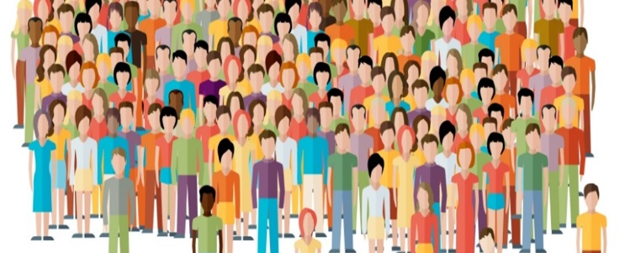

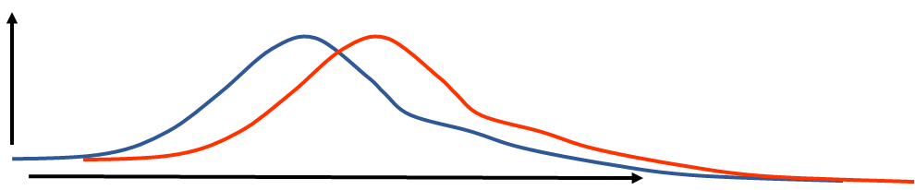

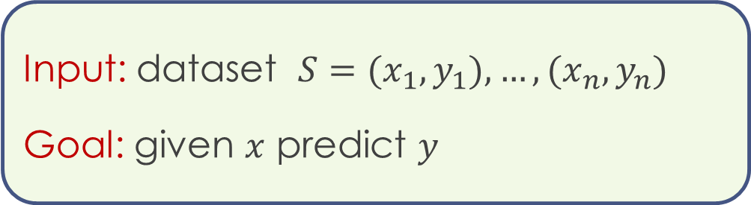
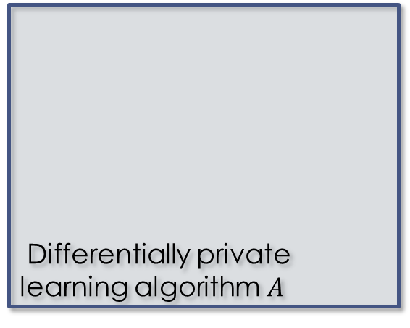



Privacy-preserving learning
Input: dataset $S=(x_{1},y_{1}),…,(x_{n},y_{n})$
Goal: given $x$ predict $y$
$$s$$
Differentially private learning algorithm $A$
Model $h$
$A(S′)$
$A(S)$

Slide 3
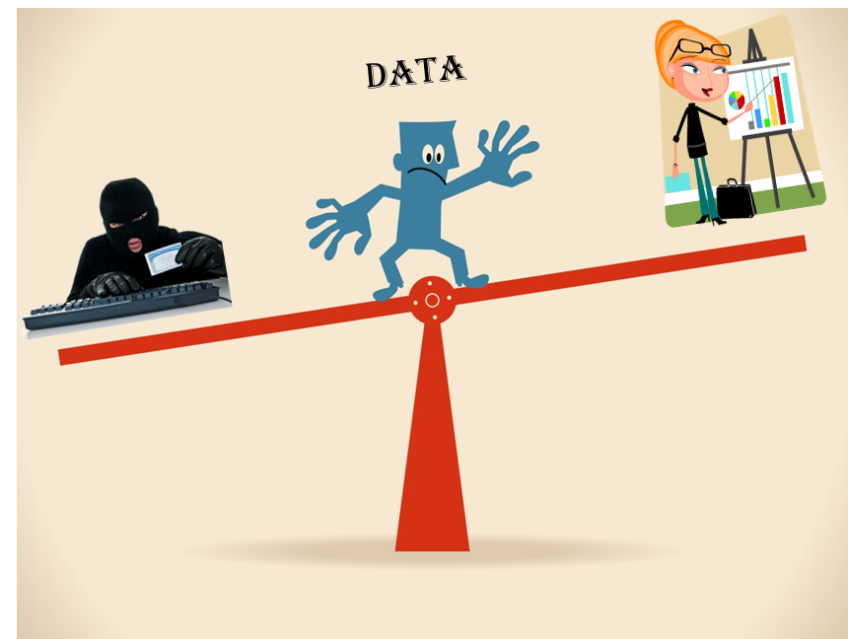
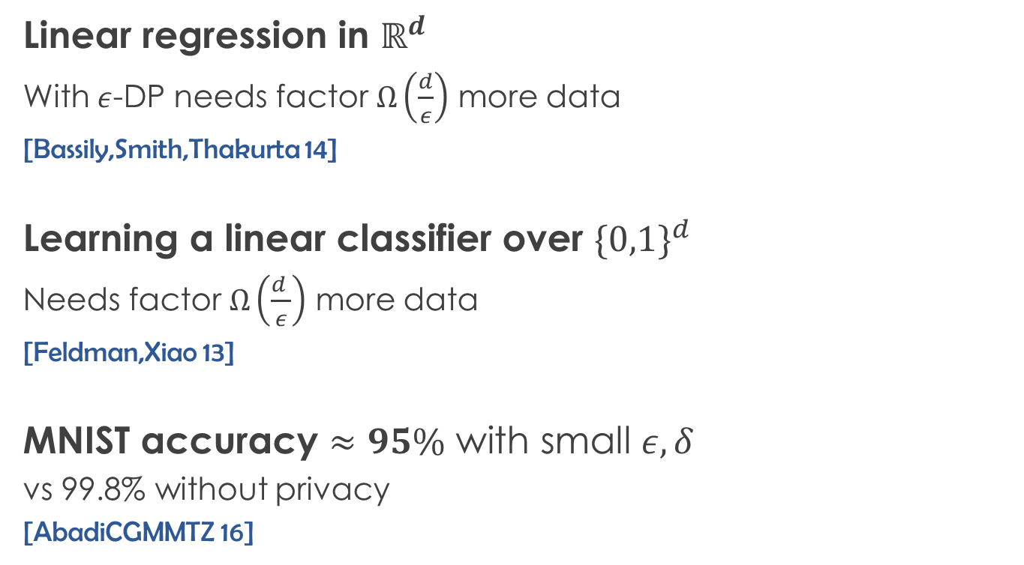
Trade-offs
Linear regression in $ℝ^{d}$
With $ε$-DP needs factor $Ω\left(\frac{d}{ε}\right)$ more data
[Bassily,Smith,Thakurta 14]
Learning a linear classifier over ${\{0,1\}}^{d}$
Needs factor $Ω\left(\frac{d }{ε}\right)$ more data
[Feldman,Xiao 13]
MNIST accuracy $≈95\%$ with small $ε, δ$
vs 99.8% without privacy
[AbadiCGMMTZ 16]

Slide 4








Prediction
Users need predictions not models
Fits many existing systems
$$p_{1}∈X$$
Prediction API
$$v_{2}$$
$$s$$
$$p_{2}$$
$$v_{2}$$
$$p_{t}$$
$$v_{t}$$
Users
DP
Notes:
Given that many existing applications

Slide 5
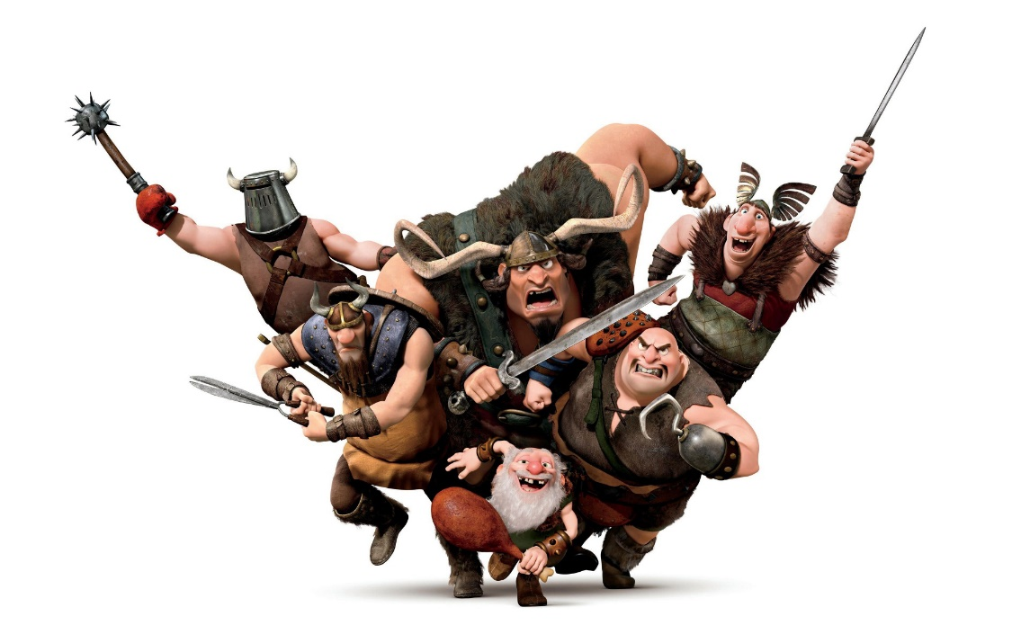
Attacks
Black-box membership inference with high accuracy
[Shokri,Stronati,Song,Shmatikov 17; LongBWBWTGC 18; SalemZFHB 18]

Slide 6
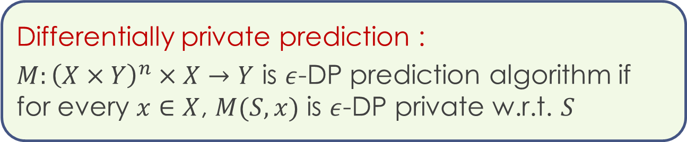
Learning with DP prediction
Accuracy-privacy trade-off
Single prediction query
Differentially private prediction :
$M:{\left(X×Y\right)}^{n}×X→Y$ is $ε$-DP prediction algorithm if for every $x∈X$, $M(S,x)$ is $ε$-DP private w.r.t. $S$

Slide 7
















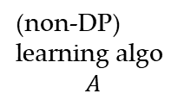








Label aggregation
[HCB 16; PAEGT 17; PSMRTE 18; BTT 18]
$$S$$
$$S^{1}$$ | $S^{2}$ | $$S^{3}$$ | $⋯$ | $$⋯$$ | $$⋯$$ | $$S^{k}$$
$$n=km$$
$⋯$
(non-DP)
learning algo
$$A$$
$$A$$
$$A$$
$$A$$
$⋯$
$$A$$
$$A$$
$$A$$
$$h_{1}$$
$$h_{2}$$
$$h_{3}$$
$$h_{k−2}$$
$$h_{k−1}$$
$$h_{k}$$
$$x$$
$$h_{1}(x)$$
$$h_{2}(x)$$
$$h_{3}(x)$$
$$h_{k−2}(x)$$
$$h_{k−1}(x)$$
$$h_{k}(x)$$
Differentially private aggregation
$$y$$
e.g. exponential mechanism $y∝e^{ε |\left\{i \right| h_{i}\left(x\right)=y\}|/2}$

Slide 8
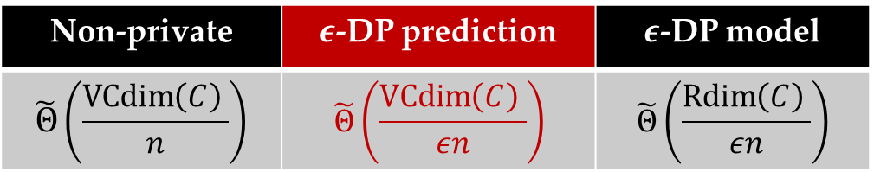
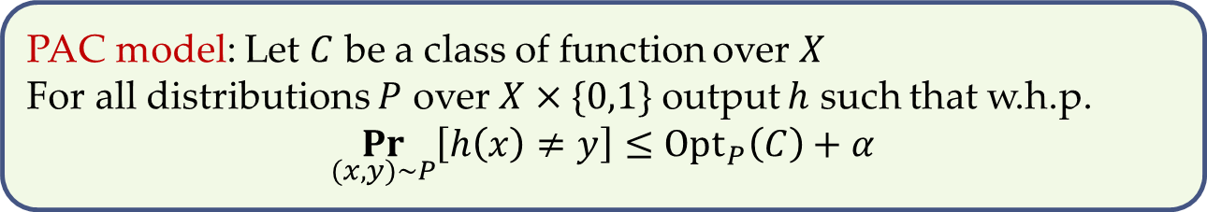
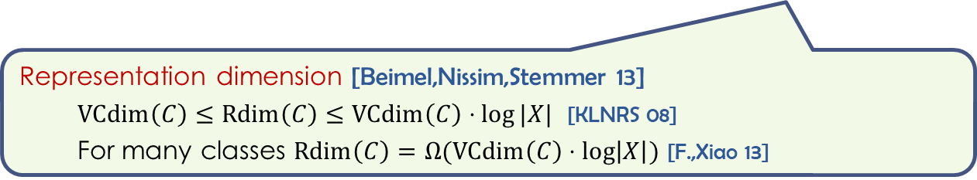
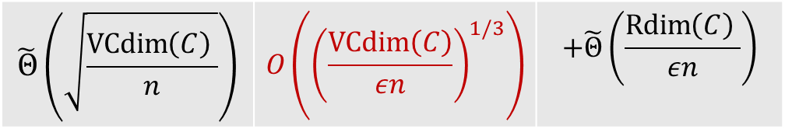
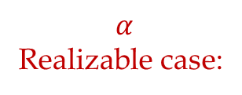
Classification via aggregation
PAC model: Let $C$ be a class of function over $X$
For all distributions $P$ over $X×\{0,1\}$ output $h$ such that w.h.p.
$$\underset{(x,y)∼P}{Pr}\left[h\left(x\right)≠y\right]≤Opt_{P}\left(C\right)+α$$
Non-private | $ε$-DP prediction | $ε$-DP model
$$\tilde{Θ}\left(\frac{\operatorname{VCdim}\left(C\right) }{n}\right)$$ | $$\tilde{Θ}\left(\frac{\operatorname{VCdim}\left(C\right) }{εn}\right)$$ | $$\tilde{Θ}\left(\frac{\operatorname{Rdim}\left(C\right) }{εn}\right)$$
$$α$$
Realizable case:
$$\tilde{Θ}\left(\sqrt{\frac{\operatorname{VCdim}\left(C\right) }{n}}\right)$$ | $$O\left({\left(\frac{\operatorname{VCdim}\left(C\right)}{εn}\right)}^{1/3}\right)$$ | $$+\tilde{Θ}\left(\frac{\operatorname{Rdim}\left(C\right) }{εn}\right)$$
Agnostic:
Representation dimension [Beimel,Nissim,Stemmer 13]
$\operatorname{VCdim}\left(C\right)≤\operatorname{Rdim}\left(C\right)≤\operatorname{VCdim}\left(C\right)⋅log⁡|X|$ [KLNRS 08]
For many classes $\operatorname{Rdim}\left(C\right)=Ω(\operatorname{VCdim}\left(C\right)⋅\log\left|X\right|)$ [F.,Xiao 13]

Slide 9
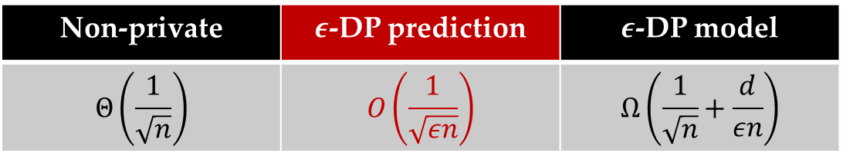
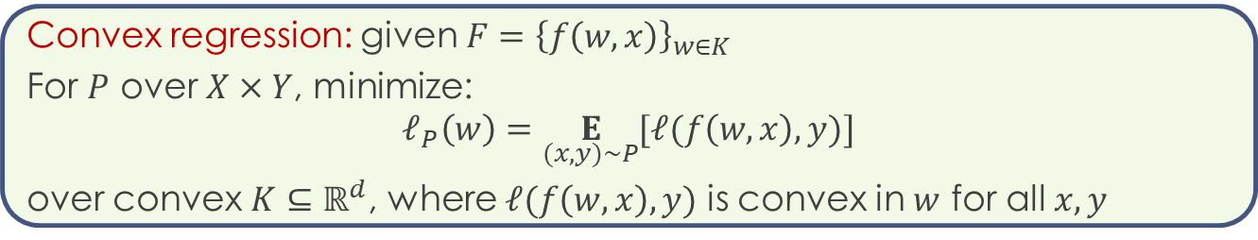
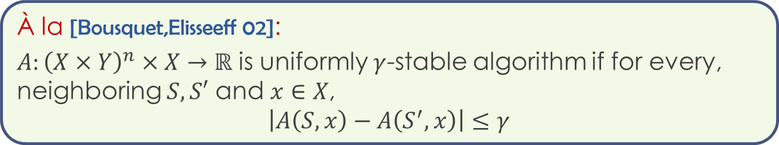
Prediction stability
À la [Bousquet,Elisseeff 02]:
$A:{\left(X×Y\right)}^{n}×X→ℝ$ is uniformly $γ$-stable algorithm if for every, neighboring $S,S′$ and $x∈X$,
$$\left|A\left(S,x\right)−A\left(S^{′},x\right)\right|≤γ$$
Convex regression: given $F={\left\{f\left(w,x\right)\right\}}_{w∈K}$
For $P$ over $X×Y$, minimize:
$$ℓ_{P}\left(w\right)=\underset{(x,y)∼P}{E}{[ℓ(f\left(w,x\right),y)]}$$
over convex $K⊆ℝ^{d}$, where $ℓ(f\left(w,x\right),y)$ is convex in $w$ for all $x,y$
Convex $1$-Lipschitz regression over $ℓ_{2}$ ball of radius $1$:
Non-private | $ε$-DP prediction | $ε$-DP model
$$Θ\left(\frac{1}{\sqrt{n}}\right)$$ | $$O\left(\frac{1}{\sqrt{εn}}\right)$$ | $$Ω\left(\frac{1}{\sqrt{n}}+\frac{d}{εn}\right)$$
Excess loss:

Slide 10
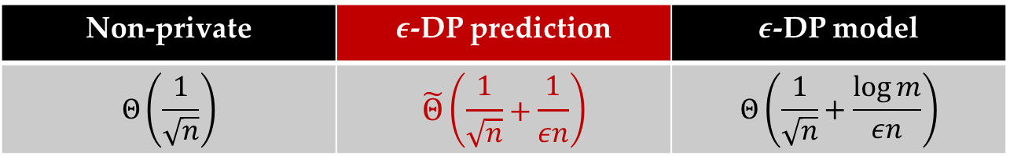


Beyond aggregation
Threshold functions on a line
$$1$$
$$m$$
Excess error for agnostic learning
Non-private | $ε$-DP prediction | $ε$-DP model
$$Θ\left(\frac{1}{\sqrt{n}}\right)$$ | $$\tilde{Θ}\left(\frac{1}{\sqrt{n}}+\frac{1}{εn}\right)$$ | $$Θ\left(\frac{1}{\sqrt{n}}+\frac{\log{m}}{εn}\right)$$
DP prediction implies generalization

Slide 11
Conclusions
Natural setting for learning with privacy
Better accuracy-privacy trade-off
Paper (COLT 2018): https://arxiv.org/abs/1803.10266
Open problems:
General agnostic learning
Other general approaches
Handling of multiple queries [BTT 18]

