Slide 1



Generalization bounds for uniformly stable algorithms
Vitaly Feldman
Brain
with Jan Vondrak

Slide 2
Uniform stability
Domain $Z$ (e.g. $X×Y$)
Dataset $S=\left(z_{1},…,z_{n}\right)∈Z^{n}$
Learning algorithm $A:Z^{n}→W$
Loss function $ℓ:W×Z→ℝ^{+}$
Uniform stability [Bousquet,Elisseeff 02]:
$A$ has uniform stability $γ$ w.r.t. $ℓ$ if
For all neighboring $S,S^{′},z∈Z$
$$\left|ℓ\left(A\left(S\right),z\right)−ℓ\left(A\left(S^{′}\right),z\right)\right|≤γ$$

Slide 3
Generalization error
Probability distribution $P$ over $Z$, $S∼P^{n}$
Population loss: $E_{P}\left[ℓ\left(w\right)\right]=E_{z∼P}\left[ℓ\left(w,z\right)\right]$
Empirical loss:
$$𝓔_{S}\left[ℓ\left(w\right)\right]=\frac{1}{n}\sum_{i=1}^{n}{ℓ\left(w,z_{i}\right)}$$
Generalization error/gap:
$$Δ_{S}\left(ℓ\left(A\right)\right)=E_{P}\left[ℓ\left(A\left(S\right)\right)\right]−𝓔_{S}\left[ℓ\left(A\left(S\right)\right)\right]$$

Slide 4

Stochastic convex optimization
$W=𝔹_{2}^{d}\left(1\right)≐\left\{w \right| {\left\|w\right\|}_{2}≤1\}$
For all $z∈Z, ℓ(w,z)$ is convex $1$-Lipschitz in $w$
Minimize $E_{P}\left[ℓ\left(w\right)\right]≐E_{z∼P}[ℓ(w,z)]$ over $W$
$$L^{∗}=\min_{w∈W}E_{P}\left[ℓ\left(w\right)\right]$$
For all $P$, $A$ being SGD with rate $η=1/\sqrt{n}$ :
$$\underset{S∼P^{n}}{Pr}\left[E_{P}\left[ℓ\left(A(S)\right)\right]≥L^{∗}+O\left(\frac{\sqrt{log\left(1/δ\right)}}{\sqrt{n}} \right)\right]≤δ$$
Uniform convergence error: $≳\sqrt{\frac{d}{n}}$
ERM might have generalization error: $≳\frac{d}{n}$
[Shalev-Shwartz,Shamir,Srebro,Sridharan ’09; Feldman 16]

Slide 5
Stable optimization
Strongly convex ERM [BE 02, SSSS 09]
$$A_{λ}(S)=argmin_{w∈W }\left\{𝓔_{S}\left[ℓ\left(w\right)\right]+\frac{λ}{2}{\left\|w\right\|}_{2}^{2}\right\}$$
$A_{λ}$ is $\frac{1}{λn}$ uniformly stable and minimizes $𝓔_{S}\left[ℓ\left(w\right)\right]$ within $\frac{λ}{2}$
Gradient descent on smooth losses [Hardt,Recht,Singer 16]
$A_{T}(S)$ : $T$ steps of GD on $𝓔_{S}\left[ℓ\left(w\right)\right]$ with $η=\frac{1}{\sqrt{T}}$
$A_{T}$ is $\frac{\sqrt{T}}{n}$ uniformly stable and minimizes $𝓔_{S}\left[ℓ\left(w\right)\right]$ within $\frac{2}{\sqrt{T}}$

Slide 6
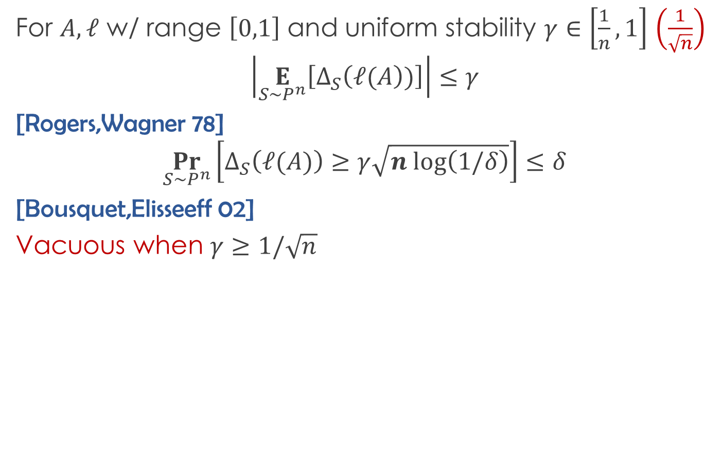
Generalization bounds
For $A,ℓ$ w/ range $\left[0,1\right]$ and uniform stability $γ∈\left[\frac{1}{n},1\right]$ $\left(\frac{1}{\sqrt{n}}\right)$
$$\left|\underset{S∼P^{n}}{E}\left[Δ_{S}\left(ℓ(A\right))\right]\right|≤γ$$
[Rogers,Wagner 78]
$$\underset{S∼P^{n}}{Pr}\left[Δ_{S}\left(ℓ(A)\right)≥γ\sqrt{n log\left(1/δ\right)}\right]≤δ$$
[Bousquet,Elisseeff 02]
Vacuous when $γ≥1/\sqrt{n}$
$$\underset{S∼P^{n}}{Pr}\left[Δ_{S}\left(ℓ(A)\right)≥\sqrt{γ log\left(1/δ\right)}\right]≤δ$$
NEW!

Slide 7
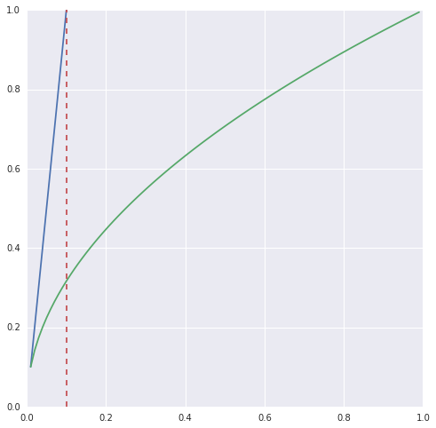
Comparison
[BE 02]
This work
$$n=100$$
Generalization error
$$\frac{1}{\sqrt{n}}$$
$$γ$$

Slide 8
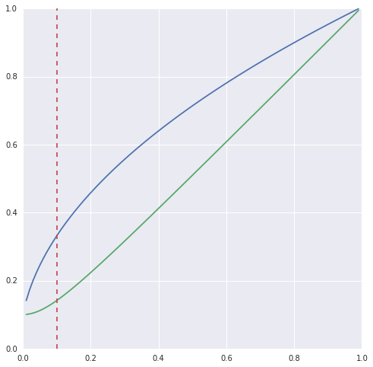
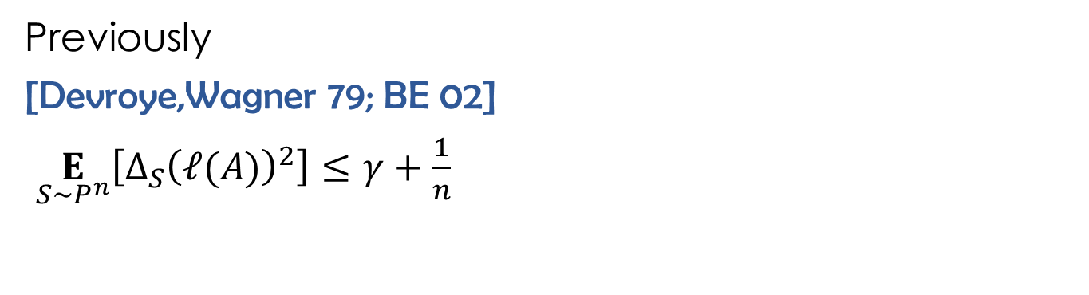
Second moment
$$\underset{S∼P^{n}}{E}\left[{Δ_{S}\left(ℓ(A)\right)}^{2}\right]≤γ^{2}+\frac{1}{n}$$
Chebyshev: $\underset{S∼P^{n}}{Pr}\left[Δ_{S}\left(ℓ\left(A\right)\right)≥\frac{γ+1/\sqrt{n} }{\sqrt{δ}}\right]≤δ$
NEW!
TIGHT!
Previously
[Devroye,Wagner 79; BE 02]
$\underset{S∼P^{n}}{E}\left[{Δ_{S}\left(ℓ(A)\right)}^{2}\right]≤γ+\frac{1}{n}$
Generalization error
[BE 02]
This work
$$\frac{1}{\sqrt{n}}$$
$$γ$$

Slide 9
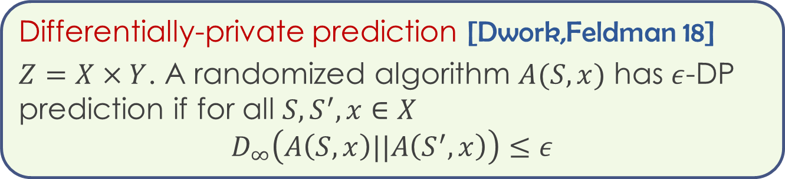
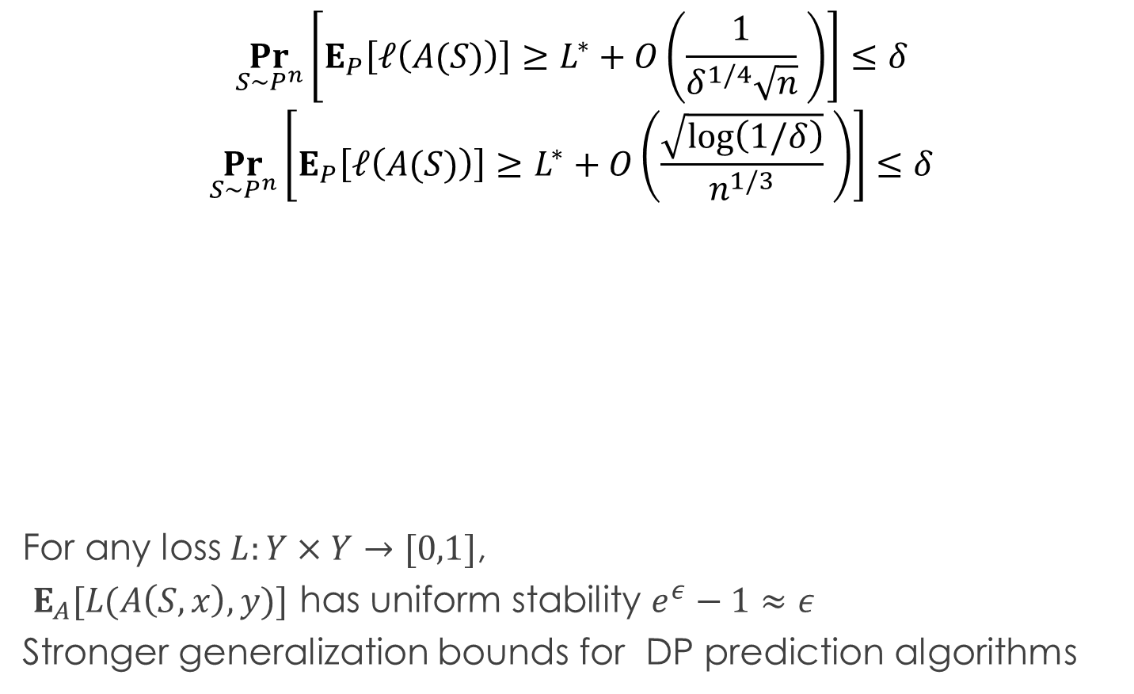
Implications
$$\underset{S∼P^{n}}{Pr}\left[E_{P}\left[ℓ\left(A(S)\right)\right]≥L^{∗}+O\left(\frac{1}{δ^{1/4}\sqrt{n}} \right)\right]≤δ$$
$$\underset{S∼P^{n}}{Pr}\left[E_{P}\left[ℓ\left(A(S)\right)\right]≥L^{∗}+O\left(\frac{\sqrt{log\left(1/δ\right)}}{n^{1/3}} \right)\right]≤δ$$
For any loss $L:Y×Y→[0,1]$,
$E_{A}[L(A\left(S,x\right),y)]$ has uniform stability $e^{ε}−1≈ε$
Stronger generalization bounds for DP prediction algorithms
Differentially-private prediction [Dwork,Feldman 18]
$Z=X×Y$. A randomized algorithm $A(S,x)$ has $ε$-DP prediction if for all $S,S^{′},x∈X$
$$D_{∞}\left(A\left(S,x\right)||A\left(S^{′},x\right)\right)≤ε$$

Slide 10
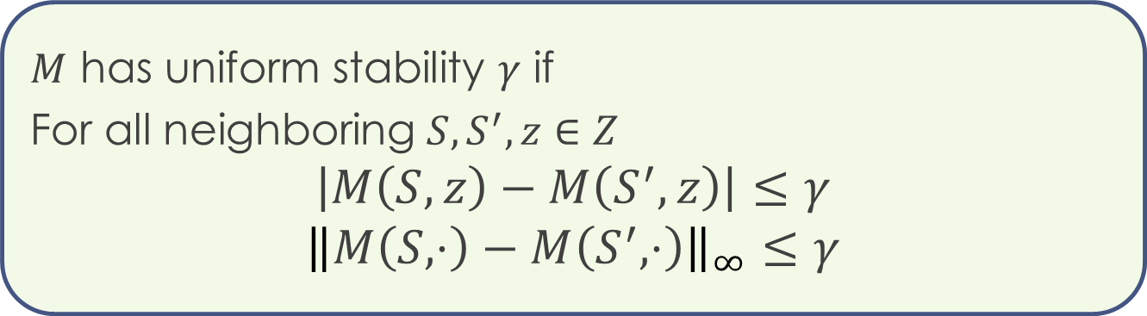


Data-dependent functions
Consider $M: Z^{n}×Z→ℝ$ . E.g. $M\left(S,z\right)≡ℓ(A\left(S\right),z)$
$M$ has uniform stability $γ$ if
For all neighboring $S,S^{′},z∈Z$
$$\left|M\left(S,z\right)−M\left(S^{′},z\right)\right|≤γ$$
$${\left\|M\left(S,⋅\right)−M\left(S^{′},⋅\right)\right\|}_{∞}≤γ$$
Generalization error/gap:
$$Δ_{S}\left(M\right)=E_{P}\left[M\left(S\right)\right]−𝓔_{S}\left[M\left(S\right)\right]$$

Slide 11
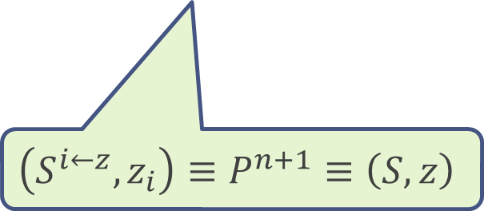
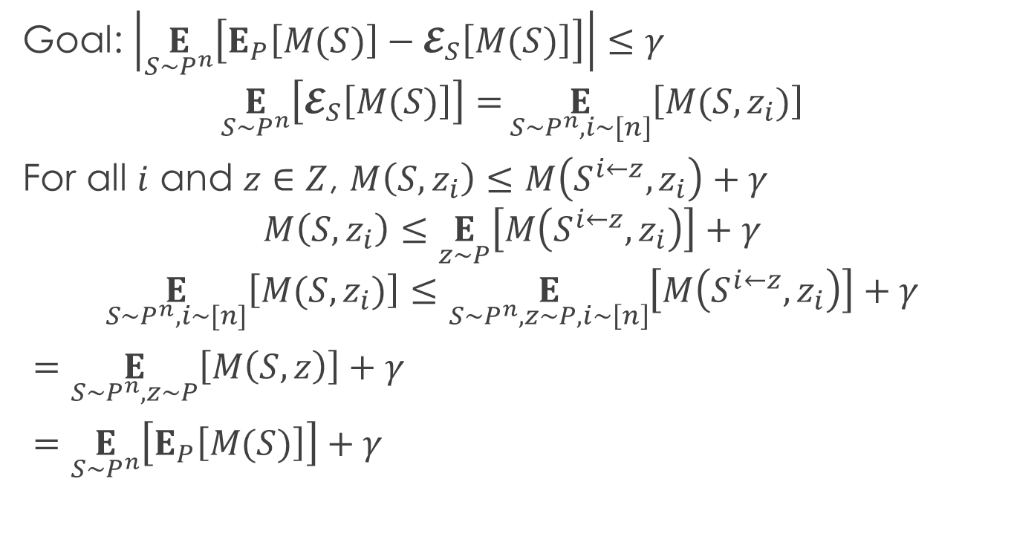
Generalization in expectation
Goal: $\left|\underset{S∼P^{n}}{E}\left[E_{P}\left[M(S)\right]−𝓔_{S}\left[M(S)\right]\right]\right|≤γ$
$$\underset{S∼P^{n}}{E}\left[𝓔_{S}\left[M(S)\right]\right]=\underset{S∼P^{n},i∼[n]}{E}\left[M(S,z_{i})\right]$$
For all $i$ and $z∈Z$, $M\left(S,z_{i}\right)≤M\left(S^{i←z},z_{i}\right)+γ$
$$M\left(S,z_{i}\right)≤\underset{z∼P}{E}\left[M\left(S^{i←z},z_{i}\right)\right]+γ$$
$$\underset{S∼P^{n},i∼[n]}{E}\left[M(S,z_{i})\right]≤\underset{S∼P^{n}, z∼P,i∼\left[n\right]}{E}\left[M\left(S^{i←z},z_{i}\right)\right]+γ$$
$=\underset{S∼P^{n},z∼P}{E}\left[M\left(S,z\right)\right]+γ$
$=\underset{S∼P^{n}}{E}\left[E_{P}\left[M(S)\right]\right]+γ$
$$\left(S^{i←z},z_{i}\right)≡P^{n+1}≡\left(S,z\right)$$

Slide 12
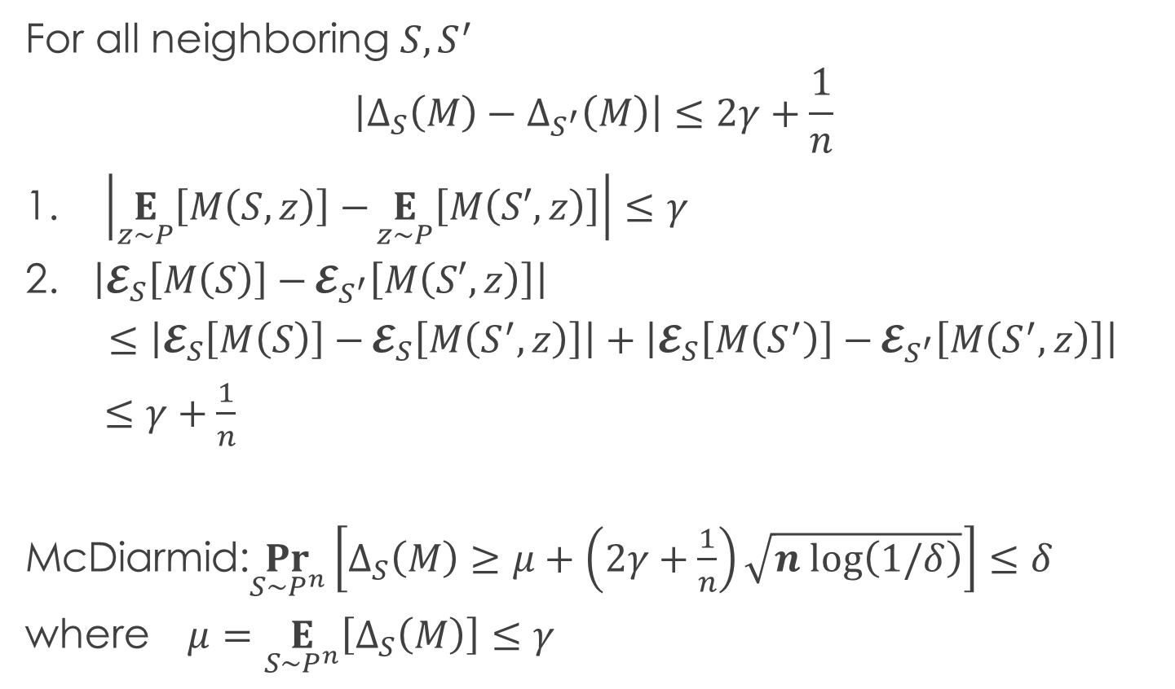
Concentration via McDiarmid
For all neighboring $S,S^{′}$
$$\left|Δ_{S}\left(M\right)−Δ_{S^{′}}\left(M\right)\right|≤2γ+\frac{1}{n}$$
1. $\left|\underset{z∼P}{E}\left[M\left(S,z\right)\right]−\underset{z∼P}{E}\left[M\left(S′,z\right)\right]\right|≤γ$
2. $\left|𝓔_{S}\left[M\left(S\right)\right]−𝓔_{S^{′}}\left[M\left(S′,z\right)\right]\right|$
$≤\left|𝓔_{S}\left[M\left(S\right)\right]−𝓔_{S}\left[M\left(S^{′},z\right)\right]\right|+\left|𝓔_{S}\left[M\left(S^{′}\right)\right]−𝓔_{S^{′}}\left[M\left(S^{′},z\right)\right]\right|$
$≤γ+\frac{1}{n}$
McDiarmid:$\underset{S∼P^{n}}{Pr}\left[Δ_{S}\left(M\right)≥μ+\left(2γ+\frac{1}{n}\right)\sqrt{n log\left(1/δ\right)}\right]≤δ$
where $μ=\underset{S∼P^{n}}{E}\left[Δ_{S}\left(M\right)\right]≤γ$

Slide 13

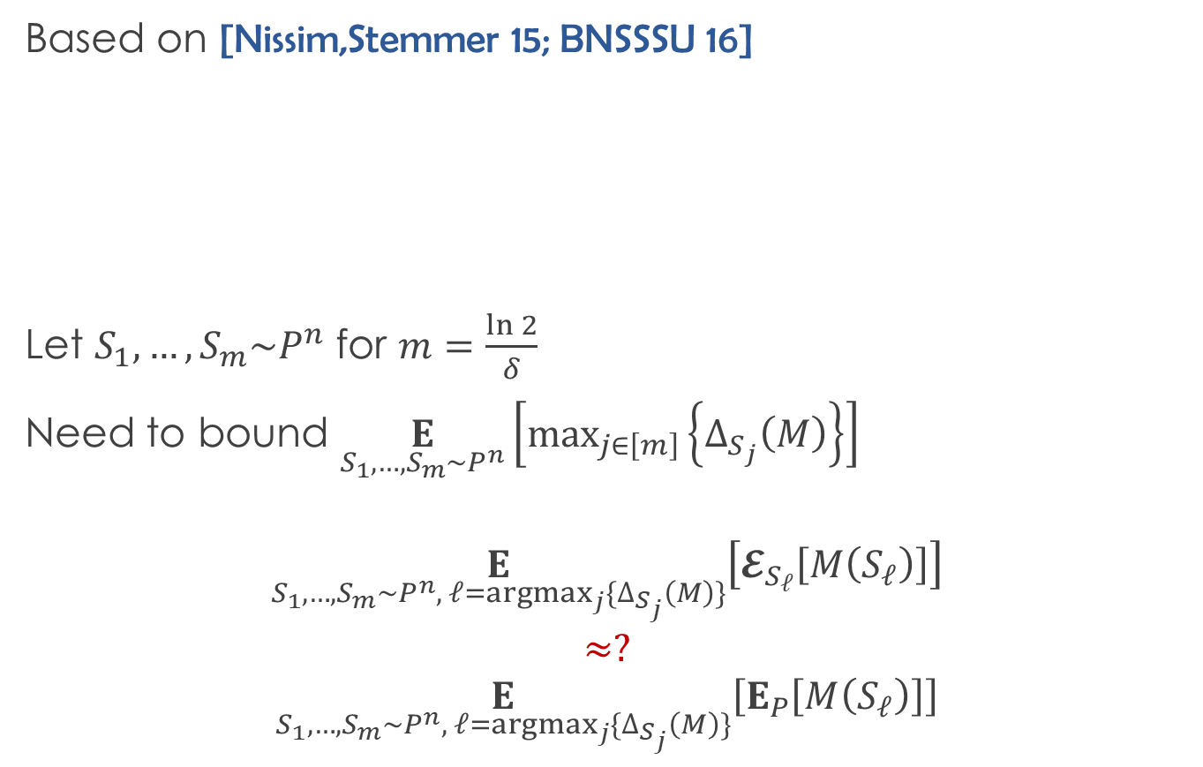
Proof technique
Based on [Nissim,Stemmer 15; BNSSSU 16]
Let $S_{1},…,S_{m}\sim P^{n}$ for $m=\frac{\ln{2}}{δ}$
Need to bound $\underset{S_{1},…,S_{m}\sim P^{n}}{E}\left[max_{j∈\left[m\right]}\left\{Δ_{S_{j}}\left(M\right)\right\}\right]$
$$\underset{S_{1},…,S_{m}\sim P^{n}, ℓ=argmax_{j}\{Δ_{S_{j}}\left(M\right)\}}{E}\left[𝓔_{S_{ℓ}}\left[M\left(S_{ℓ}\right)\right]\right]$$
$$≈?$$
$$\underset{S_{1},…,S_{m}\sim P^{n}, ℓ=argmax_{j}\{Δ_{S_{j}}\left(M\right)\}}{E}\left[E_{P}\left[M\left(S_{ℓ}\right)\right]\right]$$
Let $Q$ be a distribution over $ℝ:$
$$\underset{v∼Q}{Pr}\left[v≥2\underset{v_{1},…,v_{m}∼Q}{E}\left[\max\left\{0,v_{1},…,v_{m}\right\}\right] \right]≤\frac{ln 2}{m}$$
UNSTABLE!

Slide 14
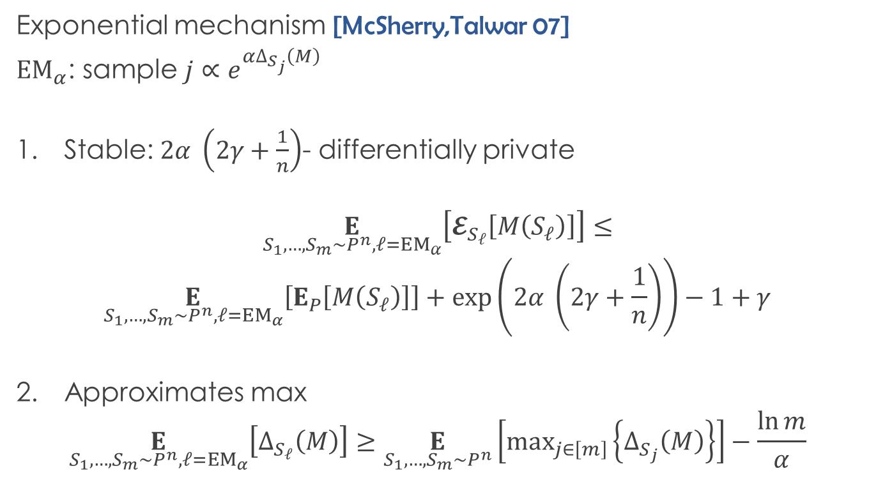
Stable max
Exponential mechanism [McSherry,Talwar 07]
${EM}_{α}$: sample $j∝e^{αΔ_{S_{j}}\left(M\right)}$
Stable: $2α \left(2γ+\frac{1}{n}\right)$- differentially private
$$\underset{S_{1},…,S_{m}\sim P^{n},ℓ=EM_{α}}{E}\left[𝓔_{S_{ℓ}}\left[M\left(S_{ℓ}\right)\right]\right]≤$$
$$\underset{S_{1},…,S_{m}\sim P^{n},ℓ=EM_{α}}{E}\left[E_{P}\left[M\left(S_{ℓ}\right)\right]\right]+\exp\left(2α \left(2γ+\frac{1}{n}\right)\right)−1+γ$$
Approximates max
$$\underset{S_{1},…,S_{m}\sim P^{n},ℓ=EM_{α}}{E}\left[Δ_{S_{ℓ}}\left(M\right)\right]≥\underset{S_{1},…,S_{m}\sim P^{n}}{E}\left[max_{j∈\left[m\right]}\left\{Δ_{S_{j}}\left(M\right)\right\}\right]−\frac{\ln{m}}{α}$$

Slide 15


Game over
$$\underset{S_{1},…,S_{m}\sim P^{n}}{E}\left[max_{j∈\left[m\right]}\left\{Δ_{S_{j}}\left(M\right)\right\}\right]≤\frac{\ln{m}}{α}+ \exp\left(2α \left(2γ+\frac{1}{n}\right)\right)−1+γ$$
Pick $α=\sqrt{\frac{\ln{m}}{γ+1/n}}$ get $O\left(\sqrt{\left(γ+\frac{1}{n}\right)ln\left(\frac{1}{δ}\right)}\right)$
Let $Q$ be a distribution over $ℝ:$
$$\underset{v∼Q}{Pr}\left[v≥2\underset{v_{1},…,v_{m}∼Q}{E}\left[\max\left\{0,v_{1},…,v_{m}\right\}\right] \right]≤\frac{ln 2}{m}$$

Slide 16
Conclusions
Better understanding of uniform stability
New technique
Open
Gap between upper and lower bounds
High probability generalization without strong uniformity

