Slide 1

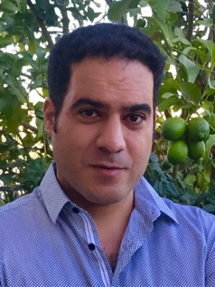
Learning without interaction
requires separation
Vitaly Feldman
Brain
with Amit Daniely
Hebrew University

Slide 2


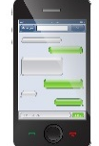

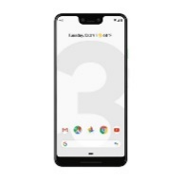
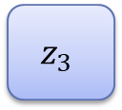
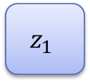
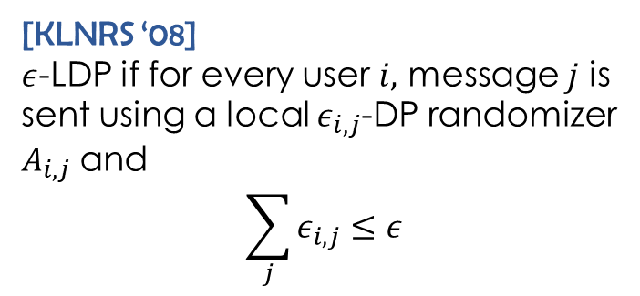

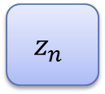
Local Differential Privacy (LDP)
$$z_{1}$$
Server
[KLNRS ‘08]
$ε$-LDP if for every user $i,$ message $j$ is sent using a local $ε_{i,j}$-DP randomizer $A_{i,j}$and
$$\sum_{j}{ε_{i,j}}≤ε$$
$$z_{2}$$
$$z_{3}$$
$$z_{n}$$

Slide 3
Non-interactive LDP
$$z_{1}$$
Server
$$z_{2}$$
$$z_{3}$$
$$z_{n}$$

Slide 4
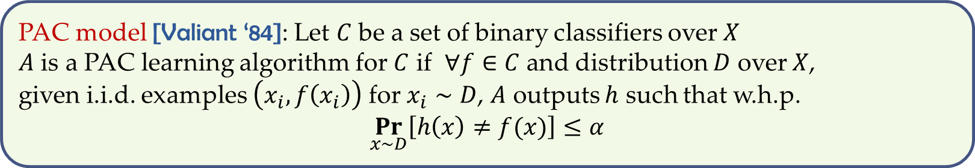
PAC learning
PAC model [Valiant ‘84]: Let $C$ be a set of binary classifiers over $X$
$A$ is a PAC learning algorithm for $C$ if $∀f∈C$ and distribution $D$ over $X$,
given i.i.d. examples $\left(x_{i},f\left(x_{i}\right)\right)$ for $x_{i}∼D$, $A$ outputs $h$ such that w.h.p.
$$\underset{x∼D}{Pr}\left[h\left(x\right)≠f(x)\right]≤α$$
Distribution-specific learning: $D$ is fixed and known to $A$

Slide 5





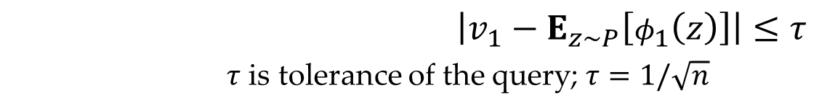
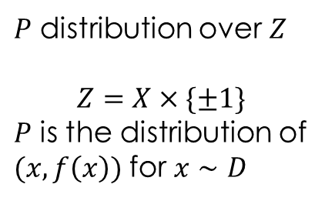

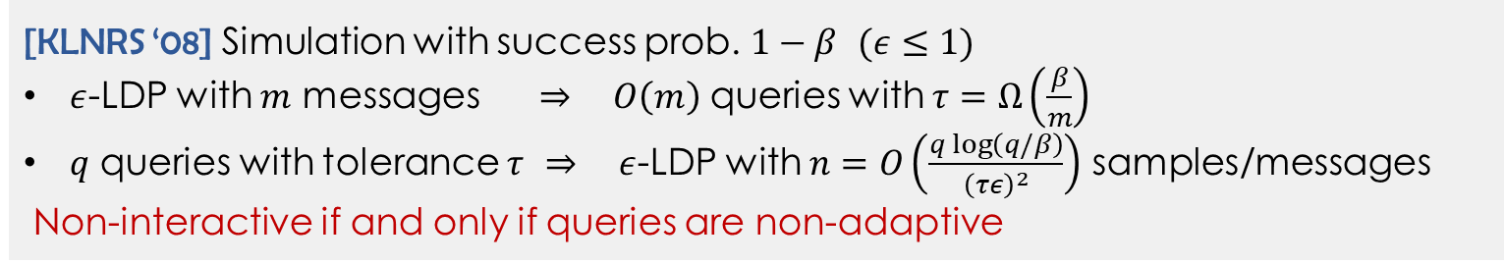




Statistical query model [Kearns ‘93]
$$φ_{1}$$
$$v_{1}$$
$P$ distribution over $Z$
$$Z=X×\{±1\}$$
$P$ is the distribution of
$(x,f\left(x\right))$ for $x∼D$
$$φ_{2}$$
$$v_{2}$$
$$P$$
$$φ_{q}$$
SQ algorithm
$$v_{q}$$
SQ oracle
$\left|v_{1}−E_{z∼P}\left[φ_{1}\left(z\right)\right]\right|≤τ$
$τ$ is tolerance of the query; $τ=1/\sqrt{n}$
$$φ_{1}:Z→\left[0,1\right]$$
[KLNRS ‘08] Simulation with success prob. $1−β$ $(ε≤1)$
$ε$-LDP with $m$ messages $⇒$ $O\left(m\right)$ queries with $τ=Ω\left(\frac{β}{m}\right)$
$q$ queries with tolerance $τ$ $⇒$ $ε$-LDP with $n=O\left(\frac{q log\left(q/β\right)}{{\left(τε\right)}^{2}}\right)$ samples/messages
Non-interactive if and only if queries are non-adaptive
Notes:
Replace i.i.d. inputs from D with oracle access to D. The oracle approximately evaluates average of any function with range [-1,1]

Slide 6


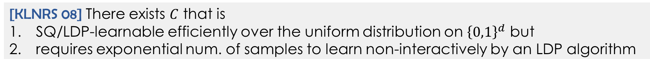
Known results
$C$ is SQ-learnable efficiently (non-adaptively) if and only if
learnable efficiently with $ε$-LDP (non-interactively)
Examples:
Yes: halfspaces/linear classifiers [Dunagan,Vempala ‘04]
No: parity functions [Kearns ‘93]
Yes, non-adaptively: Boolean conjunctions
[KLNRS 08] There exists $C$ that is
SQ/LDP-learnable efficiently over the uniform distribution on ${\left\{0,1\right\}}^{d}$ but
requires exponential num. of samples to learn non-interactively by an LDP algorithm
[KLNRS 08]:
Does separation hold for
distribution-independent learning?
Masked parity

Slide 7

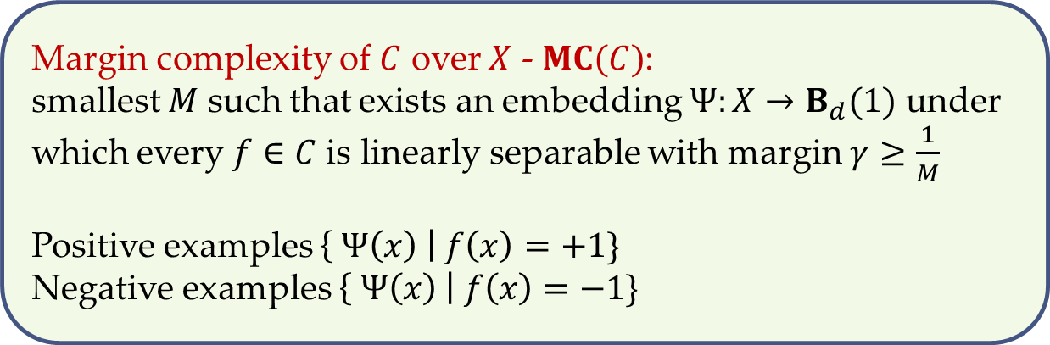

Margin Complexity
-
-
-
-
-
Margin complexity of $C$ over $X$ - $MC(C)$:
smallest $M$ such that exists an embedding $Ψ:X→B_{d}(1)$ under which every $f∈C$ is linearly separable with margin $γ≥\frac{1}{M}$
Positive examples $\left\{ Ψ\left(x\right) \right| f\left(x\right)=+1\}$
Negative examples $\left\{ Ψ\left(x\right) \right| f\left(x\right)=−1\}$
-
-
-
$γ${
-
-
-
$γ${
-
+
+
+
+
+
+
+
+
+
+
+
+

Slide 8
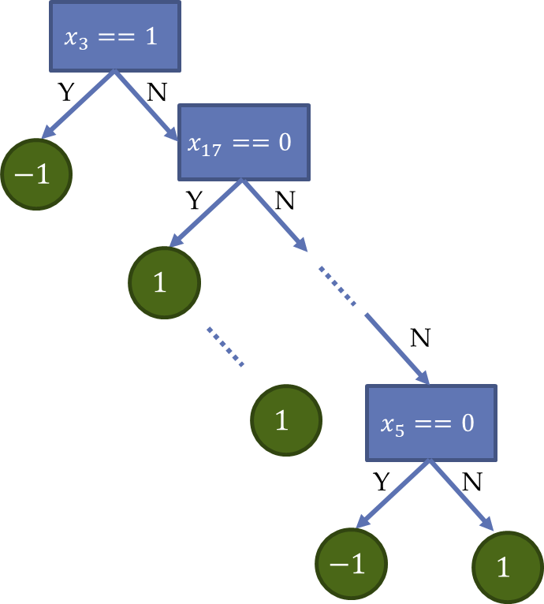
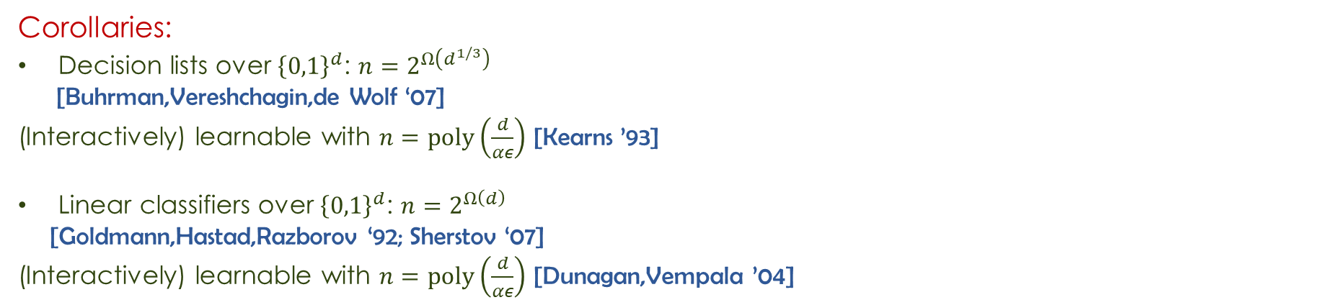
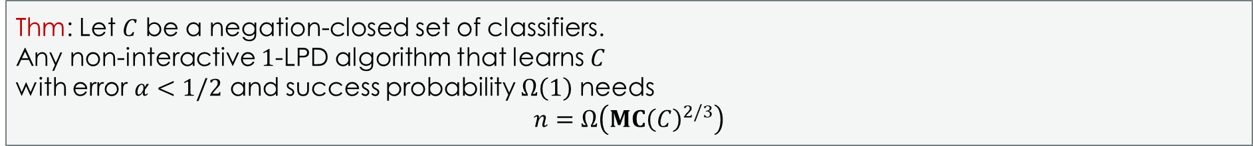
Lower bound
Thm: Let $C$ be a negation-closed set of classifiers.
Any non-interactive $1$-LPD algorithm that learns $C$
with error $α<1/2$ and success probability $Ω\left(1\right)$ needs
$$n=Ω\left({MC\left(C\right)}^{2/3}\right)$$
Corollaries:
Decision lists over ${\left\{0,1\right\}}^{d}$: $n=2^{Ω\left(d^{1/3}\right)}$
[Buhrman,Vereshchagin,de Wolf ‘07]
(Interactively) learnable with $n=poly\left(\frac{d}{αε}\right)$ [Kearns ’93]
Linear classifiers over ${\left\{0,1\right\}}^{d}$: ${n=2}^{Ω\left(d\right)}$
[Goldmann,Hastad,Razborov ‘92; Sherstov ‘07]
(Interactively) learnable with $n=poly\left(\frac{d}{αε}\right)$ [Dunagan,Vempala ’04]

Slide 9
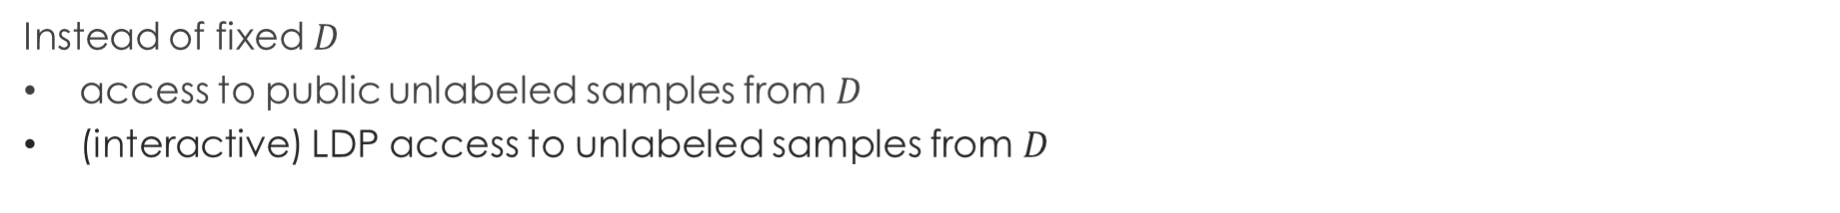
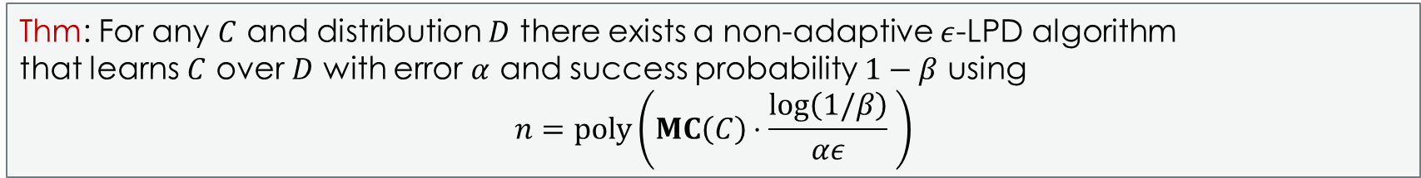
Upper bound
Thm: For any $C$ and distribution $D$ there exists a non-adaptive $ε$-LPD algorithm
that learns $C$ over $D$ with error $α$ and success probability $1−β$ using
$$n=poly\left(MC\left(C\right)⋅\frac{log\left(1/β\right)}{αε} \right)$$
Instead of fixed $D$
access to public unlabeled samples from $D$
(interactive) LDP access to unlabeled samples from $D$
Lower bound holds against the hybrid model

Slide 10
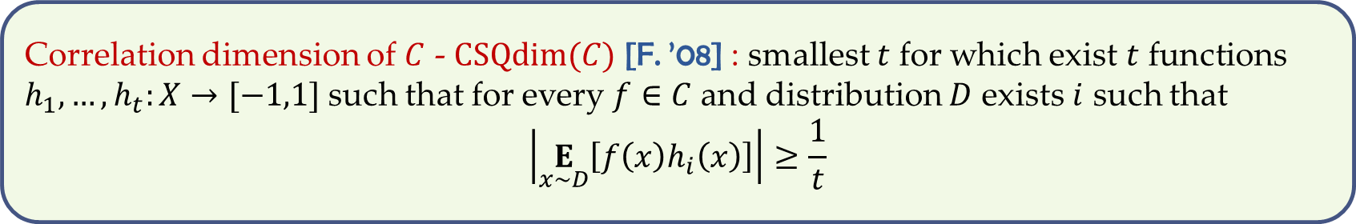
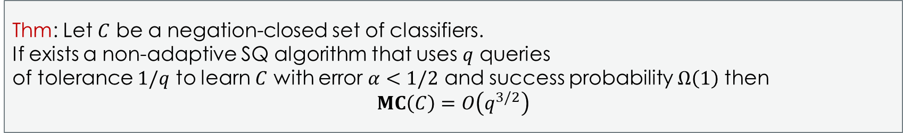
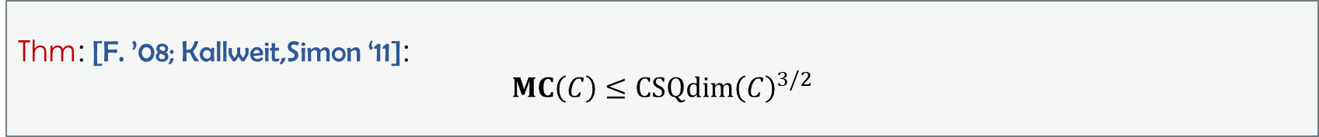
Lower bound technique
Thm: Let $C$ be a negation-closed set of classifiers.
If exists a non-adaptive SQ algorithm that uses $q$ queries
of tolerance $1/q$ to learn $C$ with error $α<1/2$ and success probability $Ω\left(1\right)$ then
$$MC\left(C\right)=O\left(q^{3/2}\right)$$
Correlation dimension of $C$ - $CSQdim(C)$ [F. ’08] : smallest $t$ for which exist $t$ functions $h_{1},…,h_{t}:X→[−1,1]$ such that for every $f∈C$ and distribution $D$ exists $i$ such that
$$\left|\underset{x∼D}{E}\left[f\left(x\right)h_{i}\left(x\right)\right]\right|≥\frac{1}{t}$$
Thm: [F. ’08; Kallweit,Simon ‘11]:
$$MC\left(C\right)≤CSQdim{\left(C\right)}^{3/2}$$

Slide 11
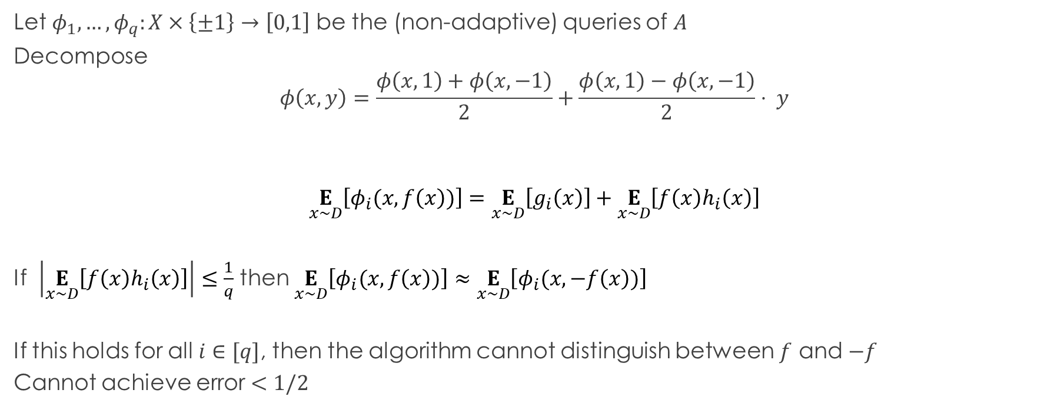


Proof
If exists a non-adaptive SQ algorithm $A$ that uses $q$ queries
of tolerance $1/q$ to learn $C$ with error $α<1/2$ then
$$CSQdim\left(C\right)≤q$$
Let $φ_{1},…,φ_{q}:X×\left\{±1\right\}→\left[0,1\right]$ be the (non-adaptive) queries of $A$
Decompose
$$φ\left(x,y\right)=\frac{φ\left(x,1\right)+φ\left(x,−1\right)}{2}+\frac{φ\left(x,1\right)−φ\left(x,−1\right)}{2}⋅ y$$
$$\underset{x∼D}{E}\left[φ_{i}(x,f\left(x\right))\right]=\underset{x∼D}{E}\left[g_{i}\left(x\right)\right]+\underset{x∼D}{E}\left[f\left(x\right)h_{i}\left(x\right)\right]$$
If $\left|\underset{x∼D}{E}\left[f\left(x\right)h_{i}\left(x\right)\right]\right|≤\frac{1}{q}$ then $\underset{x∼D}{E}\left[φ_{i}(x,f\left(x\right))\right]≈\underset{x∼D}{E}\left[φ_{i}(x,−f\left(x\right))\right]$
If this holds for all $i∈[q]$, then the algorithm cannot distinguish between $f$ and $−f$
Cannot achieve error $<1/2$
$$g$$
$$h$$

Slide 12
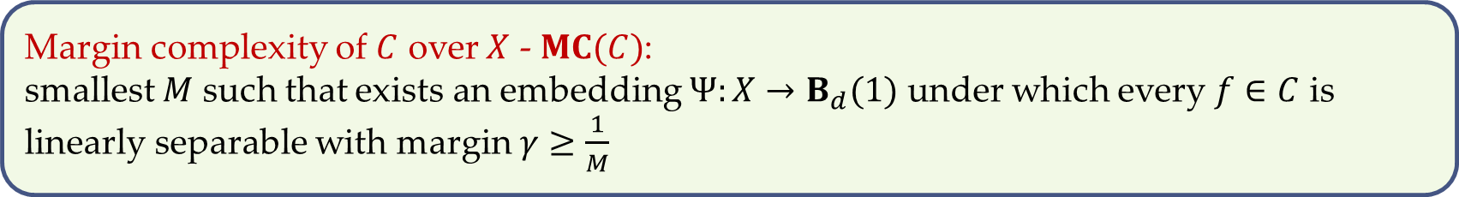
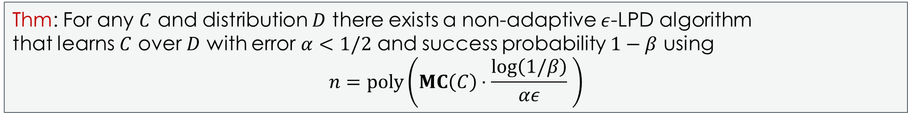
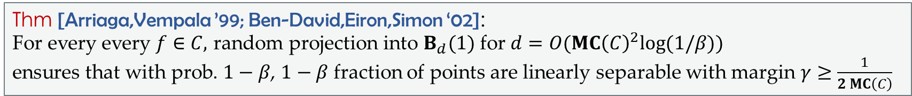
Upper bound
Thm: For any $C$ and distribution $D$ there exists a non-adaptive $ε$-LPD algorithm
that learns $C$ over $D$ with error $α<1/2$ and success probability $1−β$ using
$$n=poly\left(MC\left(C\right)⋅\frac{log\left(1/β\right)}{αε} \right)$$
Margin complexity of $C$ over $X$ - $MC(C)$:
smallest $M$ such that exists an embedding $Ψ:X→B_{d}(1)$ under which every $f∈C$ is linearly separable with margin $γ≥\frac{1}{M}$
Thm [Arriaga,Vempala ’99; Ben-David,Eiron,Simon ‘02]:
For every every $f∈C,$ random projection into $B_{d}(1)$ for $d=O(MC{\left(C\right)}^{2}log(1/β))$
ensures that with prob. $1−β$, $1−β$ fraction of points are linearly separable with margin $γ≥\frac{1}{2 MC\left(C\right)}$

Slide 13

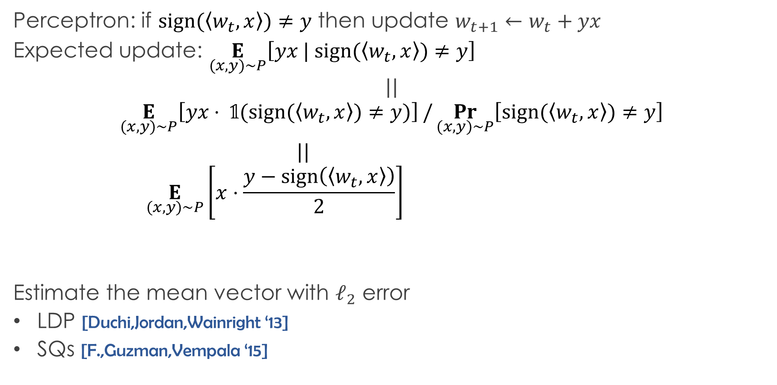
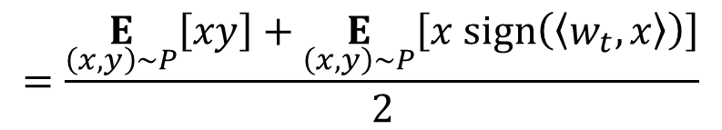
Algorithm
Perceptron: if $sign(〈w_{t},x〉)≠y$ then update $w_{t+1}←w_{t}+yx$
Expected update: $\underset{(x,y)∼P}{E}\left[yx | sign(〈w_{t},x〉)≠y\right]$
$$||$$
$$\underset{(x,y)∼P}{E}\left[yx⋅ 𝟙(sign(〈w_{t},x〉)≠y)\right]/\underset{(x,y)∼P}{Pr}\left[sign(〈w_{t},x〉)≠y\right]$$
$||$
$$\underset{(x,y)∼P}{E}\left[x⋅\frac{y−sign\left(〈w_{t},x〉\right)}{2}\right]$$
Estimate the mean vector with $ℓ_{2}$ error
LDP [Duchi,Jordan,Wainright ‘13]
SQs [F.,Guzman,Vempala ‘15]
scalar $≥α$
$$=\frac{\underset{\left(x,y\right)∼P}{E}\left[xy\right]+\underset{\left(x,y\right)∼P}{E}\left[x sign\left(〈w_{t},x〉\right)\right]}{2}$$
non-adaptive
independent of the label

Slide 14
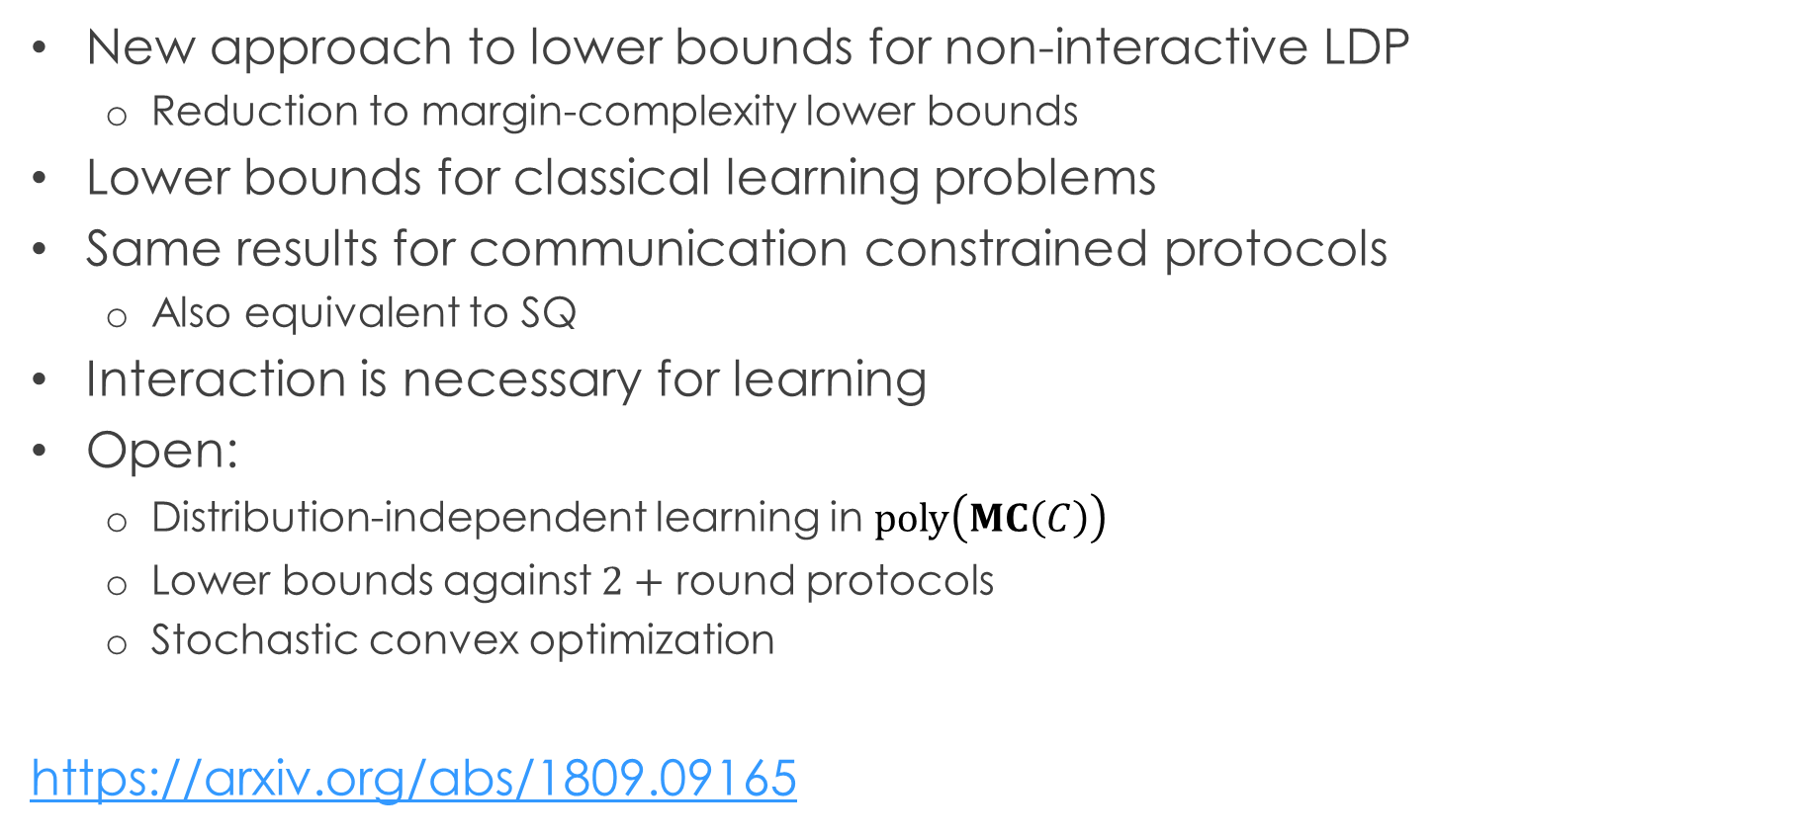
Conclusions
New approach to lower bounds for non-interactive LDP
Reduction to margin-complexity lower bounds
Lower bounds for classical learning problems
Same results for communication constrained protocols
Also equivalent to SQ
Interaction is necessary for learning
Open:
Distribution-independent learning in $poly\left(MC\left(C\right)\right)$
Lower bounds against $2+$ round protocols
Stochastic convex optimization
https://arxiv.org/abs/1809.09165

Slide 15








$$x_{3}==1$$
Y
N
$$x_{17}==0$$
$$−1$$
Y
N
$$1$$
N
$$1$$
$$x_{5}==0$$
Y
N
$$−1$$
$$1$$

