Slide 1



High probability generalization bounds for uniformly stable algorithms
Vitaly Feldman
Brain
with Jan Vondrak

Slide 2

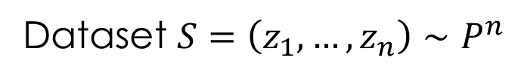

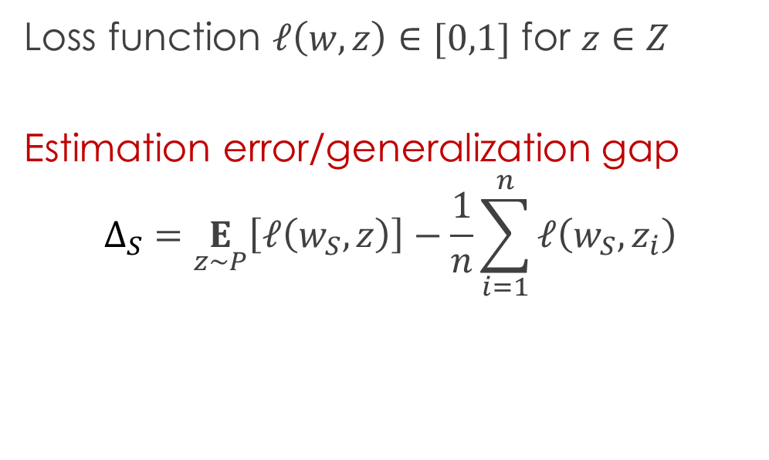
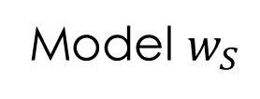
Generalization bounds
Dataset $S=\left(z_{1},…,z_{n}\right)∼P^{n}$
Learning algorithm $A$
Loss function $ℓ\left(w,z\right)∈[0,1]$ for $z∈Z$
Estimation error/generalization gap
$$Δ_{S}=\underset{z∼P}{E}\left[ℓ\left(w_{S},z\right)\right]−\frac{1}{n}\sum_{i=1}^{n}{ℓ\left(w_{S},z_{i}\right)}$$
Model $w_{S}$

Slide 3
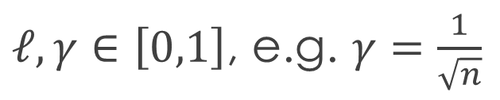
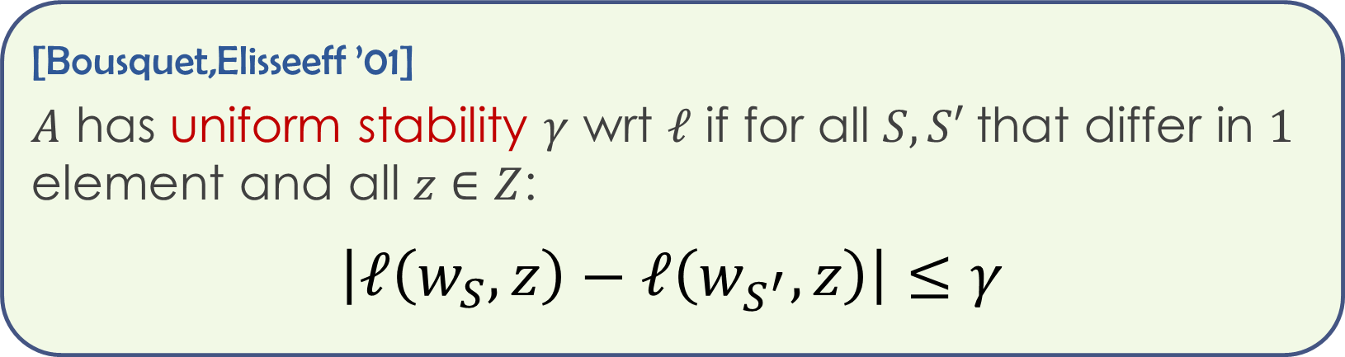
Stability
Low sensitivity to individual examples implies generalization
[Rogers,Wagner ’78; Devroye,Wagner ’79,…..]
[Bousquet,Elisseeff ’01]
$A$ has uniform stability $γ$ wrt $ℓ$ if for all $S,S′$ that differ in $1$ element and all $z∈Z$:
$$\left|ℓ\left(w_{S},z\right)−ℓ\left(w_{S^{′}},z\right)\right|≤γ$$
$ℓ,γ∈\left[0,1\right]$, e.g. $γ=\frac{1}{\sqrt{n}}$

Slide 4
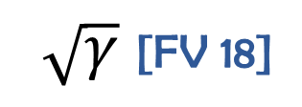
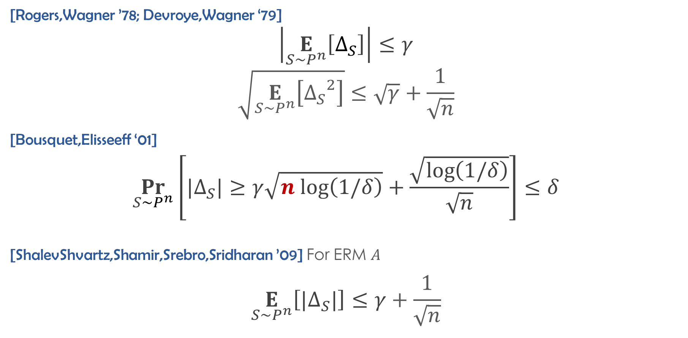
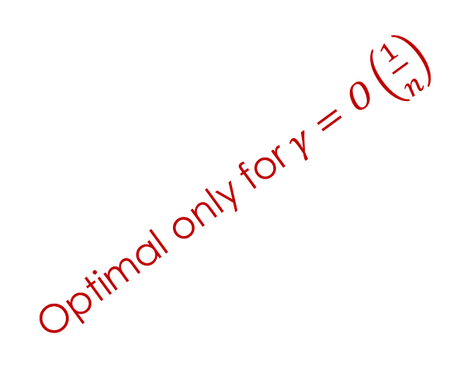
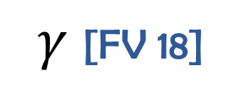
Known bounds
[Rogers,Wagner ’78; Devroye,Wagner ‘79]
$$\left|\underset{S∼P^{n}}{E}\left[Δ_{S}\right]\right|≤γ$$
$$\sqrt{\underset{S∼P^{n}}{E}\left[{Δ_{S}}^{2}\right]}≤\sqrt{γ}+\frac{1}{\sqrt{n}}$$
[Bousquet,Elisseeff ‘01]
$$\underset{S∼P^{n}}{Pr}\left[|Δ_{S}|≥γ\sqrt{n log\left(1/δ\right)}+\frac{\sqrt{\log\left(1/δ\right)}}{\sqrt{n}}\right]≤δ$$
[ShalevShvartz,Shamir,Srebro,Sridharan ’09] For ERM $A$
$$\underset{S∼P^{n}}{E}\left[{|Δ}_{S}|\right]≤γ+\frac{1}{\sqrt{n}}$$
Tight!
$γ$ [FV 18]
Optimal only for $γ=O\left(\frac{1}{n}\right)$
$\sqrt{γ}$ [FV 18]
Tight!

Slide 5
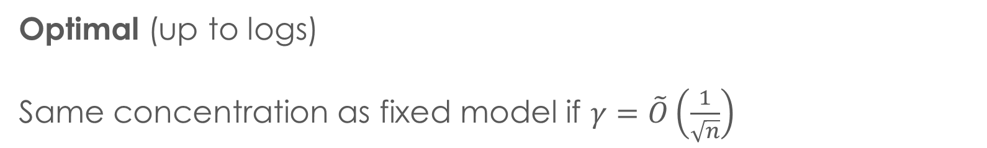

New bound
$$\underset{S∼P^{n}}{Pr}\left[{|Δ}_{S}|≥γ\log{(n)}log\left(n/δ\right)+\frac{\sqrt{\log\left(1/δ\right)}}{\sqrt{n}}\right]≤δ$$
NEW!
Optimal (up to logs)
Same concentration as fixed model if $γ=\tilde{O}\left(\frac{1}{\sqrt{n}}\right)$

Slide 6
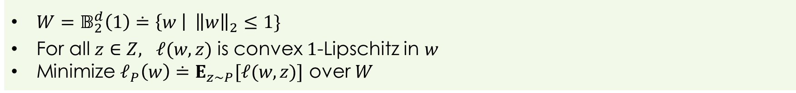
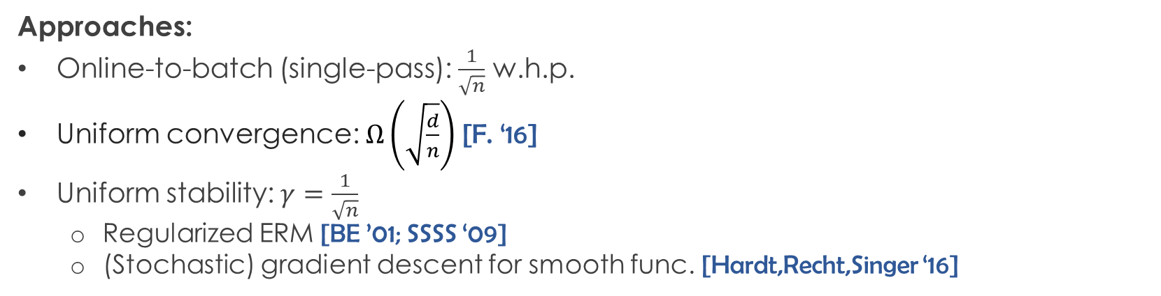
Stochastic convex optimization
$W=𝔹_{2}^{d}\left(1\right)≐\left\{w \right| {\left\|w\right\|}_{2}≤1\}$
For all $z∈Z, ℓ(w,z)$ is convex $1$-Lipschitz in $w$
Minimize $ℓ_{P}\left(w\right)≐E_{z∼P}[ℓ(w,z)]$ over $W$
Approaches:
Online-to-batch (single-pass): $\frac{1}{\sqrt{n}}$ w.h.p.
Uniform convergence: $Ω\left(\sqrt{\frac{d}{n}}\right)$ [F. ‘16]
Uniform stability: $γ=\frac{1}{\sqrt{n}}$
Regularized ERM [BE ’01; SSSS ‘09]
(Stochastic) gradient descent for smooth func. [Hardt,Recht,Singer ‘16]
High probability and (nearly) optimal $\tilde{O}\left(\frac{1}{\sqrt{n}}\right)$ rate
NEW!

Slide 7
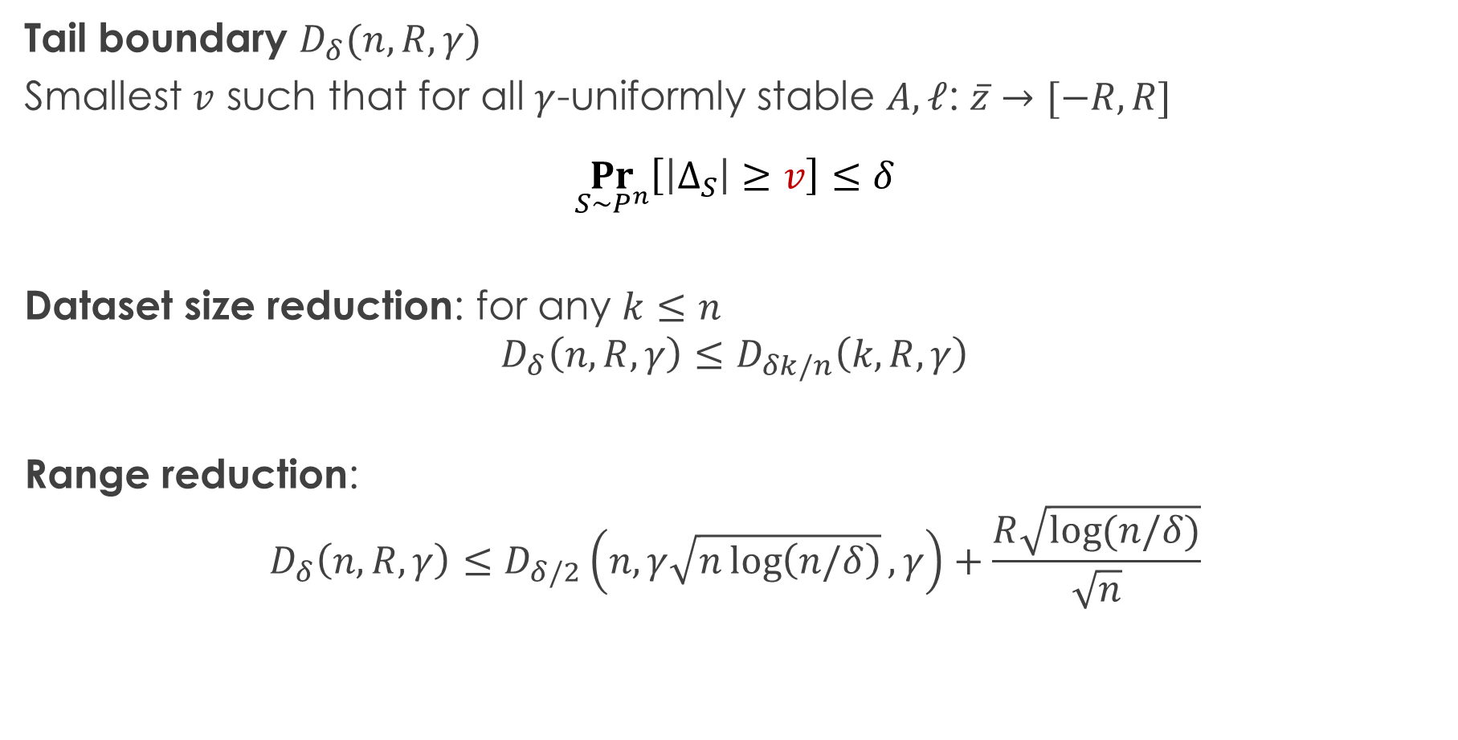
Proof approach
Tail boundary $D_{δ}(n,R,γ)$
Smallest $v$ such that for all $γ$-uniformly stable $A,ℓ$: $\overline{z}→[−R,R]$
$$\underset{S∼P^{n}}{Pr}\left[\left|Δ_{S}\right|≥v\right]≤δ$$
Dataset size reduction: for any $k≤n$
$$D_{δ}\left(n,R,γ\right)≤D_{δk/n}\left(k,R,γ\right)$$
Range reduction:
$$D_{δ}\left(n,R,γ\right)≤D_{δ/2}\left(n,γ\sqrt{n\log\left(n/δ\right)},γ\right)+\frac{R\sqrt{\log{(n/δ)}}}{\sqrt{n}}$$

Slide 8
Conclusions
Stability and generalization in ML
Bypasses limitations of uniform convergence and online-to-batch
Limited set of general analysis techniques
Requires new tools and ideas
Limited set of algorithmic techniques
Connections to differential privacy
Uniformly stable algorithms for learning VC classes with (nearly) optimal rate [Dagan,F. ‘19]

