Slide 1

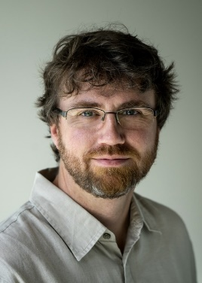

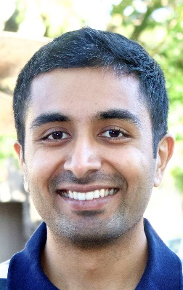
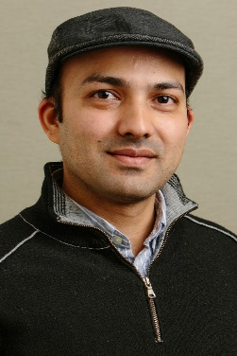
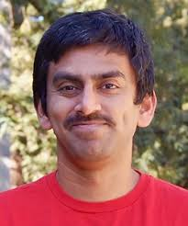



Privacy amplification by shuffling
Vitaly Feldman
Ulfar Erlingsson Ilya Mironov Ananth Raghunathan Kunal Talwar Abhradeep Thakurta

Slide 2


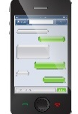
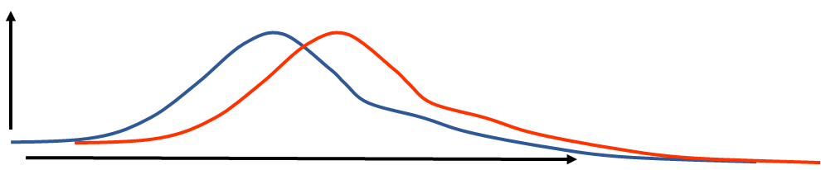
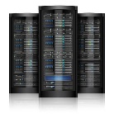
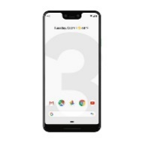
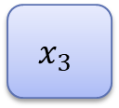








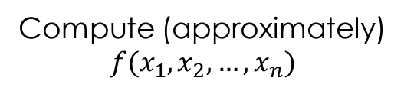

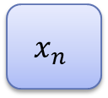
Local Differential Privacy (LDP)
Server
$$x_{1}$$
$$A_{1}$$
$$x_{2}$$
$$A_{2}$$
For all $i$, $A_{i}$ is a local $ε$-DP randomizer:
for all $v,v′∈X$
[Warner ‘65; EGS ‘03; KLNRS ‘08]
$$x_{3}$$
$$A_{3}$$
$$A_{i}(x_{i}=v)$$
$$A_{i}(x_{i}=v′)$$
$$x_{n}$$
$$A_{n}$$
Compute (approximately)
$$f(x_{1},x_{2},…,x_{n})$$

Slide 3








Encode-Shuffle-Analyze (ESA) [Bittau et al. ‘17]
Server
$$x_{1}$$
$$A_{1}$$
$$x_{2}$$
$$A_{2}$$
$$x_{3}$$
$$A_{3}$$
$$x_{n}$$
$$A_{n}$$
Shuffler

Slide 4
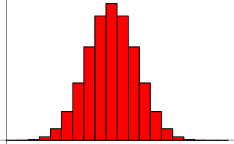
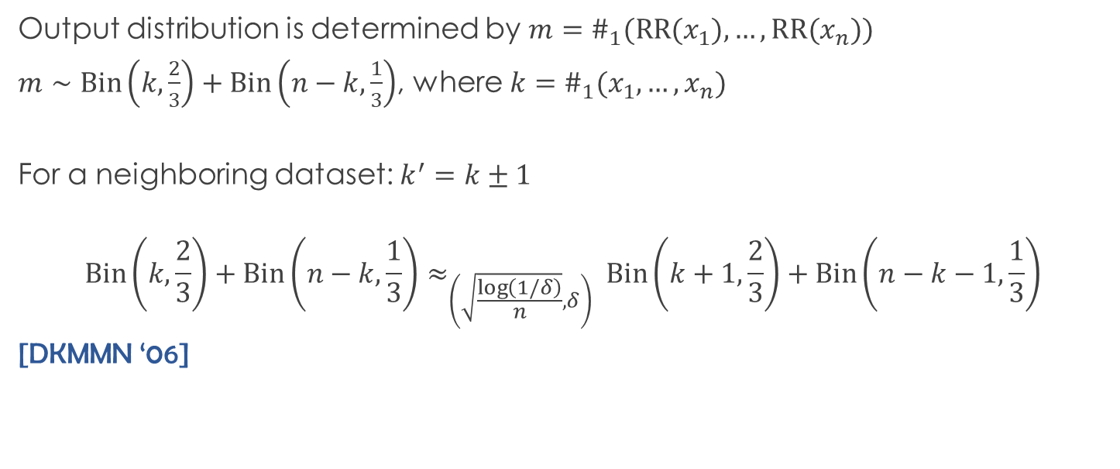
Warm-up: binary randomized response
$RR$: For $x∈\left\{0,1\right\}$, return $x$ flipped with probability $1/3$. Satisfies $(log{2})$-LDP
Output distribution is determined by $m=\#_{1}(RR(x_{1}),…,RR(x_{n}))$
$m∼Bin\left(k,\frac{2}{3}\right)+Bin\left(n−k,\frac{1}{3}\right)$, where $k=\#_{1}(x_{1},…,x_{n})$
For a neighboring dataset: $k^{′}=k±1$
$$Bin\left(k,\frac{2}{3}\right)+Bin\left(n−k,\frac{1}{3}\right)≈_{\left(\sqrt{\frac{\log\left(1/δ\right)}{n}},δ\right) }Bin\left(k+1,\frac{2}{3}\right)+Bin\left(n−k−1,\frac{1}{3}\right)$$
[DKMMN ‘06]
[Cheu,Smith,Ullman,Zeber,Zhilyaev ‘19] (independent)

Slide 5
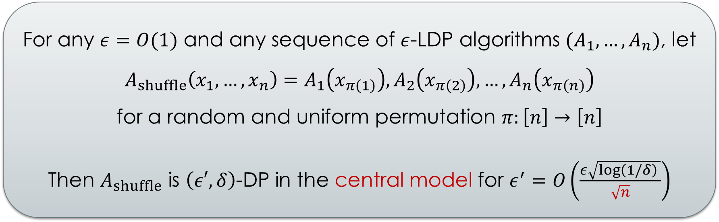
Privacy amplification by shuffling
For any $ε=O(1)$ and any sequence of $ε$-LDP algorithms $(A_{1},…,A_{n})$, let $A_{shuffle}\left(x_{1},…,x_{n}\right)=A_{1}\left(x_{π\left(1\right)}\right),A_{2}\left(x_{π\left(2\right)}\right),…,A_{n}\left(x_{π\left(n\right)}\right)$
for a random and uniform permutation $π:\left[n\right]→\left[n\right]$
Then $A_{shuffle}$ is $\left(ε′,δ\right)$-DP in the central model for $ε^{′}=O\left(\frac{ε\sqrt{\log\left(1/δ\right) }}{\sqrt{n}}\right)$
Holds for adaptive case: $A_{i}$may depend on outputs of $A_{1},…,A_{i−1}$
Generalizes to $ε$-DP algorithms on disjoint subsets of data

Slide 6



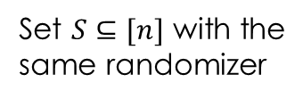





Implications for ESA
Server
$$x_{1}$$
$$A_{1}$$
$$x_{2}$$
$$A_{2}$$
$$x_{3}$$
Set $S⊆[n]$ with the
same randomizer
$$A_{3}$$
$$x_{n}$$
$$A_{n}$$
Shuffler
For every $i∈S$, the output is $\left(O\left(\frac{ε\sqrt{\log\left(1/δ\right) }}{\sqrt{\left|S\right|}}\right),δ\right)$-DP for element at position $i$

Slide 7
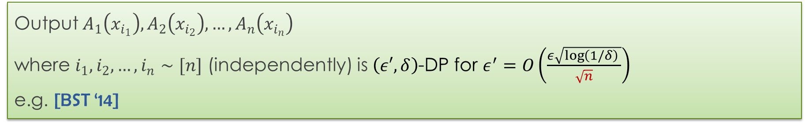
Comparison with subsampling
Running $ε$-DP algorithm on random $q$-fraction of elements is $≈qε$-DP ($ε≤1)$ [KLNRS ‘08]
Shuffling includes all elements so $q=1$
Output $A_{1}\left(x_{i_{1}}\right),A_{2}\left(x_{i_{2}}\right),…,A_{n}\left(x_{i_{n}}\right)$
where $i_{1},i_{2},…,i_{n}∼[n]$ (independently) is $\left(ε′,δ\right)$-DP for $ε^{′}=O\left(\frac{ε\sqrt{\log\left(1/δ\right) }}{\sqrt{n}}\right)$
e.g. [BST ‘14]
Advantages of shuffling:
does not affect the statistics of the dataset
does not increase LDP cost

Slide 8

Online monitoring with LDP

Slide 9
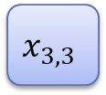
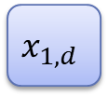

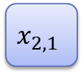
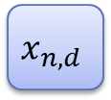

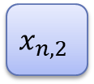

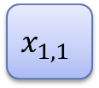
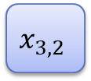
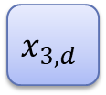
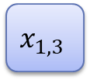

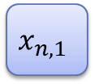
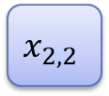


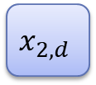
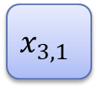
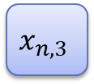

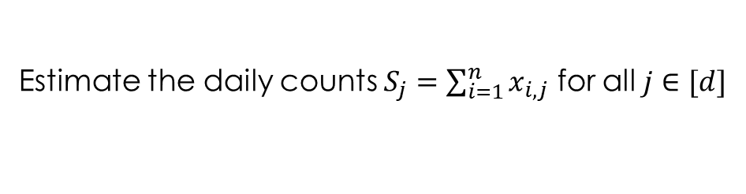

Online monitoring
time
$$x_{1,1}$$
$$x_{1,2}$$
$$x_{1,3}$$
$$x_{1,d}$$
$$x_{i,j}∈\{0,1\}$$
Status of user $i$ on day $j$
$$x_{2,1}$$
$$x_{2,2}$$
$$x_{2,3}$$
$$x_{2,d}$$
$$x_{3,1}$$
$$x_{3,2}$$
$$x_{3,3}$$
$$x_{3,d}$$
Assume that each user’s status changes at most $k$ times
only for utility
$$x_{n,1}$$
$$x_{n,2}$$
$$x_{n,3}$$
$$x_{n,d}$$
$$S_{1}$$
$$S_{2}$$
$$S_{3}$$
$$S_{n}$$
Estimate the daily counts $S_{j}=\sum_{i=1}^{n}{x_{i,j}}$ for all $j∈[d]$

Slide 10
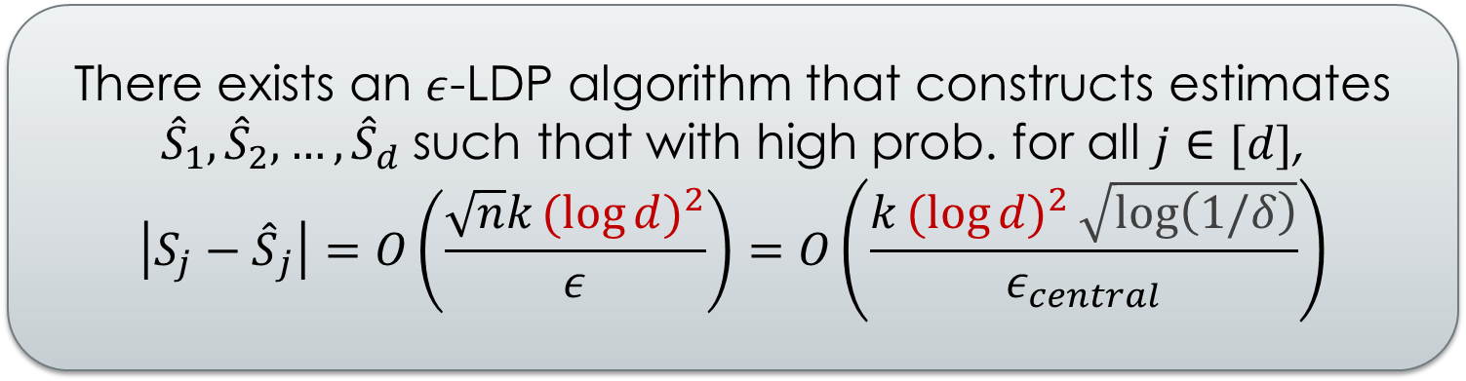

Monitoring with LDP
There exists an $ε$-LDP algorithm that constructs estimates ${\hat{S}}_{1},{\hat{S}}_{2},…,{\hat{S}}_{d}$ such that with high prob. for all $j∈[d]$,
$$\left|{S_{j}−\hat{S}}_{j}\right|=O\left(\frac{\sqrt{n}k{(log{d)}}^{2}}{ε}\right)=O\left(\frac{k{(log{d)}}^{2}\sqrt{log\left(1/δ\right)}}{ε_{central}}\right)$$
Report the status changes (only first $k$)
Maintains a tree of counters each over an interval of time
Based on [DNPR ‘10; CSS ‘11]

Slide 11
Conclusions
General privacy amplification technique
For some problems achieves state of the art in the central model
Can be used to derive lower bounds for LDP
Provable benefits of anonymity for ESA-like architectures
Same algorithm, different attack/trust models

