Slide 1
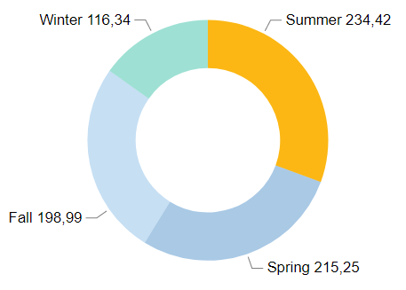
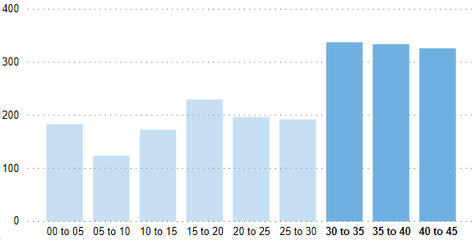
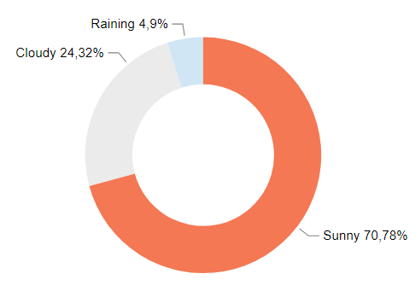
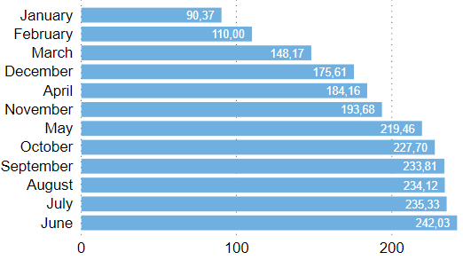
Case – Bicycle Rental
Seasons with better performance are Summer and Spring.
It can be related with the higher Temperatures.
And related with the Weather.
Most part of our revenue comes from June to September, the months with hotter days.
People prefer to rent a Bicycle when the weather is Sunny or Cloudy.
Victor Henrique Pereira – 11/09/2020
victorhp1995@gmail.com
https://www.linkedin.com/in/vithep/

Slide 2
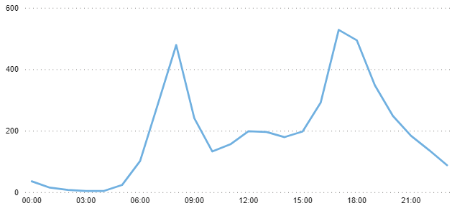
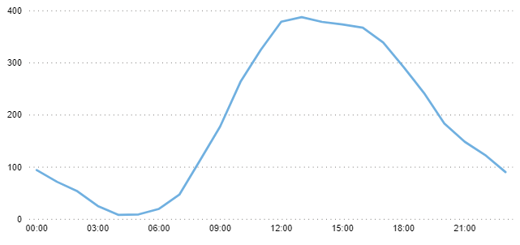
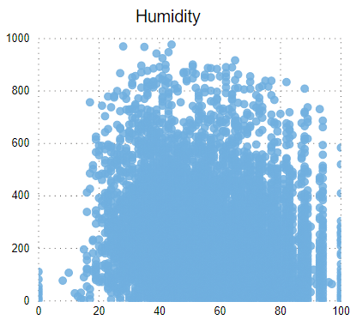
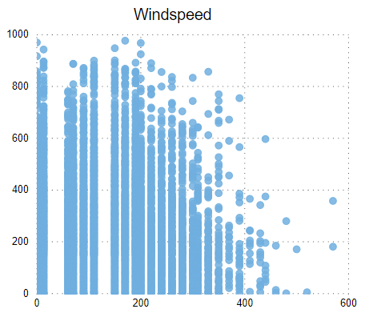

Case – Bicycle Rental
During working days, most people rent our bicycles to move to their jobs and go back to home.
In Holidays and weekends, most people rent our bicycles between 6AM and 1PM.
The humidity and the windspeed don’t influence the number of rentals.
Number of rentals with registered customers are almost five times higher than the number of rentals with casual customers.
Dashboard
Victor Henrique Pereira – 11/09/2020
victorhp1995@gmail.com
https://www.linkedin.com/in/vithep/

