Slide 1


Vithey App
Team Vithey
Organize · Share · Learn · Career
ACLEDA Bank AUB App Competition 2026
All-in-one Student Super App for AUB students
Social
Jobs & CV
Finance
Chat
AI Assistant
Vithey App · ACLEDA Bank AUB App Competition
1

Slide 2
Team Members
7 Members
Name
Role
Moeng Kimheang
Team Lead / Full-Stack
Khorn Molika
Frontend / UI
Heng Liza
Backend / API
Ponleong Bora
Backend / DevOps
Nam Ayheng
Frontend / Flutter
Nao Soksovannarith
Backend / Database
Phon Dyna
QA / Documentation
Vithey App · ACLEDA Bank AUB App Competition
2

Slide 3
Table of Contents
Project Overview & Key Features
System Architecture
Frontend & Backend Tech Stack
Microservices & Infrastructure
Project Plan & DevOps
Security & Deployment
Impact, Demo & Conclusion
Vithey App · ACLEDA Bank AUB App Competition
3

Slide 4
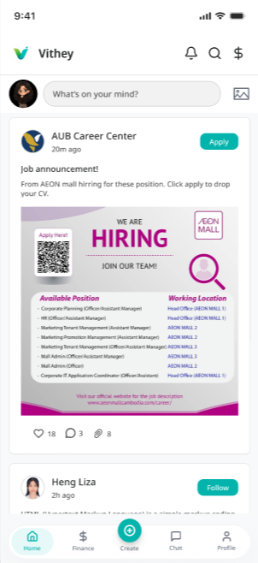
Project Overview
Unified Student Super App
Social Feed — posts, likes, comments, share
Job System — browse jobs, upload CV, apply
Student Finance — verification, fees, invoices
Private Chat — DMs, requests, block/report
AI Assistant — Vithey chatbot with history
Notifications — typed routing to all modules
Settings — account, privacy, security, help
Home Feed — social, jobs & media
Vithey App · ACLEDA Bank AUB App Competition
4

Slide 5
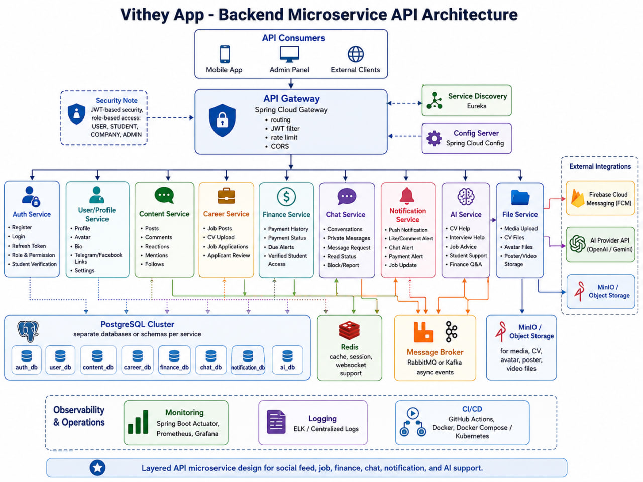
System Architecture
Flutter Client → iOS & Android mobile app
API Gateway → Single entry · routing · JWT validation
Microservices → 10 Spring Boot services + AI service
Message Bus → RabbitMQ events between services
Data Layer → PostgreSQL · Redis · MinIO
Vithey App · ACLEDA Bank AUB App Competition
5

Slide 6
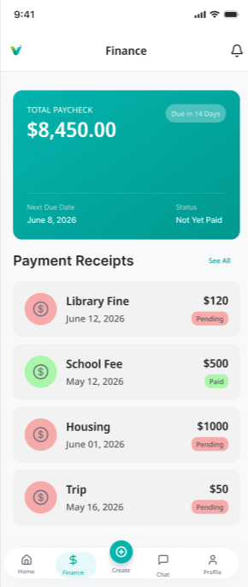
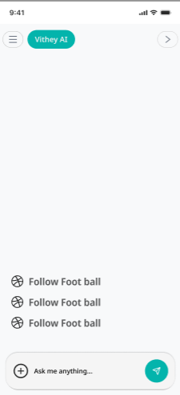
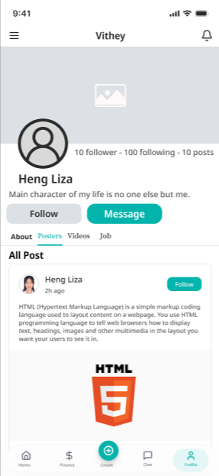
App Features (Implemented)
Social Feed
Finance
AI Chatbot
Profile & Jobs
Vithey App · ACLEDA Bank AUB App Competition
6

Slide 7
Frontend Architecture (Flutter)
Tech Stack
Key Modules
GetX — state, routing, DI
Dio + HTTPS — REST API client
flutter_secure_storage — JWT tokens
shared_preferences — theme, language
cached_network_image, intl, file_picker
Modular: 11 feature modules complete
Auth & Onboarding (splash, login, Google, startup)
Media Feed — posters, videos, job cards
Post Detail, Comments, Share, Create Post
Profile — About, Posters, Videos, Jobs, CV
Upload CV & Job Application flow
Finance — verification, invoices, payments
Vithey App · ACLEDA Bank AUB App Competition
7

Slide 8
Backend Microservices (Spring Boot 3)
Java 21 · Maven · Clean Architecture · JWT Security
● api-gateway
● chat-service
● auth-service
● finance-service
● user-profile-service
● file-service
● content-service
● notification-service
● career-service
● ai-service
Shared: Eureka Server — service discovery · Config Server — centralized configuration · PostgreSQL — primary database · Redis — caching layer
Vithey App · ACLEDA Bank AUB App Competition
8

Slide 9
Infrastructure & DevOps
Shared Infrastructure
DevOps Pipeline
Eureka Server — service discovery
Config Server — centralized configuration
PostgreSQL — primary database
Redis — caching layer
RabbitMQ — async messaging
MinIO — object / file storage
Git + GitHub — version control
Docker — per-service containerization
docker-compose — local full stack
GitHub Actions — CI per service
Bruno / Postman — API testing
Eureka + Config Server — cloud-ready
Vithey App · ACLEDA Bank AUB App Competition
9

Slide 10
Project Plan
✅ Phase 1 — Requirement Analysis & prompts
✅ Phase 2 — UI/UX Design (Figma references)
✅ Phase 3 — Backend microservices development
✅ Phase 4 — Flutter frontend (11 modules)
✅ Phase 5 — API integration & mock layer
✅ Phase 6 — Testing (unit + widget tests)
🔲 Phase 7 — Production deployment (GCP/K8s)
Vithey App · ACLEDA Bank AUB App Competition
10

Slide 11
Security Design
Frontend Security
Backend Security
Secure JWT token storage
flutter_secure_storage for credentials
HTTPS-only API communication
Biometric & 2FA placeholders
Privacy toggles — profile, data, tracking
Spring Security + JWT filters
API Gateway token validation
BCrypt password encryption
Role-based access control (RBAC)
Per-service security config
Vithey App · ACLEDA Bank AUB App Competition
11

Slide 12
Deployment Strategy
Google Cloud Platform — primary target
Kubernetes — container orchestration
OpenShift — enterprise deployment option
Docker images per microservice
Horizontal scaling via Eureka discovery
High availability — stateless services
Vithey App · ACLEDA Bank AUB App Competition
12

Slide 13
Impact & Benefits for AUB Students
One app replaces fragmented tools
Social networking within campus community
Direct job applications with CV upload
Track tuition & payment invoices in-app
Safe private messaging between students
AI help for finance, jobs & study topics
Built for ACLEDA Bank AUB Competition
Vithey App · ACLEDA Bank AUB App Competition
13

Slide 14
Conclusion
Full-stack production-ready architecture
10 microservices + Flutter mobile client
All 11 frontend modules implemented
Secure JWT auth end-to-end
Docker + CI/CD deployment ready
Solves real student daily-life problems
Vithey App · ACLEDA Bank AUB App Competition
14

Slide 15
Thank You
Team Vithey
Vithey App — Organize · Share · Learn · Career
Vithey App · ACLEDA Bank AUB App Competition
15

