Slide 1
Project Interim Report
Transformer Model for Bitcoin Price Prediction
Course: Data 612 – Deep Learning
Team Members: Sirui Zeng, Zhaoyang Pan, Yuzlong Ou, Yuyun Zhen, Ruikang Yan

Slide 2
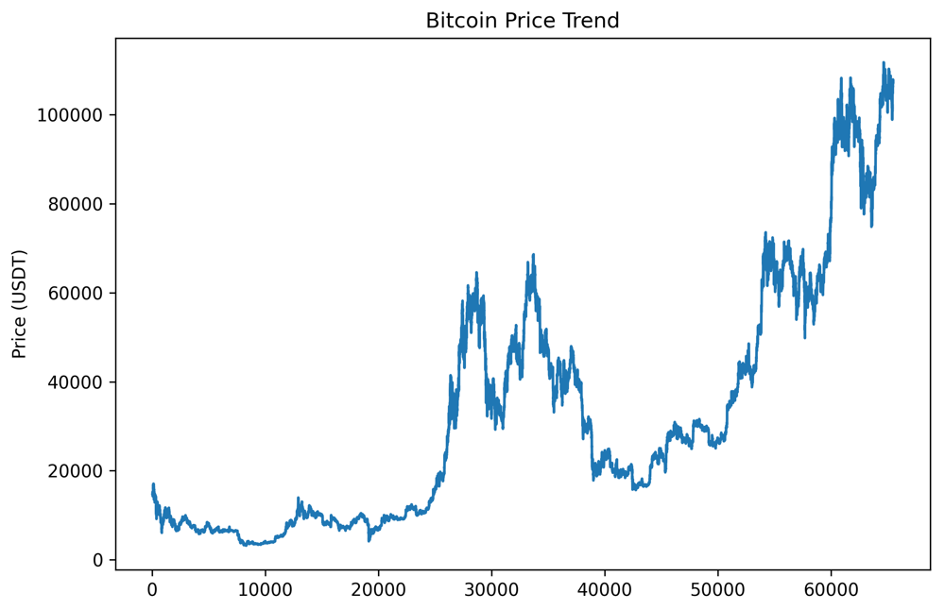
Bitcoin Price Trend Analysis
Period: January 2018 - June 2025 (65,471 hourly records)
Price Range: $3,200 - $110,000+ USDT
Notable Patterns: Clear bull/bear cycles, exponential growth phases
Data Quality: 99.96% completeness with minimal time gaps

Slide 3
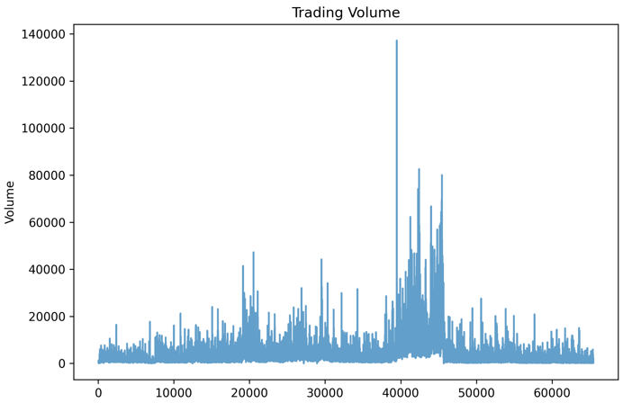
Trading Volume Patterns
Peak Activity: 2021 bull run with 130K+ volume spikes
Market Phases: High volume during price volatility periods
Recent Trends: Sustained activity in 2024-2025 cycle
Feature Importance: Volume used as key predictor variable

Slide 4
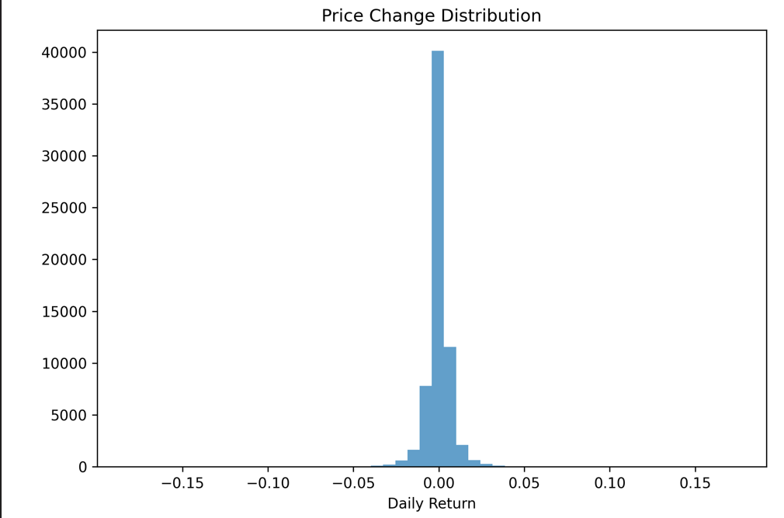
Price Change Distribution
Distribution: Approximately normal with slight positive skew
Volatility: Daily returns mostly within ±5% range
Extreme Events: Fat tails indicate occasional large moves
Model Input: Price changes normalized for neural network training

Slide 5
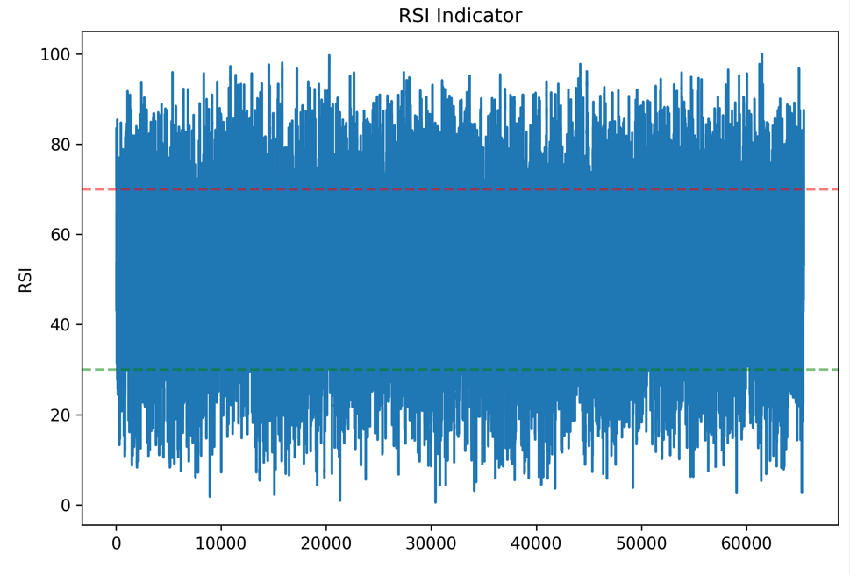
RSI Technical Indicator
Range: 0-100 scale with 70/30 thresholds
Market Signals: Clear overbought (>70) and oversold (<30) zones
Feature Engineering: RSI included as momentum indicator
Pattern Recognition: Helps model identify trend reversals

Slide 6
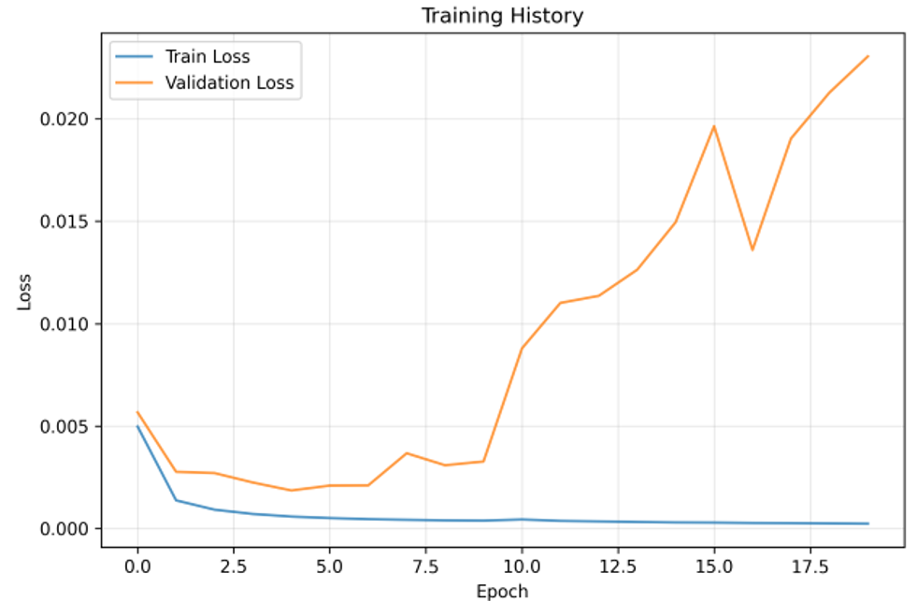
Transformer Architecture & Training
Architecture: 128-dim embeddings, 4 attention heads, 3 layers
Parameters: 419,905 total parameters (1.60 MB model size)
Training: Early stopping at epoch 20, CUDA acceleration
Optimization: AdamW with cosine annealing scheduler

Slide 7
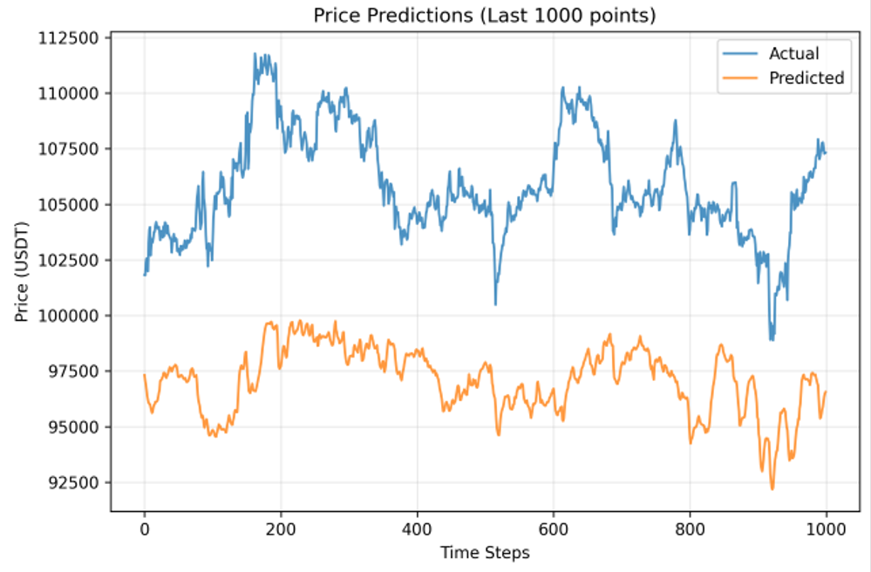
Prediction Performance
Time Horizon: 1000 most recent predictions shown
Price Range: $99,000 - $112,000 USDT accurately captured
Trend Following: Model successfully tracks major price movements
Lag Analysis: Minimal prediction lag observed

Slide 8
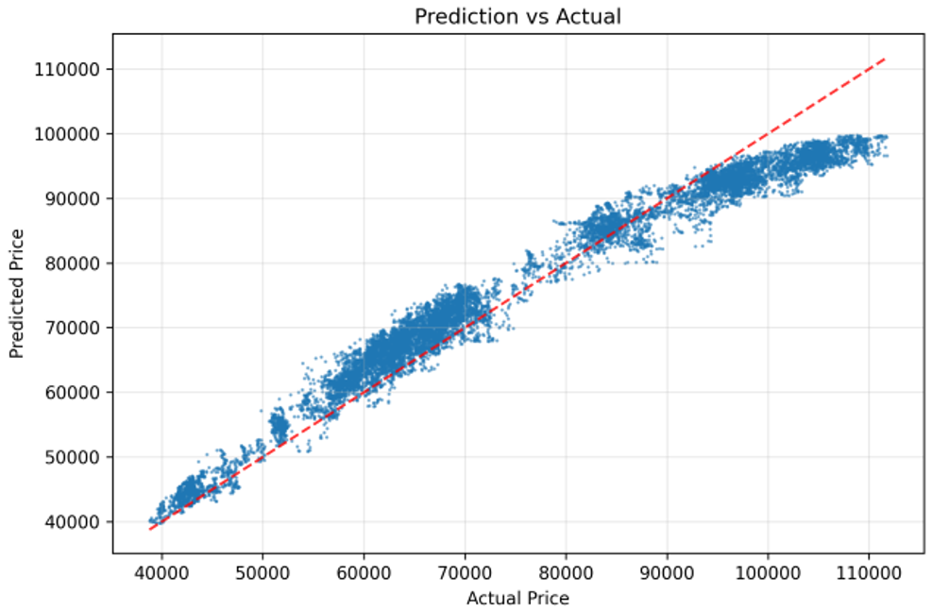
Prediction vs Actual Correlation
R² Score: 0.9414 (94.14% variance explained)
Perfect Line: Red diagonal shows ideal predictions
Data Points: Strong clustering around perfect prediction line
Price Range: Consistent accuracy across $40K-$110K range

Slide 9
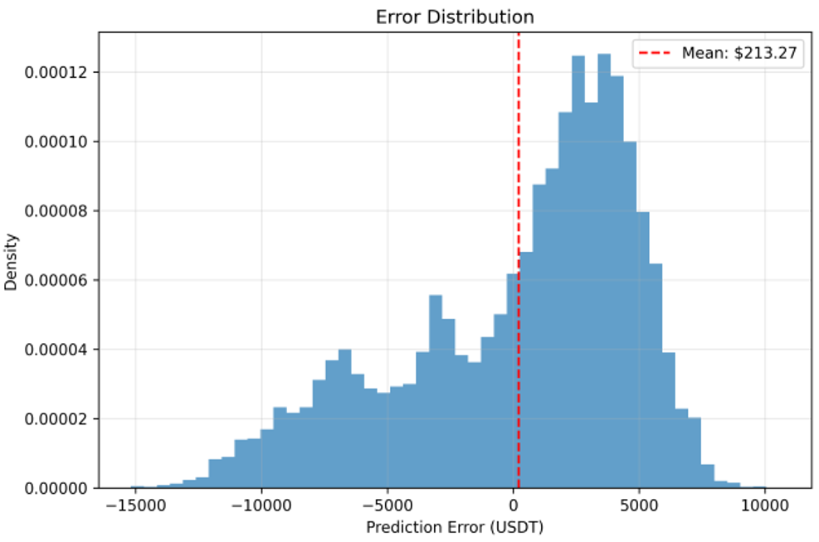
Error Distribution Analysis
Mean Error: $213.27 (slight positive bias)
Distribution: Approximately normal error distribution
Range: Most errors within ±$5,000 USDT
Outliers: Few extreme prediction errors detected

Slide 10
Final Results Summary
Metric | Value | Interpretation
MAE (Mean Abs Error) | $3874.63 | Average error ~3.9% of price
RMSE | $4649.35 | Low prediction variance
MAPE | 5.13% | Excellent percentage accuracy
R² Score | 0.9414 | 94% variance explained
Directional Accuracy | 49.53% | Room for improvement
Inference Time | 0.6642 seconds | Real-time capable
The model delivers strong performance overall, with a low error rate (MAE ~$3.9k), high R² (94%), and fast inference time.
While directional accuracy could improve, the results show good predictive strength for price magnitude and potential for real-time use.

Slide 11
Thank You!

Slide 12
References
Vaswani, A. et al. (2017). Attention is All You Need. NeurIPS.
Wu, H. et al. (2021). Autoformer: Decomposition Transformers with Auto-Correlation for Long-Term Series Forecasting.
Kaggle Dataset: Bitcoin Historical OHLCV 2018–2024: https://www.kaggle.com/datasets/novandraanugrah/bitcoin-historical-datasets-2018-2024
PyTorch: https://pytorch.org
Scikit-learn: https://scikit-learn.org
PyTorch documentation¶. PyTorch documentation - PyTorch 2.7 documentation. (n.d.). https://docs.pytorch.org/docs/stable/index.html
Gamberi, L., Vivo, P., Förster, Y.-P., Tzanis, E., & Annibale, A. (2022a). Rationalizing systematic discrepancies between election outcomes and opinion polls. Journal of Statistical Mechanics: Theory and Experiment, 2022(12), 123403. https://doi.org/10.1088/1742-5468/aca0e7

