Slide 1
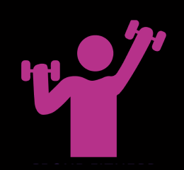
LetsGetFit
Developers: vithu mathi, Kajal Patel

Slide 2
Inspiration
As friend that used to workout together, we found it hard to stay motivated working out alone due to social distancing
We used to love tracking our group workouts using our smartwatches and then sharing that information with each other
We used calories burned and heart rate info to push each other to work harder
Although we could workout together over Zoom, we thought having an app that was dedicated to just working out, would allow us to also display data and use synchronized timers for our workout
This led us to designing LetsGetFit!

Slide 3
LetsGetFit Design
See the Figma Sketch:
https://www.figma.com/file/gBrUrzfydpRkQYfrHPMeW5/LetsGetFit?node-id=0%3A1

Slide 4
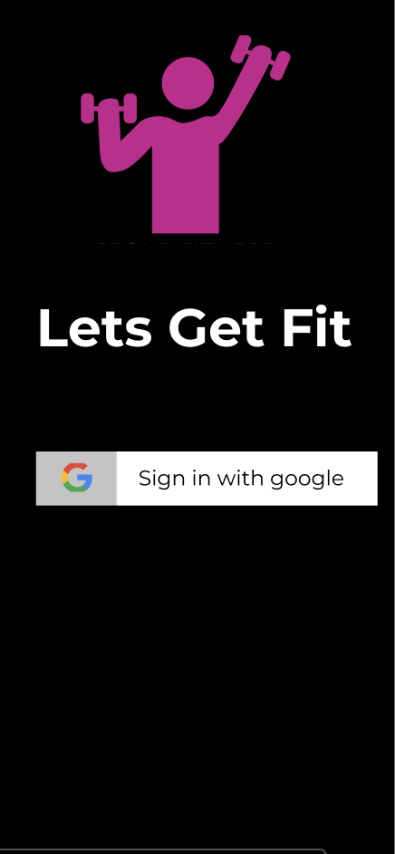
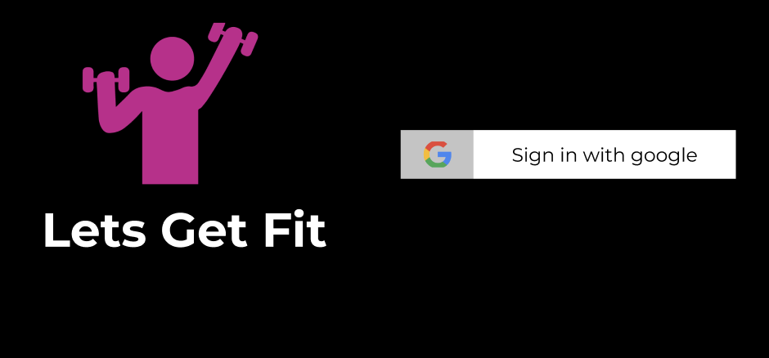
LetsGetFit Design – Authentication Screen
Easy authentication using Google account
Grant permissions for fitness data which will either be taken from the device or companion device (wearables)

Slide 5
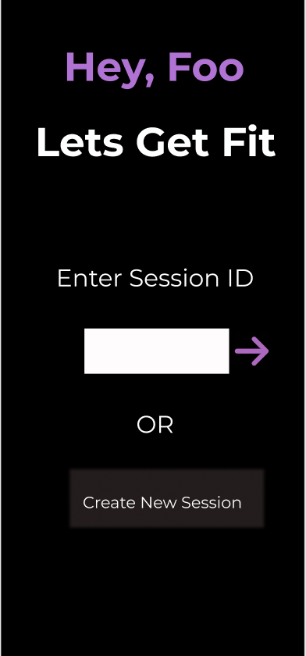
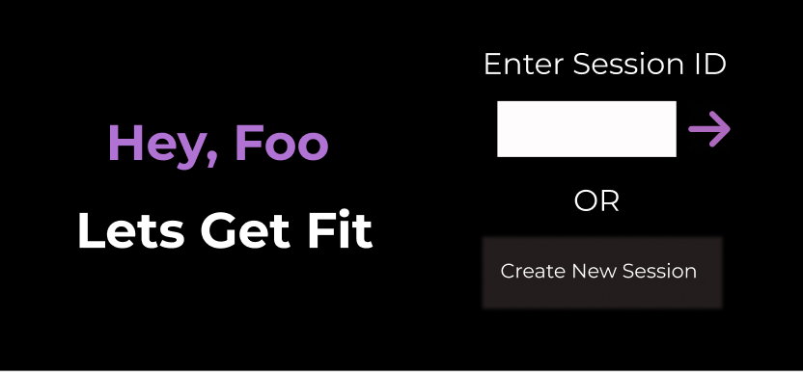
LetsGetFit Design – Session Creation
Easily join an existing session using the session ID
OR
Create a new session and get a session ID

Slide 6
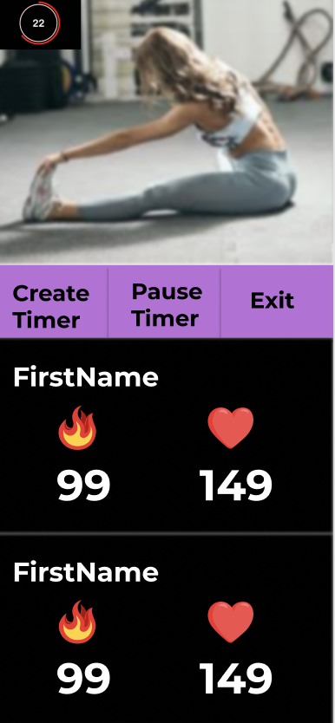
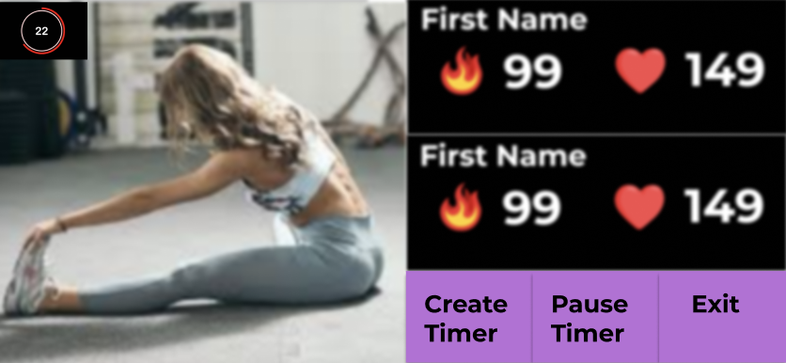
LetsGetFit Design – Workout
Enter your partnered workout session
Have a synchronized timer count down
Use the real time information about calories burned and heart rate to keep each other motivated

Slide 7
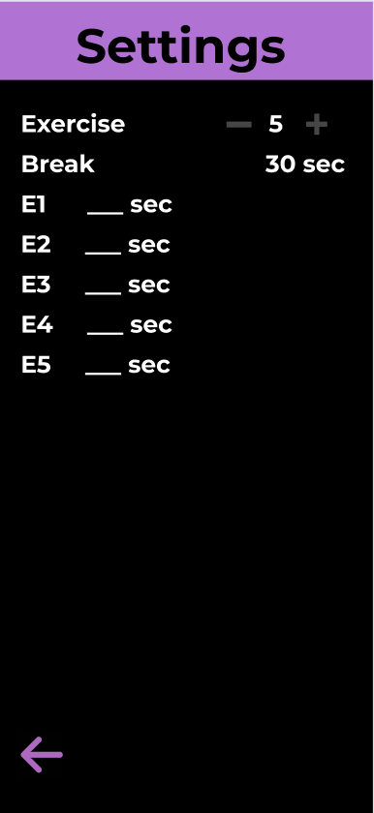
LetsGetFit Design – Synchronized Workout Timer
Create a HIIT workout timer with several exercises and automatic breaks between exercises !
The timer will be synchronized between you and your partner

Slide 8
The Future
In the future, we envision LetsGetFit to be used by personal trainers with a few more features
Trainer’s can conduct virtual workouts with their clients in real time, allowing them to keep motivating their clients to do their best!
The trainer’s can later store and access workout session info about their clients, such as calories burnt and average heart rate info
Based on this info, trainer’s will be able to make better personalized workouts that are catered to each individual based on data that they have collected over several workouts ☺

