Slide 1
Traffic Violations Insight System
Submitted By: Vithyaa Soundararajan
Technologies: Python, MySQL, Streamlit, Pandas, Plotly

Slide 2
Problem Statement
Analyze large traffic violation datasets and generate meaningful insights through dashboards.

Slide 3
Project Objectives
Data Cleaning
Database Integration
SQL Analytics
Interactive Dashboard
Insight Generation

Slide 4
Dataset Overview
Total Records: 2,067,761
Total Columns: 43
Source: Traffic Violations Dataset

Slide 5
Technology Stack
Python
MySQL
Pandas
Plotly
Streamlit
SQLAlchemy

Slide 6
System Architecture
CSV → Preprocessing → MySQL → SQL Analysis → EDA → Dashboard

Slide 7
Data Preprocessing
Removed duplicates
Handled missing values
Feature Engineering (Month, Day)

Slide 8
Database & SQL Analysis
Top Violations
Top Vehicle Makes
Gender Analysis
Race Analysis

Slide 9
Dashboard Features
Overview
Violation Analysis
Vehicle Analysis
Demographic Analysis
Geographic Analysis

Slide 10
SCREENSHOT FOR FOLLOWING

Slide 11
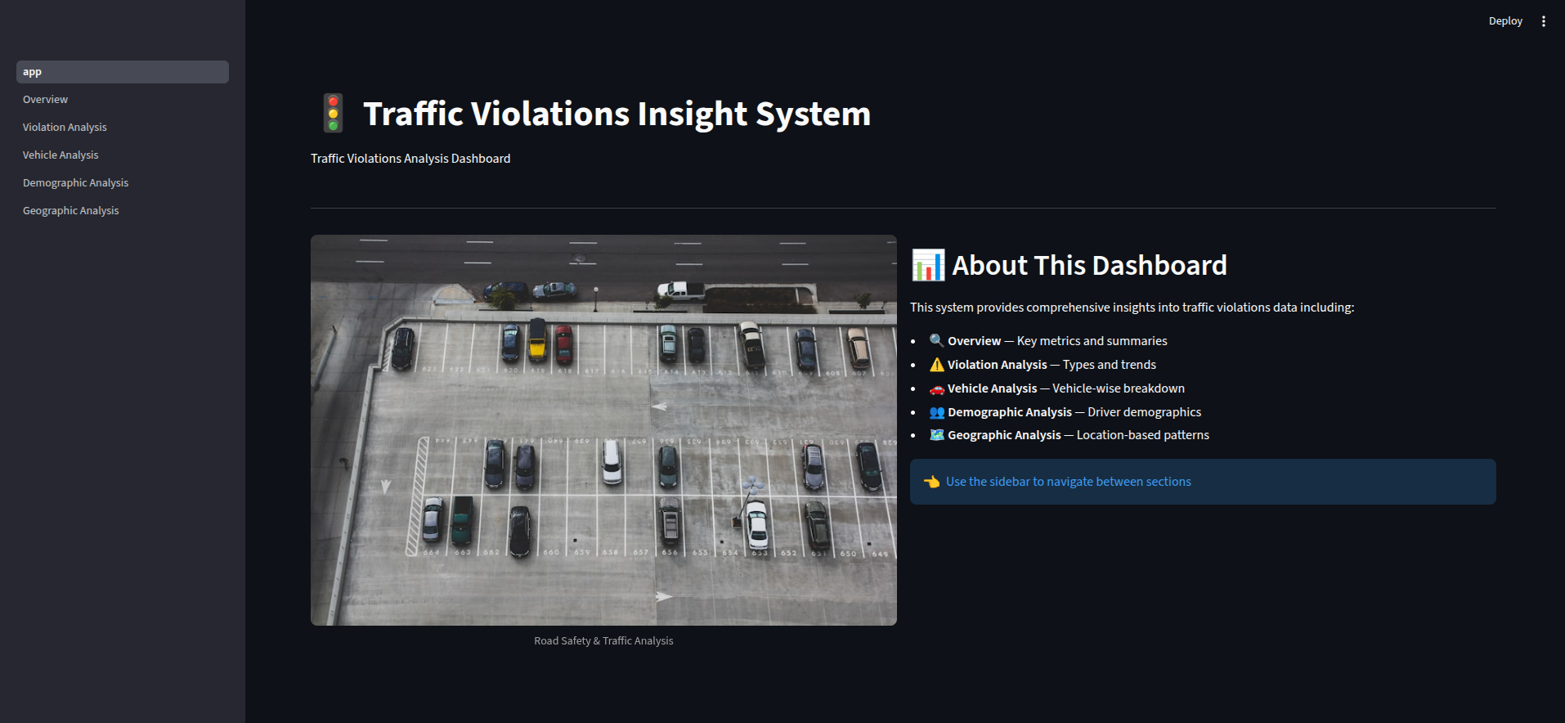

Slide 12
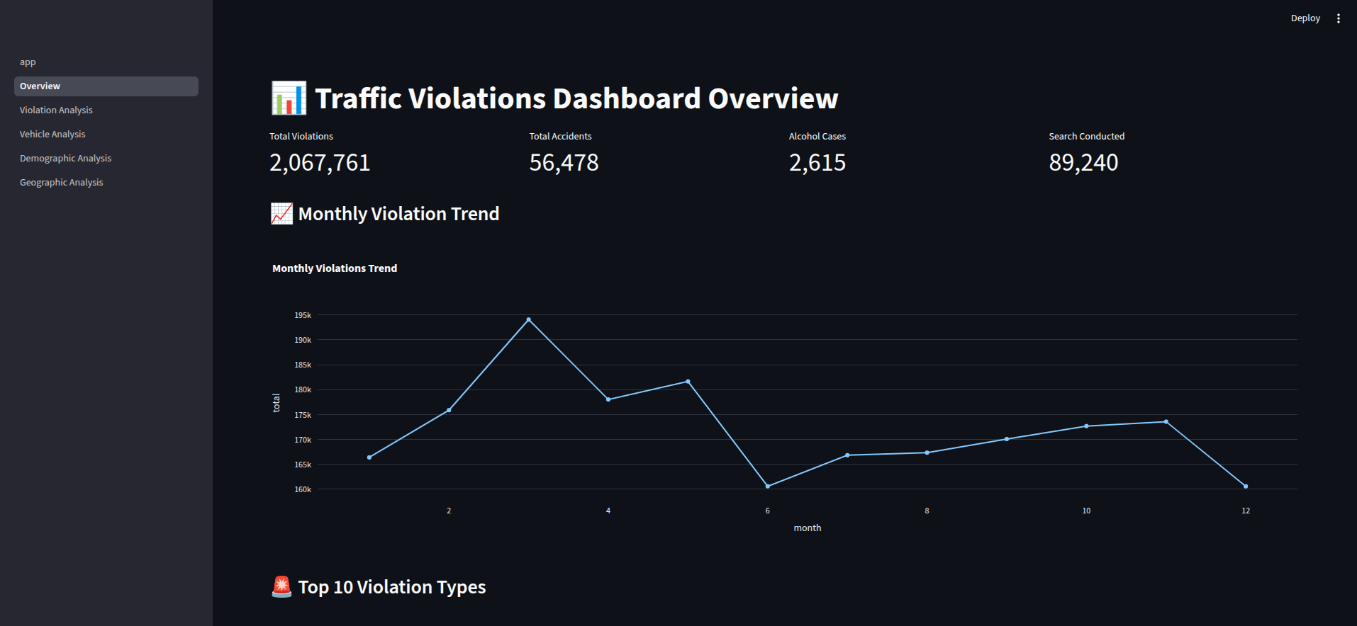

Slide 13
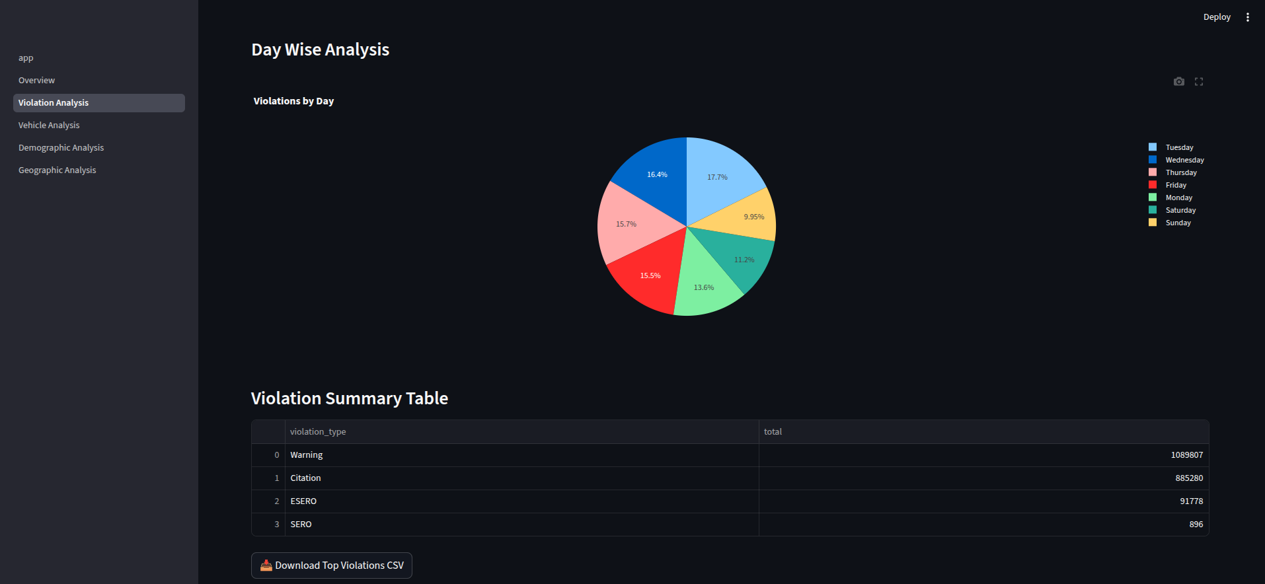

Slide 14
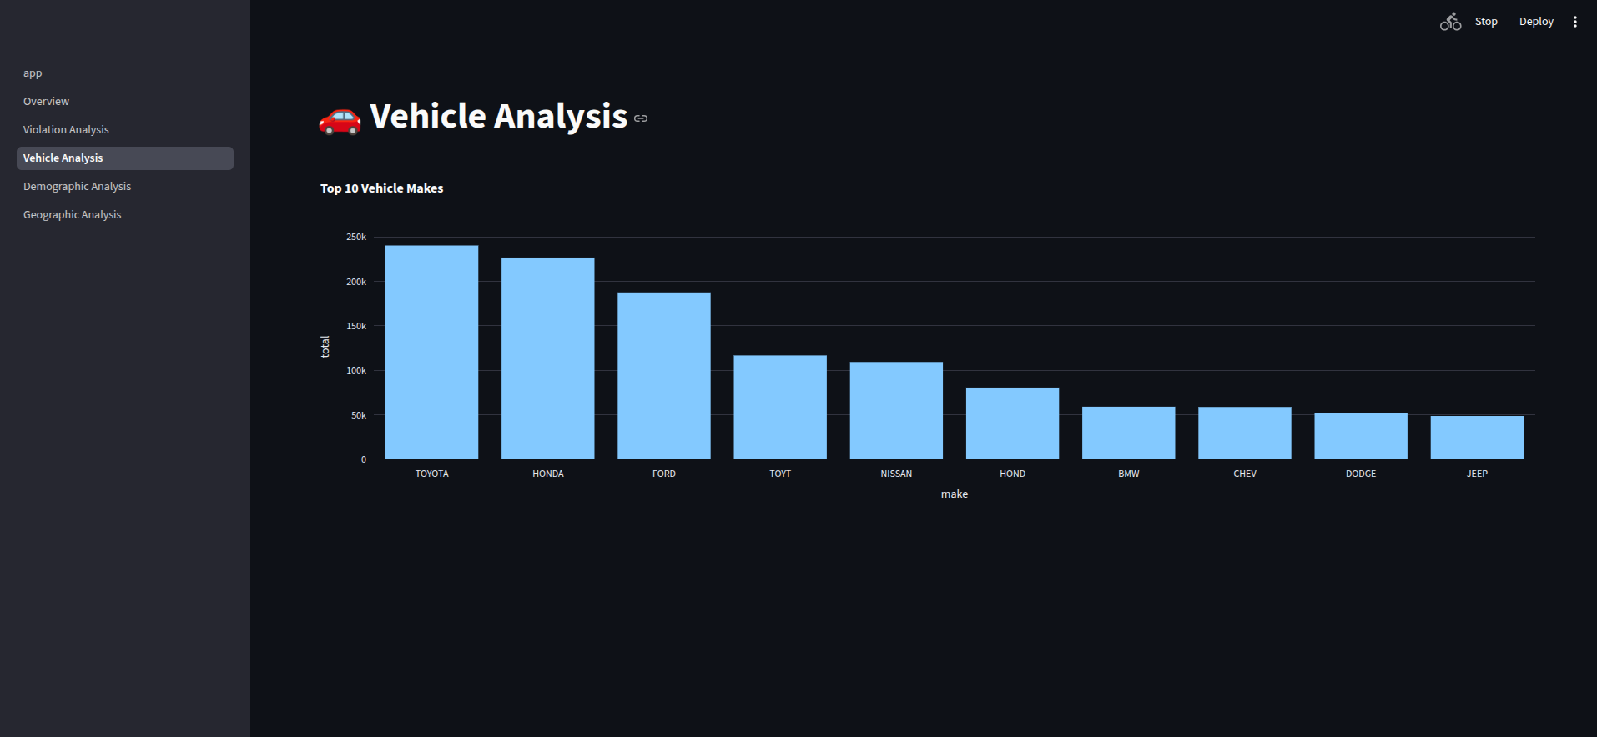

Slide 15
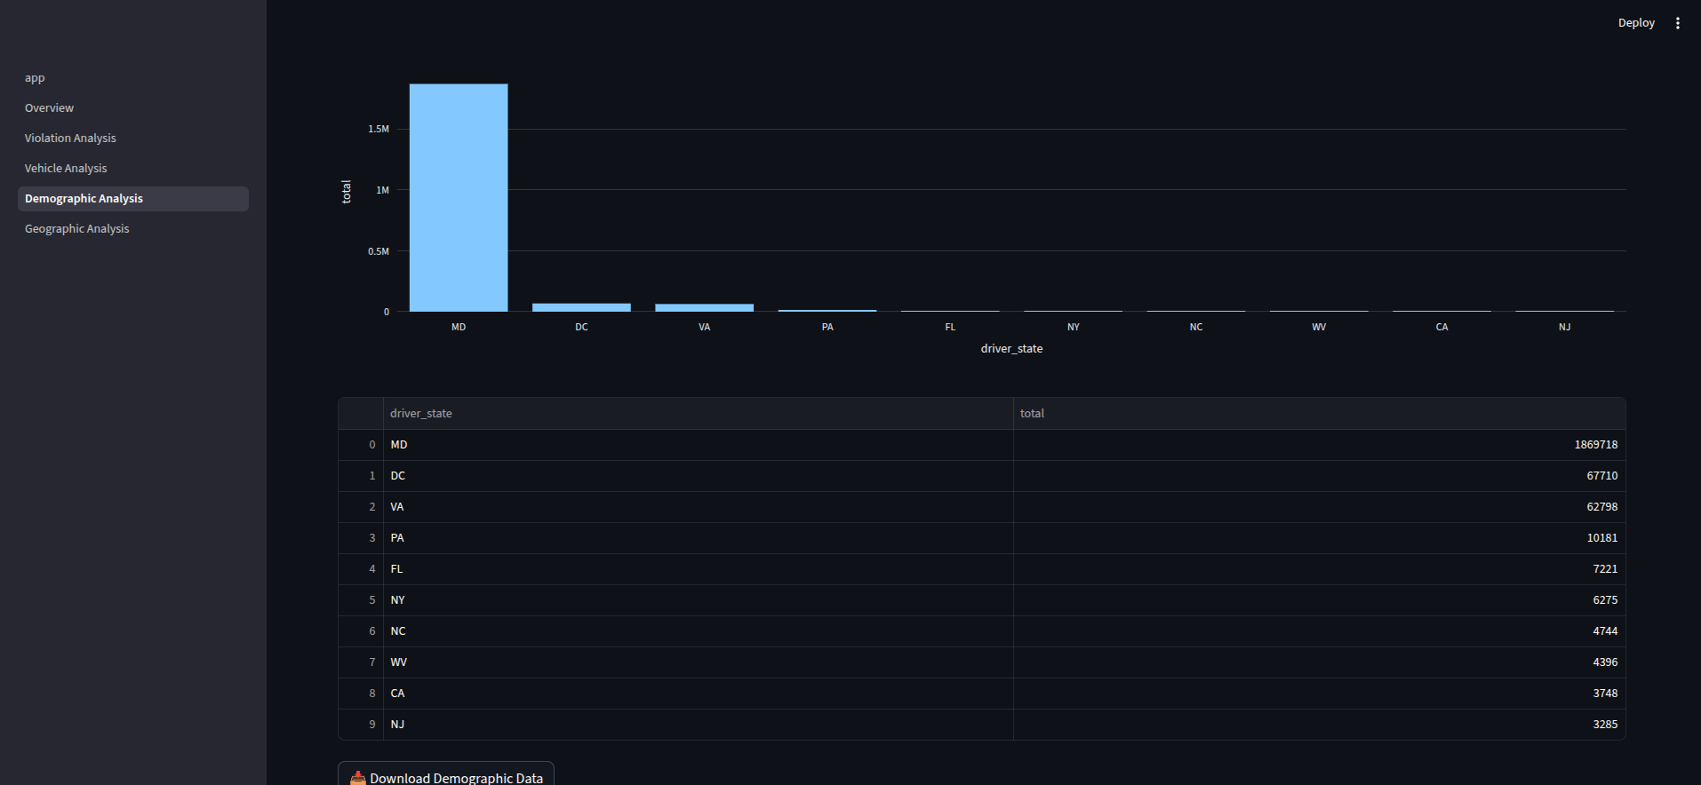

Slide 16
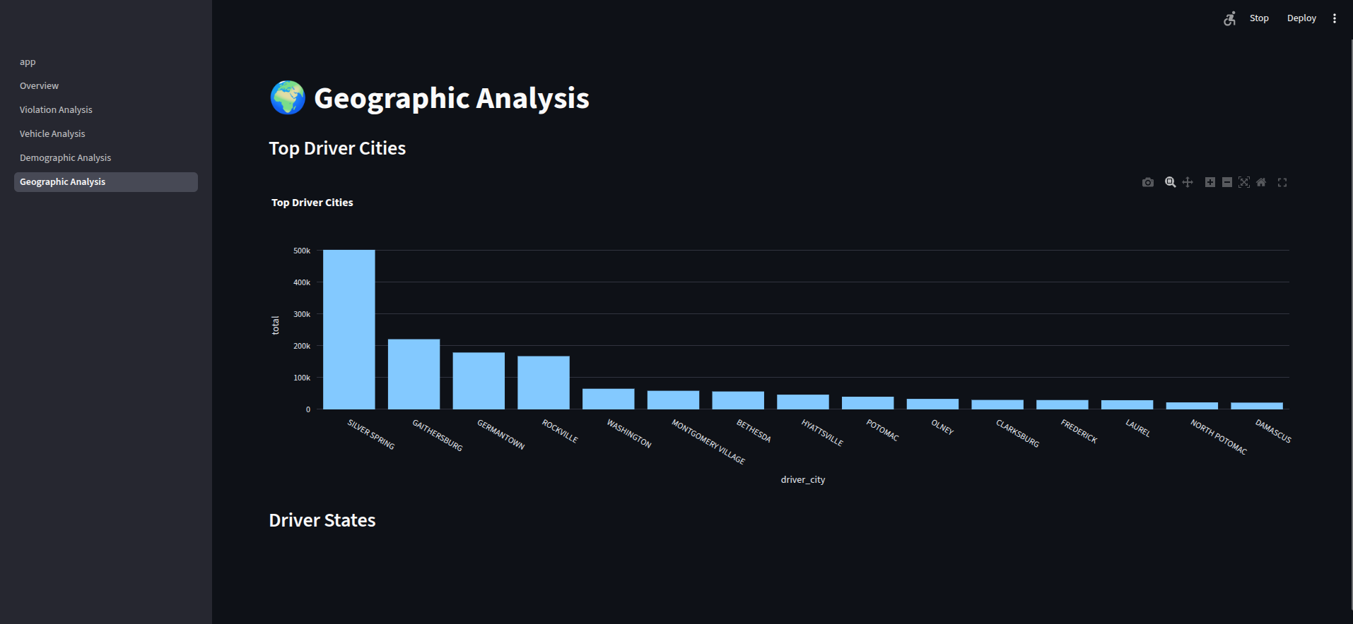

Slide 17
Conclusion
Successfully processed 2M+ records and built an interactive analytics dashboard.

