Slide 1
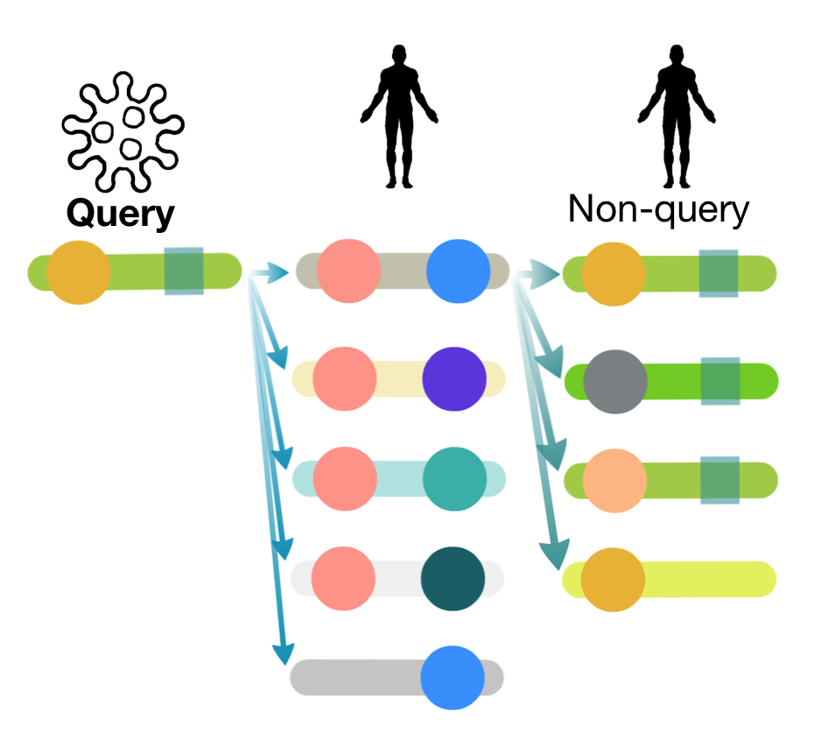
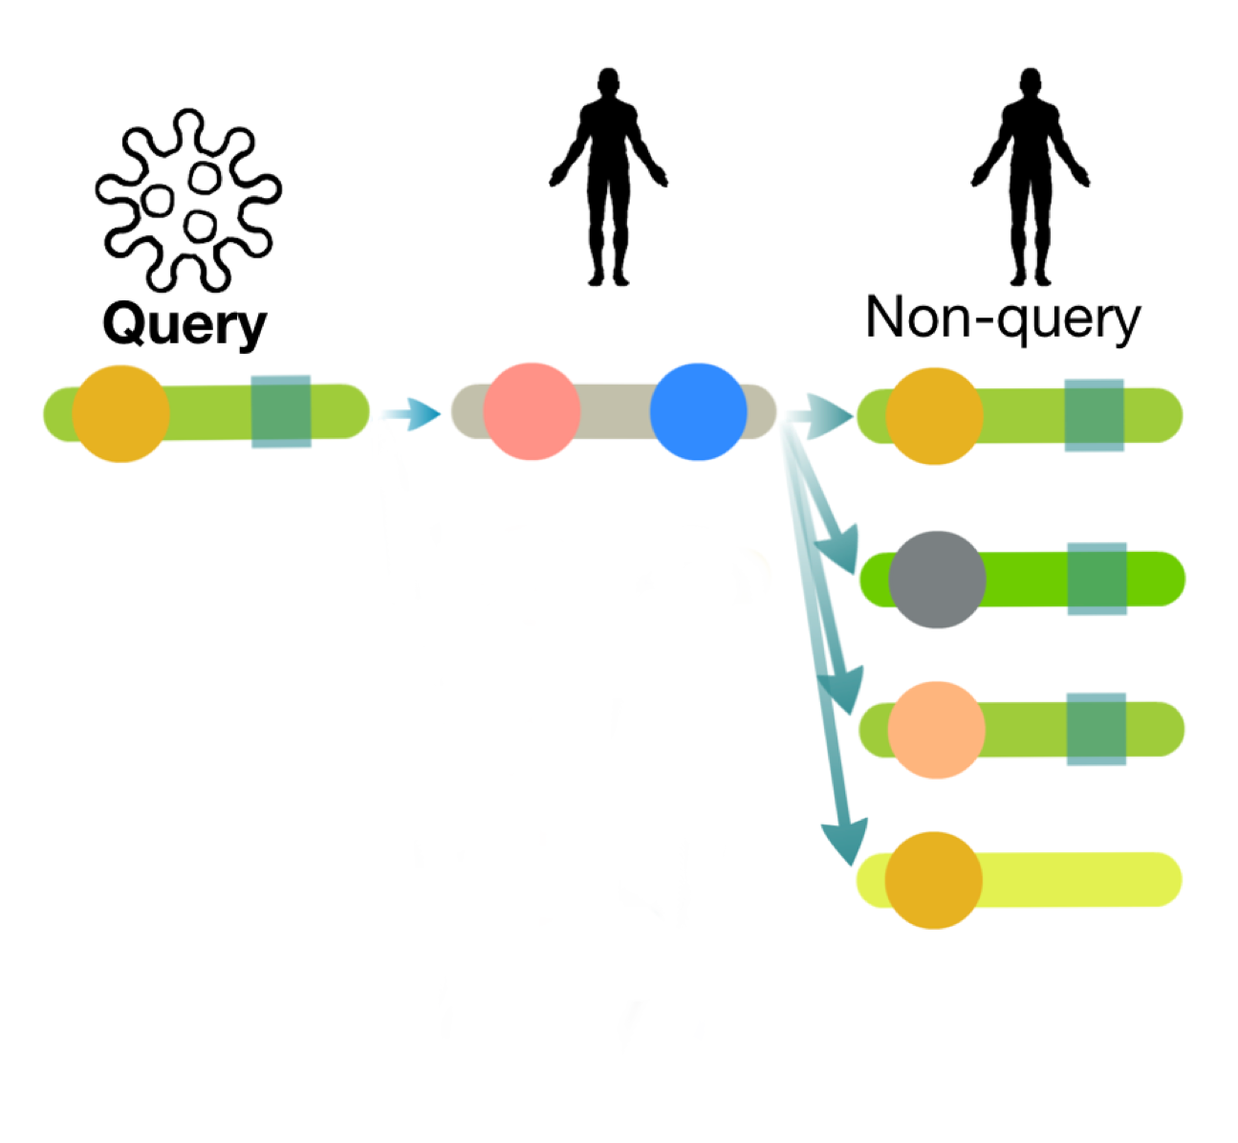
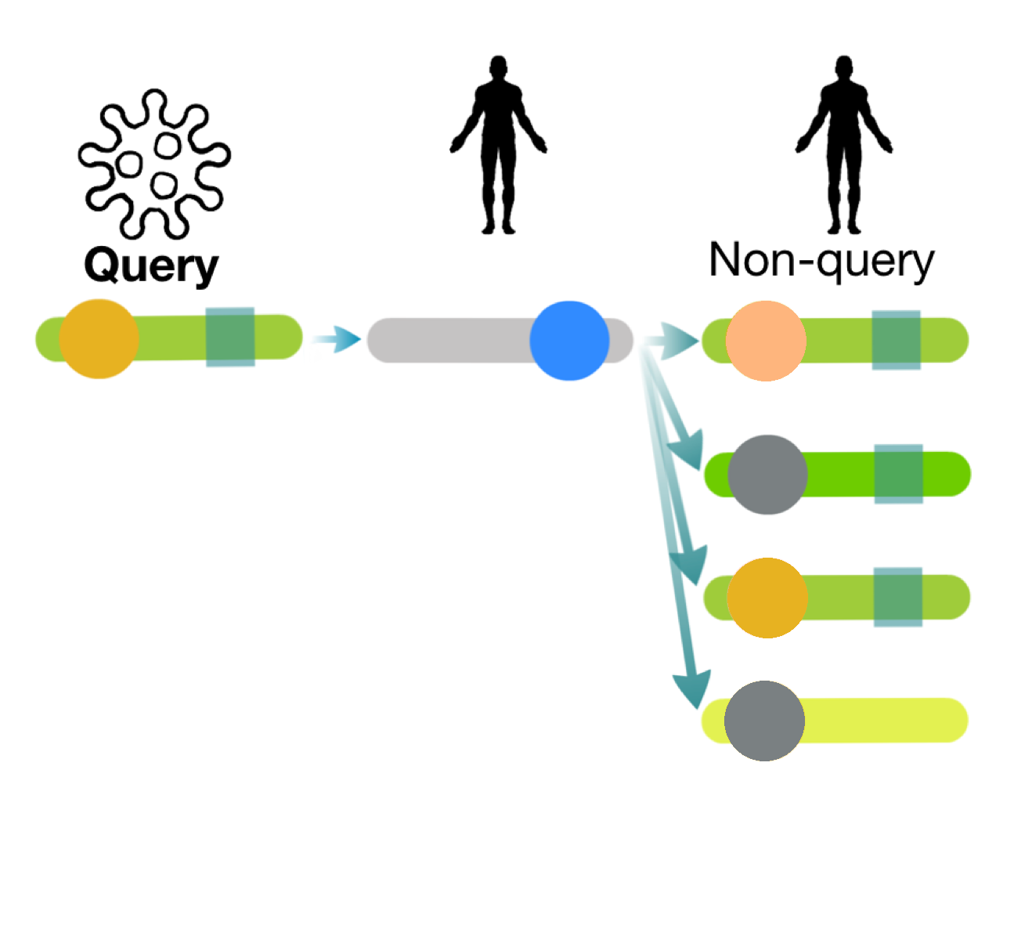
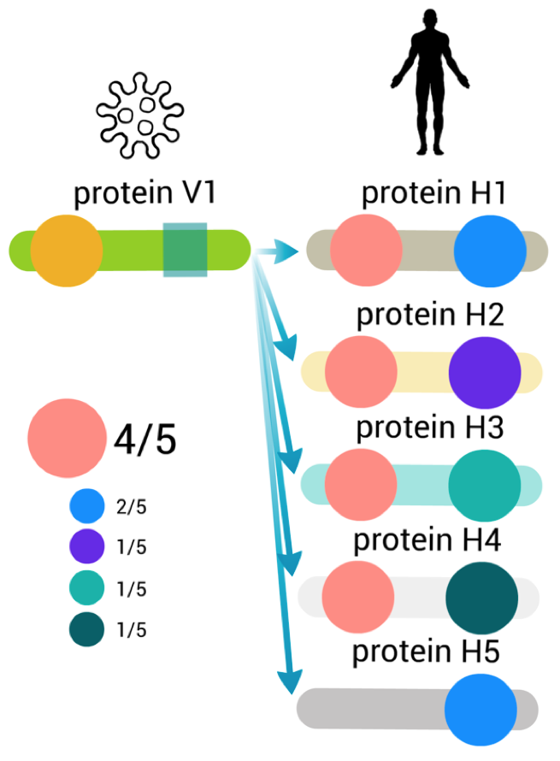
Get human-viral PPI data
Generate QSLIMFinder datasets
+ … +
Estimate enriched domains
Filter by likely recognition domain
+ … +
Use BLAST to group homologous proteins into UPCs
Identify disordered regions using IUPRED and mask
Find motifs overrepresented in each dataset using QSLIMFinder, filter using query proteins
Mask low complexity regions
Evaluate predicted motifs and domains against a benchmark

Slide 2
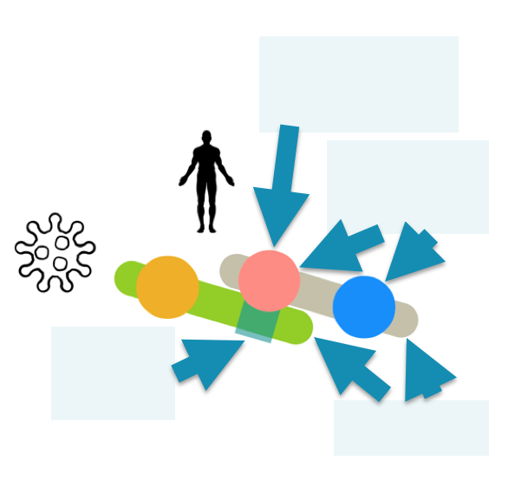
Домен розпізнавання
Глобулярний домен
Лінійний мотив
Білки

