Slide 1
FPT’s PROPOSAL
Smart Device Link ’s HMI development process suggestion.
Authors: hieutc3@fsoft.com.vn, trungnt51@fsoft.com.vn, giangnv2@fsoft.com.vn
Ha Noi | Apr 2019

Slide 2
Table of Content
Background – the motivation of this proposal.
FPT latest thinking – A SDL’s HMI design process suggestion.
Q&A.
Appendix.
2

Slide 3
History, acronym and abbreviation
Date | Author | Description | Version
01-Apr-2019 | hieutc3@fsoft.com.vn | First created | 1.0
Acronym/Abbreviation | Description
SDL | Smart Device Link
HMI | Human Machine Interface
OEM
IVI
ECS | Entity Component System

Slide 4
Background
The motivation of this proposal

Slide 5
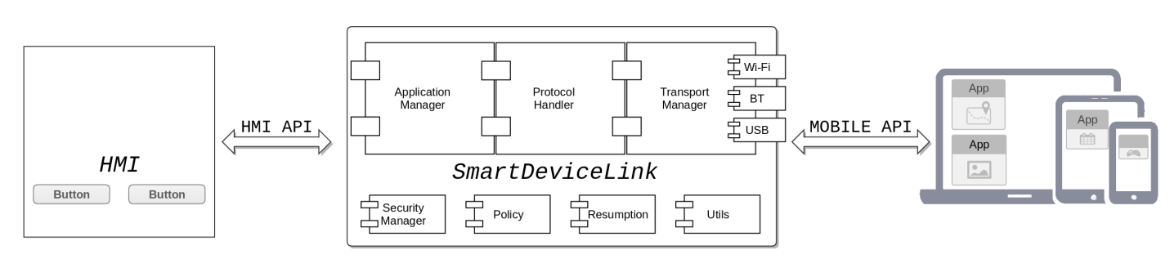
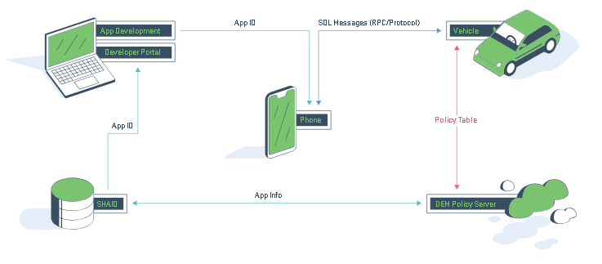
About SDL
Expandable software framework to both mobile application developers and automotive IVI device.
Industry standard for open source in-vehicle connectivity.
A Ford AppLink platform built.
Note: Image is referred somewhere from internet

Slide 6
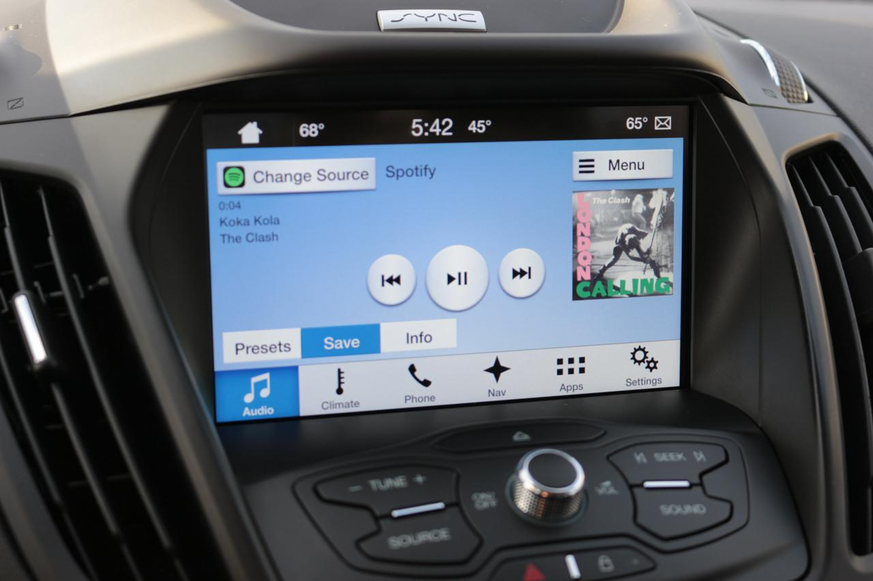
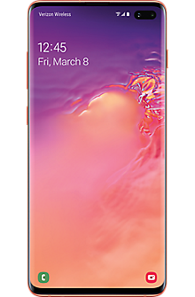
Current status of SDL’s HMI development in AGL platform
Leverage just only generic HMI: https://github.com/smartdevicelink/generic_hmi
Qt-based approach uses rather old platform version (Qt 5.1): https://github.com/smartdevicelink/sdl_core/wiki/SDL-on-Linux-with-QT
Heavyweight HMI framework:
DOM/CSS.
Qt: bloat, overkill.
Have not mentioned about UI/UX design process flow:
There is no SDL template creator toolset.
An intermediate abstract data is needed to describe the design language from OEM’s designer.

Slide 7
FPT’s lastest thinking
A SDL’s HMI design process suggestion

Slide 8
HMI’s intermediate data
Data refinement flow.
Abstraction for UI/UX logic.
Reduce complicated matrix when support multiple platform.
Executable, reproducible:
Platform/framework source code generator.
Interpreter: transparent deployment, model debugging, hot reload.
(2) HMI Intermediate Data
Graphic editor
(Sketch, Photoshop,…)
UI Data/MetaData
(Font, Images, Text, ...)
(3)Framework
SDL core
HMI application I/F
Graphic renderer framework
Screen Transition Info
OEM site
SDL framework
HMI design flow best practice for in-vehicle device
UI metadata

Slide 9
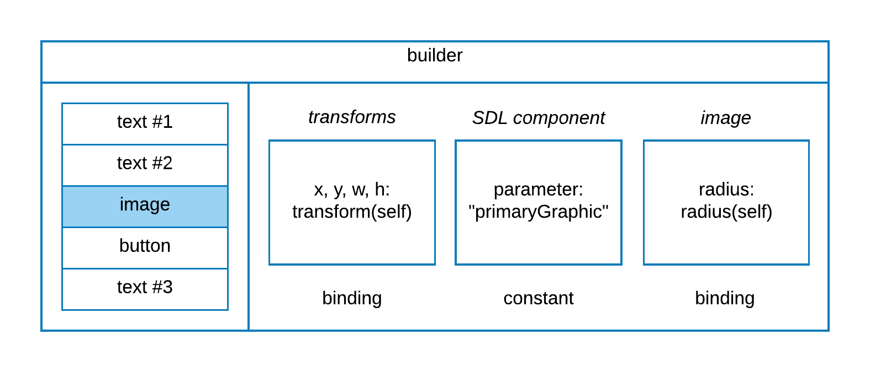



Go Live Without Coding
Annotation & Prototype
Deploy
Design
Rich intermedia representation => auto mapping to target runtime
Binding => non-destructive import
Primitives: Image, Text, Group
Import
GUI component: add Button, List etc.
Export
Target Runtime

Slide 10
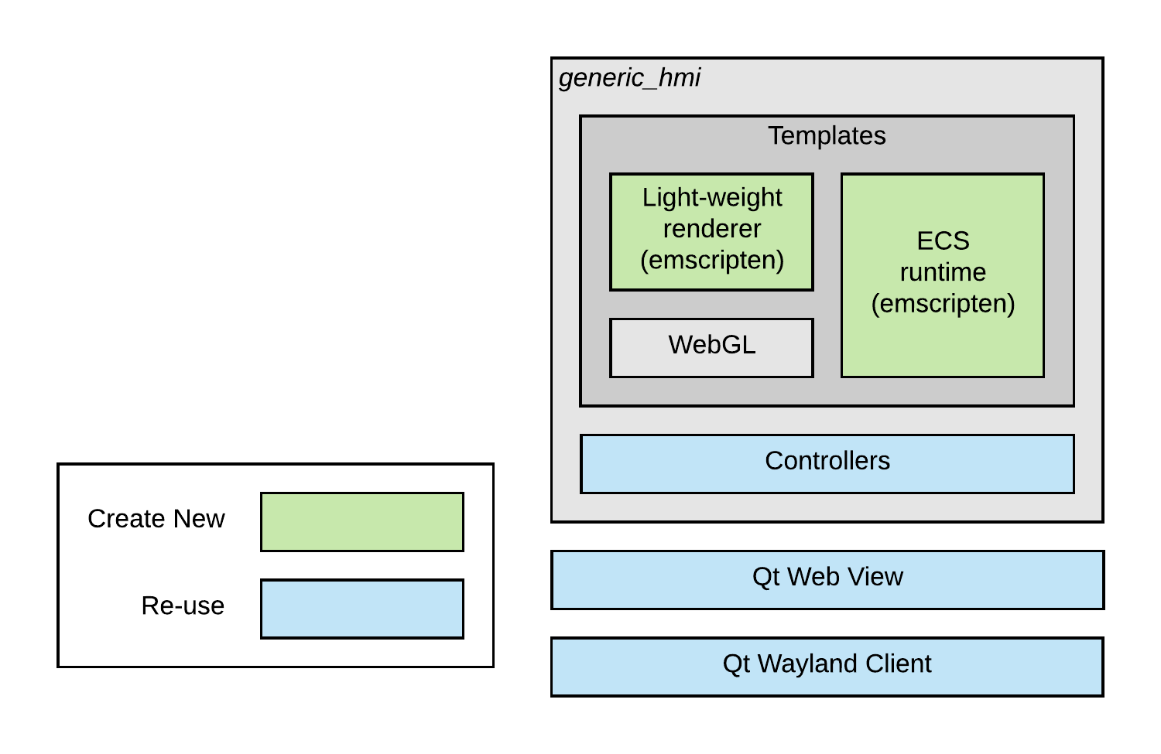
Integration to AGL
Leverage generic_hmi controller and Qt integration on AGL.
We just focus on Template rendering, by get rid of DOM, CSS and “bloat browser”.
Abstract HMI intermediate data.

Slide 11
Q&A

Slide 12





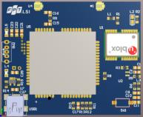
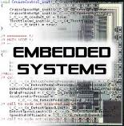
About FPT Automotive Business
Amount of sales
Number of engineers
Resources for Automotive/LSI/Embedded system: 1,600 engineers
Resources for CAD/CAE: 540 engineers
20% of total FPT software revenue
The proportion of Japan and Korea market is 75%
Supported scope
Process
Acquired certifications: A-Spice L3, CMMI-5, ISO9001, ISO27001, TS16949
Participated in ISO/ISO 26262 training course
Membership:
Genivi Alliance
R-Car Consortium
AUTOSAR.org
Scheduled to participate in AGL (Automotive Grade Linux)
Automotive
IVI / AVN
Telematics
Instrument & Cluster
AUTOSAR
Connectivity
ECU Testing
MBD
ADAS
Cloud/IoT
CAD / CAE
Embedded / LSI
Embedded Application
Middleware
Driver
RTOS
LSI Design

Slide 13

THANK YOU

