Slide 1
Welcome to CSE1002

Slide 2

About the Course
A lab only course for problem solving and coding skill development
What is Skill? How does it differ from knowledge and information?
Painting, carpentry, welding, singing, dancing, swimming etc are skills
How to gain it?
Can be obtained only through continuous practice

Slide 3
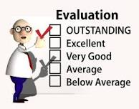
Evaluation
Continuous
Solving problems in class – 10%
Home works – 30%
Assessments (Five) – 40%
Challenging task (One or Two) – 20%

Slide 4
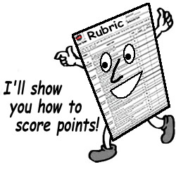
Rubrics for Evaluation
Understanding/ Defining the Problem
Developing a logic to Solve the Problem
Developing an appropriate pseudocode/ flowchart
Usage of Coding Styles
Choosing appropriate constructs/ data structure/ proper modularization of code
Execution of code

Slide 5
About the Teacher

Slide 6

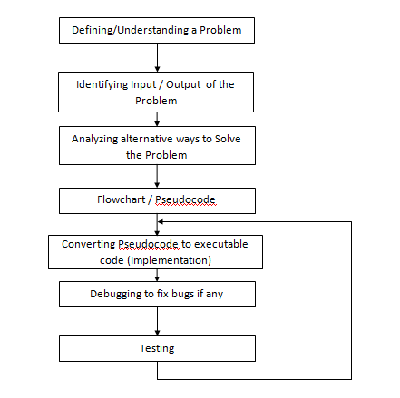
Problem Solving Steps – A Recap

Slide 7

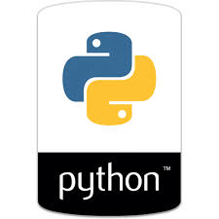
Why did We Learn Python?
Easy to learn
Language with simple rules
Good for beginners
Code is readable
Less development time
No memory management
Great support for building web apps
Dynamic language and no type checking

Slide 8

Limitations of Python
Python is not a good choice for:
Memory intensive and computation intensive tasks
Embedded Systems where processor has limited capacity
For graphic intensive 3D game that takes up a lot of CPU
Applications that demand concurrency and parallelism
Developing mobile apps
Design restrictions
Interpreted language and is slow compared to C/C++ or Java

Slide 9

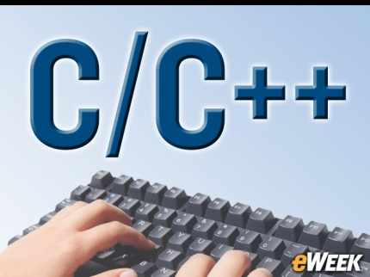
Why to learn more languages?
Similar to why a carpenter has more than just a hammer in his/her toolbox
Every programming language has its positive and negative points
One language cannot do everything
That is why there are many languages; some are fantastic for some things
Eg: C/C++ is typically the benchmark for speed and memory usage, and some languages provide strengths elsewhere (Eg: Python is very easy to pick up)

Slide 10
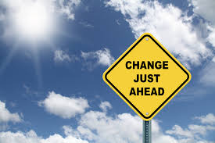
Transiting from Python to C/C++
Will not be so hard
There are quite a few syntax differences between the two languages
Only way to learn a new programming language is by writing programs in it
Dennis Ritchie

Slide 11

History of C
Born at AT & T Bell Laboratory of USA in 1972
Many of C’s principles and ideas were derived from the earlier language B
Ken Thompson was the developer of B Language
C was written by Dennis Ritchie
http://www.nytimes.com/2011/10/14/technology/dennis-ritchie-programming-trailblazer-dies-at-70.html?_r=0
C language was created for a specific purpose i.e designing the UNIX operating system (which is currently base of many UNIX based OS)
Quickly spread beyond Bell Labs in the late 70’s because of its strong features

Slide 12
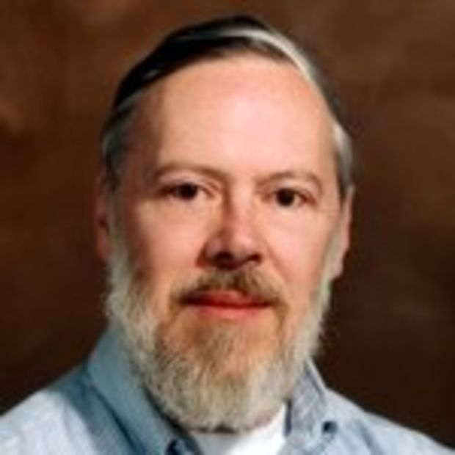
About Dennis Ritchie
Born September 9, 1941
Known for ALTRAN, B, BCPL, C, Multics, Unix
Won Turing Award in 1983
Developed C language which is widely used developing, operating systems, compiler, and embedded system development, Assemblers, Text editors, Print Spoolers, Network drivers databases etc and its influence is seen in most modern programming languages
Died on October 12, 2011

Slide 13

Features of C language
Portability - C Programs can run on any compiler with little or no modification
Low level features: C provides low level features and is closely related to lower level assembly Languages
Modular programming - software design technique that increases the extent to which software is composed of separate parts, called modules
Has many successor languages which are designed to look like C, e.g., C++, C#, Objective-C, Java, JavaScript, PHP and Perl.

Slide 14
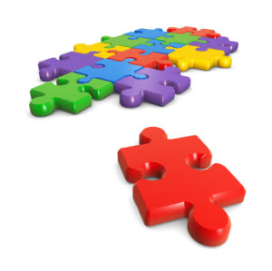
C is a structured programming language
Divides the large problem in to smaller modules called functions or procedures
Each function or module handles the particular task and the collection of all the functions is called a program, which solves the large problem
Easier to modify and debug

Slide 15

Modularity in Technology and Management
Product systems are deemed “modular”
They can be decomposed into a number of components that may be mixed and matched in a variety of configurations
Components are able to connect, interact, or exchange resources
Plugs and plug points are independent, may be manufactured even by different companies

Slide 16
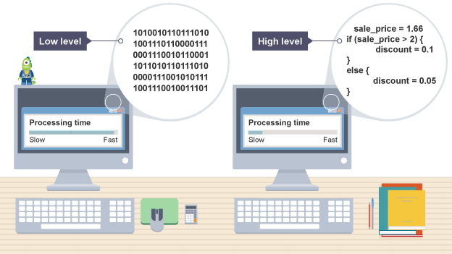
Difference between Python and C
C programs – Compiled
Python programs – Interpretered
Compiler | Interpreter
Takes entire program as input and generate a output file with object code | Takes instruction by instruction as input and gives an output. But does not generate a file
Errors are displayed after entire program is checked | Errors are displayed for every instruction interpreted (if any)

Slide 17
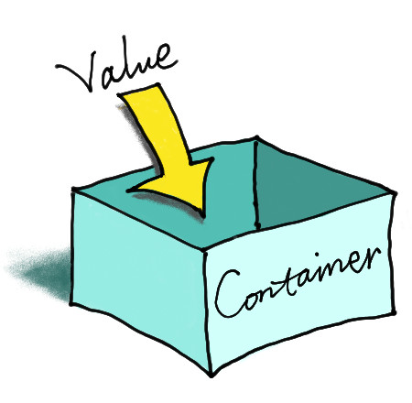
Variable Declaration in C
In C, it is mandatory to do variable declaration
We say variable's type, whether it is an integer (int), floating-point number (float), character (char) etc
Syntax is type of variable, white space, name of variable semicolon
Eg: int number;

Slide 18
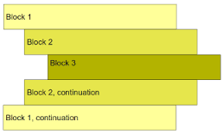
White spaces and Intendation
No problem of difference between white space and tab in C (Happy!)
Block of code in C need not be intended as in Python
In C, Curly braces are used for giving a block of code Eg: Block of code in ‘C’
{
-----
}

