Slide 1
Single and Multidimensional Arrays

Slide 2
Accident Problem
Each year the Department of Traffic Accidents receives accident count reports from a number of cities and towns across the country. Given details of ‘n’ days, develop an algorithm and write a program to determine the average number of accidents and for each day, print the difference between the number of accidents on that day and average. For example, if the number of days is 5 and the values are 10, 12, 15, 13, 5 then average is 11 and the difference of values are 1, 1, 4, 2, 6

Slide 3
Accident problem
Input | Output | Logic Involved
Value of ‘n’, ‘n’ numbers | Average and ‘n’ values that is the difference between average and value | Find average and difference

Slide 4
Algorithm
Read the value of ‘n’
Read the number of accidents happened in ‘n’ days
Find average
For each value print the difference between average and the value

Slide 5
New Stuff...
We can find the difference between average and the number of accidents on a particular day only after reading all numbers from the user
So data has to be stored
Same type of data is to be stored
Number of items not known prior
Best choice would be using arrays in C
Array - Can store a fixed-size sequential collection of elements of the same type

Slide 6
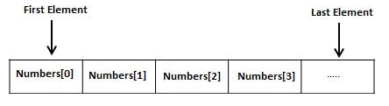
Arrays in C
Consist of contiguous memory locations
lowest address corresponds to the first element
highest address to the last element
Array indices start with zero
The elements have indices from 0 to ‘n-1’
Similar to list in Python but homogenous

Slide 7
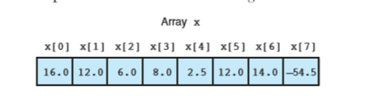
Declaration of Arrays in C
type arrayName [ arraySize ];
double balance[10];
Initializing Arrays
double balance[] = {1000.0, 2.0, 3.4, 7.0, 50.0};
(or)
double balance[5] = {1000.0, 2.0, 3.4, 7.0, 50.0};

Slide 8
Difference between Initialization and Assignment
Assignment
int a;
a = 5;
Intialization
int a = 5;

Slide 9
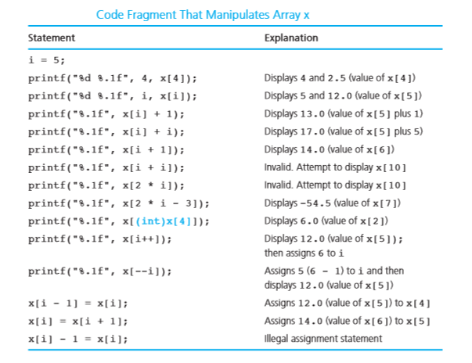

Slide 10
Cannot assign one array to other
int ia[] = {0, 1, 2}; // ok: array of ints
int ia2[] = ia; // error: cannot initialize one array with another
int main()
{
const unsigned array_size = 3;
int ia3[array_size];
// ok: but elements are uninitialized!
ia3 = ia; // error: cannot assign one array to another
return 0;
}

Slide 11
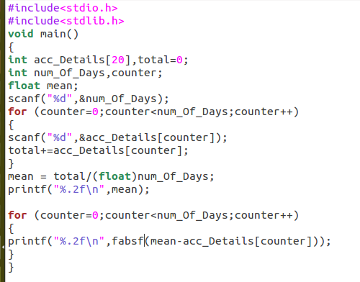

Slide 12
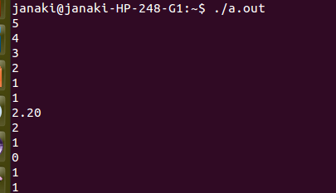

Slide 13
Compare List and Arrays
List | Arrays
Can have mixed type of elements | Can have only one type of element
Size is not given in the beginning L = [] | Size has to be specified during declaration int a[10];
Elements are accessed by subscript operator L[0], L[1]... | Same way a[0], a[1], a[2],...
Size is dynamic, increases when elements are added and decreases when removed | Size is static and memory

Slide 14
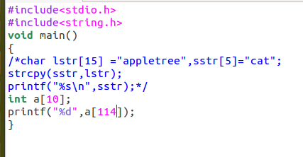

Slide 15
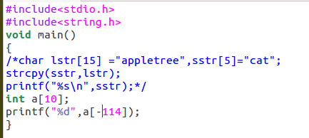

Slide 16
Huffman Coding Problem
Huffman code is a particular type of optimal prefix code for characters. It is commonly used for lossless data compression. It is a variable-length code derived from frequency of occurrence. Given a string develop an algorithm and write a C program to determine frequency of occurrence of each character in the string.

Slide 17
Huffman Coding problem
Input | Output | Logic Involved
A string S | Frequency count of each letter in S | Convert all letters to uniform case and check if it is a particular letter and increment corresponding count

Slide 18
Algorithm
Read a string
Make all letters in the string to be in lowercase
Process character by character
If the character is an alphabet then increment count of it
Print count of all alphabets

Slide 19
Strings in C
No data type string
Represented as array of characters
strncpy strcpy

Slide 20
Character Arrays Are Special
Can be initialized with either a list of comma-separated character literals enclosed in braces or a string literal
Two forms are not equivalent
String literal contains an additional terminating null character

Slide 21

Strcpy
used to copy a string and can be as strcpy(destination, source)
Will not perform any boundary checking, and thus there is a risk of overrunning the strings

Slide 22
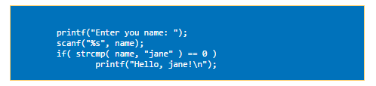
Strcmp
used to compare two strings and can be used as strcmp(str1, str2)
If the first string is greater than the second string a number greater than null is returned.
If the first string is less than the second string a number less than null is returned.
If the first and the second string are equal a null is returned.

Slide 23
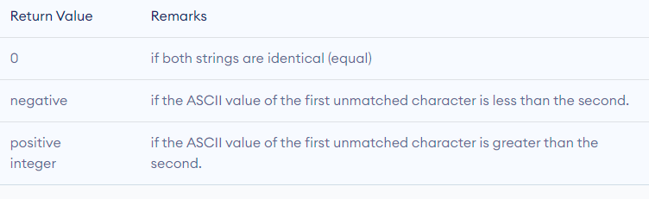

Slide 24

strcat
concatenates a string onto the end of the other string and the resultant string is returned
strcat() will not perform any boundary checking, and thus there is a risk of overrunning the strings.

Slide 25

strlen
returns the length of a string
All characters before the null termination

Slide 26
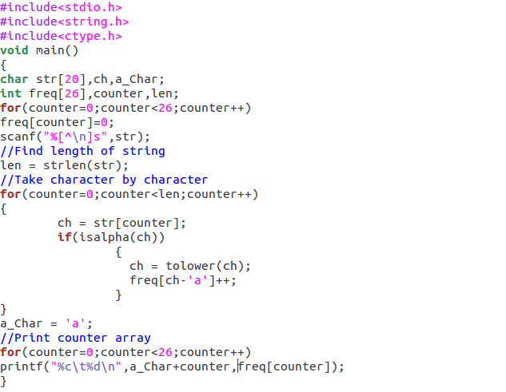

Slide 27
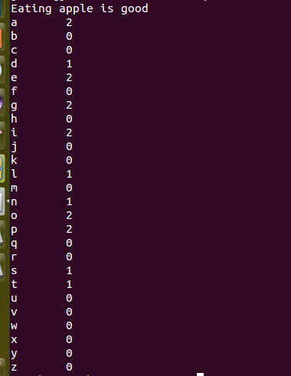

Slide 28

Tic Tac Toe Problem
Tic-tac-toe is a paper-and-pencil game for two players, X and O, who take turns marking the spaces in a 3×3 grid. Player who succeeds in placing three of their marks in a horizontal, vertical, or diagonal row wins the game.

Slide 29
Tic Tac Toe Problem Contd...
Given the board configuration of the tic tac toe game, determine if the board is in either of the following states: empty, player1 wins, player2 wins, draw or intermediate. The board is said to be in initial state if all the cells contain ‘-1’, player1 uses ‘1’ as his coin and player2 uses ‘2’ as his coin. The game is draw when the board is full and no one has won the game. The game is in intermediate state when no one has won and board is not full

Slide 30
Tic Tac Toe problem
Input | Output | Logic Involved
Current board configuration | State of the board as win, draw, initial or intermediate | Logical comparison

Slide 31
Algorithm
Represent the board in memory
Get the elements in first row, second row and so on
Process the elements
If all are -1 then print ‘empty’
If ‘1’ is placed row wise, column wise or diagonally then print ‘Player 1’ wins
If ‘2’ is placed row wise, column wise or diagonally then print ‘Player 2’ wins
If all cells are full and no one has won the game then print ‘Draw’
Otherwise print intermediate

Slide 32
New Stuffs...
Represent the board in memory using a 2 d array
Traverse the board using nested loop
Memory is only a 1 d structure
But high level languages supports arrays of multiple dimensions
A kind of ordering is done internally to support multi dimensional arrays
Either row major or column major ordering is done
‘C’ does row major ordering for 2 D arrays

Slide 33
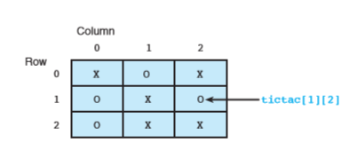
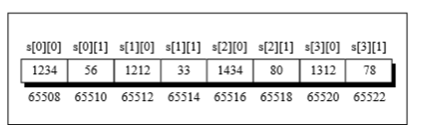
Representation of Tic Tac Toe Board

Slide 34
Row Major Ordering of 2 D Arrays
Elements in the first row are placed followed by elements of second row and so on
Contiguous memory allocation is done and address of first byte of memory is stored in the name of the array
Address of nth element in an array named as a (i.e.) a[n], is determined as: (a+n*b) where b is the number of bytes allocated for the data type

Slide 35

Initialization of a Character 2 D Arrays

Slide 36

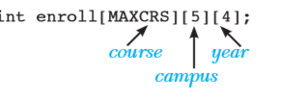
Multi dimensional Arrays
store the enrolment data for a college
assume that the college offers 100 ( MAXCRS ) courses at five different campuses
Students from any of the four years can opt for the courses

Slide 37
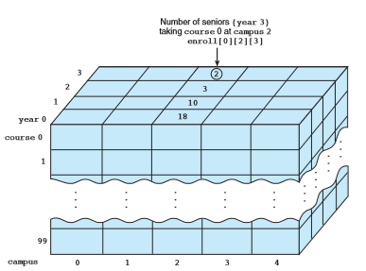

Slide 38
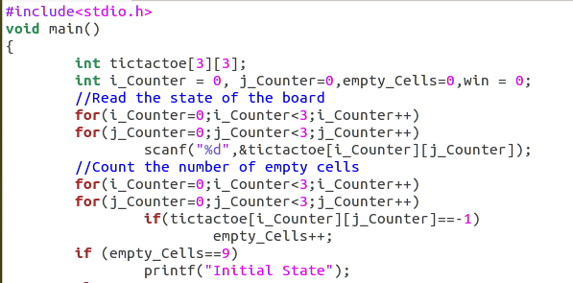

Slide 39
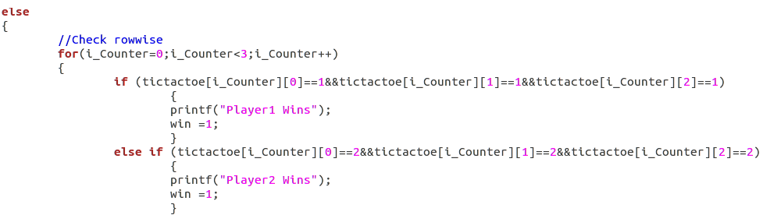

Slide 40
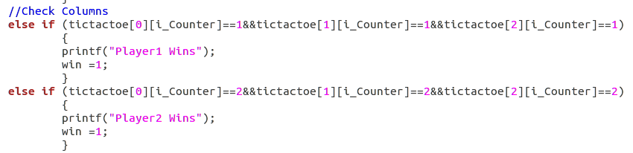

Slide 41
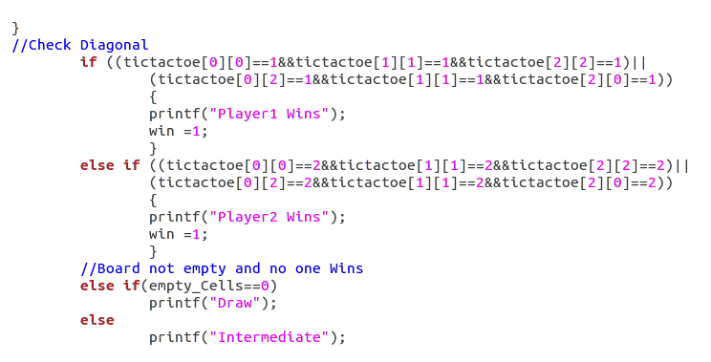

Slide 42
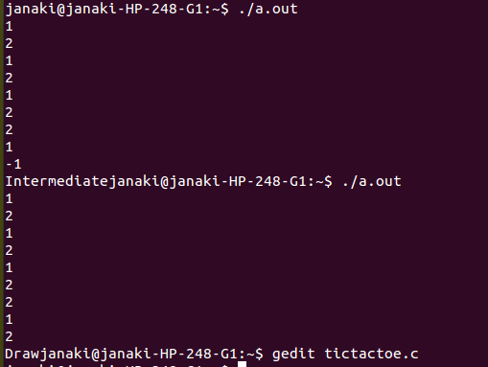

Slide 43
In Lab Practice Problems
Add two matrices
Multiply two matrices
Check if a matrix is sparse

