Slide 1
Dynamic Memory Allocation

Slide 2
Statistics of Rainfall
The weather station of each city has the detail of rainfall in a year. Given the date and cm of rainfall recorded on that day, write a C program to determine the rainfall recorded in each month of the year and average monthly rainfall in the year.

Slide 3
Rainfall problem
Input | Output | Logic Involved
Details of rainfall recorded in the year (Date and cm of rainfall) | Rainfall recorded for each month and monthly average | Find sum of values for each month and then determine monthly average

Slide 4
Implementation in C
For storing each row of the table we need a structure and we may use array of structures for storing details
Memory allocation for arrays – Statically done
But number of days varies from city to city...
Cherrapunji has 170 rainy days on average
Rajasthan gets least rainfall and receives only rainfall for 30 days in a year.

Slide 5
Static Vs Dynamic Memory Allocation
If we declare an array of size 180 then for a city that has less rainfall wastage of memory
If the programmer declares an array of size 50 then there will be shortage of memory.
It is better to get the number of raining days from the user during execution of program and allocate memory
C supports dynamic memory allocation
Allocates a chunk of memory and returns the address of first byte

Slide 6
Allocation of Memory
Static Allocation: Allocation of memory space when execution begins.
Dynamic Allocation: Allocation of memory space at run time.

Slide 7
Pointers
Variable that contains address in memory of another variable.
We can have a pointer to any variable type.
Unary or monadic operator & gives the ``address of a variable''.
Indirection or dereference operator * gives the ``contents of an object pointed to by a pointer''.
To declare a pointer to a variable :
datatype * name_Of_Variable;
Eg: int *pointer;

Slide 8
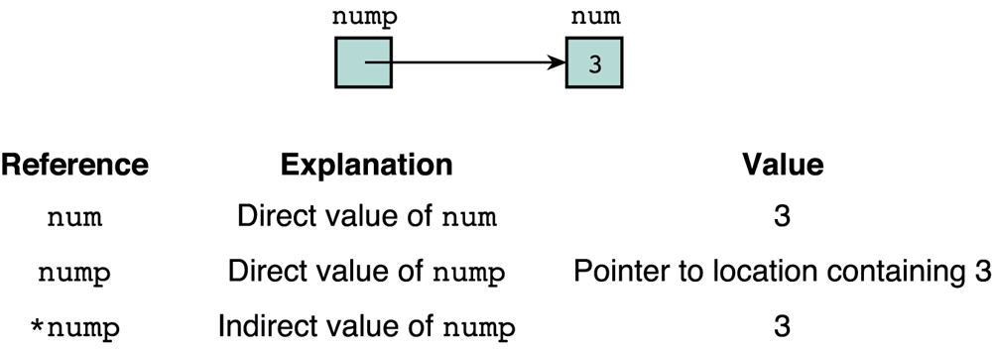
Pointers
void main () { int num = 3; int *nump = &num; …..

Slide 9
Assignment of Pointer Variables (Cont ..)
float data = 50.8;
float *ptr;
ptr = &data;
FFF0
FFF1
FFF2
FFF3
data
FFF4
50.8
FFF5
FFF6

Slide 10
Assignment of Pointer Variables
float data = 50.8;
float *ptr;
ptr = &data;
ptr
FFF0
FFF1
FFF2
FFF3
data
FFF4
50.8
FFF5
FFF6

Slide 11
Assignment of Pointer Variables
float data = 50.8;
float *ptr;
ptr = &data;
ptr
FFF0
FFF4
FFF1
FFF2
FFF3
data
FFF4
50.8
FFF5
FFF6

Slide 12
Assignment of Pointer Variables
Don’t try to assign a specific integer value to a pointer variable since it can be disastrous
float *ptr;
ptr = 120;
You cannot assign the address of one type of variable to a pointer variable of another type even though they are both integrals
int data = 50;
float *ptr;
ptr = &data;

Slide 13
Initializing pointers
If a pointer is not initialized during declaration, it is wise to give it a NULL value
float *fp = NULL;

Slide 14
The NULL pointer
The NULL pointer is a valid address for any data type.
But NULL is not memory address 0.
It is an error to dereference a pointer whose value is NULL.
Such an error may cause your program to crash, or behave erratically.
It is the programmer’s job to check for this.

Slide 15
Dereferencing Example
#include <iostream.h>
void main()
{
float data = 50.8;
float *ptr;
ptr = &data;
cout << ptr << *ptr << endl;
*ptr = 27.4;
cout << *ptr << endl;
cout << data << endl;
}
Output:
ptr
FFF0
FFF4
FFF1
FFF2
FFF3
data
FFF4
50.8
FFF5
FFF6

Slide 16
Dereferencing Example
#include <iostream.h>
void main()
{
float data = 50.8;
float *ptr;
ptr = &data;
cout << ptr << *ptr << endl;
*ptr = 27.4;
cout << *ptr << endl;
cout << data << endl;
}
Output:
FFF4 50.80
ptr
FFF0
FFF4
FFF1
FFF2
FFF3
data
FFF4
50.8
FFF5
FFF6

Slide 17
Dereferencing Example
#include <iostream.h>
void main()
{
float data = 50.8;
float *ptr;
ptr = &data;
cout << ptr << *ptr << endl;
*ptr = 27.4;
cout << *ptr << endl;
cout << data << endl;
}
Output:
ptr
FFF0
FFF4
FFF1
FFF2
FFF3
data
FFF4
27.4
FFF5
FFF6

Slide 18
Dereferencing Example
#include <iostream.h>
void main()
{
float data = 50.8;
float *ptr;
ptr = &data;
cout << ptr << *ptr << endl;
*ptr = 27.4;
cout << *ptr << endl;
cout << data << endl;
}
Output:
27.4
ptr
FFF0
FFF4
FFF1
FFF2
FFF3
data
FFF4
27.4
FFF5
FFF6

Slide 19
Dereferencing Example (Cont ..)
#include <iostream.h>
void main()
{
float data = 50.8;
float *ptr;
ptr = &data;
cout << ptr << *ptr << endl;
*ptr = 27.4;
cout << *ptr << endl;
cout << data << endl;
}
Output:
27.4
ptr
FFF0
FFF4
FFF1
FFF2
FFF3
data
FFF4
27.4
FFF5
FFF6

Slide 20
Operations on Pointer Variables
Assignment – the value of one pointer variable can be assigned to another pointer variable of the same type
Relational operations - two pointer variables of the same type can be compared for equality, and so on
Some limited arithmetic operations
integer values can be added to and subtracted from a pointer variable
value of one pointer variable can be subtracted from another pointer variable

Slide 21
Pointers to arrays
A pointer variable can be used to access the elements of an array of the same type.
int gradeList[8] = {92,85,75,88,79,54,34,96};
int *myGrades = gradeList;
cout << gradeList[1];
cout << *myGrades;
cout << *(myGrades + 2);
cout << myGrades[3];
Note that the array name gradeList acts like the pointer variable myGrades.

Slide 22
Arithmetic Operators and Pointers
Four arithmetic operators can be used on pointers: ++, --, +, and –
Consider that ptr is an integer pointer which points to the address 1000
Assume 4 bytes are allocated for integers
After the following operation
ptr++
ptr will point to location 1004
On integer pointers -- will decrement by 4

Slide 23
Arithmetic Operators and Pointers
Adding 1 will also be done based on the type of pointer
If it is character pointer then 1 is added to the pointer variable
If the pointer is of type double then 8 is added to the pointer variable
Subtraction is also completely based on the type of pointer variable

Slide 24
Arrays and Pointers
An array name in C contains the address of the byte of memory allocated
But array name is a “Pointer Constant”
Value cannot be changed
++ operator cannot be applied directly
Therefore base address of array is copied into a pointer variable and the operation is performed

Slide 25
Example for Arrays and Pointers
const int MAX = 3;
int main ()
{ int var[] = {10, 100, 200};
int i, *ptr;
/* let us have array address in pointer */
ptr = var;
for ( i = 0; i < MAX; i++)
{ printf("Address of var[%d] = %x\n", i, ptr );
printf("Value of var[%d] = %d\n", i, *ptr );
/* move to the next location */
ptr++;
}
return 0; }

Slide 26
Pointer Comparisons
Pointers may be compared by using relational operators, such as ==, <, and >
const int MAX = 3;
int main ()
{
int var[] = {10, 100, 200};
int i, *ptr;
// let us have address of the first element in pointer
ptr = var;
i = 0;

Slide 27
Pointer Comparisons
while ( ptr <= &var[MAX - 1] )
{
printf("Address of var[%d] = %x\n", i, ptr );
printf("Value of var[%d] = %d\n", i, *ptr );
/* point to the previous location */
ptr++;
i++;
}
return 0;
}

Slide 28
Pointer to an Array and Array of Pointers
int (*a)[35]; - declares a pointer to an array of 35 ints.
int *a[35]; - declares an array of 35 pointers to ints.

Slide 29
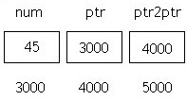
Double Pointer
Pointer to pointer
int **ptr2ptr;
Example:
int num = 45 , *ptr , **ptr2ptr ;
ptr = &num;
ptr2ptr = &ptr;

Slide 30
Dynamic Memory Allocation

Slide 31
malloc()
Dynamically allocates memory when required
This function allocates ‘size’ byte of memory and returns a pointer to the first byte or NULL if there is some kind of error
Syntax is as follows: void * malloc (size_t size);
return type is of type void *, also receive the address of any type

Slide 32
calloc()
Used to allocate storage to a variable while the program is running
Syntax
void * calloc (size_t n, size_t size);
For example, an int array of 10 elements can be allocated as follows.
int * array = (int *) calloc (10, sizeof (int));

Slide 33
Difference between malloc() and calloc()
Calloc allocates multiple blocks of data whereas malloc allocates as a single block
Calloc initializes all bytes in the allocation block to zero
Allocated memory may/may not be contiguous.

Slide 34
realloc()
Modifies the allocated memory size by malloc () and calloc () functions to new size
If enough space doesn’t exist in memory of current block to extend, new block is allocated for the full size of reallocation, then copies the existing data to new block and then frees old block
Syntax void * realloc (void * ptr, size_t size);

Slide 35
free()
frees the allocated memory by malloc (), calloc (), realloc () functions and returns the memory to the system

Slide 36
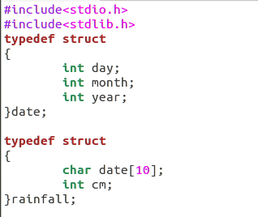

Slide 37
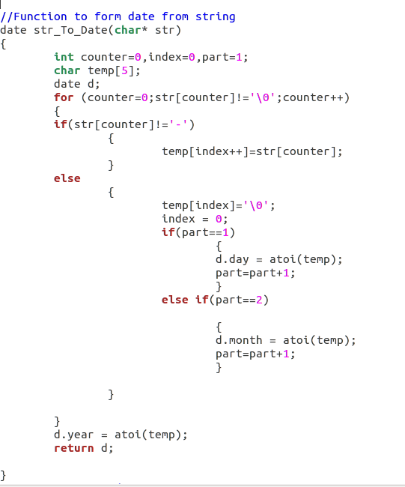

Slide 38
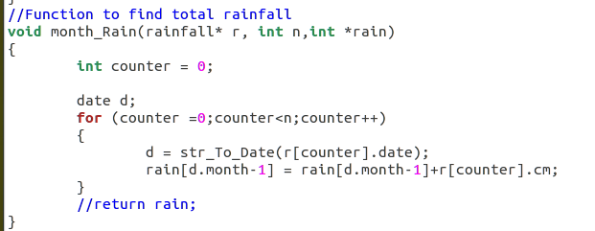

Slide 39
