Slide 1
Structures and Unions

Slide 2
Growth of Bacteria Problem
Depending on the growth requirements of the bacteria and the information that the scientist hopes to gain, various types of growth media are available for culturing bacteria. Culturing means cultivating bacteria in a microbiology laboratory environment
Basic concept for the MPN (Most Probable Number) method is to dilute the sample to such a degree that inocula in the tubes will sometimes (but not always) contain viable organisms. By replicates, and dilution series, this will result in a fairly accurate estimate of the most probable number of cells in the sample

Slide 3
Growth of Bacteria Problem
Three sets of five tubes are taken. First set of five tubes of nutrient medium receives 10 ml of the sample. Second set of five tubes receives 1 ml of sample per tube, and in each of a third set of five tubes, only 0.1 ml of sample is placed. Each tube in which bacterial growth is observed is recorded as a positive. Numbers for the three groups are combined to create a triplet such as 5-2-1.

Slide 4
Growth of Bacteria Problem
5-2-1 means that all five tubes receiving 10 ml of sample show bacterial growth, only two tubes in the 1-ml group show growth, and only one of the 0.1-ml group is positive.
A microbiologist would use this combination-of-positives triplet as an index to a table like the table below to determine that the most probable number of bacteria per 100 ml.

Slide 5
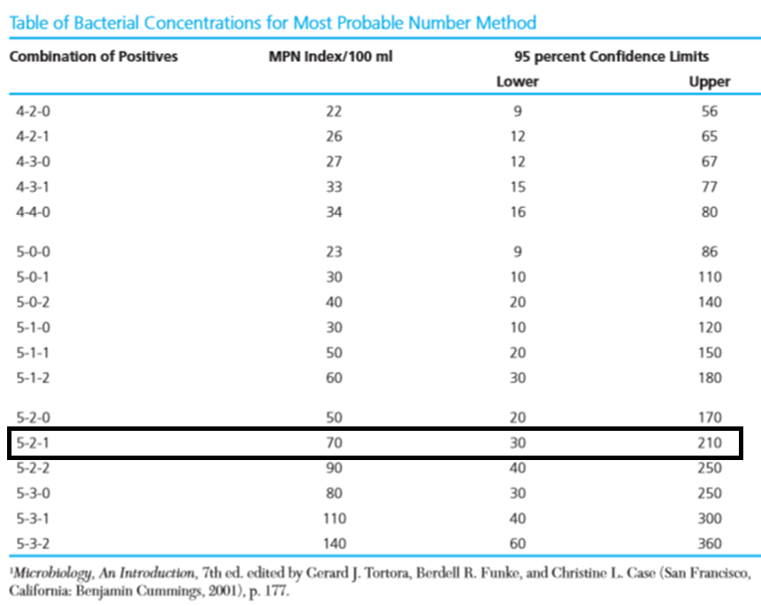

Slide 6
Growth of Bacteria Problem
For the combination of positives of 5-2-1, most probable number of bacteria per 100 ml of the sample is 70 and 95 percent of the samples yielding this triplet contain between 30 and 210 bacteria per 100 ml. Given the table and a combination-of-positives triplet, develop an algorithm and write a C program to return the index of combination-of-positives that component matches the target or -1 if not found.

Slide 7
Algorithm for Bacteria Growth Problem
Read the number of entries in the table
For each entry in the table read Combination of positives, MPN Index/100ml, lower and upper limit values
Read the combination to be checked
Search the table
Print the MPN Index, lower and upper limit values

Slide 8
Implementation in C
Have to represent each row in the table
Then group the rows
Each row contains four fields
combination of positives - String
MPN Index - Int
lower limit - Int
upper limit - Int
and here heterogeneous data should be grouped

Slide 9
Structures in C
Heterogeneous data can be grouped together by structures in C
Syntax of a struture
struct <structure name>
{
datatype element 1 ;
datatype element 2 ;
datatype element 3 ;
......
} ;

Slide 10
Example for Structures
struct book
{
char name ;
float price ;
int pages ;
} ;
struct book b1, b2, b3 ;
Same as

Slide 11
Example for Structures
struct book
{
char name ;
float price ;
int pages ;
} b1, b2, b3 ;
Same as

Slide 12
Anonymous Structures – Structures without name
struct
{
char name ;
float price ;
int pages ;
} b1, b2, b3 ;

Slide 13
Initialization of Structures
struct book {
char name[10] ;
float price ;
int pages ;
} ;
struct book b1 = { "Basic", 130.00, 550 } ;
struct book b2 = { "Physics", 150.80, 800 } ;

Slide 14
Accessing Structure Elements
To refer pages,
b1.pages
refer to price we would use,
b1.price

Slide 15
Values of One Structure Variable to Another
struct employee
{ char name[10] ;
int age ;
float salary ;
} ;
struct employee e1 = { "Sanjay", 30, 5500.50 } ;
struct employee e2, e3 ;

Slide 16
Values of One Structure Variable to Another
/* piece-meal copying */
strcpy ( e2.name, e1.name ) ;
e2.age = e1.age ;
e2.salary = e1.salary ;

Slide 17
Values of One Structure Variable to Another
/* copying all elements at one go */
e3 = e2 ;
printf ( "\n%s %d %f", e1.name, e1.age, e1.salary ) ;
printf ( "\n%s %d %f", e2.name, e2.age, e2.salary ) ;
printf ( "\n%s %d %f", e3.name, e3.age, e3.salary ) ; }

Slide 18
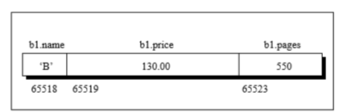
How Structure Elements are Stored
struct book
{
char name ;
float price ;
int pages ;
} ;
struct book b1 = { 'B', 130.00, 550 } ;

Slide 19
Array of Structures
struct book
{
char name ;
float price ;
int pages ;
} ;
struct book b[100] ;
for ( i = 0 ; i <= 99 ; i++ )
{
printf ( "\n Enter name, price and pages " ) ;
scanf ( "%c %f %d", &b[i].name, &b[i].price, &b[i].pages ) ;
}

Slide 20
typedef in C
typedef is a keyword used in C language to assign alternative names to existing types.
Its mostly used with user defined data types, when names of data types get slightly complicated.
Following is the general syntax for using typedef:
typedef existing_name alias_name
Example
typedef unsigned long ulong;
ulong i, j ;

Slide 21
typedef in C
typedef struct
{
type member1;
type member2;
type member3;
} type_name ;
Useful in structures – keyword struct need not used everywhere if it is typedef-ed.

Slide 22
Passing to Functions
Default is passed by value
What about array in a structure?
Passed by value – Only...
But array of structures is passed by reference

Slide 23
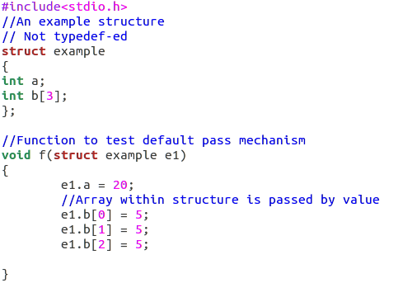

Slide 24
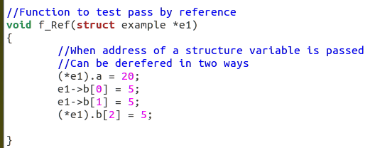

Slide 25
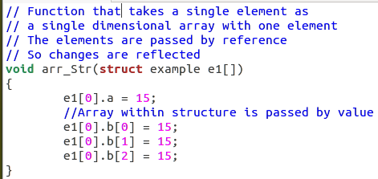

Slide 26
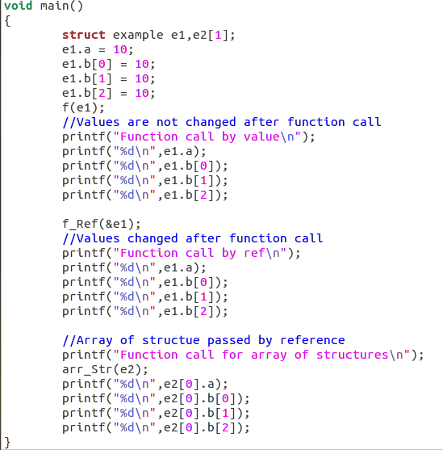

Slide 27
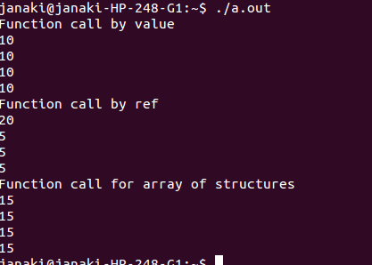

Slide 28
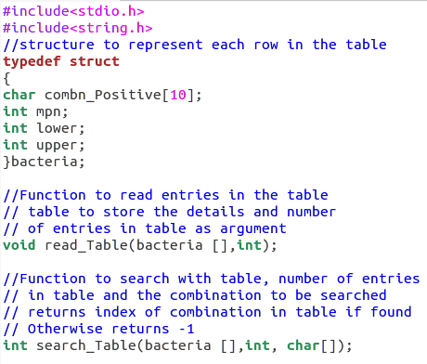
Declaration of Structure and Functions

Slide 29
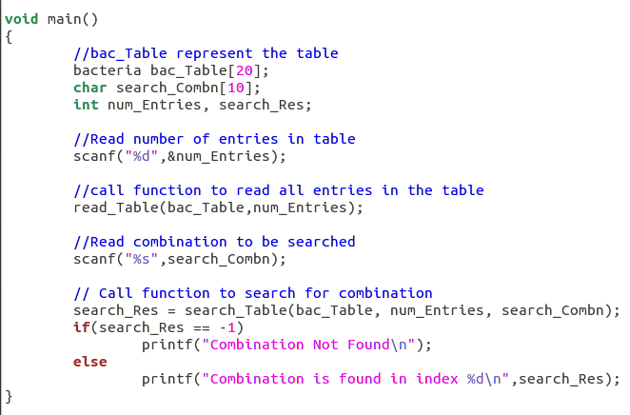
Main function of Bacteria Program

Slide 30
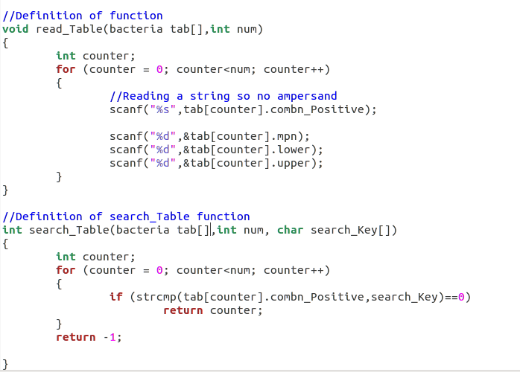
Function to Read and Search Table

Slide 31
Surprise Gift Problem
Details of employees (emp ID, name, joining date and mobile number) of a company is stored and maintained by the company’s IT department. On his birthday, the GM of the company wants to give a surprise gift of Rs.5000 for his employees who joined before 01/01/2010 and whose employee id is divisible by 5. Develop an algorithm and write a C program to display the name of the employees who are eligible to receive the gift and their mobile number

Slide 32
Algorithm for Surprise Gift Problem
Read the number of employees
Read the details of the employees
Traverse the employee records
Check if emp id is divisible by 5
If it is divisible then check if the employee has joined the company before 01/01/2010
Display employee names and mobile numbers of employees if condition satisfied

Slide 33
Implementation in C
We have to store employee id, name, date of joining and mobile number
Date of joining has to be stored as date an user defined data type
So we have to include a structure variable as member of structure

Slide 34
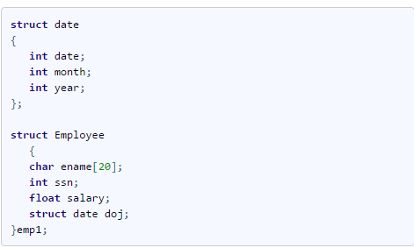
Nested Structures in C
A structure variable can be placed inside another structure

Slide 35
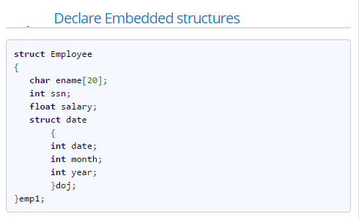

Slide 36
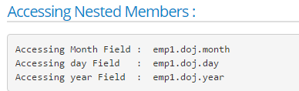

Slide 37
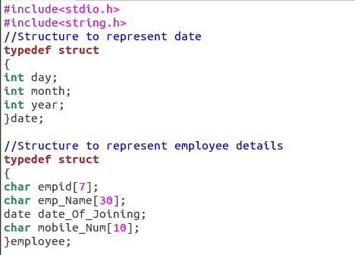

Slide 38
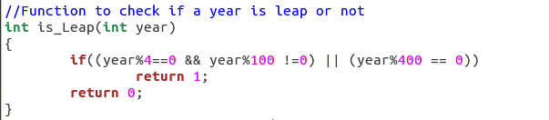

Slide 39
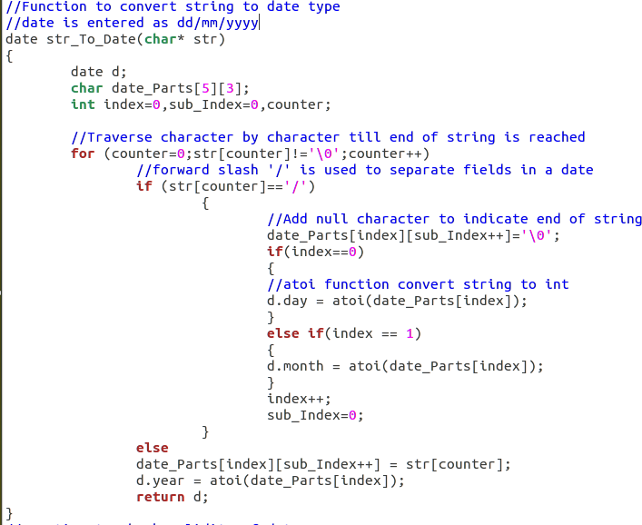

Slide 40
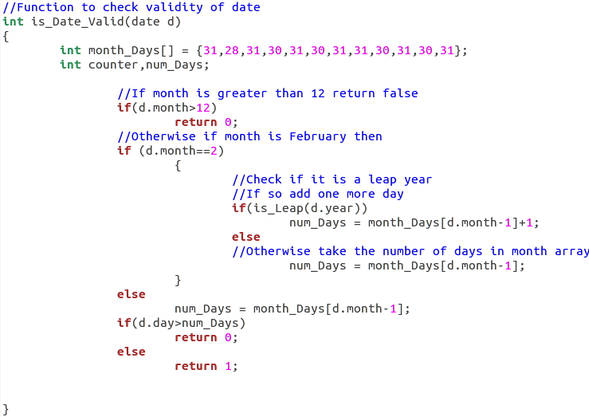

Slide 41
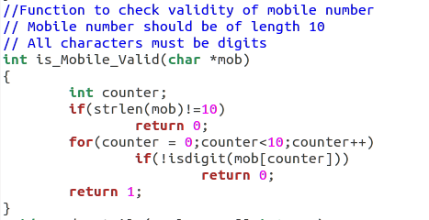

Slide 42
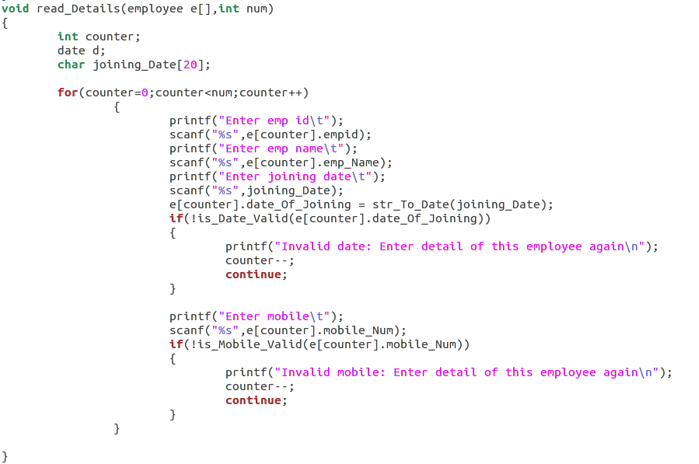

Slide 43
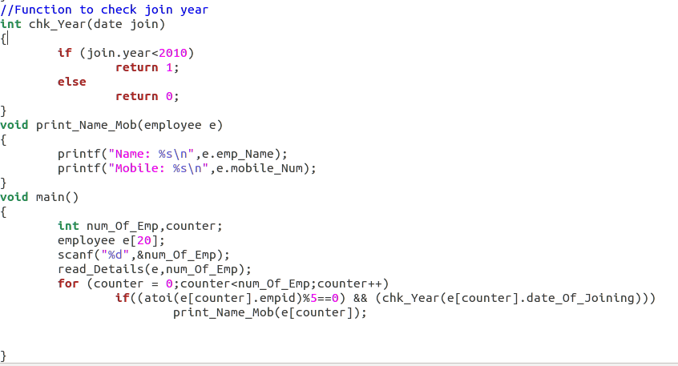

Slide 44
Identity Card for Railway Reservation
In railway reservation system, identity of the person is got by either aardhar card number or voter id. Given Aardhar card number as a number and voter id as a string. Write a C program to store the details of thousands of people. It is important to store such that less memory is wasted.

Slide 45
Using Structures?
Structure can be used to store the details but the memory occupied will be sum of memory required for both the fields.
A large wastage when the program is used to store details of many people
Since either one of the detail is going to be stored, it is sufficient to allocate memory for the largest member
Supported in C as Unions!

Slide 46
Union in C
Special data type available in C that allows to store different data types in the same memory location.
Union may have many members, but only one member can contain a value at any given time.
Unions provide an efficient way of using the same memory location for multiple-purpose.

Slide 47
Syntax of Union
union [union tag]
{
member definition;
member definition;
...
member definition;
} [one or more union variables];

Slide 48
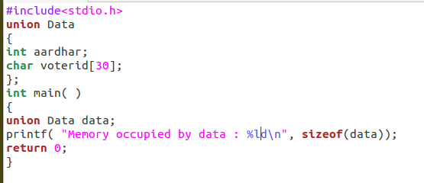
Space Occupied by Union

Slide 49
Features of Union
Similar to structures
Can have array
Can be nested inside structures
Structures can be nested within union

Slide 50
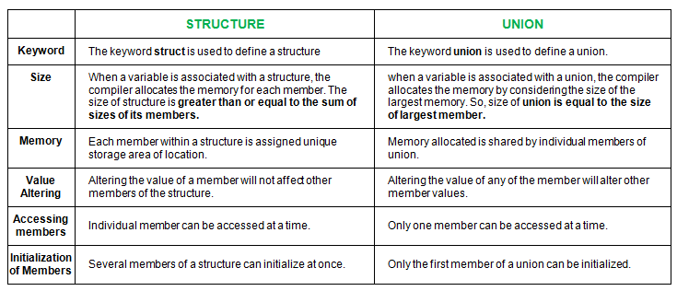

Slide 51
Macros
Operation defined in #define
A macro is a fragment of code which has been given a name. Whenever the name is used, it is replaced by the contents of the macro
Macro without arguments: treated like a symbolic constant
Macro with arguments: arguments substituted for replacement text, macro expanded

Slide 52
Example:
#define CIRCLE_AREA( x ) ( (PI) * ( x ) * ( x ) )
area = CIRCLE_AREA( 4 );
is expanded to
area = ( 3.14159 * ( 4 ) * ( 4 ) );

Slide 53
Macros
Use parenthesis
Without them:
#define CIRCLE_AREA( x ) ((PI) * ( x ) * ( x ))
#define CIRCLE_AREA( x ) PI * x * x
area = CIRCLE_AREA( c + 2 );
becomes
area = 3.14159 * c + 2 * c + 2;
Evaluates incorrectly
Macor’s advantage is that avoiding function overhead
Macro inserts code directly.
Macro’s disadvantage is that its argument may be evaluated more than once.
double circleArea ( double x )
{ return 3.1415926 * x * x ;
}

Slide 54
Macros
Multiple arguments
#define RECTANGLE_AREA( x, y ) ( ( x ) * ( y ) )
rectArea = RECTANGLE_AREA( a + 4, b + 7 );
becomes
rectArea = ( ( a + 4 ) * ( b + 7 ) );

