Slide 1
Encapsulation, Data Hiding and Static Data Members

Slide 2
Encapsulation in C++
Bind the Data and Code together
Classes are provided in C++ to bind data and code together
View everything in world as objects
Generalization of objects is classes
Characteristics / Properties are data members and operations that can be performed by the objects / on the objects are member functions

Slide 3
What are Classes?
Stroustrup initially named classes as structures with functions
In C++, structures can have functions

Slide 4
Time Problem
In a online examination system, each test will be scheduled for ‘x’ minutes. The student is free to take up the test on his convenience but once he starts the test, he must complete. Given the start time and the value of ‘x’ for an examination, develop an algorithm and write a ‘C++’ code for the examination system to calculate the finish time of the test.

Slide 5
Structural Programming for Time Problem
Its also possible to write a purely procedural program in C++
Time problem shall be solved using purely structural programming in C++

Slide 6
Structures in C++
Can have functions in it
Solution for time problem with functions in structure

Slide 8
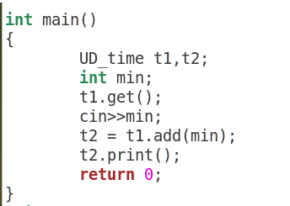

Slide 9
Classes in C++
Similar to structures, only access specifier changes
Data hiding is achieved by using access specifiers
By default all members of structures in C++ has public access whereas members of classes have private access by default

Slide 10
Access Specifiers in C++
Three
Public
Private
Protected

Slide 11
Constant member functions
A function becomes const when const keyword is used at the end of function’s declaration
The idea of const functions is not allow them to modify the object on which they are called.
It is recommended practice to make as many functions const as possible so that accidental changes to objects are avoided.

Slide 12
Constant member functions
Objects can also be constants
Constant functions can be accessed by both constant and non-const member functions

Slide 13
Static Data Members
Class members can be static using static keyword
Shared by all objects of the class
Shall be initialized outside the class using scope resolution operator
Static data members can be referred to without referring to an object of class type but by using class name and scope resolution operator

Slide 14
Each object has a copy of normal variables whereas static variables are shared among the objects
In figure, Variable1, Variable2 etc are normal variables

Slide 15
Static Member Functions
can be called even if no objects of the class exist and the static functions are accessed using only the class name and the scope resolution operator ::.
can only access static data member, other static member functions and any other functions from outside the class.

