Slide 1
Constant member functions
A function becomes const when const keyword is used at the end of function’s declaration
The idea of const functions is not allow them to modify the object on which they are called.
It is recommended practice to make as many functions const as possible so that accidental changes to objects are avoided.

Slide 2
Constant member functions
Objects can also be constants
Constant functions can be accessed by both constant and non-const member functions

Slide 3
Static Data Members
Class members static using static keyword
Shared by all objects of the class
Shall be initialized outside the class using scope resolution operator
Static data members can be referred to without referring to an object of class type but by using class name and scope resolution operator

Slide 4
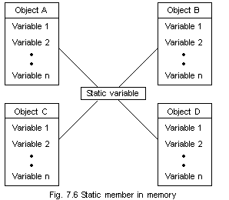
Each object has a copy of normal variables whereas static variables are shared among the objects
In figure, Variable1, Variable2 etc are normal variables

Slide 5
Static Member Functions
can be called even if no objects of the class exist and the static functions are accessed using only the class name and the scope resolution operator ::.
can only access static data member, other static member functions and any other functions from outside the class.

Slide 6
This pointer
‘this’ pointer is passed as a hidden argument to all nonstatic member function calls and is available as a local variable within the body of all nonstatic functions
constant pointer that holds the memory address of the current object
Not available in static member functions as static member functions can be called without any object (with class name).

Slide 7
When local variable’s name is same as member’s name
‘this’ pointer is passed as a hidden argument to all nonstatic member function calls and is available as a local variable within the body of all nonstatic functions
constant pointer that holds the memory address of the current object
Not available in static member functions as static member functions can be called without any object (with class name).

Slide 8
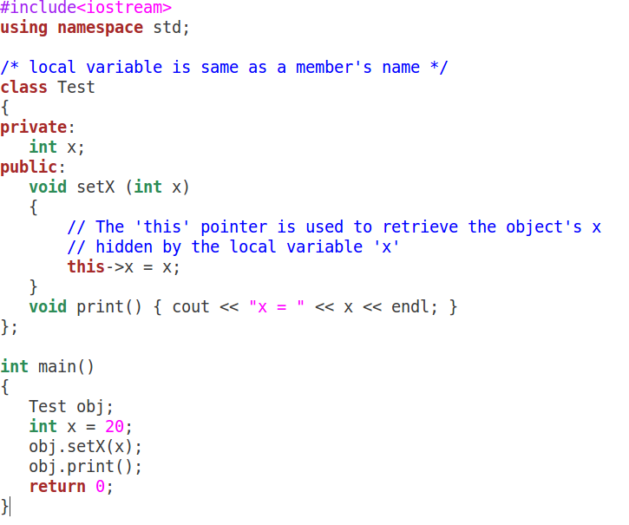

Slide 9
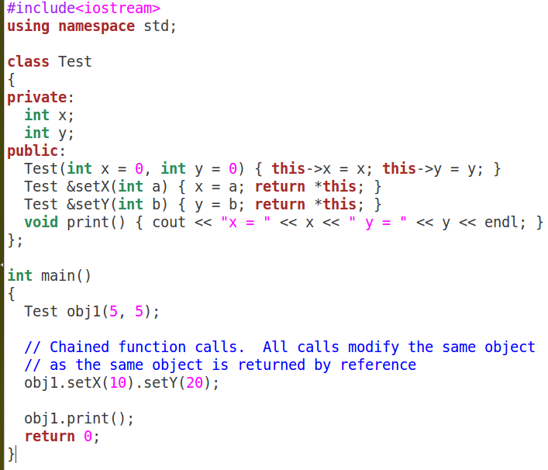

Slide 10
New and delete in C++
Similar to malloc and free in C
But there is an option to initialize memory
Can be used allocate memory for single or array of elements

Slide 11
New and delete in C++
If memory is available, the new operator allocates memory space for the requested object/array, and returns a pointer to (address of) the memory allocated.
If sufficient memory is not available, the new operator returns NULL.
Dynamically allocated object/array exists until the delete operator destroys it

Slide 12
